Slide 1
Credit Card Analysis
Developed By
SURAJ SINGH

Slide 2
Credit Card
As you now guys, Credit card is a convenient financial tool in now days every one using in their day-to-day life, like to spend over the things they need.
Credit cards help to our customer to borrow money and make purchase anytime or anywhere without any needing cash concern.
By using credit card customers can get benefits like :- rewards, cashback offers, and travel perks.
Customers can build their credit score that will help in future, but it’s also important to pay off balance on time, to avoid interest charges.

Slide 3
Objectives
Analyze the transaction & customers of credit card.
Identify the performance of credit card based on Genders, Customer Type.
Analyze the Revenue, Amount, Interest Rate, Transaction of credit card
Evaluate what type of cards influences customer to use & make transactions.
Analyze the Defaulter users who does not pay their balance on time.
Analyze credit card over the times like, quarterly, weekly.
Analyze revenues over the states & expenditures.

Slide 4
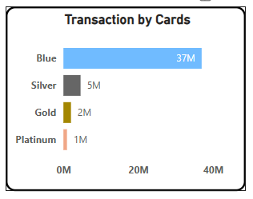
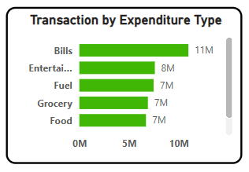
Transactions by cards
More than 37M transactions are done by using only blue card.
Out of 4 cards, blue card is the most preferred by customers.
Most of transactions are done in quarter 3(July – Sept) which is around 14.2M.
Transactions over the expenditures are mostly done in bills, entertainment, fuel, grocery & food.

Slide 5
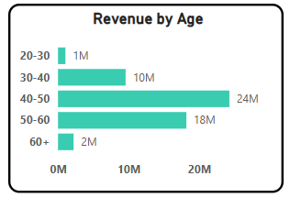
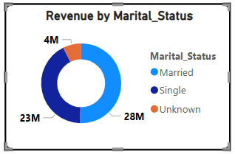
Revenue of Credit card
Total Revenue of credit card is 55M, and total interest rate is 8M.
Customer satisfaction score count is 32K.
Individuals aged 40 – 50 generate the highest revenue among all age groups.
Married people contributes the most.
Males with 30M contributes the most as compared to Females with 25M revenue.

Slide 6
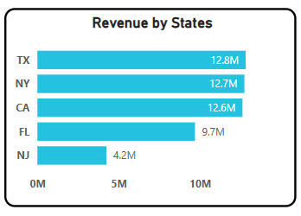
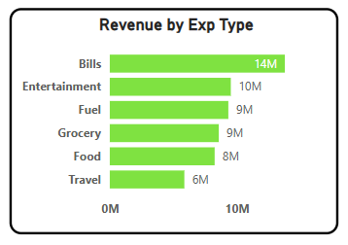
Revenue over the states & Expenditures
There are top 5 states which helps to generate more revenue than the other states.
Texas with 12.8M
New York with 12.7M
California with 12.6M
Florida with 9.7M
New Jersey with 4.2M
Expenditures
There are a lot of expenditures where customers love to spend.
Bills, Entertainment, fuel, Grocery, Food, are where customers spend most.
Bills with 14M
Entertainment with 10M
Fuel & Grocery with 9M
Food with 8M

Slide 7
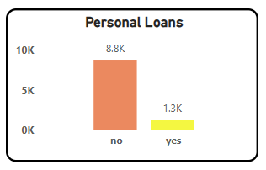
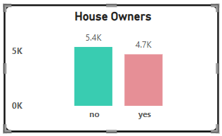
Personal Loans & House Owners
1.3K customers have personal loans.
4.7K customer have their own house, and 5.4k customer do not have their own houses.

Slide 8
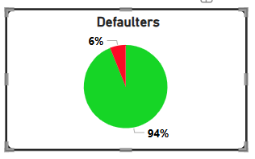
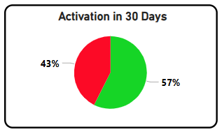
Defaulter & Activation rate.
94% customers are paying their debts on time. With only 6% defaulters.
The activation rate is 57%, meaning these customers activate their credit cards within 30 days, while 43% do not.

Slide 9
Thank you

