Slide 1

B.M.S. College of Engineering · Bengaluru
BIO INSPIRED ALGORITHMS · 23DS7BSBIO
Cover Slide/Main Slide
Plant Disease Detection using Transfer-Learning CNN Optimized with Differential Evolution
TEAM 10
INTELLIGENCE, NATURALLY.
Aryanraj S Singh
1BM23CD008
Richik Chaudhuri
Under the guidance of
Manoj Kumar S, Assistant Professor
1BM23CD050
Suraj B
1BM23CD061
Sushant Deo
1BM23CD062
Academic Year 2026–2027
Department of Computer Science & Engineering (Data Science)
1
Notes:
Aryanraj S Singh — 20 seconds.
“We are Team 10. We study whether Differential Evolution can improve the training recipe of an EfficientNet-B0 tomato classifier. We built the optimizer, the evaluation pipeline, and an offline interface for inspecting predictions and search behavior. Our guide is Manoj Kumar S, Assistant Professor.”

Slide 2
B.M.S. College of Engineering · Bengaluru
FIND THE BEST RECIPE
Introduction to Optimization Problems
01
02
03
Choose
Measure
Improve
Seven decisions define a training recipe: learning, regularization, architecture and augmentation.
Train on the training split. Measure macro-F1 on validation images only.
Search for a better recipe under a fixed evaluation budget.
Department of Computer Science & Engineering (Data Science)
2
Notes:
Aryanraj S Singh — 25 seconds.
“An optimization problem has decisions, an objective, and constraints. Our decisions include learning rate, regularization, head width, and fine-tuning depth. The objective is validation macro-F1. A candidate costs an actual training run, and this mixed recipe cannot be optimized directly by differentiating the validation score.”

Slide 3
B.M.S. College of Engineering · Bengaluru
VARIATION · EXPLORATION · SELECTION
What are Nature-Inspired Algorithms?
01
02
03
A population
Useful variation
Evidence-led selection
Maintain several possible solutions instead of one guess.
Create trials by mutation and recombination.
Keep a candidate when its measured fitness is no worse.
Department of Computer Science & Engineering (Data Science)
3
Notes:
Aryanraj S Singh — 25 seconds.
“A population maintains several possible solutions. Variation explores new recipes, while selection retains useful ones. Exploration seeks new regions and exploitation refines promising ones. DE uses numerical differences between candidates to propose steps. Its operators are inspectable, but it does not guarantee a global optimum.”

Slide 4
B.M.S. College of Engineering · Bengaluru
A MAP OF THE FIELD
Classification of Nature-Inspired Algorithms
01
02
03
Evolutionary
Swarm
Other families
Genetic Algorithm
Differential Evolution
Evolution Strategies
Particle Swarm
Ant Colony
Artificial Bee Colony
Simulated Annealing
Biogeography
Teaching–Learning
Department of Computer Science & Engineering (Data Science)
4
Notes:
Aryanraj S Singh — 25 seconds.
“GA, DE, and evolution strategies are evolutionary methods. PSO, ACO, and ABC are swarm methods. Simulated annealing uses a physics analogy; BBO uses biogeography. Categories overlap. We judge mechanisms and measured behavior, not the metaphor. In particular, binomial crossover makes the full DE algorithm coordinate-dependent.”
Handoff: “Richik will explain the data and the baseline fixed before search.”

Slide 5
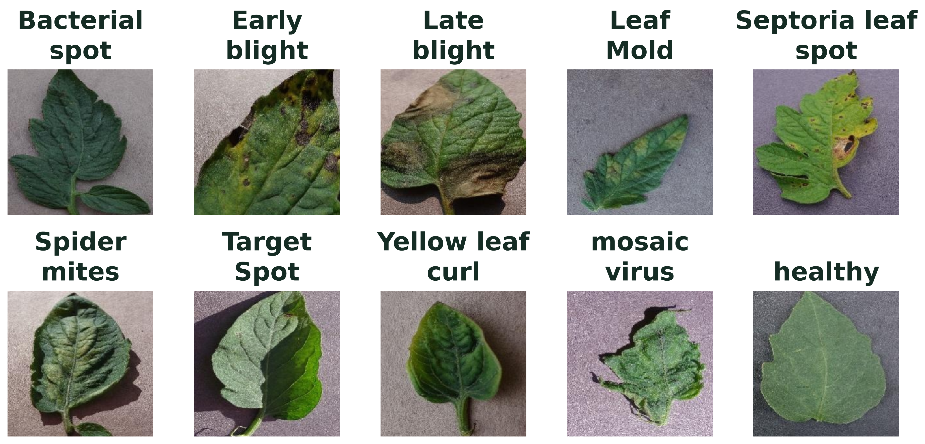
B.M.S. College of Engineering · Bengaluru
TOMATO LEAF HEALTH
Problem Statement
Evolve seven training decisions. Maximize validation macro-F1.
18,146 images · 10 classes · group-aware 70 / 15 / 15 split · 14 exact duplicates removed
Department of Computer Science & Engineering (Data Science)
5
Notes:
Richik Chaudhuri — 30 seconds.
“The fixed application is the color tomato subset of PlantVillage. The cleaned count on the slide comes from the preparation output. Exact duplicates are removed and perceptually similar groups stay in one split. These controlled leaf images support reproducible evaluation, but they do not establish performance on arbitrary field photographs.”

Slide 6
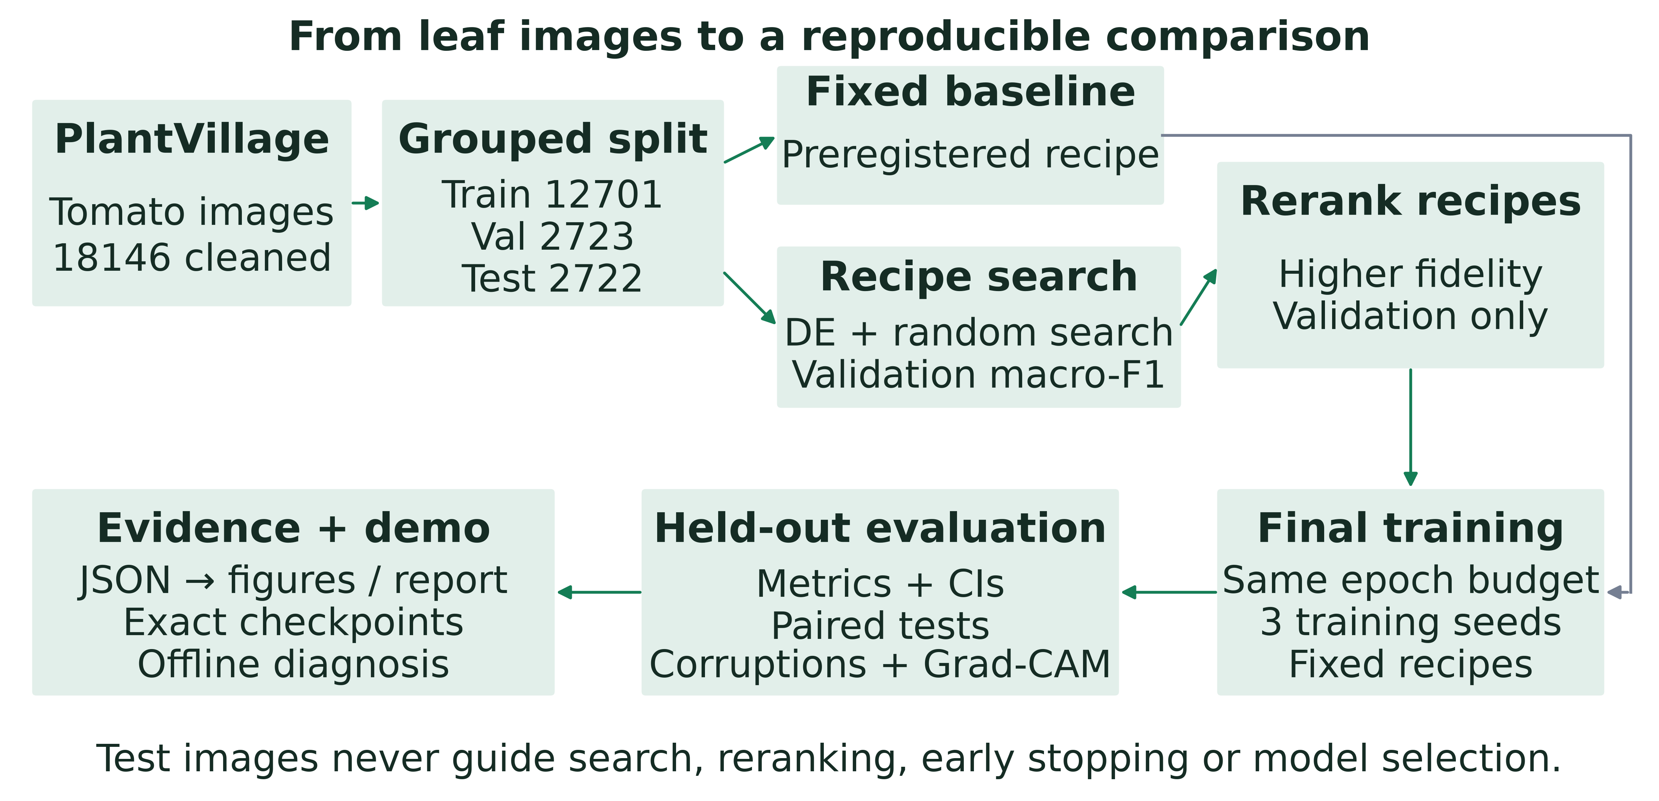
B.M.S. College of Engineering · Bengaluru
THE FULL SYSTEM
Implementation and Results (1/10)
Department of Computer Science & Engineering (Data Science)
6
Notes:
Richik Chaudhuri — 30 seconds.
“Follow the pipeline from verified images to the fixed baseline, DE and random search, validation reranking, repeated final training, and the locked test. Both searches use equal candidate budgets and the same proxy conditions. Final recipes are frozen before test evaluation. The demo loads the exact seed-zero checkpoints.”
Point to the baseline path and the separate reranking paths. Do not imply that the baseline is selected by reranking.

Slide 7
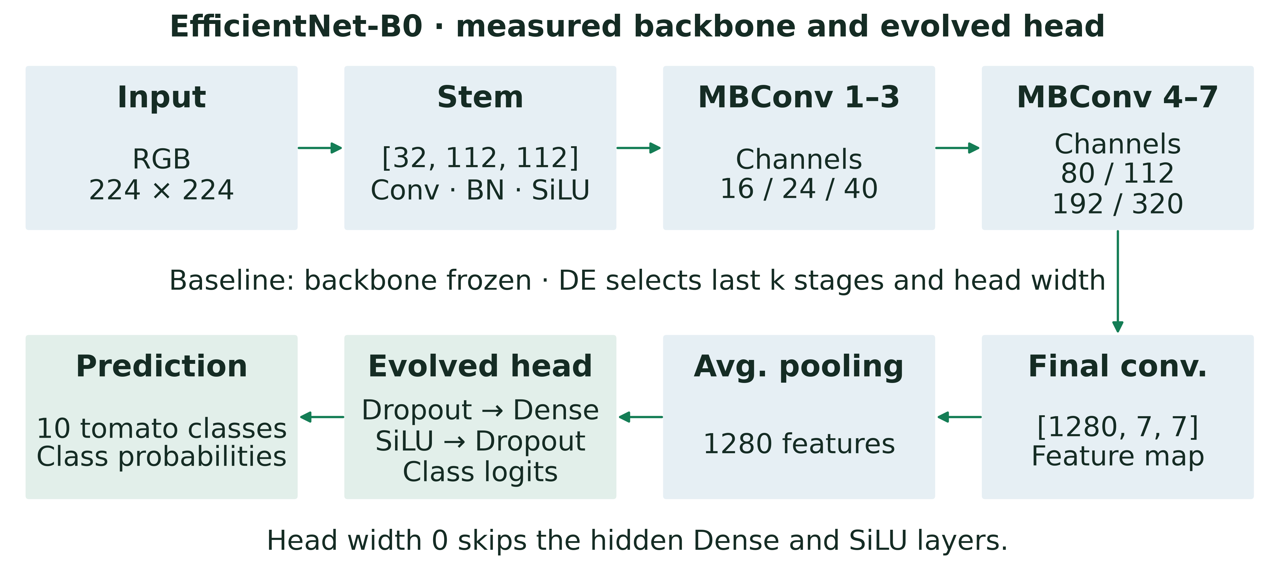
B.M.S. College of Engineering · Bengaluru
A PRE-REGISTERED BASELINE
Implementation and Results (2/10)
The head and the number of unfrozen feature blocks are architecture genes.
Department of Computer Science & Engineering (Data Science)
7
Notes:
Richik Chaudhuri — 30 seconds.
“The baseline freezes EfficientNet-B0 and trains a 256-unit head with dropout 0.2, Adam at 0.001, and no weight decay or label smoothing. It uses the common crop-and-flip pipeline without extra RandAugment. Candidate recipes use AdamW. Therefore, the baseline comparison concerns the whole recipe; DE versus random search more directly compares proposal strategies.”
Handoff: “Suraj will explain the operators and the seven decisions they evolve.”

Slide 8
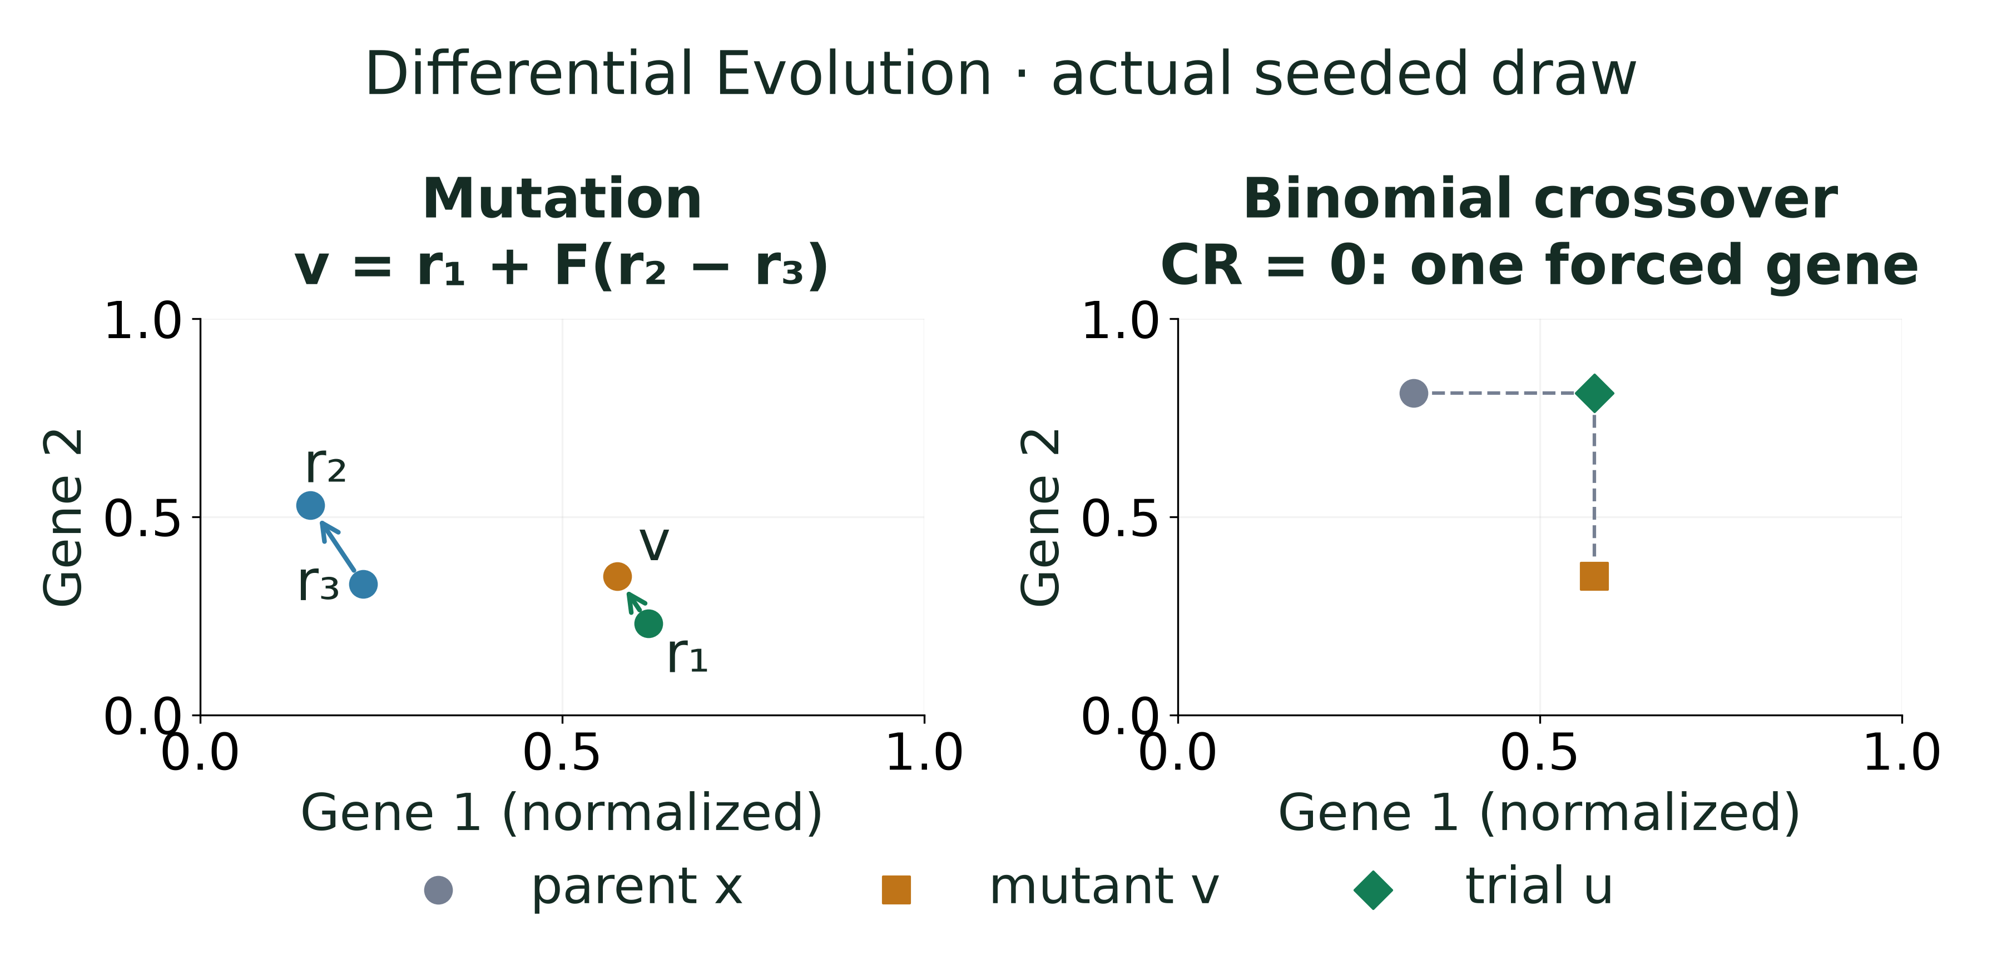
B.M.S. College of Engineering · Bengaluru
DIFFERENTIAL EVOLUTION, FROM SCRATCH
Implementation and Results (3/10)
Department of Computer Science & Engineering (Data Science)
8
Notes:
Suraj B — 45 seconds.
“For each target, choose three distinct donors, all excluding that target. Mutation adds F times a donor difference to the third donor. Repair an out-of-range coordinate between its parent and violated bound. Binomial crossover takes mutant coordinates with probability CR and forces at least one mutant coordinate. Selection accepts an equal or better validation score.”
Point to the operator example. “We test these invariants directly. Each completed evaluation persists the population and random-generator state so an interrupted run can resume.”

Slide 9
B.M.S. College of Engineering · Bengaluru
THE CHROMOSOME AND ITS SEARCH BUDGET
Implementation and Results (4/10)
GENE
DECODED CHOICE
SCALE
Learning rate
10⁻⁴·⁵ to 10⁻²
Logarithmic
Weight decay
10⁻⁶ to 10⁻²
Logarithmic
Dropout
0.0 to 0.6
Linear
Head width
0, 128, 256, 512
Categorical
Unfrozen blocks
0 to 9
Integer
Label smoothing
0.0 to 0.2
Linear
Augmentation magnitude
0 to 15; 0 = no extra RandAugment
Integer
NP 8 · F 0.6 · CR 0.9 · 8 generations · 72 evaluations per method
Department of Computer Science & Engineering (Data Science)
9
Notes:
Suraj B — 25 seconds.
“All seven genes lie between zero and one. Learning rate and weight decay decode logarithmically; head width, unfreezing depth, and augmentation are discrete. A zero-width head is a direct linear classifier. Augmentation zero disables extra RandAugment, retaining the common crop-and-flip transforms. Population, F, CR, and the evaluation budget are fixed before search.”
Point to the two logarithmic rows and the printed budget; avoid reading every bound aloud.

Slide 10
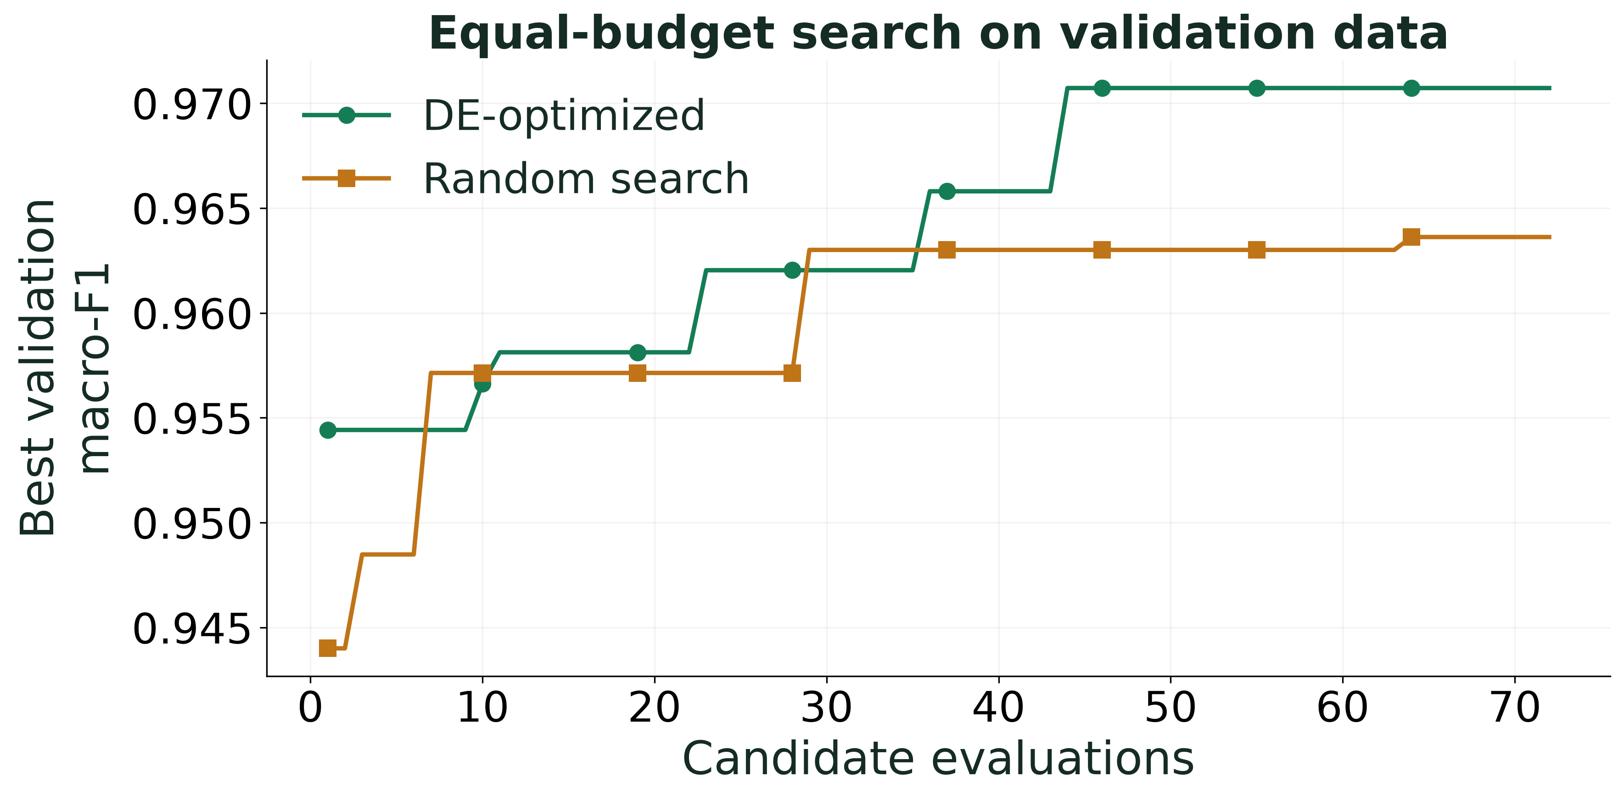
B.M.S. College of Engineering · Bengaluru
SEARCH UNDER AN EQUAL BUDGET
Implementation and Results (5/10)
Proxy validation fitness; final test performance is evaluated separately.
Department of Computer Science & Engineering (Data Science)
10
Notes:
Suraj B — 30 seconds.
“This is proxy validation macro-F1 against candidate evaluations. Both searches use a fresh pretrained model, a shared training seed, and the same fixed subset. Their top three distinct recipes are reranked at full resolution using validation only. Discuss the actual curves, including random-search advantages or ties; a proxy winner need not be the final test winner.”
If search is still running: “This is a partial search trace. The planned budget and final comparison are not complete.”

Slide 11
B.M.S. College of Engineering · Bengaluru
BEFORE AND AFTER: MEASURED PERFORMANCE
Implementation and Results (6/10)
Figure becomes available after its experiment completes.
DRAFT DESIGN PREVIEW — final evaluation has not completed.
Department of Computer Science & Engineering (Data Science)
11
Notes:
Suraj B — 35 seconds.
“The displayed means and standard deviations cover all three registered training seeds. Compare baseline and DE accuracy and macro-F1, then relate them to the random-search control in the full results. Relative error reduction is signed: a negative value means more error. We do not substitute the best seed or a search score.”
Read the current values and state the observed direction. Do not invent a winner or significance claim. If the final artifact is absent, say: “These held-out results remain pending.”
Handoff: “Sushant will show where the models succeed, fail, and disagree.”

Slide 12
B.M.S. College of Engineering · Bengaluru
WHERE DO THE MODELS DISAGREE?
Implementation and Results (7/10)
Figure becomes available after its experiment completes.
Department of Computer Science & Engineering (Data Science)
12
Notes:
Sushant Deo — 25 seconds.
“The confusion matrices have identical normalized scales. Rows show true classes; off-diagonal cells show mistakes. Point to the largest measured confusion and compare the same cells between models. Similar symptoms may be relevant, but a biological explanation requires image inspection and expertise. We do not assume a particular class pair will dominate.”

Slide 13
B.M.S. College of Engineering · Bengaluru
EVERY CLASS COUNTS
Implementation and Results (8/10)
Figure becomes available after its experiment completes.
Per-class F1 across all three seeds; classes ordered by measured gain.
Department of Computer Science & Engineering (Data Science)
13
Notes:
Sushant Deo — 20 seconds.
“These per-class F1 values average all registered seeds and are ordered by measured DE-minus-baseline change. Read the strongest gain and any regression or remaining weakness. Macro-F1 gives every class equal weight, which matters for this imbalanced dataset.”
If final class metrics are absent, identify this as a pending analysis instead of choosing example winners.

Slide 14
B.M.S. College of Engineering · Bengaluru
WHERE THE MODELS LOOK
Implementation and Results (9/10)
Figure becomes available after its experiment completes.
Within-image normalized activation; attention is not a lesion mask or causal proof.
Department of Computer Science & Engineering (Data Science)
14
Notes:
Sushant Deo — 20 seconds.
“Grad-CAM uses gradients at the last convolution to highlight evidence for the predicted class. Compare the same leaf, the labels, and both maps. A heatmap is not a lesion mask or causal proof, and its intensity is not a calibrated confidence score.”
Point to one actual displayed case. Describe only visible evidence; do not infer a biological explanation from the colors alone.

Slide 15
B.M.S. College of Engineering · Bengaluru
BEYOND THE IDEAL IMAGE
Implementation and Results (10/10)
Figure becomes available after its experiment completes.
Seed-zero models · identical held-out images and deterministic corruption settings.
Department of Computer Science & Engineering (Data Science)
15
Notes:
Sushant Deo — 20 seconds.
“Both models see identical blur, noise, illumination, JPEG, and low-light corruptions at three severities. Read the actual trend and identify where either model remains sensitive. These controlled probes test selected disturbances; they do not replace independently collected field images.”
If final corruption metrics are unavailable, identify this analysis as pending. Do not predict a robustness advantage.

Slide 16
B.M.S. College of Engineering · Bengaluru
PLANTWISE · INTELLIGENCE, NATURALLY
Live Demo
01
02
03
Diagnose
Explain
Evolve
Compare exact baseline and DE seed-zero checkpoints on a sample leaf.
Inspect top-three probabilities and genuine Grad-CAM attention.
Change the landscape and watch the population converge.
Department of Computer Science & Engineering (Data Science)
16
Notes:
Sushant Deo — 60 seconds.
First 25 seconds: Open the local demo, press P if needed, select an included leaf, and analyze it. Point to both predictions, top-three probabilities, and the Grad-CAM maps that appear automatically. Probabilities apply to the known tomato classes.
Next 15 seconds: Apply mild blur and analyze again. Describe the actual change in scores without promising that DE improves this particular example.
Final 20 seconds: Open Evolution Lab, select Rastrigin, run, pause with Space, and inspect the timeline. Explain the population points and objective. Distinguish this mathematical search from replaying the separate CNN experiment. Return to the slides.
If a checkpoint is unavailable or analysis fails, acknowledge the state. Use demo/demo.gif only as an identified recording, never as a substitute claimed to be live inference.

Slide 17
B.M.S. College of Engineering · Bengaluru
ACCURACY IS ONLY THE BEGINNING
Performance Metrics and Benchmarking (1/5)
01
02
03
Classification
Macro-F1
Beyond accuracy
Accuracy = correct / total
Precision = TP / (TP + FP)
Recall = TP / (TP + FN)
F1 = 2PR / (P + R)
Macro-F1 = mean class F1
Every class counts equally.
ROC-AUC: ranking quality
ECE: calibration gap
Latency: time per forward pass
Department of Computer Science & Engineering (Data Science)
17
Notes:
Sushant Deo — 25 seconds.
“Accuracy counts correct labels. Precision, recall, and F1 are calculated per class and macro-averaged. ROC-AUC measures ranking. Calibration asks whether confidence matches correctness, and latency measures the specified forward pass. These metrics answer different questions; none alone proves readiness for field deployment.”

Slide 18
B.M.S. College of Engineering · Bengaluru
UNCERTAINTY AND PAIRED EVIDENCE
Performance Metrics and Benchmarking (2/5)
Confidence intervals and paired statistics appear after the locked evaluation.
Department of Computer Science & Engineering (Data Science)
18
Notes:
Sushant Deo — 25 seconds.
“These confidence intervals use one thousand deterministic bootstrap resamples of seed-zero predictions. They describe resampling uncertainty on this split, not differences across farms. Exact two-sided McNemar compares paired correctness on the same images. Read its disagreement counts and p-value; statistical significance is not effect size. Three-seed variation was reported separately.”
If evaluation is unfinished, the intervals and paired test remain pending. Do not replace them with training or validation variation.
Handoff: “Richik will separate optimizer validation from classifier evaluation and explain the computational cost.”

Slide 19
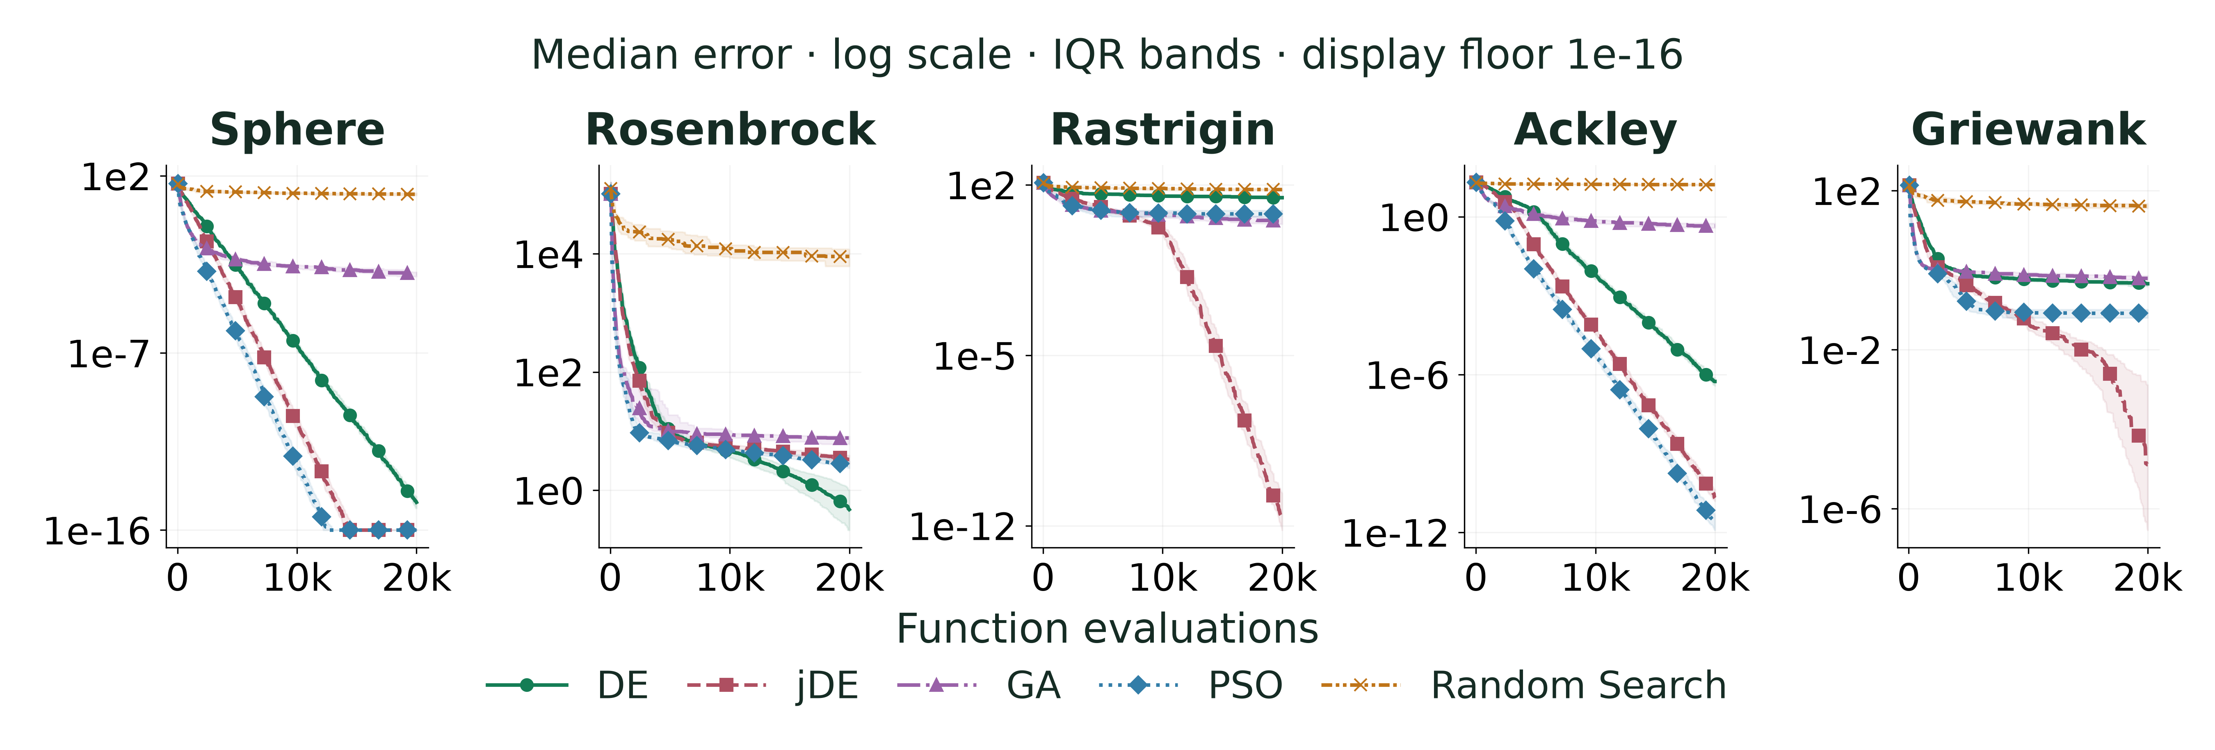
B.M.S. College of Engineering · Bengaluru
FIVE ALGORITHMS. EQUAL EVALUATIONS.
Performance Metrics and Benchmarking (3/5)
30 runs per algorithm/function · 20,000 evaluations per run · 10 dimensions
Department of Computer Science & Engineering (Data Science)
19
Notes:
Richik Chaudhuri — 30 seconds.
“The completed analytic study uses Sphere, Rosenbrock, Rastrigin, Ackley, and Griewank. DE, jDE, GA, PSO, and random search receive equal function-evaluation budgets across all registered seeds. Curves show median best-so-far error with interquartile spread. This tests the optimizer independently of the expensive CNN objective.”
Point to the budget and dimension printed on the slide. The two-dimensional landscapes in the demo are explanatory; the main quantitative study is ten-dimensional.

Slide 20
B.M.S. College of Engineering · Bengaluru
NO UNIVERSAL WINNER
Performance Metrics and Benchmarking (4/5)
FUNCTION
DE
jDE
GA
PSO
Random Search
Sphere
2.59e-15
1.27e-23
1.06e-03
2.59e-26
1.17e+01
Rosenbrock
4.72e-01
3.33e+00
7.66e+00
2.66e+00
8.99e+03
Rastrigin
3.00e+01
2.05e-12
3.30e+00
6.47e+00
6.44e+01
Ackley
5.46e-07
2.02e-11
4.47e-01
2.33e-12
1.66e+01
Griewank
4.57e-01
1.29e-05
6.22e-01
8.24e-02
4.10e+01
Median final objective · lower is better · 30 seeds per method and function
Department of Computer Science & Engineering (Data Science)
20
Notes:
Richik Chaudhuri — 25 seconds.
“Lower final error is better. DE has the lowest median on Rosenbrock; PSO on Sphere and Ackley; jDE on Rastrigin and Griewank. This is landscape-dependent evidence, not a universal ranking. The report also shows mean, standard deviation, best runs, and exploratory rank-sum outputs.”
If asked about those tests: “They are unadjusted for multiple comparisons and not tie-corrected, despite some ties. We do not treat their approximate p-values as confirmatory significance evidence.”

Slide 21
B.M.S. College of Engineering · Bengaluru
THE COST OF A BETTER RECIPE
Performance Metrics and Benchmarking (5/5)
Measured training and inference costs appear after all runs complete.
Department of Computer Science & Engineering (Data Science)
21
Notes:
Richik Chaudhuri — 25 seconds.
“Training time sums all three final seeds. Search time sums uncached candidate-training durations; it is not exclusive wall-clock use. Inference is a warmed batch-one forward pass on the recorded device. The local demo also decodes images and computes Grad-CAM on CPU, so its complete response time is a different measurement.”
Read the table only after final costs exist. Keep completed mathematical-benchmark time separate from unfinished CNN training costs.

Slide 22
B.M.S. College of Engineering · Bengaluru
WHAT THE EVIDENCE SUPPORTS
Advantages and Limitations
01
02
Advantages
Limitations
Auditable operators
Reproducible data splits
Equal-budget control
Offline inference
Controlled-condition images
One crop/split; one search per method
Proxy-fidelity noise
Training cost
Department of Computer Science & Engineering (Data Science)
22
Notes:
Aryanraj S Singh — 25 seconds.
“Our strengths are auditable operators, documented splits, equal budgets, resumable execution, and offline inference. Limitations include controlled imagery, one crop and split, proxy noise, and training cost. We ran one CNN search per method. Repeated final seeds measure training variation for selected recipes, not variation across independent searches. Negative results remain visible.”

Slide 23
B.M.S. College of Engineering · Bengaluru
FROM THE LAB TOWARD THE FIELD
Future Scope
01
02
03
Field evidence
Efficient intelligence
Adaptive learning
Validate on real field images with an explicit class mapping.
Optimize quality alongside latency and model size.
Explore SHADE, multi-fidelity search and expert feedback.
Department of Computer Science & Engineering (Data Science)
23
Notes:
Suraj B — 20 seconds.
“Next studies should evaluate real field images, validate unknown-input handling, and balance predictive quality with latency. Adaptive DE, multi-fidelity allocation, on-device export, and expert feedback are promising extensions. These require fresh evaluation protocols; they are proposed work, not completed claims.”

Slide 24
B.M.S. College of Engineering · Bengaluru
VERIFIED DOI SOURCES
References (1/2)
01
Storn, Rainer et al. (1997). Differential Evolution -- A Simple and Efficient Heuristic for global Optimization over Continuous Spaces
DOI: 10.1023/a:1008202821328
02
Mohanty, Sharada P. et al. (2016). Using Deep Learning for Image-Based Plant Disease Detection
DOI: 10.3389/fpls.2016.01419
03
Tan, Mingxing et al. (2019). EfficientNet: Rethinking Model Scaling for Convolutional Neural Networks
DOI: 10.48550/arxiv.1905.11946
04
Das, Swagatam et al. (2011). Differential Evolution: A Survey of the State-of-the-Art
DOI: 10.1109/tevc.2010.2059031
05
Brest, Janez et al. (2006). Self-Adapting Control Parameters in Differential Evolution: A Comparative Study on Numerical Benchmark Problems
DOI: 10.1109/tevc.2006.872133
Department of Computer Science & Engineering (Data Science)
24
Notes:
Aryanraj S Singh — 10 seconds.
“These references have verified DOI records. The checker matches title, first author, and year against Crossref or DataCite and checks DOI resolution.”
Do not read every reference aloud.

Slide 25
B.M.S. College of Engineering · Bengaluru
VERIFIED DOI SOURCES
References (2/2)
06
Selvaraju, Ramprasaath R. et al. (2017). Grad-CAM: Visual Explanations from Deep Networks via Gradient-Based Localization
DOI: 10.1109/iccv.2017.74
07
Dietterich, Thomas G. et al. (1998). Approximate Statistical Tests for Comparing Supervised Classification Learning Algorithms
DOI: 10.1162/089976698300017197
08
Guo, Chuan et al. (2017). On Calibration of Modern Neural Networks
DOI: 10.48550/arxiv.1706.04599
09
Hendrycks, Dan et al. (2019). Benchmarking Neural Network Robustness to Common Corruptions and Perturbations
DOI: 10.48550/arxiv.1903.12261
10
Singh, Davinder et al. (2020). PlantDoc: A Dataset for Visual Plant Disease Detection
DOI: 10.1145/3371158.3371196
Department of Computer Science & Engineering (Data Science)
25
Notes:
Aryanraj S Singh — 10 seconds.
“The report provides the complete bibliography and source-specific claims. Published findings supply context; each measurement of our own system comes from a saved experiment artifact.”
Point to the second reference page; keep this transition brief.

Slide 26

B.M.S. College of Engineering · Bengaluru
TEAM 10 · 23DS7BSBIO
Thank You / Questions
A healthier future.
One leaf at a time.
Plantwise · Intelligence, naturally.
github.com/Suraj-B12/
BIO-INSPIRED-ALGO---AAT
Department of Computer Science & Engineering (Data Science)
26
Notes:
All members — 10 seconds.
“Thank you. The QR code links to the source, report, presentation, tests, and offline demo. We welcome questions about an operator, a measurement, or a limitation.”

