Slide 1

B.M.S. College of Engineering · Bengaluru
BIO INSPIRED ALGORITHMS · 23DS7BSBIO
Cover Slide/Main Slide
Plant Disease Detection using Transfer-Learning CNN Optimized with Differential Evolution
TEAM 10
INTELLIGENCE, NATURALLY.
Aryanraj S Singh
1BM23CD008
Richik Chaudhuri
Under the guidance of
Manoj Kumar S, Assistant Professor
1BM23CD050
Suraj B
1BM23CD061
Sushant Deo
1BM23CD062
Academic Year 2026–2027
Department of Computer Science & Engineering (Data Science)
1
Notes:
Aryanraj S Singh — 20 seconds.
Good morning. We are Team 10. Our project is plant disease detection using a pretrained CNN, tuned with Differential Evolution. In simple words, we used an evolution-inspired search to find better training settings for a tomato leaf disease classifier. Our guide is Manoj Kumar S, Assistant Professor.

Slide 2
B.M.S. College of Engineering · Bengaluru
FINDING THE BEST SETTINGS
Introduction to Optimization Problems
Optimization = finding the settings that give the best result.
01
02
03
Settings
Score
Search
Our model has 7 training settings, such as learning speed and how much of the network to retrain.
Each set of settings is tested by training a model and scoring it on images it has not seen.
Try settings smartly, with a fixed number of attempts, and keep the best one.
Department of Computer Science & Engineering (Data Science)
2
Notes:
Aryanraj S Singh — 25 seconds.
Optimization means finding the settings that give the best result. Our model has seven training settings, such as how fast it learns and how much of the network we retrain. To score one set of settings, we train a model and test it on images it has not seen. With a fixed number of tries, we want the best settings.

Slide 3
B.M.S. College of Engineering · Bengaluru
LEARNING FROM NATURE
What are Nature-Inspired Algorithms?
Search methods that borrow ideas from nature, such as evolution or swarms.
01
02
03
A population
Variation
Selection
Work with a group of candidate solutions, not just one guess.
Mix and change candidates to create new ones, like offspring.
Keep whichever candidate scores better, like survival of the fittest.
Department of Computer Science & Engineering (Data Science)
3
Notes:
Aryanraj S Singh — 25 seconds.
Nature-inspired algorithms borrow ideas from nature to search for good solutions. They keep a population, a group of candidate solutions. They create new candidates by mixing and changing old ones, like offspring. And they keep whichever candidate scores better, like survival of the fittest.

Slide 4
B.M.S. College of Engineering · Bengaluru
A MAP OF THE FIELD
Classification of Nature-Inspired Algorithms
Our choice, Differential Evolution (DE), belongs to the evolutionary family.
01
02
03
Evolutionary
Swarm
Other families
Genetic Algorithm
Differential Evolution (ours)
Evolution Strategies
Particle Swarm
Ant Colony
Artificial Bee Colony
Simulated Annealing
Biogeography-based
Teaching–Learning
Department of Computer Science & Engineering (Data Science)
4
Notes:
Aryanraj S Singh — 25 seconds.
These methods come in a few families. Evolutionary methods include the Genetic Algorithm and Differential Evolution. Swarm methods include Particle Swarm and Ant Colony. Others include Simulated Annealing. We chose Differential Evolution, or DE, because it is simple, has few settings of its own, and works well on problems like ours.
Handoff: “Richik will now explain our problem and data.”

Slide 5
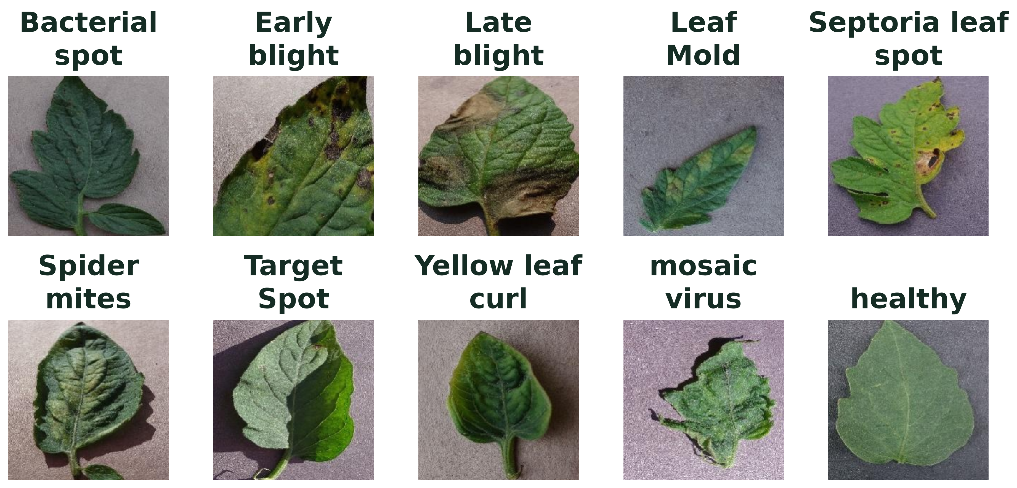
B.M.S. College of Engineering · Bengaluru
TOMATO LEAF HEALTH
Problem Statement
Goal: use DE to pick the training settings that best detect tomato leaf diseases.
18,146 leaf images · 10 classes (9 diseases + healthy) · 70% train / 15% validation / 15% test
Department of Computer Science & Engineering (Data Science)
5
Notes:
Richik Chaudhuri — 30 seconds.
Tomato leaf diseases cause big crop losses, and experts are not always available. Our goal is to let DE pick the training settings that best detect these diseases. We use the PlantVillage tomato images: 18,146 photos in ten classes, nine diseases plus healthy. We split them into 70% for training, 15% for validation and 15% for the final test.

Slide 6
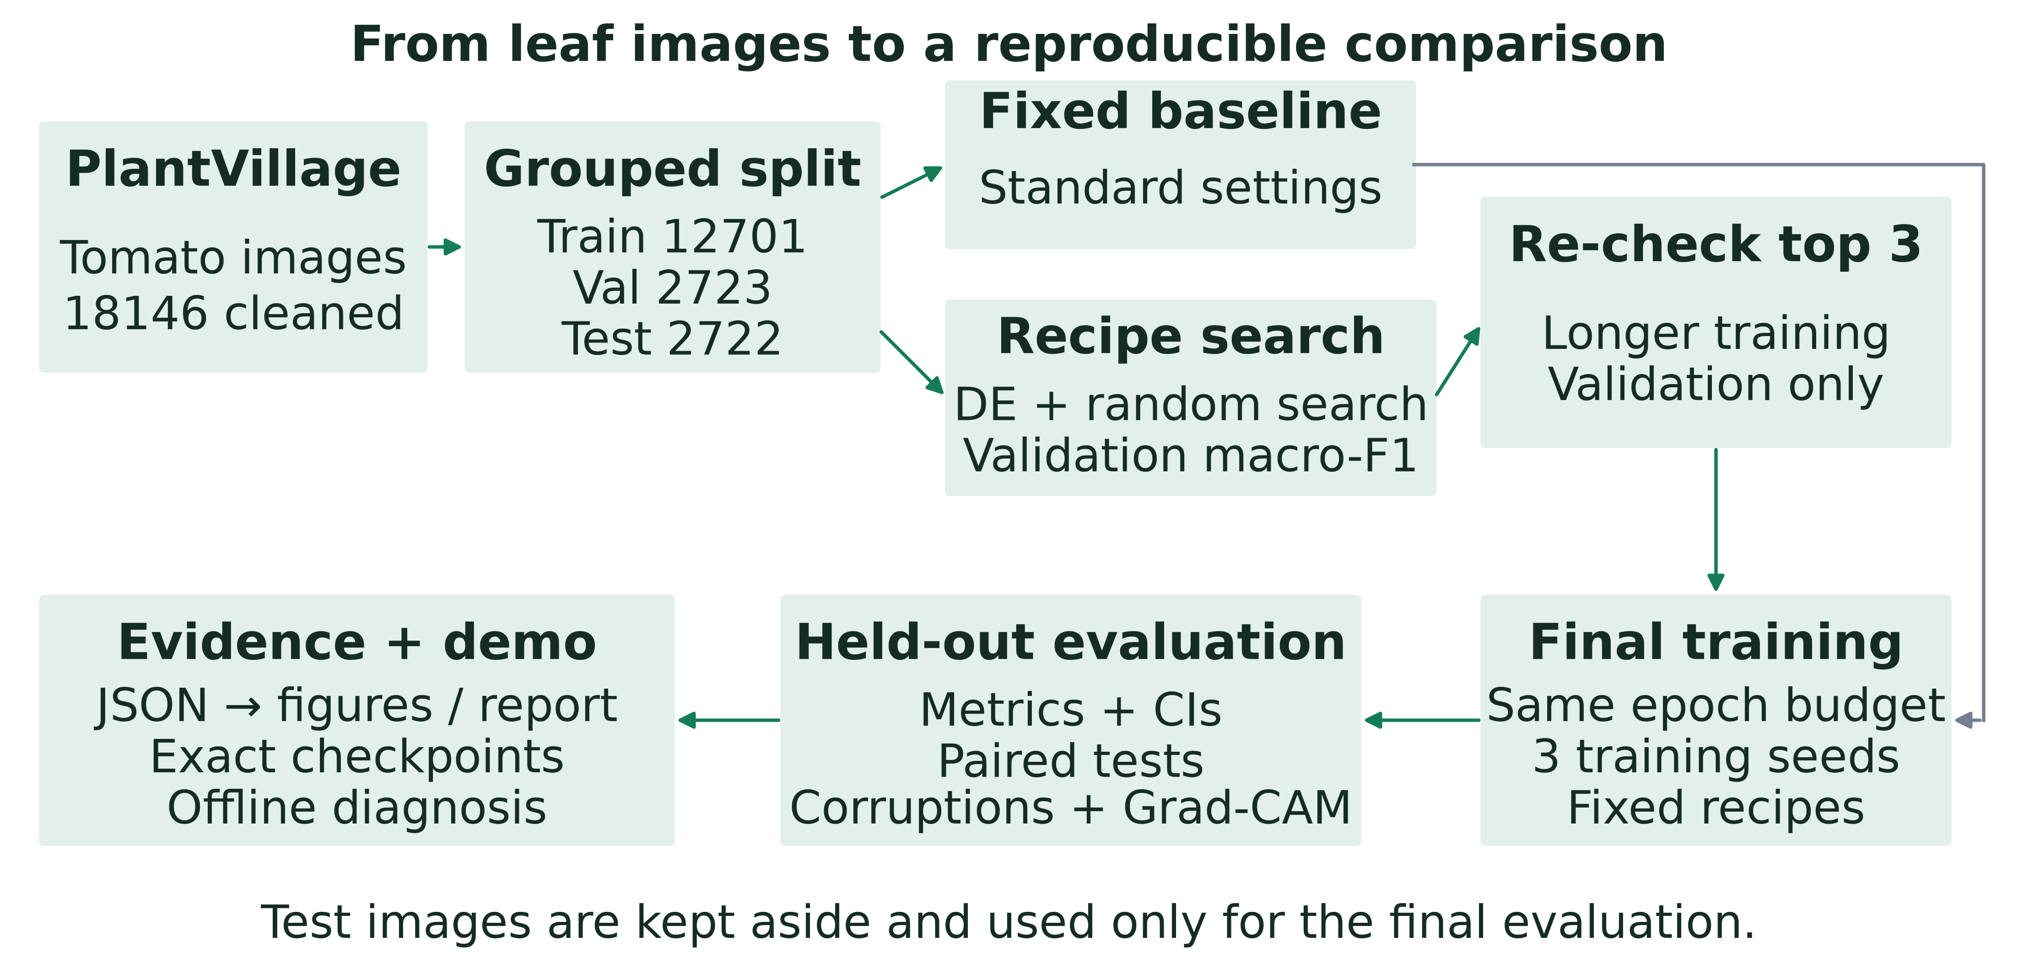
B.M.S. College of Engineering · Bengaluru
THE FULL SYSTEM
Implementation and Results (1/10)
Test images are kept aside and used only once, for the final score.
Department of Computer Science & Engineering (Data Science)
6
Notes:
Richik Chaudhuri — 30 seconds.
This is our full system. We clean the images and split them. We train a standard baseline. Then DE and random search each look for better settings using the validation images. The best recipes are trained three times, and only then do we score them on the test images. Finally, the models power our offline demo.

Slide 7
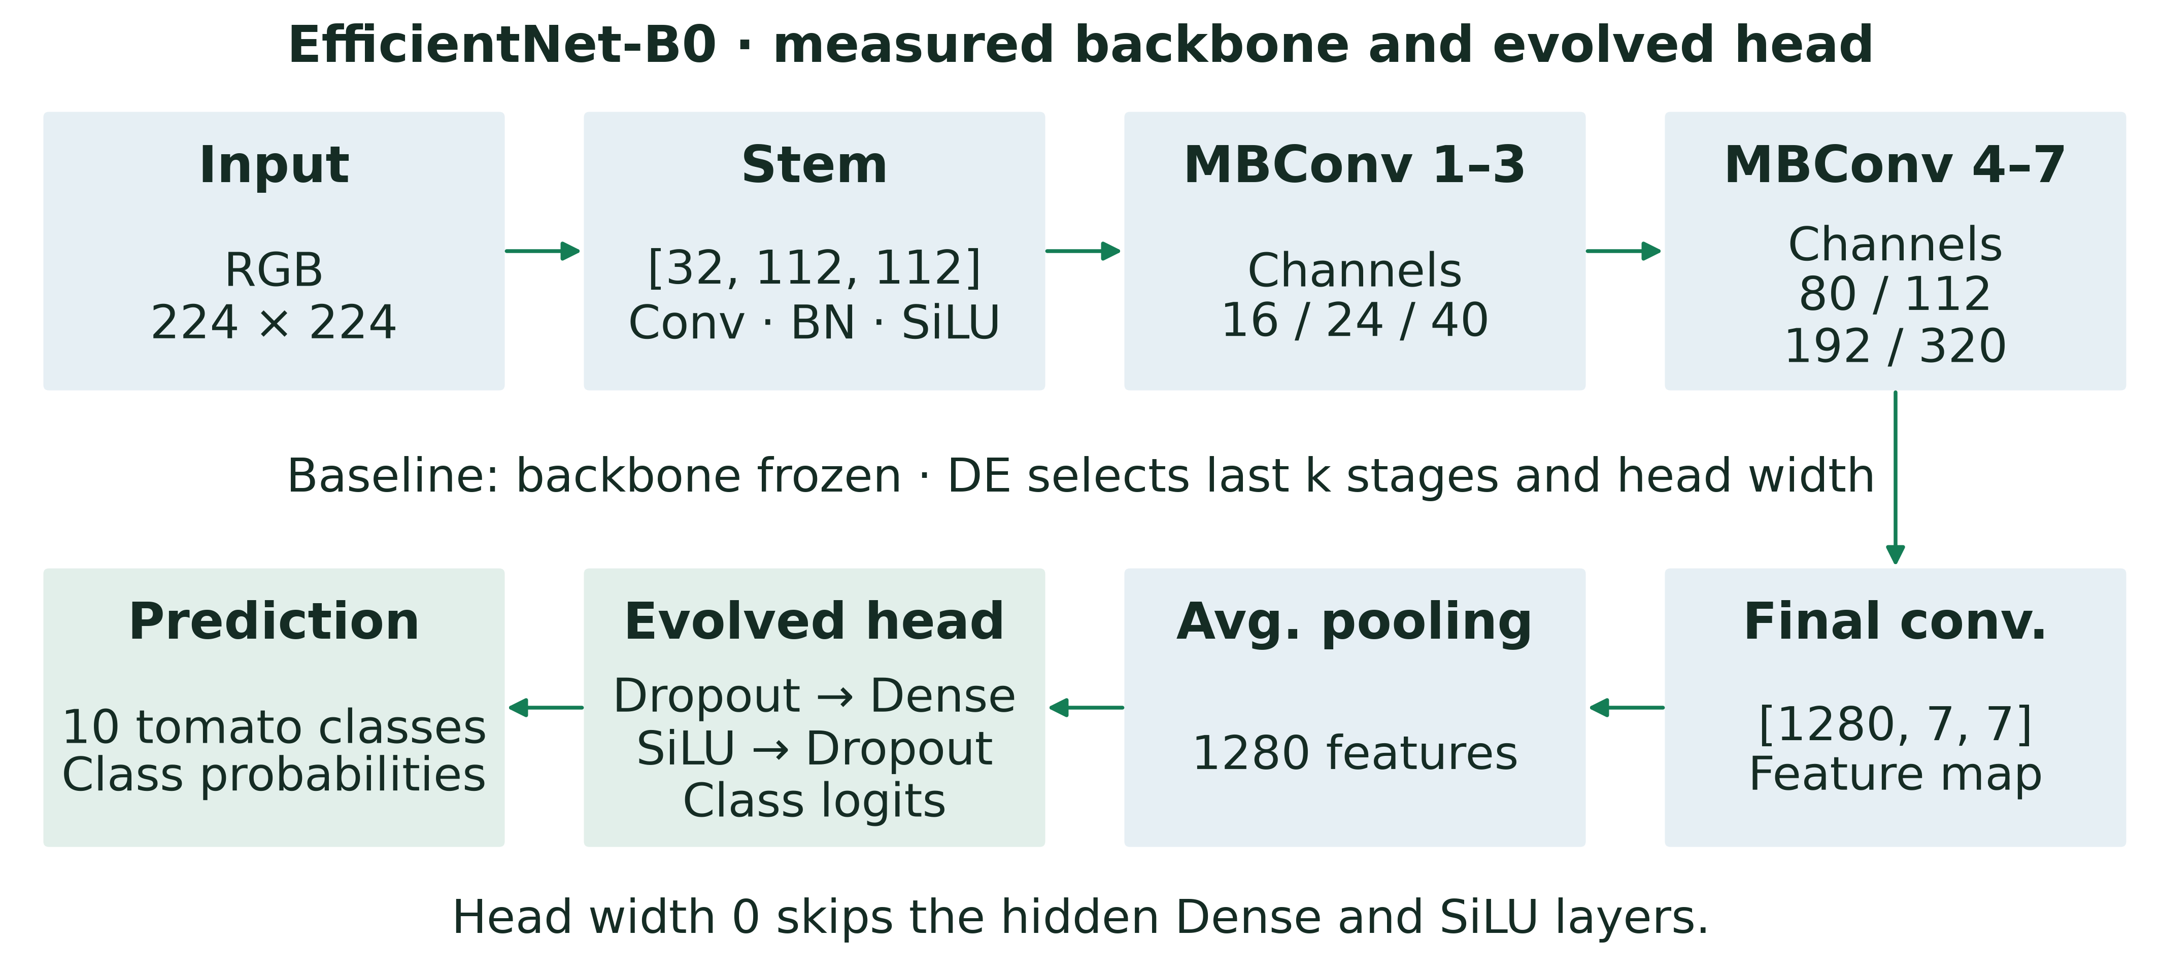
B.M.S. College of Engineering · Bengaluru
OUR MODEL AND THE BASELINE
Implementation and Results (2/10)
EfficientNet-B0: a compact, pretrained image network. Baseline = standard recipe fixed in advance.
Department of Computer Science & Engineering (Data Science)
7
Notes:
Richik Chaudhuri — 30 seconds.
Our model is EfficientNet-B0, a compact image network already trained on over a million everyday photos (ImageNet). We reuse that knowledge and add a small classification layer for our ten classes. The baseline is a standard, common recipe: it keeps the pretrained part frozen and trains only the last layer. We fixed it before any search began.
Handoff: “Suraj will explain how DE works.”

Slide 8
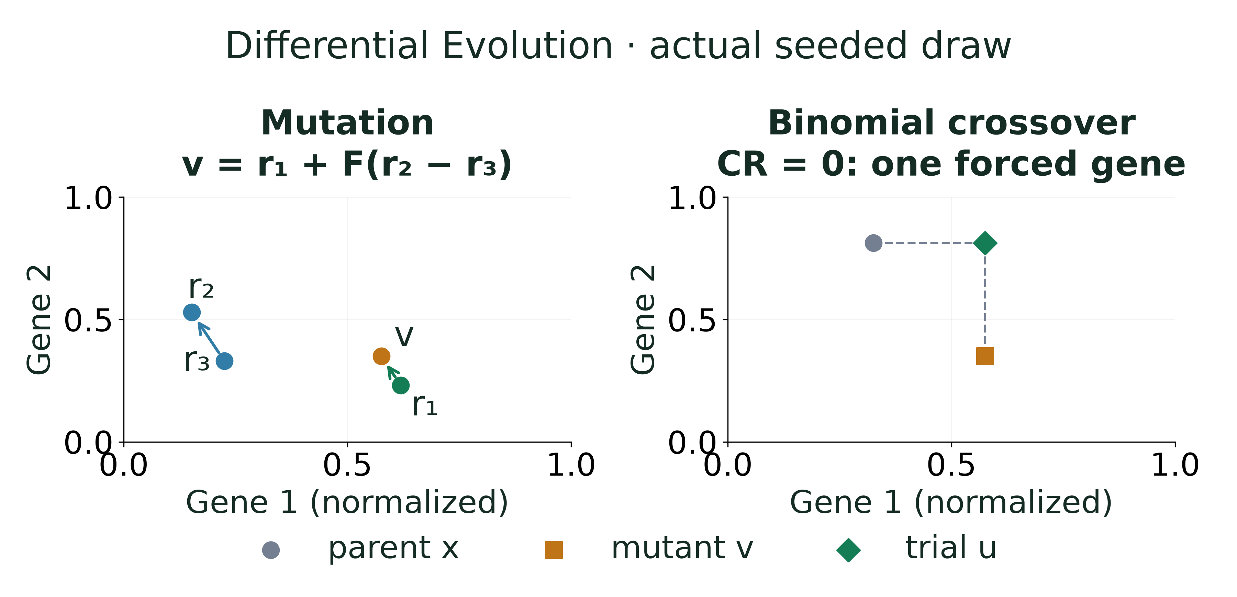
B.M.S. College of Engineering · Bengaluru
HOW DE CREATES BETTER CANDIDATES
Implementation and Results (3/10)
Mutate: combine three candidates · Crossover: blend with the parent · Select: keep the better one
Department of Computer Science & Engineering (Data Science)
8
Notes:
Suraj B — 45 seconds.
DE improves a group of candidate settings, generation by generation. First, mutation: it takes three other candidates and adds the difference between two of them to the third, giving a new direction to try. Second, crossover: it blends this new candidate with the current one, setting by setting. Third, selection: we train both and keep the one with the better validation score. We wrote all of this ourselves in NumPy and tested every step.

Slide 9
B.M.S. College of Engineering · Bengaluru
THE 7 SETTINGS DE TUNES
Implementation and Results (4/10)
SETTING
WHAT IT CONTROLS
RANGE SEARCHED
Learning rate
How fast the model learns
0.00003 to 0.01
Weight decay
Keeps the model simple to avoid overfitting
0.000001 to 0.01
Dropout
Randomly switches off neurons during training
0 to 0.6
Head width
Size of the final classification layer
0, 128, 256 or 512
Unfrozen blocks
How much of the pretrained network is retrained
0 to 9 blocks
Label smoothing
Stops the model from being over-confident
0 to 0.2
Augmentation
Random image changes that add variety
Level 0 to 15
Population 8 · 8 generations · 72 training runs for DE, and the same 72 for random search
Department of Computer Science & Engineering (Data Science)
9
Notes:
Suraj B — 25 seconds.
These are the seven settings DE tunes. Some control learning, like the learning rate. Some prevent overfitting, like dropout and weight decay. Two control the network itself: the size of the final layer and how many blocks of the pretrained network we retrain. DE used 8 candidates over 8 generations, 72 training runs, and random search got exactly the same 72.

Slide 10
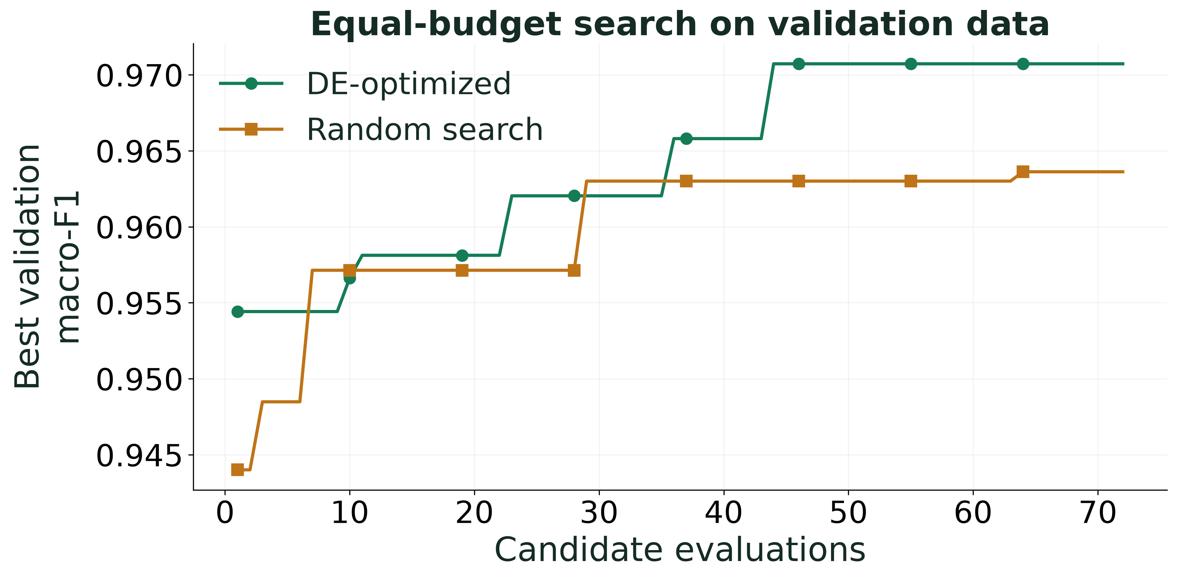
B.M.S. College of Engineering · Bengaluru
DE VERSUS RANDOM SEARCH
Implementation and Results (5/10)
During the search, DE found the best validation score: 97.07% vs 96.36% for random search.
Department of Computer Science & Engineering (Data Science)
10
Notes:
Suraj B — 30 seconds.
Here is the search itself. The line shows the best validation score found so far. Random search is a strong, fair control: it tries random settings with the same budget. DE climbs steadily and ends with the best search score, 97.07% against 96.36% for random search.

Slide 11
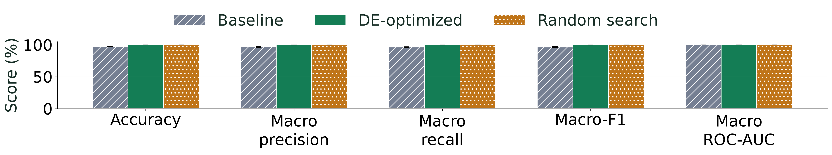
B.M.S. College of Engineering · Bengaluru
BEFORE AND AFTER DE
Implementation and Results (6/10)
BASELINE ACCURACY
DE ACCURACY
BASELINE MACRO-F1
DE MACRO-F1
97.43%
99.85%
96.60%
99.80%
± 0.45 pp · 3 runs
± 0.06 pp · 3 runs
± 0.54 pp · 3 runs
± 0.09 pp · 3 runs
DE cuts the baseline’s errors by 94.29% · both search methods reach 99.85% · macro-F1 = average score across all 10 classes
Department of Computer Science & Engineering (Data Science)
11
Notes:
Suraj B — 35 seconds.
This is our main result. Averaged over three training runs, the baseline reaches 97.43% accuracy. The DE recipe reaches 99.85%. Macro-F1, the average score across all ten classes, rises from 96.60% to 99.80%. That means DE removes about 94% of the baseline’s mistakes. Random search also reaches 99.85%, so DE matches a strong equal-budget control.
Handoff: “Sushant will show where the improvements come from.”

Slide 12
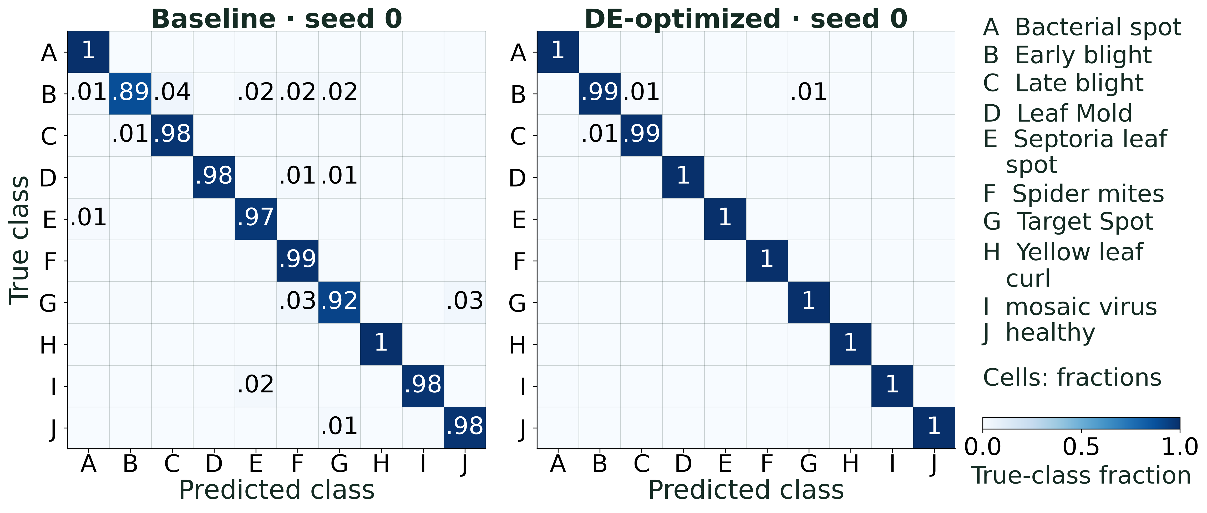
B.M.S. College of Engineering · Bengaluru
WHERE THE MISTAKES GO
Implementation and Results (7/10)
Each row is the true disease. A strong diagonal means correct answers; DE removes most baseline mix-ups.
Department of Computer Science & Engineering (Data Science)
12
Notes:
Sushant Deo — 25 seconds.
These grids show where mistakes go. Each row is the true disease and each column is the prediction, so a dark diagonal means correct answers. The baseline mixes up several diseases, for example Target Spot with spider mites. With DE, almost every image lands on the diagonal.

Slide 13
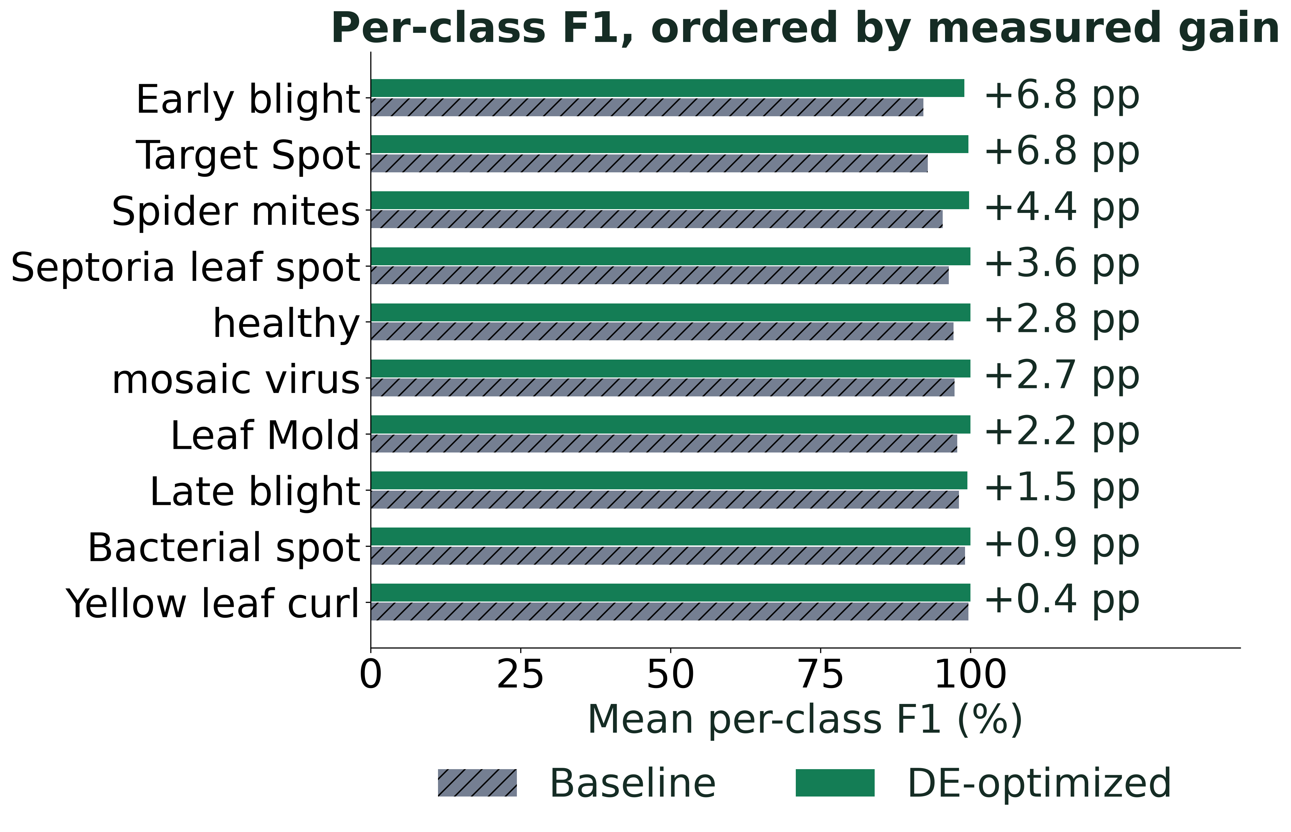
B.M.S. College of Engineering · Bengaluru
EVERY DISEASE IMPROVES
Implementation and Results (8/10)
All 10 classes improve with DE · largest gain: Early blight (+6.8 points)
Department of Computer Science & Engineering (Data Science)
13
Notes:
Sushant Deo — 20 seconds.
Here we look at each disease separately. Every one of the ten classes improves with DE. The biggest gains are on Early blight and Target Spot, about 6.8 points each, which were the hardest classes for the baseline.

Slide 14
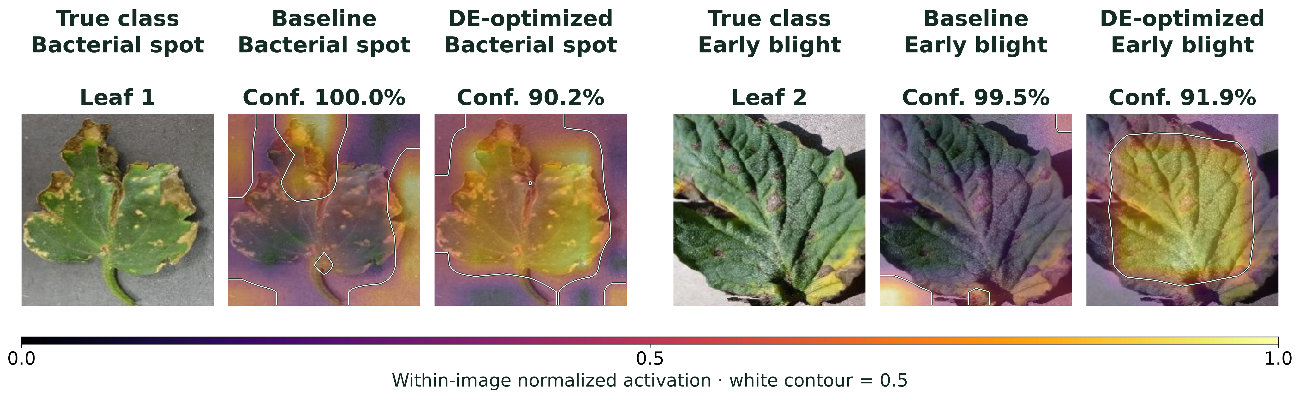
B.M.S. College of Engineering · Bengaluru
WHERE THE MODELS LOOK
Implementation and Results (9/10)
Grad-CAM: a heatmap of where the model looked. Warm colours = more attention.
Department of Computer Science & Engineering (Data Science)
14
Notes:
Sushant Deo — 20 seconds.
Grad-CAM is a heatmap that shows where the model looked when it made its decision. Warm colours mean more attention. Both models classify these leaves correctly, and the DE model spreads its attention across the leaf itself rather than the edges or background.

Slide 15
B.M.S. College of Engineering · Bengaluru
WHAT DE DISCOVERED
Implementation and Results (10/10)
SETTING
BASELINE
DE CHOICE
IN PLAIN WORDS
Unfrozen blocks
0
9
Retrain the whole network, not only the top
Learning rate
0.001
0.0013
Slightly faster learning
Label smoothing
0
0.11
Less over-confident training
Weight decay
0
0.00042
Mild simplicity penalty
Dropout
0.20
0.22
About the same
Head width
256
256
Unchanged
Key insight: DE learned that retraining all 9 blocks of the pretrained network pays off.
Department of Computer Science & Engineering (Data Science)
15
Notes:
Sushant Deo — 20 seconds.
So what did DE actually learn? The biggest change is that it chose to retrain all nine blocks of the pretrained network instead of keeping them frozen. It also picked a slightly higher learning rate and added label smoothing, which keeps the model from being over-confident. This is a clear, useful finding about how to fine-tune.

Slide 16
B.M.S. College of Engineering · Bengaluru
PLANTWISE · INTELLIGENCE, NATURALLY
Live Demo
An offline web app that runs on a normal laptop.
01
02
03
Diagnose
Explain
Evolve
Pick a tomato leaf and compare the baseline and DE models side by side.
See the top-3 predictions and the Grad-CAM heatmap.
Watch a DE population search a landscape, step by step.
Department of Computer Science & Engineering (Data Science)
16
Notes:
Sushant Deo — 60 seconds.
First 25 seconds: Open the demo at http://127.0.0.1:8000, press P for presentation mode, pick a sample tomato leaf and click analyze. Point to the two predictions side by side, the top-3 probabilities, and the Grad-CAM heatmaps.
Next 15 seconds: Apply a mild blur and analyze again, and describe how the scores change.
Final 20 seconds: Open Evolution Lab, pick Rastrigin and press run. Press Space to pause and explain: each dot is a candidate, and the group moves toward the lowest point. Then return to the slides.
If the demo cannot start, play demo/demo.gif, the recording of the same demo.

Slide 17
B.M.S. College of Engineering · Bengaluru
HOW WE MEASURE SUCCESS
Performance Metrics and Benchmarking (1/5)
Three simple ways to score a disease classifier.
01
02
03
Accuracy
Macro-F1
ROC-AUC
Share of test images labelled correctly.
Average score across all 10 classes, so rare diseases count as much as common ones.
How well the model ranks the right disease above the wrong ones (1.0 = perfect).
Department of Computer Science & Engineering (Data Science)
17
Notes:
Sushant Deo — 25 seconds.
We use three simple scores. Accuracy is the share of test images labelled correctly. Macro-F1 averages the score across all ten classes, so a rare disease counts as much as a common one. ROC-AUC tells us how well the model ranks the right disease above the wrong ones, where 1.0 is perfect.

Slide 18
B.M.S. College of Engineering · Bengaluru
IS THE GAIN REAL?
Performance Metrics and Benchmarking (2/5)
MODEL (RUN 1)
ACCURACY · LIKELY RANGE
MACRO-F1 · LIKELY RANGE
Baseline
97.13% – 98.24%
96.15% – 97.70%
Random search
99.74% – 100.00%
99.69% – 100.00%
DE-optimized
99.63% – 99.96%
99.48% – 99.95%
A statistical test (McNemar) confirms the gain is not due to chance (p < 0.001).
On the same test images, DE fixes 60 baseline mistakes; the baseline is right on only 3 that DE misses.
Likely range = 95% confidence interval from 1,000 resamples of the test set.
Department of Computer Science & Engineering (Data Science)
18
Notes:
Sushant Deo — 25 seconds.
Is the gain real? The table shows the likely range of each score, from a thousand resamples of the test set. The DE range sits well above the baseline range. On the same test images, DE fixes 60 baseline mistakes, while the baseline is right on only 3 that DE misses. The McNemar test confirms this is not due to chance: p is about 9.05 times ten to the minus 15, far below 0.001.
Handoff: “Richik will show how DE performs on its own.”

Slide 19
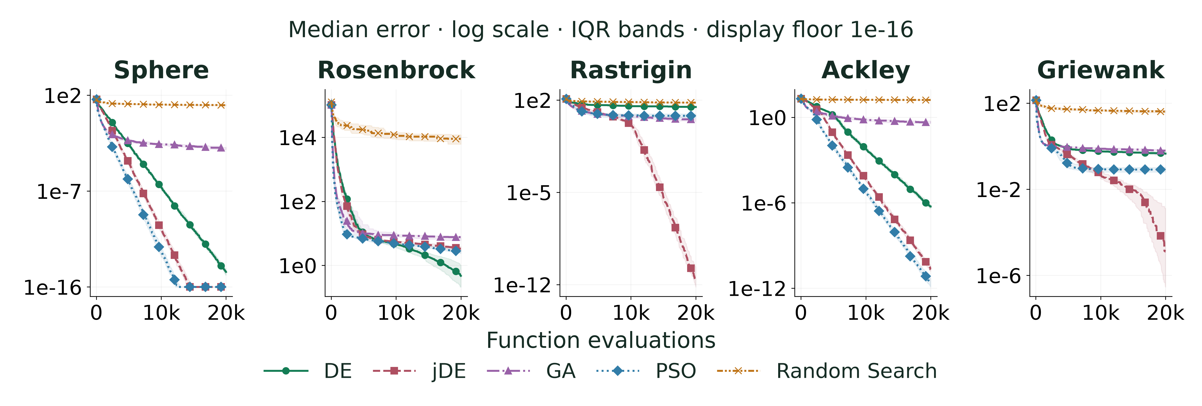
B.M.S. College of Engineering · Bengaluru
TESTING DE ON ITS OWN
Performance Metrics and Benchmarking (3/5)
5 standard test functions · 30 runs each · 20,000 tries per run · lower error is better
Department of Computer Science & Engineering (Data Science)
19
Notes:
Richik Chaudhuri — 30 seconds.
To check that our DE code works well by itself, we also tested it on five standard math test functions, separate from the CNN. We compared DE with an adaptive DE called jDE, the Genetic Algorithm, Particle Swarm and random search. Each method had 30 runs with 20,000 tries per run, and lower error is better.

Slide 20
B.M.S. College of Engineering · Bengaluru
BENCHMARK RESULTS
Performance Metrics and Benchmarking (4/5)
FUNCTION
DE
jDE
GA
PSO
Random Search
Sphere
2.59e-15
1.27e-23
1.06e-03
2.59e-26
1.17e+01
Rosenbrock
4.72e-01
3.33e+00
7.66e+00
2.66e+00
8.99e+03
Rastrigin
3.00e+01
2.05e-12
3.30e+00
6.47e+00
6.44e+01
Ackley
5.46e-07
2.02e-11
4.47e-01
2.33e-12
1.66e+01
Griewank
4.57e-01
1.29e-05
6.22e-01
8.24e-02
4.10e+01
Median final error · lower is better · DE beats random search on 5 of 5 functions and is best on Rosenbrock
Department of Computer Science & Engineering (Data Science)
20
Notes:
Richik Chaudhuri — 25 seconds.
This table shows the typical final error. DE beats random search on all five functions and is the best method on Rosenbrock, a famously tricky valley-shaped function. Other methods win on other functions, which is normal: each method has its strengths.

Slide 21
B.M.S. College of Engineering · Bengaluru
COST OF A BETTER RECIPE
Performance Metrics and Benchmarking (5/5)
MODEL
TRAINING (3 RUNS)
TIME PER IMAGE
PARAMETERS
Baseline
30.5 min
4.71 ms
4.34 M
Random search
66.1 min
4.80 ms
4.67 M
DE-optimized
84.5 min
4.74 ms
4.34 M
Search time: DE 45.9 min · random search 39.4 min
All three models predict at about the same speed and size.
Department of Computer Science & Engineering (Data Science)
21
Notes:
Richik Chaudhuri — 25 seconds.
Here is the cost. Training the DE recipe three times took 84.5 minutes, compared with 30.5 for the baseline, because DE retrains the whole network. The search itself took about 46 minutes. Once trained, all three models answer in under 5 milliseconds per image and have a similar size.

Slide 22
B.M.S. College of Engineering · Bengaluru
WHAT WE ACHIEVED
Advantages and Limitations
01
02
Advantages
Limitations
Accuracy 97.43% → 99.85%
DE written from scratch and unit-tested
Fair comparison with an equal budget
Works offline on a normal laptop
Lab photos of single leaves
One crop: tomato
Search needs extra training time
Department of Computer Science & Engineering (Data Science)
22
Notes:
Aryanraj S Singh — 25 seconds.
To sum up our strengths: accuracy rose from 97.43% to 99.85%, our DE is written from scratch and tested, the comparison is fair with equal budgets, and everything runs offline on a laptop. The main limitations are that PlantVillage photos are taken in a lab, we cover one crop, and the search needs extra training time.

Slide 23
B.M.S. College of Engineering · Bengaluru
NEXT STEPS
Future Scope
Build on these results with harder data and richer goals.
01
02
03
Field photos
Multi-objective DE
Mobile and adaptive
Test on real farm photos taken with phones.
Also reward robustness to blur and noise, reliable confidence and speed.
On-device app; self-tuning DE variants such as SHADE.
Department of Computer Science & Engineering (Data Science)
23
Notes:
Suraj B — 20 seconds.
Next, we want to test on real farm photos taken with phones. We also plan a multi-objective DE, which would reward not just accuracy but also robustness to blur and noise, reliable confidence and speed. Finally, we would like an on-device mobile app and self-tuning DE variants such as SHADE.

Slide 24
B.M.S. College of Engineering · Bengaluru
KEY SOURCES
References (1/2)
01
Storn, Rainer et al. (1997). Differential Evolution -- A Simple and Efficient Heuristic for global Optimization over Continuous Spaces
DOI: 10.1023/a:1008202821328
02
Mohanty, Sharada P. et al. (2016). Using Deep Learning for Image-Based Plant Disease Detection
DOI: 10.3389/fpls.2016.01419
03
Tan, Mingxing et al. (2019). EfficientNet: Rethinking Model Scaling for Convolutional Neural Networks
DOI: 10.48550/arxiv.1905.11946
04
Das, Swagatam et al. (2011). Differential Evolution: A Survey of the State-of-the-Art
DOI: 10.1109/tevc.2010.2059031
05
Brest, Janez et al. (2006). Self-Adapting Control Parameters in Differential Evolution: A Comparative Study on Numerical Benchmark Problems
DOI: 10.1109/tevc.2006.872133
Department of Computer Science & Engineering (Data Science)
24
Notes:
Aryanraj S Singh — 10 seconds.
These are our key references, including the original Differential Evolution paper and the EfficientNet paper. The full list is in our report.

Slide 25
B.M.S. College of Engineering · Bengaluru
KEY SOURCES
References (2/2)
06
Selvaraju, Ramprasaath R. et al. (2017). Grad-CAM: Visual Explanations from Deep Networks via Gradient-Based Localization
DOI: 10.1109/iccv.2017.74
07
Dietterich, Thomas G. et al. (1998). Approximate Statistical Tests for Comparing Supervised Classification Learning Algorithms
DOI: 10.1162/089976698300017197
08
Guo, Chuan et al. (2017). On Calibration of Modern Neural Networks
DOI: 10.48550/arxiv.1706.04599
09
Hendrycks, Dan et al. (2019). Benchmarking Neural Network Robustness to Common Corruptions and Perturbations
DOI: 10.48550/arxiv.1903.12261
10
Singh, Davinder et al. (2020). PlantDoc: A Dataset for Visual Plant Disease Detection
DOI: 10.1145/3371158.3371196
Department of Computer Science & Engineering (Data Science)
25
Notes:
Aryanraj S Singh — 10 seconds.
These cover Grad-CAM, the statistical test we used, and related plant disease datasets.

Slide 26

B.M.S. College of Engineering · Bengaluru
TEAM 10 · 23DS7BSBIO
Thank You / Questions
A healthier future.
One leaf at a time.
Plantwise · Intelligence, naturally.
github.com/Suraj-B12/
BIO-INSPIRED-ALGO---AAT
Department of Computer Science & Engineering (Data Science)
26
Notes:
All members — 10 seconds.
Thank you for listening. The QR code links to our code, report and demo. We are happy to take your questions.

