Slide 1

"IoT-Based Smart Irrigation System for Efficient Water Management in Agriculture"
221FJ01003
SIDDHARDHA AMIRISETTY
BCA 3RD

Slide 2
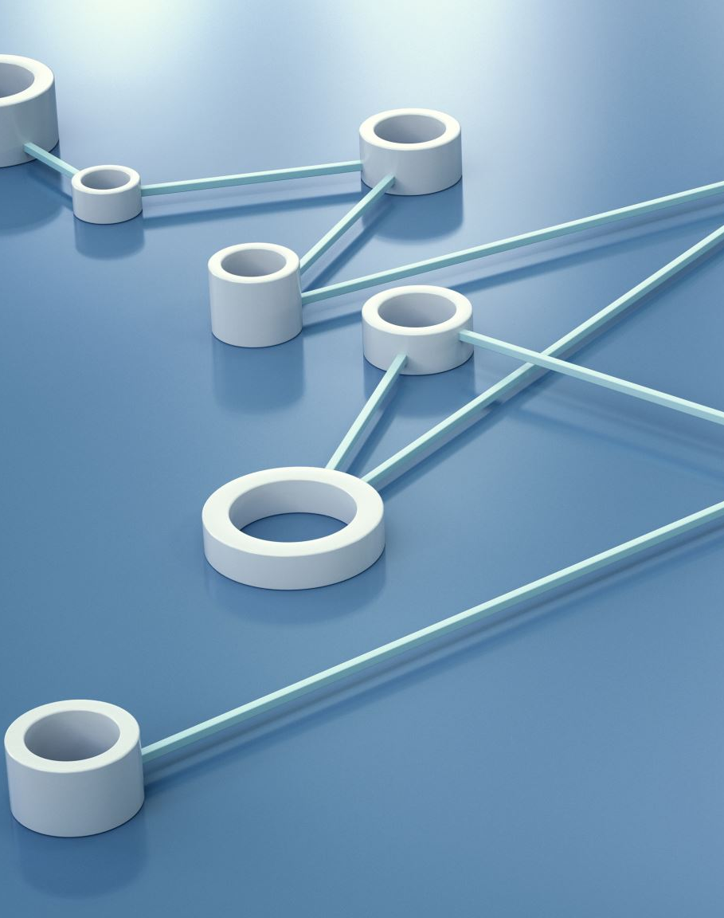
PROBLEM STATEMENT
Describe the physical design of this IoT-based smart inigation system. Identify and explain the functions blocks of this lot system. What are the roles of each block, and how do they interact with each other to achieve efficient irrigation?

Slide 3
physical design of the IoT-based smart irrigation system
The physical design of the IoT-based smart irrigation system involves the integration of various sensors, actuators, and control units that work together to monitor environmental conditions and automate the irrigation process.
The system is divided into several functional blocks, each playing a crucial role in ensuring efficient and automated irrigation.

Slide 4

Functional Blocks & Processing and Control Block
Soil Moisture Sensor: Measures the moisture level in the soil. This sensor is critical in determining whether the soil is dry and needs watering or if it has sufficient moisture.
DHT22 Sensor (Temperature and Humidity): This sensor measures the ambient temperature and humidity. ES
P32 Microcontroller: This microcontroller serves as the brain of the system. It collects data from the sensors, processes it, and makes decisions about when to activate or deactivate.

Slide 5
Actuation Block & Display and User Interface Block
Relay Module: Controls the water pump by turning it on or off based on signals received from the ESP32. The relay acts as an electronic switch that can handle the high current required to operate the water pump.
Servo Motor: Controls the valve position to regulate water flow. The servo is controlled by the ESP32 to either start or stop water flow based on soil moisture levels.
Liquid Crystal Display (LCD): Provides real-time feedback to the user by displaying sensor readings such as soil moisture, temperature, humidity, and the status of the irrigation system. This allows for easy monitoring and manual intervention if necessary.

Slide 6
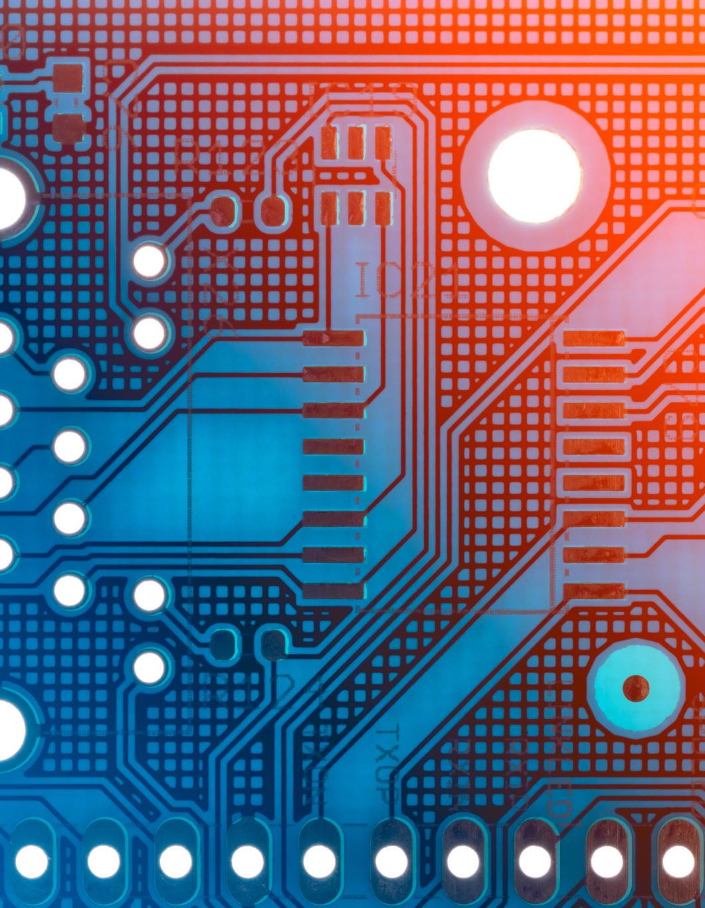
Implementing using wokwi
Arduino IDE:
The Arduino Integrated Development Environment (IDE) is used for writing and uploading code to the microcontroller (ESP32).
ESP32 Board Libraries:
The ESP32 board libraries are required for programming the ESP32 microcontroller using the Arduino IDE.
Additional Libraries:
LiquidCrystal_I2C
DHT
ESP32Servo
Wire

Slide 7
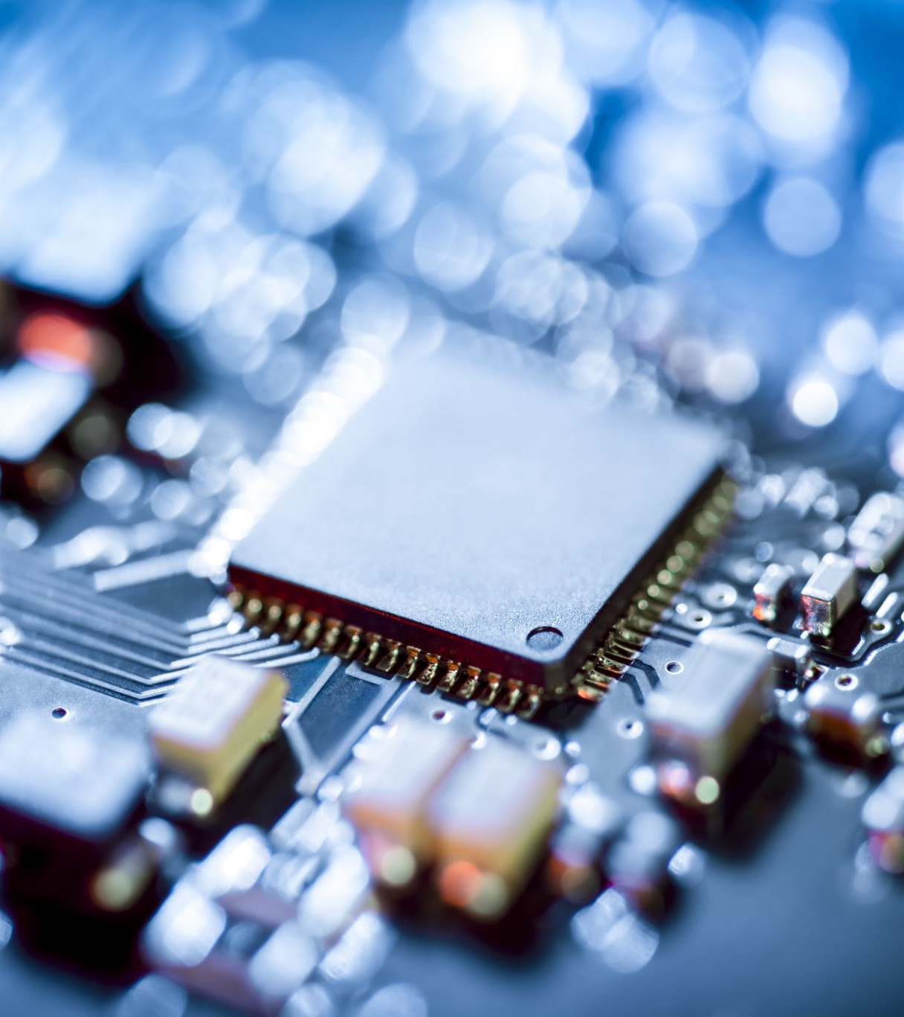
Hardware components
ESP32 Microcontroller
DHT22 Temperature and Humidity Sensor
Soil Moisture Sensor
Relay Module
Servo Motor
Liquid Crystal Display (LCD) with I2C Interface
Power Supply Unit

Slide 8
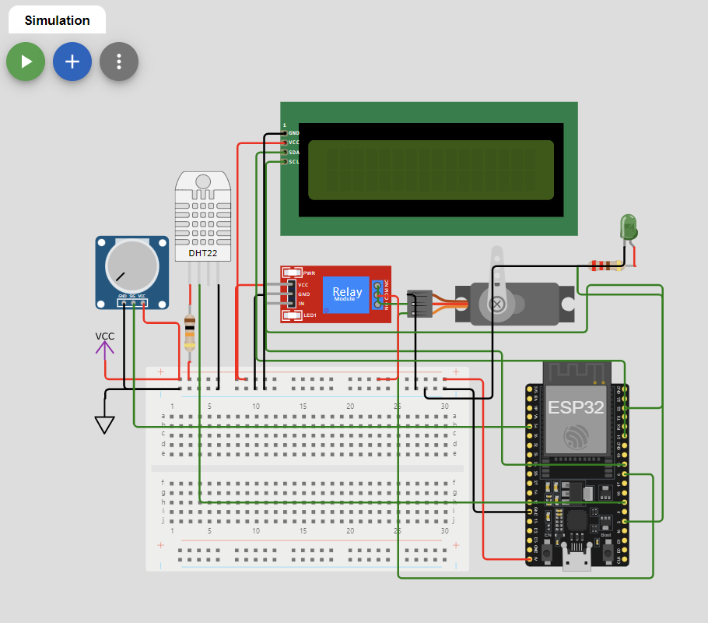
Connectivity diagram

Slide 9
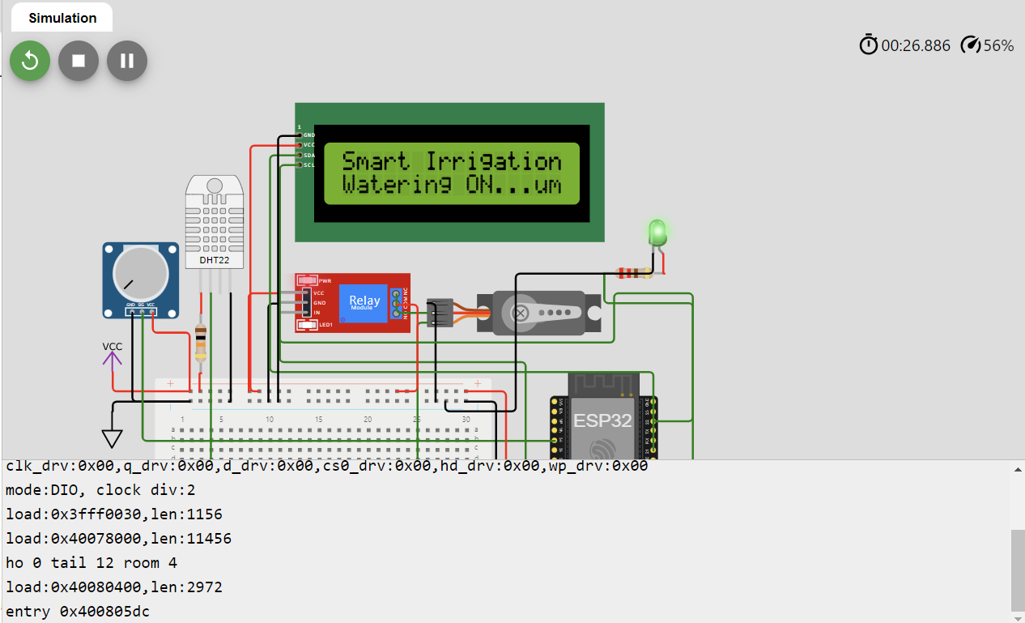
OUTPUT
https://wokwi.com/projects/406817820760974337

Slide 10

THANK YOU

