Slide 1
Mobile Application Development M2 T3-PPT
BATCH-10
221FJ01031
221FJ01039
221FJ01041
221FJ01071
221FJ01072

Slide 2
QUESTION :
Design an app for the following. The Date picker should allow to pick the date and the value should be set in the Textview. When the device is rotated then the date in the textview should be restored. Write the Create method and the XML code for the same.

Slide 3
JAVA Code :
package com.example.datepicker; import android.app.DatePickerDialog; import android.os.Bundle; import android.widget.Button; import android.widget.DatePicker; import android.widget.TextView; import androidx.annotation.NonNull; import androidx.appcompat.app.AppCompatActivity; import java.util.Calendar; public class MainActivity extends AppCompatActivity { private TextView selectedDateText; private Button datePickerButton;
@Override protected void onCreate(Bundle savedInstanceState) { super.onCreate(savedInstanceState); setContentView(R.layout.activity_main); selectedDateText = findViewById(R.id.selectedDateText); datePickerButton = findViewById(R.id.datePickerButton);

Slide 4
02
04
{ String selectedDate = dayOfMonth + "/" + (monthOfYear + 1) + "/" + year1; selectedDateText.setText(selectedDate); }, year, month, day ); datePickerDialog.show(); }); } @Override protected void onSaveInstanceState(@NonNull Bundle outState) { super.onSaveInstanceState(outState); } }
// Reset the selected date when the activity is created (on rotation) selectedDateText.setText("Selected Date"); datePickerButton.setOnClickListener(v -> { Calendar calendar = Calendar.getInstance(); int year = calendar.get(Calendar.YEAR); int month = calendar.get(Calendar.MONTH); int day = calendar.get(Calendar.DAY_OF_MONTH); DatePickerDialog datePickerDialog = new DatePickerDialog( MainActivity.this, (view, year1, monthOfYear, dayOfMonth) ->

Slide 5
XML Code :
<TextView android:id="@+id/selectedDateText" android:layout_width="wrap_content" android:layout_height="wrap_content" android:text="Selected Date" android:textSize="18sp" android:padding="8dp"/> <Button android:id="@+id/datePickerButton" android:layout_width="match_parent" android:layout_height="wrap_content" android:text="Pick a Date" android:textSize="18sp"/> </LinearLayout>
<?xml version="1.0" encoding="utf-8"?> <LinearLayout xmlns:android="http://schemas.android.com/apk/res/android" android:layout_width="match_parent" android:layout_height="match_parent" android:orientation="vertical" android:gravity="center" android:padding="16dp">

Slide 6
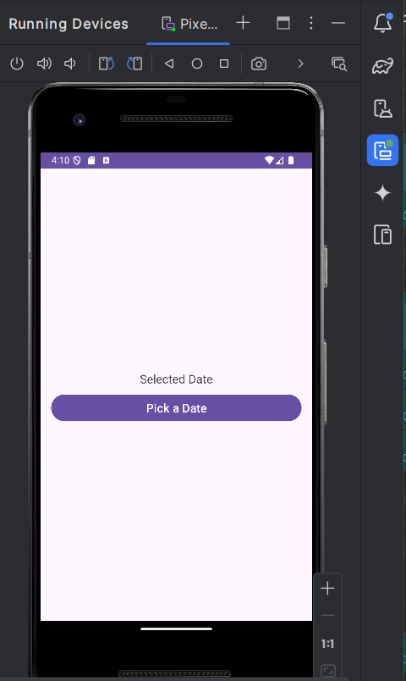
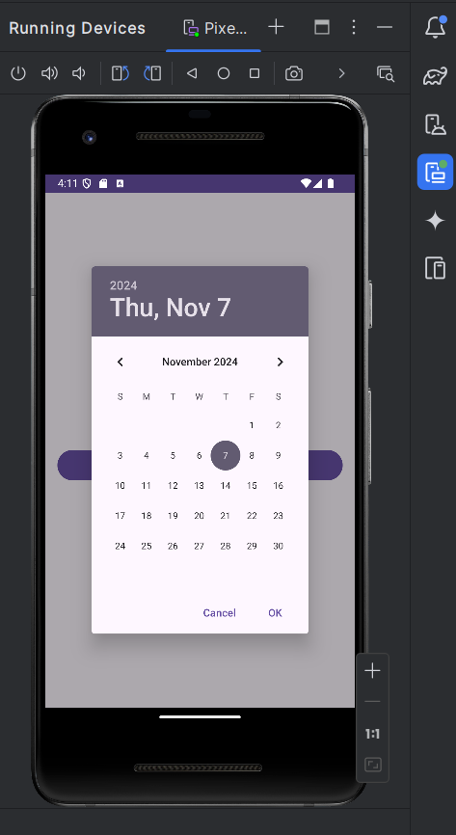
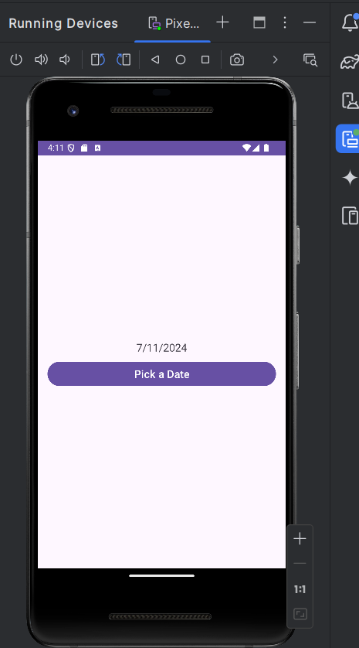
Output :

Slide 7
Components used..
Linear Layout
TextView:
Button

Slide 8

LinearLayout:
A layout container that arranges its children in a single column or row.
Here, it arranges components vertically (android:orientation="vertical").
android:gravity="center" centers all child elements within the layout.

Slide 9
TextView :
A UI component for displaying text on the screen.
selectedDateText is used here to show the selected date or a default message ("Selected Date").
Attributes like android:textSize, android:padding, and android:text are used to customize the appearance.

Slide 10
Button :
A clickable component that users can interact with to trigger actions.
datePickerButton here is used to open the Date Picker dialog when clicked.
Customizations:
android:backgroundTint sets the button's background color.
android:textColor changes the color of the button text.
android:padding makes the button larger.
android:textSize adjusts the size of the text.
android:layout_marginTop adds spacing between the button and the TextView.

Slide 11
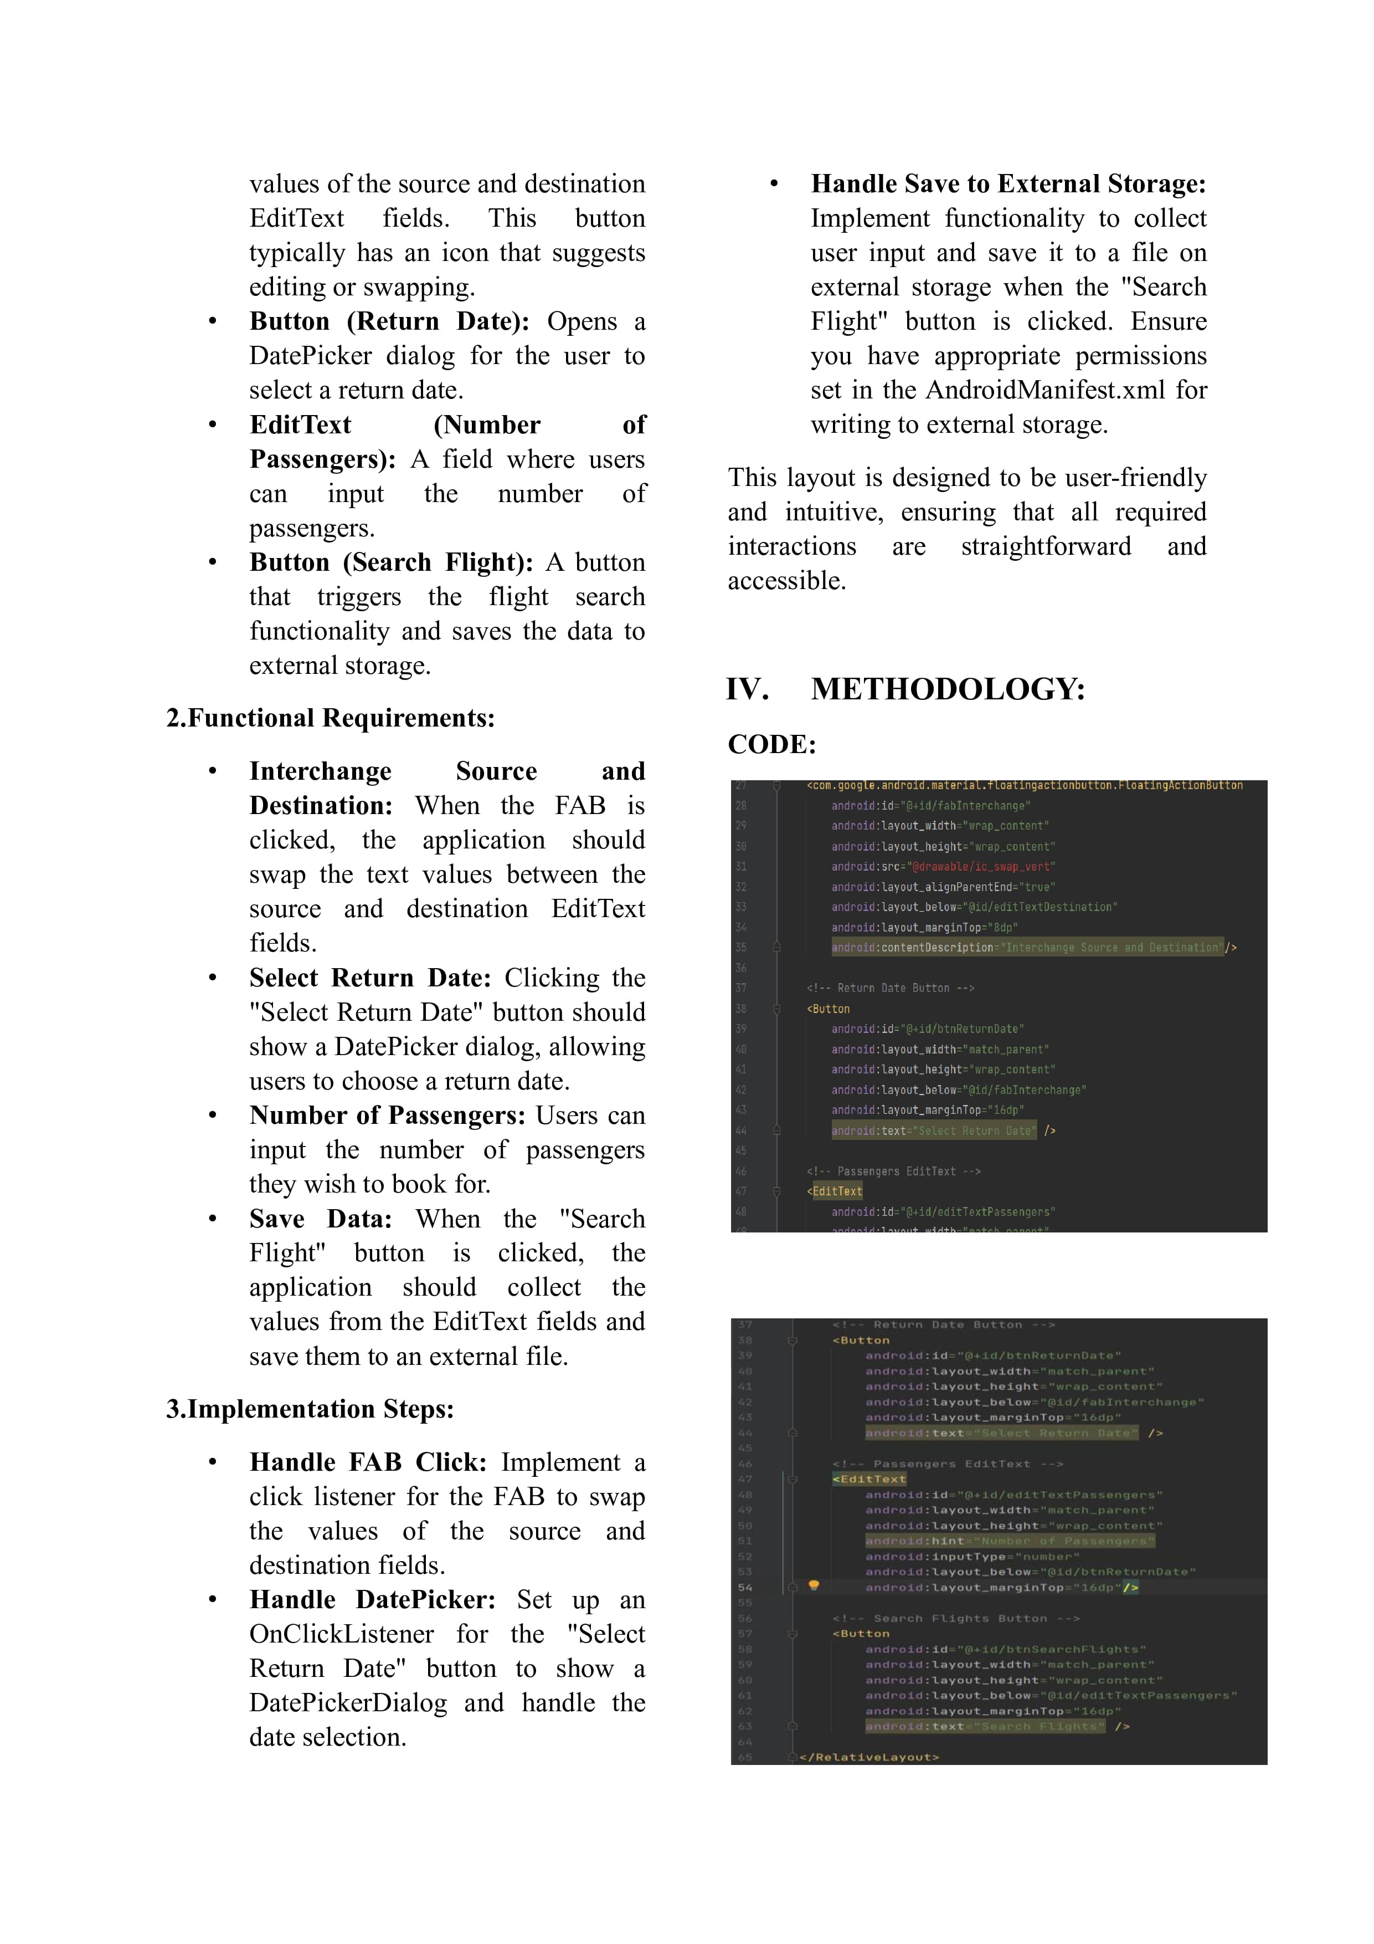
What we’ve learnt..
Basic Android Components
About various views such as edit text , button and Floating action button.
We used the DatePickerDialog to open a calendar date picker when the button is clicked, allowing users to select a date.
About how actually emulator works
Learnt how to create and align buttons,text etc in xml

Slide 12
IEEE WORD DOCUMENT
BATCH-10
221FJ01031
221FJ01039
221FJ01041
221FJ01071
221FJ01072

Slide 13
.
.

Slide 14
.
.

Slide 15
Thank you!
Mobile
Application
Development

