Slide 1





ENABLING DIGITAL TRANSFORMATION WITH AI

Slide 2

BRIEF INTRODUCTION
DIGITAL TRANSFORMATION
We help our customers for digital transformation using our unified integrated INFRAON SUITE enabled with AI/ML
The company is founded by a group of technocrats who have been working with each other for over 15 years and have a combined experience of close to 100+ yrs in the I&O scape. With a rich market experience in the I&O space, the company has built its widespread presence across the country through its product portfolio. EverestIMS envisages a future where Digital Transformation is a harbinger of enterprise change. The organization specializes in providing integrated IT solutions to empower corporations and enterprises to deliver enhanced services to their end-users.
OSS SOLUTION
We provide complete OSS Solutions to Telecom using INFRAON products and by integrating with other EMS
IoT Solution
Infraon IoTMS is flexible framework has churned out a platform for monitoring and management of IOT devices.

Slide 3


















OUR OFFERINGS - TELECOM
UNIFIED TELECOM OSS OFFERING
KEY FEATURES
AI Based Core
Cross Domain Correlation
Resource M&O Support Readiness
Asset Life Cycle
Workforce Management
Resource Data Collection & Distribution
infraon UNMS
Integrates with multiple EMS / NMS for the unified management of multiple technologies like Transport, IP Core & Access Layers.
infraon Desk
AI driven Service Management system to take care of orders , map the life cycle of assets and trouble management.
Resource Trouble Management
Fault and Performance Management
Resource Mediation & Reporting
Service Fulfilment & Assurance
Service Problem Management
Service Quality Management

Slide 4





























KEY CUSTOMERS
Telecom
BFSI
Enterprise

Slide 5

MAJOR AWARDS AND CERTIFICATIONS
13 Process certifications by Pink Elephant (one of the top 10 ITSM systems in the world )
Winner of India 500 Start-up Awards, 2019,
Winner of International Trade Council Go Global Award 2019,
Winner of Premium Usability and Rising Star awards-Finance Online 2019,
Winner of Vibrant Start-up of The Year 2019 by Startupcity Magazine,
ISO 20000-1:2018 , ISO 9001:2015, ISO 27001:2015, ISO/IEC 25010:2011.

Slide 6

DIGITAL TRANSFORMATION FOR TELECOM
Products
Features
Benefits
Digital Transformation
infraon OSS
Framework For Telecom
Telco Grade
Service Assurance and Fulfilment
Service Provisioning
Fault, Performance, Asset Management
API Based Integration
Framework
High ROI
UNMS
Integrated System
Customer Experience
Business Process
Operational Efficiencies
Central Operations
UNMS
ITSM
Multi Telecom Vendor
Tickets
Change
Life Cycle
Workflow
Field Management
CSAT
Multi Telecom Technology
ITSM
Cross-Domain Correlation
Integrated Service Mgmt
Compliance and Policy

Slide 7
Infraon OSS COMPONENTS eTOM PROCESS
Fulfilment
Assurance
Inventory & Topology
Device Provisioning
Service Provisioning
Fault & Correlation
Performance
Device and Service Inventory
Resource Provisioning
Service Configuration
Resource Trouble Management
Resource Performance Management
Multi Domain Topology
Automation
Service Activation
Service Problem Management
Service Quality Management

Slide 8
infraon OSS – TMF STANDARDS
Infraon OSS is built based on following standards:
TMF 814 MTNM
TMF OMG Notification Service
GB922 Information Data Model (SID)
ITU-T X.730 (Object Management Function)
ITU-T X.731 (State Management Function)
ITU-T X.732 (Attributes)
ITU-T X.733 (Alarm Reporting Function)
ITU-T X.734 (Event Management Function)

Slide 9


infraon Desk PINK ELEPHANT CERTIFICATION
13 ITILv3 Processes
AM - Asset Management
AVM - Availability Management
CHG - Change Management
EM - Event Management
IM - Incident Management
PM - Problem Management
RF - Request Fulfillment
SACM - Software Asset and Change Management
SCM - Service Catalogue Management
SLM - Service Level Management
KB – Knowledge Base
RM - Release Management
Portfolio

Slide 10
SOLUTION BASE
TMF 814 CORBA
Operator
SDH
Inventory & Topology
TMF 518 XML
DWDM
SNMP
Customer
ASON
SOAP/XML
Fault
Core & Transmission
REST/JSON
IPMPLS
Analytical
CORBA
RF
TL1
Correlation
Metro Ethernet
Telnet
BI
Telecom
SSH
GPON
Performance
Query
ITSM
WiFi
File
Links
MQTT
Device Provisioning
Access
Billing
MPLS
SCADA / BACNET
VSAT
MODBUS
Serial / Direct
Service Provisioning
CRM
IoT
Etc.,

Slide 11
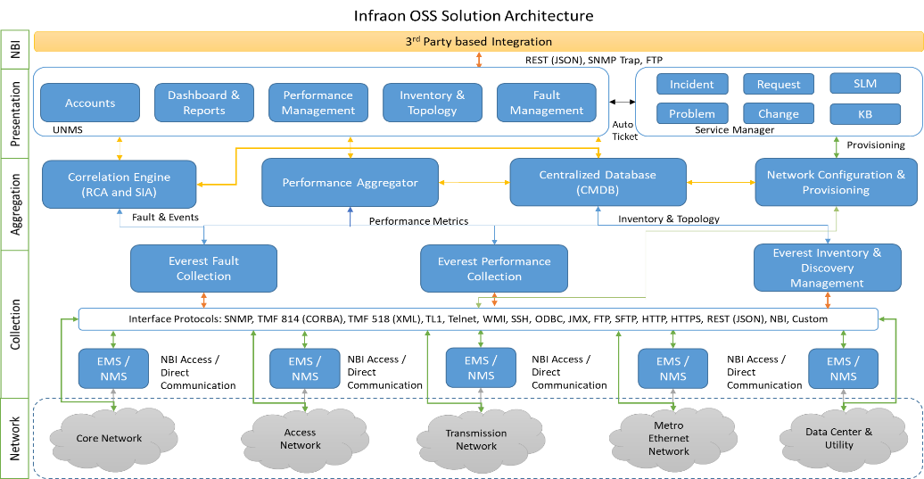
infraon OSS SOLUTION ARCHITECTURE

Slide 12
infraon Desk SOLUTION ARCHITECTURE
Everest Service Manager
Service Automation Suite
NOC, Helpdesk, Manager Technical Staff view
Knowledgebase Management
IT & Service Asset Management
Problem & Change Management
Incident Management
SLA Management
Helpdesk , Workforce Management
Dashboard & Reports
Customer view
Event Management & Automation Layer
Service order & fulfillment
3PP
Automation
Alerts
BIA
Service Order Management
Service Catalog
Events
& SM
Database
Event processing
Rule Engine
SLA Engine
Service and Resource Inventory (CMDB)
Event Aggregation Layer
Rest API
Rest API
Email
Monitoring system
Integration layer
Rest API
3rd Party application
(monitoring or others)
User sending emails
Everest UNMS
Network Configuration and Service Provisioning

Slide 13
KEY FEATURES
Unified Inventory
Unified Fault Management
Unified Performance Management
TCA & RCA
Cross Domain Correlation
Central CMDB
Network Agnostic
Domain Agnostic
Complete Life Cycle Management
Reconciliation
Real time Fault Detection
Faults from across the domain
Automated Incident
Unified Dashboard Console
Data collection thru EMS / NMS & Direct communication
Configurable collection frequency
Combined View of all the domains
Performance Threshold Breach Alarms
Component Level Threshold tuning
ML enabled Threshold Base lining
Detailed Root Cause Analysis
Topological Relation based and Rule based Correlation
Engine works across the domain and identify RCA
NE Configuration & Provisioning
Service Provisioning
Service Assurance
Automation
Smart Analytics
End to end provisioning from the beginning
Periodic OS Image, Configuration Backup and Change alert
Resource Reconciliation & Feasibility Check
End to end Service Provisioning across the Domain Network Elements
Detailed CoS / QoS Monitoring
Customer related Experience Monitoring and management
SLA Management
Flexible automation configuration for all the routine tasks
Manual and Auto triggered the task based on Alert
Ease the operation
Reporting & Dashboards
Forecast Prediction
Customer Insights
Capacity Planning
Decision Making

Slide 14
CENTRALIZED FAULT MANAGEMENT
Detect
Diagnose
Analyze
Alert
Restore
Resolve
Detection of the Problem – Using multiple intelligent techniques
Isolate and Diagnose – Using in-built ways to diagnose and localize the problem
Root Cause and Service Impact Analysis – Using various correlation algorithms, identifying the root cause of the events and the impacts and prioritize the problem based on impact
Alert the administrator or respective NOC with root cause of the problem and the initial diagnostics
Automatic correction of the potential problem causing conditions
Resolve the problem and keep track of the actions taken
Maintain the Knowledge Base of the problem and resolution provided.

Slide 15
FAULT MANAGEMENT
Alarm details as per TM Standard (ASAP)
Fault Collection
Event Type
Managed Object Identifier
Date & Time of Alarm
Perceived Severity
Probable Cause
Specific Problem
Notification Identifier or Correlated Notification Identifier
Additional Text
Push Method from NE directly (via SNMP Trap)
Real-time basis.
Triggered from device directly.
Pull Method from NE directly via standard protocols such as SNMP
Periodic collect
Collect via vendor provided EMS / NMS using API
Vendor specific API based.
Periodic collect
Option to re-synchronize.
Key Features in Fault Management.
Alarm isolation.
Trouble ticket generation & Life cycle management for Network & Service Problems for NMS & Helpdesk tool.
Alarms Binning for different types of alarms (Resource alarms , service problems , fibre alarms , Threshold crossing alert -TCAs )

Slide 16





PERFORMANCE MANAGEMENT
Covering various network technologies like IP/MPLS, SDH, DWDM, GPON, DCN, WiFi, RF, Utility, etc.,
Uses the SNMP, CORBA, XML to connect to NE directly
Uses EMS / NMS vendor provided API
Device Health Indication Parameters
Multi-level
Performance Thresholds
Reports with Multi-tier Logical Views
Data Aggregation with Long-term Storage
Capacity Planning
Role-based Dashboards
Device Performance Parameters
Environment Parameters
Bandwidth usage & capacity
Port usage and capacity
Errors & Discards
Automatic Performance Notification
Easy Configurable Settings
Delay & Variance Measurement
Verify
QoS / CoS
Ensure SLA Compliance
Predictive Analysis
Optical Power
Quality of Service

Slide 17
NETWORK CONFIGURATION AND CHANGE MANAGEMENT
Backup & Configuration Repository
Bulk Provisioning
OS / Firmware Management
Service Provisioning & Rollback
Inventory Tracking
Task Automation
Operational Audit
User-Roles based Access Control
Auto-Discovery of Target Devices
Inventory Capture with EOX details
Scheduled Backup
Reusable Templates for Bulk Changes
Vulnerability Detection
Policy Compliance
Audit of Critical Changes
Regulatory Standards
(PCI-DSS)
Intelligent Remediation of Policy Violations
Network Security Audit Report
Vulnerability Report
Unauthorized Changes Report
EOX Report
Policy Compliance Report
General Features
Secure NCCM
Compliance
Reports

Slide 18



SERVICE CATALOGUE
Service Catalog Design
Service Catalogue
Map to End-Users
Pre-Defined Service Issues
Optimize Service Delivery across users with a well-defined Service Catalog
Service-based Workflows
& Reports
Self Service Portal
Service Based SLA

Slide 19

SERVICE ORDER & REQUEST MANAGEMENT
Request verification
Network Capacity & Availability Check
Request Assessment
Service Request Templates
Feasibility Check
Self Service Portal
Network & Service provisioning
Service Catalogue
Approvals
Approvals
Service Order
Provisioning
Request
Fulfillment & Delivery
Order Processing
Service Activation
Customer/ End user update
Change Notification
CMDB Update
Change Management
Invoice
& Billing

Slide 20
SERVICE MONITORING
System maps the network components and the circuits with customers and monitor the service level and the quality as per the services offered. Different technology services like,
Transport Services like SDH Circuits, DWDM Circuits
IP Core Services like VRF, Routing Services
L3 VPN Services
Ethernet Services
GPON Services
Etc.,
Discover the circuits across vendors and technologies.

Slide 21

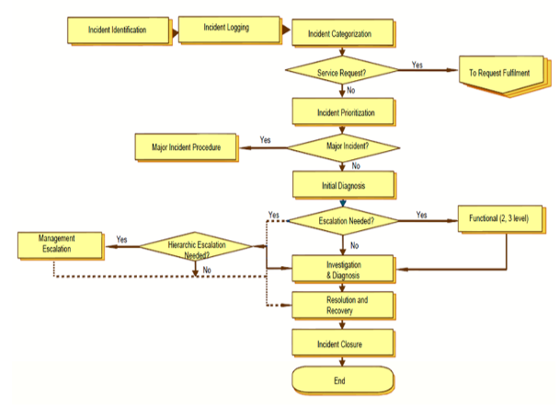
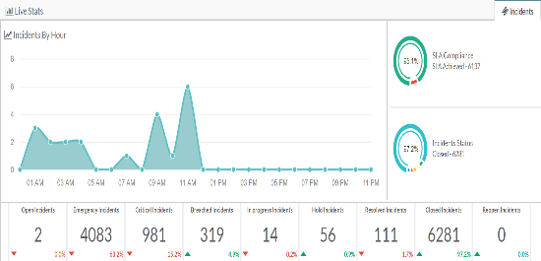
INCIDENT MANAGEMENT
Event /NMS/Logs/3rd party application/API
Email
Web/Self Service Portal
Phone
Mobile App

Slide 22

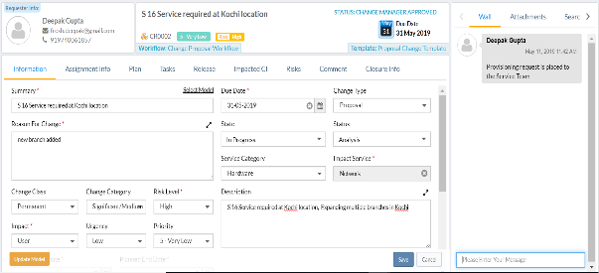
CHANGE MANAGEMENT
Change Raised from Incident
RFC Authorized
Planning & Risk Assessment
Change Raised from Problem
Web/Self Service Portal (Requester)
Change Raise by Service Request
Change Categorization
Change by Standard Change Templates
Change Planning, Test Plan, Roll Out , Roll back
CAB Approval
CMDB CI Integration
Release Build & Test
Time Tracking of Granular for each Tasks
Implementation & Deployment
Change Close
PIR
PIR, Document, Collaborations, Report , Dashboard

Slide 23
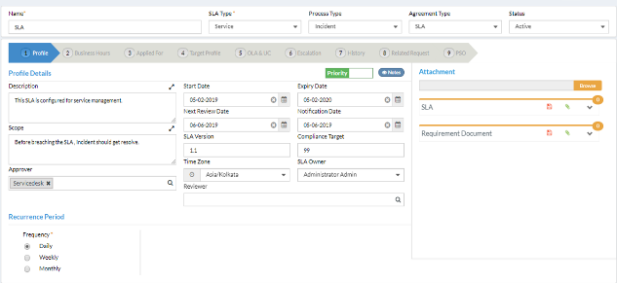
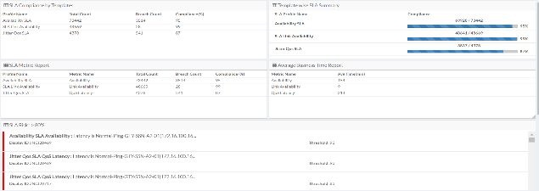
SLA MANAGEMENT
Customer Based
Service Base
System/Asset-Specific
SLAs
System/Asset-Specific
SLAs
Dynamic SLA Metrics
OLA Management
Underpinning Contracts
Flexible SLA templates
Notification & Escalation
Critical & Non-Critical Business Hours Support
SLA Business Impact
Analysis, Penalty Reports
SLA Adjustment
KPI, SLA Reports & Dashboards

Slide 24
THANK YOU
WE ARE NEW WITH
16+ YEARS IT INFRASTRUCTURE EXPERIENCE

