Slide 1



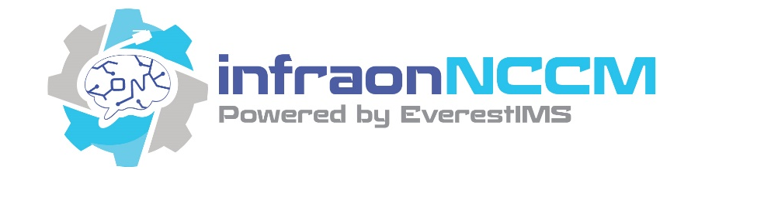
Product Insight

Slide 2



infraonNCCM - Overview
Define, Authorize, Deploy and Track Change
on any network device…
infraonNCCM (Network Configuration and Change Manager) automates the Configurations and Compliance of network devices

Slide 3

infraonNCCM – Core USPs
Rapid, Easy Deployment
Vendor Agnostic
infraonNCCM makes change
management, network automation, disaster recovery, configuration auditing, painless and affordable for a network of any size and type.
Intuitive & Easy to Use
Multi-Platform Deployable
Web Based GUI
Modern and Secure Platforms

Slide 4






Vulnerability Management
Devices Managed
Network standard configuration protocols used
SSHv1, SSHv2, Telnet, SNMP v2c & v3, PING, SCP, SFTP, TFTP/FTP, NETConf, HTTP REST-API etc.
Routers
Switches
Bridges
Manages devices using dual IP stacks IPv4 and IPv6
Scales the management of devices ranging from 5K to 25K from a single management pane.
Firewalls
Load
Balancers
Wi-Fi Access
Controllers

Slide 5
NCCM Features
3rd Party Integration
Auto Discovery
Multi-Channel Notification
Inventory Tracker
NCCM
Reports & Dashboards
Scheduled Backup
Compliance Automation
Role-Based Access Control
Workflow Automation
Vulnerability Management
Configuration Templates

Slide 6
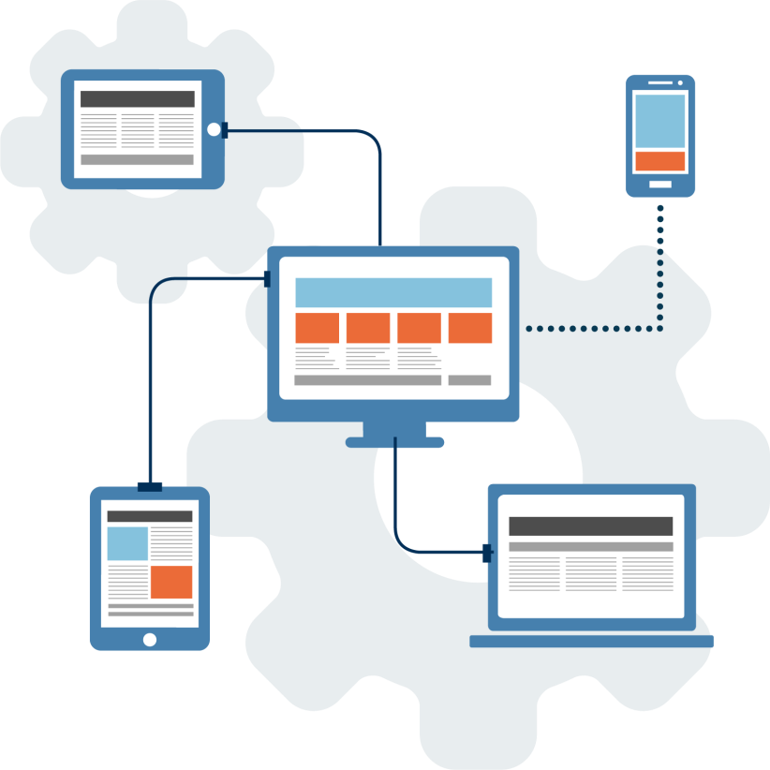
Auto Discovery
NCCM supports multi mode of discovery including Topology Connections
Discovery from infraonIMS system
Typically required SNMP and device credentials
IP Scan
CSV
Scheduled
Manual
API

Slide 7





Inventory Tracker
Vendor name
Device Series
Device Model
Serial Number
End of Life
End of Support
Serial Number
OS Type, Version
Running OS Image file
Flash Size
Memory size
NVRAM size
Configuration Register
Chassis
Ports
Fan Power PIC, etc
Maintains Device critical inventories

Slide 8




Download Process
Download
Compare
Workflow
Config Store
Baseline
Notify
Rectify
Security
Inventory
Changes
Startup Config
Policy Violations

Slide 9



Upload Process
Config Templates
Templates
Workflow
Execute
Merge
Replace
Roll Back
Upgrade
Audited
IP Range
Approval based
Policy Check
Failure Remedy
Test and Review
ACL
Zero Touch
Service Config

Slide 10

Workflow Automation – CLI Job& Live Session
Perform audited adhoc configuration changes on devices directly
Approval based or direct config jobs with role-based access
CLI Job live session view
Will only audit the commands executed on devices and will not restrict the commands in case of commands having Policy violations.
All CLI JOB’s are audited and view available
Auto Remediations for policy violations

Slide 11
Vulnerability Management
CVV Score
CVE
Scan and Identify
Notify
Device
3rd Party
OEM
Remediate

Slide 12

Accounts & Role-based Access Control
Local User configurable account database
Role based granular access control
Device Group: controls based on Vendors, Series, Models, IP Address, Locations, Priority, Category, Product Type, Service Type attributes combinations
NCCM ACL feature in Policies, Upload Job, Templates, Reports and Dashboard controls specific users or user groups to manage or view the objects of specific modules
External Account Systems like “Active Directory”, “TACACS+”, “RADIUS”, “infraonDesk” Systems for managing users.

Slide 13

Compliance Automation
Out of box delivers the following Compliance Policy standards. PCI DSS v3.2, NIST, DISA, Major Vendors Hardening Policies, etc.
Policies shall have multiple rules and rule groups as per compliance and/or golden template.
Can be customized for other Compliances and Operational Policies
Policy Execution audits are maintained at device level
Automatic Policy check before any change in the network.
Any network change (out-of-band change) is detected during the policy check on the next configuration download.
Auto remediation of the violations based on approvals from admins.

Slide 14

Reports
Offers customizable reporting where users can choose from predefined widgets (50+ no’s) and apply filters
Some Report types
Audit reports
Failure report: Backup, non configured
Download and Upload Job
Policy Audit and compliance reports
Inventory Report
Events Reports
Task Report
Device Download Statistics Report
Device Vulnerability Statistics Report
And Many More…

Slide 15




Multi Channel Notification
Any Event detected by the system can be notified to the users.
Different methods are prebuilt.
SMS
Email
Syslog
HTTP API

Slide 16




3rd Party Integration
ITSM
REST API
CMDB
NMS
SOAP XML
NCCM
TACACS+
VA
OEM Connectors
Active
Directory
SIEM
HTTP

Slide 17
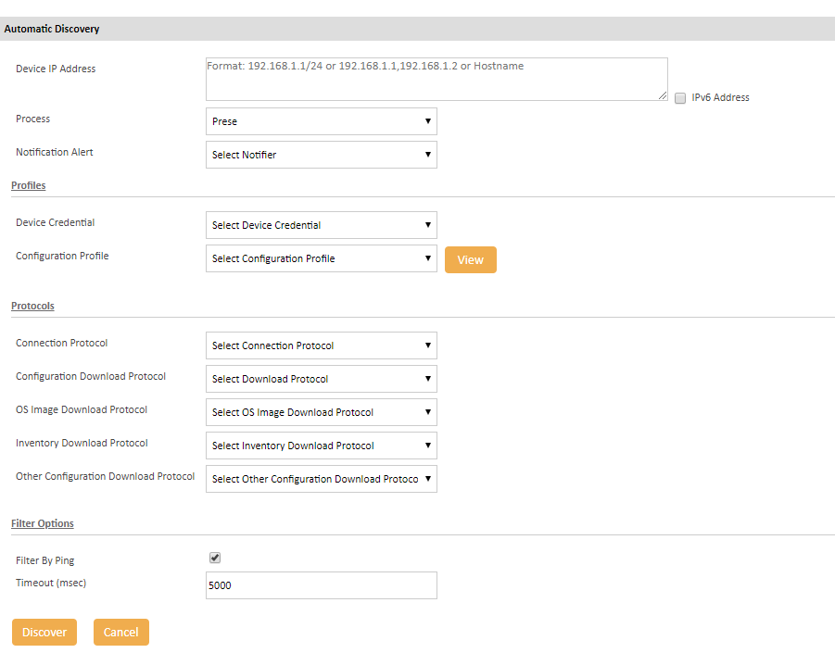
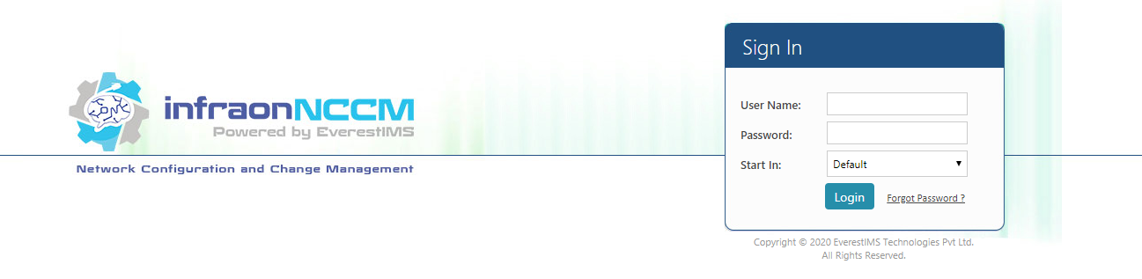
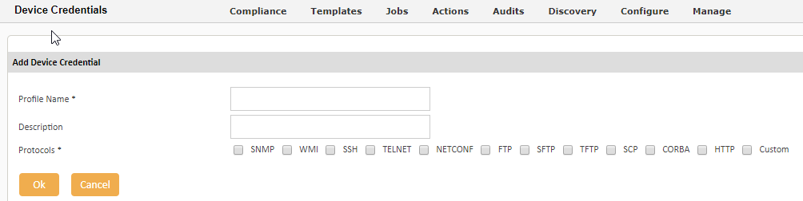
Sample Screen - Login, Device Credentials, Discovery
ITSM
TACACS+
VA
Active
Directory
SIEM

Slide 18
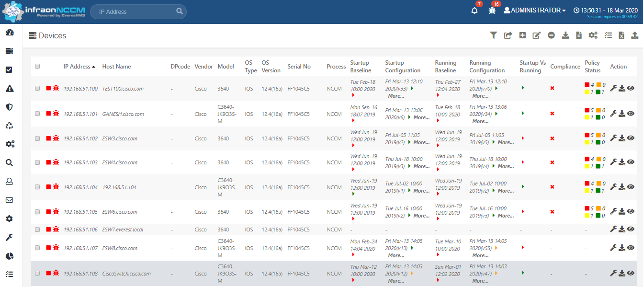
Sample Screen - Inventory
ITSM
TACACS+
VA
Active
Directory
SIEM

Slide 19
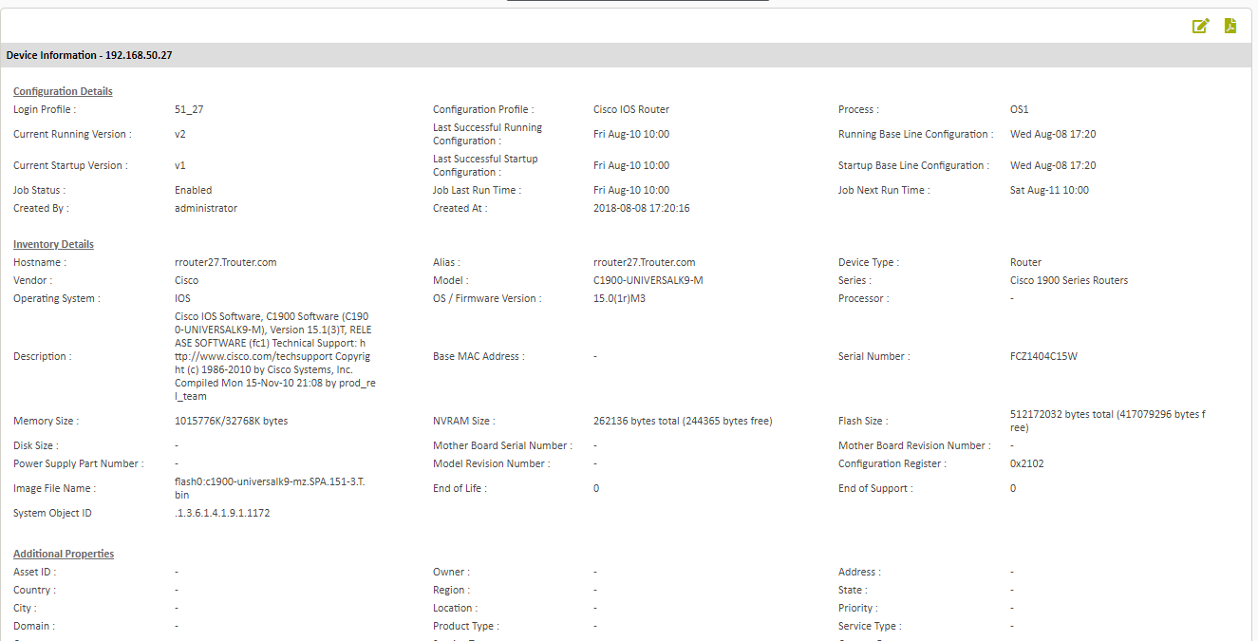
Sample Screen - Inventory
ITSM
TACACS+
VA
Active
Directory
SIEM

Slide 20
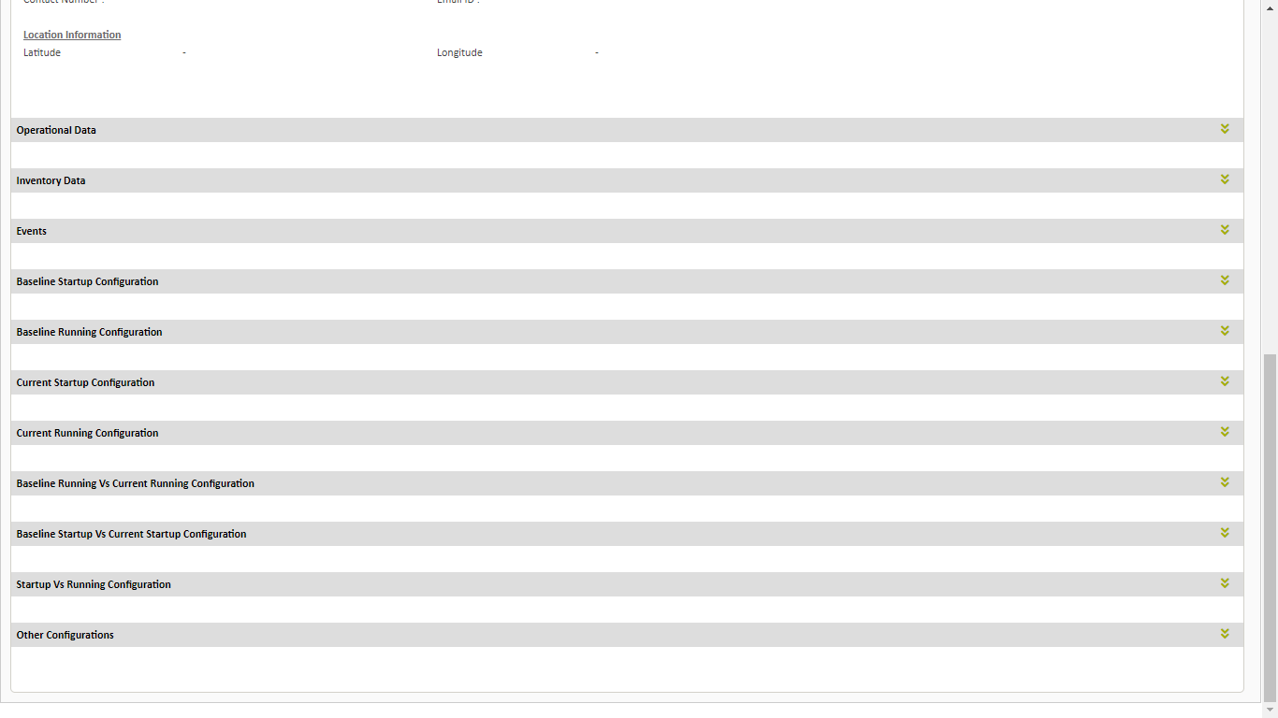
Sample Screen - Inventory
ITSM
TACACS+
VA
Active
Directory
SIEM

Slide 21
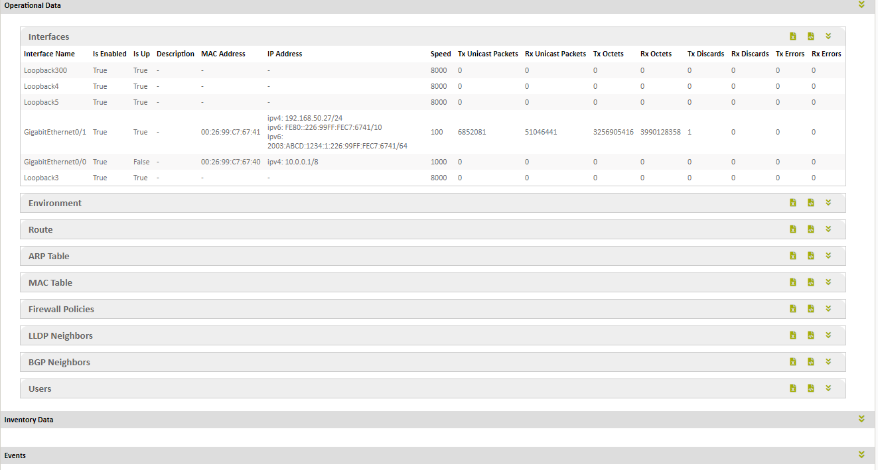
Sample Screen - Inventory
ITSM
TACACS+
VA
Active
Directory
SIEM

Slide 22
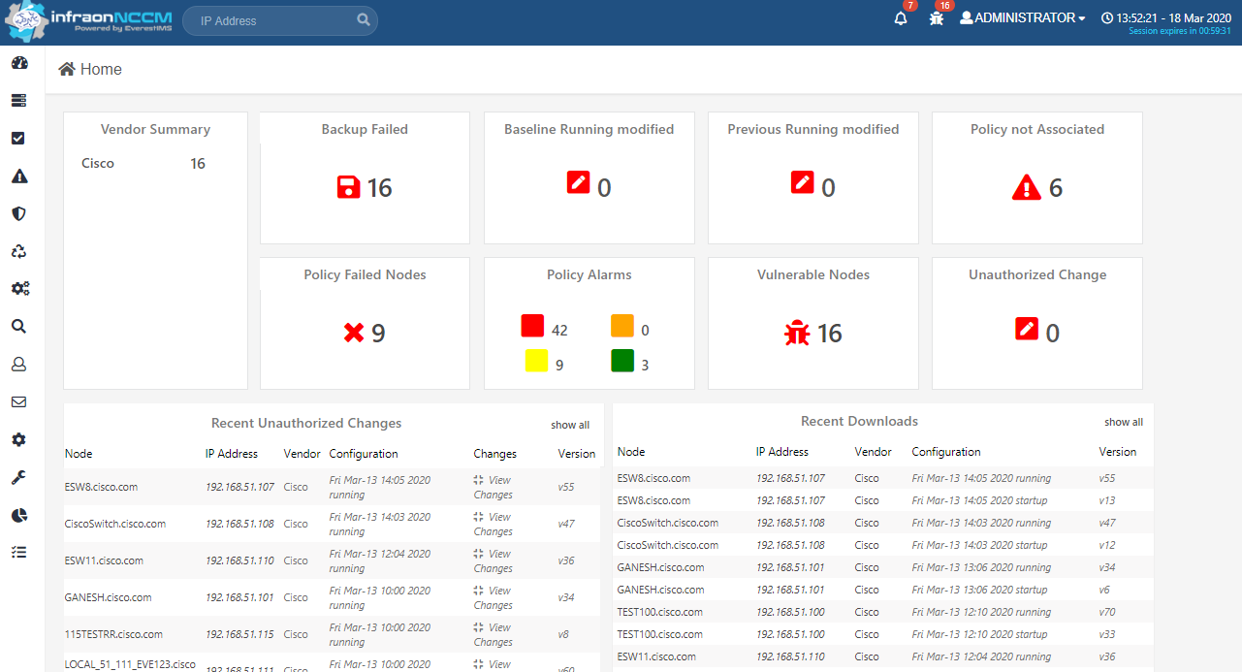
Sample Screen - Dashboard
ITSM
TACACS+
VA
Active
Directory
SIEM

Slide 23
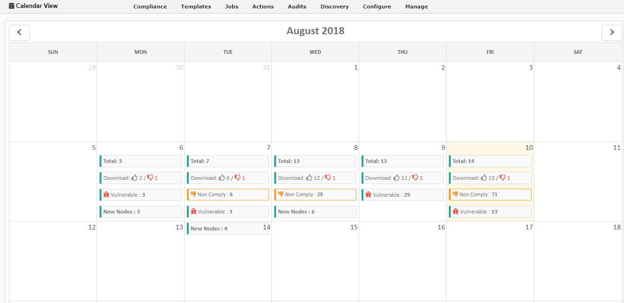
Sample Screen – Calendar Dashboard
ITSM
TACACS+
VA
Active
Directory
SIEM

Slide 24
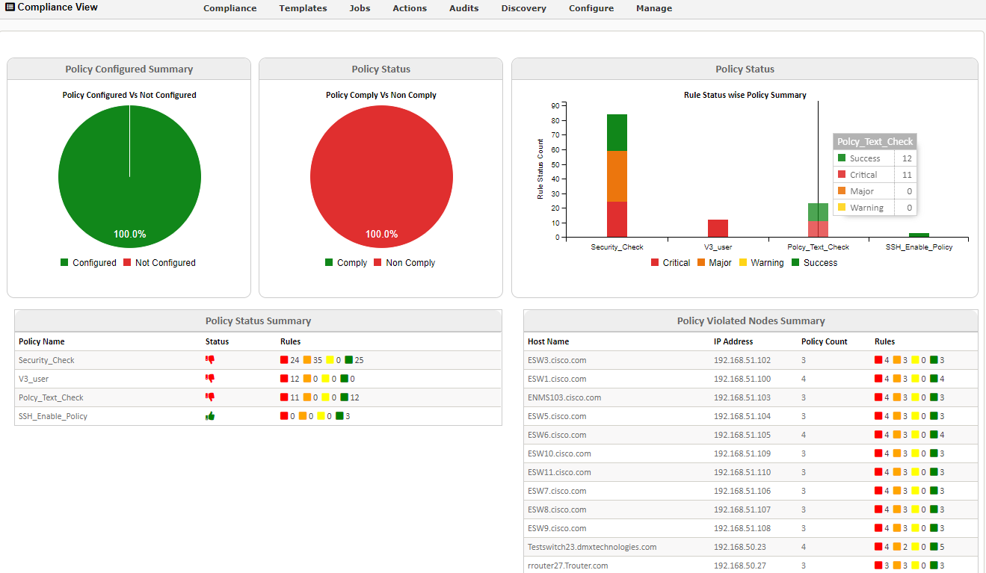
Sample Screen – Calendar Dashboard
ITSM
TACACS+
VA
Active
Directory
SIEM

Slide 25
Sample Screen – Calendar Dashboard
ITSM
VA
Take Action Now
TACACS+
www.everest-ims.com
sales@everest-ims.com
+91 80 46567100

