Slide 1



Slide 2

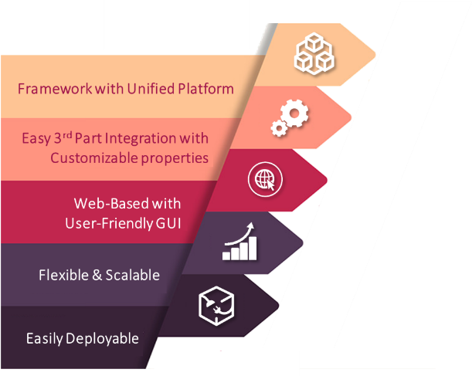
What is infraon IMS ?
infraon IMS is a Unified IT
Infrastructure Management Suite
that manages IT, non-IT, IOT and SCADA
devices through a single platform using a
simple map-monitor-manage technique to proactively monitor heterogeneous IT Environments both on-premise and on-cloud.

Slide 3
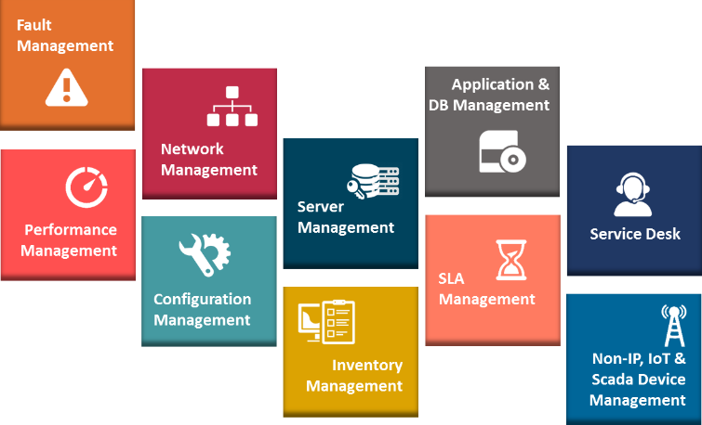
Features

Slide 4



Fault
Management
Across Network devices, Servers, Applications, Databases, Web Apps, Email and Desktops
Multi-mode fault detection
Network availability management
Alerts & notifications
through SMS, email,
SNMP traps, Syslog
Network topology
& logical map views
Problem diagnosis,
event correlation &
root cause analysis
Trigger alert based
remedial actions

Slide 5






Across Network devices, Servers, Applications,
Databases, Web Apps, Email and Desktops
Performance Management
Multi-level
Performance Thresholds
Reports with Multi-tier Logical Views
Data Aggregation with Long-term Storage
Capacity Planning
Role-based Dashboards
Automatic Performance Notification
Easy Configurable Settings
Verify
QoS / CoS
Ensure SLA Compliance
Predictive Analysis

Slide 6


Monitoring of network availability with traffic & bandwidth analysis
Network Management
Automatic,
topology-based,
routing table based,
VLAN discovery
Scheduled
network rediscovery
Supports heterogeneous networks
IP SLA,
VoIP / Jitter
Traps, Syslog
collection &
analysis
Trend &
historical performance
analysis
Net-flow
traffic analysis

Slide 7

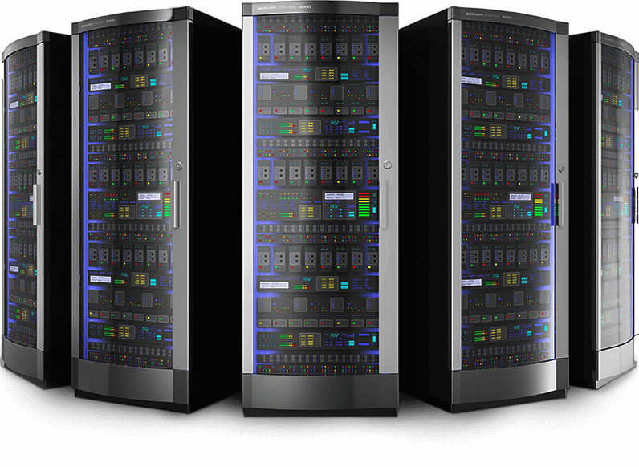
Server
Management
Support for multiple OS, vendors, technologies
Monitoring of server hardware & availability
Process and Services
monitoring
Historical analysis for
optimizing server
performance
Monitoring of virtualized
server environments
Supported:
OS : Windows, Linux, Solaris, AIX & more
Vendors : HP, Compaq, Dell, IBM & more
Protocols : SNMP, WMI, SSH & more
Syslog based event
management

Slide 8


Application &
DB Management
Comprehensive health and performance monitoring of web, email and database applications
Application-specific Dashboards & Views
Transaction Monitoring
Custom Application Management
Web Content Monitoring
Historical Performance Analysis
End User Experience

Slide 9



Configuration Management for devices across
Vendors (Cisco/Juniper/NetScreen etc.)
Configuration Management
Configuration management with Comparison across configurations
Scheduled configuration downloads & backup
Quick rectification of configuration errors
Automatic configuration change detection & alert
Tagging, Base-line and Start-up configurations

Slide 10



SLA Management
SLA Management for Network performance, Server performance and Application performance
Contract-based
SLA comparison
Holidays support
SLA templates
Business
hours SLAs
Scheduled outage
& maintenance

Slide 11


Integrated incidents & problems management
with support for ITIL V3 framework
Service Desk
Incident
& Problem Management
Change Management
CMDB & Knowledge Base
Service Catalogue Management
SLA Management with Priority Matrix
Workflow Management & Customer Portal
Configurable Dashboard & Reports

Slide 12
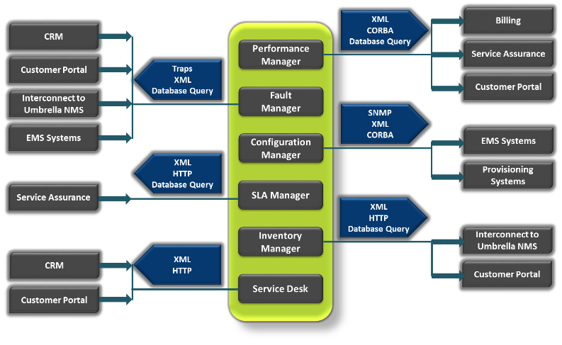
Integration Capabilities

Slide 13
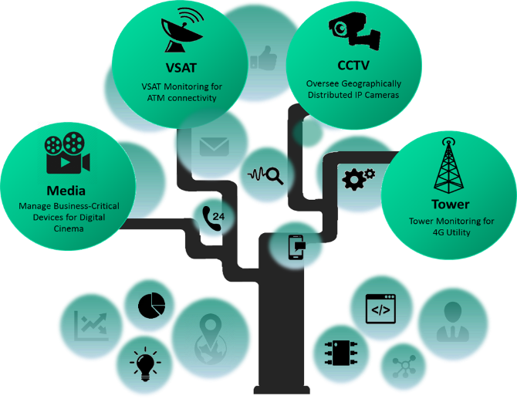
Few Unique Stories …

Slide 14
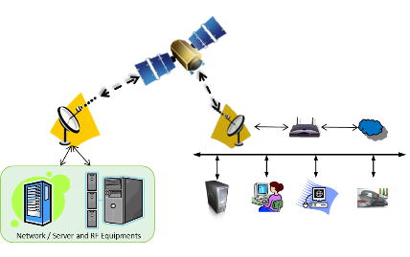
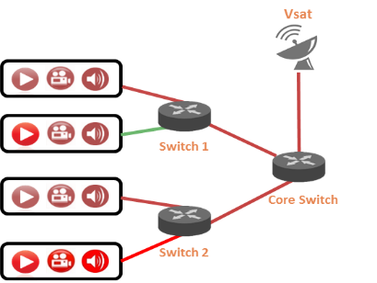
Infraon IMS helps Airtel provide uninterrupted services to its customers …
Airtel – VSAT Monitoring
Monitoring 50k+ VSATs across India
ATMs connectivity being monitored ensuring minimal Business Downtime
Airtel – Digital Cinema
Flexible network monitoring of all the PVR’s across India.
Monitoring all the PVR’s like players, projectors, servers are running fine or not.
Monitoring critical parameters like lamp parameters (life time)

Slide 15
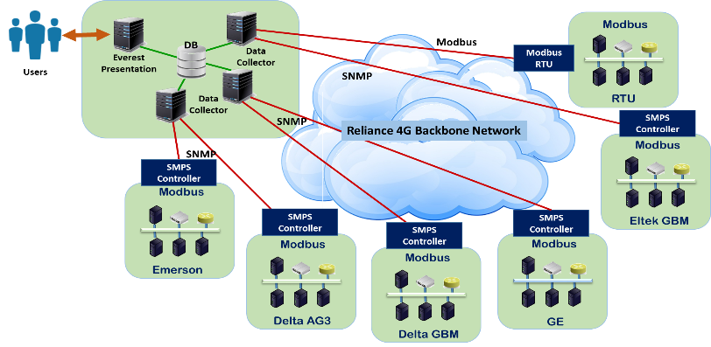
Infraon IMS helps Reliance deliver 4G Tower Utility …
Effectively collects the parameters from more than 80000+ SMPS controllers
Export alerts to central alarm management server via SNMP Trap
Integrated with HPNNM to convert SNMP Traps to tickets

Slide 16





















International Clientele
… any many more

Slide 17


































Home Clientele
… any many more

Slide 18




EverestIMS Technologies Pvt Ltd
Headquarters:
Address: # 45, B N Rao Plaza, 1st & 2nd Floor, 24th Main Road,
J P Nagar 7th Phase, Bangalore – 560078.
| : sales@everest-ims.com | : +91-80-46567100 | : www.everestims.com |
Branches in India:
Mumbai:
Millennium Business Park, Unit No-109, Building No-2,
Sec-1 Mahape, Navi Mumbai - 400710
| : +91-22-41270170 |

Slide 19

THANK YOU!

