Slide 1
Final Project
BALJINDER SMAGH & SURAJ JHA

Slide 2
Problem Definition
CLEANING DATA: Work on Missing Data
OUTLIER DETECTION: Find out the months of sale which are considered as outliers for any shop.
FEATURE SELECTION/ENGINEERING: Identify and convert Categorical columns/values to Numerical representation using Dummy Variables if suitable for modelling.
MODELING: Build 2 different models that uses all data from the training.csv and other files for all the months and years except October 2015.
VALIDATION: Use October 2015 data as test set and present
a. Mean squared error b. root mean squared error (RMSE)
COMPUTE CONFIDENCE INTERVAL OF MODELS: Compute confidence interval of Model 1 and Model 2 for the following different confidence levels: (80%, 90%, 95%)
COMPARSION BETWEEN TWO MODELS: Compare these two models considering:
a. error b. efficiency in training time (scalability)

Slide 3
Dataset
Sales_train.csv- the dataset. Daily historical data from January 2013 to October 2015.
Items.csv-supplemental information about the items/products.
Item_categories.csv- supplemental information about the item's categories.
Shops.csv-supplemental information about the shops.

Slide 4
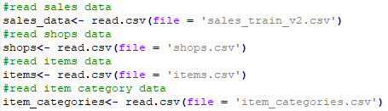


Pre-PROCESSING
Read all Dataset:
Join all Datasets on sales_data using left Join:
Split Train Data and Test Data:

Slide 5
CLEANING DATA
Looking for missing Data.
-We found no missing data in sales dataset.
Looking for negative values in item_price and item_cnt_day (As these cannot be negative).
-We found one negative item price and 7228 negative item count per
day.
Check if the negative count per day is due to return of an item purchased prior to that date.
-We grouped the data with shop_id and item_id and added the
item_count. We found the value of negative count decrease to 27
(which are mainly from date_block_num 0 and 1). That may be for
item purchased in December 2012

Slide 6
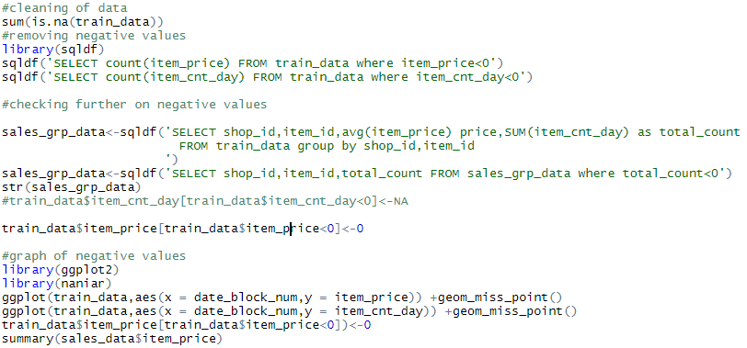
DEMO Code FOR CLEANING

Slide 7
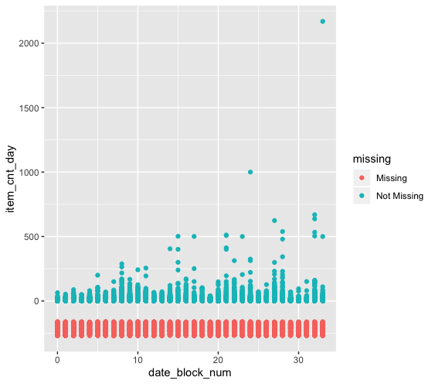
Analyzing item count day negative values

Slide 8
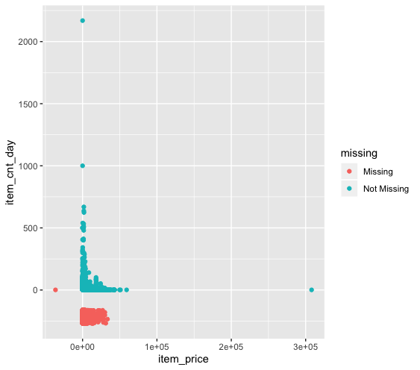
Analyzing item price and item count negative values

Slide 9
OUTLIER DETECTION
Find out the months of sale which are considered as outliers for any shop?
- We checked Total Revenue (Item_price * item_count_day) for each date_block_num for every Shop_id, and found below Shop_Id have following months as outlier:
Month Number | Shop_ID
11 | 4,5,7,10,15,16,17,19,21,22,24,25,26,28,29,30,31,35,38,44,45,46,50,51,52,53,54,56,57,58,59,14, 2,6,42,43,27,41,18
23 | 4,5,7,10,15,16,17,19,21,22,24,25,26,28,29,30,31,35,38,44,45,46,50,51,52,53,54,56,57,58,59,14, 2,6,42,43,27, 3,38,47,48,49,39,40
22 | 59,14,2,6,42,43,27
32 | 55

Slide 10
Feature Engineering
Added Columns:
Year ,Month, Day, Weekday, ID
Deleted Columns:
item_name, item_category_name, shop_name, date

Slide 11
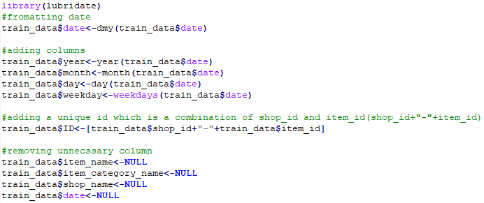
Demo code FOR FEATURE ENGINEERING

Slide 12
FIRST MODEL
Liner Regression:
Linear regression is used to predict the value of a continuous variable Y based on one or more input predictor variables X. The aim is to establish a mathematical formula between the response variable (Y) and the predictor variables (Xs). You can use this formula to predict Y, when only X values are known.
Ref. https://www.machinelearningplus.com/machine-learning/complete-introduction-linear-regression-r/

Slide 13
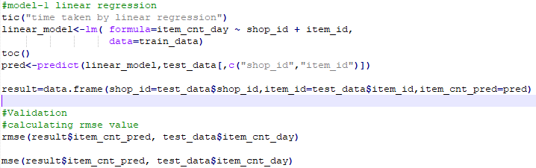
Demo CODE FOR MODEL ONE

Slide 14
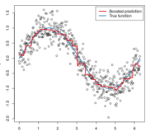
SECOND MODEL
Generalized Boosting Model:
GBM is unique compared to other decision tree algorithms because it builds models sequentially with higher weights given to those cases that were poorly predicted in previous models, thus improving accuracy incrementally instead of simply taking an average of all models like a random forest algorithm would. By reducing the error iteratively to produce what will become the final model, GBM is an efficient and powerful algorithm for classification and regression problems.
Ref. https://www.storybench.org/tidytuesday-bike-rentals-part-2-modeling-with-gradient-boosting-machine/

Slide 15
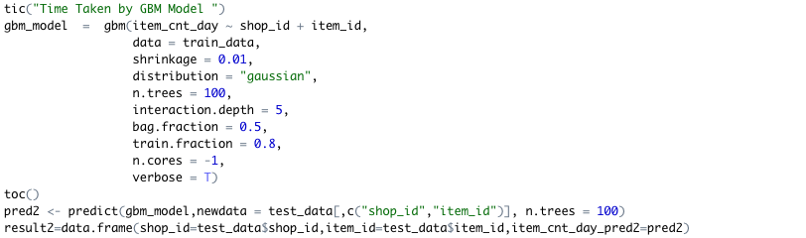
DeMO CODE for model2

Slide 16
comparison
ERROR WISE:
MODEL 2 has a lesser RMSE/MSE value than MODEL1.
EFFICIENCY WISE:
MODEL 1 takes lesser time to train as compare to MODEL 2.

Slide 17
Who did what (only for groups with 2 members)
Baljinder
Cleaning of data
Exploratory Analysis
Outlier detection
Linear model
Suraj
Feature Engineering
GBM Model
Confidence Interval
Comparison between models done by both

Slide 18
Conclusion
Cleaning and Outlier detection are very important to done before we can apply any model.
Learned about various models while implementing and get to know which model is better in training.

Slide 19
ROADBLOCKS
Dealing with large amount of data.
Tried two other models ARIMA and neural networks, but dropped due to their various complications like for ARIMA to obtain stationary dataset first and for neural networks to find the optimum number of hidden layer for better performance.
Selection of Model
R language

