Slide 1

KALYANI GOVERNMENT ENGINEERING COLLEGE
MINI-PROJECT ON THE TOPIC:
QR CODE GENERATION USING PYTHON
done by
Suraj Kundu – 10200320024 Subhadeep saha – 10200320036
Sk mahafujur rahaman – 10200321059 Pronay Chandra mridha – 10200321055
Guided by:-
Mr. Dwaipayan Ghosh

Slide 2
CONTENTS
Introduction.
What are QR codes.
Why use python to generate QR code.
How to generate QR code with python.
Generate QR code in python.
Steps to build QR code generator in python.
Output of the QR code generator in python.
Conclusion.
Refrences.

Slide 3

GeneratiNG ǪR Codes with Python

Slide 4
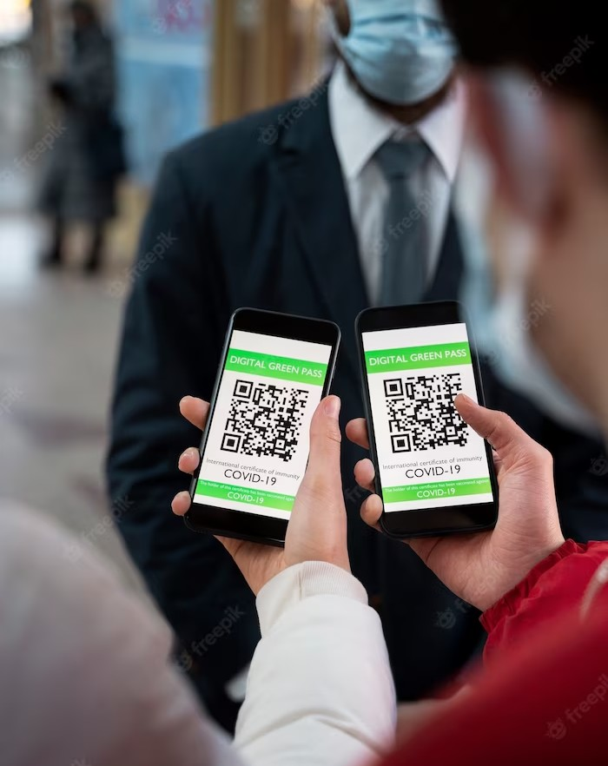
INTRODUCTION
Creating QR Codes with Python. In this presentation, we will discuss the importance of efﬁcient code generation and how to create QR codes using Python. We will cover the basics of QR codes, how they work, and why they are important in today's digital world and at last we will build a QR Code Generator with the help of python modules.

Slide 5
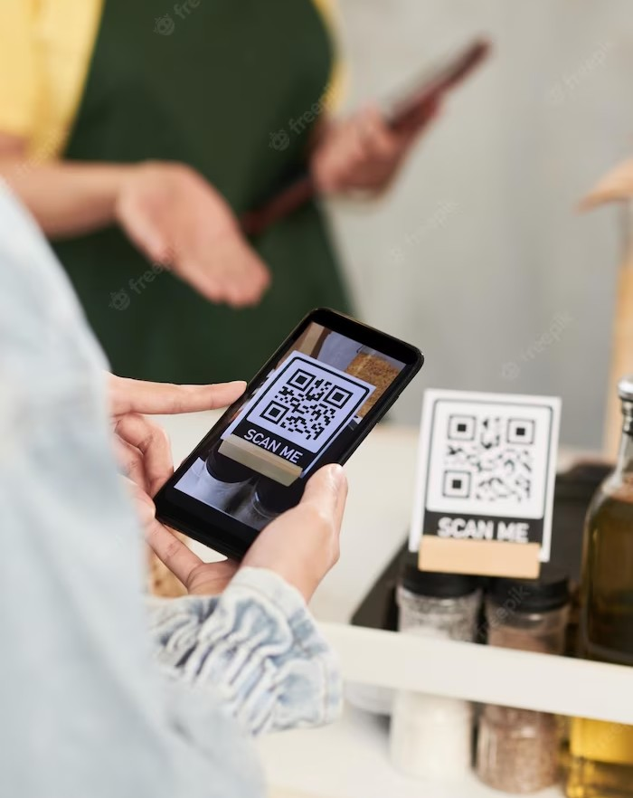
WHAT ARE QR CODES?
QR codes are two-dimensional barcodes that can be scanned using a smartphone or other device.
They are used to store information such as website URLs, contact information, and product details.
QR codes can hold much more information than traditional barcodes, and are becoming increasingly popular in marketing and advertising.

Slide 6
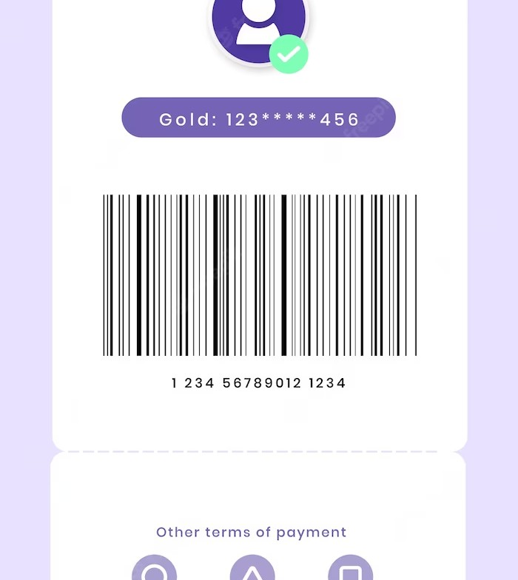
Why use Python for QR Code
Generation?
Python is a high-level programming language that is easy to learn and use.
It has a large number of libraries and modules that make it ideal for generating QR codes.
Python's simplicity and ﬂexibility make it a great choice for beginners and experts alike.

Slide 7

How to Generate QR Codes with
Python?
To generate a QR code in Python, we can use the qrcode module.
The qrcode module allows us to create QR codes with just a few lines of code.
We can specify the size, type, and content of the QR code, and save it to an image ﬁle.
The qrcode module makes it easy to create high-quality QR codes.

Slide 8
Generate QR Code in Python
We will be using tkinter and qrcode modules in Python to build this project. We use the tkinter module to build the GUI to take the following inputs:
text/URL to convert to QR Code.
location to save the QR code with name.
size of the QR code.
Then we generate the QR code from the above inputs and save in the given location using the qrcode module.

Slide 9
Steps to build the QR Code Generator in Python:
To build the QR code generator project using Python we need to follow the below steps:
1. Importing the modules.
2. Creating the main window.
3. Taking the input of the text/URL, location to store the QR code, name of the QR code and the size of the QR code.
4. Writing the function to generate and save the QR Code.

Slide 10
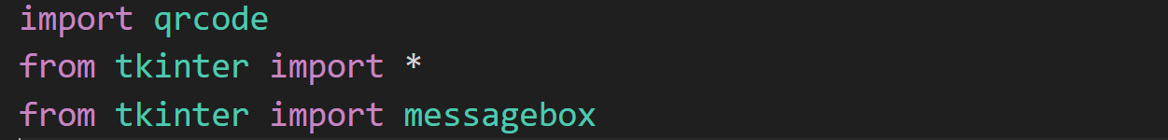
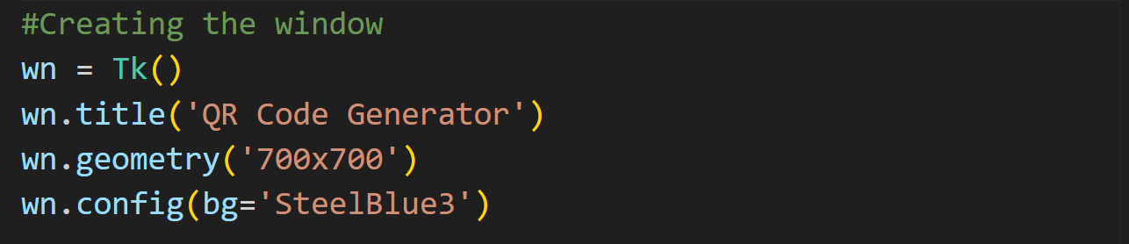
1. Importing the modules
The first step is to import the qrcode and the tkinter module. We use the messagebox in the tkinter module to show the pop up messages.
2. Creating the main window
Next, we create the main window with title, size and color.

Slide 11
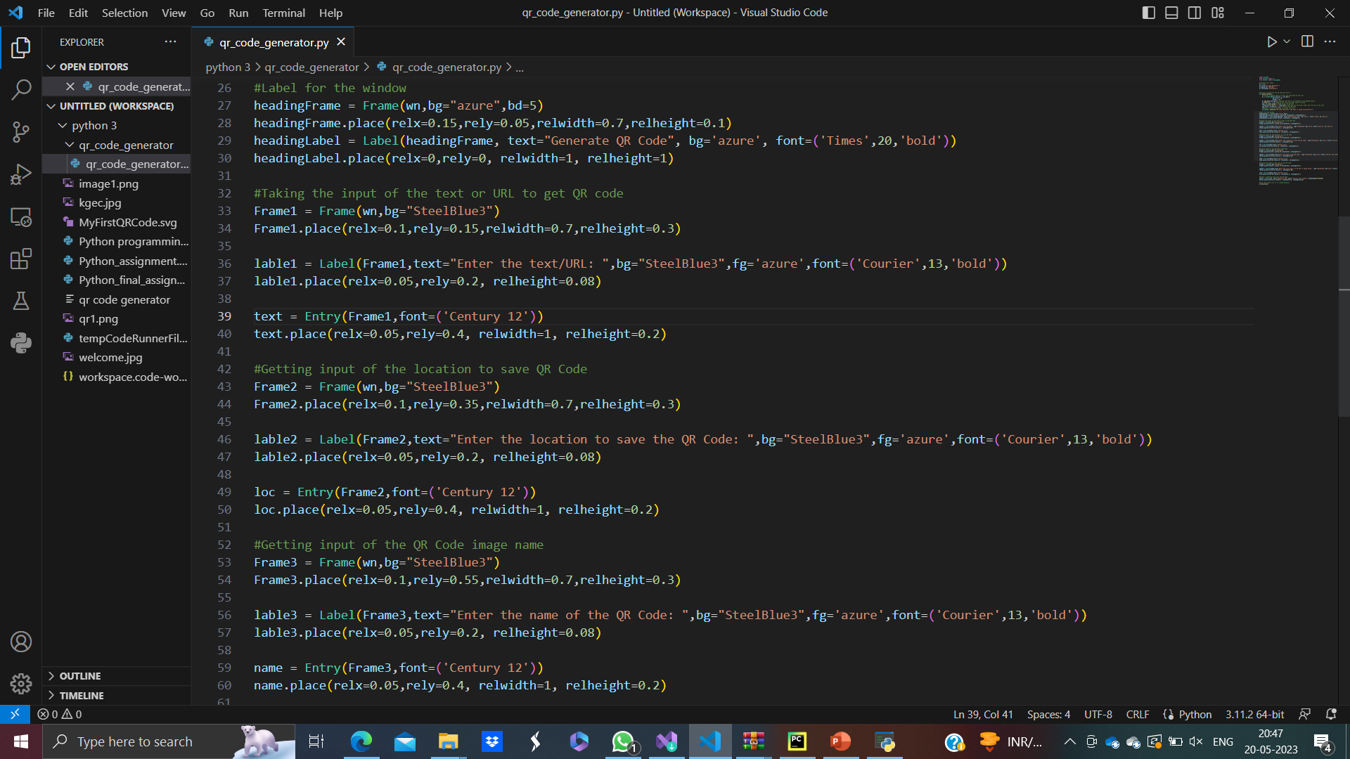
3. Taking the inputs ,
Now, we take the inputs from the user to create the QR Code. We take the following inputs:
Text/URL as Entry() named as ‘text’.
Location to save the QR Code as Entry() named as ‘loc’
Name of the QR Code image when saved in the device as Entry() named as ‘name’
Size of the QR Code to be generated as Entry() named ‘size’. In this the user has to give the size in the range 1-40. 1 being the smallest size of 21×21.
Then we create a button when clicked generates the QR Code and saves it by executing the generateCode() function.
P.T.O

Slide 12
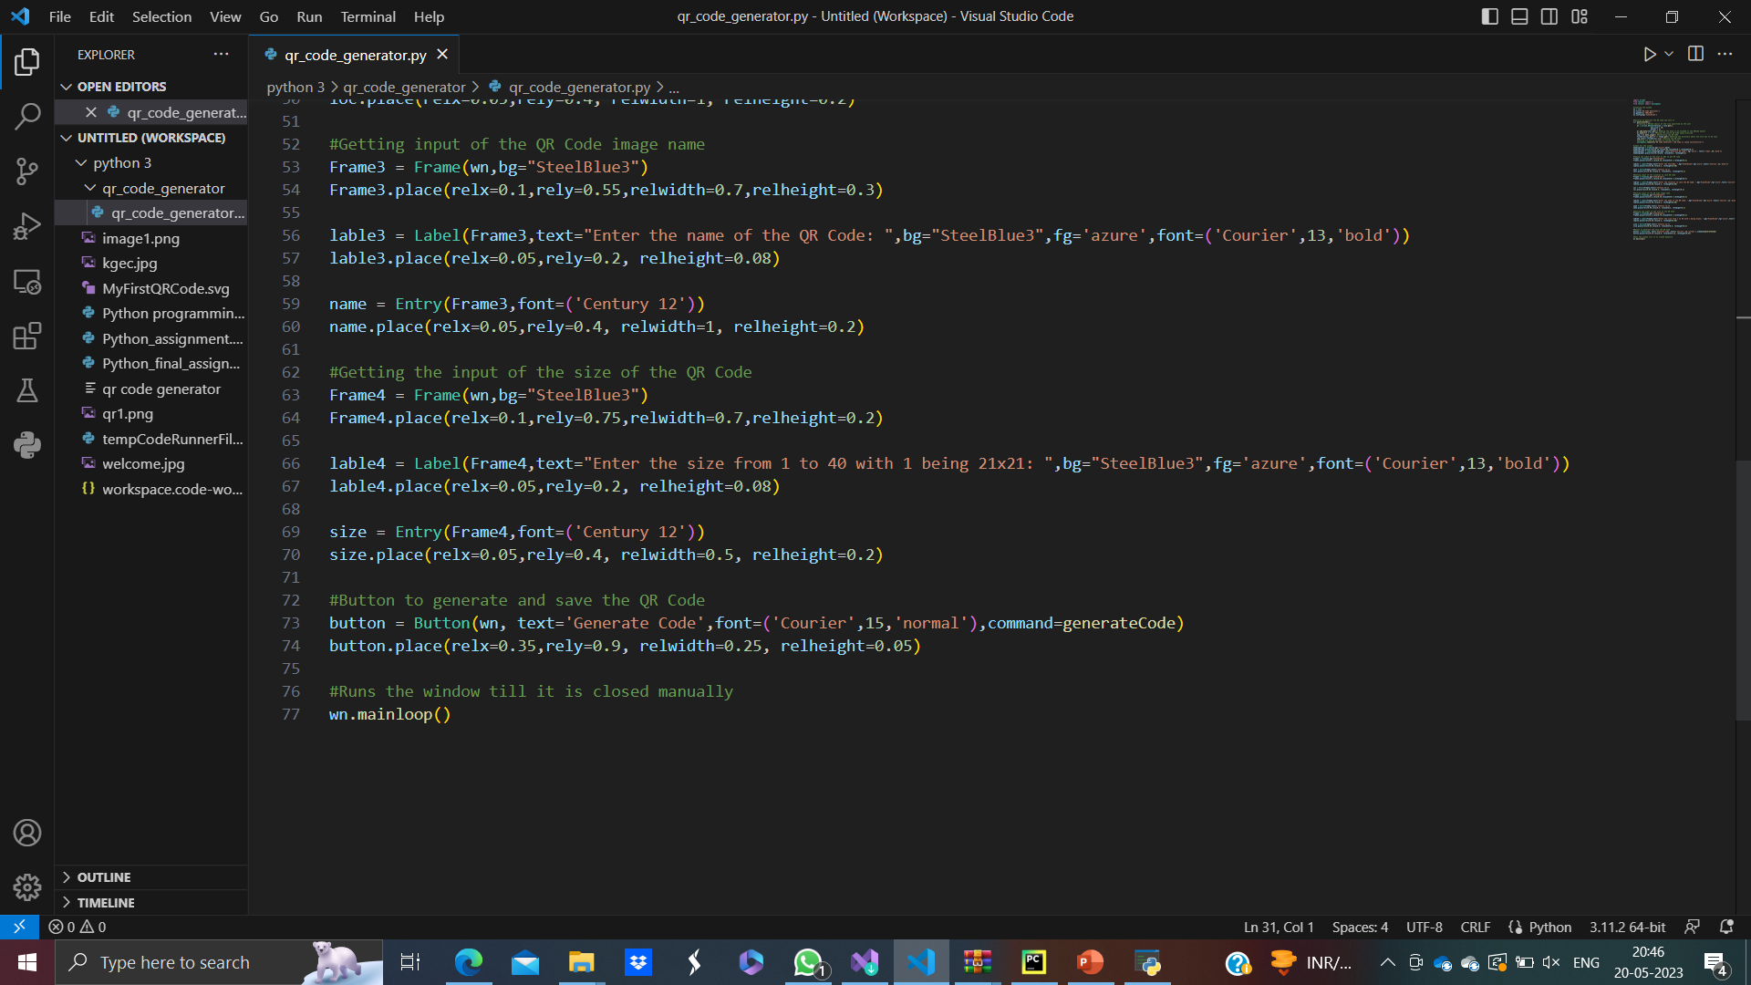
CONTINUED

Slide 13
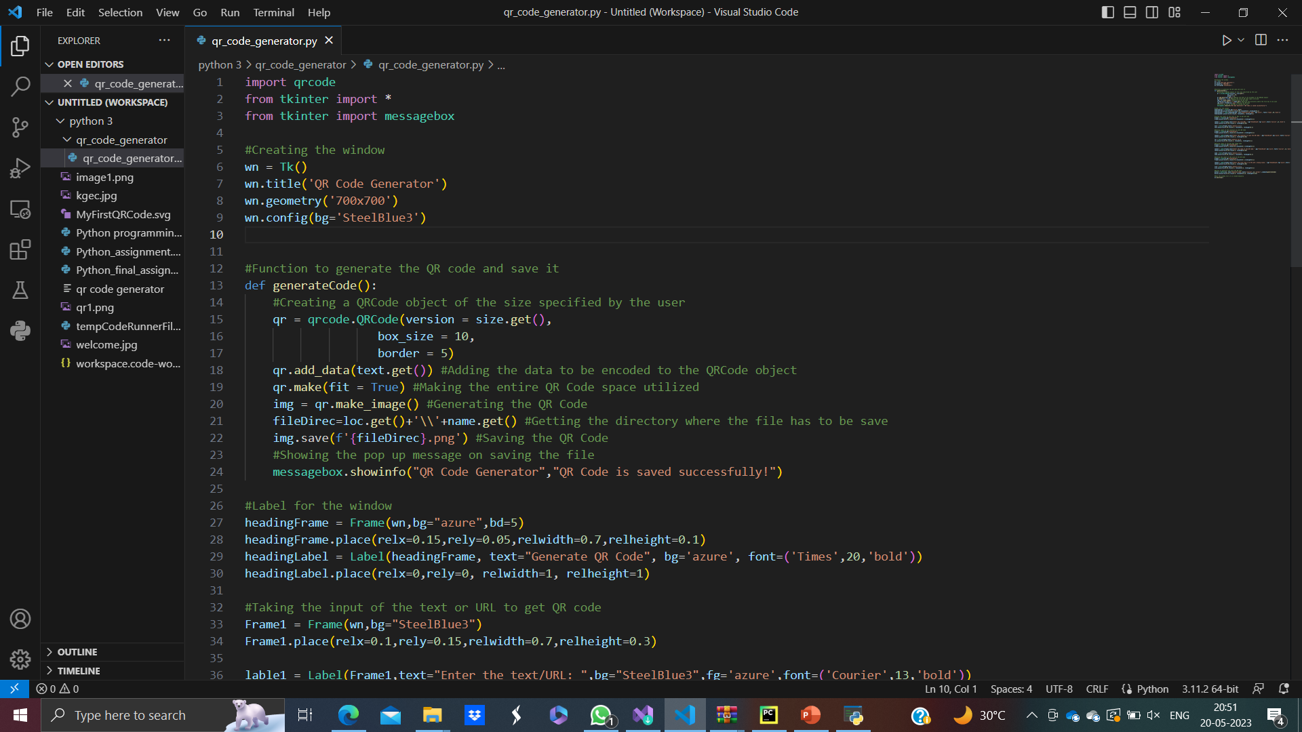
4. Creating the function to generate QR code and save it,
Finally, we create the function to generate the code that runs on clicking the button. In this,
First we create the QRCode object with the version/size that user gave as input in the size() entry
Then we add the text that we need to encode by getting from the entry ‘text’
Then we get the QR code and save it in the directory that user gave as input
After this, we show the pop up message to confirm the user that the image is saved

Slide 14
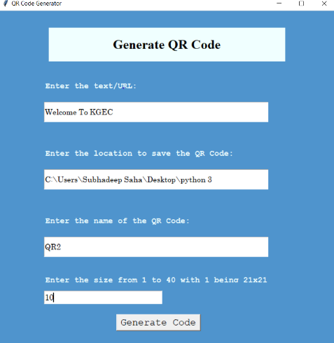
Output of the QR Code Generator in Python 1)Image of the GUI to take a text as a inputs from the user for generating QR Code

Slide 15
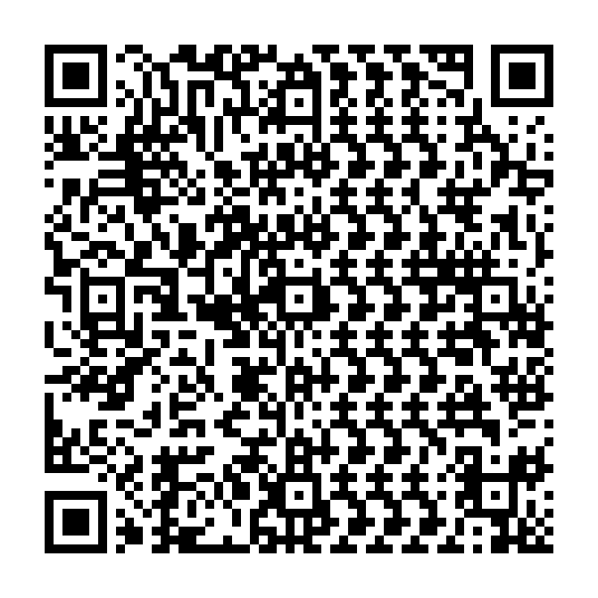
Generated QR code Is as follows:
After scanning this QR Code , we will get a text “Welcome To KGEC” as a output.

Slide 16
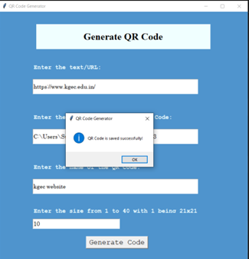
2)Image of the GUI to take a URL as an input from the user for generating QR Code.

Slide 17
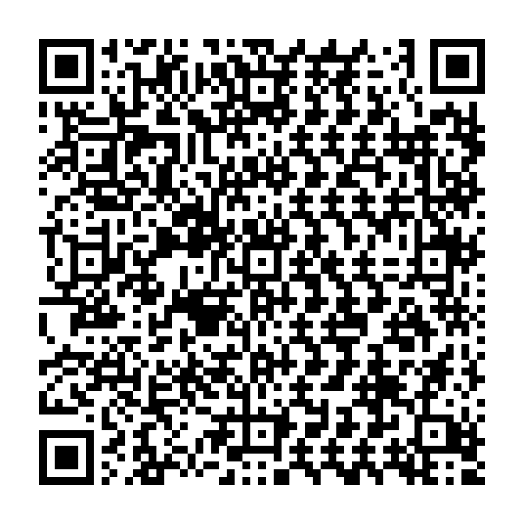
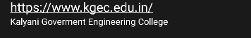
Generated QR code Is as follows:
After scanning this QR Code , we will get KGEC website link which will redirect us to our college website.

Slide 18
Conclusion
In this presentation, we have discussed the importance of efﬁcient code generation and how to create QR codes using Python. We have covered the basics of QR codes, how to generate them in Python, and how to optimize our code for faster generation. With these techniques, we can create high-quality QR codes quickly and efﬁciently. Finally we have written a code to generate a QR code using python and the generated QR code is also given as output.

Slide 19
REFRENCES
https://docs.python.org/3/library/tkinter.html
https://pypi.org/project/qrcode/

Slide 20
THANK YOU

