Slide 1



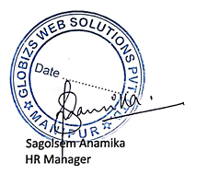

1000*
C 1. I E N T é I. P.
Date: - 12/06/2025
TO WHOMEVER IT MAY CONCERN
Project Completion Certificate
This is to certify that the students Satyam Mayengbam (22WJ1A05U5), Suraj Ranjan (22WJ1A05W2) , Yash Gupta (22WJ1A05AC) have successfully completed their project titled “Plagiarism Checker” under the guidance of Dr. Khushbu Doulani, Assistant Professor, CSE, GNITC in collaboration with Globizs Web Solutions Pvt. Ltd., as a part of their academic requirements for the Computer Science & Engineering course during the academic year [2024-2025].
The project was executed with dedication, technical understanding, and excellent teamwork. We acknowledge the group’s effort and validate the successful completion of the project through this certificate.
(Globizs Web Solutions Pvt. Ltd.)
Globizs Web Solutions Pvt. 1td. Konung Mamang New Checkon Road. lmphal East, Manipur - 795001
84484-47720
87986-48717
www.globizs.com contact@globizs.com

