Slide 1
University Placement Portal
A Modern Solution for Campus Recruitment

Slide 2
Project Vision & Objectives
Problem: Manual, inefficient placement process (spreadsheets, emails).
Solution: Centralized, web-based placement platform.
Objectives:
• Automate applications and shortlisting
• Single source of truth for placement data
• Improve communication among stakeholders
• Generate insightful reports

Slide 3
Core Features
Student Portal: Apply to jobs, track applications.
Recruiter Dashboard: Post jobs, shortlist candidates.
Faculty Workflow: Approve shortlisted students.
Admin Reports: Placed students, company selections.

Slide 4
User Roles & Workflow
Student → Applies (Status: APPLIED)
Recruiter → Shortlists (Status: SHORTLISTED)
Faculty → Approves (Status: APPROVED)
System Trigger → Updates status to PLACED

Slide 5

Technology Stack
Frontend: Next Js, Tailwind CSS
Backend: Node.js, Express.js
Database: MySQL, Prisma ORM
Authentication: JWT, bcrypt

Slide 6

Database Design & Concepts
Key Tables: User, Student, Recruiter, Faculty, Job, Application
Application = join table (Many-to-Many)
Triggers: Auto-update student placement status
Stored Procedures: Eligibility filtering

Slide 7
Security - Role Based Access Control
JWT for authentication
Protected API routes
Role-based authorization checks
Unauthorized actions blocked (403 Forbidden)

Slide 8

UI Preview
Student Dashboard → Job listings, Apply, Track status
Recruiter Dashboard → Applicants, Shortlist options
Faculty Dashboard → Approve shortlisted candidates

Slide 9
Future Enhancements
Advanced analytics dashboards
Email & SMS notifications
AI Based mock interview

Slide 10
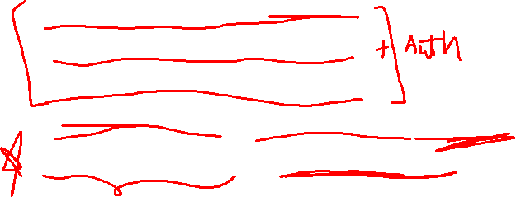
Student Dashboard -> Paras
Admin Dashboard -> Himadri
Recruter Dashboard -> Kritika
Frontend API and Components -> Suraj
Database Model -> Kritika + Himadri
Backend controller -> Suraj
Middlewere setup -> Kritika + Himadri
Route setup + Server JS -> Paras
Connecting route (Backend + Frontend) -> Suraj

Slide 11

Thank You

