Slide 1

WebNova : Our Own Web Server

Slide 2
Introduction
save_file → Saves uploaded content to disk.
read_file → Reads requested file to send to client.
file_exists → Checks if a file is present before serving.
get_file_size → Helps set correct Content-Length in HTTP response.
Developed a custom web server in C
• Implemented using Operating System concepts
• Features include:
- Multithreading for concurrency
- Caching for performance optimization

Slide 3
Architecture of Web Server
• Client-Server model
• Server handles multiple requests using threads
• Cache layer stores frequently accessed data
• Request Flow:
1. Client sends HTTP request
2. Server parses request
3. Cache checked for data
4. Response sent back to client

Slide 4
Core parts
Socket Programming
Multithreading (pthread library) in C
Caching Layer
HTTP Methods (GET, POST, PUT, DELETE)

Slide 5
1. HTTP Request Handlers
handle_get → Serves files/resources (HTML, images, etc.)
1
handle_post → Handles data submission (e.g., form data).
2
handle_put → Creates or updates resources (like uploading a file or updating content).
3
handle_find → Can be a custom API (search inside files or directories).
4
handle_file_upload → Allows users to upload files to server storage.
5
handle_file_download → Enables downloading files from the server.
6

Slide 6
2. File Operations
save_file → Saves uploaded content to disk.
1
read_file → Reads requested file to send to client.
2
file_exists → Checks if a file is present before serving.
3
get_file_size → Helps set correct Content-Length in HTTP response.
4

Slide 7
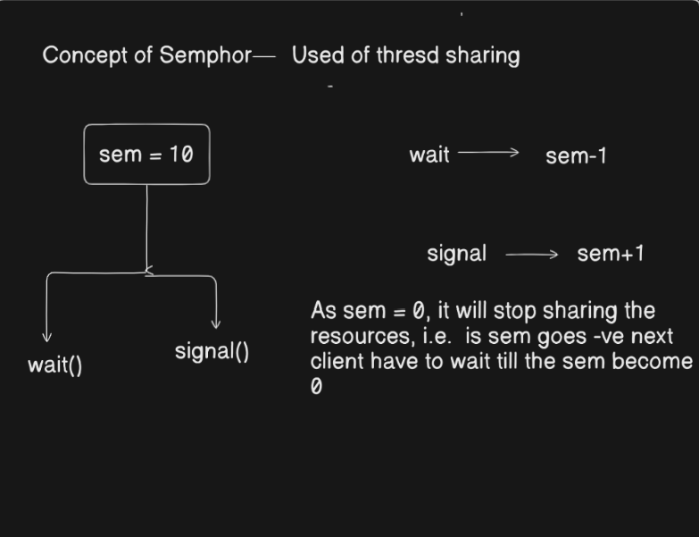
Multithreading
• Each client request handled by a separate thread
• Benefits:
- Improves concurrency
- Efficient CPU utilization
- Reduced response time
• Implemented using pthread library in C

Slide 8
Caching
• Stores frequently accessed web pages/files in memory
• Reduces disk I/O operations
• Improves response time
• Implemented using data structures (linked list)
• Example: LRU (Least Recently Used) cache mechanism

Slide 9
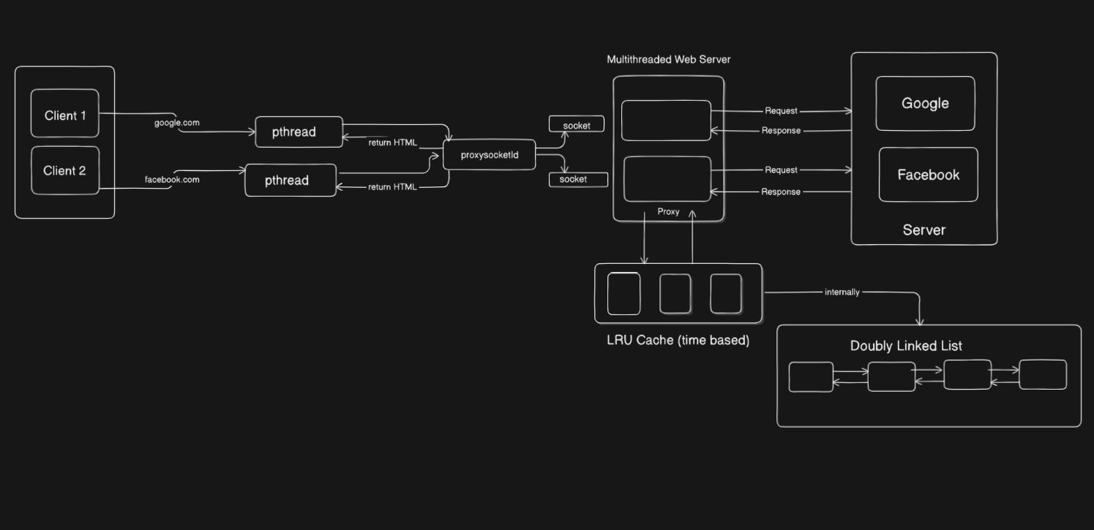

Slide 10
Suraj Sharma – HTTP Request Parsing & Handlers
Paras Mehta – File Operations & Caching
Himadri + Kritika – Multi Threading + Error Handling + Authentication+ Testing Strategies.
OS -> All members
Most difficult part -> research

