Slide 1
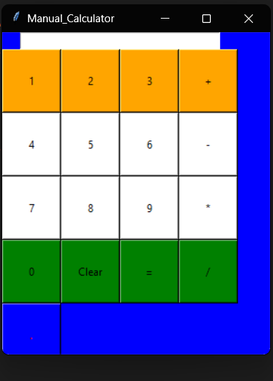
Manual Calculator
Name : Suraj Ganesh Shejul
Affiliations : Digichrome

Slide 2
Project overview/Problem Statement
To create a simple calculator using GUI Tkinter
To develop a simple calculator app with attractive presentation to ensure the
Quality and effectiveness of the program.

Slide 3
Methodology/Software requirements
Creating a calculator app using Tkinter GUI
Using the tkinter library
It can perform basic mathematical operations such as addition,subtraction,multiplication,dividion.
System requirements us as follow
Windows 10/11
Vs code
Python 3.2 or the latest version

Slide 4
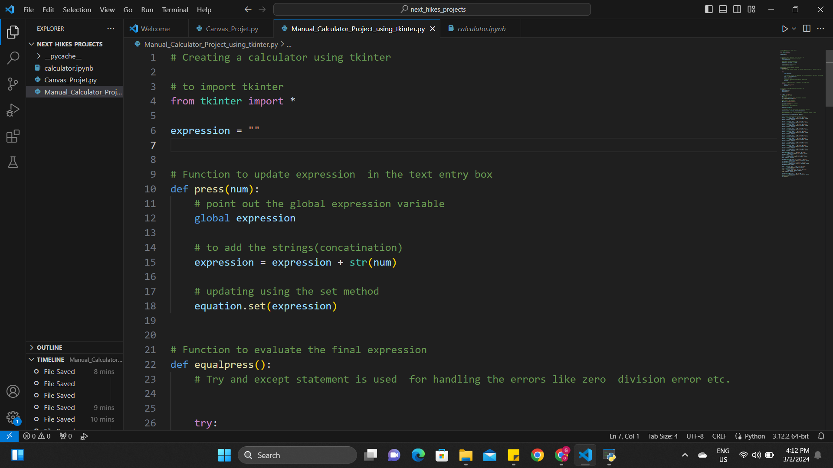
Following are the screen shots of the program used to create the claculator

Slide 5
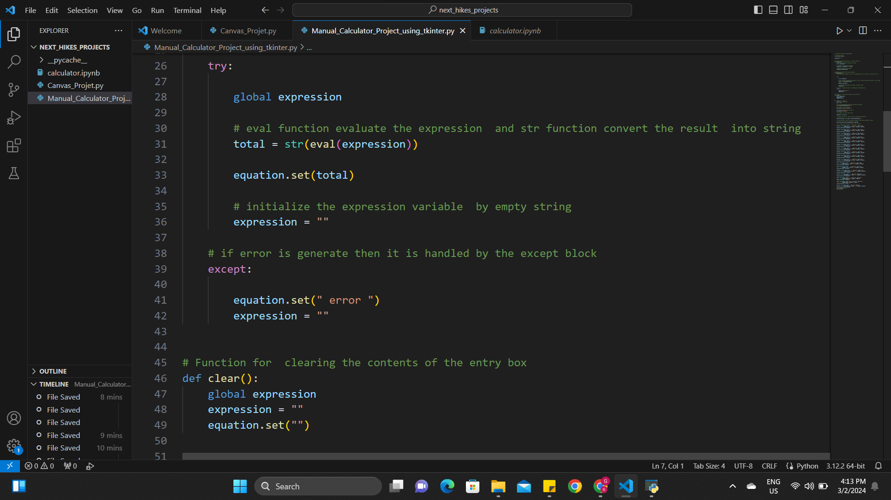

Slide 6
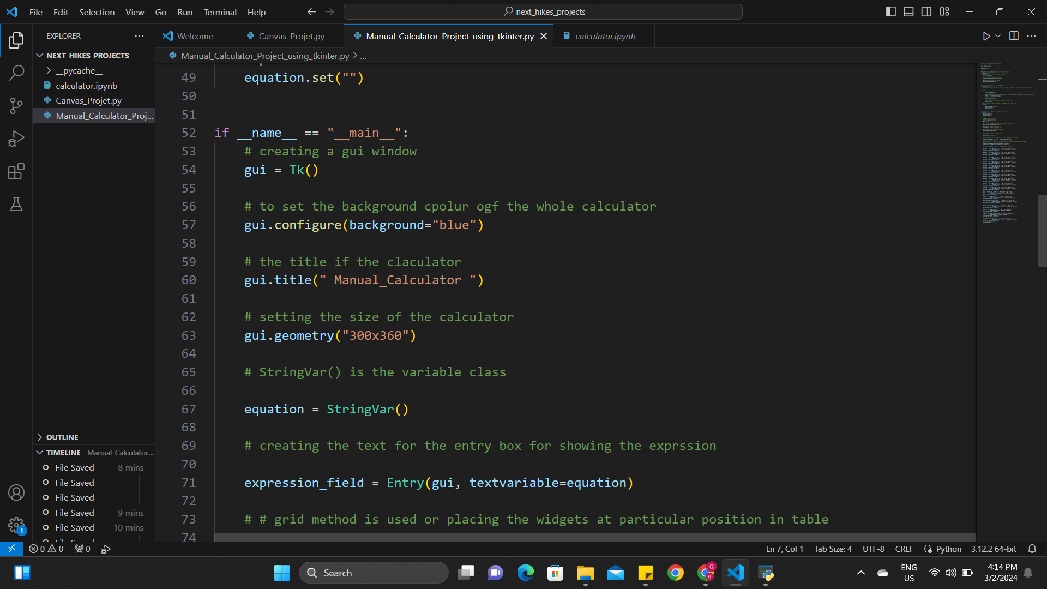

Slide 7
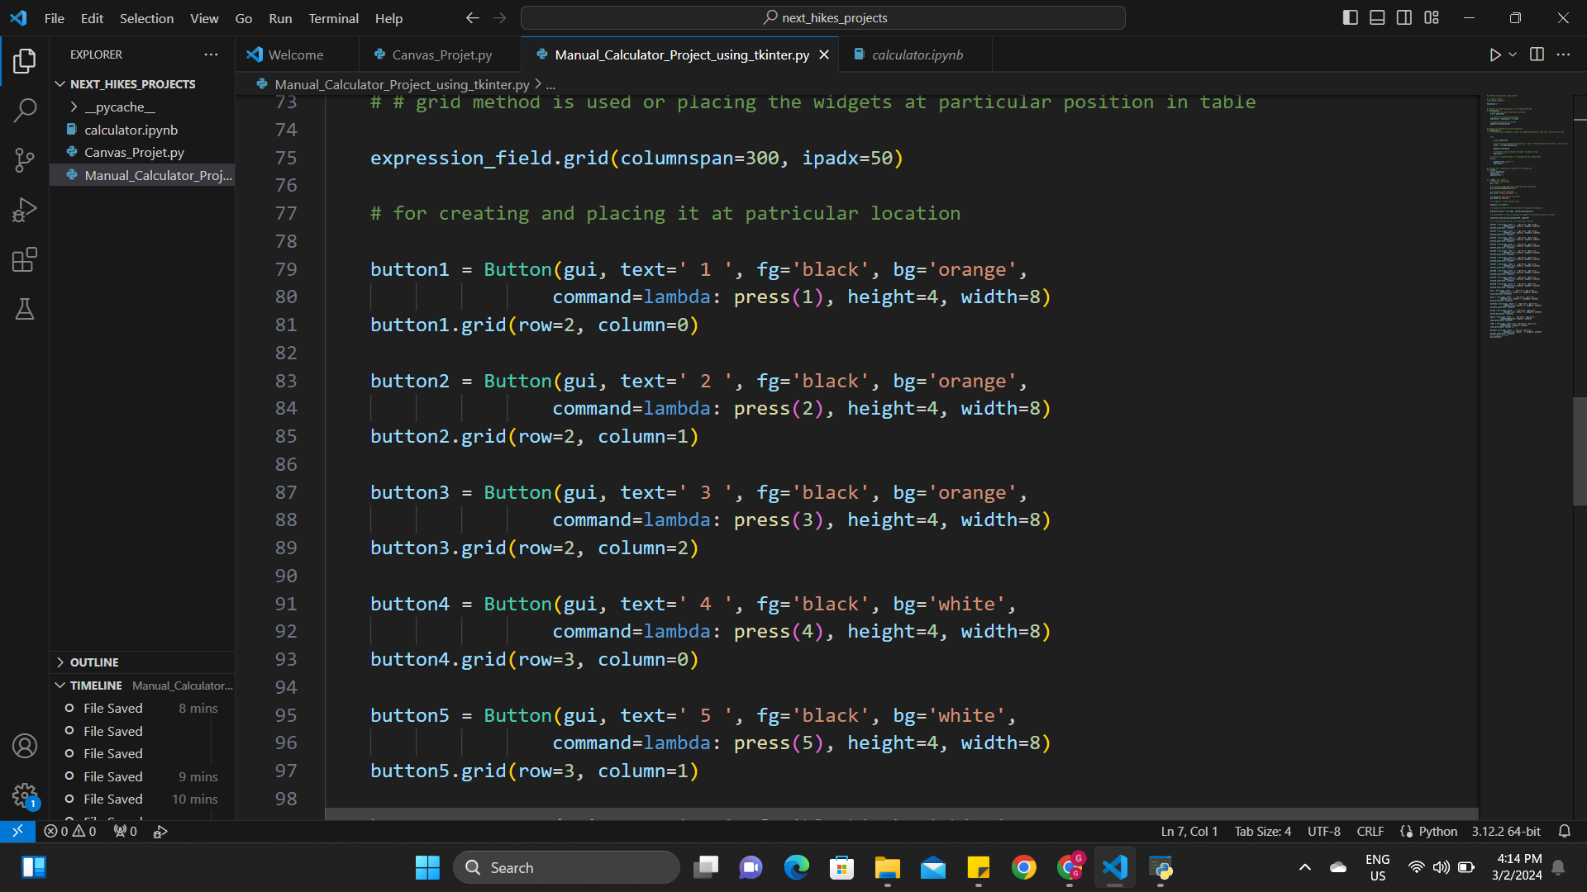

Slide 8
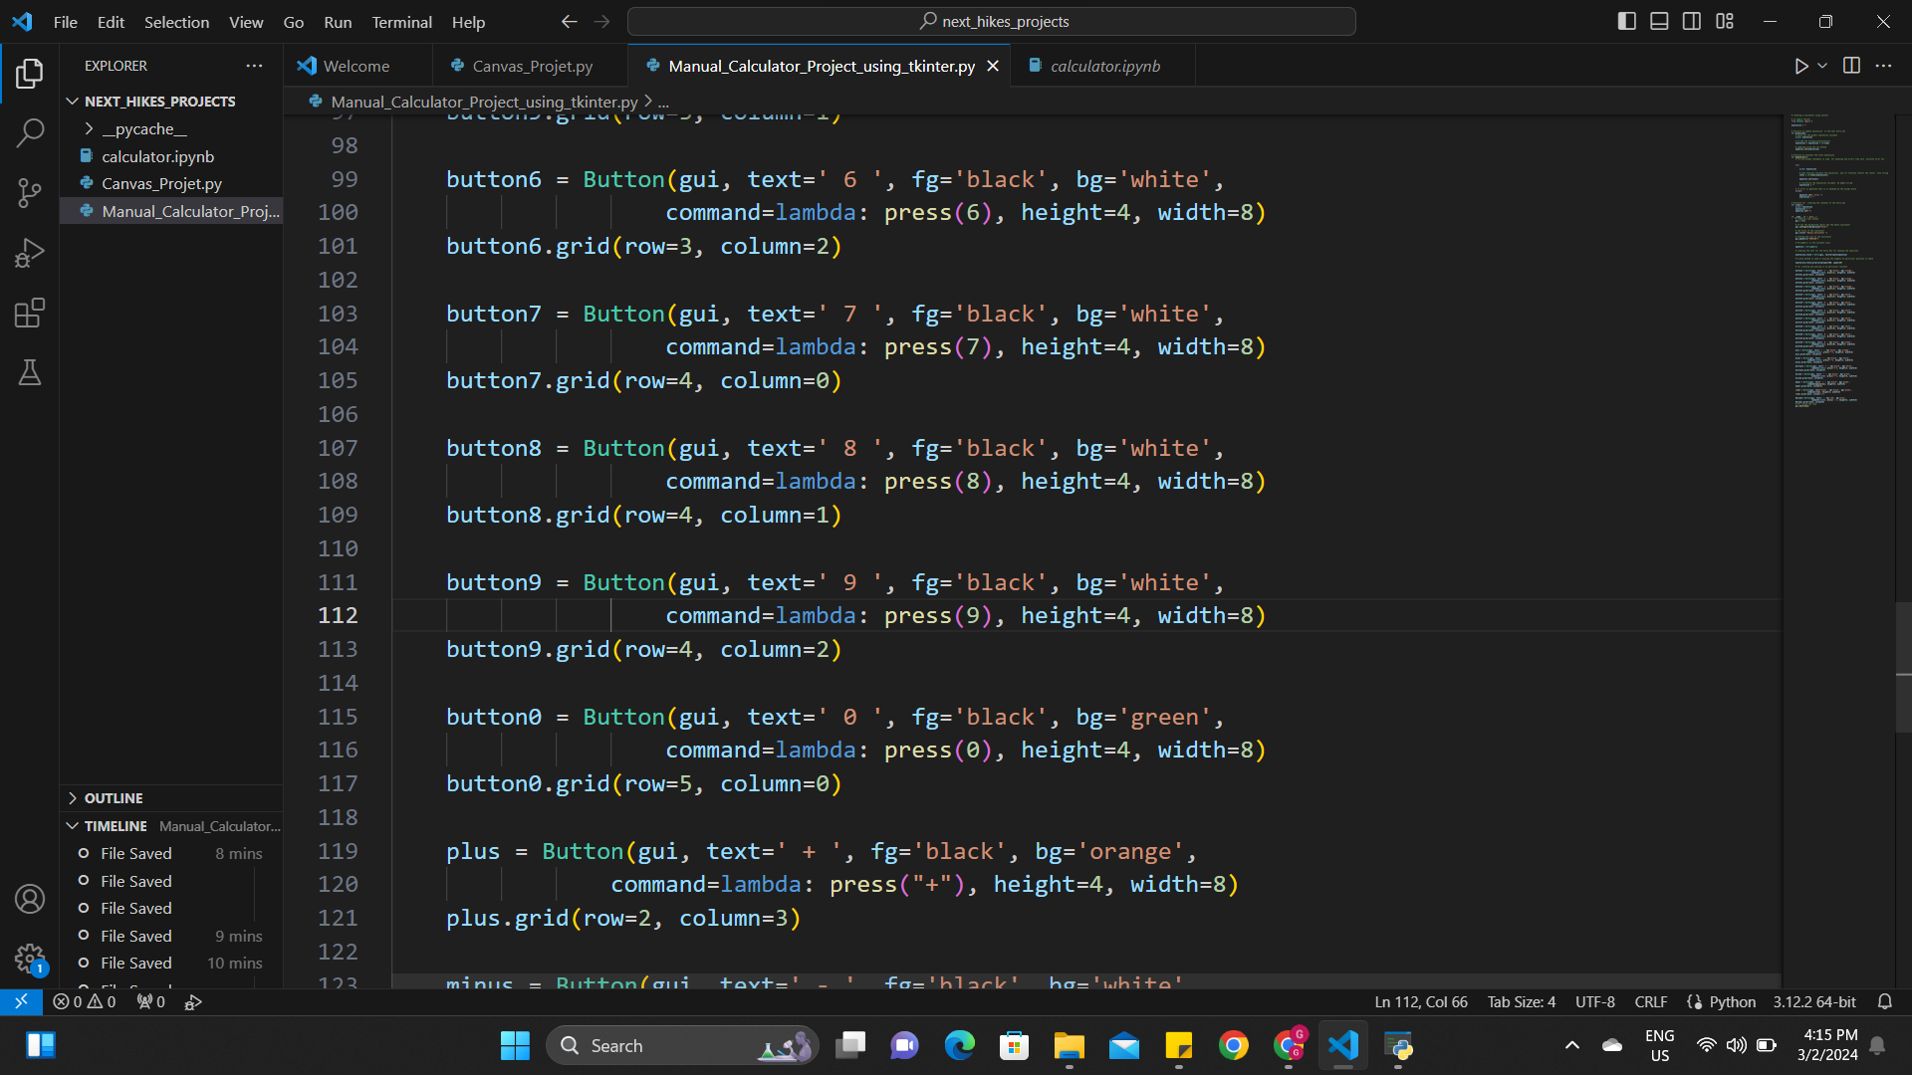

Slide 9
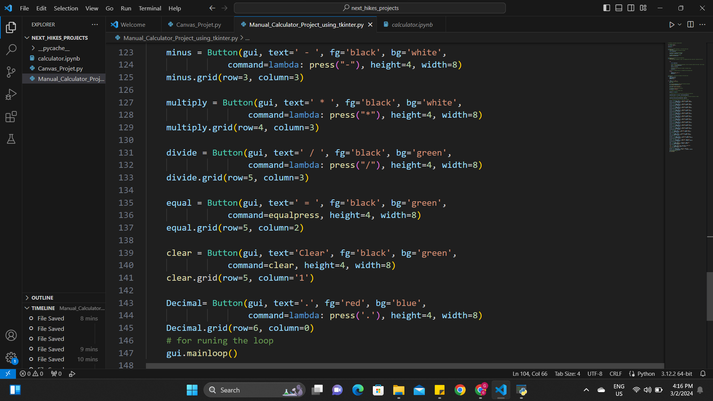

Slide 10
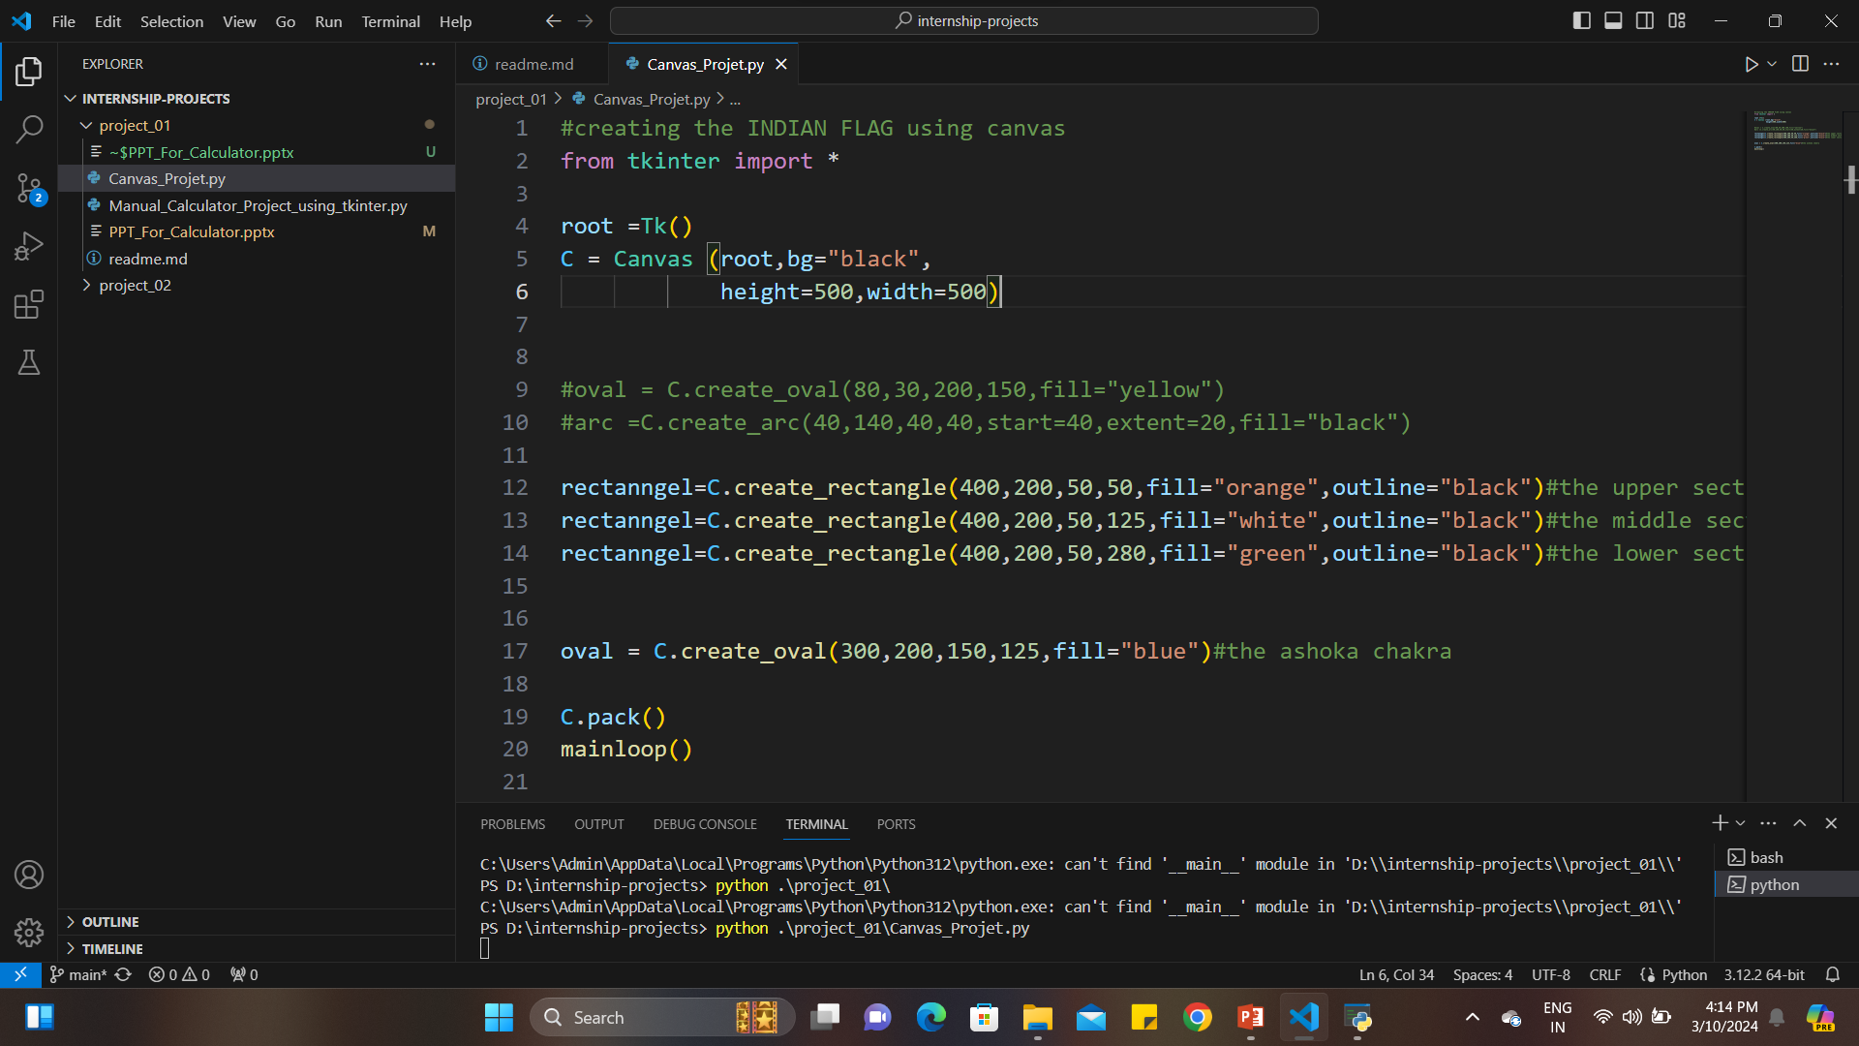
A canvas project of an INDIAN FLAG

Slide 11
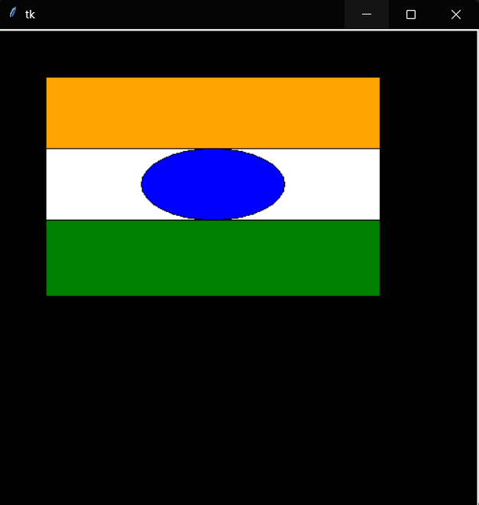
OUT PUT for the canvas program

Slide 12
THANK_YOU

