Slide 1


Exploratory Data Analysis (EDA)
Unveiling insights from data through a comprehensive exploration and feature engineering process.
by G.S Suraj

Slide 2

Problem Statement
In the dynamic landscape of the residential real estate market, determining an optimal and competitive price for a house is a multifaceted challenge. As a key member of the analytics team in a leading real estate company, your task is to conduct a comprehensive analysis to identify and understand the myriad variables that significantly influence house prices. By leveraging advanced data analytics techniques and visualization tools, your goal is to uncover patterns, correlations, and trends within the dataset, enabling the company to make informed decisions and strategically position properties for better business opportunities.

Slide 3



Definition of EDA
Exploratory Data Analysis
Uncovering Insights
Iterative Process
The primary goal of EDA is to gain a deeper understanding of a dataset, identify its key characteristics, and uncover hidden insights that can inform further analysis and decision-making.
EDA is an iterative process that involves generating hypotheses, exploring the data, and refining the analysis to obtain a comprehensive understanding of the information.
EDA is an approach to analyzing and understanding data through visual and statistical methods. It involves examining the data to uncover insights and patterns.

Slide 4


Importance of EDA in Data Science
EDA is indispensable in extracting actionable insights from raw data, especially in domains like real estate where numerous factors contribute to the final property value. Through EDA, we can identify key variables that significantly impact house prices, allowing us to tailor pricing strategies, enhance customer satisfaction, and gain a competitive edge in the market. Moreover, EDA helps us uncover hidden relationships, outliers, and trends that may be obscured at first glance, ensuring a comprehensive analysis that goes beyond surface-level observations.
Data Insights
Data Preparation
Model Selection
EDA helps uncover hidden insights and nuances within the data that may be overlooked in a cursory glance, guiding the data scientist towards more informed decisions.
EDA informs the data cleaning and preprocessing steps, ensuring the data is fit for purpose and ready for subsequent modeling and analysis.
By understanding the data characteristics, EDA assists in selecting the most appropriate machine learning algorithms and techniques, leading to better model performance.

Slide 5
Goals of EDA
Gain Insights
Identify Issues
Inform Modeling
Communicate Findings
EDA aims to uncover patterns, trends, and relationships within the data to gain a deeper understanding of the problem at hand.
EDA helps detect data quality issues, such as missing values, outliers, and data distribution anomalies, allowing for better data cleaning and preprocessing.
Insights from EDA can guide the feature engineering process and inform the selection of appropriate machine learning models.
EDA results can be effectively communicated through visualizations, summaries, and narratives, aiding in the presentation of data-driven insights.

Slide 6
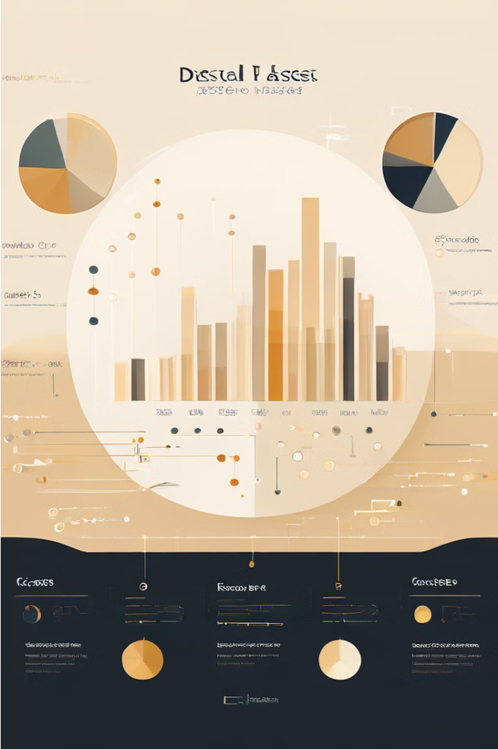
Overview of the Dataset
The dataset we will be exploring provides a comprehensive view of various customer and product attributes. It includes numeric data such as sales figures and customer demographics, as well as categorical variables describing customer profiles and product features.
The dataset covers a wide range of industries, offering an opportunity to uncover valuable insights through detailed Exploratory Data Analysis (EDA).

Slide 7

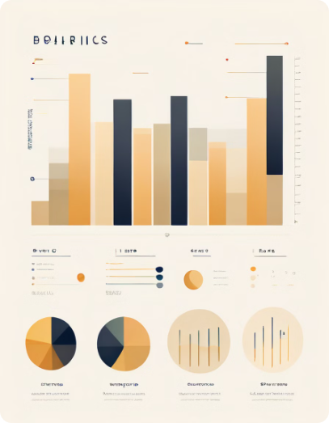
Data Types: Numeric, Categorical, Textual
1
Numeric Data
2
Categorical Data
Quantitative measurements or counts, such as age, income, or sales figures. These can be used for statistical analysis and modeling.
Data that can be divided into distinct groups or categories, like gender, product type, or region. Categorical data is often used for grouping and classification.
3
Textual Data
Unstructured data in the form of text, such as customer reviews, social media posts, or product descriptions. Textual data requires specialized techniques for analysis and feature extraction.

Slide 8
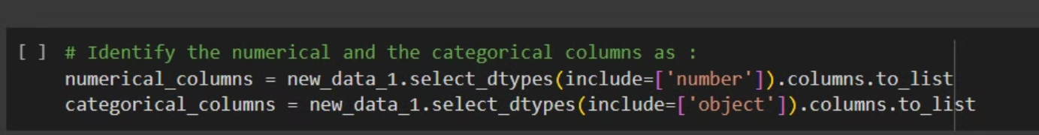
Summary Statistics
Analyzing the summary statistics of the dataset is a crucial step in understanding its key characteristics. This includes examining measures of central tendency (mean, median, mode) as well as measures of dispersion (standard deviation, range, quartiles) for the numeric variables. Additionally, reviewing the unique value counts and value distributions for categorical variables can provide valuable insights.

Slide 9
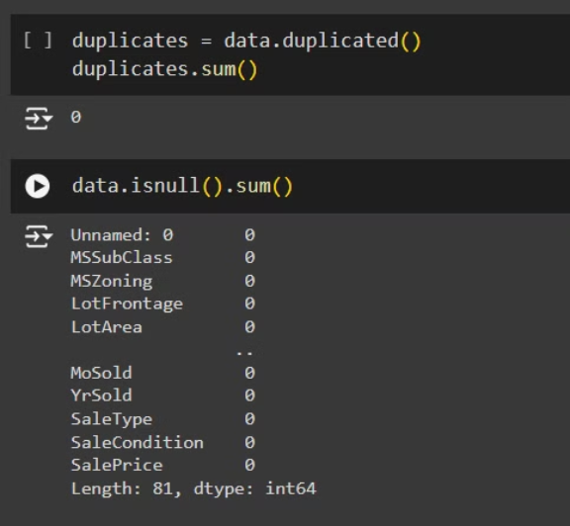
Handling Missing Values
1
Identify
Detect missing values in the dataset
2
Analyze
Understand patterns and potential causes
3
Impute
Use appropriate techniques to fill in gaps
Dealing with missing data is a crucial step in the EDA process. We first identify the missing values, analyze their patterns and potential causes. Then, we employ appropriate imputation techniques to fill in the gaps, ensuring the dataset is complete and ready for further analysis.

Slide 10
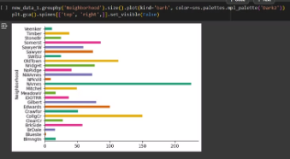
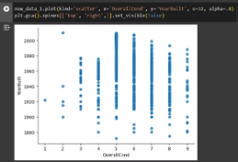
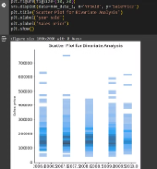
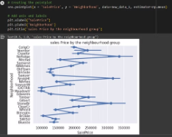
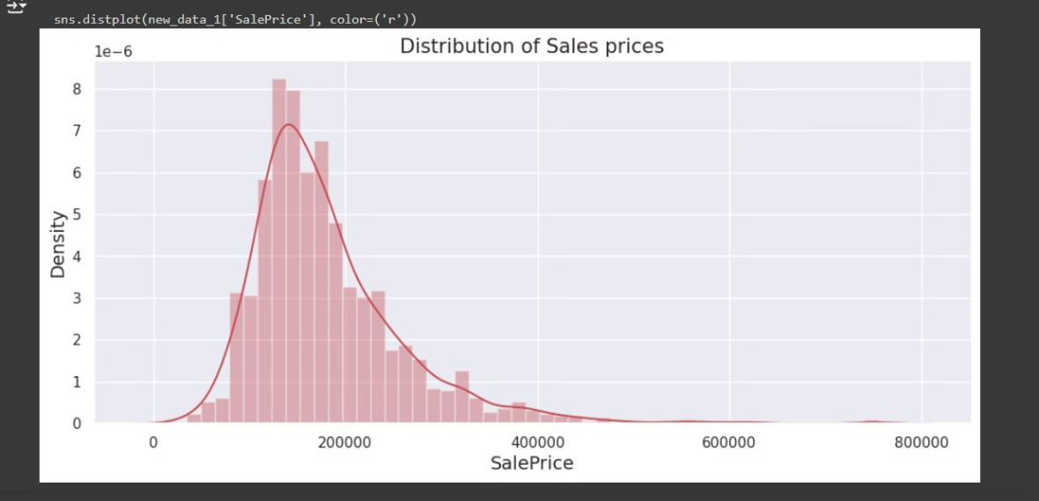
Graphical Representation

Slide 11
Thank_You

