Slide 1
Tender Management System
Name : Suraj Bhagwan Shinde
Division : B
Roll No : 244

Slide 2
Introduction
A tender management system (TMS) is a web-based software solution designed to automate the entire tender management process, from the creation of tender to accepting bids from vendors. By centralizing data and streamlining workflows, it enhances transparency, efficiency, and accountability. A tender management system enhances the tendering process by simplifying tasks, improving communication and efficiency, saving time and resources. Key features include user management, tender management, bid submission, and notice management, all accessible through a basic user interface

Slide 3
Scope of the System
Tender Management: Ability for administrators to create, publish, and manage tender opportunities.
User Authentication: Secure login for administrators and vendors to access the system.
Bid Submission: Functionality to the vendors to submit bids for available tenders.
Notice Management: Functionality to the administrators to create and publish notice for system users.
Feedback Submission: Allowing users to provides feedback on their tender experience.
User Experience: User-friendly interface with navigation and responsive design for seamless user experience.

Slide 4
Operating Environment
Operating System: Windows 7 +
Processor: Intel core i3 or Ryzen 3
Ram: 4GB
Hard-disk: 10Gb
IDE: Eclipse

Slide 5
Technology Used
Frontend: JSP(Java Server Pages), HTML, CSS.
Backend: Java and Servlet.
Database: MySQL.
Server: Apache tomcat.

Slide 6
Module Specification
Vendor Module
Admin Module
Tender Module
Bids Module
Notice Module
Feedback Module

Slide 7
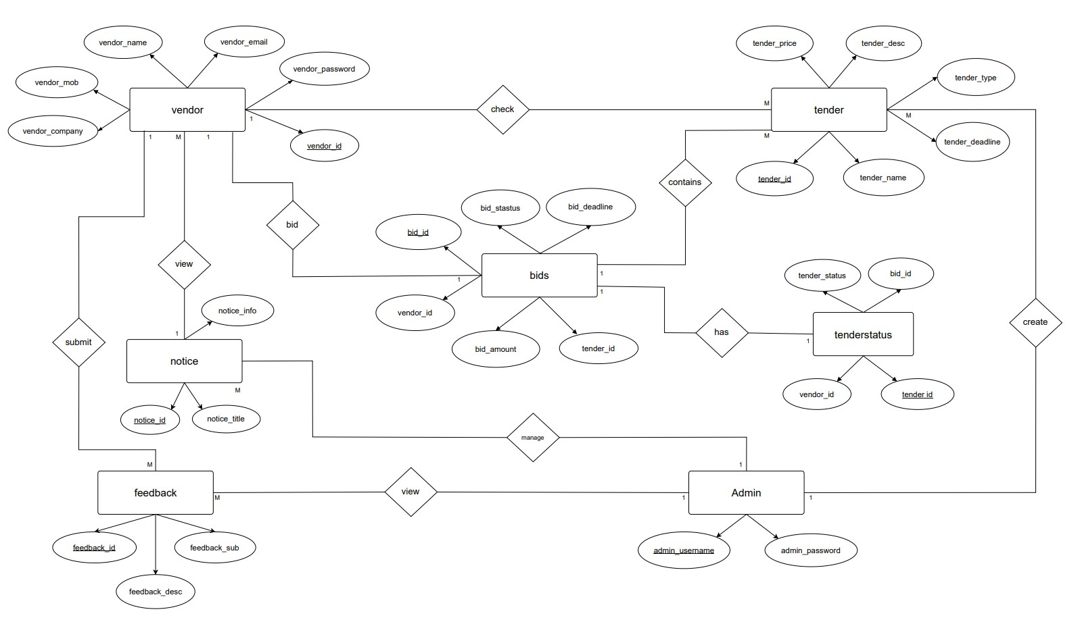

Slide 8
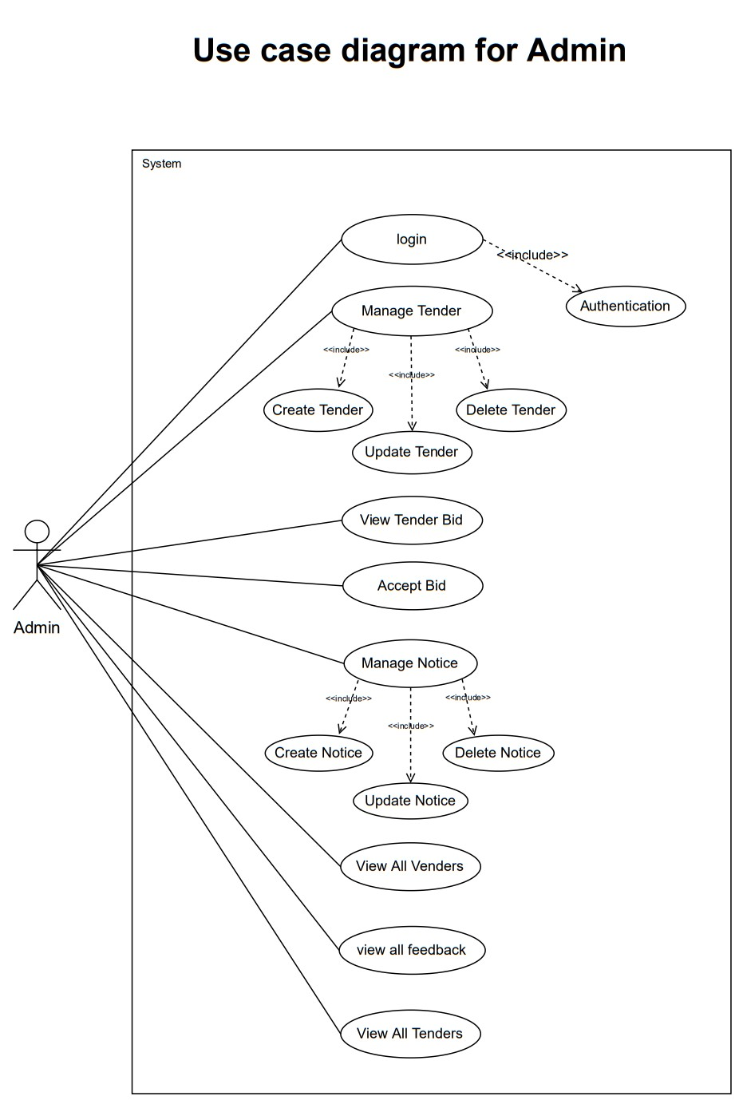

Slide 9
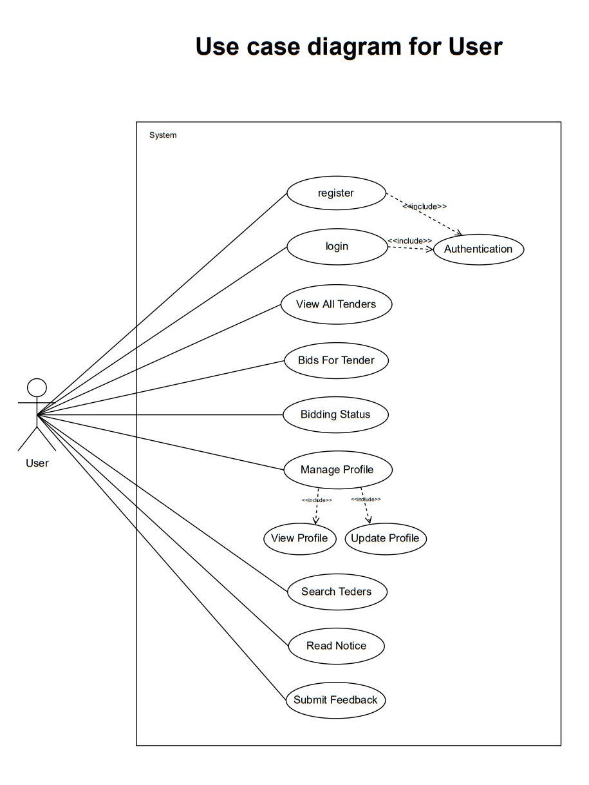

Slide 10
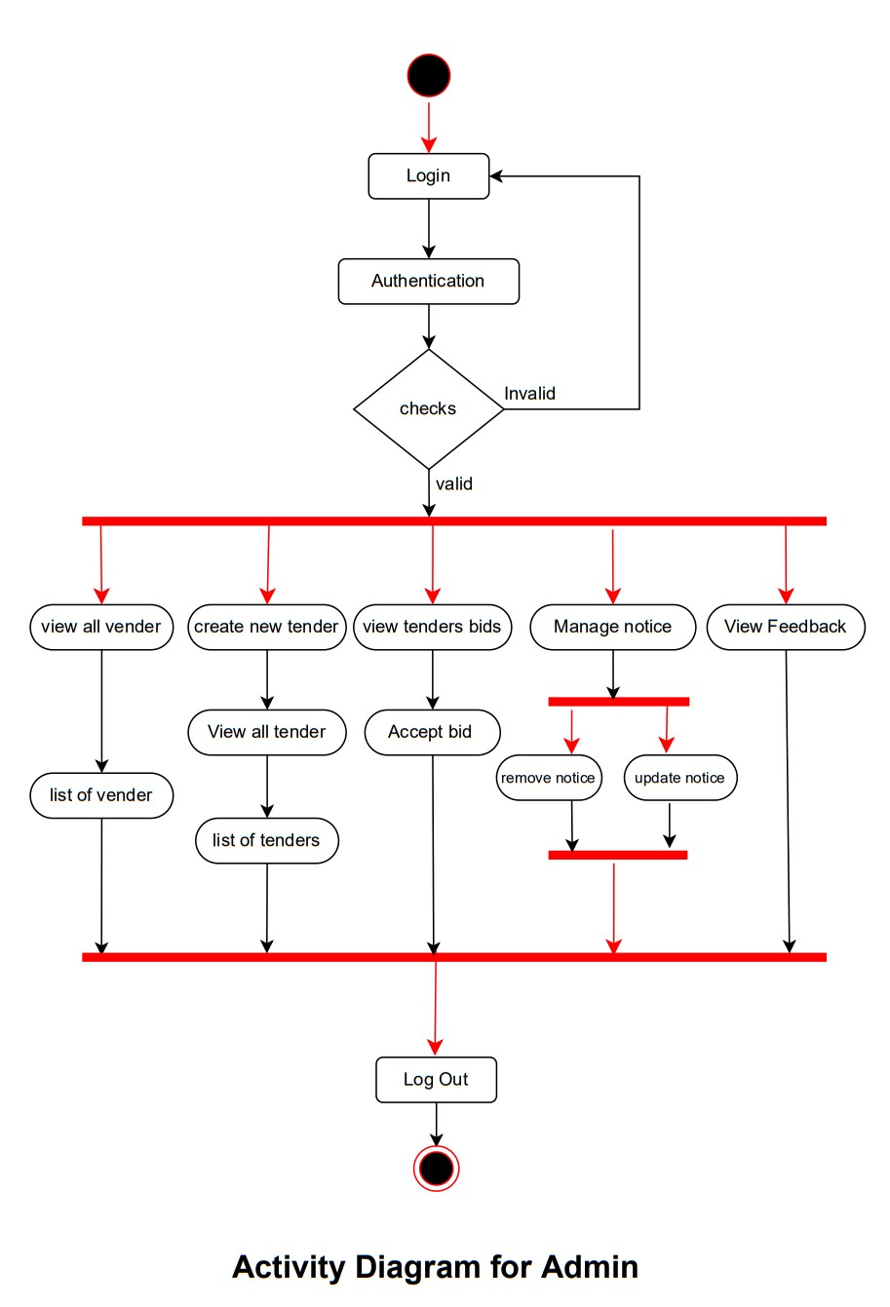

Slide 11
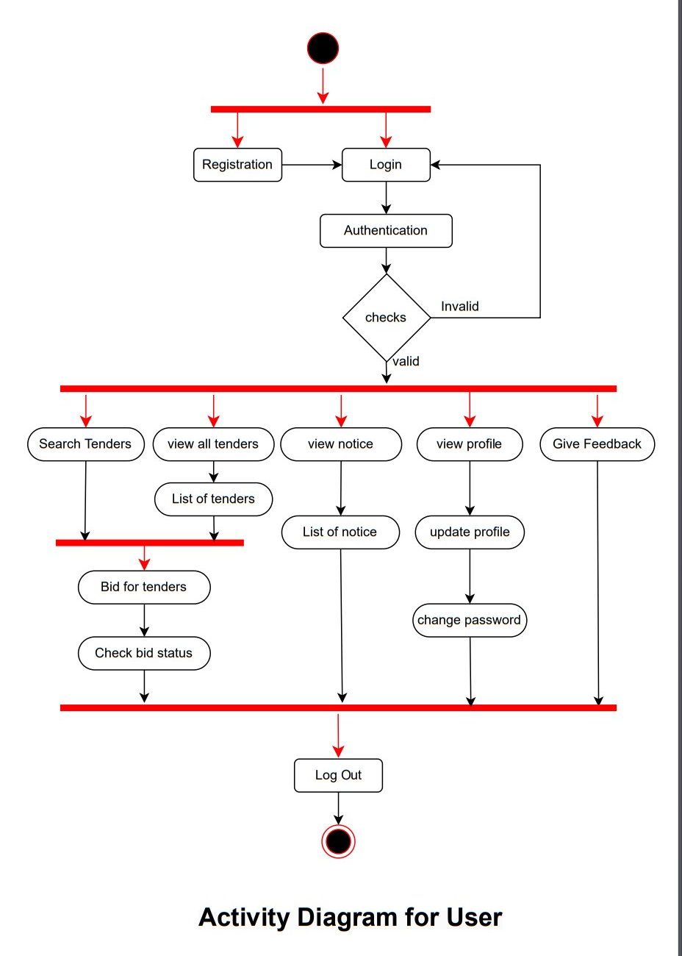

Slide 12
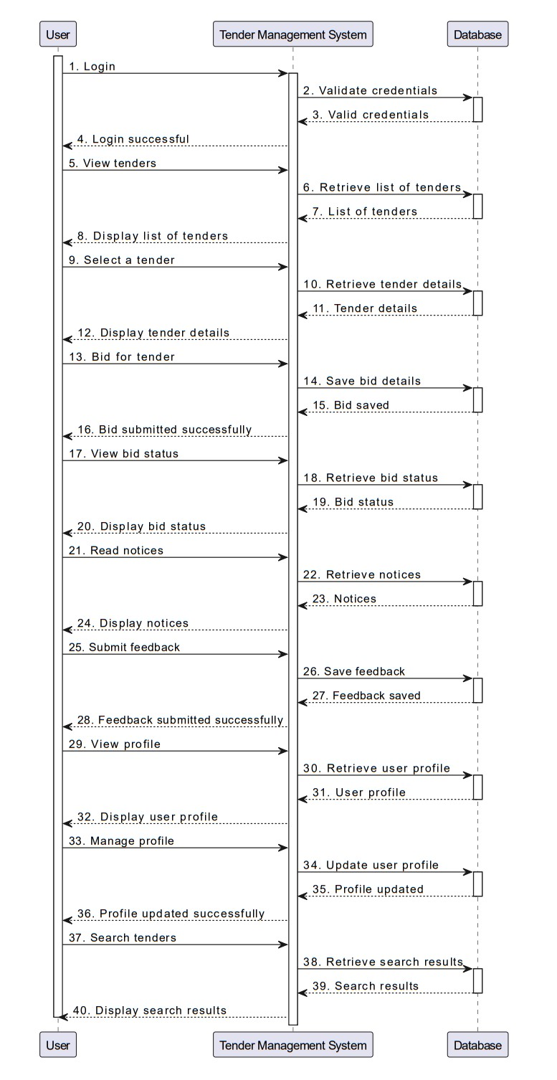

Slide 13
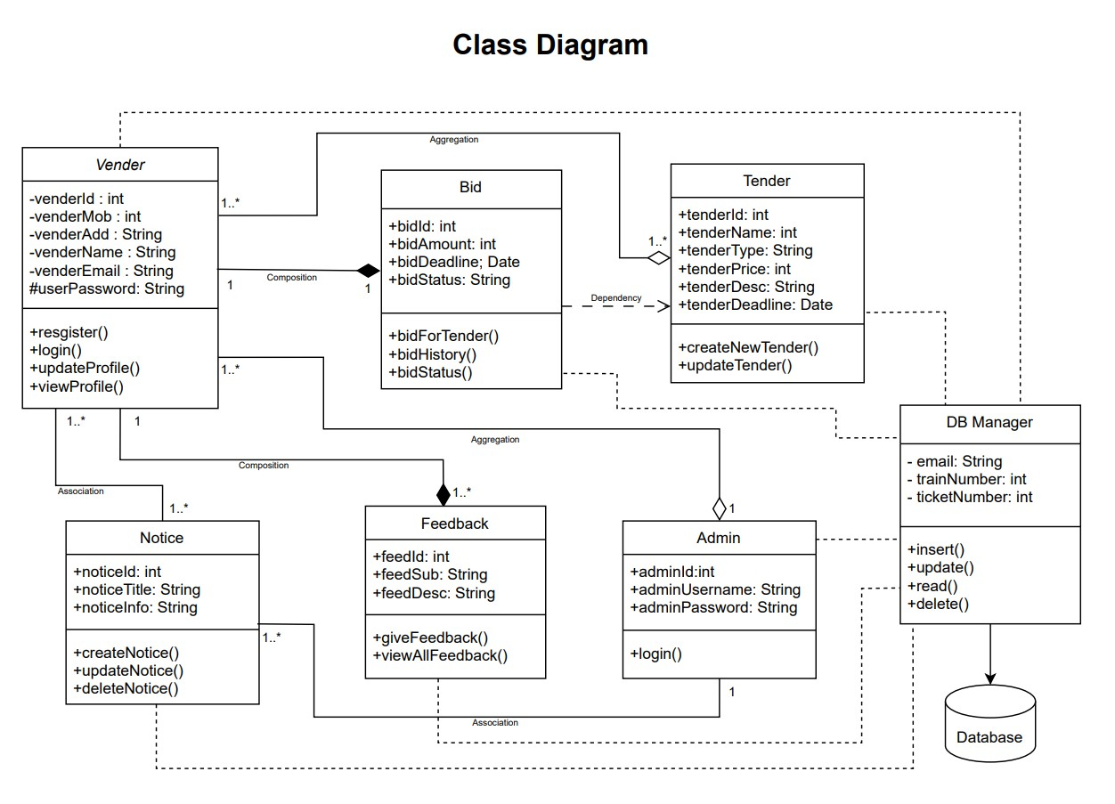

Slide 14
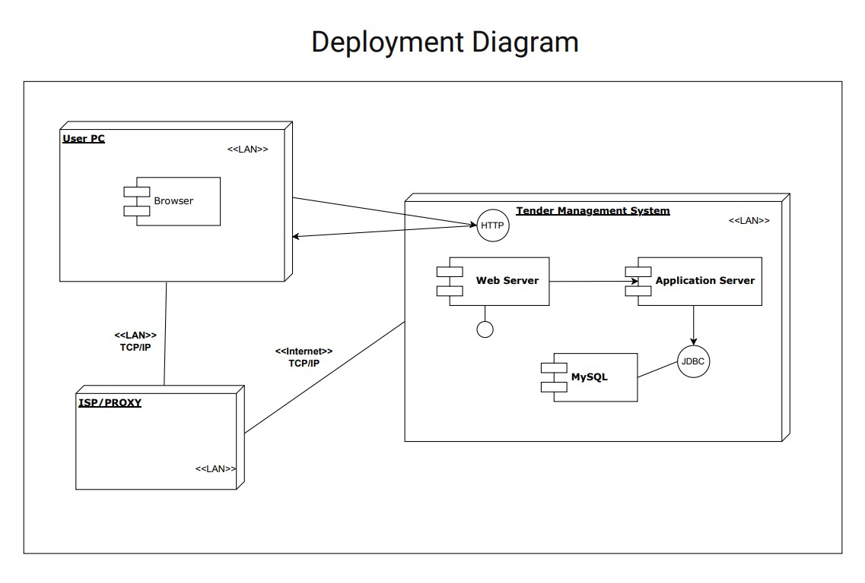

Slide 15
Table Name: Vendor
Sr. No | Field | Data Type | Size | Constraint | Description
1. | vendor_id | int | 11 | PRIMARY KEY | Vendor Id
2. | vendor_name | varchar | 20 | NOT NULL | Vendor name
3. | vendor_email | varchar | 20 | NOT NULL | Vendor email
4. | vendor_password | varchar | 20 | NOT NULL | Vendor password
5. | vendor_mob | int | 10 | NOT NULL | Vendor mobile number
6. | vendor_address | varchar | 50 |  | Vendor address
7. | vendor_company | varchar | 20 | NOT NULL | Vendor company name

Slide 16
Table Name: tender
Sr. No | Field | Data Type | Size | Constraint | Description
1. | tender_id | int | 11 | PRIMARY KEY | Tender Id
2. | tender_name | varchar | 20 | NOT NULL | Tender name
3. | tender_type | varchar | 20 | NOT NULL | Tender Type
4. | tender_desc | varchar | 30 | NOT NULL | Tender description
5. | tender_price | int | 10 | NOT NULL | Tender price
6. | tender_loc | varchar | 20 |  | Tender lock
7. | tender_deadline | varchar | 10 | NOT NULL | Tender deadline date

Slide 17
Table Name: bid
Sr. No | Field | Data Type | Size | Constraint | Description
1. | bid_id | int | 10 | PRIMARY KEY | Bid id
2. | bid_status | varchar | 20 | NOT NULL | Bid status
3. | bid_deadline | varchar | 20 | NOT NULL | Bid status
4. | tender_id | int | 10 | FOREIGN KEY | Tender id
5. | bid_amount | int | 10 | NOT NULL | Bid amount
6. | vendor_id | int | 10 | FOREIGN KEY | Vendor id

Slide 18
Table Name: notice
Sr. No | Field | Data Type | Size | Constraint | Description
1. | notice_id | int | 10 | PRIMARY KEY | Notice id
2. | notice_title | varchar | 20 | NOT NULL | Notice title
3. | notice_sub | varchar | 50 | NOT NULL | Notice Subject

Slide 19
Table Name: tenderstatus
Sr. No | Field | Data Type | Size | Constraint | Description
1. | tender_id | int | 10 | PRIMARY KEY | Tender id
2. | vendor_id | int | 10 | FOREIGN KEY | Vendor id
3. | bidder_id | Int | 10 | FOREIGN KEY | Bidder id
4. | tender_status | varchar | 20 | NOT NULL | Tender status

Slide 20
Table Name: feedback
Sr. No | Field | Data Type | Size | Constraint | Description
1. | feedback_id | int | 10 | PRIMARY KEY | Feedback id
2. | feedback_title | varchar | 20 | NOT NULL | Feedback title
3. | feedback_desc | varchar | 50 | NOT NULL | Feedback Description
4. | vendor_id | int | 10 | FOREIGN KEY | Vendor Id
5. | vendor_email | varchar | 20 | NOT NULL | Vendor Email

Slide 21
Thank You

