Slide 1
Airline Reservation System
Name : Shinde Suraj Bhagwan
Div : B
Roll No : 244
Seat No :

Slide 2
UML Diagrams
1. Entity-Relationship Diagram
2. Use case Diagram
3. Activity Diagram for Admin
4. Activity Diagram for User
5. Sequence Diagram
6. Class Diagram
7. Component Diagram
8. Deployment Diagram

Slide 3
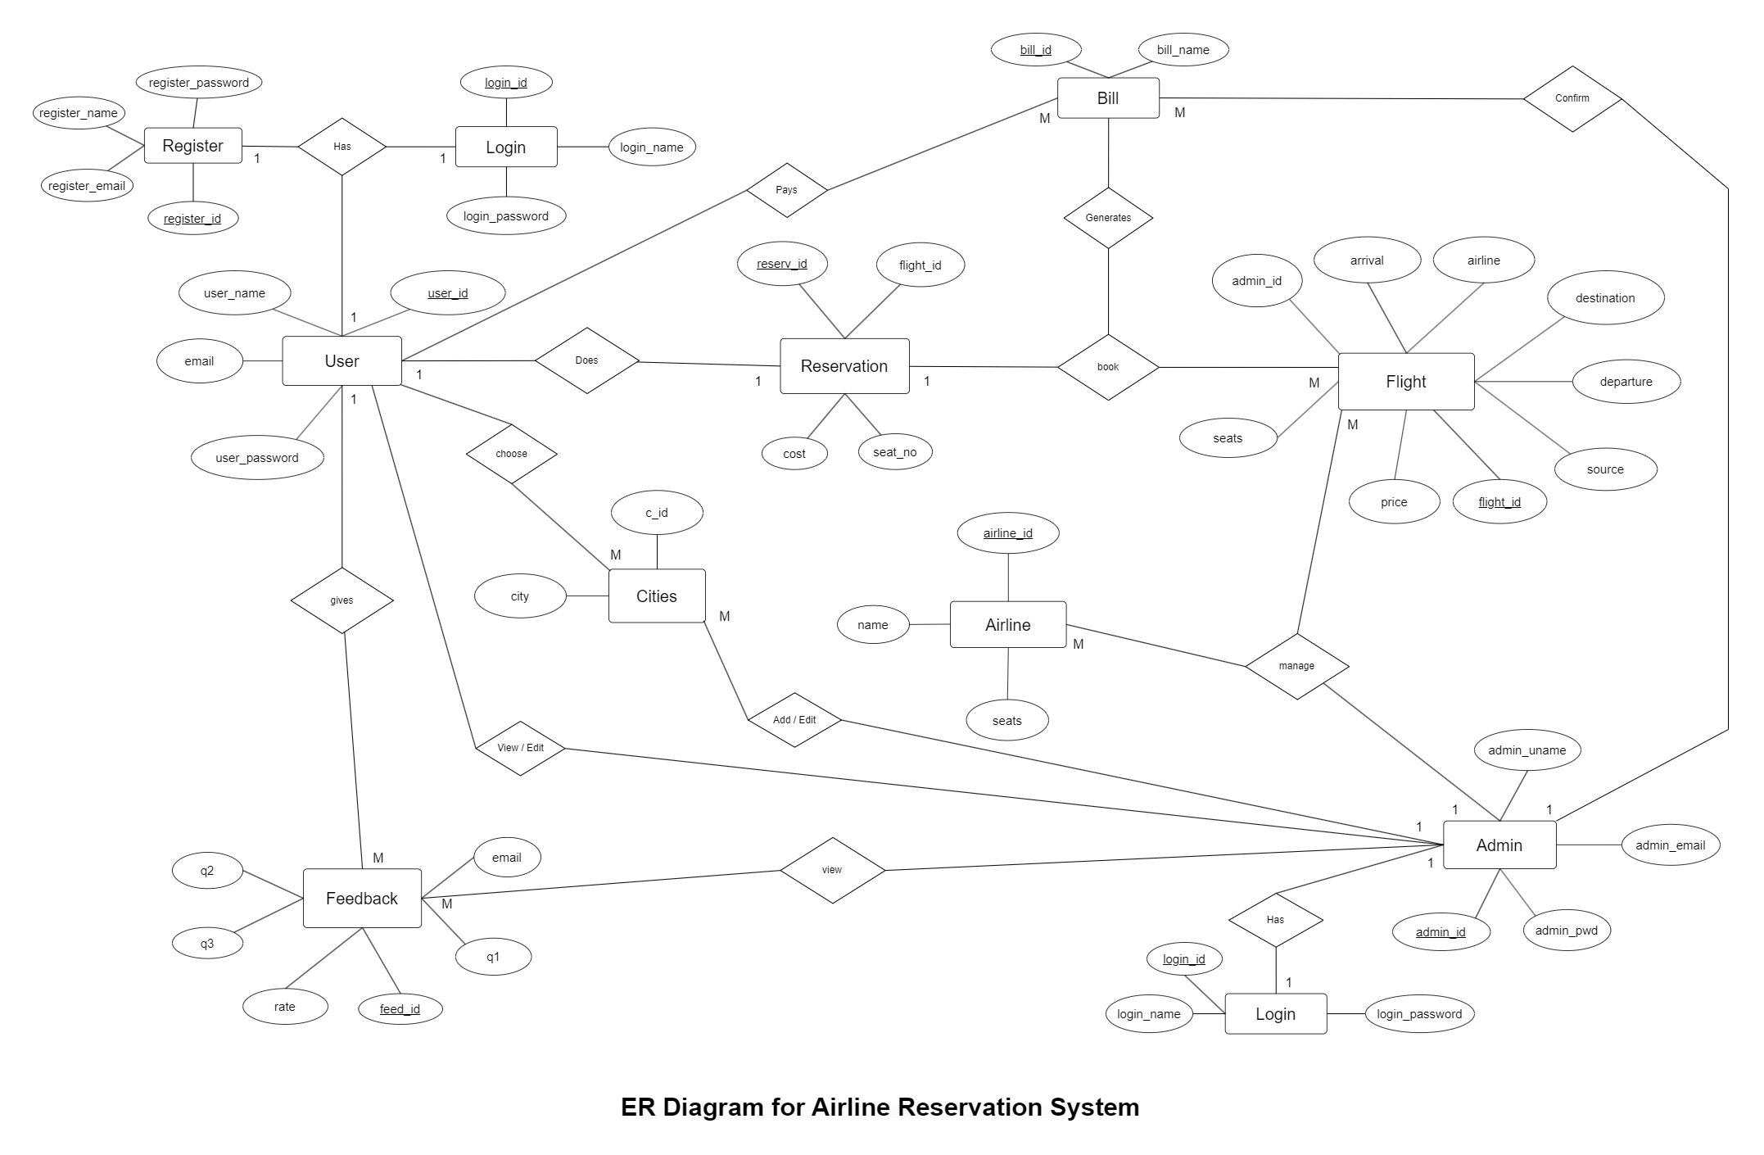

Slide 4
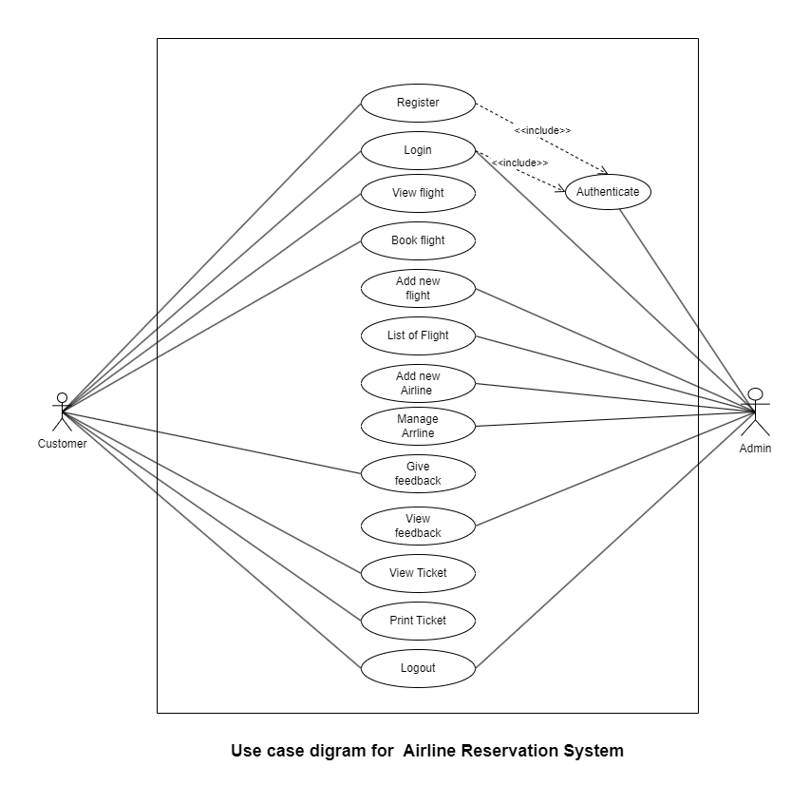

Slide 5
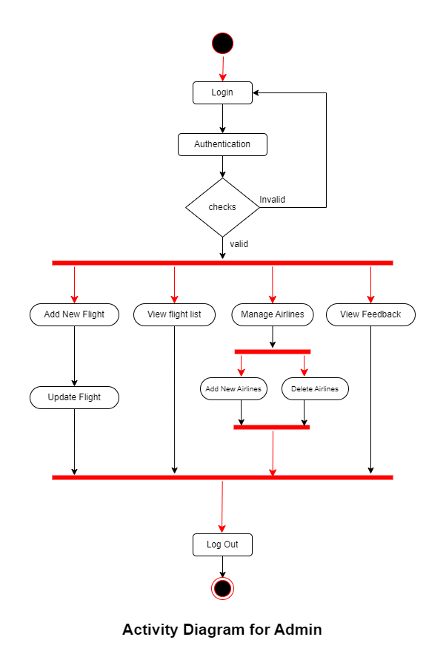

Slide 6
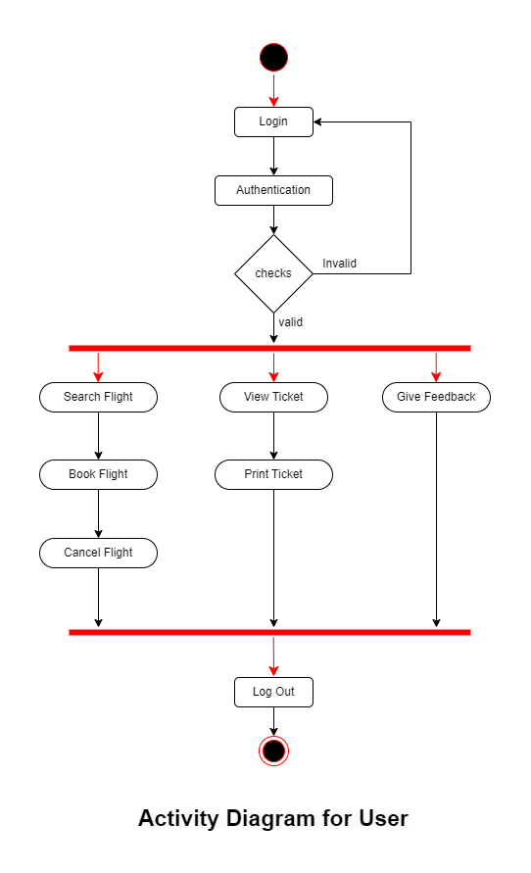

Slide 7
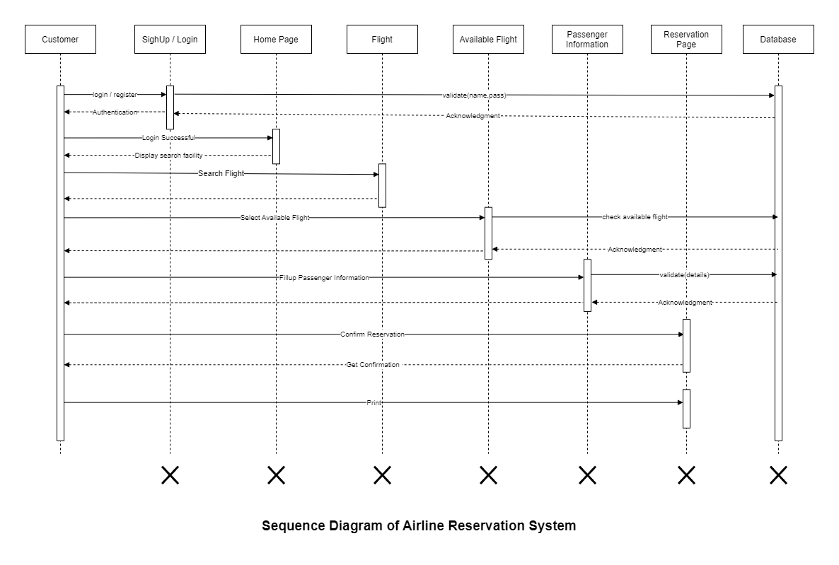

Slide 8
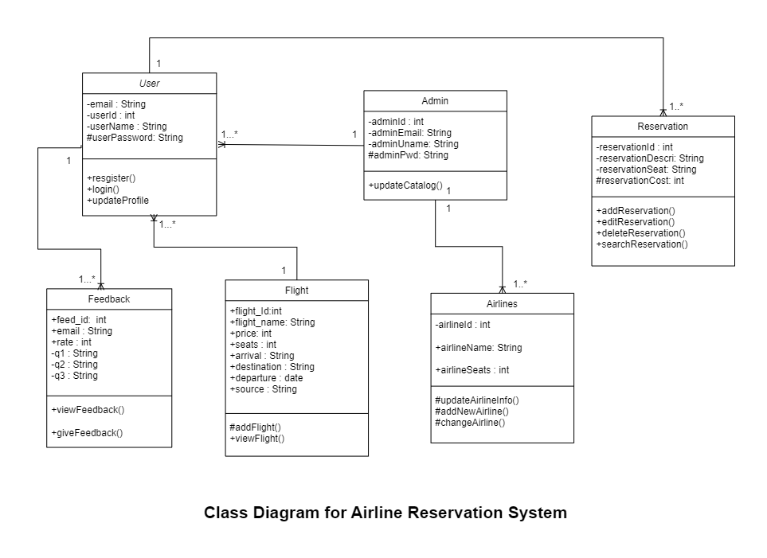

Slide 9
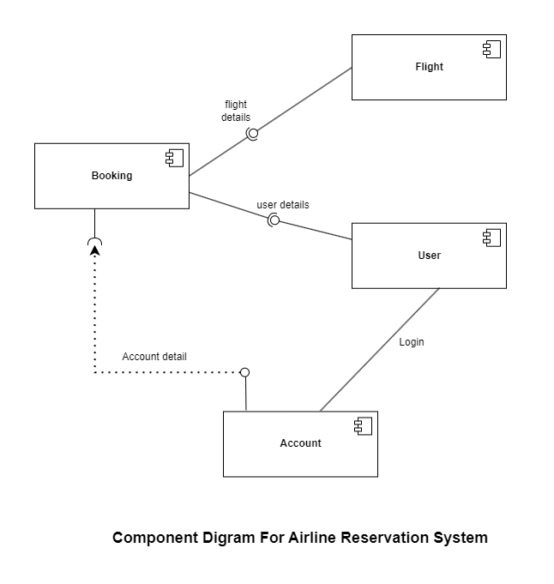

Slide 10
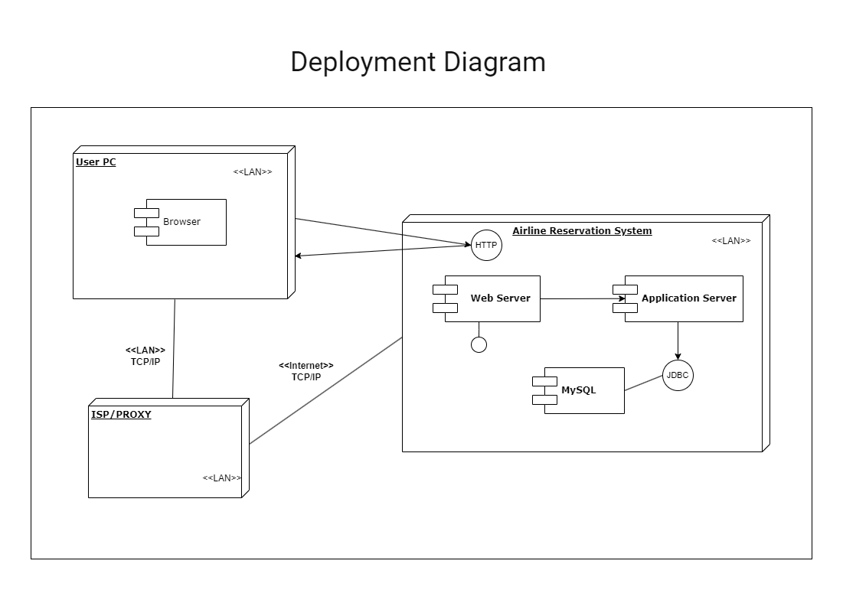

Slide 11
Normalized Database Table
Table Name: Admin
This table is used to store details about the admin
Sr. No | Field | Data Type | Size | Constraint | Description
1. | admin_id | Int | 11 | PRIMARY KEY | Admin Id
2. | admin_uname | varchar | 20 | UNIQUE KEY | Admin Name
3. | admin_email | varchar | 50 | UNIQUE KEY | Admin Email
4. | admin_pwd | varchar | 100 | NOT NULL | Admin password

Slide 12
2.Table Name: Airline
This table is used to store details about the Airline (company) names
SR. No | Field | Data Type | Size | Constraint | Description
1. | airline_id | int | 11 | PRIMARY KEY | Airline Id
2. | name | Varchar | 20 | UNIQUE KEY | Airline Name
3. | seats | int | 11 | NOT NULL | Airline Seats
3. Table Name: users
This table is used to store details about the Users
SR. No | Field | Data Type | Size | Constraint | Description
1. | user_id | int | 11 | PRIMARY KEY | User Id
2. | user_name | varchar | 20 | UNIQUE KEY | User Name
3. | email | varchar | 50 | UNIQUE KEY | User Email
4. | password | varchar | 100 | NOT NULL | User Password

Slide 13
4. Table Name: feedback
This table is used to store details about the Feedback from the users.
SR. No | Field | Data Type | Size | Constraint | Description
1. | feed_id | int | 11 | PRIMARY KEY | Feedback Id
2. | email | varchar | 50 | UNIQUE KEY | User Email
3. | q1 | varchar | 250 | NOT NULL | Question 1
4. | q2 | varchar | 20 | NOT NULL | Question 2
5. | q3 | varchar | 250 | NOT NULL | Question 3
6. | rate | int | 11 | NOT NULL | Ratings
5. Table Name: cities
This table is used to store details about the city names
SR. No | Field | Data Type | Size | Constraint | Description
1. | c_id | int | 11 | PRIMARY KEY | City Id
2. | city | varchar | 20 | UNIQUE KEY | City Name

Slide 14
6. Table Name: Flight
This table is used to store details about the Flight
SR. No | Field | Data Type | Size | Constraint | Description
1. | flight_id | int | 11 | PRIMARY KEY | Flight Id
2. | admin_id | int | 11 | FOREIGN KEY | Admin Id
3. | arrival | datetime |  | NOT NULL | Arrival Time
4. | departure | datetime |  | NOT NULL | Departure Time
5. | destination | varchar | 20 | NOT NULL | Destination Name
6. | source | varchar | 20 | NOT NULL | Source Name
7. | airline | varchar | 20 | NOT NULL | Airline Name
8. | seats | varchar | 110 | NOT NULL | Seat No
9. | price | int | 11 | NOT NULL | Ticket Price

Slide 15
7.Table Name: Reservation
This table is used to store details about the Reservation
SR. No | Field | Data Type | Size | Constraint | Description
1. | reser_id | int | 11 | PRIMARY KEY | Reservation Id
2. | user_id | int | 11 | FOREIGN KEY | User Id
3. | flight_id | int | 11 | FOREIGN KEY | Flight Id
4. | seat_no | varchar | 10 | NOT NULL | Seat No
5. | cost | int | 11 | NOT NULL | Cost of Flight

Slide 16
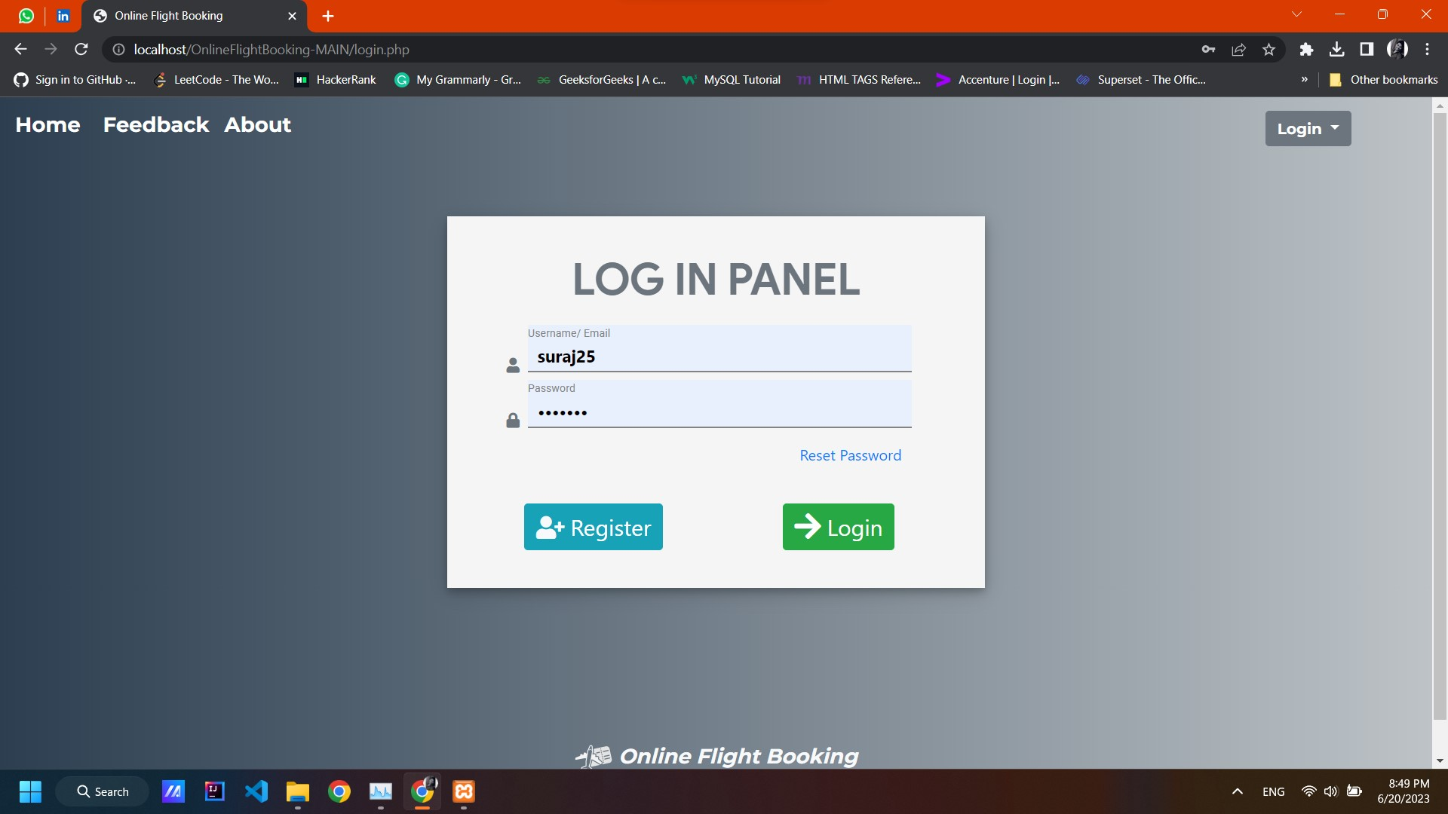
Inputs Screens
User Login Page :

Slide 17
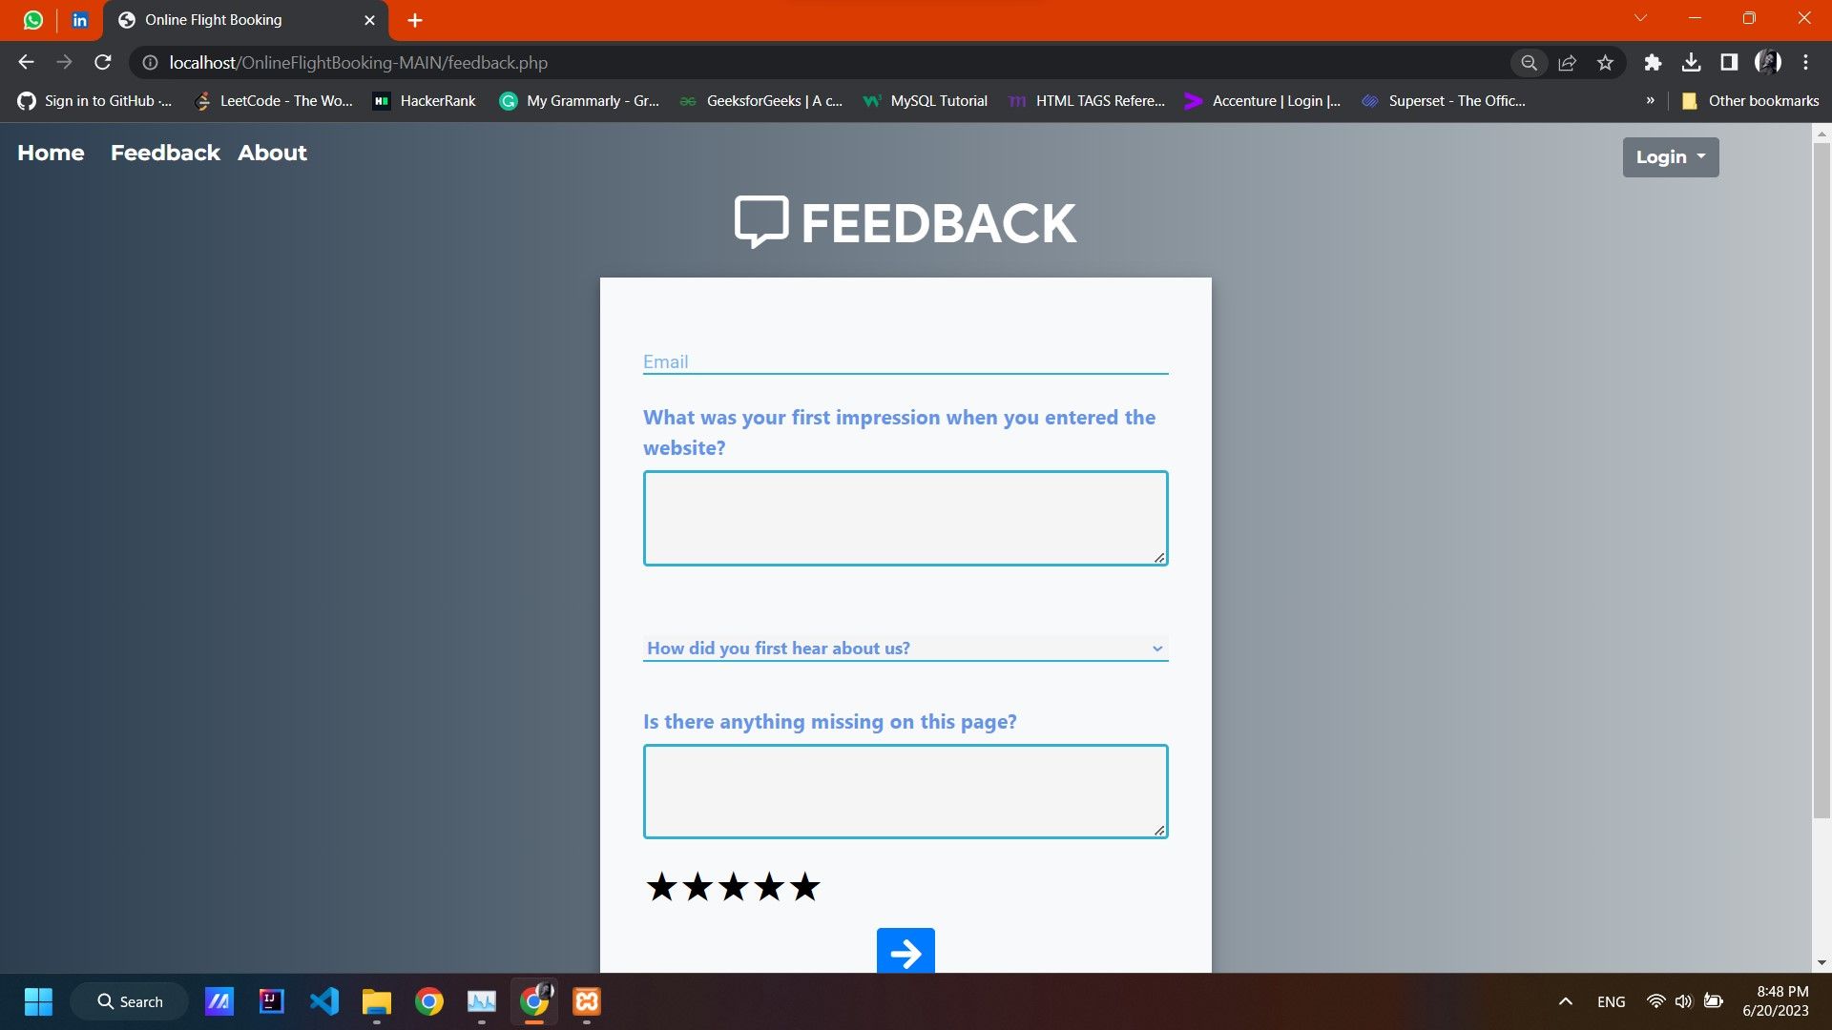
User Feedback Page :

Slide 18
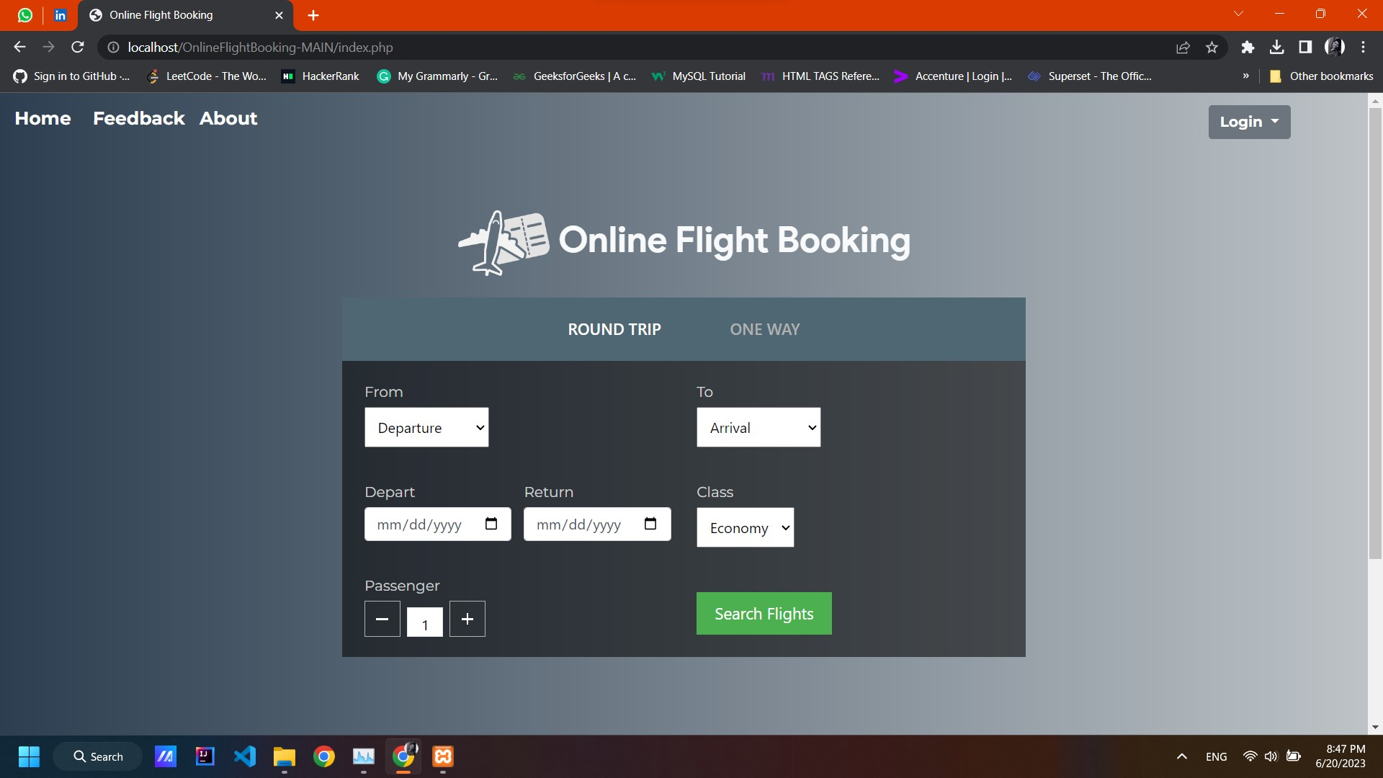
User Home Page :

Slide 19
User Feedback Page :

Slide 20
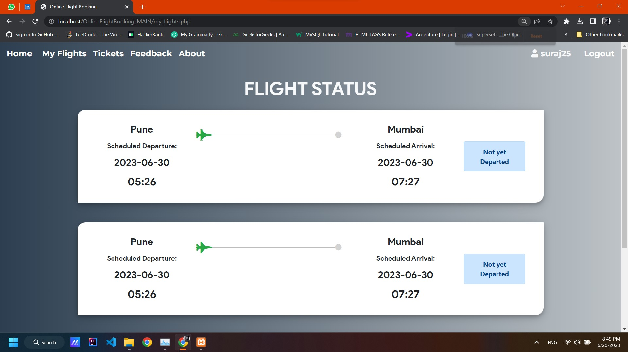
User Flight Status Page :

Slide 21
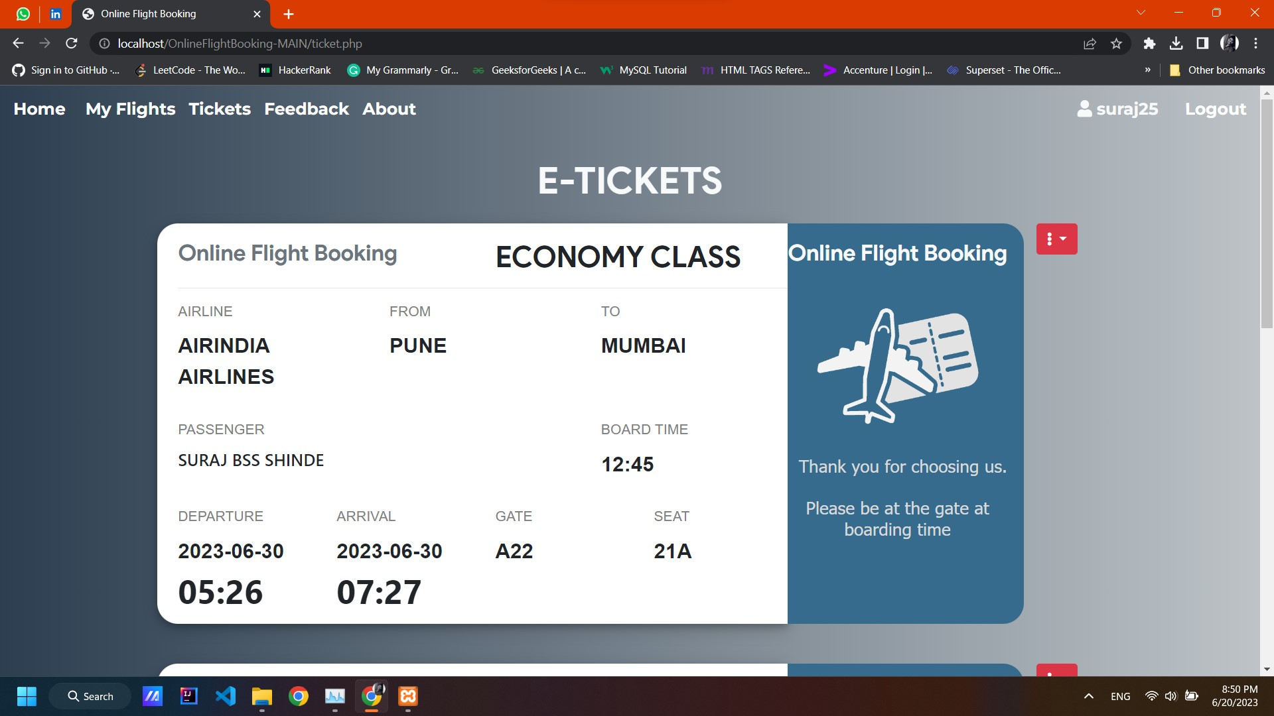
User Ticket Page :

Slide 22
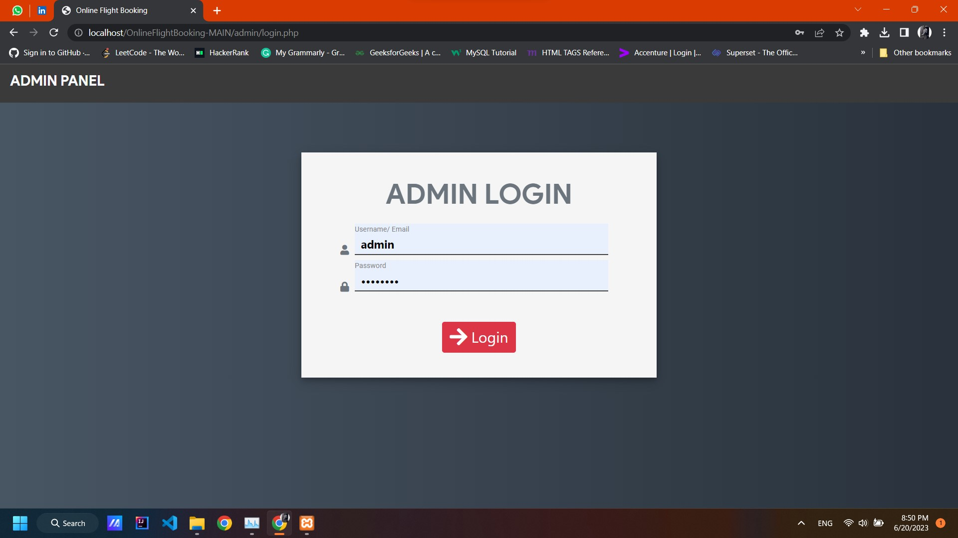
Admin Login Page :

Slide 23
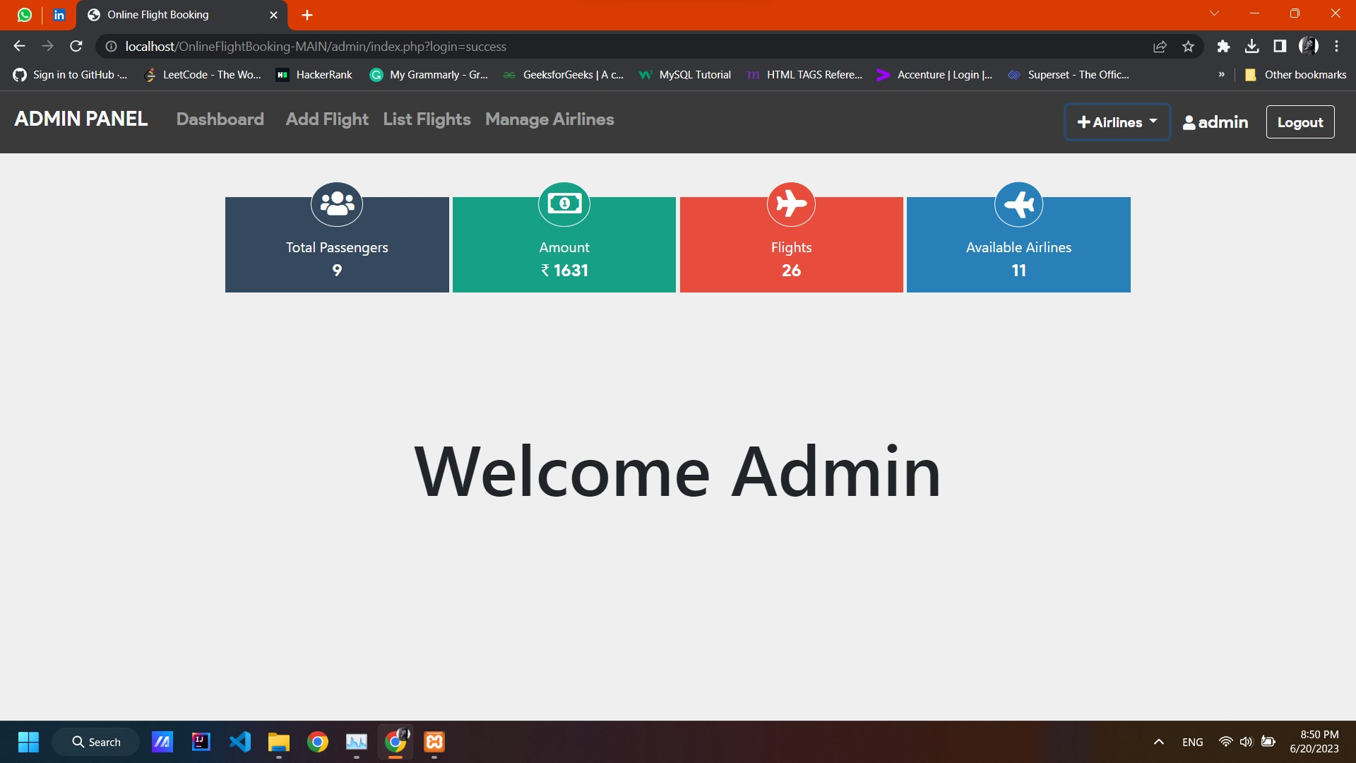
Admin Home Page :

Slide 24
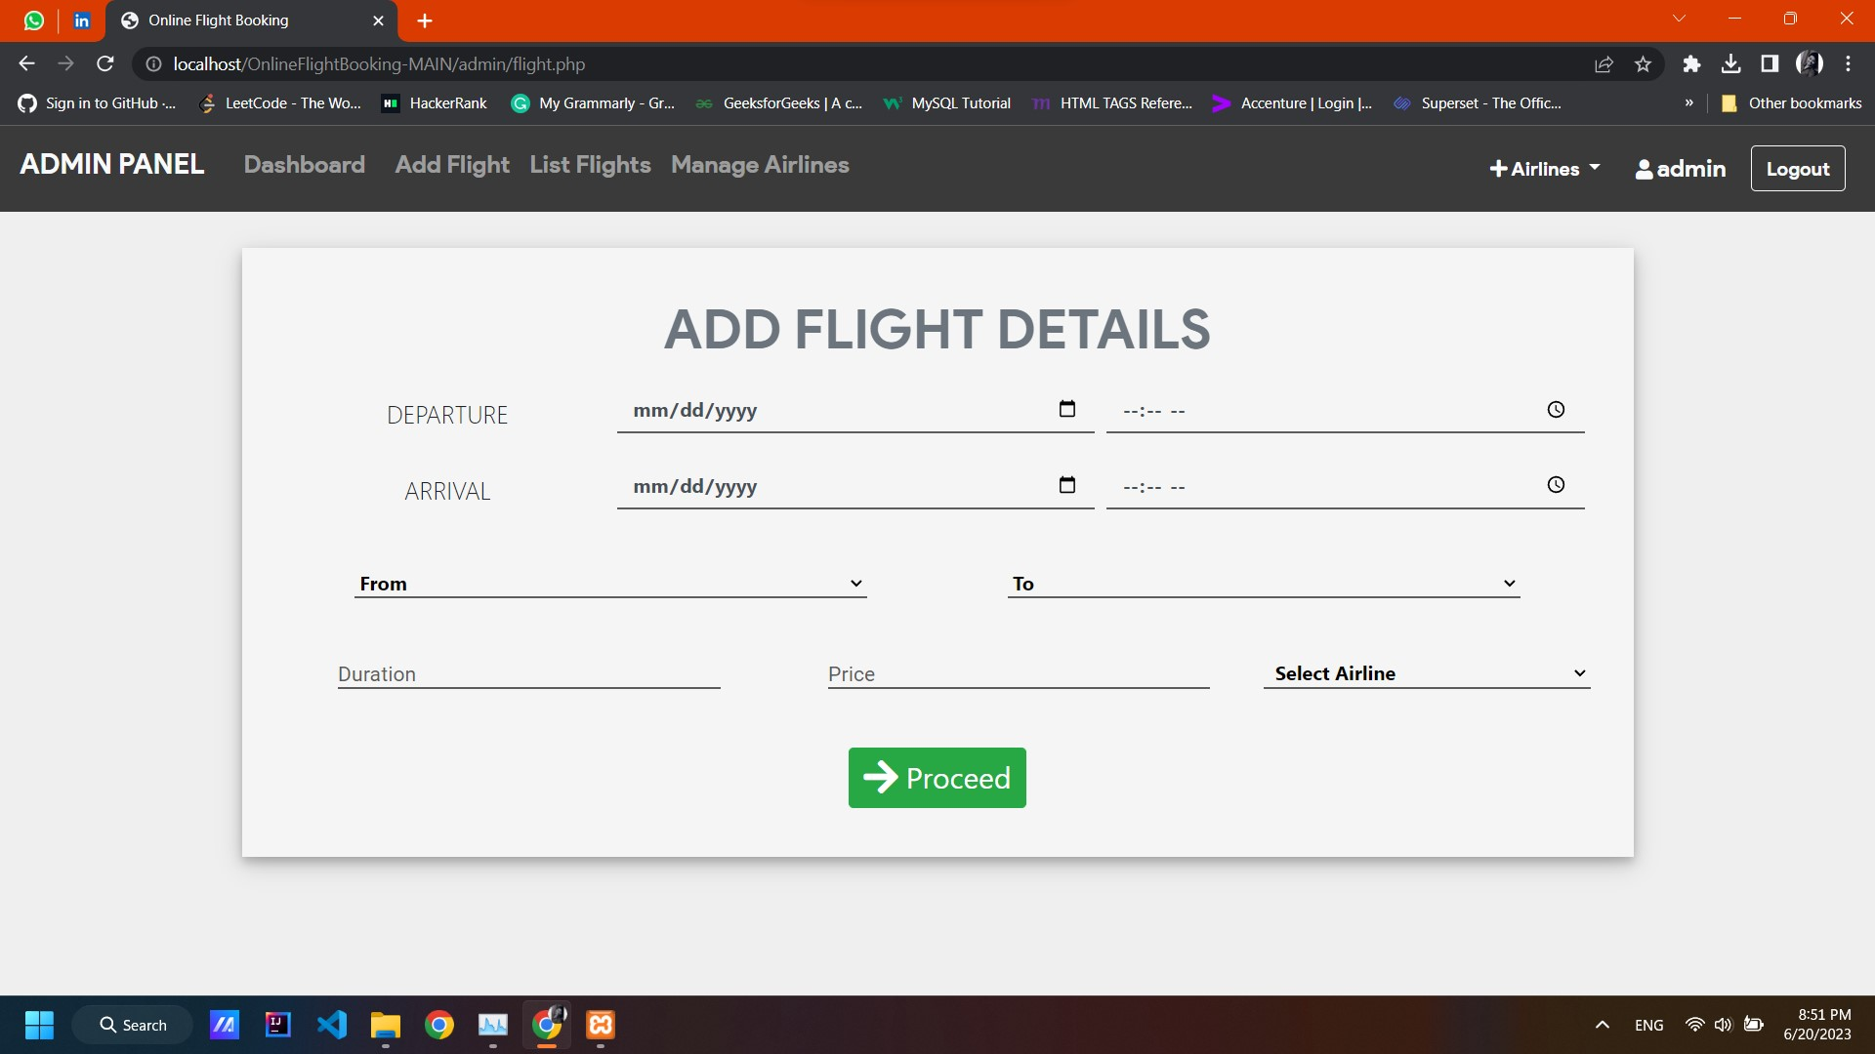
Admin Add Flight Page :

