Slide 1
Physics for Computing Science
Samrudhi Kulkarni
Class: FY CSBS
Div: C
Roll No.: C-22

Slide 2
Schrodinger Time Dependent Equation.
The form of the Schrödinger equation depends on the physical situation.
The most general form is the time-dependent Schrödinger equation, which gives a description of a system evolving with time.

Slide 3
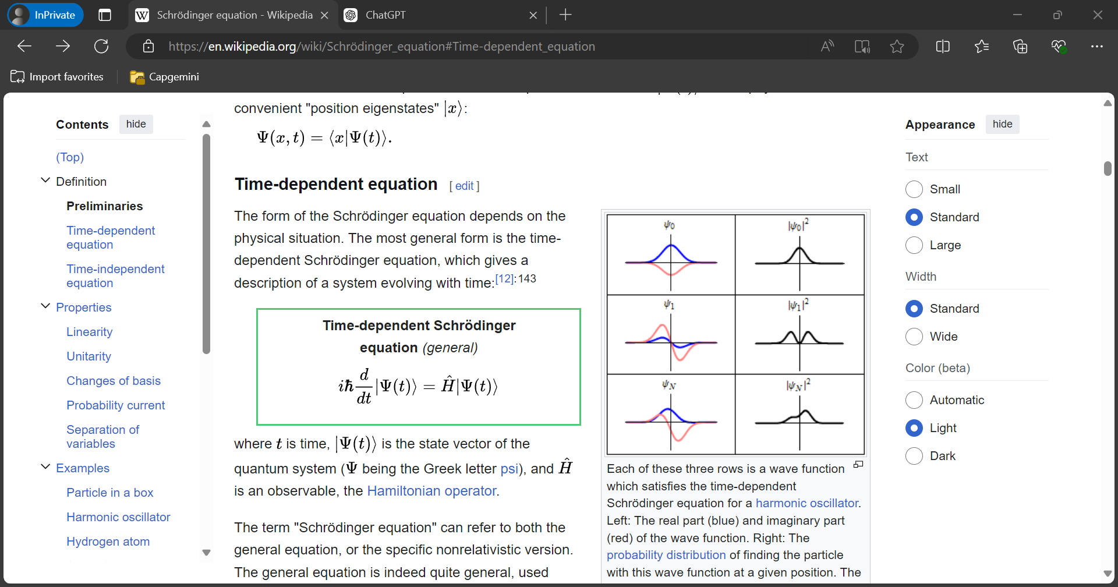
Time-dependent Schrodinger equation (general).

Slide 4
Elements of the Formula.
Imaginary unit i square root of negative one , used to define complex numbers.
Reduced Planck constant ђ physical constant, Dirac’s constant: the Planck constant divided by 2π; mathematical symbol h-bar <h> (U+210F)
Duration t physical quantity for describing the temporal distance between events
Quantum state vector |ψ(t)⟩ nonzero elements of a Hilbert space describing the state of a quantum system
Hamiltonian operator Ĥ quantum operator for the energy

Slide 5
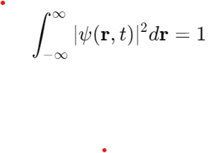
1. Normalizability (Total Probability = 1)
One of the most important properties of a wave function is that it must be normalizable. This means that the total probability of finding the particle anywhere in space should be 1. Mathematically, this condition is expressed as:
This ensures that the probability of finding the particle in the entire space sums to unity.
Explanation: The time-dependent Schrödinger equation itself does not directly impose normalizability, but we can interpret the wave function as a probability amplitude, where ∣ψ(r,t)∣2|\psi(\mathbf{r}, t)|^2∣ψ(r,t)∣2 represents the probability density of finding the particle at position r\mathbf{r}r at time ttt. For physical realism, the total probability must be conserved and normalized. After solving the Schrödinger equation, we can adjust the constant of the wave function (if needed) to satisfy the normalization condition.

Slide 6
2. Reality of Physical Observables
Although the solution to the Schrödinger equation is typically complex-valued, the measurable quantities (like position, momentum, energy, etc.) derived from the wave function must be real numbers.
For example:
The probability density ∣ψ(r,t)∣² is always real and non-negative because it is the absolute square of a complex number.
Explanation:
Even though the wave function ψ(r,t)\psi(\mathbf{r}, t)ψ(r,t) itself may be complex, physical quantities like energy, momentum, and position, derived from the wave function, must be real. This is ensured because the wave function enters into expectation values and observables in a way that leads to real results, often through the use of the complex conjugate ψ∗(which makes the product ψ∗(r,t)ψ(r,t) real and non-negative).
3. Time Evolution of the Wave Function
The time dependence of the wave function is governed by the Schrödinger equation. For a time-independent potential, the solution to the Schrödinger equation can be separated into a time-dependent part and a time-independent spatial part:
ψ(r,t)=ψ(r)
Explanation: The time-dependent factor e^{−iEt/ℏ} is a complex exponential, but the overall wave function’s physical quantities (like probability densities) do not directly depend on this oscillatory phase. The phase factor does not affect the probability density ∣ψ(r,t)∣², which remains real and positive, ensuring that the physical interpretation remains consistent with the probabilistic nature of quantum mechanics.

Slide 7
4. Complex Conjugate and Its Role
The complex conjugate of the wave function, ψ∗(r,t), plays a critical role in calculating probabilities and expectation values. The product ψ∗(r,t)ψ(r,t) gives a real, non-negative quantity, which corresponds to the probability density.
Explanation:
The complex conjugate is essential when performing operations like finding the expectation value of an observable. For example, the probability density, given by ∣ψ(r,t)∣², is always real and non-negative, ensuring that the probability of finding a particle is physically meaningful. Similarly, other physical quantities that depend on the wave function, such as momentum or energy, yield real numbers when calculated correctly, even if the wave function itself is complex.
5. Continuity and Smoothness
The wave function ψ(r,t) should be continuous and smooth, except possibly at points where there is an infinite potential or some singularity. This ensures that the probability density ∣ψ(r,t)∣² does not have any discontinuities, which would be physically problematic.
Explanation:
The Schrödinger equation itself requires the wave function to be sufficiently smooth so that derivatives (like the Laplacian in the Hamiltonian) make sense mathematically. The physical assumption is that a quantum particle behaves in a continuous, smooth manner. A discontinuous wave function would imply infinite momenta or energies, which are non-physical for most real-world systems.

Slide 8
6. Boundary Conditions and Symmetry
The wave function must satisfy boundary conditions that reflect the nature of the system. For example, in an infinite potential well, the wave function should go to zero at the boundaries (since the probability of finding the particle outside the well is zero). Additionally, symmetries like parity (even or odd functions) may apply to the wave function in certain systems
Explanation:
The boundary conditions help to define the physical limits of the system and are typically part of the initial setup when solving the Schrödinger equation. These conditions ensure that the wave function behaves appropriately at the edges of the system, providing a well-defined and physical solution.

Slide 9
Summary of how the solution is satisfying the properties of real wave function:
Normalizability: The wave function can be normalized to satisfy the condition that the total probability is 1.
Real Physical Observables: Though the wave function is generally complex, physical quantities derived from it, like energy or probability density, are real.
Time Evolution: The wave function evolves over time according to the Schrödinger equation, with the time-dependent part not affecting the probability density.
Complex Conjugate: The complex conjugate of the wave function ensures that physical quantities (e.g., probability densities, expectation values) remain real and well-defined.
Continuity and Smoothness: The wave function should be smooth and continuous, ensuring a realistic quantum system.
Thus, the solution to the time-dependent Schrödinger equation is physically meaningful and satisfies the necessary properties of real wave functions in quantum mechanics.

Slide 10
Thank You!

