Slide 1


M.Tech Program
Advanced Industry Integrated Programs
Jointly offered by University and LTIMindTree
Autonomous AI Employee Onboarding & HR Automation Agent
SURAJ KUMAR
T Series ID: T9986
VIT CHENNAI
Knowledge partner | Implementation partner

Slide 2
Autonomous AI Employee Onboarding & HR Automation Agent
Introduction….
HR ASSIST is an Agentic AI-based system that automates employee onboarding and repetitive HR operations.
It understands natural-language HR requests and executes tasks such as profile creation, meeting scheduling, IT tickets, asset requests, emails, and team notifications.
Using MCP-based architecture, it integrates multiple enterprise systems to reduce manual effort, improve accuracy, and speed up onboarding.

Slide 3
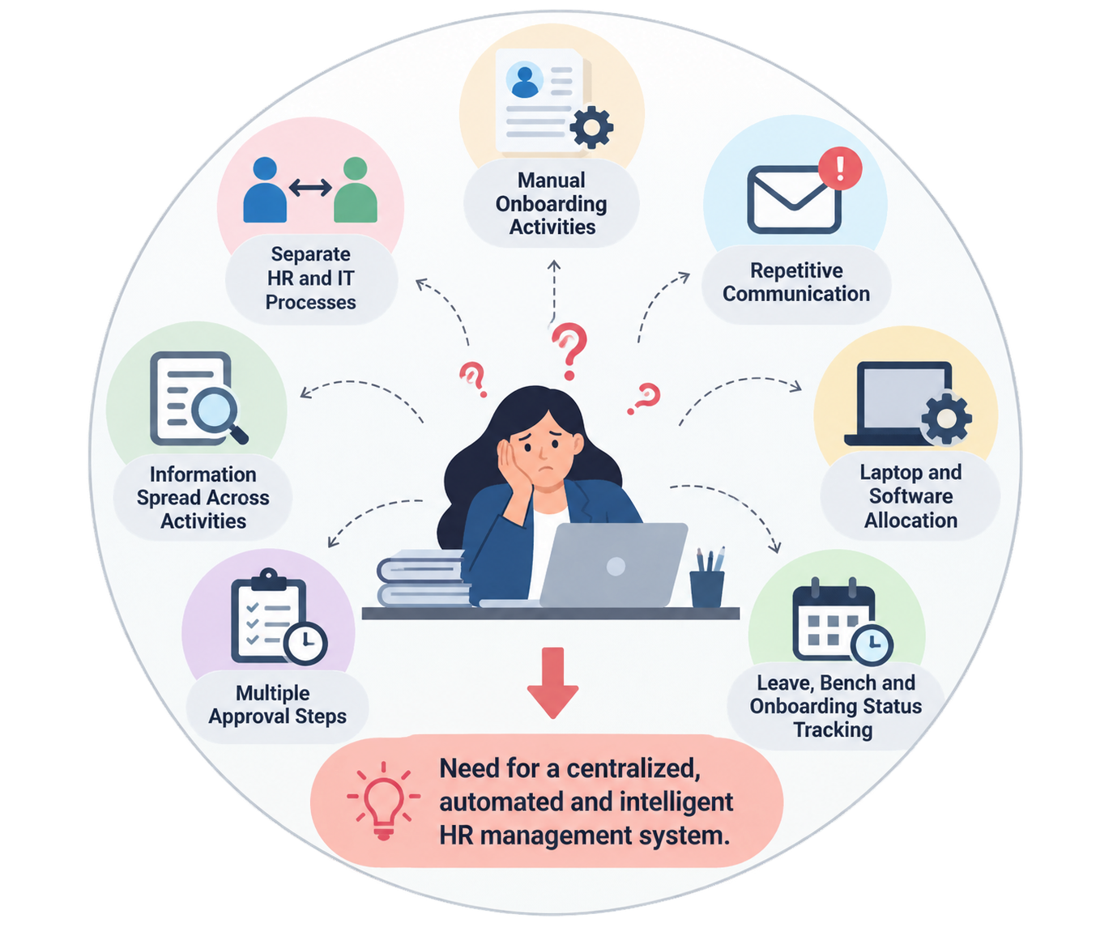
Autonomous AI Employee Onboarding & HR Automation Agent
Problem Statement
Employee onboarding involves multiple manual activities.
HR and IT processes are often handled separately.
Repetitive communication increases HR workload.
Laptop and software allocation requires coordination with IT.
Employee leave, bench and onboarding status can be difficult to track.
Multiple approval steps may delay the onboarding process.
Managing information across different activities reduces overall efficiency.

Slide 4
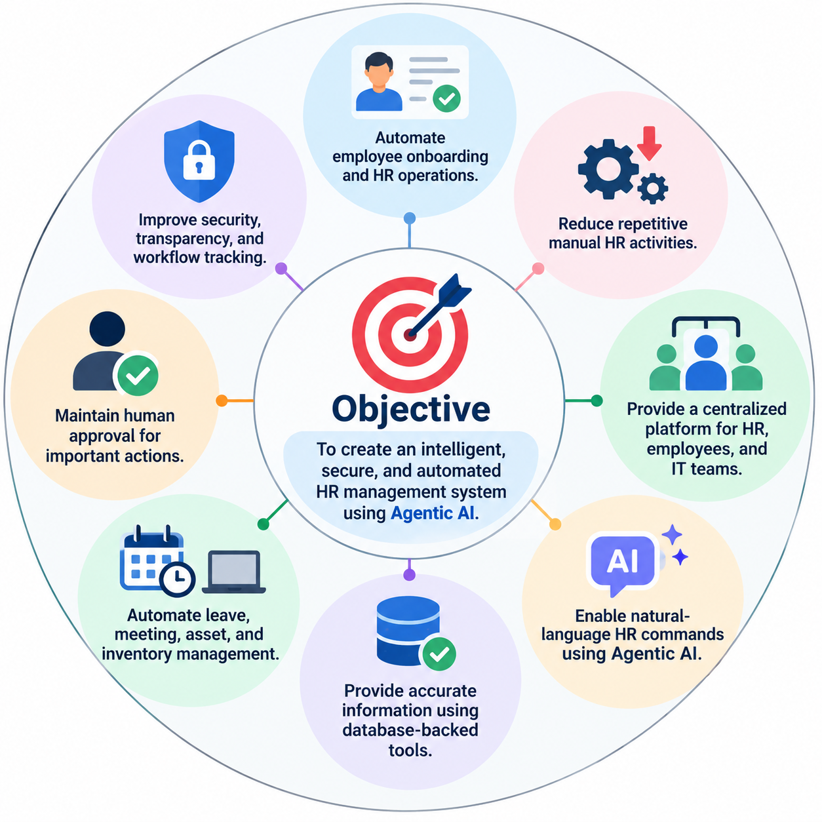
Autonomous AI Employee Onboarding & HR Automation Agent
Objective
Automate employee onboarding and HR operations.
Reduce repetitive manual HR activities.
Provide a centralized platform for HR, employees, and IT teams.
Enable natural-language HR commands using Agentic AI.
Provide accurate information using database-backed tools.
Automate leave, meeting, asset, and inventory management.
Maintain human approval for important actions.
Improve security, transparency, and workflow tracking.

Slide 5
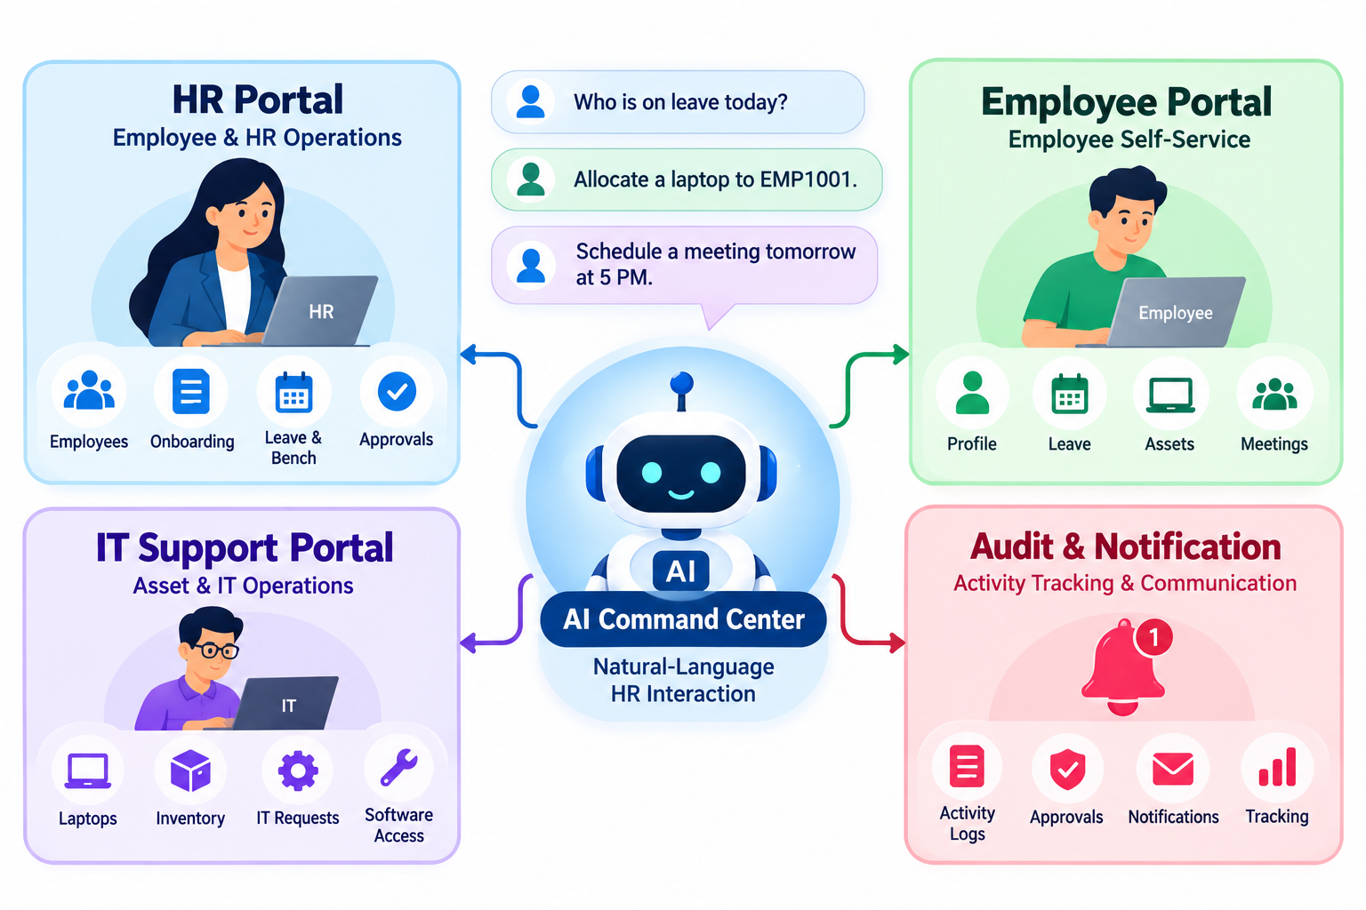
Autonomous AI Employee Onboarding & HR Automation Agent
HR Portal
Employee & HR Operations Management
Create and manage employee profiles
Manage employee onboarding
Track leave and bench status
Verify and approve employees
Assign employees to teams
Manage portal activation
Monitor HR approvals and activities

Slide 6
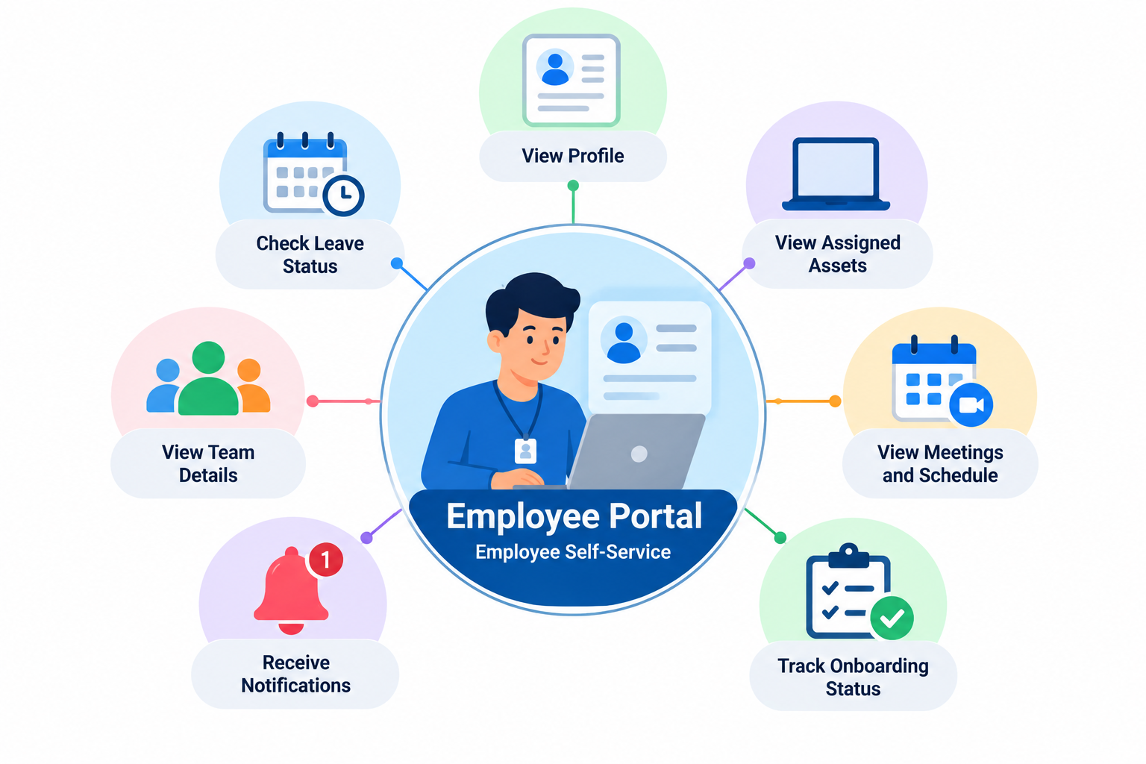
Autonomous AI Employee Onboarding & HR Automation Agent
Employee Portal
Employee Self-Service Platform
View employee profile
Check leave balance and status
View assigned laptop and assets
Check team assignment
View meetings and schedules
Receive HR notifications
Track onboarding and portal status

Slide 7
Autonomous AI Employee Onboarding & HR Automation Agent
IT Support
Asset & IT Operations Management
Manage laptop and asset inventory
View available laptop stock
Handle provisional allocations
Confirm employee laptop allocation
Manage IT support requests
Process software access requests
Update asset allocation status

Slide 8
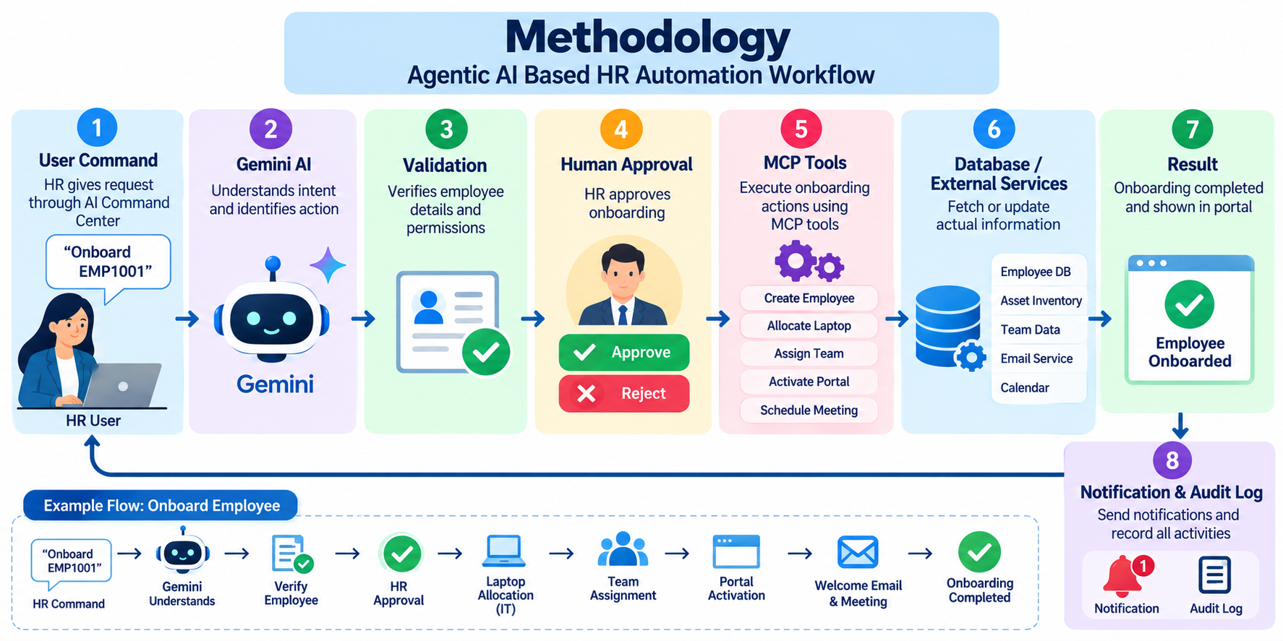
Autonomous AI Employee Onboarding & HR Automation Agent
Methodology

Slide 9
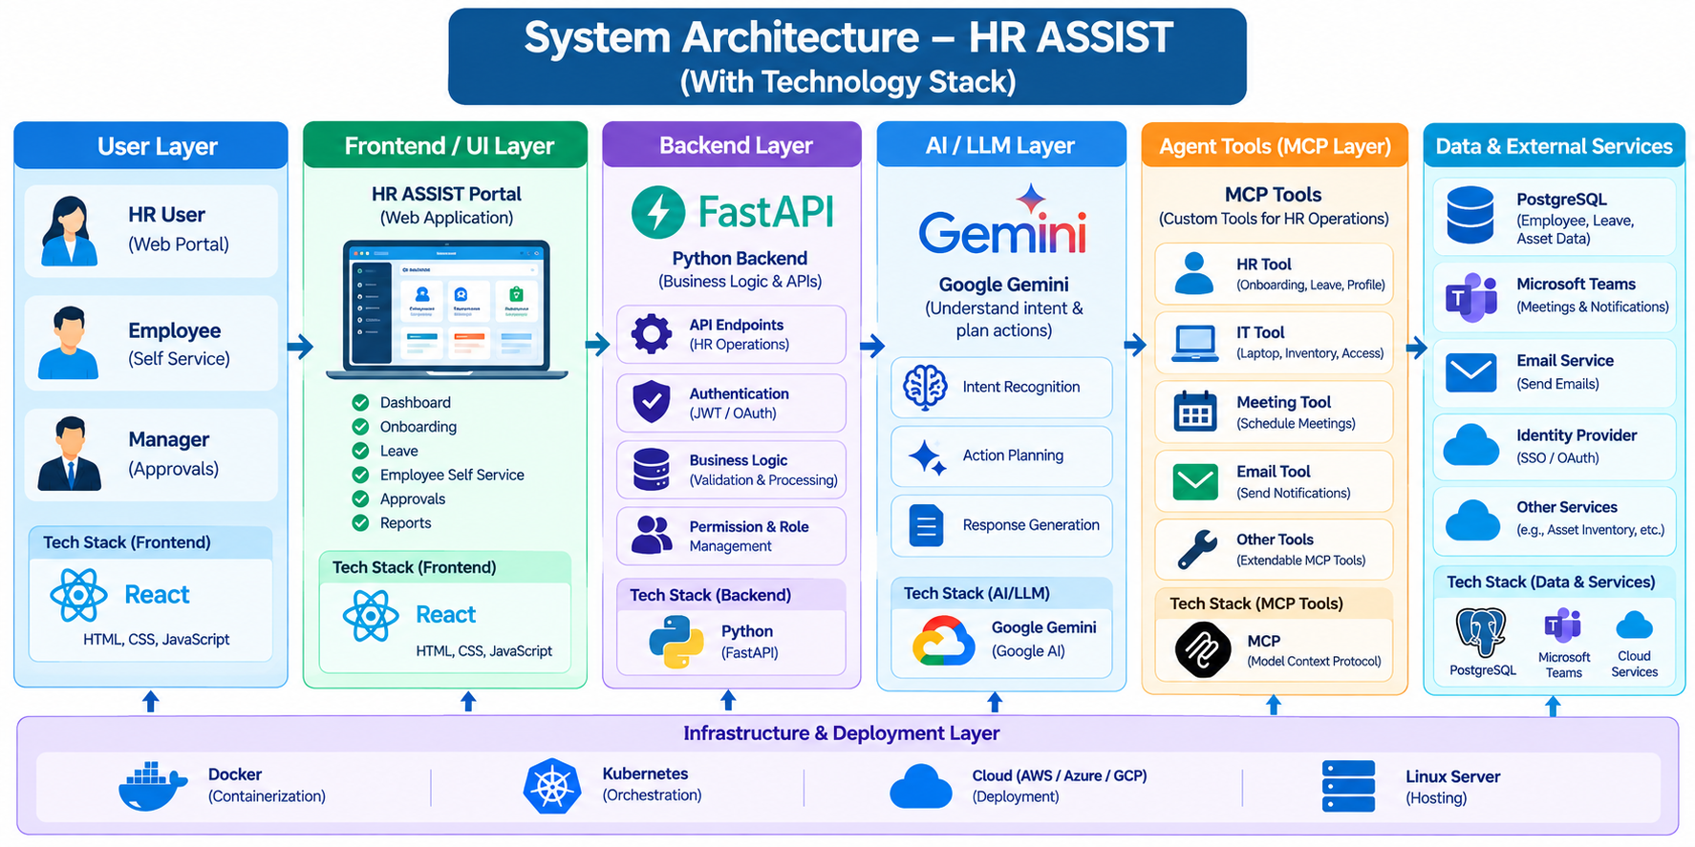
Autonomous AI Employee Onboarding & HR Automation Agent

Slide 10
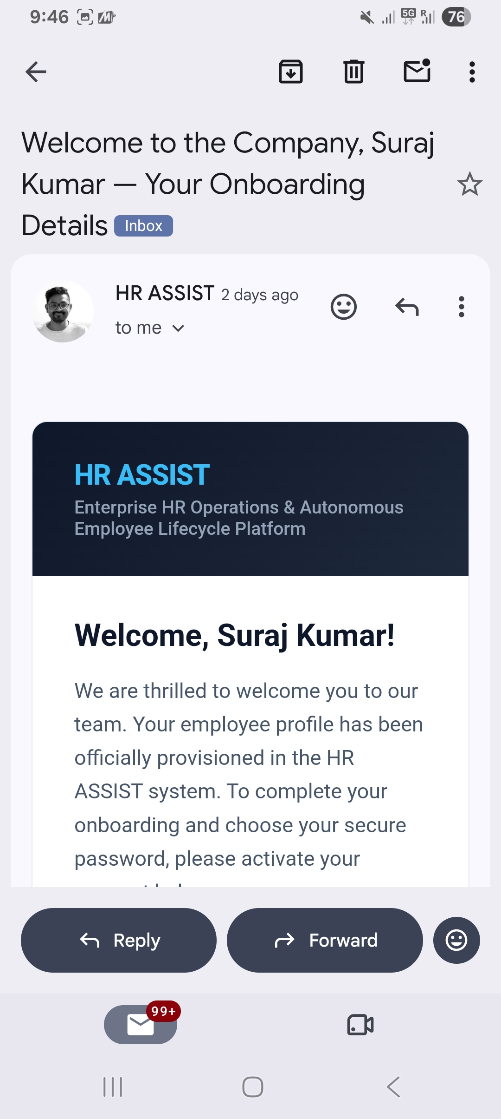
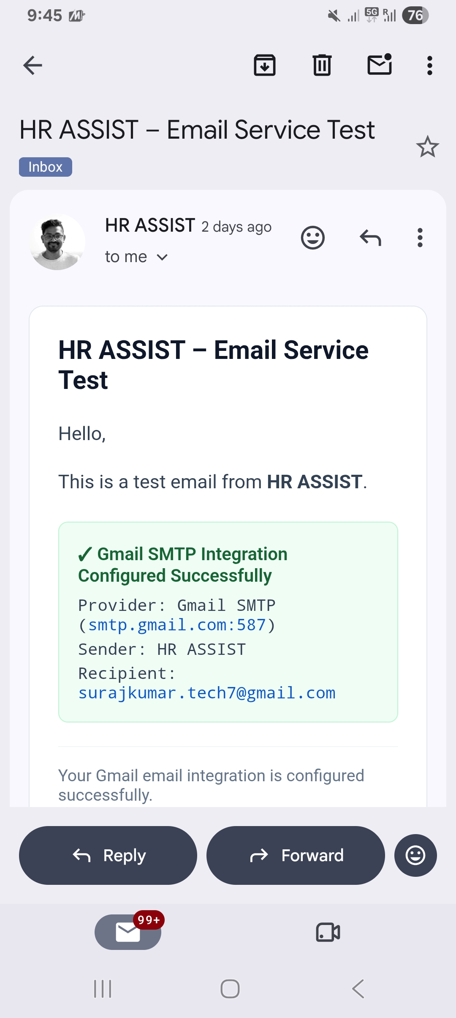
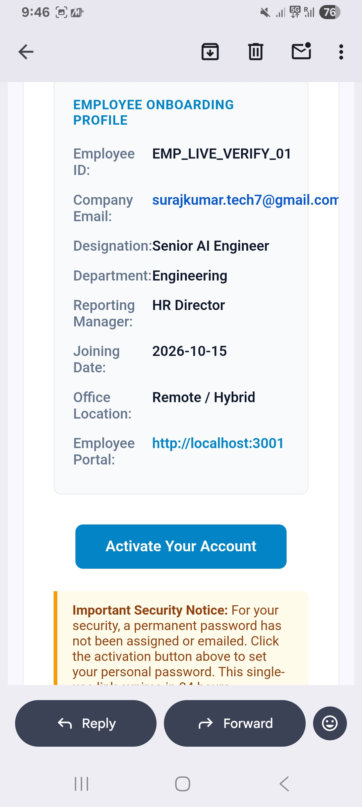
Results

Slide 11
Autonomous AI Employee Onboarding & HR Automation Agent
Conclusion
Automates employee onboarding and HR operations, reducing manual work.
Connects HR, Employee and IT teams through one centralized platform.
Uses Agentic AI and MCP tools for intelligent and controlled actions.
Provides accurate database-backed information for HR operations.
Ensures security and transparency through human approval, notifications and audit logs.

