Slide 1

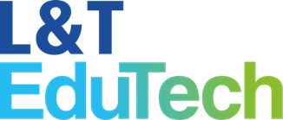
M.Tech Program
Advanced Industry Integrated Programs
Jointly offered by University and LTIMindTree
Autonomous AI Employee Onboarding & HR Automation Agent
SURAJ KUMAR
T Series ID: T9986
Knowledge partner | Implementation partner

Slide 2
Autonomous AI Employee Onboarding & HR Automation Agent
Introduction….
HR ASSIST is an Agentic AI-based system that automates employee onboarding and repetitive HR operations.
It understands natural-language HR requests and executes tasks such as profile creation, meeting scheduling, IT tickets, asset requests, emails, and team notifications.
Using MCP-based architecture, it integrates multiple enterprise systems to reduce manual effort, improve accuracy, and speed up onboarding.

Slide 3
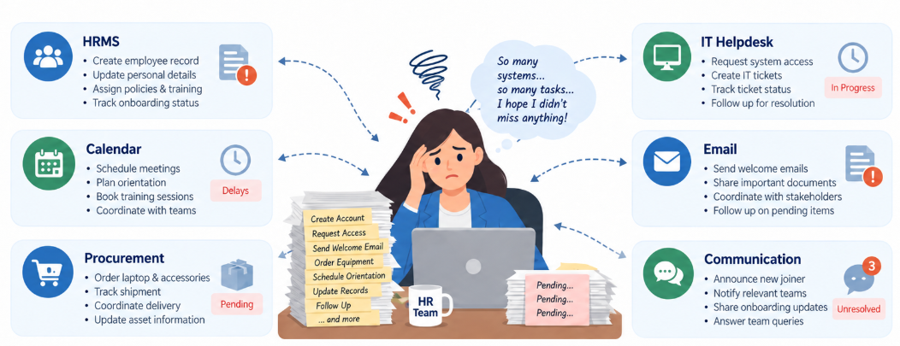
Autonomous AI Employee Onboarding & HR Automation Agent
Problem Statement
Employee onboarding is a repetitive and manual process. HR teams need to coordinate with HRMS, IT helpdesk, calendar, email, procurement, and communication platforms. This takes time, increases workload, and may cause delays or missed tasks.

Slide 4
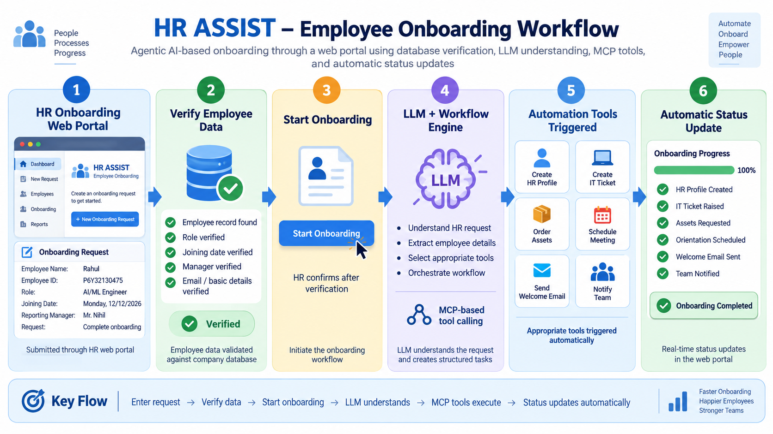
Autonomous AI Employee Onboarding & HR Automation Agent

Slide 5
Autonomous AI Employee Onboarding & HR Automation Agent
Objective
Automate employee onboarding and repetitive HR tasks.
Understand natural-language HR requests using Agentic AI.
Integrate HRMS, IT helpdesk, calendar, email, and communication tools through MCP.
Reduce manual effort, processing time, and human errors.
Maintain workflow status, logs, and audit records for reliable HR automation.
Ensure the system is scalable and extensible so new HR tools.

Slide 6
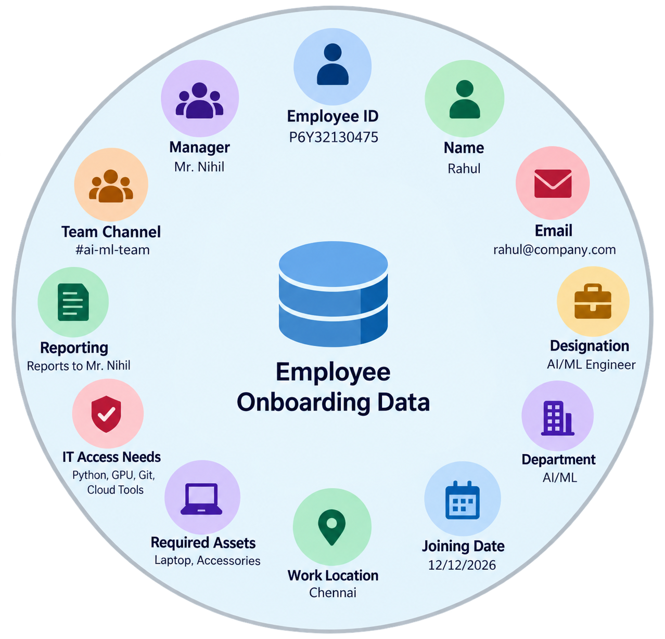
Autonomous AI Employee Onboarding & HR Automation Agent
Dataset
The project uses a mock employee onboarding dataset containing employee details such as Employee ID, Name, Email, Department, Designation, Joining Date, Manager, Location, Required Assets, IT Access Needs, Meeting Details, and Onboarding Status.

Slide 7
Autonomous AI Employee Onboarding & HR Automation Agent
Technical Stack
Python – Used for backend logic and automation.
FastAPI – Handles REST APIs and backend services.
Gemini – Understands natural-language HR requests.
LangGraph – Manages multi-step workflow execution.
MCP – Connects the AI client with tools and external services.
PostgreSQL – Stores employee data, workflow status, logs, and audit records.
External APIs – Integrate HRMS, email, calendar, IT helpdesk, and Slack/Teams.

Slide 8
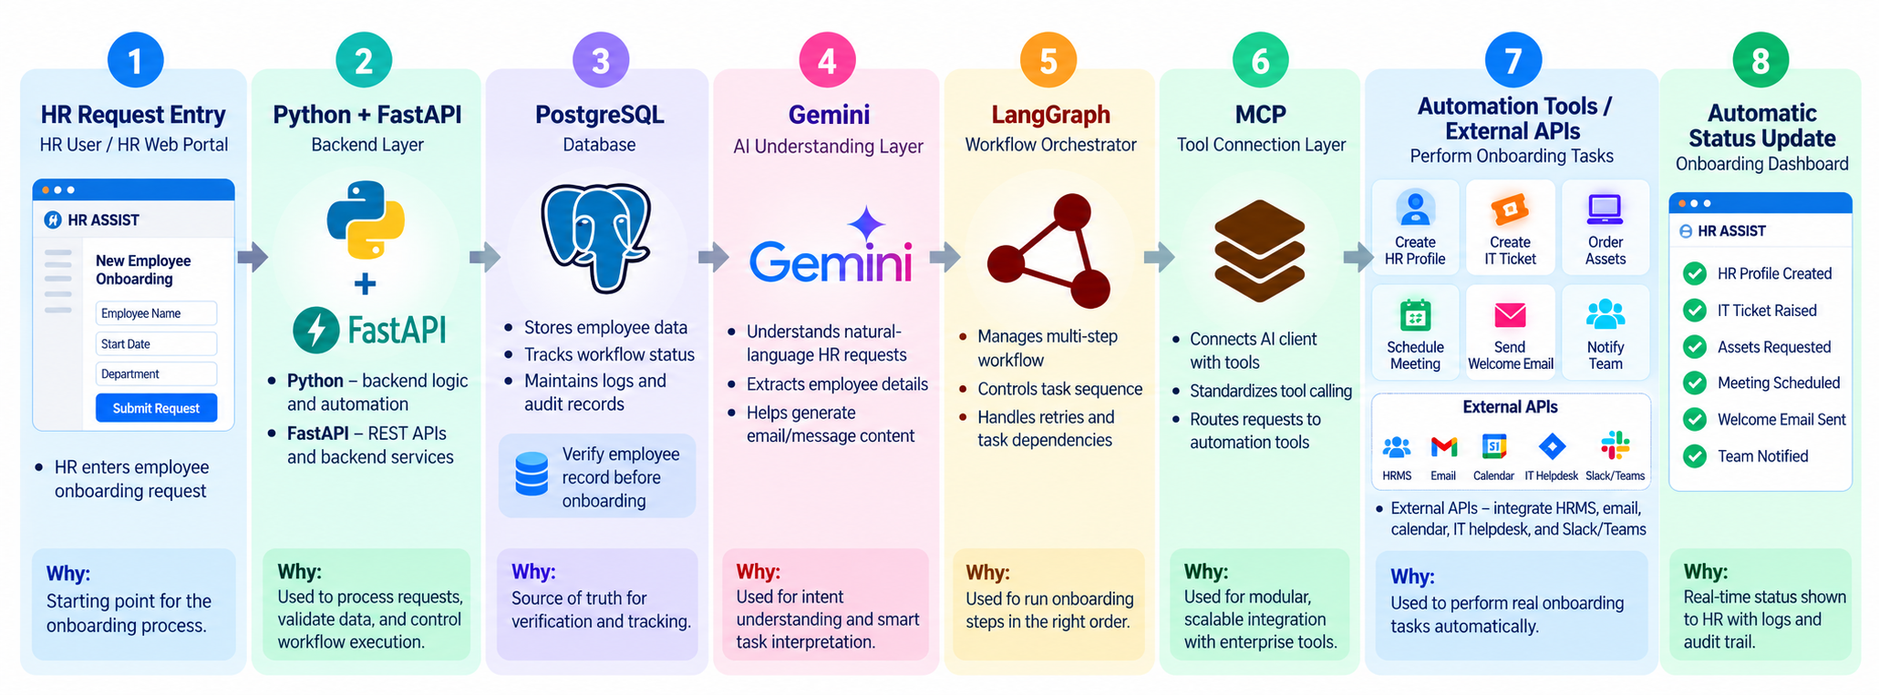
Autonomous AI Employee Onboarding & HR Automation Agent
Technical Stack

Slide 9
Autonomous AI Employee Onboarding & HR Automation Agent
Expected Outcome
Automate the complete employee onboarding workflow from a single HR request.
Create employee profiles and schedule onboarding meetings automatically.
Generate IT helpdesk tickets and asset requests for new employees.
Send welcome emails and team notifications through integrated platforms.
Track task progress, workflow status, logs, and audit records for better monitoring.

