Slide 1


M.Tech Program
Advanced Industry Integrated Programs
Jointly offered by University and LTIMindTree
AI Career & Research Copilot
SURAJ KUMAR
T Series ID: T9986
Knowledge partner | Implementation partner

Slide 2
AI Career & Research Copilot
Problem Statement
Students and professionals often struggle to identify skill gaps between their profiles and job requirements.
Researchers also spend significant time manually understanding papers, methodologies, limitations, and research gaps.
Existing platforms often provide generic recommendations instead of personalized, document-based guidance.

Slide 3
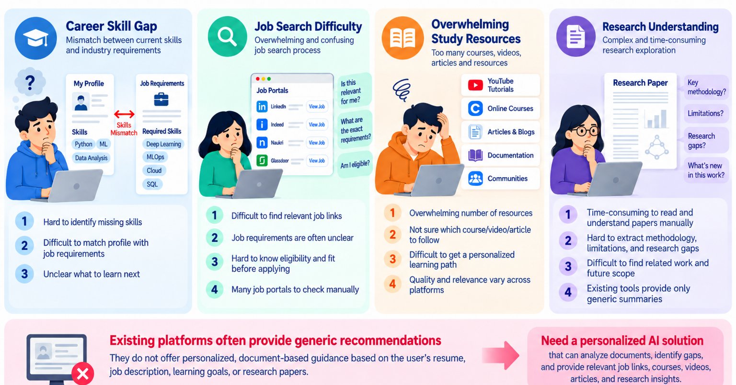
AI Career & Research Copilot

Slide 4
AI Career & Research Copilot
Objectives
Analyze resumes and job descriptions.
Identify matched skills and missing skills.
Provide relevant job links for direct application.
Recommend courses, videos, articles, and learning resources.
Generate personalized learning plans and interview questions.
Analyze research papers using RAG to identify methodology, results, research gaps, limitations, and future work.

Slide 5
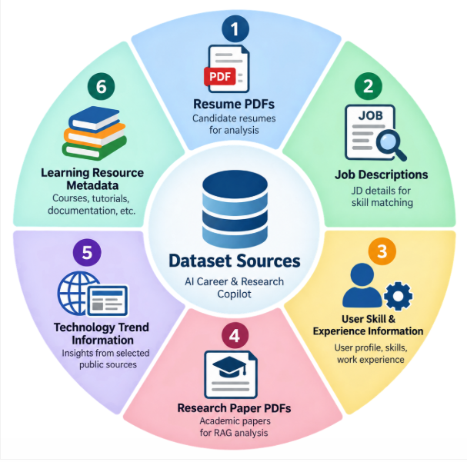
AI Career & Research Copilot
Dataset
Resume PDFs
Job descriptions
User skill and experience information
Research paper PDFs
Technology trend information from selected public sources
Learning resource metadata

Slide 6
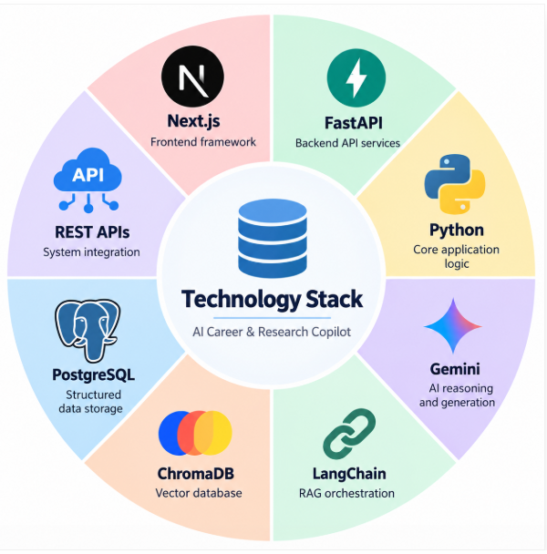
AI Career & Research Copilot
Technical Stack
Next.js
FastAPI
Python
Gemini
LangChain
ChromaDB
PostgreSQL
REST APIs

Slide 7
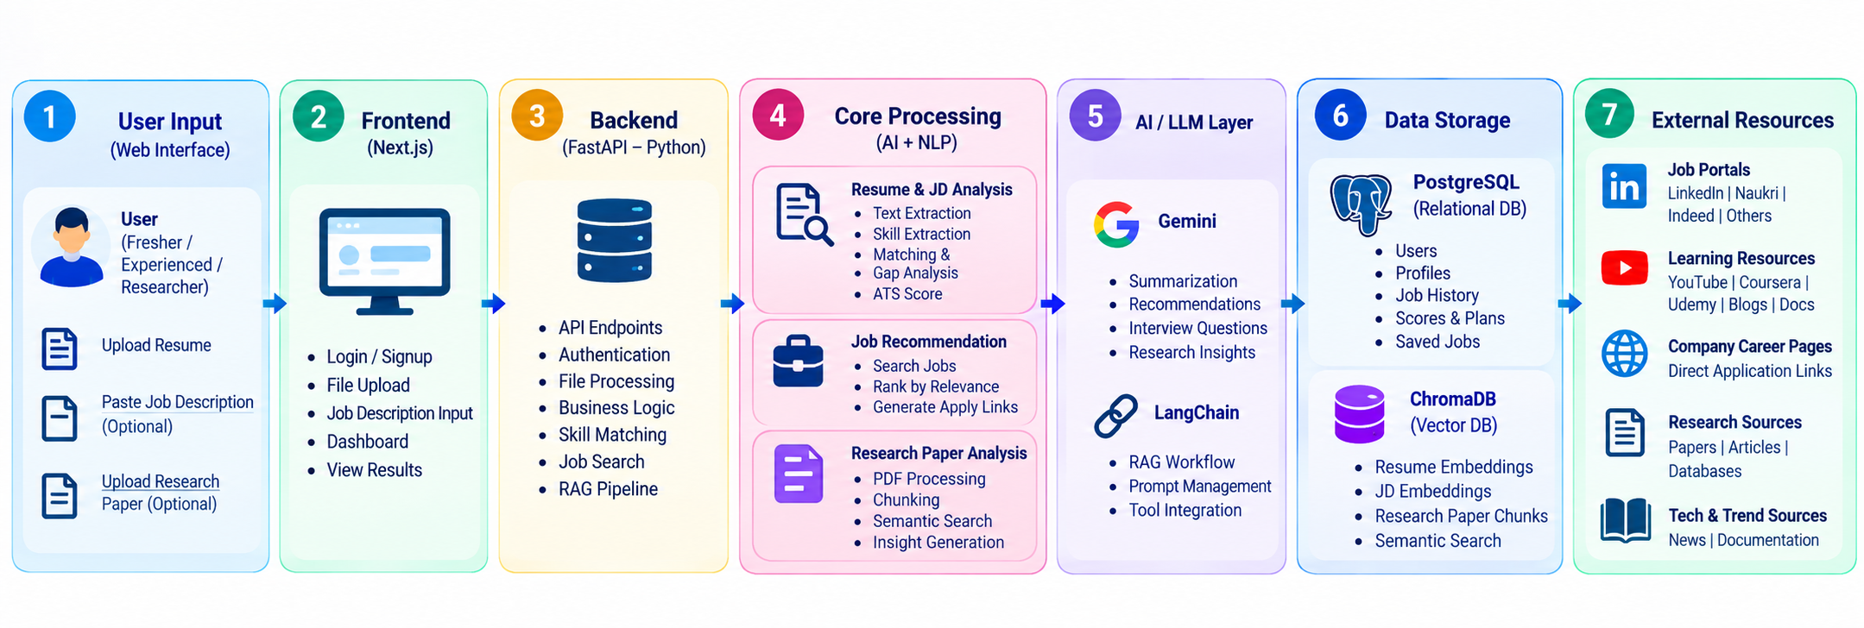
AI Career & Research Copilot

Slide 8
AI Career & Research Copilot
Expected Outcome
Personalized career guidance for freshers and experienced professionals.
Automatic resume analysis, skill-gap detection, and ATS/job-match score.
Relevant job recommendations based on resume skills, experience, and target role.
Direct job application links from job portals and company career pages.
Recommended study materials such as courses, YouTube videos, articles, documentation, and practice resources.

Slide 9
AI Career & Research Copilot
Expected Outcome
Customized learning roadmap and interview preparation based on missing skills.
Research-paper question answering using RAG with methodology, results, limitations, research gaps, and future scope.
Evidence-grounded AI recommendations with progress tracking and next-best actions.

Slide 10
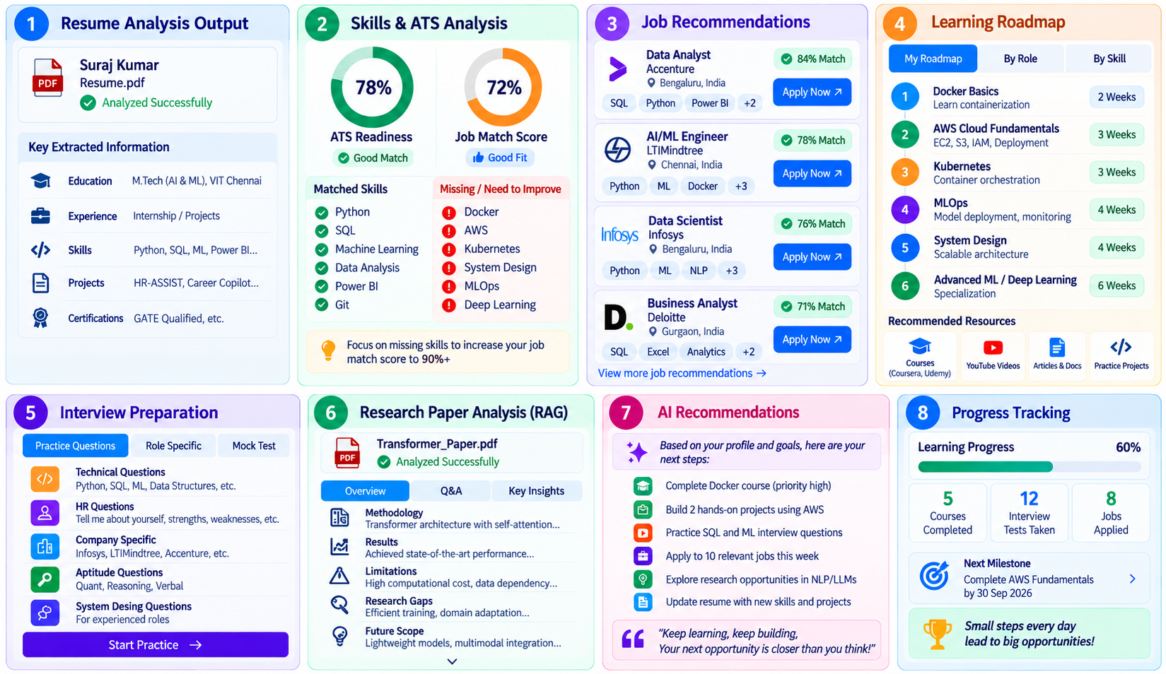
AI Career & Research Copilot

Slide 11

AI Career & Research Copilot

