Slide 1


M.Tech Program
Advanced Industry Integrated Programs
Jointly offered by University and LTIMindTree
AI Career & Research Copilot
SURAJ KUMAR
T Series ID: T9986
VIT CHENNAI
Knowledge partner | Implementation partner

Slide 2
AI Career & Research Copilot
Introduction
An AI-powered platform designed to support career development and academic research.
Uses LLM, RAG, document processing and recommendation techniques.
Analyzes resumes, job descriptions, professional profiles and research papers.
Provides skill-gap analysis, learning recommendations and research guidance.
Supports three user personas:
  Fresher / Student
  Experienced Professional
  Academic Researcher

Slide 3
AI Career & Research Copilot
Problem Statement
Scattered Resources: Career, learning, and research information is distributed across multiple platforms.
Lack of Personalization: Existing platforms often provide generic recommendations without considering individual profiles.
Skill Gap Identification: Students struggle to identify missing skills required for their target job roles.
Research Challenges: Finding, understanding, and summarizing relevant research papers is time-consuming.
No Unified Platform: There is a need for an AI-powered system combining resume analysis, career guidance, skill development, and research assistance.

Slide 4
AI Career & Research Copilot
Objective
Analyze resumes and profiles to identify the user’s skills, experience, projects, and strengths.
Identify skill gaps by comparing the user’s profile with target job descriptions and career roles.
Provide personalized recommendations for learning resources, career roadmaps, and interview preparation.
Support research activities by finding, summarizing, and retrieving relevant research papers using RAG.
Develop a unified AI-powered platform using Gemini, LangChain, MongoDB, and vector search for personalized career and research guidance.

Slide 5
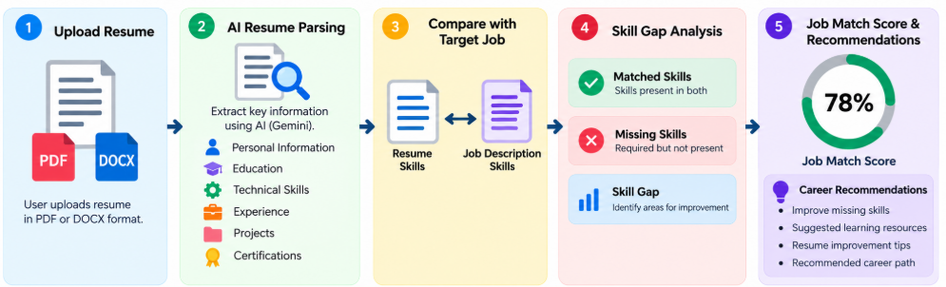
AI Career & Research Copilot
Module1(Resume & Career Analysis)
Analyze the user's profile and identify career-related skill gaps
Upload and parse PDF/DOCX resumes.
Extract skills, education, projects, experience, and certifications using AI.
Compare resume skills with the target job description.
Calculate a job-match score and identify missing skills.
Recommend improvements for the resume and technical skills.

Slide 6
AI Career & Research Copilot
Module2(career growth/upskilling)
Career Upskilling & Market Trend Analysis
Analyze the professional’s resume, experience, and existing skills.
Collect and analyze current job-market trends and in-demand technologies.
Compare the user’s skills with current industry requirements.
Identify skill gaps and emerging skills relevant to their career.
Recommend a personalized learning and career progression path.

Slide 7
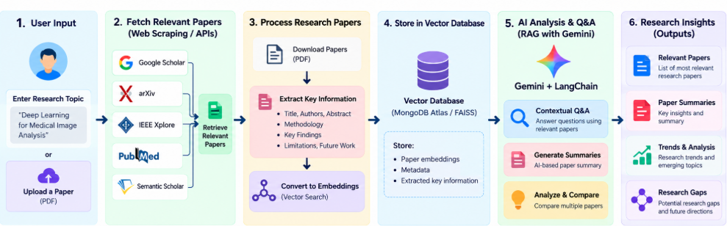
AI Career & Research Copilot
Module3(AI Research Assistant)
Help students efficiently explore and understand research information
Search for relevant research papers based on the user's topic.
Extract important information from research documents.
Generate AI-based paper summaries.
Use RAG and vector search for contextual research Q&A.
Help identify research topics, trends, and potential research gaps.

Slide 8
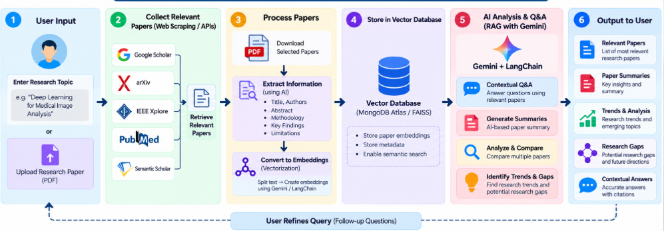
AI Career & Research Copilot
Methodology

Slide 9
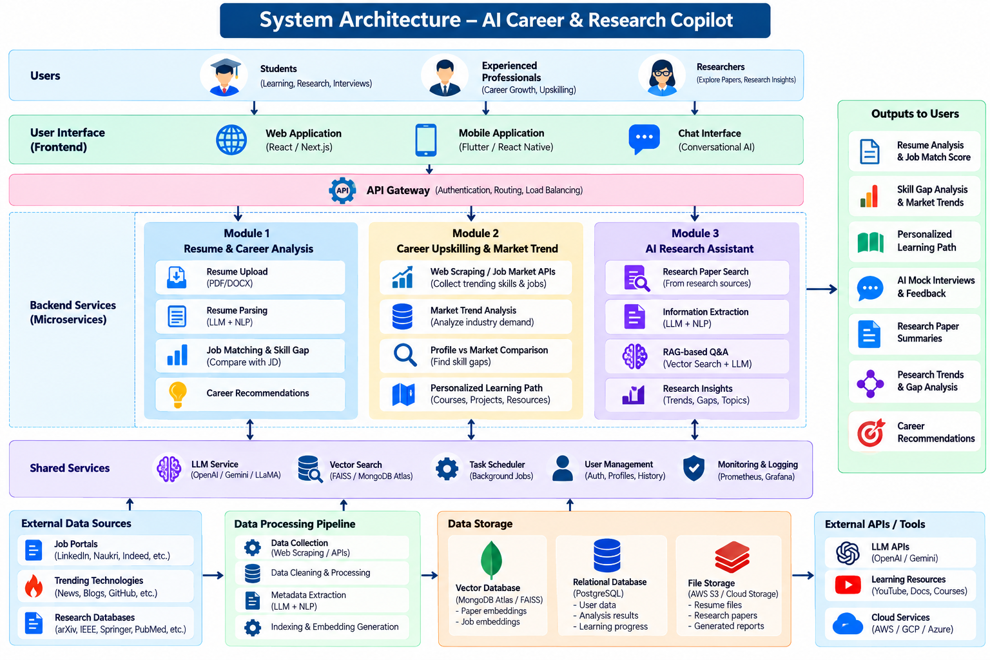

Slide 10
AI Career & Research Copilot
Conclusion
Developed a unified AI-powered platform for career development and research assistance.
Provides resume analysis, job matching, and skill-gap identification for students and job seekers.
Helps experienced professionals identify market trends and in-demand skills for career upskilling.
Uses RAG, LLMs, and vector search to provide research paper summaries, contextual Q&A, and research insights.
Delivers personalized learning paths and recommendations, supporting continuous career growth and research development.

