Slide 1
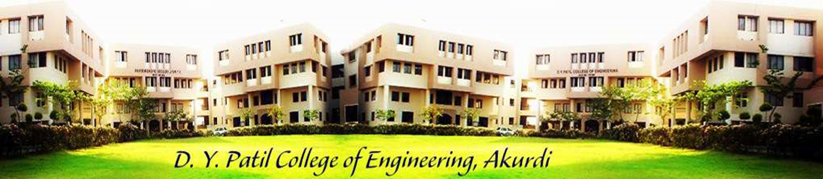
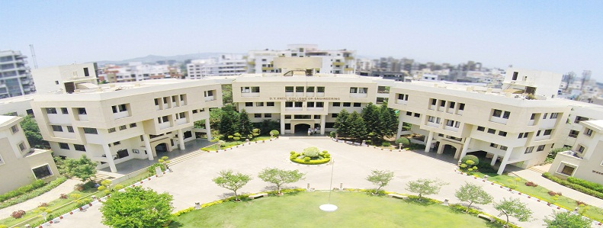
D. Y. Patil College of Engineering, Akurdi, Pune
Project Based Learning(PBL) Presentation
on
Grow Green
Tree Plantation Website
Presented By:
Name | Seat no
Kalpesh Pawar | S190088501
Rasika Ghadge | S190088549
Suraj Pisal | S190088612
Pradnya Barve | S190088613
Guided by:
Mrs. Himani Patel Mam

Slide 2

Overview
Introduction
Problem Description
Proposed System
How System Works
Implementation Details
Conclusion
References

Slide 3
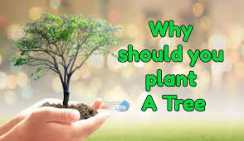
Introduction
Trees filter our air and keep it fresh by absorbing carbon dioxide and producing oxygen.
Tree roots stabilize the soil and prevent erosion.
Trees improve water quality by slowing and filtering rainwater as well as protecting aquifers and watersheds.
Three-quarters of the world's people rely on wood as their main source of energy.

Slide 4
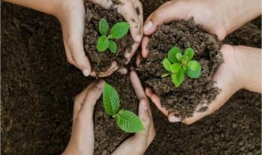
Problem Description
Problem Statement:
The central government’s afforestation scheme, Green India Mission (GIM), was able to only achieve 2.8 percent of its plantation target, according to the Economic Survey released by the Ministry of Finance on January 29, 2021.
Problem Solution
We provide a platform where anyone can plant or donate a tree and provide a helping hand in saving our environment.

Slide 5
Proposed System
Plant a tree for free, every day, in less than a minute
Introducing the grow-green tree plantation website
How this platform is different from other platforms:
1)User can plant a tree without any money.
2)Those who don’t have the time can donate.
3) Users can call our team to plant a tree.
4)visit grow_green.org for more information.

Slide 6




How System Works
Visit
Create your account
Growgreen.org
Click on Plat Tree
Fill the required details
You have successfully Planted Tree

Slide 7





Implementation Details
Languages and frameworks used : -
Frontend – HTML, CSS, Bootstrap, JavaScript.
Backend – Django(Python Framework)
Database - MySQL

Slide 8
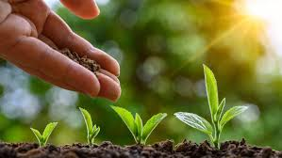
Conclusion
Trees should be treated and nurtured nicely so that human beings can survive on this planet.
We should encourage others to plant more and more trees. It is for our own betterment and the sooner we understand this the better it is for us.

Slide 9
Our motto:
“We are crazy nature-centric enthusiasts, planting trees for the people, by the people!”
यही मुद्दा हमको आपको समझाने से फरक पढ़ा है!
THANK YOU

Slide 10
References
https://www.nelda.org.in/
https://sankalptaru.org/
https://catchfoundation.in/plantenance/
https://en.wikipedia.org/wiki/Tree_planting
https://treesisters.org/blog/how-to-start-your-own-tree-planting-project
https://www.artofliving.org/in-en/projects/tree-planting
http://www.cmseducation.org/environment/treeplantation.html
https://www.grow-trees.com/projects.php
.

