Slide 1
Secure Data Hiding in Image Using Steganography
CAPSTONE PROJECT
Presented By.
Student Name : Suraj Karn
College Name & Department : C.V. Raman Global University (CSE)

Slide 2
OUTLINE
Problem Statement
Technology used
Wow factor
End users
Result
Conclusion
Git-hub Link
Future scope

Slide 3
Problem Statement
This project aims to implement image-based steganography, allowing users to hide and retrieve secret messages within an image using pixel manipulation. The goal is to provide a simple yet effective way to conceal text data securely.

Slide 4
Technology used
Programming Language: Python
Libraries: OpenCV (cv2) for image processing, OS for file operations
Image Format: JPG (lossy format, may alter pixel values slightly due to compression)
Encoding Technique: Basic pixel value modification (uses the blue channel to store ASCII values)

Slide 5
Wow factors
Uses image pixels to embed a secret message, making it invisible to the naked eye.
Password-protected decryption ensures only authorized users can retrieve the message.
Works with JPG format, demonstrating message embedding even in a lossy compression format.
Lightweight & Fast: No need for external databases or complex encryption, runs entirely on a local machine.
Cross-platform compatibility allows it to run on Windows, Linux, and macOS with minimal modifications.
Potential for steganographic security enhancements, making it useful for cybersecurity applications.

Slide 6
End users
Who are the end users
Cybersecurity enthusiasts – Explore steganography techniques for secure data hiding.
Individuals needing secure communication – Hide confidential messages within images for privacy.
Digital watermarking applications – Embed hidden identifiers to protect intellectual property.
Data hiding for sensitive information – Conceal sensitive data within images to prevent unauthorized access.

Slide 7
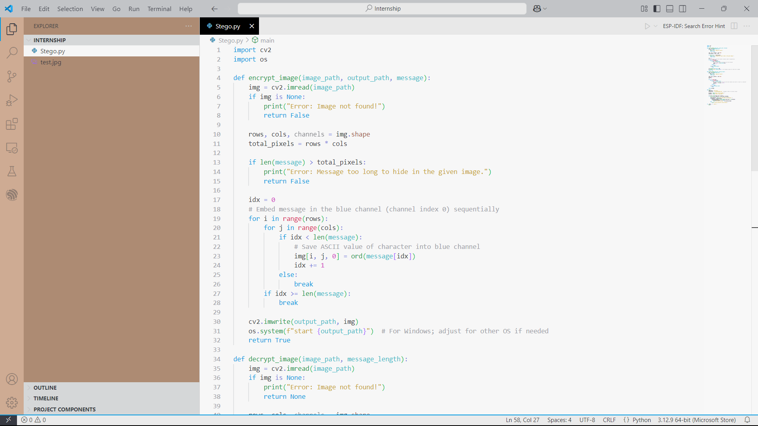
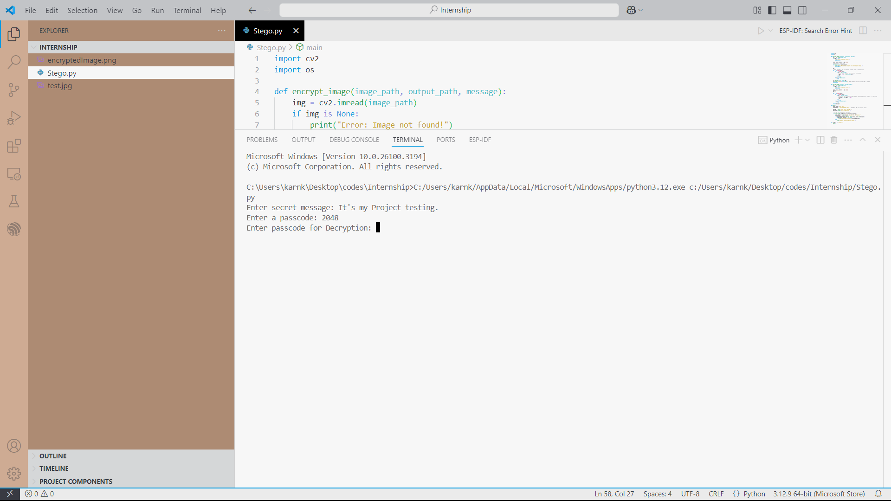
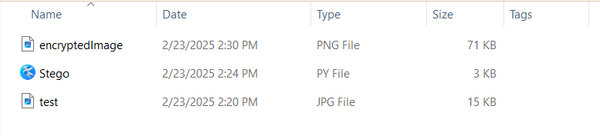
Results

Slide 8

Results
The project successfully embeds a message within an image and retrieves it with minimal distortion when using a high-quality JPG format. Decryption works accurately when the correct passcode is provided, though minor pixel alterations may occur due to JPEG compression.

Slide 9
Conclusion
This steganography approach offers a simple yet effective method for hiding text within images. It demonstrates how digital media can be leveraged for secure communication by embedding messages within image pixels, making them invisible to the naked eye. The project provides a foundation for exploring more advanced techniques, such as multi-channel encoding and encryption, to enhance security. While JPEG compression may introduce slight distortions, careful optimization ensures reliable message retrieval. This method can be adapted for various applications, including watermarking, covert communication, and secure data storage.

Slide 10
GitHub Link
https://github.com/Suraj2048/Steganography.git
Project Link (Github)

Slide 11
Future scope(optional)
Improve security by integrating encryption (AES or RSA) before embedding the message.
Extend support for multiple image formats while maintaining lossless storage.
Implement a graphical user interface (GUI) for user-friendly interaction.
Hide messages across all three RGB channels for increased capacity.

Slide 12
THANK YOU

