Slide 1
Executive Presentation
Customer Shopping Behavior Analysis
Data-Driven Insights for Marketing, Retention & Revenue Optimization
Python | PostgreSQL | Power BI
Presenter: Suraj Mishra

Slide 2
Business Context & Problem Statement
Understanding the levers that influence retail growth, profitability and customer retention
Business Objective
Scale retail sales while improving customer retention and protecting profit margins.
Core Business Questions
• Are discounts and promo codes increasing sales enough to justify margin impact? • How do subscribed and non-subscribed customers differ in purchasing behavior?
Dataset Scope
3,900 customer transactions covering demographics, basket value, payment preferences and customer reviews. The analysis combines customer-level and transaction-level attributes to identify actionable patterns.
Customer Data
Behavior Analysis
Business Insights
Customer Shopping Behavior Analysis • Suraj 02

Slide 3
Key Analytical Findings
The analysis highlights clear opportunities across customer segments, subscriptions and product categories
01 Demographics & Spending
High-value age groups and selected product categories are key contributors to revenue and sales. The dashboard indicates that the Senior segment leads the displayed age groups for both revenue and sales.
02 Discount Elasticity
Promo codes can support basket growth, but discounting should be segmented by customer and order value. The objective is to balance conversion uplift with margin protection.
03 Subscription Opportunity
Non-subscribed customers represent the majority in the displayed dashboard view. This creates a clear opportunity to improve subscription conversion through relevant benefits and targeted offers.
Key takeaway: Segment customers before applying discounts, loyalty benefits or marketing spend.
Customer Shopping Behavior Analysis • Suraj 03

Slide 4
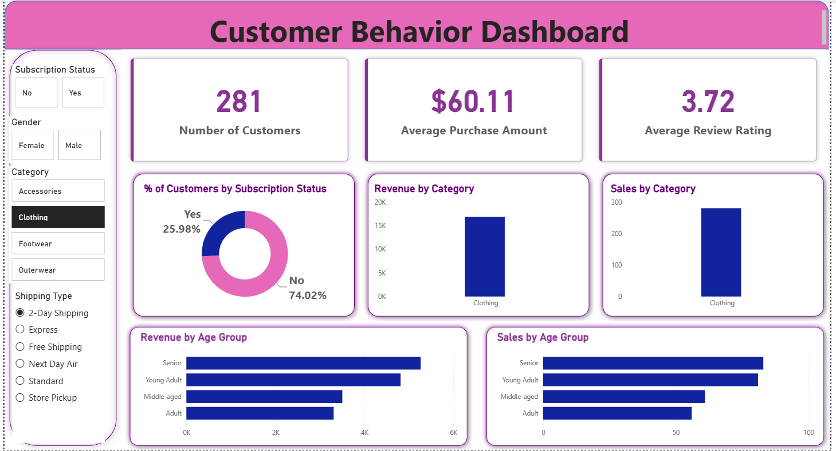
Power BI Dashboard & Visual Highlights
Interactive view of customer behavior, category performance and age-group trends
Customer Shopping Behavior Analysis • Suraj 04

Slide 5
Strategic Recommendations
Translate analytical findings into focused actions for growth, retention and profitability
Targeted Loyalty Program
Convert high-potential non-subscribers using free-shipping benefits and relevant exclusive offers.
Optimized Promo Strategy
Set dynamic discount limits based on order value and customer segment to reduce unnecessary margin erosion.
Category Focus
Prioritize inventory availability and targeted advertising for top-performing categories.
Customer Experience
Use review and delivery insights to identify friction points and improve customer satisfaction.
Expected Business Impact
Higher subscription conversion • Better promo efficiency • Stronger category ROI • Improved customer experience
Customer Shopping Behavior Analysis • Suraj 05

Slide 6
Next Steps & Deliverables
A complete analytics workflow from data preparation to executive decision-making
01
Executive Report
Detailed business findings and recommendations in PDF format.
02
Data Pipeline & Staging
Python notebook for data cleaning, transformation and analysis.
03
PostgreSQL Warehouse
SQL queries for data preparation, KPI calculation and business analysis.
04
GitHub Repository
Project code, documentation and README links for reproducibility.
From raw transactions to actionable business decisions.
Customer Shopping Behavior Analysis • Suraj 06

Slide 7
Thank You
Customer Shopping Behavior Analysis
Suraj Mishra
Python | PostgreSQL | Power BI

