Slide 1
Project Name - Medibot
Team Name
NO NAME

Slide 2
INTRODUCTION
In the medical field, there are robots designed to assist with various tasks, including medication delivery. These robots can help provide medication to patients in the absence of a nurse or healthcare provider. They are equipped with hardware systems and AI algorithms to ensure accurate and efficient medication administration.

Slide 3
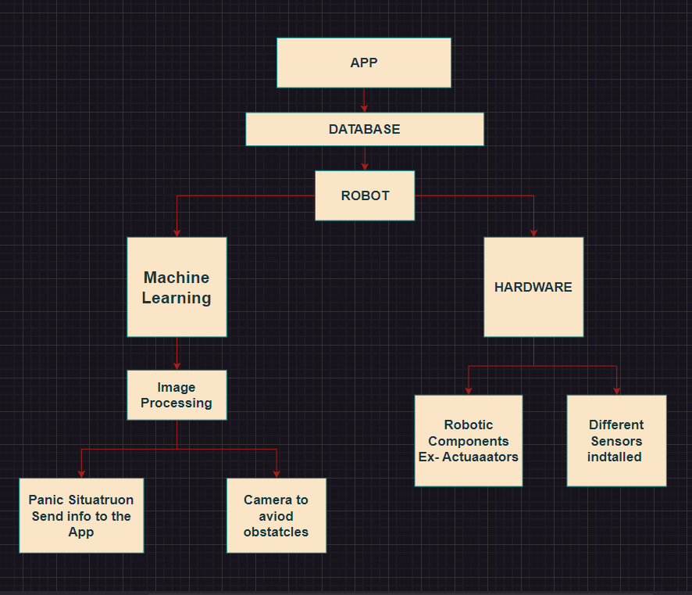
BLOCK DIAGRAM

Slide 4
APP
Log in Interface for doctors.
Details of each Patients.
Medical Progress report.
Health improvement in percentage based on daily basis.
Database and Firebase integration.

Slide 5
AIML
The AI algorithms employed in these robots, often using AIML techniques, help with tasks such as patient identification, medication verification, and dosage calculation. These algorithms can analyze patient information, such as medical records and prescriptions, to ensure the right medication is administered to the right patient at the right time and in the correct dosage.
Models used :
Open cv, SAM(Segement Anything Model), YOLO model

Slide 6
COMPONENTS
Microcontroller/Processor: A microcontroller or processor serves as the brain of the robot, controlling its functions and coordinating the interaction between different hardware components. Popular choices for medical robots include microcontrollers like Arduino or Raspberry Pi, or more powerful processors like Intel Core or NVIDIA Jetson.
Robotic Arm: A robotic arm is an essential component for precise medication delivery. It typically consists of several joints and links that enable the arm to move and position itself accurately. Actuators (discussed next) control these joints to achieve the desired movements.
Actuators: Actuators are responsible for the mechanical movements of the robotic arm and other parts of the robot. Commonly used actuators include servo motors, stepper motors, or linear actuators. These actuators translate electrical signals from the microcontroller into physical motion.
Gripper/End Effector: The gripper or end effector is the part of the robotic arm that holds and manipulates medication containers, such as pill bottles or syringes. The design of the gripper depends on the specific requirements of the medication delivery system, ensuring it can securely grasp and release items as needed.

Slide 7
Sensors: Various sensors are utilized in medical field robots to monitor and gather data. These include:
Proximity Sensors: Proximity sensors, such as infrared or ultrasonic sensors, can detect the presence of objects or obstacles around the robot, preventing collisions.
Vision Sensors: Vision sensors, such as cameras or depth sensors (e.g., Microsoft Kinect), enable the robot to perceive its environment, identify medication containers, and locate patients for accurate medication delivery.
Force/Torque Sensors: Force or torque sensors can provide feedback on the force exerted during gripping or interactions with patients, allowing the robot to apply appropriate pressure while handling medication or administering injections.
Temperature/Humidity Sensors: These sensors can monitor the environmental conditions within the robot's surroundings, ensuring medication is stored and transported under optimal conditions.
Biometric Sensors: Some advanced medical field robots incorporate biometric sensors, such as heart rate monitors or blood pressure sensors, to gather patient-specific data for medication administration.
Thermal sensor: A device that measures the temperature of a system or space is called a thermal sensor. IR sensors are electronic sensors that detect temperature by emitting IR radiations.
Pulse Sensor : The Pulse Sensor is a well-designed low-power plug-and-play heart-rate sensor for the Arduino.

Slide 8
User Interface: A user interface component provides a means for interaction between the robot and healthcare providers or patients. It could include touchscreens, buttons, or voice recognition systems, enabling users to input commands or request information from the robot.
Connectivity: Medical field robots often require connectivity options for communication and data exchange. This can include wired or wireless connections, such as Ethernet, Wi-Fi, or Bluetooth, to integrate with hospital networks, electronic health record systems, or other medical devices.

Slide 9
OBJECTIVES
Patient Care and Assistance.
Automatic pills dispense.
Efficiency and Workflow Improvement.
100% accuracy with different ml models.

Slide 10
FEATURES
The hardware system of a medical field robot typically includes features such as an automated medication dispensing unit, a robotic arm for precise movements, a computer interface, and sensors for monitoring patient data. These components work together to safely and accurately administer medications.

Slide 11
FUTURE SCOPE
The robots may also have the ability to interact with patients, using natural language processing algorithms to understand and respond to verbal or written instructions. This allows patients to communicate any concerns or questions they may have regarding their medication.

