Slide 2
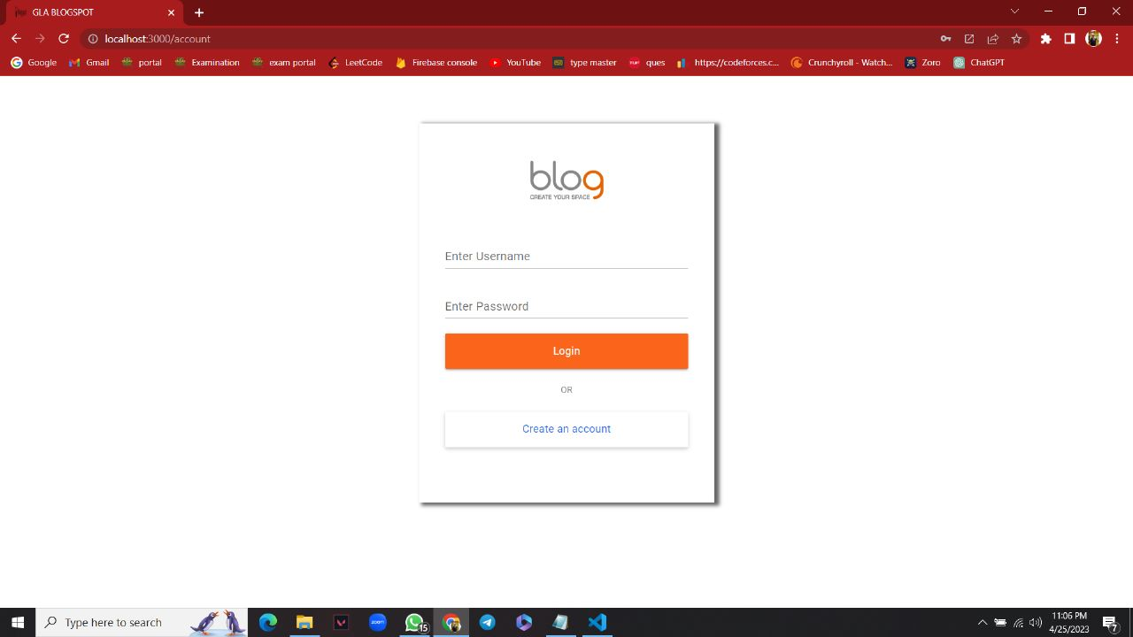
LOGIN PAGE

Slide 3
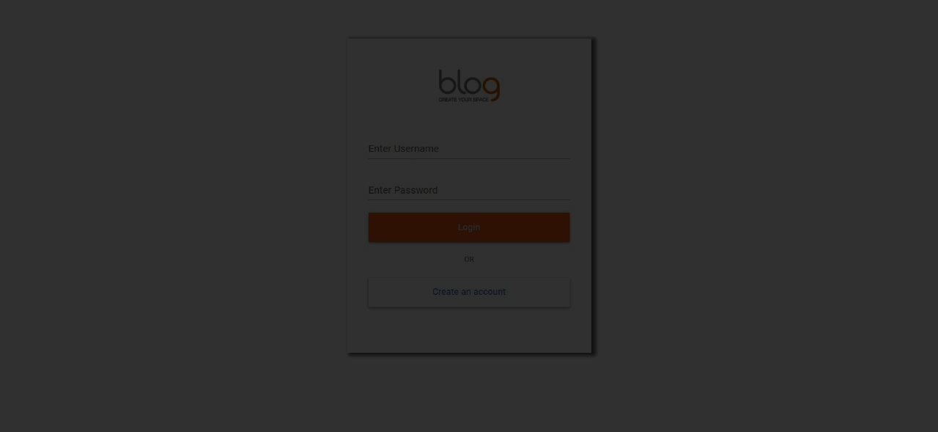
LOGIN
For Existing User/ Admin

Slide 4
SIGN UP
For New Users

Slide 5
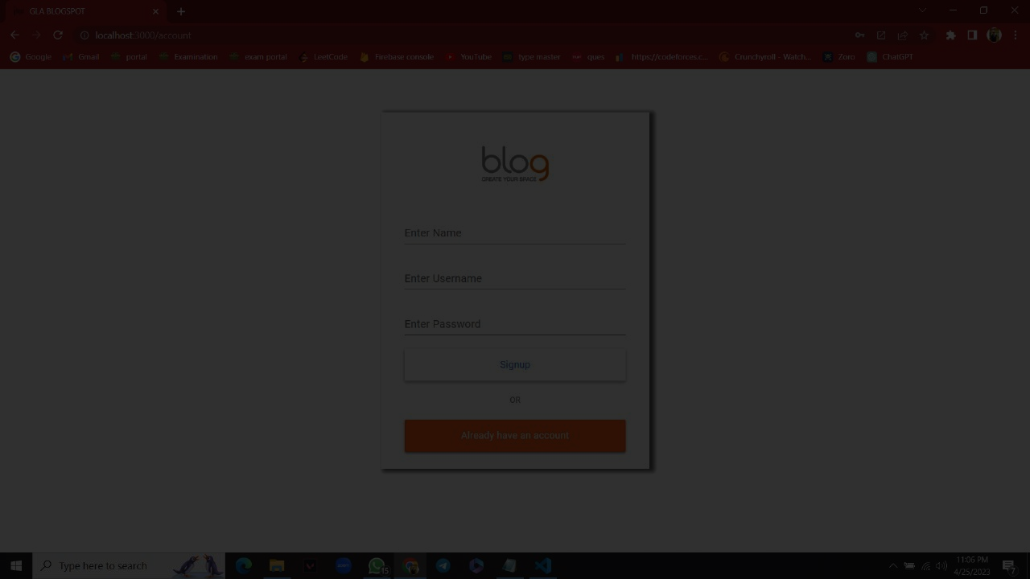
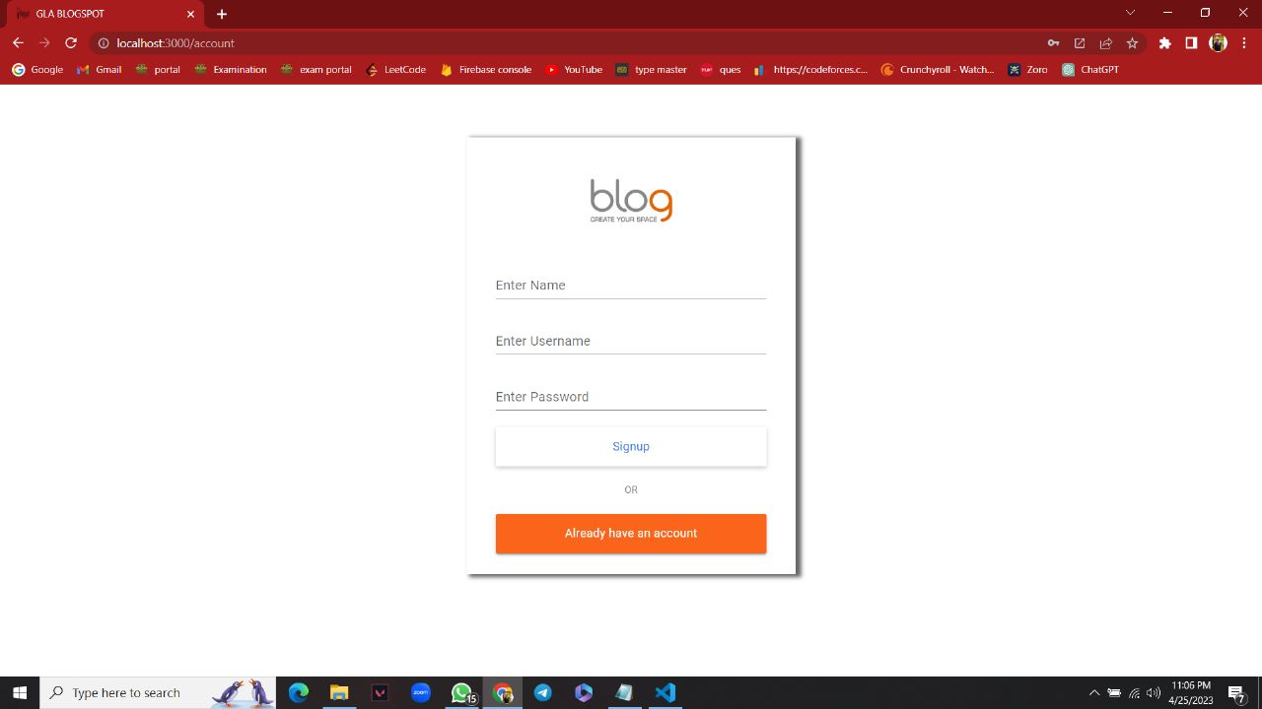
SIGN UP
For New User

Slide 6
Back to LOGIN
If user already have an account

Slide 7
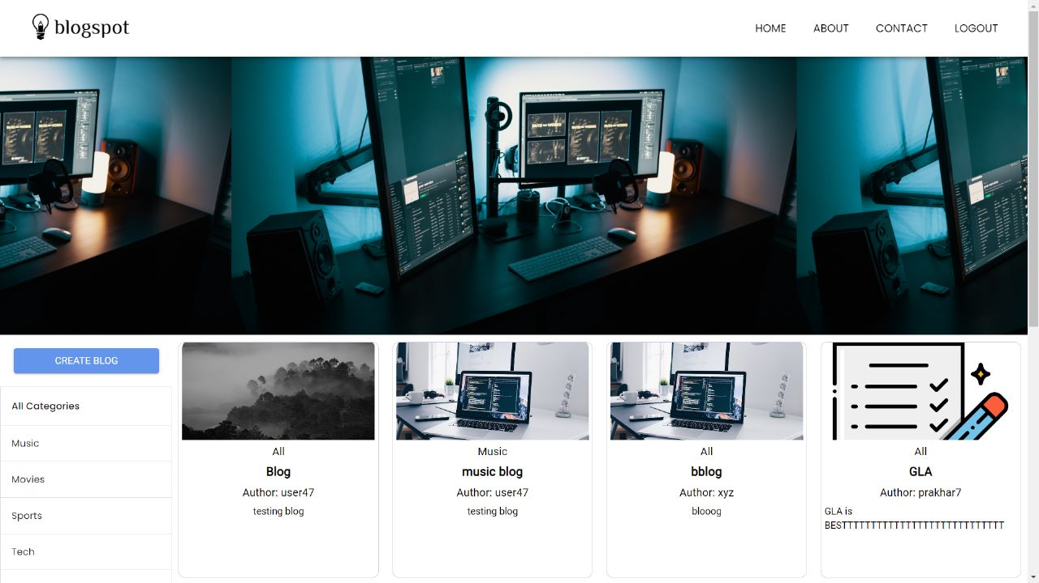
Home Page

Slide 8
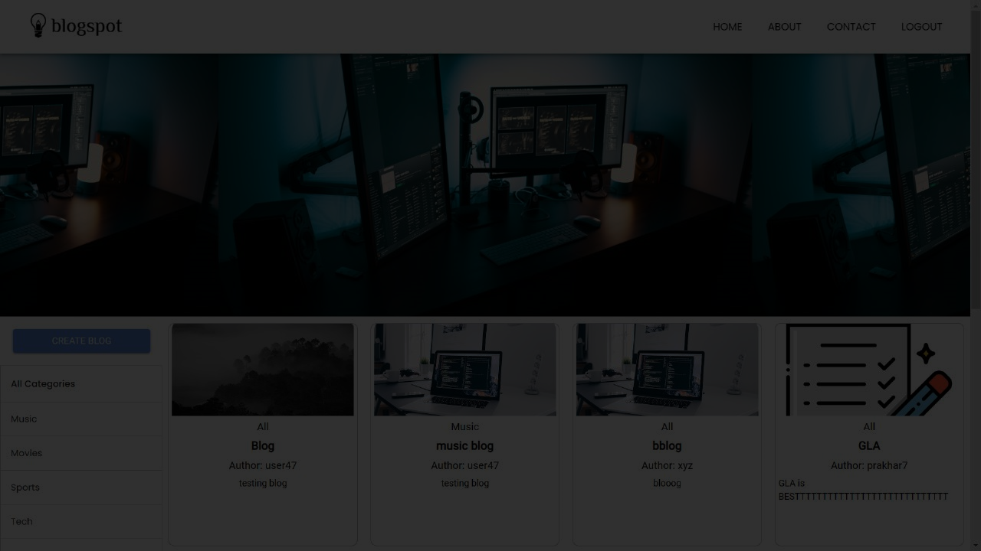
Navigation bar
Brand logo, Other Links

Slide 9
Blog section
All the Post are displayed here

Slide 10
Categories
User can select the categories of their choice

Slide 11
Create Post
User can create a post

Slide 12
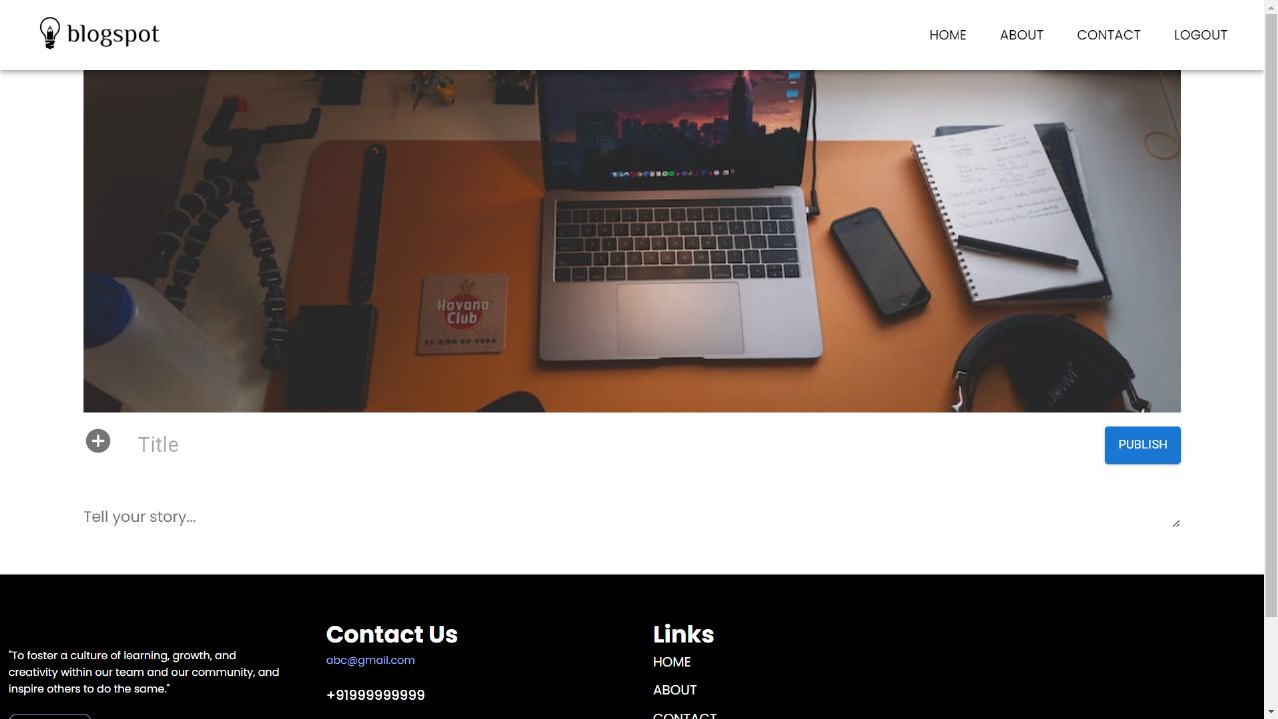
Create Blog

Slide 13
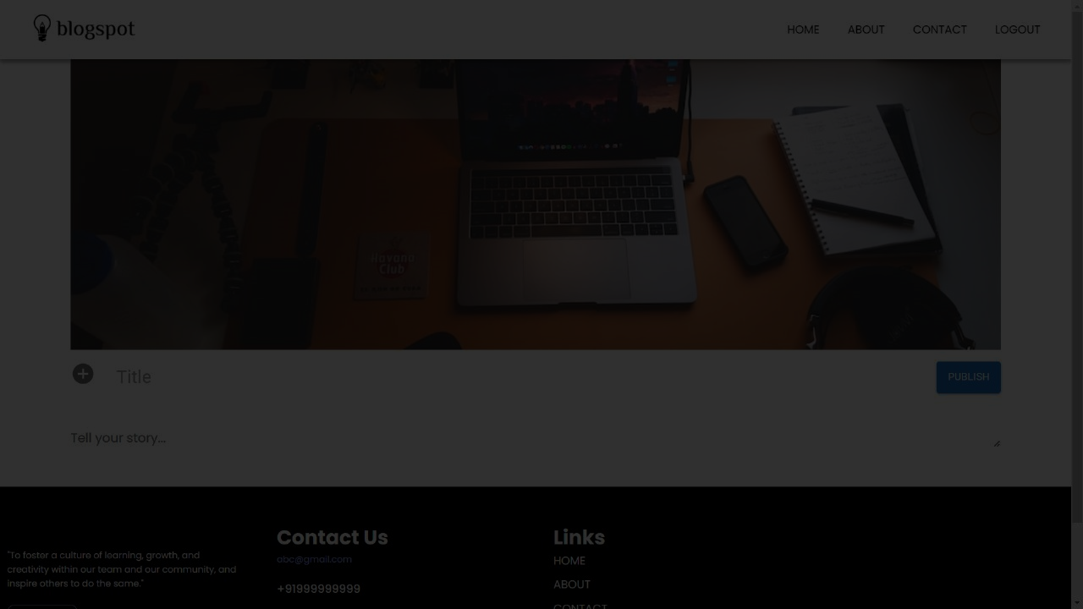
Upload Image
User can upload the cover photo
of the blog

Slide 14
Blog title
User can write the title for the blog

Slide 15
Description
User can write the content for their blog

Slide 16
Publish
User can publish the blog after filling the details of the blog

Slide 17
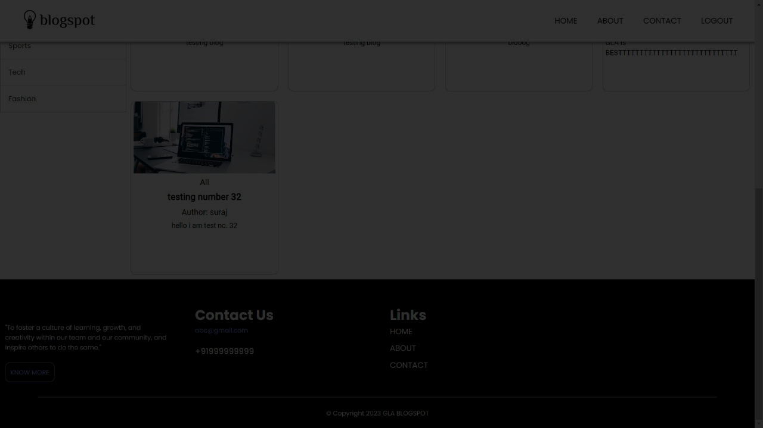
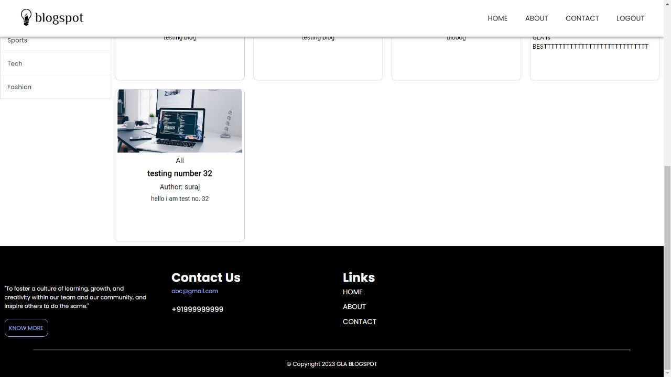
Published blog
User can see their post and can make changes to it

Slide 18
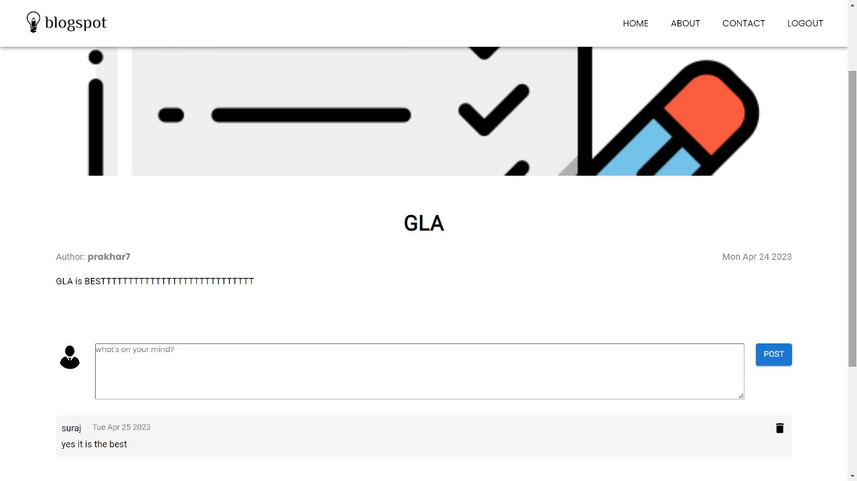
Read and
Comment

Slide 19
Footer
Contact us and other links

Slide 20
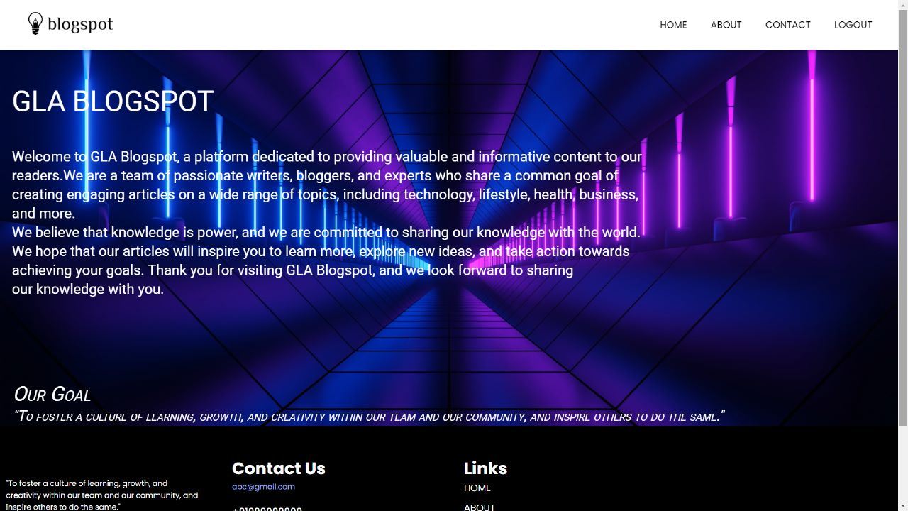
About us

Slide 21
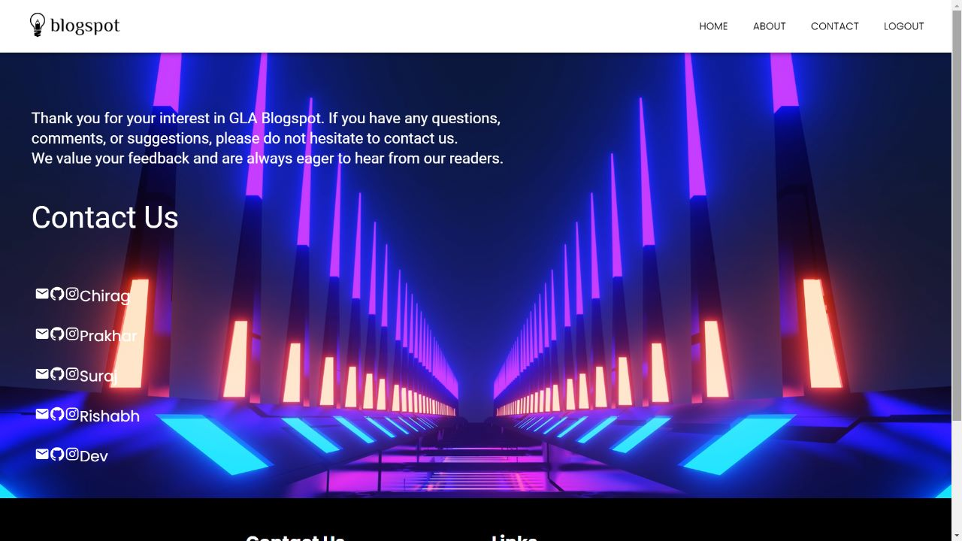
Contact us

Slide 22
THANK
YOU

