Slide 1

AI-based cyber bullying detection & prevention
UNIVERSITY INSTITUTE OF ENGINEERING
SUPERVISED BY:
Dr. Monika Anand
SUBMITTED BY:
Amrit Naunyal (22BCS12577)
Amrit Paudel (22BCS14341)
Gahan Mani Sigdel (22BCS11485)
Jagadish Bhatta (22BCS14017)
Suraj Kiran Airi (22BCS11173)
EVALUATED BY:
Surinder Kaur
Divya Verma
DISCOVER . LEARN . EMPOWER

Slide 2

CONTENT OF PPT
Introduction
Why this Topic
Objective
Need and Scope
Progress Monitoring
References
www.cuchd.in
Campus: Gharuan, Mohali

Slide 3

INTRODUCTION
Bullying, harassment, or harm to individuals, abusive messages, or unauthorized sharing of personal information.
Use of online social networks for Bullying, harassment, and other such purposes.
Experts used to suggest going offline or avoiding using phones in case of cyber bullying, but it is not possible to isolate oneself from the internet with an increase in the use of online social networks.
www.cuchd.in
Campus: Gharuan, Mohali

Slide 4

OBJECTIVE
Past work analysis with their strengths and flaws.
Utilization of natural language processing (NLP) technique.
Comparison of different ML and DL algorithms.
Write a research paper and create a live working prototype.
www.cuchd.in
Campus: Gharuan, Mohali

Slide 5

NEED & SCOPE
Depressed 37.3% Anxious 51.6%, Self-harmed 19,9% Attempted Suicide 5%
Impact on Mental Health
Rising issue and rapid boom in AI
Pioneer steps for a better online environment.
www.cuchd.in
Campus: Gharuan, Mohali

Slide 6
Methodology
Data Collection
Pre-Processing
Train various
ML & DL Models
Base Dataset
Evaluate Models
Best Model
www.cuchd.in
Campus: Gharuan, Mohali

Slide 7
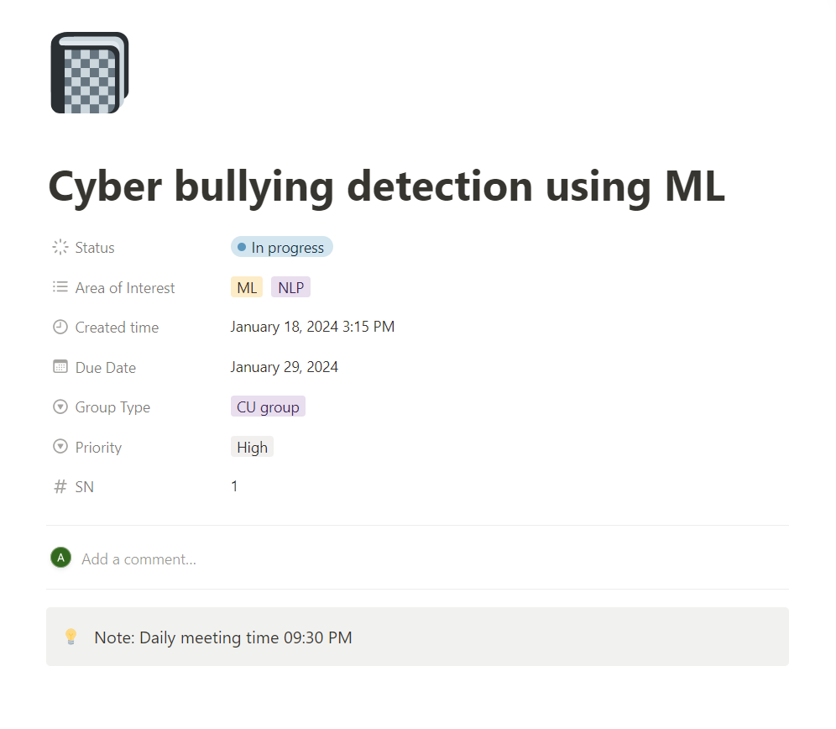
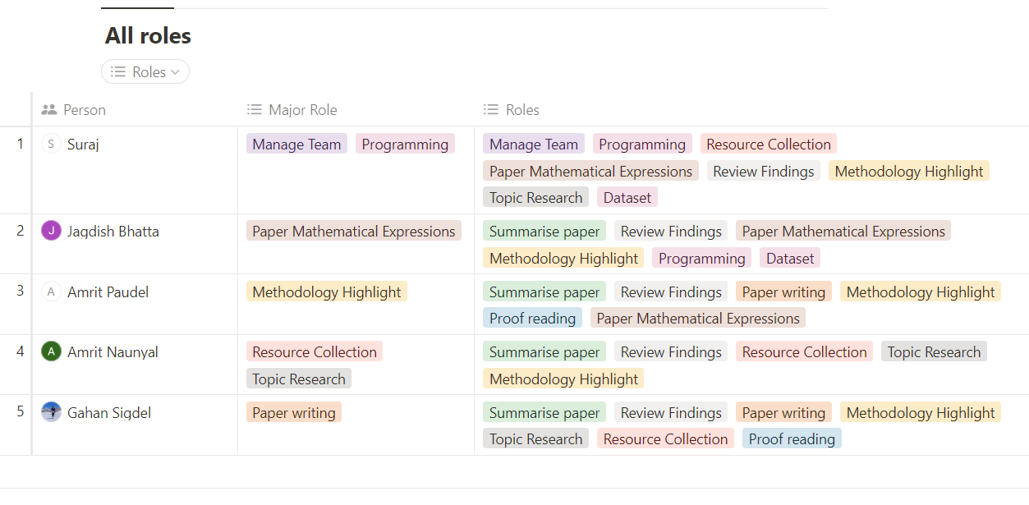
Progress Monitoring
Using Notion
www.cuchd.in
Campus: Gharuan, Mohali

Slide 8
PROJECT TIMELINE
3 weeks
1 week
4 weeks
10 days
4 days
Time in Days
www.cuchd.in
Campus: Gharuan, Mohali

Slide 9
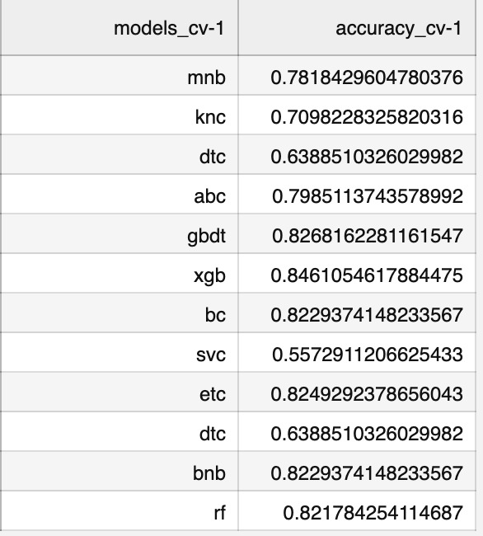
Result
www.cuchd.in
Campus: Gharuan, Mohali

Slide 10
REFERENCES AND SOURCES
https://www.ncbi.nlm.nih.gov/pmc/articles/PMC9321314/
https://www.researchgate.net/publication/351131976_Cyberbullying_Detection_on_Social_Networks_Using_Machine_Learning_Approaches
www.cuchd.in
Campus: Gharuan, Mohali

Slide 11
THANK YOU
www.cuchd.in
Campus: Gharuan, Mohali

