Slide 1
PORTFOLIO PROJECT 5
Loan Portfolio
Risk Analysis
What actually predicts a loan default — and where the credit team should focus first
Prepared by Surajkumar Bevnale

Slide 2
The Problem
Loan approvals weren't grounded in data. Officers leaned on gut feeling and rules of thumb — like assuming job type signals risk — so risky applicants could get approved as easily as safe ones.
The Approach
1
Clean
Excel — dedupe, fix formatting bugs
2
Load & Query
Goal
MySQL — SQL joins, CTEs, windows
What factors make a loan more likely to default — and how can that drive better lending decisions?
3
Verify
Python / pandas sanity checks
Examined: income · employment type · credit score · loan type · debt-to-income · repayment history
Visualize
4
Power BI two-page dashboard
5
Recommend
Actionable steps for credit & risk
Loan Portfolio Risk Analysis
2

Slide 3
Portfolio Snapshot
At a glance — the numbers behind the analysis
5,500
18
₹435.09 Cr
Loan applications analyzed
Branches across 5 regions
Total loan value disbursed
677.32
68.75%
13.91%
Average credit score
Applications approved
Default rate (of approved loans)
Loan value currently at risk of default: approx. ₹57.7 crore
Loan Portfolio Risk Analysis
3

Slide 4
Data & Cleaning
Two raw files, joined on Branch ID — cleaned before anything was trusted
Source Files
Removed duplicates
25 exact duplicate rows dropped (5,525 → 5,500)
loan_applications.csv 5,525 rows × 24 columns — applicant, loan & repayment details branch_master.csv 18 rows × 4 columns — branch, state, region
Left blanks as blank
Age (137), Income (110), Credit Score (82) missing — kept empty
Guiding rule
Fixed a formatting bug
Never guess a number when the honest answer is “we don’t know.” Missing values were left blank, not estimated.
Interest Rate had silently been divided by 100 (8.67% → 0.0867)
Found a data mismatch
16 loans marked defaulted with no default date — flagged for source fix
Loan Portfolio Risk Analysis
4

Slide 5
Independent Check in Python
Before writing a single SQL query, pandas confirmed the Excel cleaning held up
✓
Row & column counts
Missing Values — Excel matched Python exactly
✓
Column data types
Age
137
Annual Income
110
✓
Summary statistics (.describe())
Credit Score
82
✓
Missing-value counts (.isnull().sum())
Default Date
4,751
Default Date shows 4,751 missing — and that's correct: only the 749 loans that actually defaulted should carry a default date (5,500 − 749 = 4,751).
Loan Portfolio Risk Analysis
5

Slide 6
SQL Analysis
From simple aggregates to window functions, CTEs, and a reusable view
GROUP BY
WHERE filter
JOIN
Loan volume & profile by employment type
Isolate defaulted + credit score < 600
Top 5 branches by disbursed value
Job type alone barely moves average credit score (674–680)
195 applicants meet both — the clearest high-risk list
Mumbai Andheri leads total loan exposure
ROW_NUMBER()
RANK()
CTE + subquery
Rank each loan within its branch
Employment types by avg. credit score
High-risk flags & above-average earners
Flags concentration risk from a few large loans
Confirms job type is a weak risk signal
Risk is spread across job types, not concentrated
Loan Portfolio Risk Analysis
6

Slide 7
One Source of Truth: branch_risk_summary
A saved SQL view feeds the SQL analysis, Python checks, and the Power BI dashboard alike
CREATE VIEW branch_risk_summary AS
SELECT b.Branch_Name, b.Region,
COUNT(l.Applicant_ID) AS total_loans,
SUM(CASE WHEN l.Default_Flag='Yes'
THEN 1 ELSE 0 END) AS total_defaults,
ROUND(SUM(CASE WHEN l.Default_Flag='Yes'
THEN 1 ELSE 0 END) * 100.0 /
COUNT(l.Applicant_ID), 2) AS default_rate_pct,
AVG(l.Credit_Score) AS avg_credit_score
FROM loan_applications l
JOIN branch_master b
ON l.Branch_ID = b.Branch_ID
GROUP BY b.Branch_Name, b.Region;
Why it matters
Querying it sorted by default rate immediately surfaces which branches need attention first. It's the same logic every downstream tool relies on — no re-derivation, no drift between SQL, Python, and Power BI numbers.
Loan Portfolio Risk Analysis
7

Slide 8
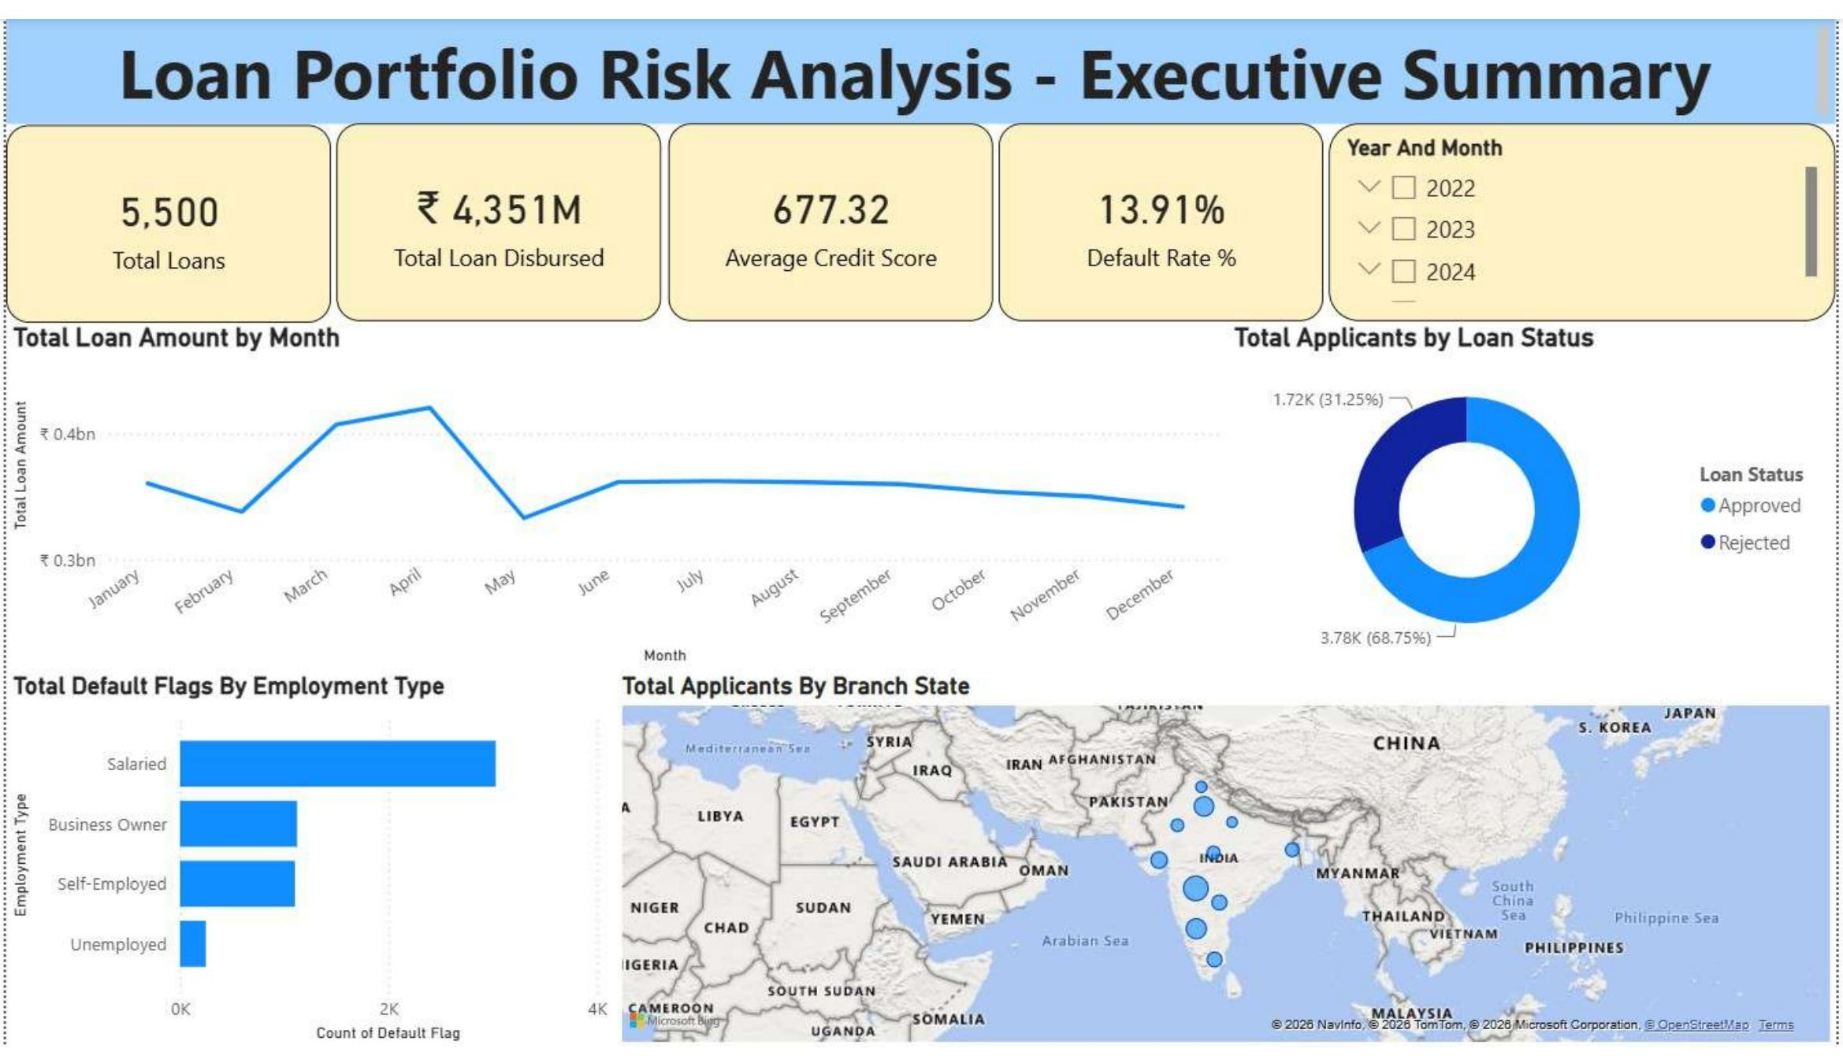
Dashboard — Executive Summary
Power BI, Page 1 — “how is the portfolio doing right now?”, answered in under 10 seconds
5,500 loans · ₹4,351M disbursed
677.32 avg. credit score · 13.91% default rate
Monthly loan-volume trend for seasonality
Approved vs. rejected split (68.75% / 31.25%)
Defaults by employment type
Branch map + Year/Month filter for any viewer
Loan Portfolio Risk Analysis
8

Slide 9
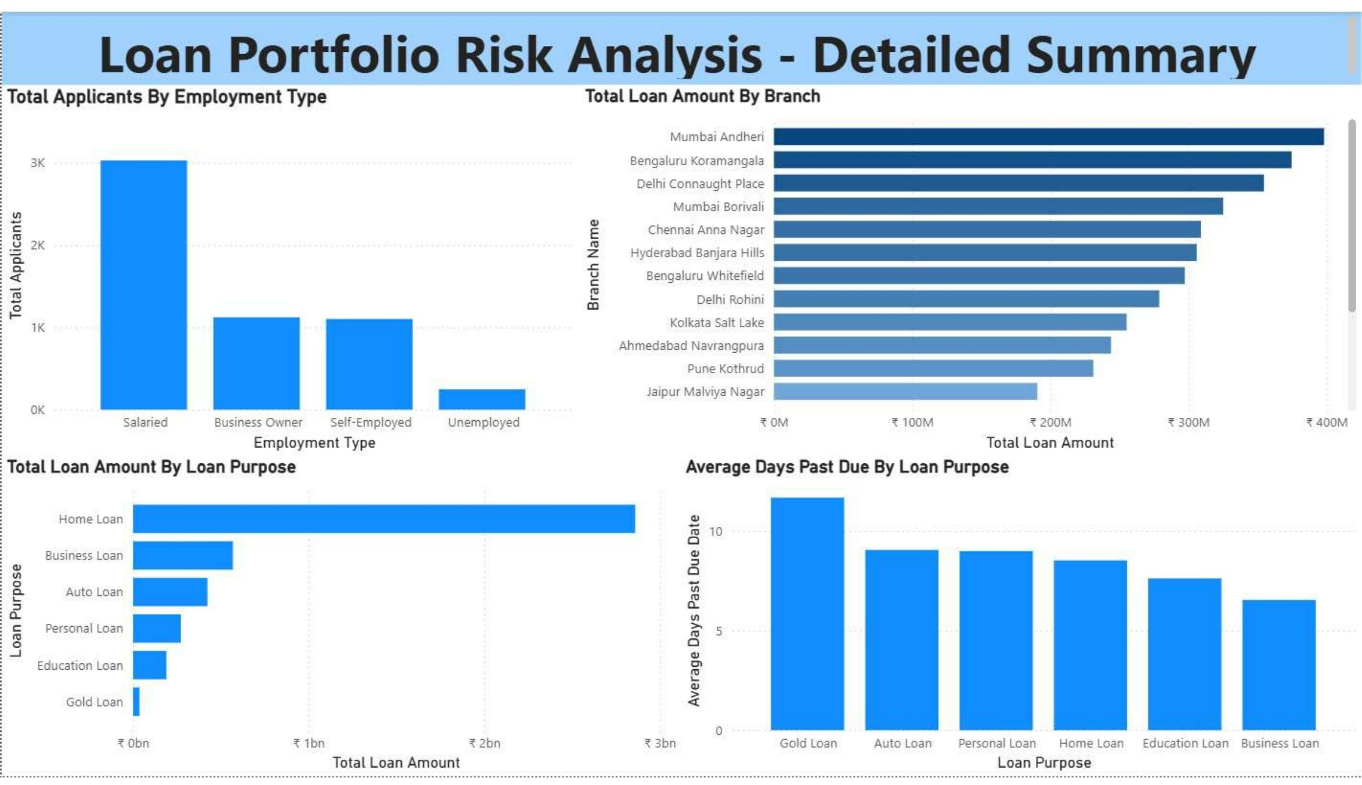
Dashboard — Detailed Analysis
Power BI, Page 2 — one level deeper: branches, loan purpose, and days past due
Salaried applicants are the largest single group
Mumbai Andheri disbursed the most loan value
Home Loans are the largest category by value
Gold Loans: longest avg. days past due (11.7) despite smallest volume — the key operational finding
Loan Portfolio Risk Analysis
9

Slide 10
Key Findings
What the data actually says about default risk
Gold Loans lag on repayment
Smallest category by volume, but the highest average days past due at 11.7 days.
1
Risk varies sharply by region
Default rates range from 12.12% (East) to 15.09% (North) — a gap worth investigating.
2
Job type is a weak predictor
Average credit scores across employment types cluster within a narrow 674–680 band.
3
Credit score & history matter more
Far stronger signals of default risk than any demographic factor.
4
A clear high-risk group exists
195 applicants both defaulted and had credit score < 600 — ready for recovery action.
5
Loan Portfolio Risk Analysis
10

Slide 11
Recommendations
Five concrete, actionable steps for the credit and risk teams
1
2
3
Review the Gold Loan approval process
Standardize approval rules across regions
Weigh credit score & history over job type
11.7 days average past due — tighter collateral checks or earlier follow-up on late payments.
A 3-point default-rate gap (East 12.12% vs. North 15.09%) is too large to be noise.
Lean underwriting models on credit score, DTI, and repayment history instead.
4
5
Prioritize the 195 confirmed high-risk defaulters
Fix the 16 missing default-date records
Defaulted + credit score < 600 — the clearest list for immediate recovery action.
A cheap data-entry fix that prevents broken days-past-due and time-to-default reporting.
Loan Portfolio Risk Analysis
11

Slide 12
Conclusion
How you handle messy data matters as much as the analysis itself.
Leaving genuine gaps blank instead of guessing — and catching the interest-rate bug before it touched a single calculation — is what makes every number in this report trustworthy. And the data is clear: credit score and repayment behavior beat job type as risk signals, every time.
Next Steps
Stronger data-entry validation at the source
Longer history to reveal seasonal trends
A predictive default-risk score at time of application
Thank you
Surajkumar Bevnale · Loan Portfolio Risk Analysis

