Slide 1

Flight Price Prediction Project
By
Suraj Chakraborty
FLIP ROBO (Intern)
Internship 15

Slide 2
Contents
Introduction
Problem statement and understanding
EDA steps and visualization
Steps and assumptions used
Model dashboard
Finalized model
Conclusion

Slide 3
Introduction
Booking a flight nowadays has become very unpredictable with respect to the fare of the flights. Also with the covid 19 impact on the transport industry, it has become more challenging to keep up with the fluctuating prices of fares of the flights. Anyone who has booked a flight ticket knows how unexpectedly the prices of tickets vary. The cheapest available ticket on a given flight gets more and less expensive over time. This usually happens as an attempt to maximize revenue based on, 1. Time of purchase patterns 2. Keeping the flight as full as they want it (raising prices on a flight which is filling up in order to reduce sales and hold back inventory for those expensive last-minute expensive purchases)
With an aim to increase their profits the airlines often play different kinds of tricks, making the customers clueless on what the fare might be. So here, we have to work on this project where we need to collect data of flight fares along with other features and work to make a model to predict fares of flights.

Slide 4
Problem statement and understanding
With the prices of flight tickets varying very unexpectedly and because of which the problems that the passengers are facing, we are assigned with the project where we have to collect data of flight fares along with other features and make a model using those to predict fares of flights.
The project consists of three phases, the data collection phase, the data analysis phase and the model building phase. In the data collection phase, we have to scrape at least 1500 records of data. In this section we need to scrape the data of flights from different websites.
After collecting the data, we have to do some analysis on them and find answers to some queries. After analysing the data and finding the answers, we need to build a machine learning model, and before model building we need to do all data pre-processing steps then try different models with different hyper parameters and select the best model.

Slide 5
EDA steps and visualization
We scraped the data using jupyter notebook and saved the data in an excel sheet, then we loaded the dataset into another jupyter notebook and performed the following EDA on it :
First we checked the size of the dataset and all the feature that were present in it.
Then we dropped the unwanted columns from the dataset which was the index column.
We then checked for any missing values in the dataset.
We checked the unique values of all the features in the dataset, where we found some junk data along with the actual values.
We checked the value counts for certain columns to check for imbalance in data.
We checked the data types of all the columns in the dataset and description of the continuous numeric data.
In the further steps we checked for outliers in the dataset and also checked for skewness in the data.

Slide 6
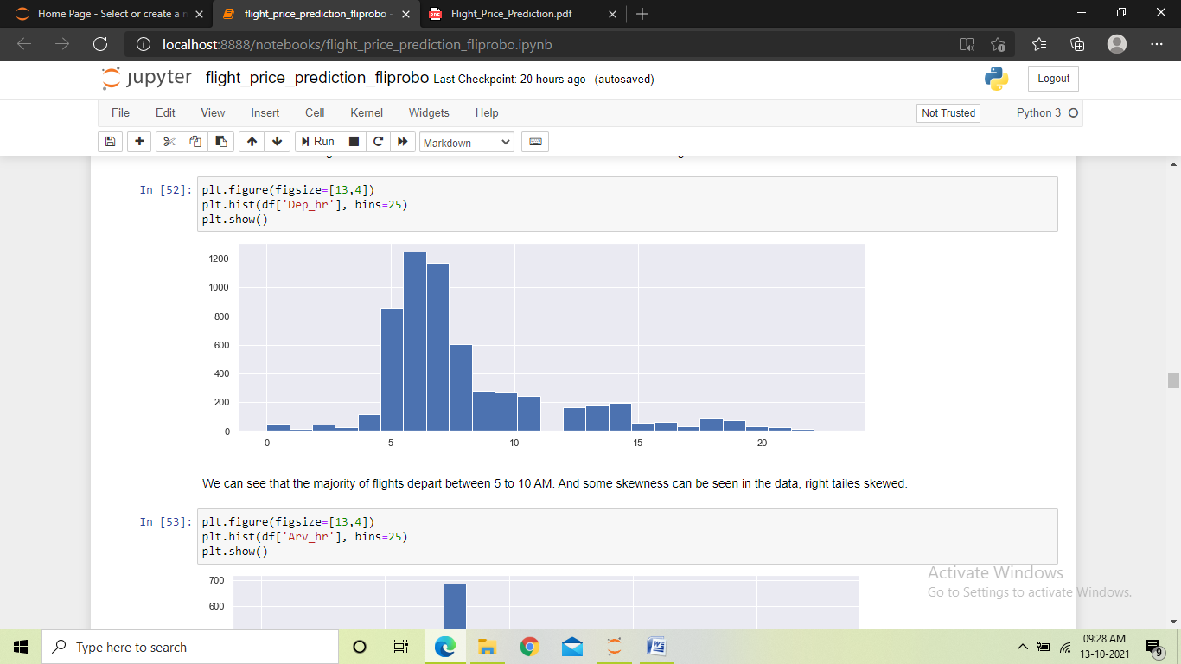
We performed the following visualizations in the dataset:
Histogram : We used the histogram to see the distribution of data in the continuous numeric columns. We found some columns having skewness in the data and some had variance in their data.

Slide 7
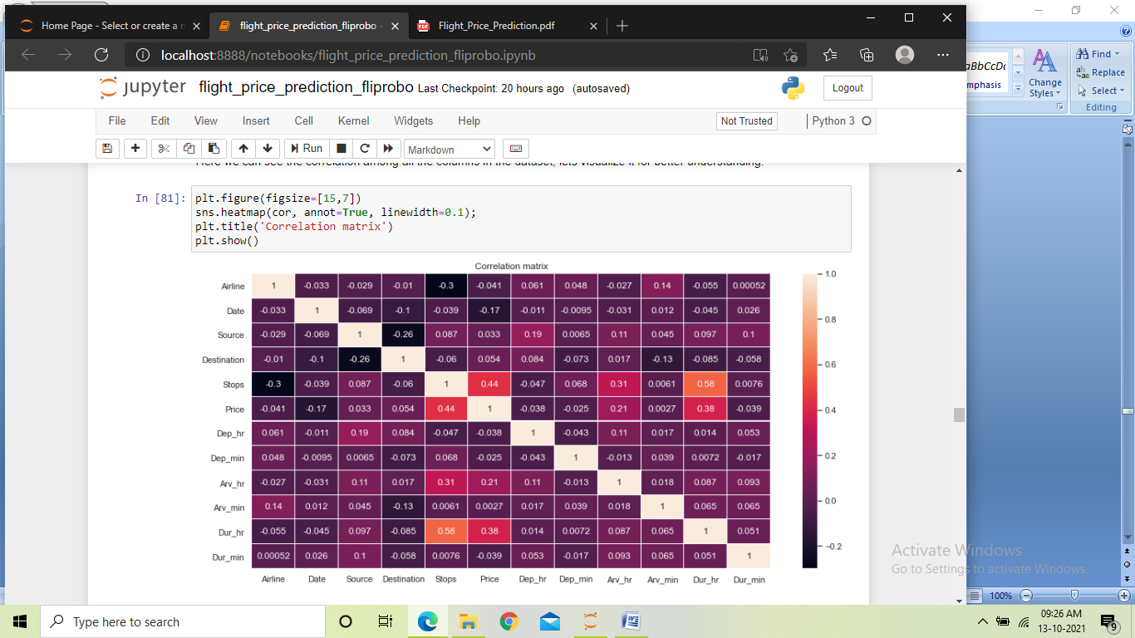
Heatmap : Heat map was used on two occasions in the project, once for checking any missing values in the dataset and the next time to plot the correlation matrix of the dataset. In the first case, we found no missing values in the dataset. And in the second case we found many types of correlation between the columns. There were some positive as well as negative relations in the matrix, and also some columns showed no correlation.

Slide 8
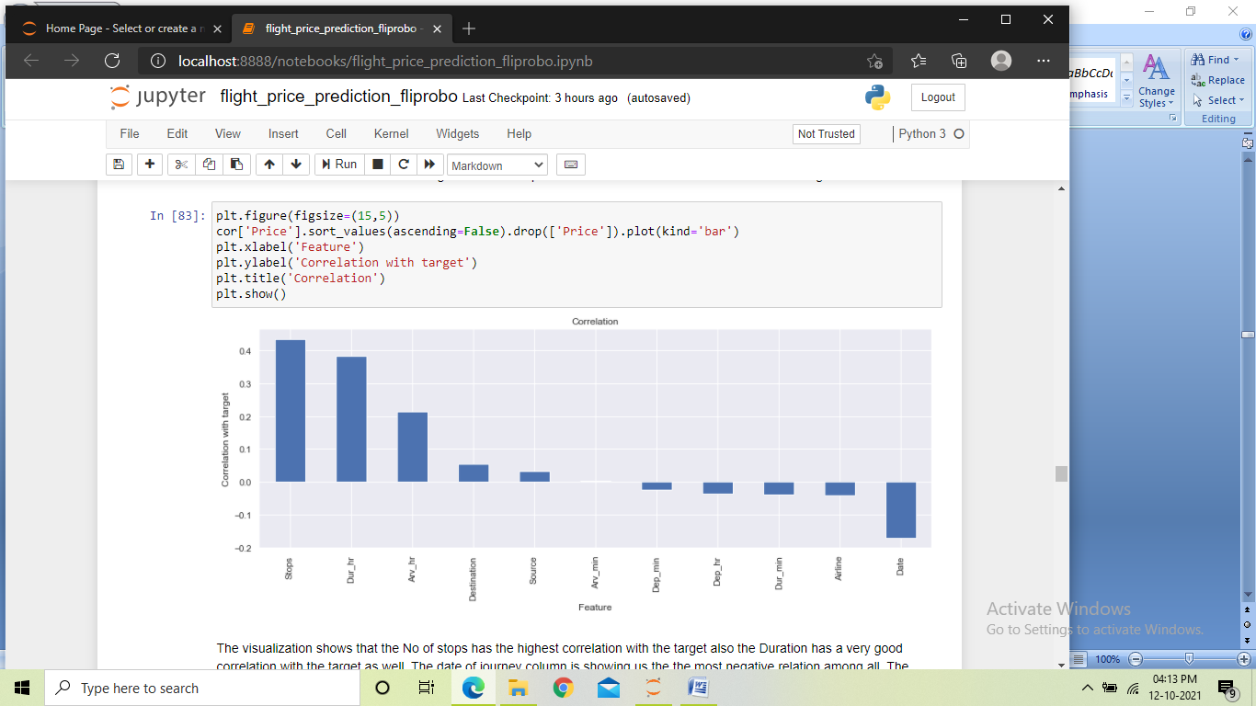
Bargraph: We plotted this bar graph to visualize the correlation of all the independent columns with the target column. We found some positive as well as negative corelation in between the columns, and also a column showed no correlation.

Slide 9
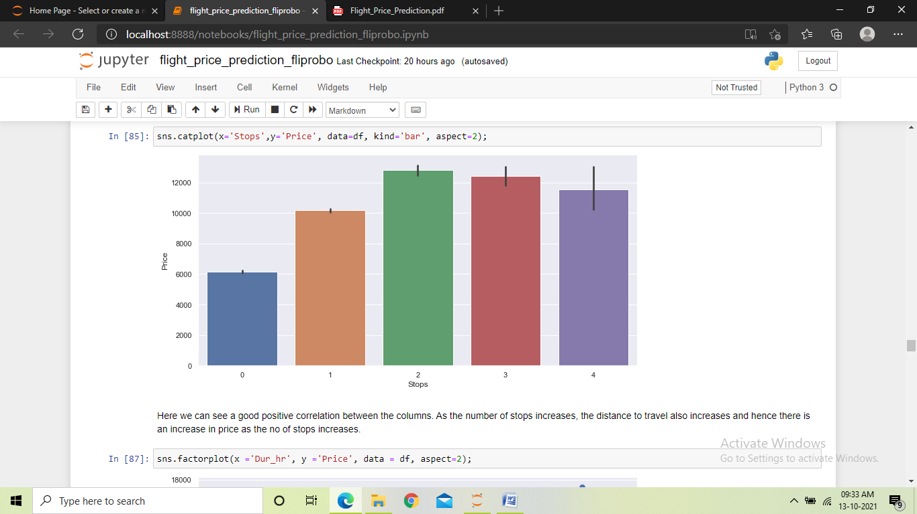
Catplot: We used the catplot multiple times to visualize the relationship between an independent columns and the target. Here in this plot we found a good positive correlation between the Stops feature and the price. This meant that more the number of stops, the higher the price gets.

Slide 10
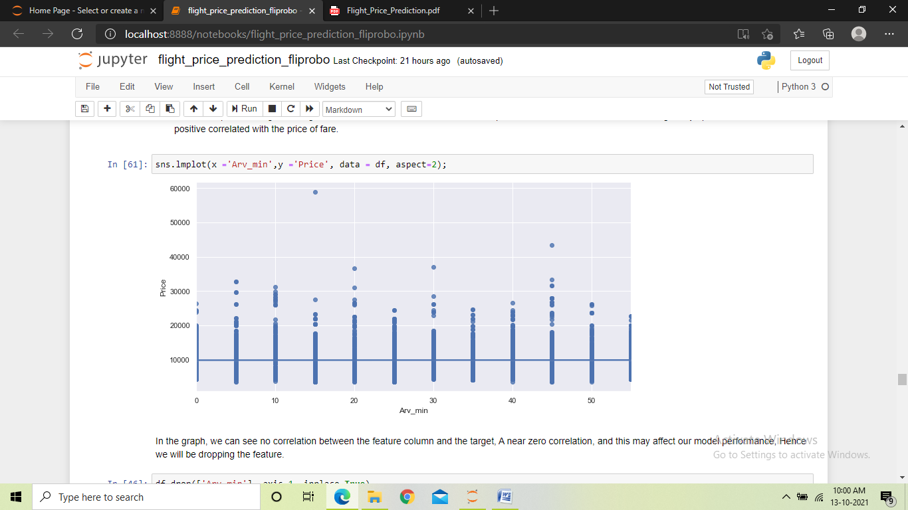
Lineplot: We used the lineplot multiple times to visualize the relationship between an independent columns and the target. Here in this plot we found no correlation between the target and the arrival min column, which showed that the price do not depend on the min of arrival.

Slide 11
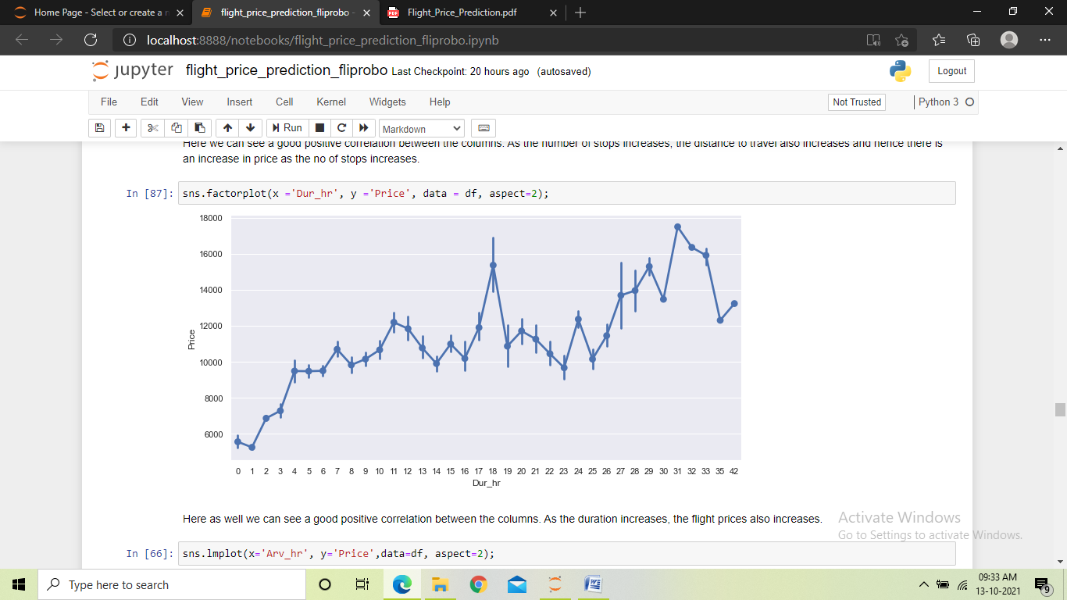
Factorplot: We used the factor plot multiple times to visualize the relationship between an independent columns and the target. Here in this plot we can see the trend of the graph, which is going up, this showed that the duration hr is positive correlated with the target.

Slide 12
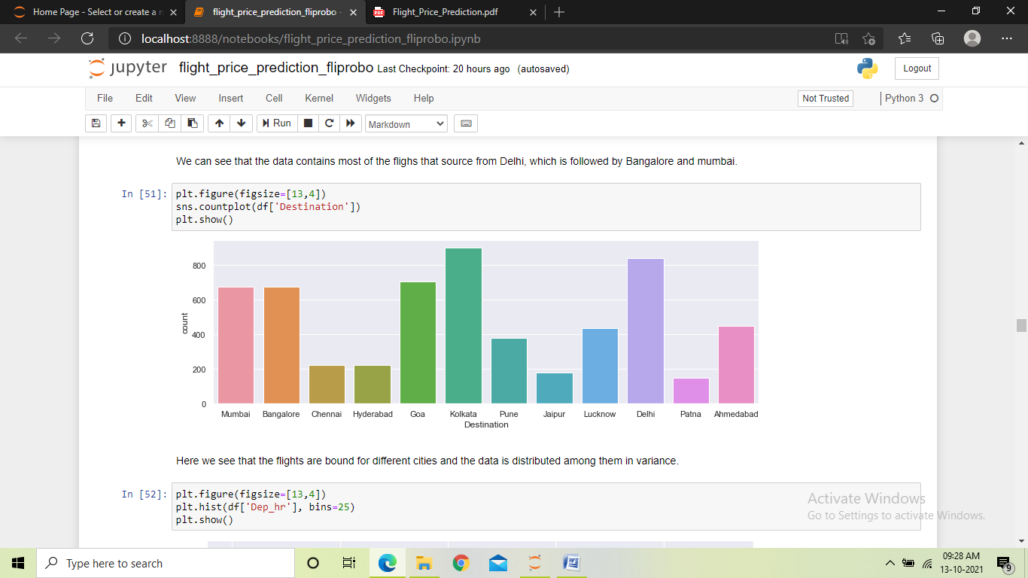
Countplot: We used the count plot to check the count of values in different columns of the dataset. And we found some values being more, some being less and some having equally distributed values in different columns of the dataset.

Slide 13
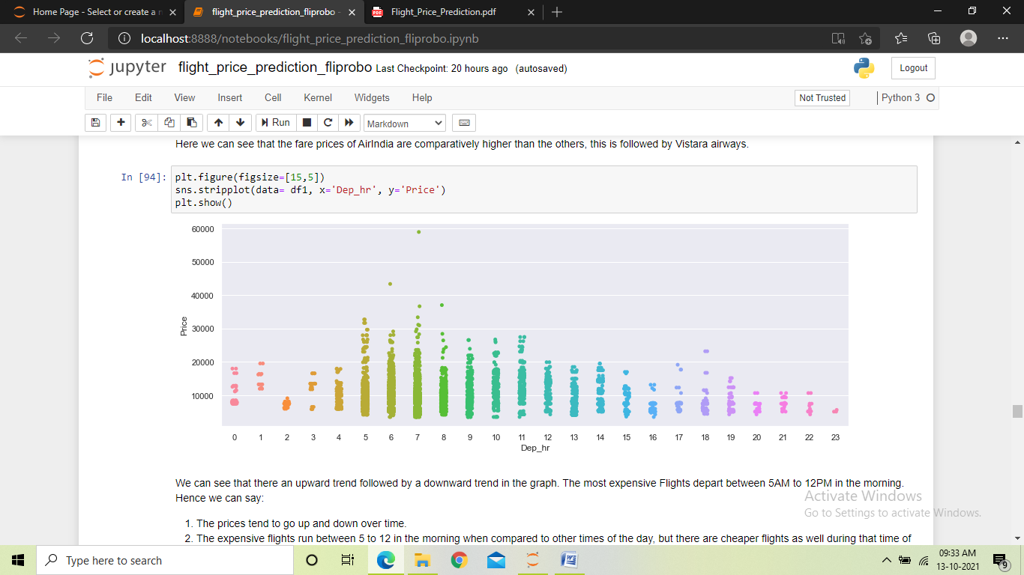
Stripplot: We used the Stripplot to visualize the relationship between an independent columns and the target. The graph here showed some negative correlation between the columns. This showed that the more expensive flights run between 5 to 12 AM of the day.

Slide 14
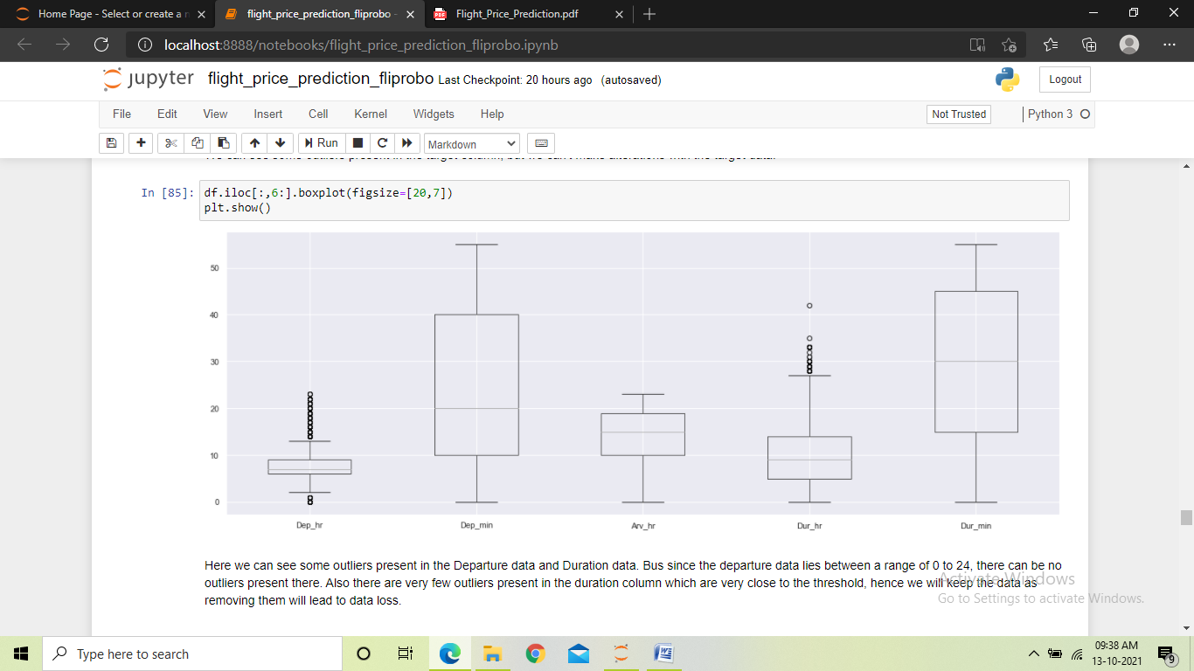
Boxplot: We used the boxplot to check for any outliers in the dataset. In this plot we can see some outliers present in some columns which are very close to the threshold.

Slide 15
Steps and assumptions used
Loaded the dataset into a jupyter notebook
Performed EDA on the dataset to get better insights into the data.
Checked for missing values in the dataset.
Performed data cleaning by cleaning all junk data from the columns and converting all numeric columns to integer data type.
Performed visualization to check the distribution and the value counts of data in different columns.
Encoded the columns containing categorical data.
Checked the correlation between all the columns in the dataset.
Performed bivariate analysis to check the relationship between the features and the target and tried finding answers to different queries.
Checked for outliers in the dataset.
Checked for skewness and then handled the skewness in the dataset.

Slide 16
Split the dataset into target and features.
Performed scaling on the features.
Found the best random state and preformed train test split using that.
Trained different models using the train datasets and checked their scores on the test dataset.
Checked CV score for all the models for any overfitting or underfitting.
Hyper-parameter tuned the better performing models to find the best parameters for those models.
Trained those models using the parameters found to be performing best during the hyper parameter tuning.
Saved the best performing model as the final model.

Slide 17
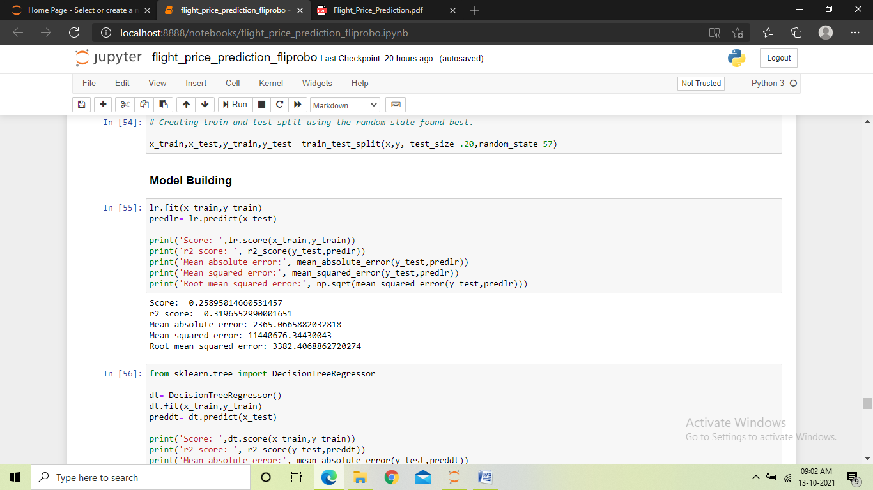
Model dashboard
In this project we used six different regression models to train the data, the models that we used are:
Linear Regression: It measures the relationship between continuous numeric dependent variable and the independent variables by estimating probabilities. Using linear regression, we found the training score to be 26%, the R2 score to be 32% and the errors being high.

Slide 18
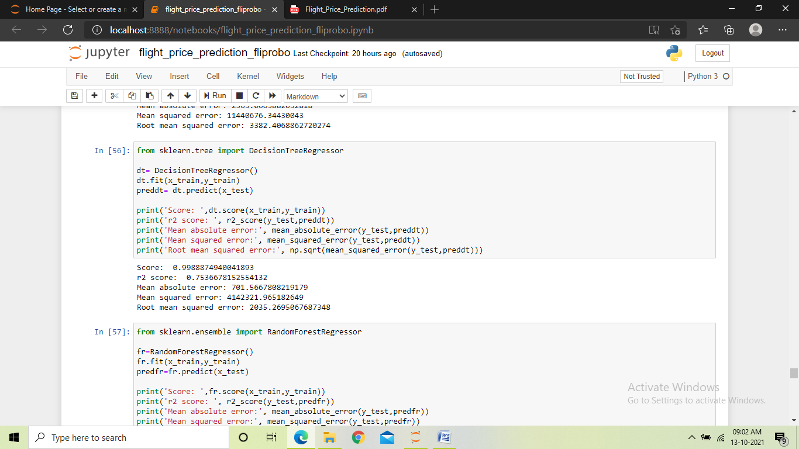
Decision Tree Regressor: Builds regression models in the form of a tree structure. It breaks down the dataset into smaller subsets. Using Decision tree regressor, we found the training score to be 99%, the R2 score to be 75%, and errors are less.

Slide 19
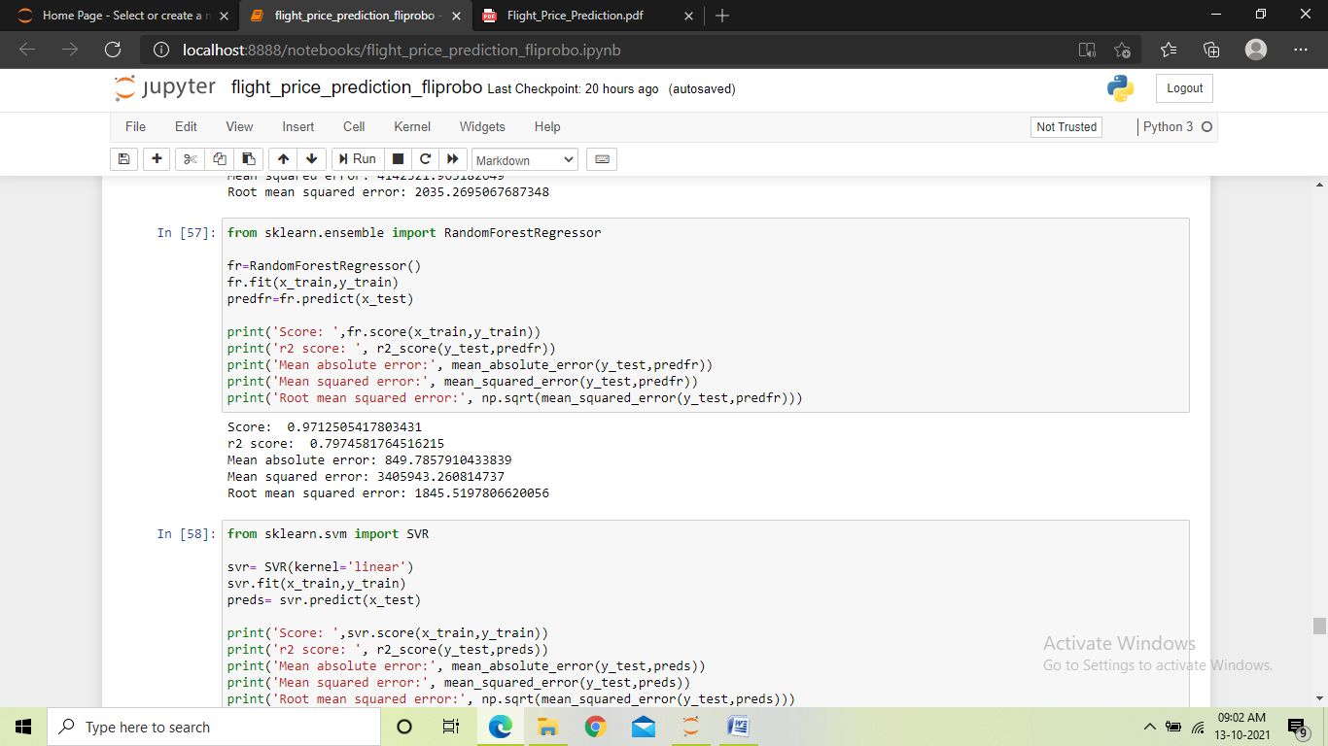
Random Forest Regressor: It builds multiple decision trees and merges them together to get a more accurate prediction. Using Random forest regressor, we found the training score to be 97%, the R2 score to be 80%, and with less errors.

Slide 20
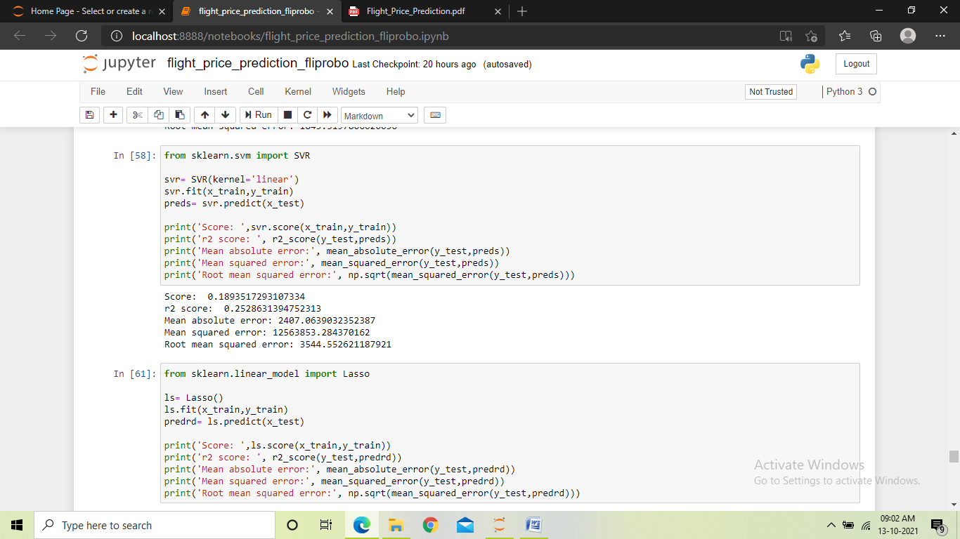
Support Vector Regressor: It looks at data and sorts it into one of two categories. It helps in determining the closest match between the data points and the function which is used to represent them. Using support vector regressor, we found the training score to be 11%, the R2 score to be 25%, and with high errors.

Slide 21
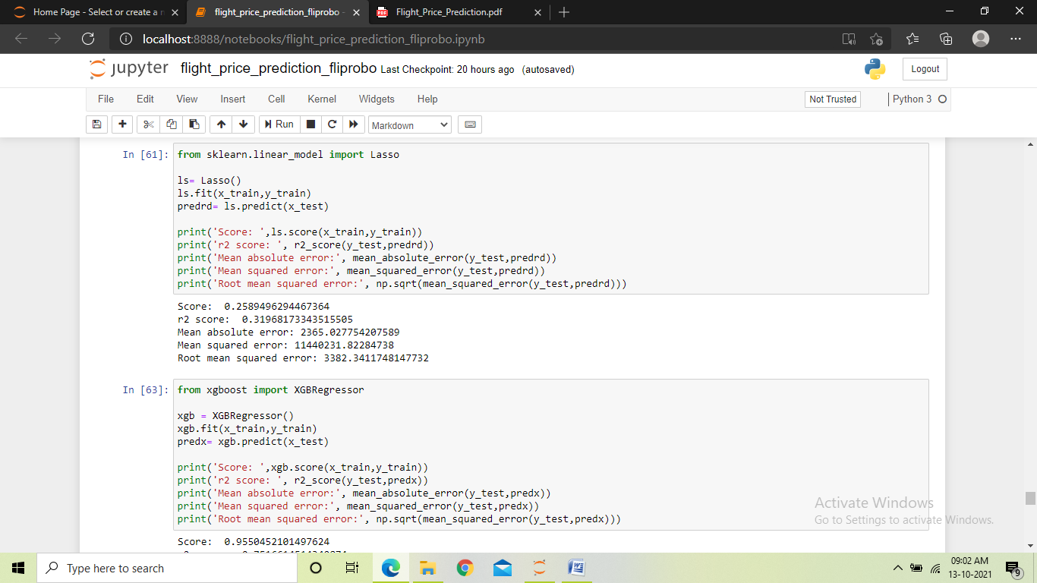
Lasso Regression: It uses shrinkage. Shrinkage is where data values are shrunk towards a central point, like the mean. The lasso procedure encourages simple, sparse models i.e. models with fewer parameters. Using Lasso regressor, we found the training score to be 25%, the R2 score to be 32%, and with high errors.

Slide 22
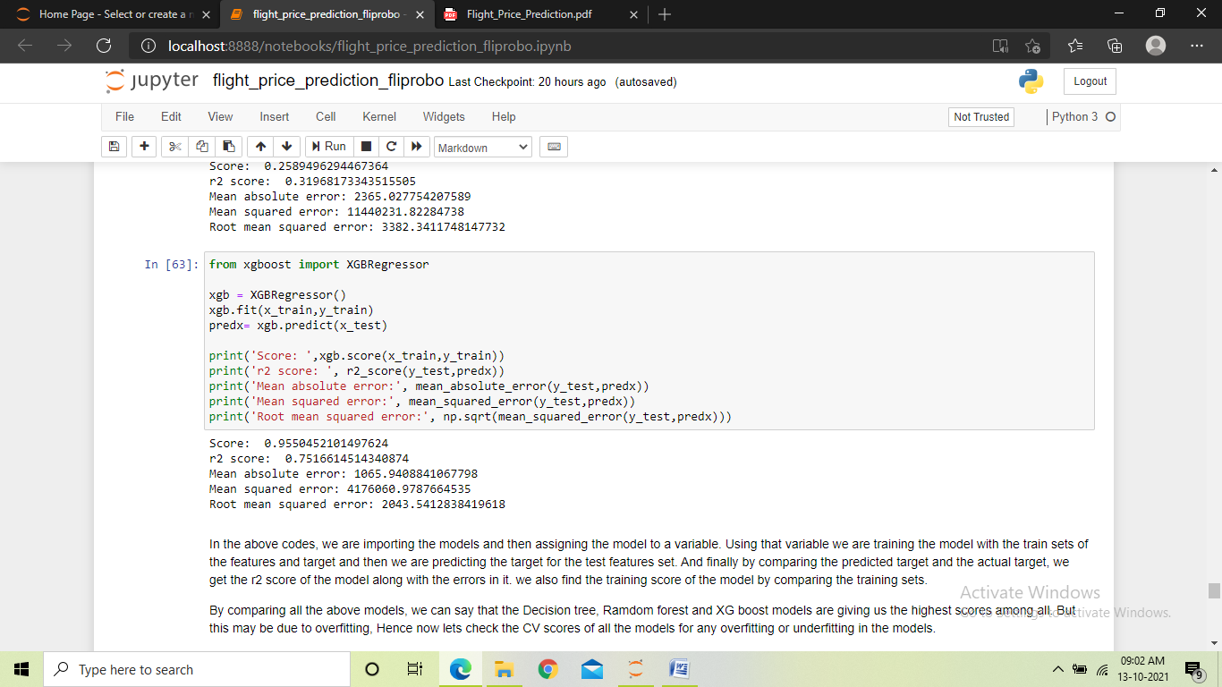
XGB Regressor: It is an efficient implementation of gradient boosting that can be used for regression predictive modelling. Using XGB regressor, we found the training score to be 95%, the R2 score to be 75%, with the errors being comparatively less.

Slide 23
Finalized model
We trained the dataset using six different models to select a final model which will perform the best among all the models.
We used Linear regression, Decision tree regressor, Random forest regressor , SVR, Lasso regressor and XGB regressor. After training we found the models Decision tree, Random forest and XGBoost were performing similar and better as compared to other models and they gave us a good training as well as r2 score along with less errors. But since the high scores could have been a result of overfitting, we performed the cross validation check.

Slide 24
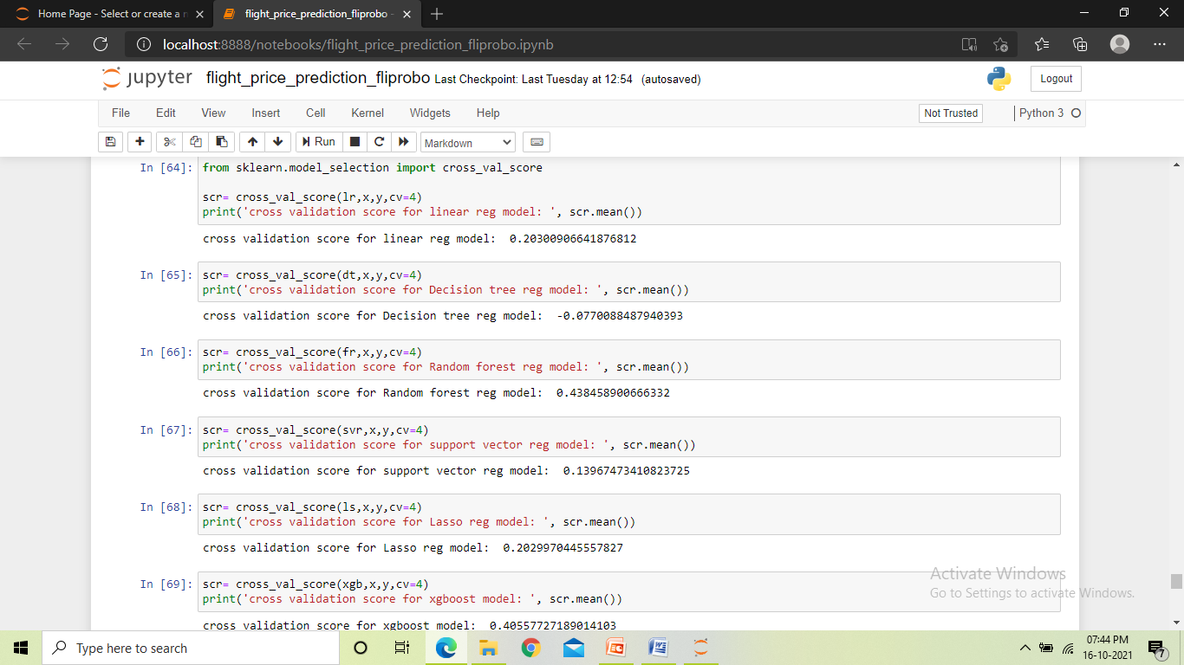
From the cross validation check, we found that the Random forest model and the XGBoost model gave us the highest scores but the decision tree models gave a very low score which meant that the model was being overfitted. Hence we selected the two higher scoring models to perform hyper parameter tuning.

Slide 25
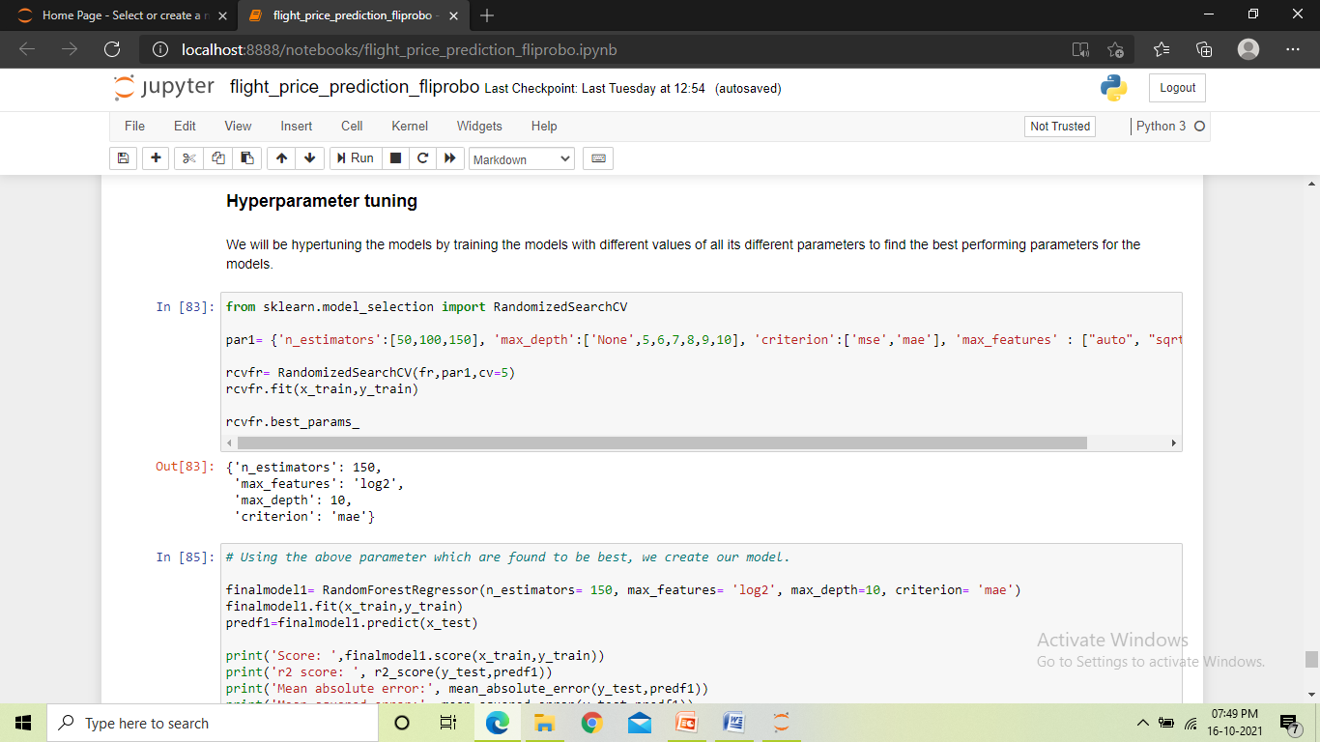
We used Randomized_search_CV to hyper parameter tune both the models. We gave different values for the parameters to the randomized_search_cv and it gave us the best performing values for those parameters. And finally using those values in the parameters, we trained our final two models.

Slide 26
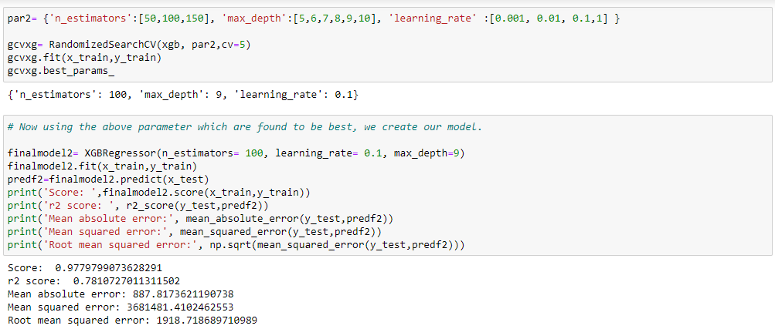
After training the two models, we found that the XGBoost model was performing slightly better as compared to the Random forest model and also gave us comparatively less errors. And hence we made the XGB Regressor model as our final model and saved it.

Slide 27
Conclusion
From the project, we found that while scraping the data it is important to use different websites as the data source. We fetched nearly 5900 records, which formed the dataset for the project and since the target was price, we had to follow the regression approach. We found that the data contained an unwanted column which was the index column which we dropped, also we found many junk data attached to the actual data for which the numeric columns turned to object data type, along with this some duplicate values were also found which were written in different manners.
During data cleaning we found that for the feature airline, a value contained only three records in the entire dataset, which we then removed as it may have affected our model. We found that majority of the features were of date and time, for time data we had to split the features into hours and minutes also the date contained different dates but of the same month and year, hence we kept only the date data. Also we found a feature ‘arrival minute’ that had no correlation with the target data, for which we dropped the feature.
As we were given some queries to find answers for, we analysed the data visually by checking correlations between different features and the target and we came up with the following analysis:

Slide 28
Yes, airfares do change frequently, it changes with different times of the day and also for different dates.
The fare for the present day flights are very high and for the next day there is a drop in the price with a quite large jump, and following this the fares of flights vary in small jumps in the prices decreasing as we go further in the date.
The prices tend to go up and down over time.
As we get closer to the departure date, the price of the fares increases.
The expensive flights run between 5 to 12 AM in the morning when compared to other times of the day, but there are cheaper flights as well during that time of the day. So we can say morning that flights have both expensive as well as cheaper flights.
We can say that the best time to buy tickets is a week or two before the travel date, and if this is not possible customers can buy tickets at least 2 days before the travel and they can opt for flights between 5AM to 2PM of the day as the majority of the flights fly between these hours and the customers will find more options on flights during these hours, also the customers should keep into consideration the duration of the flight they opt for as the duration is positive correlated with the price of fare.

Slide 29
Then we found that the dataset contained few outliers, but they were very close to the threshold, also some skewness were found in certain features which we then treated. During the model building, while checking for CV score we found that the decision tree model was being overfitted and finally by hyper parameter tuning we found that the XGBoost model was performing the best in our project and hence we saved the model as our final model.

