Slide 1

Housing Price Prediction Project
By
Suraj Chakraborty
FLIP ROBO (Intern)
Internship 15

Slide 2
Contents
Introduction
Problem statement and understanding
EDA steps and visualization
Steps and assumptions used
Model dashboard
Finalized model
Conclusion

Slide 3
Introduction
Houses are one of the necessary need of each and every person around the globe and therefore housing and real estate market is one of the markets which is one of the major contributors in the world’s economy. It is a very large market and there are various companies working in the domain.
A US-based housing company named Surprise Housing has decided to enter the Australian market. The company uses data analytics to purchase houses at a price below their actual values and flip them at a higher price. For the same purpose, the company has collected a data set from the sale of houses in Australia.
The company is looking at prospective properties to buy houses to enter the market.

Slide 4
Problem statement and understanding
The company is looking at prospective properties to buy houses to enter the market. We are required to build a model using Machine Learning in order to predict the actual value of the prospective properties and decide whether to invest in them or not.
The company wants to know:
• Which variables are important to predict the price of variable?
• How do these variables describe the price of the house?
We are required to model the price of houses with the available independent variables. This model will then be used by the management to understand how exactly the prices vary with the variables. They can accordingly manipulate the strategy of the firm and concentrate on areas that will yield high returns. Further, the model will be a good way for the management to understand the pricing dynamics of a new market.

Slide 5
EDA steps and visualization
We loaded the dataset and performed EDA on it to get better insights into the data.
First we checked the size of the dataset and all the feature that were present in it.
We checked the unique values of all the features in the dataset, where we found some columns with continuous data and some with categorical data.
We then checked for any missing values in the dataset and handled it.
We analysed the data that contained date and time.
We checked the description of the continuous numeric data and the data types of all the columns in the dataset.
In the further steps we checked for the skewness and also for any outliers in the dataset.

Slide 6
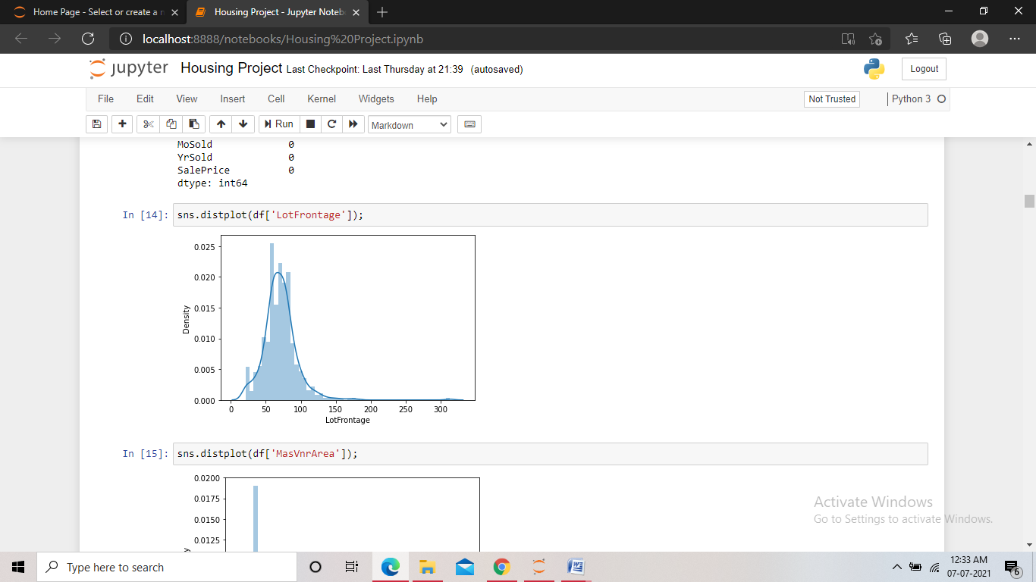
We performed these visualizations in the dataset:
Distribution plot: The distribution plot was used to check the distribution of data in the columns that contained missing values, so that we could decide whether to use mean or median in replacing the missing values.

Slide 7
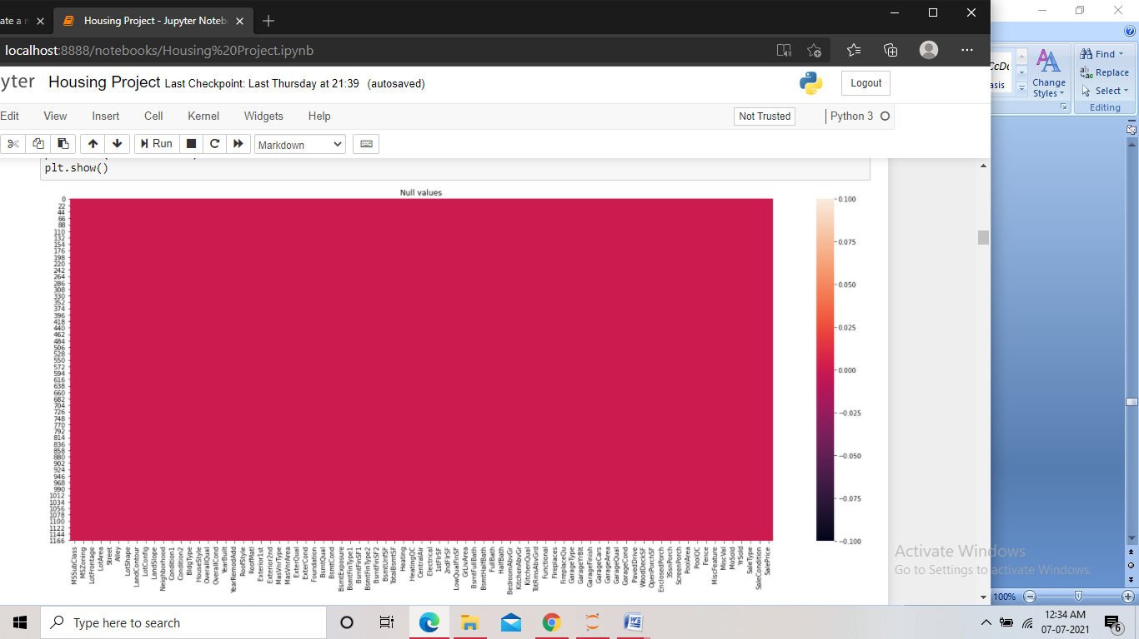
Heatmap : Heat map was used at two occasions in the project, once for checking any missing values in the dataset and the next time to plot the correlation matrix of the dataset. . In the first case, we found some missing values and after treating them we can see no missing values present. And in the second case we found many types of correlation between the columns. There were some positive as well as negative relations in the matrix, and also some columns showed no correlation.

Slide 8
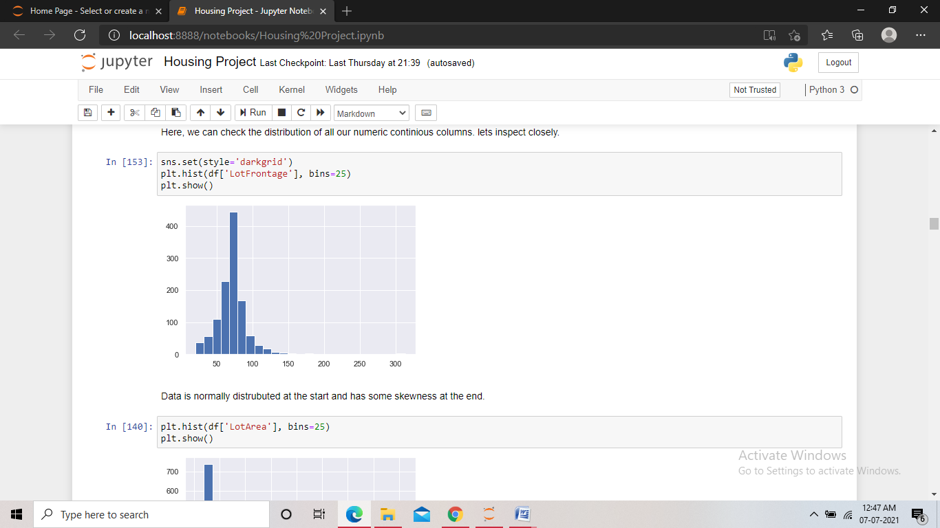
Histogram: We used the histogram to see the distribution of data in the continuous numeric columns. We found few columns being close to normal distribution, and the majority of the columns were found to have variance and skewness in the data.

Slide 9
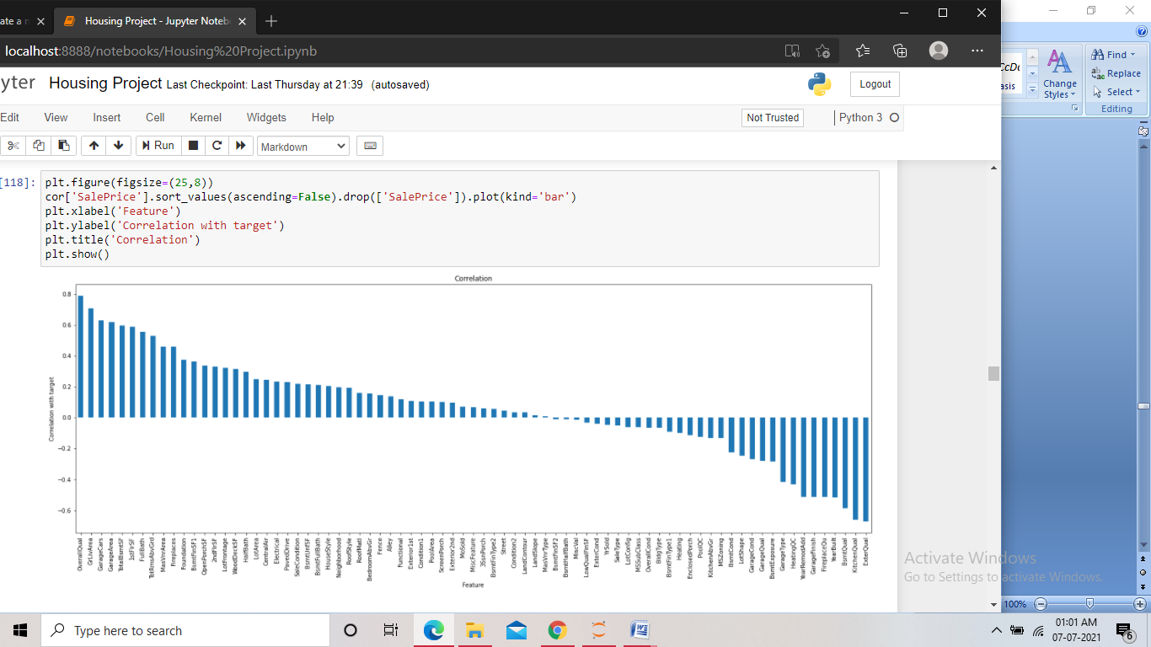
Bargraph: We plotted this bar graph to visualize the correlation o all the independent columns with the target column. We found mostly positive relations in between the columns. But there were some negative and near zero correlations as well.

Slide 10
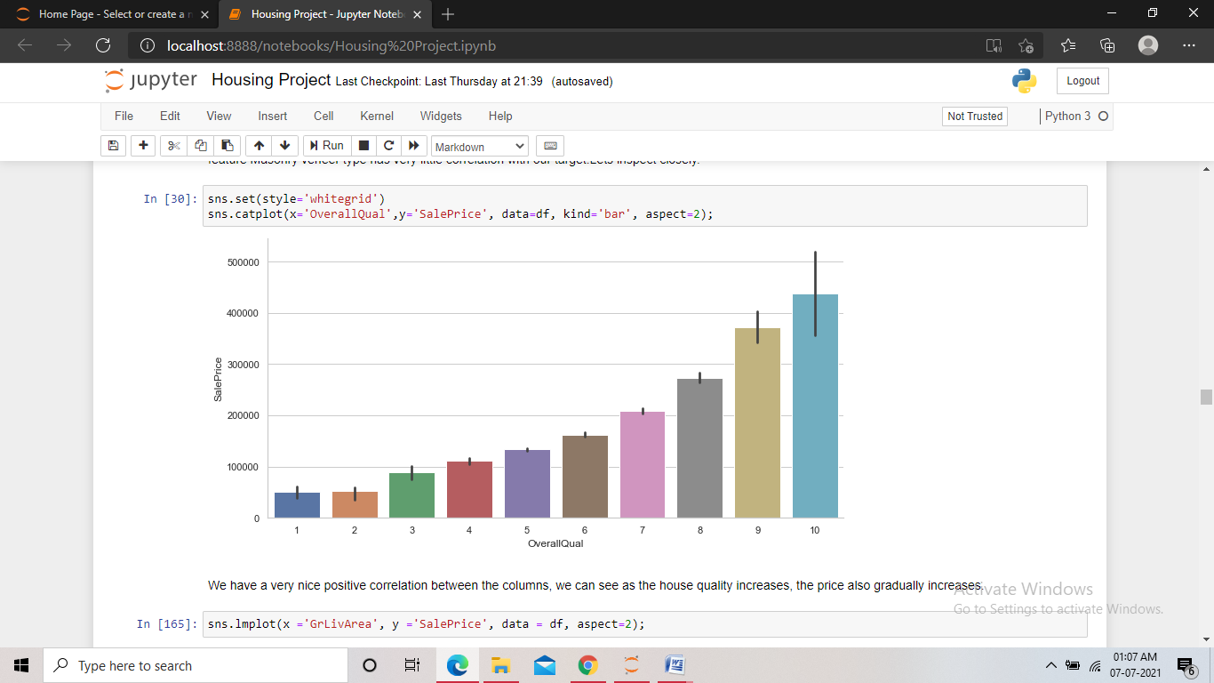
Catplot: We used the catplot multiple times to visualize the relationship between an independent columns and the target. Here in this plot we found a strong correlation between the overall quality feature and the sale price. Which meant that as the overall quality increased the sale price also increased.

Slide 11
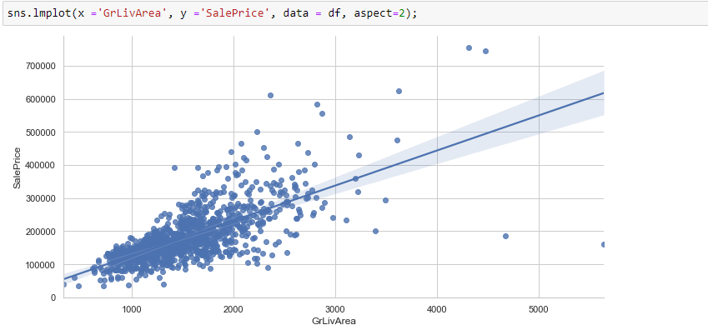
Lineplot: We used the lineplot multiple times to visualize the relationship between an independent columns and the target. Here in this plot we found a good correlation between the target and the ground living area column, which showed that the sale price increased as the ground living area increased.

Slide 12
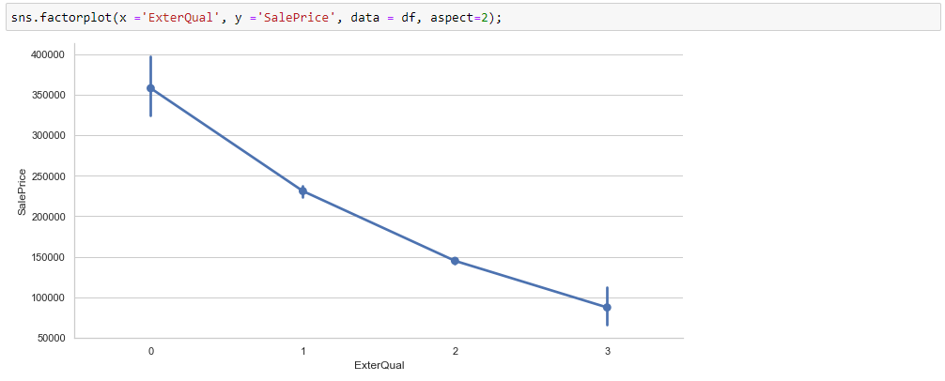
Factorplot: We used the factorplot multiple times to visualize the relationship between an independent columns and the target. Here in this plot we can see the line of the graph going down, but the external quality in the x axis is in encoded form and the value 0 in it represented an excellent quality and value 4 represented a poor quality, which means that as the external quality improved, the sale price also increased which meant a positive correlation.

Slide 13
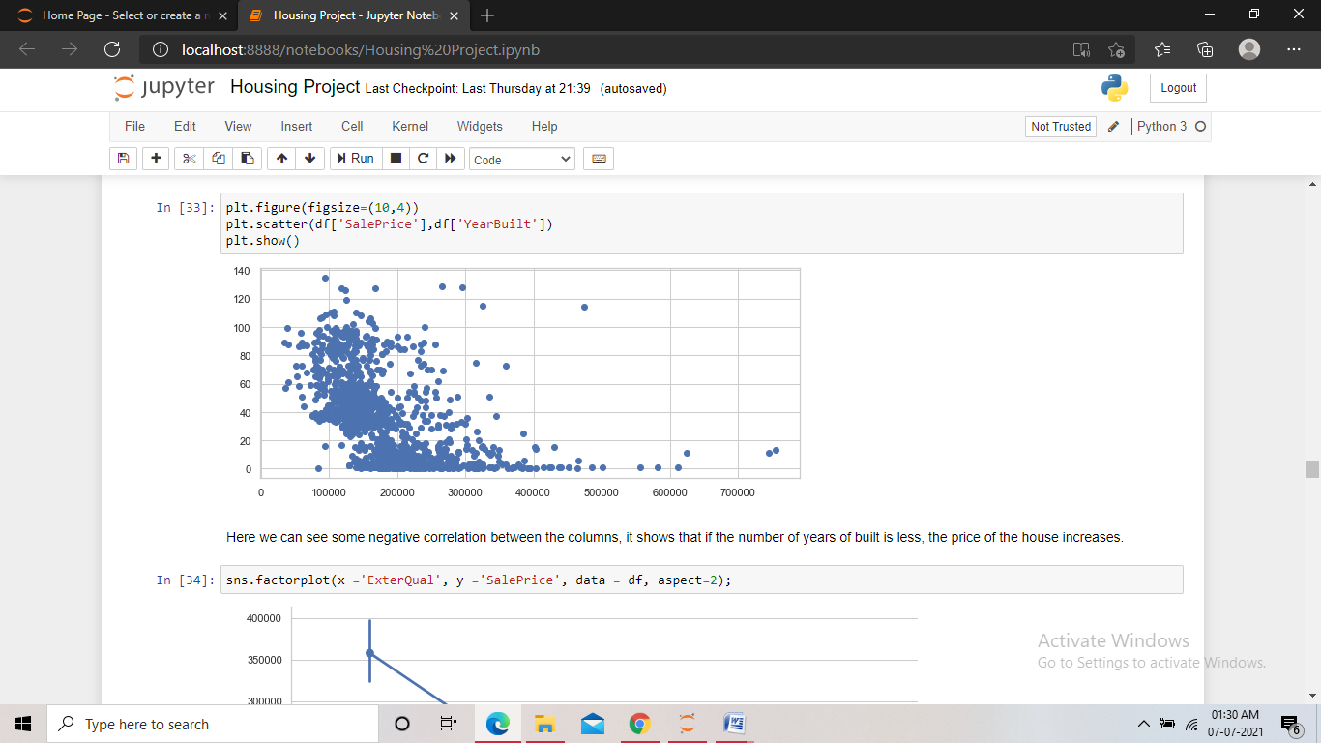
Scatterplot: We used the Scatterplot multiple times to visualize the relationship between an independent columns and the target. The plot here showed a negative correlation between the columns, as the price data can be seen increasing as the years of built decreased. This meant that more new the house, the more costly it was.

Slide 14
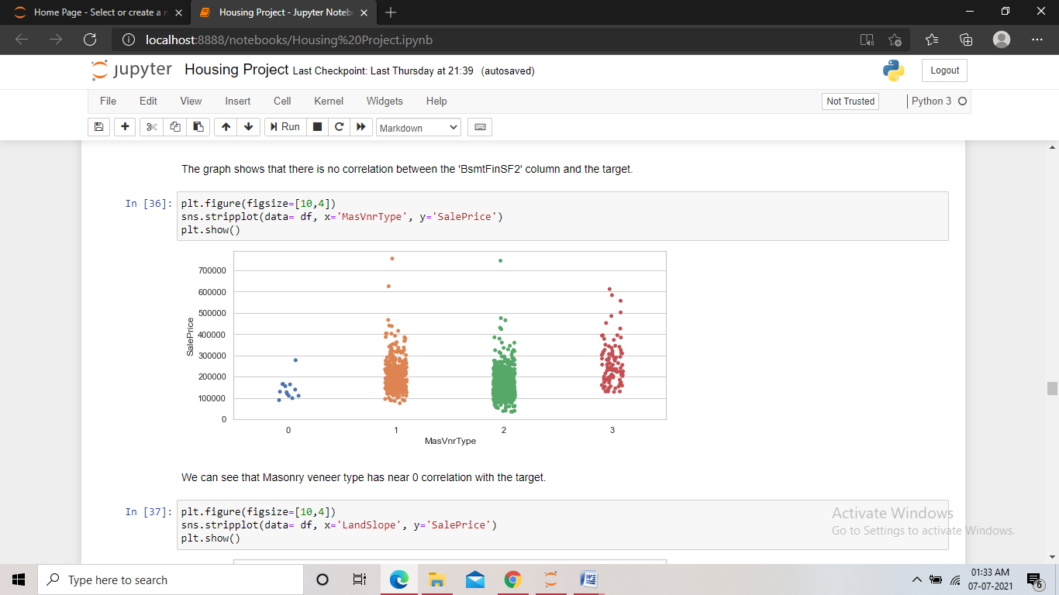
Stripplot: We used the Stripplot multiple times to visualize the relationship between an independent columns and the target. The plot here showed no correlation between the columns. As, the sale price range remains the same for all types of masonry veneer. This meant that the sale price does not depend on the masonry veneer type in any way.

Slide 15
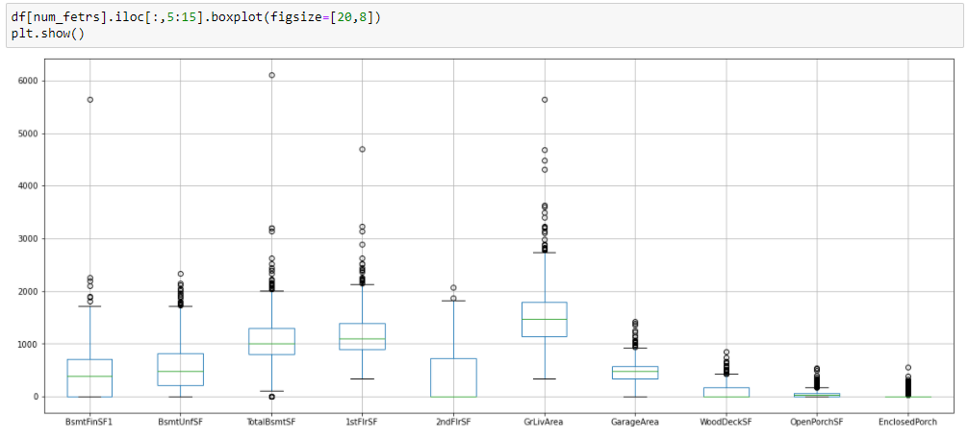
Boxplot: We used the boxplot to check for any outliers in the dataset. In this plot we can see many outliers in the columns, some seem to be very close to the threshold but some also can be seen very far away from the threshold

Slide 16
Steps and assumptions used
We loaded the dataset into a dataframe and displayed it.
We performed extensive EDA to get better understanding of the dataset.
We dropped some unwanted columns from the dataset which had no role to play in the model building.
Checked for missing values in the dataset. We found some columns containing missing data. In the categorical data, the missing values were present where the feature of the house was not present. So we replaced them with ‘Unavailable’. For the numeric data, we replaced the missing values with the median of the column .
Extracted information from the dates. There were some features containing the year of its built, which was of no use in the model building. Hence we extracted the number of years of built with respect to the year of sale and kept them in the same columns. In further steps we encoded the year of sale column as there were only few categorical years present.
Visualized the distribution of data in different features of the dataset.

Slide 17
Encoded the categorical object type data in the dataset.
Checked the correlation of the features with the target using different visualization techniques and then removed the features that showed no correlation with the target.
Checked for outliers in the dataset. We found some outliers present and then removed a considerable amount of outliers using IQR technique.
Treated skewness in the dataset. We found some skewness present in the continuous numeric data, we them minimised the skewness using log transformation technique.
Scaled the features of the dataset using standard scaler.
Pre-processed the test dataset in the same way as the train dataset.
Performed feature selection on the dataset and kept only the best scoring features in the dataset.
Calculated the best random state and used it for the train validation split.

Slide 18
We trained five different models using the train and validation data.
Checked the cross validation score of each model for any overfitting or underfitting in the models.
Performed hyper parameter tuning on the final two selected models to find the best parameters for the models and to select the better performing model among the two by the results from applying those parameters.
We saved the final model.
Finally we loaded the saved model and used it to predict the target values for the test dataset.

Slide 19
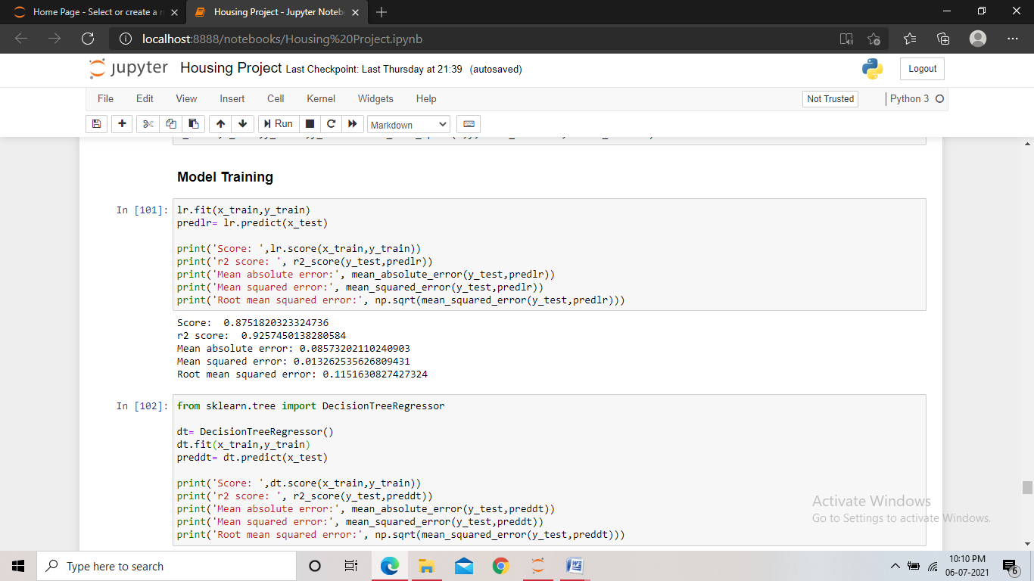
Model dashboard
In this project we used five different regression models to train the data. The models we used are:
Linear Regression: Using linear regression, we found the training score to be 85%, the R2 score to be 92%, MAE of 8%, MSE of 1% and RMSE of 11%

Slide 20
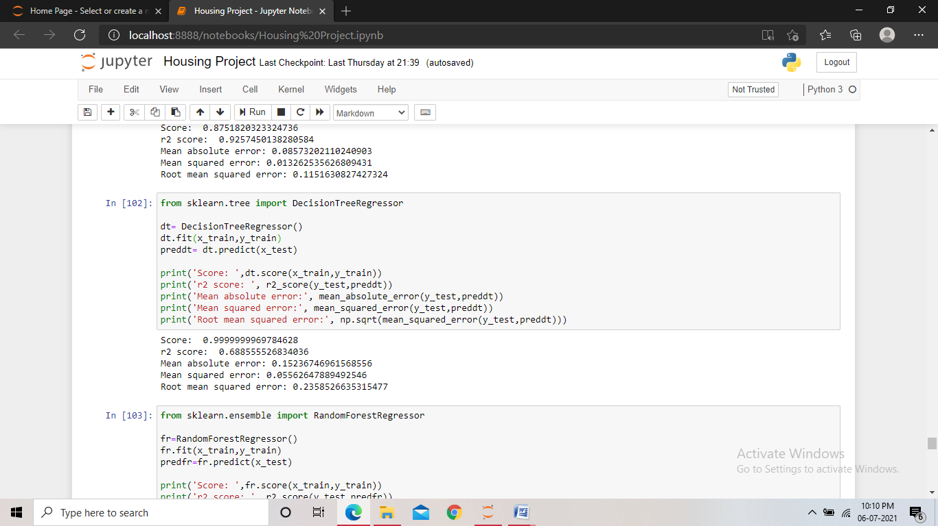
Decision Tree Regressor: It builds regression models in the form of a tree structure. It breaks down the dataset into smaller subsets.
Using Decision tree regressor, we found the training score to be 99%, the R2 score to be 68%, MAE of 15%, MSE of 5% and RMSE of 23%.

Slide 21
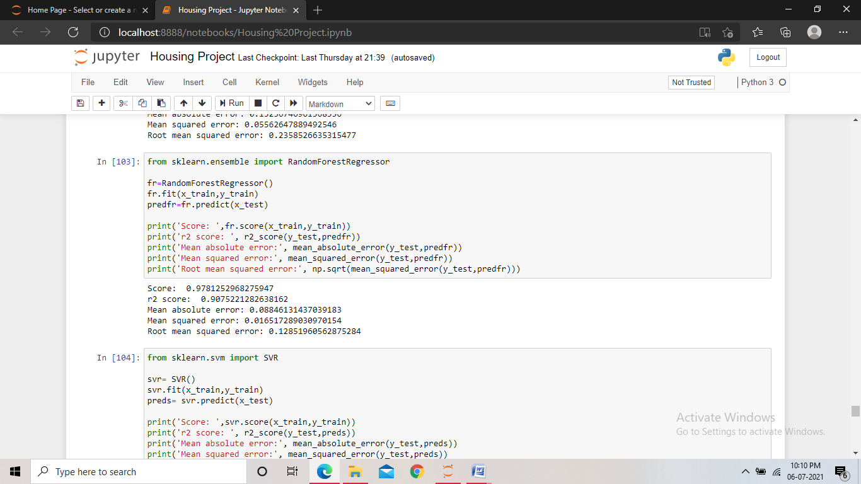
Random Forest Regressor: It builds multiple decision trees and merges them together to get a more accurate prediction.
Using Random forest regressor, we found the training score to be 97%, the R2 score to be 90%, MAE of 8%, MSE of 1% and RMSE of 12%.

Slide 22
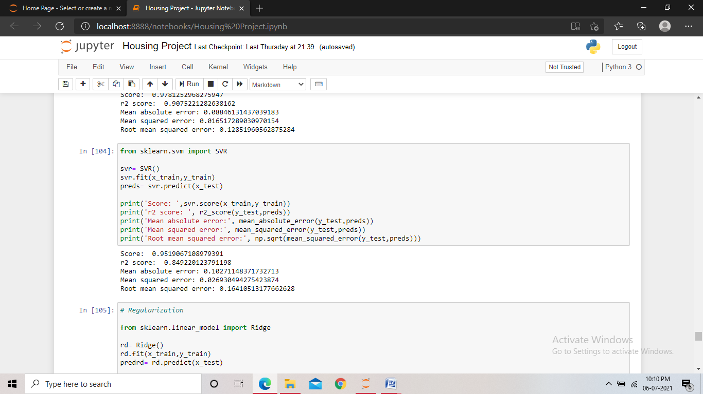
Support Vector Regressor: It looks at data and sorts it into one of two categories. It helps in determining the closest match between the data points and the function which is used to represent them.
Using support vector regressor, we found the training score to be 95%, the R2 score to be 84%, MAE of 10%, MSE of 2% and RMSE of 16%.

Slide 23
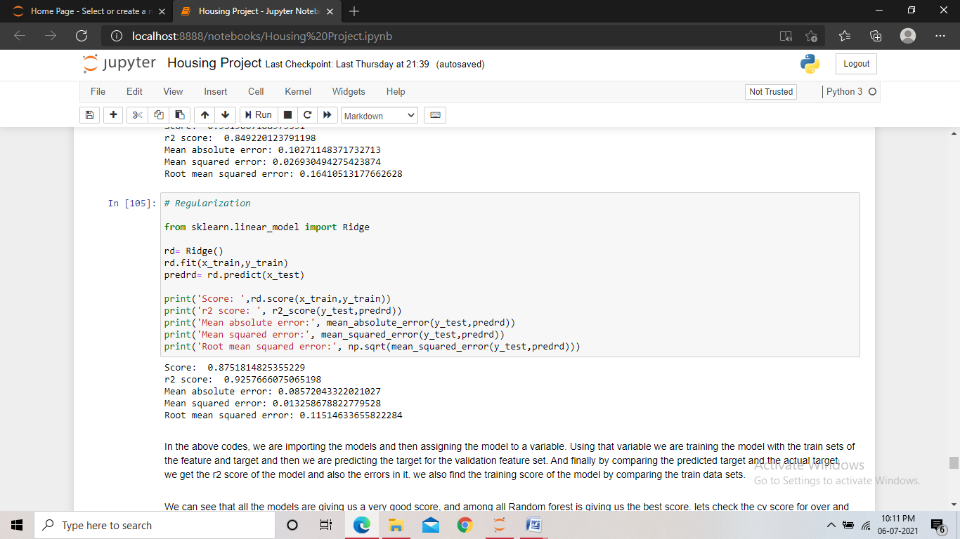
Ridge Regression: It estimates the coefficient of multiple-regression models in scenarios where independent variables are highly correlated.
Using Ridge regressor, we found the training score to be 87%, the R2 score to be 92%, MAE of 8%, MSE of 1% and RMSE of 11%.

Slide 24
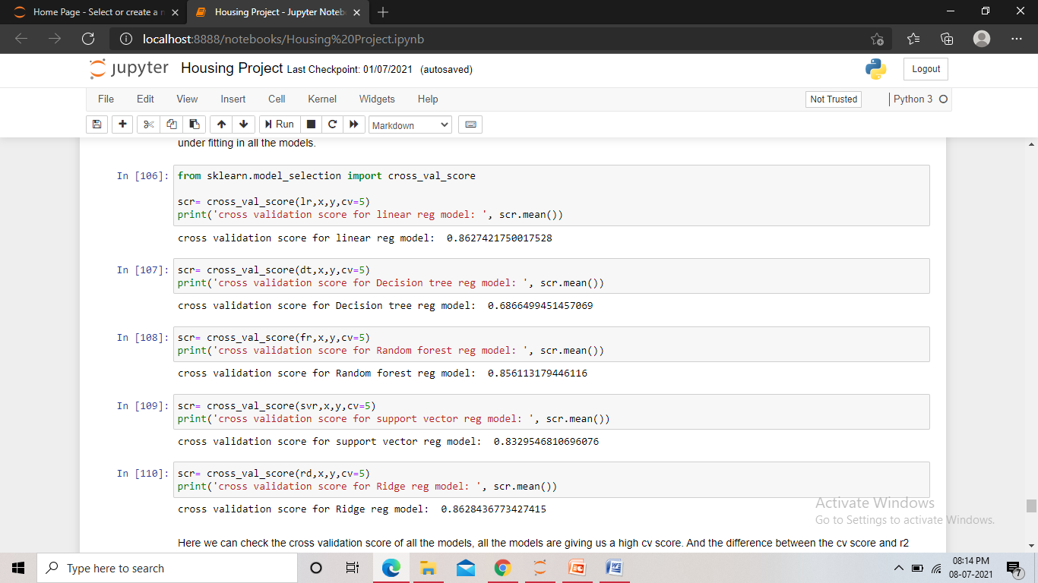
Finalized model
We trained the dataset using five models to select a final model which will perform the best among all others.
We used Linear regression, Decision tree regressor, Random forest regressor , SVR and Ridge regressor. After training we found that all the models were performing very well and gave us a good training score and r2 score along with very less errors. But since the high score could be a result of overfitting, we performed the cross validation check.

Slide 25
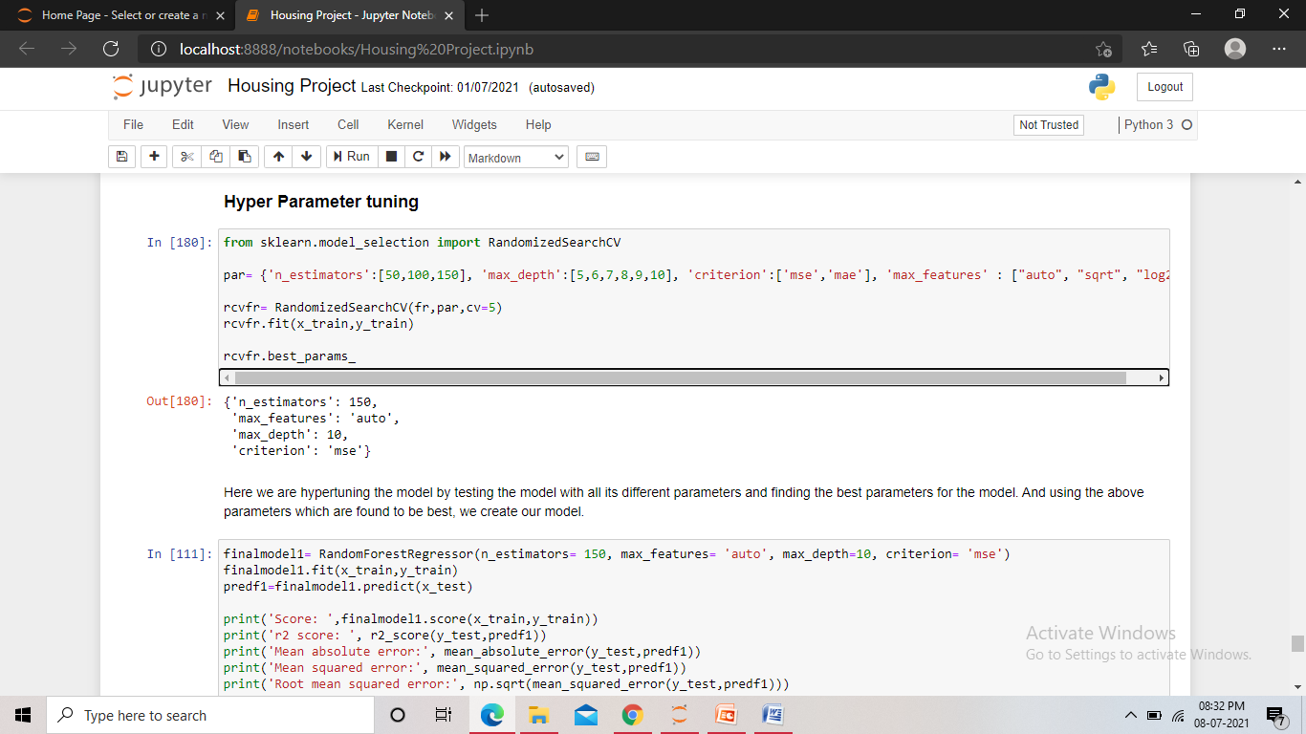
From the cross validation check, we found that the Random forest model and the SVR model had the least difference between the r2 score and the CV score, which is an indicator of a higher performance.
We then hyper parameter tuned both the models to find the model that gives the best score.

Slide 26
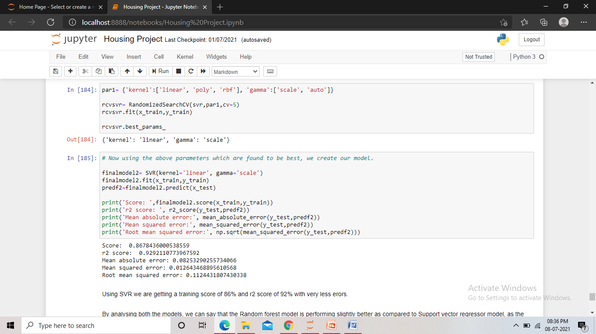
We hyper parameter tuned both the models and found the best parameters for the models. And then we trained the models using those parameters found best.
After training the models and getting the scores, we found that the Random forest model was performing slightly better than the SVR model. And hence we made the Random forest regressor model as our final model and saved it.

Slide 27
Conclusion
From this project we learnt that EDA, feature engineering, visualization, feature selection all play a very crucial role in the outcome of the model. The EDA when done thoroughly gives us many insights into the data on the basis of which we can take the approach. We can implement the approach in the feature engineering part and clean the data. The visualization of the dataset is also very powerful in conveying the importance of different features in the dataset. Also we got the idea that scaling the dataset can be very useful in improving the model performance and also how cross validation and hyper parameter tuning can help us find the best model for out project.
As the company wanted to know the important features which affect the price positively or negatively, we have the conclusion on it.
For the continuous numeric columns, the feature ‘ground living area’ showed a very positive relation with the sale price along with ‘garage area’, ‘total basement surface area’, ‘first floor surface area’. As the value of these above features increases, the sale price also goes up.

Slide 28
For the categorical data, the features ‘overall quality’, ‘garage cars’, ‘external quality’, ‘kitchen quality’, ‘basement quality’, ‘full bath’, ‘total rooms above ground’ all showed a very positive relation with the sales price, with the ‘overall quality’ having the highest correlation among all features. All these features refer to the quality of that particular feature, and as the quality becomes better, the sale price also goes up. The features ‘year built’ and ‘year remodelled’ had a negative relationship with the sales price, as the value in these two features increased the sale price went down, which meant that newer the house, the higher its sale price was.
All the above mentioned features are very important in predicting the price of the house. As mentioned above some effect the price positively and some negatively.
This model can be used by the company to understand how exactly the prices vary with the variables. They can accordingly manipulate the strategy of the firm and concentrate on areas that will yield high returns. Further, the model will be a good way for the management to understand the pricing dynamics of a new market.

