Slide 1

Ratings Prediction Project
By
Suraj Chakraborty
FLIP ROBO (Intern)
Internship 15

Slide 2
Contents
Introduction
Problem statement and understanding
EDA steps and visualization
Steps and assumptions used
Model dashboard
Finalized model
Conclusion

Slide 3
Introduction
Reviews and Ratings are two very important factors that give us an understanding of the product quality and decency. Product reviews are the opinions or feedbacks of customers for a particular product. A product review helps other users get a clear idea of the product before purchasing it. This has a great impact on the business and people tend to purchase products which have public reviews on it.
We have a website where people write different reviews for different products and through the website people can get better understanding of the product they are looking to purchase. But there are people who don’t want to spend time in reading long reviews, for them a new feature can be added to the website i.e. rating. Ratings are the short and quick interpretation of the reviews and it generally ranges from 1 to 5. Adding the rating feature to the website in corresponding with the reviews will help the website grow more. The reviews will need to add ratings to the reviews from now. But for the old reviews we need the help of data science and machine learning to come up with a solution to add ratings to them.

Slide 4
Problem statement and understanding
We have a client who has a website where people write different reviews for technical products. Now they are adding a new feature to their website i.e. the reviewer will have to add stars (rating) as well with the review. The rating only has 5 options available 1 star, 2 stars, 3 stars, 4 stars, 5 stars. Now they want to predict ratings for the reviews which were written in the past and they don’t have a rating. So, we have to build an application which can predict the rating by seeing the review.
We have to complete the project in two phases, the data collection phase and the model building phase. In the data collection phase, we have to scrape at least 20000 rows of data. In this section we need to scrape the reviews and ratings of different laptops, Phones, Headphones, smart watches, Professional Cameras, Printers, Monitors, Home theatre, Router from different ecommerce websites.
After collecting the data, you need to build a machine learning model. Before model building we need to do all data pre-processing steps involving NLP. Try different models with different hyper parameters and select the best model.

Slide 5
EDA steps and visualization
We scraped the data using a jupyter notebook and saved the dataset in an excel sheet. And then we loaded the dataset into another jupyter notebook and performed the following EDA on it:
We checked the size of the dataset and then we dropped the unwanted columns from the dataset which was the index column that had no role to play.
Checked for any missing values in the dataset and we found some missing data. We then dropped the missing values.
We then checked the data types of the feature and the target. And also checked the percentage ratio of all the unique target data.
Then we created a new column that contained the length of the feature data.
We started data cleaning by first converting all the text in the feature into lower case.
Then we cleaned all the junk in the data by replacing all the punctuations, white spaces, web addresses etc by a space or a single text that defines the element such as an email id.

Slide 6
After this we removed the stopwords from the data and before removing them we made some alterations to the English stopwords.
Then again we created a new column containing the new length of the cleaned data and then compared the new length to the old length.
Checked for imbalance in the dataset and found a target value containing way more records as compared to the other target values. Hence we down-sampled that target value data to that of another target value
We then performed some visualization.
Finally we converted the text data in the feature to vectors using a vectorizer.

Slide 7
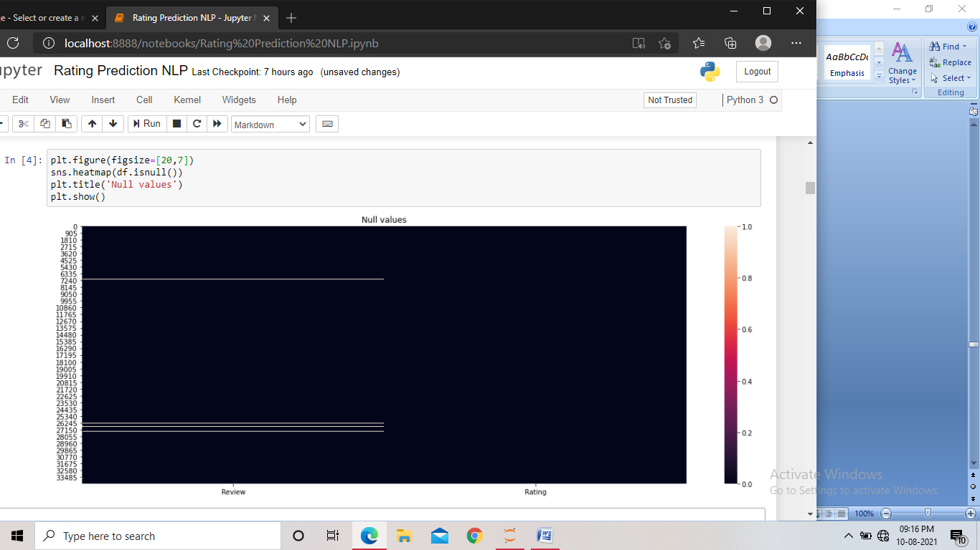
We performed the following visualizations in the dataset:
Heatmap: Heat map was used for checking any missing values in the dataset. We found that some missing values were present in it and then treated those missing values.

Slide 8
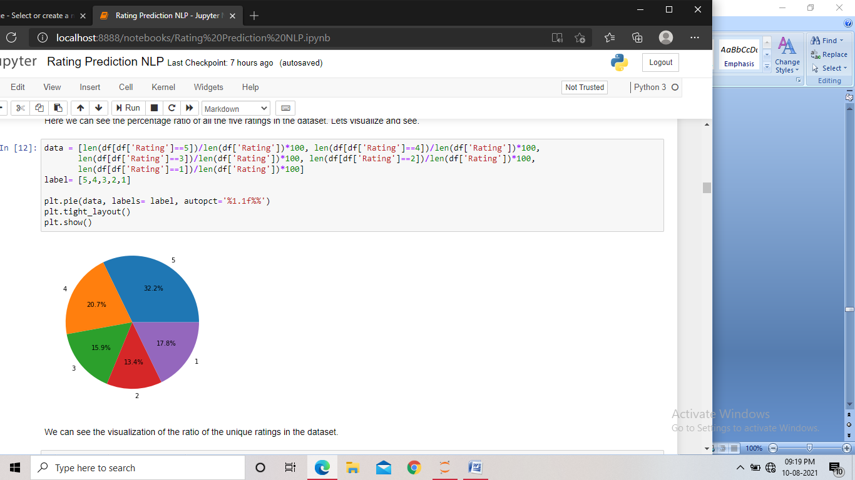
Pie Chart: We used the Pie chart to visualize the percentage ratio of all the unique target values in the dataset. We found the target 5 star rating having the highest percent of data, followed by 4 star rating and the 2 star rating gave us the least percentage of data.

Slide 9
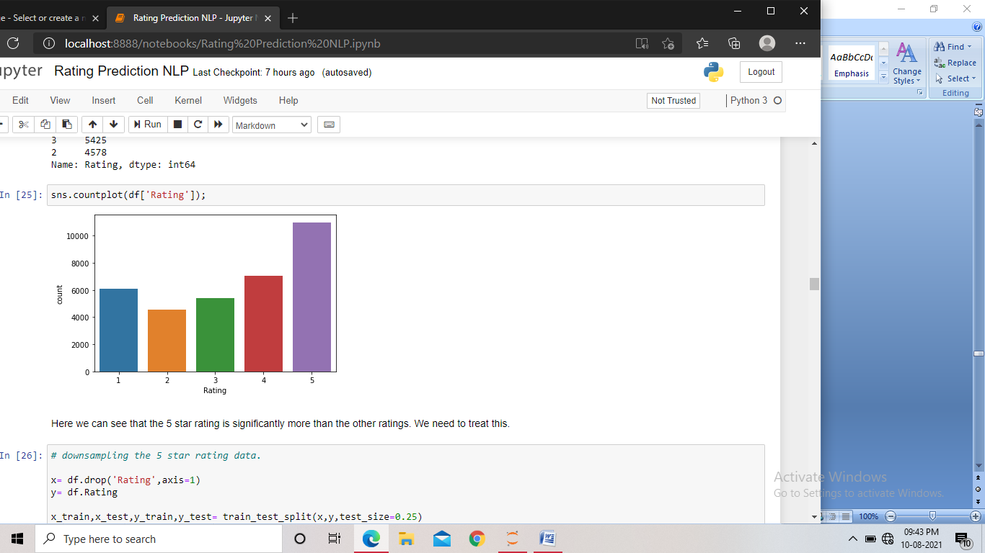
Count Plot: We used the count plot to check of imbalance in the dataset. And we found that there was some imbalance present in the dataset, the 5 star rating contained much more records as compared to other ratings in the dataset.

Slide 10
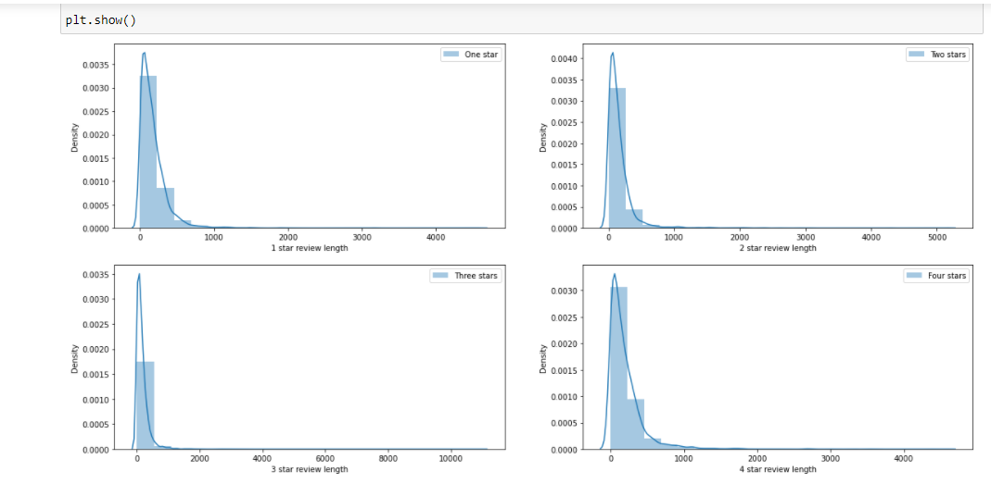
Distribution Plot: The distribution plot was used two times in the project. It was used to see the distribution of the length of data for all unique target values before and after data cleansing using subplots. By comparing the two plots, we found that after performing data cleaning, the skewness in the length was reduced.

Slide 11
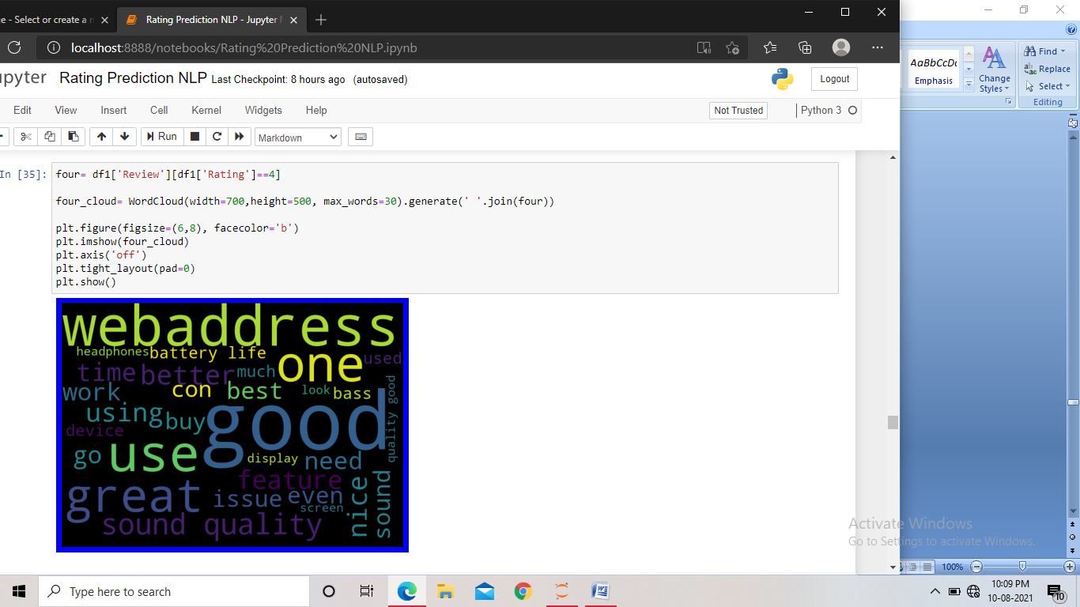
Word cloud: We used the word cloud to visualize the mostly occurring words for all the unique target values in the dataset. We displayed the word cloud for all the ratings and the words that occurred the most were highlighted in the display.

Slide 12
Steps and assumptions used
We scraped the data using a jupyter notebook and saved the data in an excel sheet.
Loaded the dataset into the jupyter notebook.
Performed EDA to get better insights into the dataset.
Checked for missing values in the dataset and treated them.
Created a new column containing the length of the feature data.
Converted all the text in the feature to lower case.
Performed data cleaning by removing all the unwanted texts, symbols, stop-words etc.
Created another new column containing the new length of the cleaned data.
Checked for imbalance in the dataset and performed down-sampling when found some.
Performed some visualization by comparing the distribution of the length of data before and after data cleaning.

Slide 13
Visualized the word cloud for every unique target values.
Converted the feature text data into vectors using a vectorizer.
Found the best random state and preformed train test split using it.
Trained different models that can be used for a multi class classification.
Checked CV score for all the models for any overfitting or underfitting.
Hyper-parameter tuned the better performing models to find the best parameters for those models.
Trained the models using those parameters and saved the highest scoring model as the final model.

Slide 14
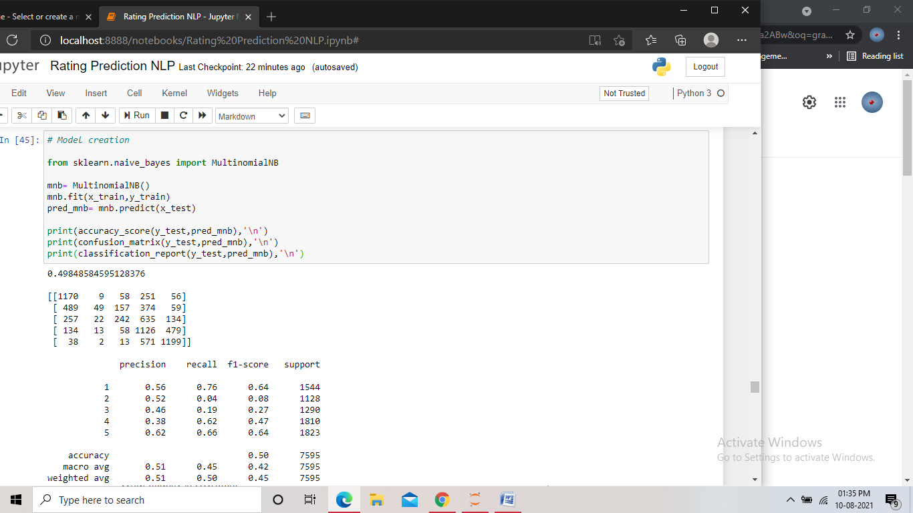
Model dashboard
In this project we used five different multi class classification models to train the data. The models we used are:
Multinomial Naive bayes: Multinomial Naive Bayes classifier is a specific instance of a Naive Bayes classifier which uses a multinomial distribution for each of the features. Using Multinomial naive bayes, we found the accuracy score to be 50%, and the F1 score of be 64%, 8%, 27%, 47% and 64% for all the unique target values starting from 1 to 5.

Slide 15
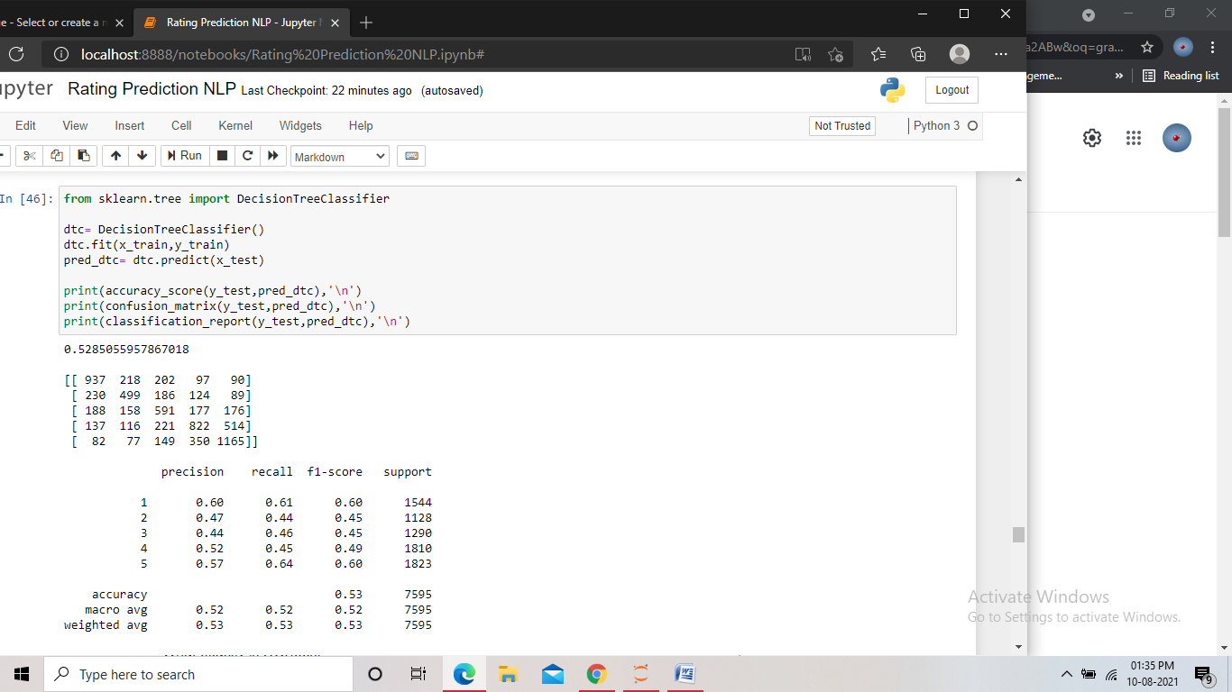
Decision tree classifier: Decision tree classifier builds classification models in the form of a tree structure. It breaks down a dataset into smaller and smaller subsets while at the same time an associated decision tree is incrementally developed.
Using Decision tree classifier, we found the accuracy score to be 53%, and the F1 score of be 60%, 45%, 45%, 49% and 60% for all the unique target values starting from 1 to 5.

Slide 16
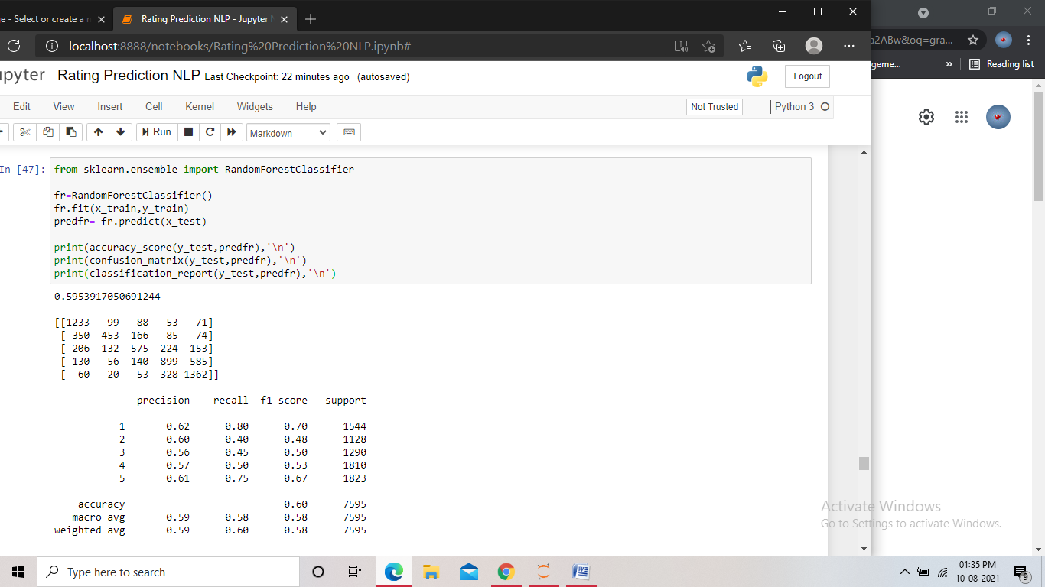
Random forest classifier: Random forest (RF) is an ensemble classifier that uses multiple models of several DTs to obtain a better prediction performance. It creates many classification trees and a bootstrap sample technique is used to train each tree from the set of training data.
Using Random forest classifier, we found the accuracy score to be 59%, and the F1 score of be 70%, 48%, 50%, 53% and 67% for all the unique target values starting from 1 to 5.

Slide 17
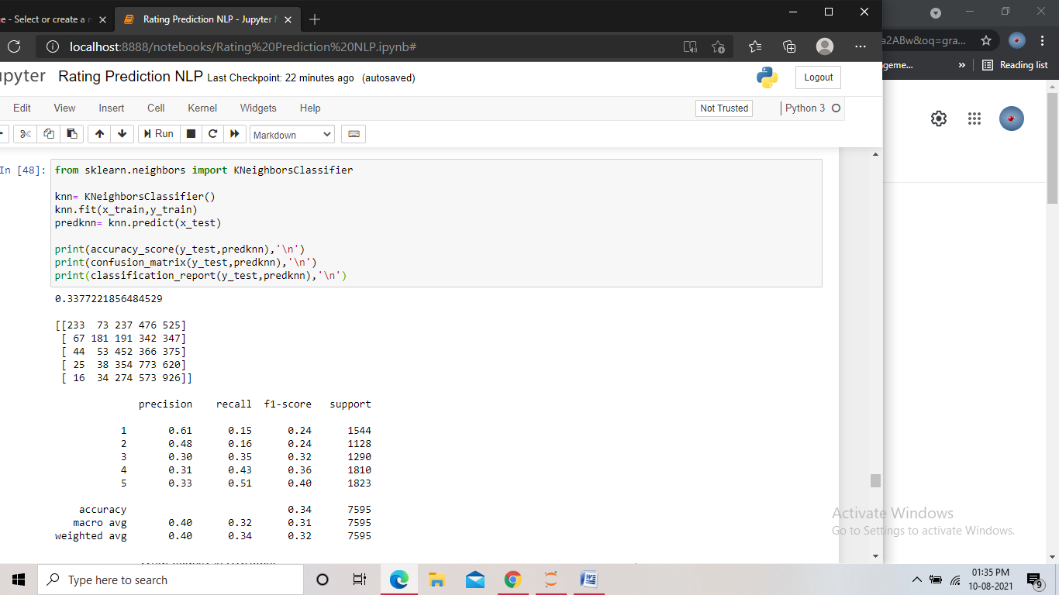
K- Nearest Neighbour classifier: K-nearest neighbors (KNN) algorithm uses ‘feature similarity’ to predict the values of new data-points which further means that the new data point will be assigned a value based on how closely it matches the points in the training set.
Using K Neighbour classifier, we found the accuracy score to be 34%, and the F1 score of be 24%, 24%, 32%, 36% and 40% for all the unique target values starting from 1 to 5.

Slide 18

Gradient Boosting classifier: Gradient boosting is a type of machine learning boosting. It relies on the intuition that the best possible next model, when combined with previous models, minimizes the overall prediction error. The key idea is to set the target outcomes for this next model in order to minimize the error.
Using Gradient boosting classifier, we found the accuracy score to be 48%, and the F1 score of be 62%, 27%, 33%, 44% and 58% for all the unique target values starting from 1 to 5.

Slide 19
Finalized model
We trained the dataset using five different models to select a final model which will perform the best among all the models. We used the models Multinomial Naive bayes, Decision tree classifier, Random Forest Classifier, K- Nearest Neighbour classifier and Gradient Boosting Classifier.
After training we found that all the models were performing nearly similar with random forest and decision tree model showing us a better score. We then performed the cross validation check to make sure that there is no overfitting or underfitting problem.

Slide 20
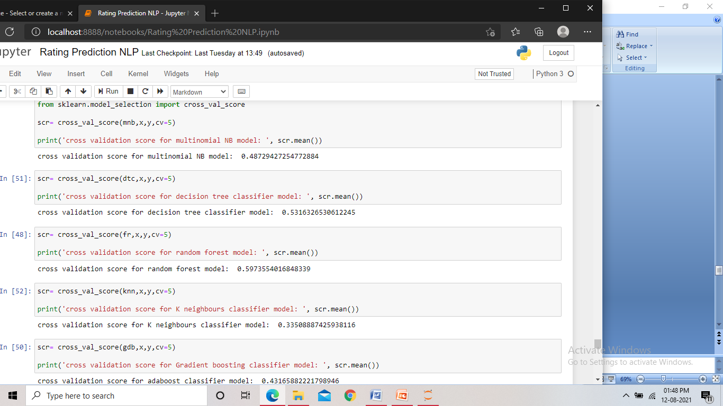
From the cross validation check, we found that here too, the random forest and decision tree had a better score compared to the rest. We also found that all the models had a very less difference between the accuracy score and the CV score and the difference were nearly the same. Hence we took the two higher scoring models to perform hyper parameter tuning.

Slide 21
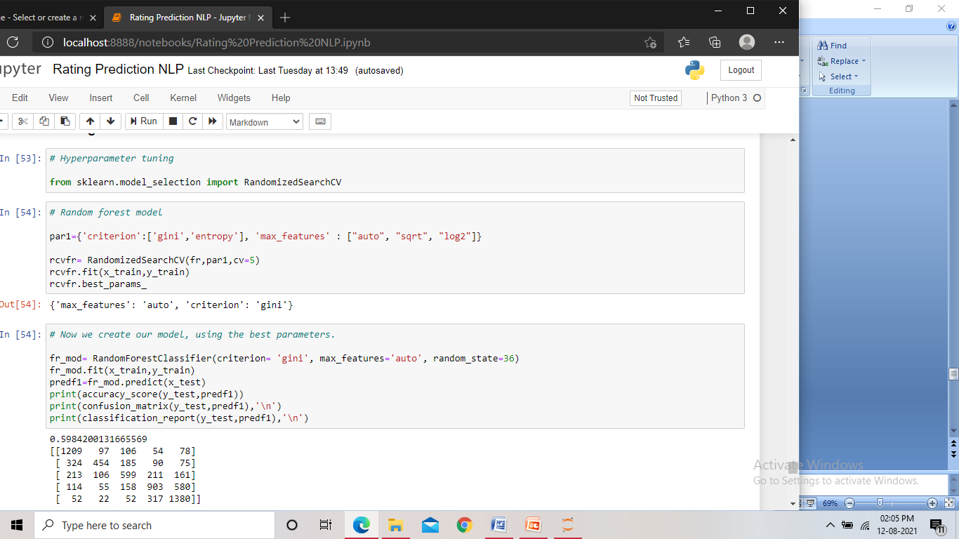
We then hyper parameter tuned both the higher scoring models to find the model that will give us the best score.
We used Randomized_search_CV to hyper parameter tune both the models. We gave different values for the parameters to the randomized_search_cv and it gave us the best performing values for those parameters. And finally using those values for the parameters, we made our final two models.

Slide 22

After training the models and getting the scores, we found that the Random forest model was performing slightly better as compared to the Decision tree model. And hence we made the Random forest classifier model as our final model and saved it.

Slide 23
Conclusion
From the project, we found that while scraping data, it is important to try fetching the data for all particular target values. This will help us during our model building phase. While scraping the data, we used many websites, but there were more websites which we could not use, as no reviews were present there. Also we could not use the website ‘snapdeal’ as it did not contain the rating data in text. We fetched nearly 35000 records, which formed a large dataset.
We found that the project was a multi class classification project. We had an index column in the dataset, which did not have any role to play in the modelling, also some missing values were found in the review data of the dataset. We also understood that in a NLP project, the cleansing of the data play a very crucial role in the model performance. After cleaning the data, we found few missing values again, which meant that those records contained only junk data. We found the word ‘good’ being highlighted in each of the word-clouds for every particular rating, that might affect the model, and hence we had to remove the word from the dataset.

Slide 24
From this project we learnt that EDA and Data cleaning play a very crucial role in the outcome of a NLP project. The EDA when done thoroughly gives us many insights into the data. We also learnt that having a balanced dataset for training a classification model is very important in order to get a good performance. From the data cleaning, we got an idea on what type of data we need to avoid while working on NLP and how to do alternations with stopwords, we also learnt that the word cloud is a very important feature, this helps us identify the mostly occurring words in the data and lets us check if there is any common occurring word for multiple targets, which can affect the training. We got the understanding on which models we can use while working on a multi class classification problem. The checking of cross validation score and performing the hyper parameter tuning helped us in the selection of the final model for this project.

