Slide 1

Car Price Prediction Project
By
Suraj Chakraborty
FLIP ROBO (Intern)
Internship 15

Slide 2
Contents
Introduction
Problem statement and understanding
EDA steps and visualization
Steps and assumptions used
Model dashboard
Finalized model
Conclusion

Slide 3
Introduction
With the covid 19 impact in the market, we have seen lot of changes in the car market. Now some cars are in demand hence making them costly and some are not in demand hence cheaper.
One of our clients works with small traders, who sell used cars. The client is facing problems with the previous car valuation model, this is because of the impact of covid 19 which has changed the market for nearly all businesses. Now, using new data and machine learning we need to deliver a fresh new valuation model to our client so that our client can resume business as before in the new market.
This project will help our client to get a better understanding of the new trends in the automobile business and the factors that contribute to the price of the vehicle.

Slide 4
Problem statement and understanding
With the change in market due to covid 19 impact, our client is facing problems with their previous car price valuation machine learning models. So, they are looking for new machine learning models from new data. We have to make car price valuation model.
The project needs to be complete in two phases, the data collection phase and the model building phase. In the data collection phase, we have to scrape at least 5000 records of data. In this section we need to scrape the data of different used cars from different websites.
After collecting the data, we need to build a machine learning model and before model building we need to do all data pre-processing steps then try different models with different hyper parameters and select the best model.

Slide 5
EDA steps and visualization
We scraped the data using a jupyter notebook and saved the dataset in an excel sheet. And then we loaded the dataset into another jupyter notebook and performed the following EDA on it :
First we checked the size of the dataset and all the feature that were present in it.
Then we dropped the unwanted columns from the dataset which was the index column.
We then checked for any missing values in the dataset and handled them accordingly.
We checked the unique values of all the features in the dataset, where we found some junk data along with the actual values.
We checked the data types of all the columns in the dataset and description of the continuous numeric data.
In the further steps we checked for any outliers in the dataset and also checked the skewness in the continuous numeric data.

Slide 6
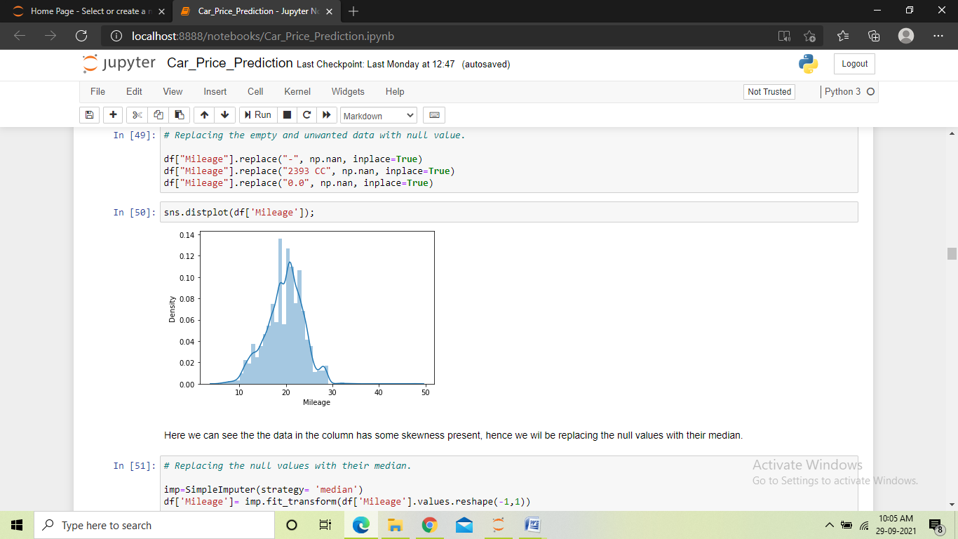
We performed the following visualizations in the dataset:
Distribution plot: The distribution plot was used to check the distribution of data in the columns that contained missing values, so that we could decide whether to use mean or median in replacing the missing values.

Slide 7
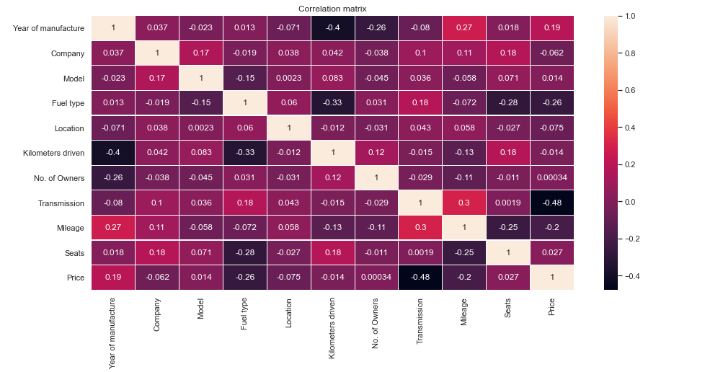
Heatmap : Heat map was used at two occasions in the project, once for checking any missing values in the dataset and the next time to plot the correlation matrix of the dataset. In the first case, we found some missing values and then treating them. And in the second case we found different types of correlation between the columns.

Slide 8
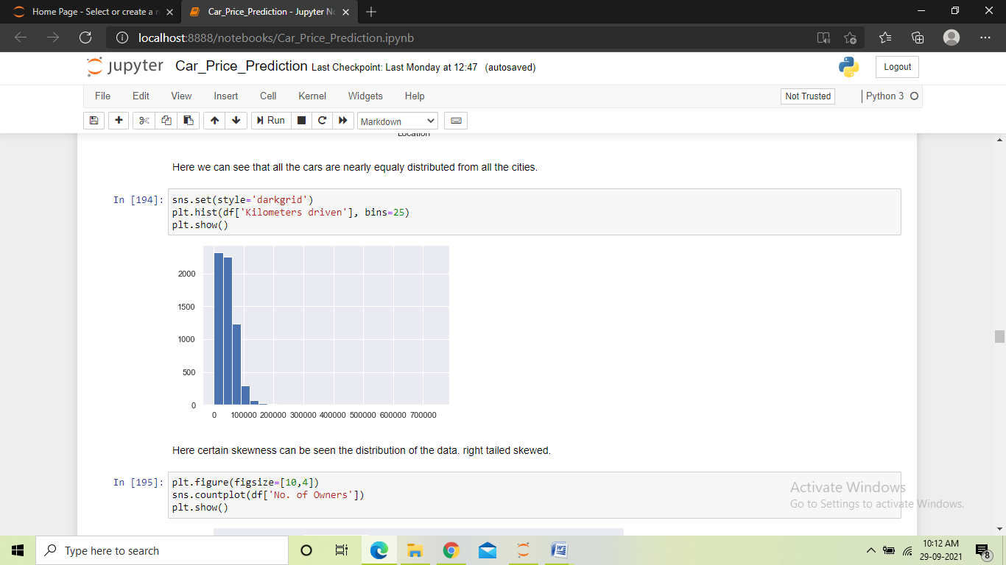
Histogram: We used the histogram to see the distribution of data in the continuous numeric columns. We found a columns being close to normal distribution, and the other column was found to have some skewness in the data.

Slide 9
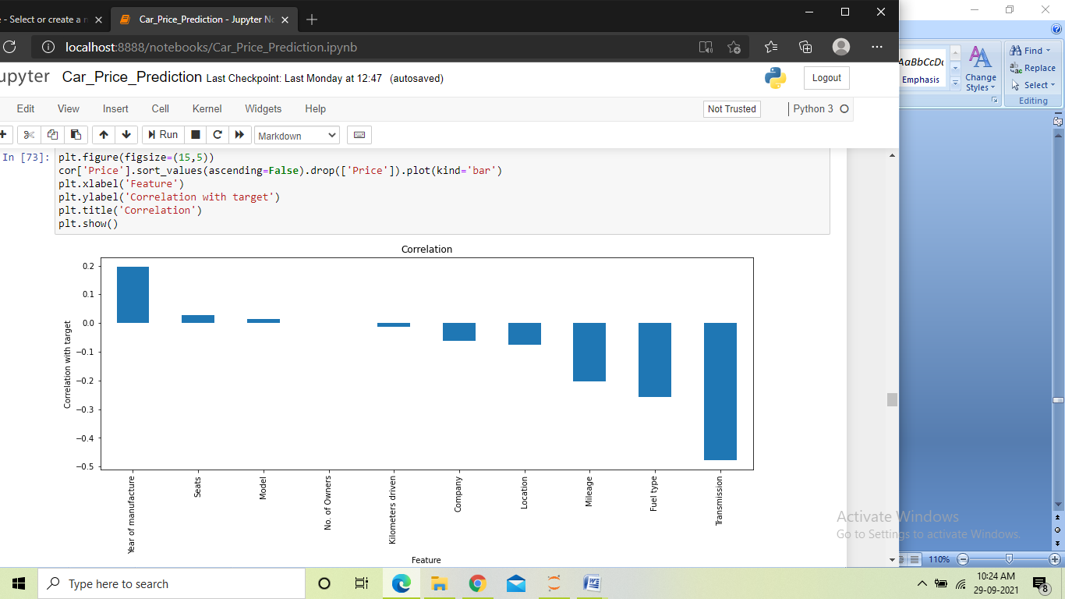
Bargraph: We plotted this bar graph to visualize the correlation of all the independent columns with the target column. We found one positive relations in between the columns. But there were mostly negative relations and a near zero correlations was also found.

Slide 10
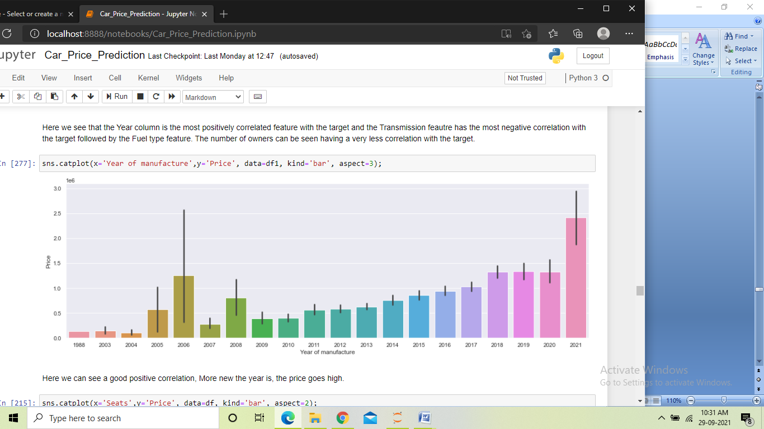
Catplot: We used the catplot multiple times to visualize the relationship between an independent columns and the target. Here in this plot we found a good correlation between the year feature and the price. This meant that more new the car is, the more is the price.

Slide 11
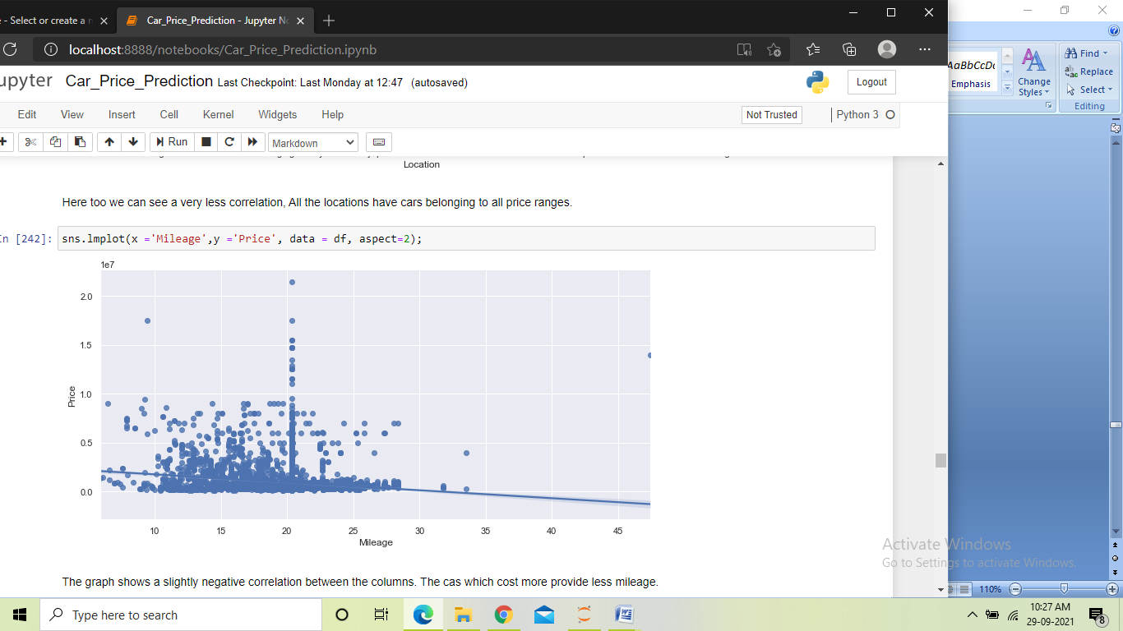
Lineplot: We used the lineplot multiple times to visualize the relationship between an independent columns and the target. Here in this plot we found a slight negative correlation between the target and the mileage column, which showed that as the mileage increased the price of car decreases.

Slide 12
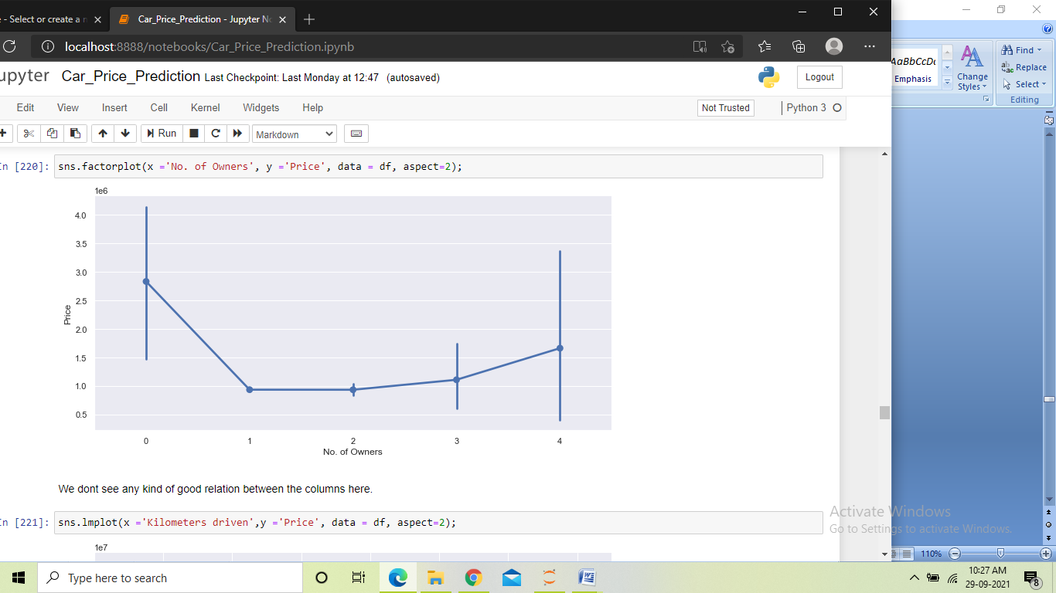
Factorplot: We used the factorplot multiple times to visualize the relationship between an independent columns and the target. Here in this plot we can see the line of the graph going down, then up, this shows no significant correlation between the columns.

Slide 13
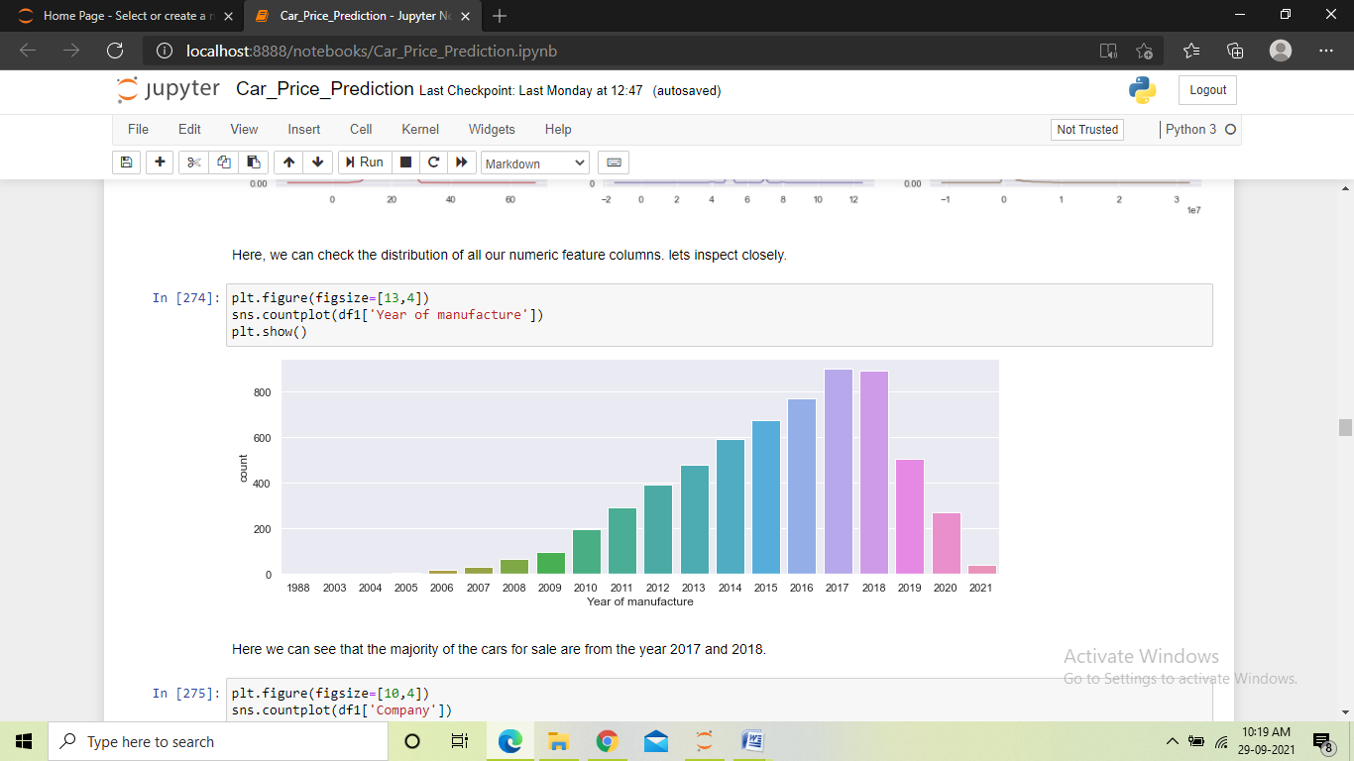
Countplot: We used the count plot to check the count of values in different columns of the dataset. And we found some values being more and some being less in different columns of the dataset.

Slide 14
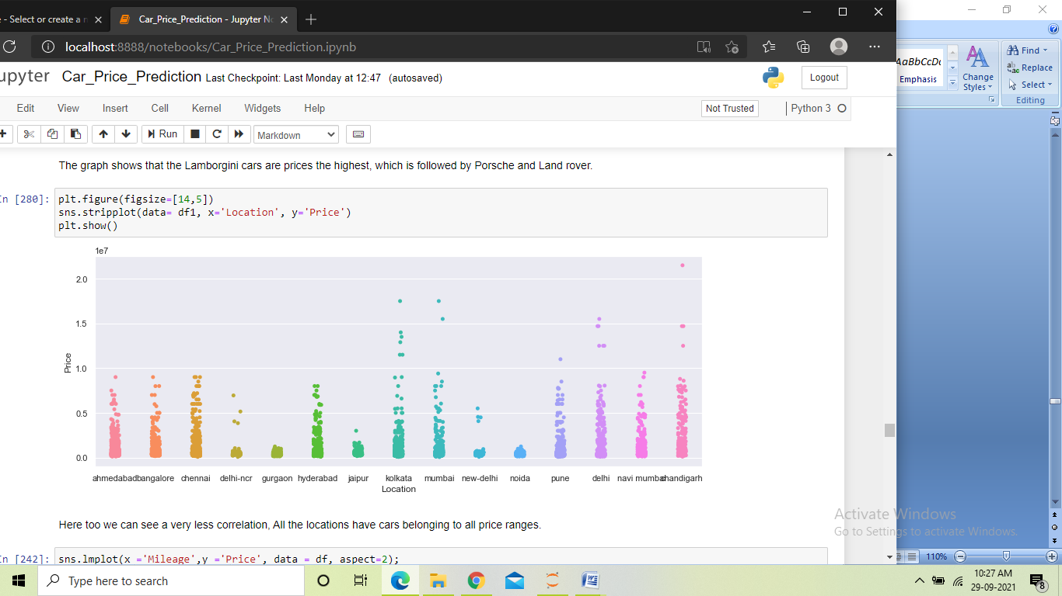
Stripplot: We used the Stripplot multiple times to visualize the relationship between an independent columns and the target. The plot here showed very little correlation between the columns. Here we can say that the cars with different price are quite equally distributed between the cities.

Slide 15
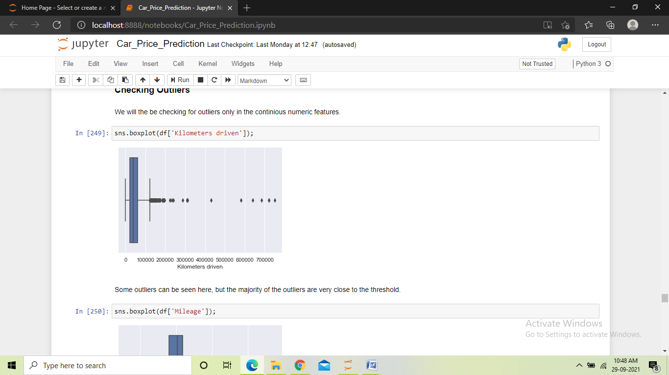
Boxplot: We used the boxplot to check for any outliers in the dataset. In this plot we can see some outliers in the column, some are very close to the threshold and a few can be seen far away.

Slide 16
Steps and assumptions used
Loaded the dataset into the jupyter notebook
Performed extensive EDA to get better insights of the dataset.
Checked for missing values and treated them accordingly.
Performed data cleaning by cleaning and converting all columns to the format they can be used for model building.
Changed the data types of columns containing numeric data to integer data type.
Encoded the categorical types of data.
Performed visualization to check the distribution and counts of the data.
Checked the correlation among all the columns in the dataset and performed visualization to see the relationship between the features and the target column.
Checked for outliers in the dataset.

Slide 17
Handled the skewness in the dataset.
Split the dataset into target and features.
Performed scaling on the features.
Found the best random state and preformed train test split using it.
Trained different models.
Checked CV score for all the models for any overfitting or underfitting.
Hyper-parameter tuned the better performing models to find the best parameters for those models.
Trained the models using those parameters found to be performing best.
Saved the best performing model as the final model.

Slide 18
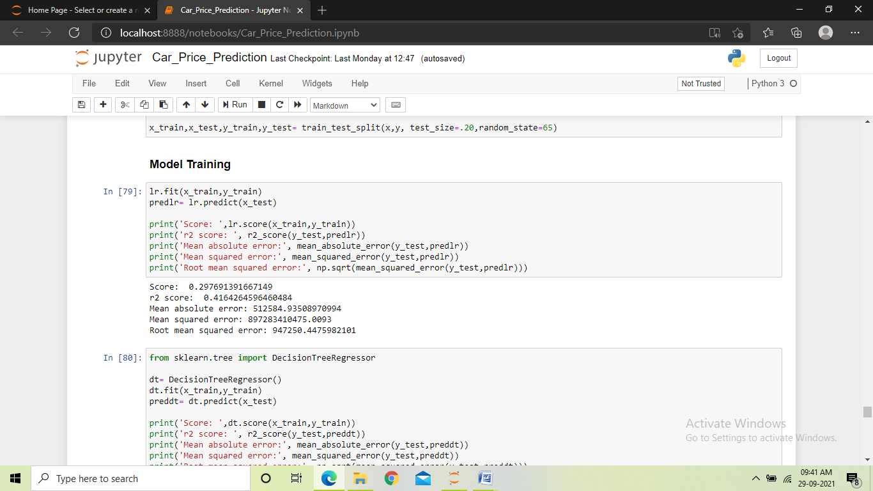
Model dashboard
In this project we used six different regression models to train the data, the models we used are:
Linear Regression: It measures the relationship between continuous numeric dependent variable and the independent variables by estimating probabilities. Using linear regression, we found the training score to be 30%, the R2 score to be 42% and the errors being very high.

Slide 19
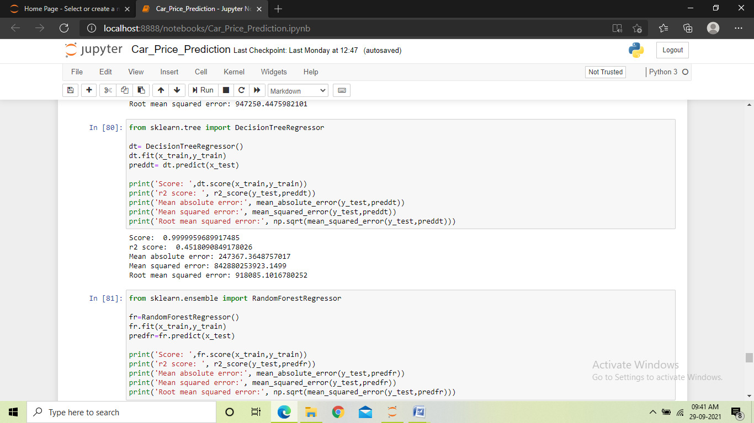
Decision Tree Regressor: Builds regression models in the form of a tree structure. It breaks down the dataset into smaller subsets. Using Decision tree regressor, we found the training score to be 99%, the R2 score to be 45%, and high errors.

Slide 20
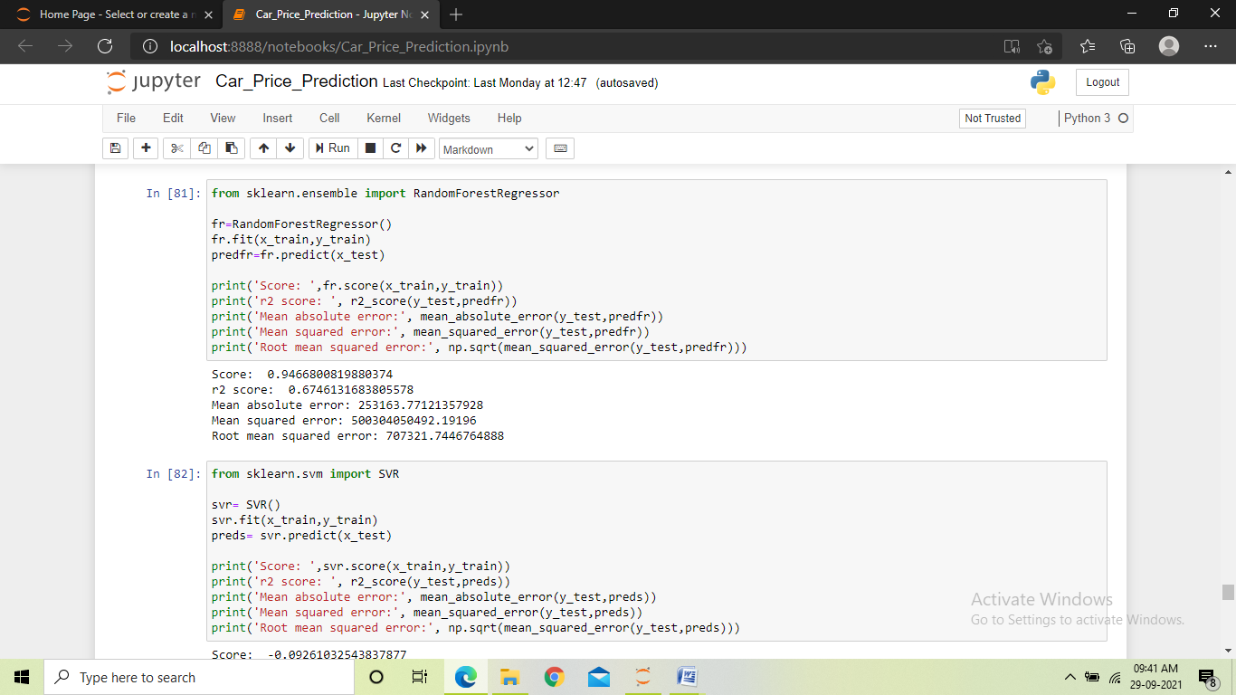
Random Forest Regressor: It builds multiple decision trees and merges them together to get a more accurate prediction. Using Random forest regressor, we found the training score to be 94%, the R2 score to be 67%, and comparative less errors

Slide 21
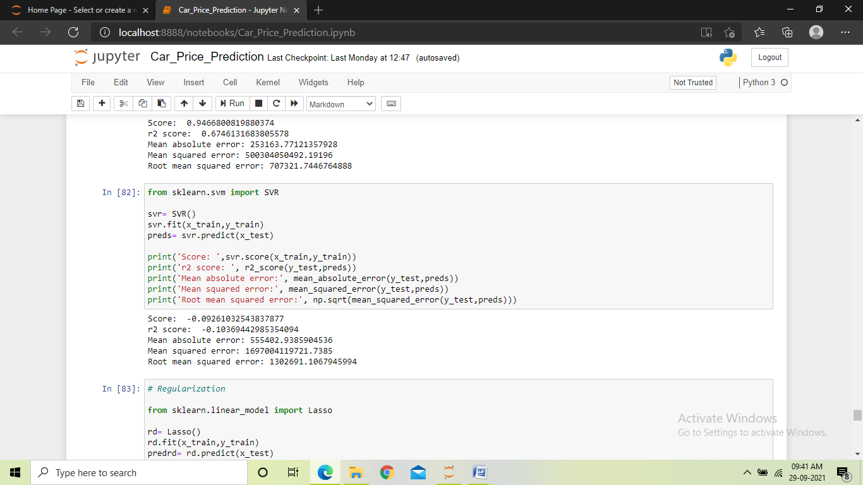
Support Vector Regressor: It looks at data and sorts it into one of two categories. It helps in determining the closest match between the data points and the function which is used to represent them. Using support vector regressor, we found the training score to be -9%, the R2 score to be -10%, and with very high errors.

Slide 22
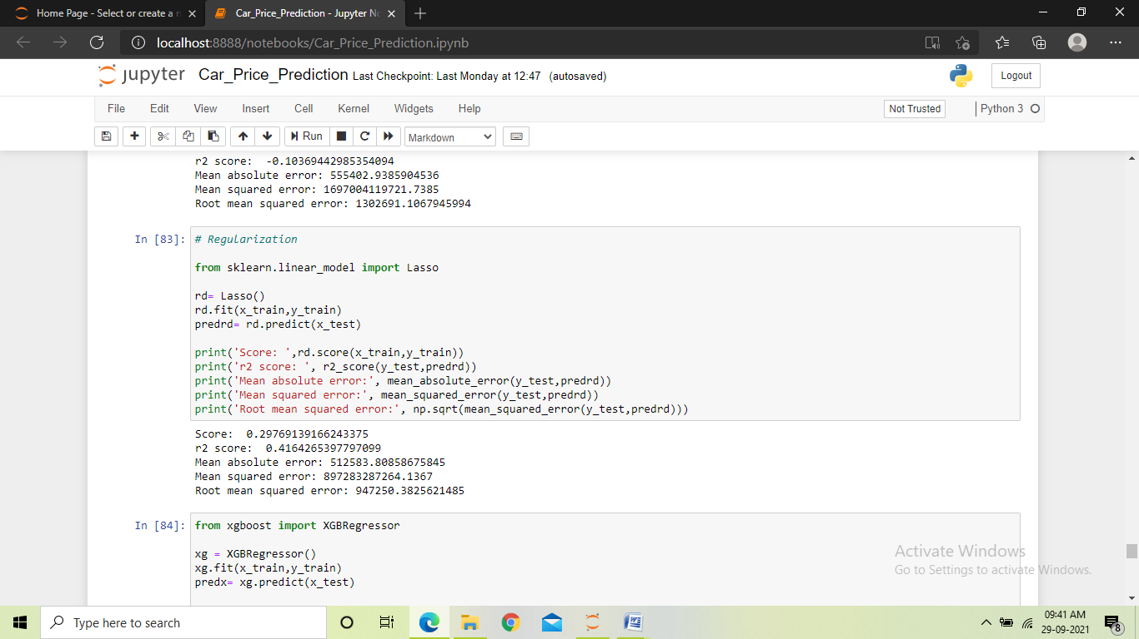
Lasso Regression: It uses shrinkage. Shrinkage is where data values are shrunk towards a central point, like the mean. The lasso procedure encourages simple, sparse models i.e. models with fewer parameters. Using Lasso regressor, we found the training score to be 30%, the R2 score to be 41%, and with high errors.

Slide 23
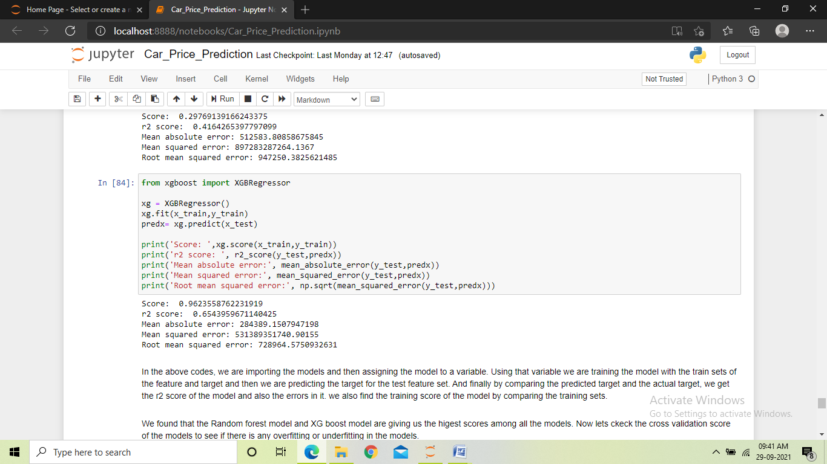
XGB Regressor: It is an efficient implementation of gradient boosting that can be used for regression predictive modelling. Using XGB regressor, we found the training score to be 96%, the R2 score to be 65%, with the errors being comparatively less.

Slide 24
Finalized model
We trained the dataset using six different models to select a final model which will perform the best among all the models.
We used Linear regression, Decision tree regressor, Random forest regressor , SVR, Lasso regressor and XGB regressor. After training we found the models Random forest and XGBoost were performing better as compared to other models and they gave us a good training score and r2 score along with less errors. But since the high score could be a result of overfitting, we performed the cross validation check.

Slide 25
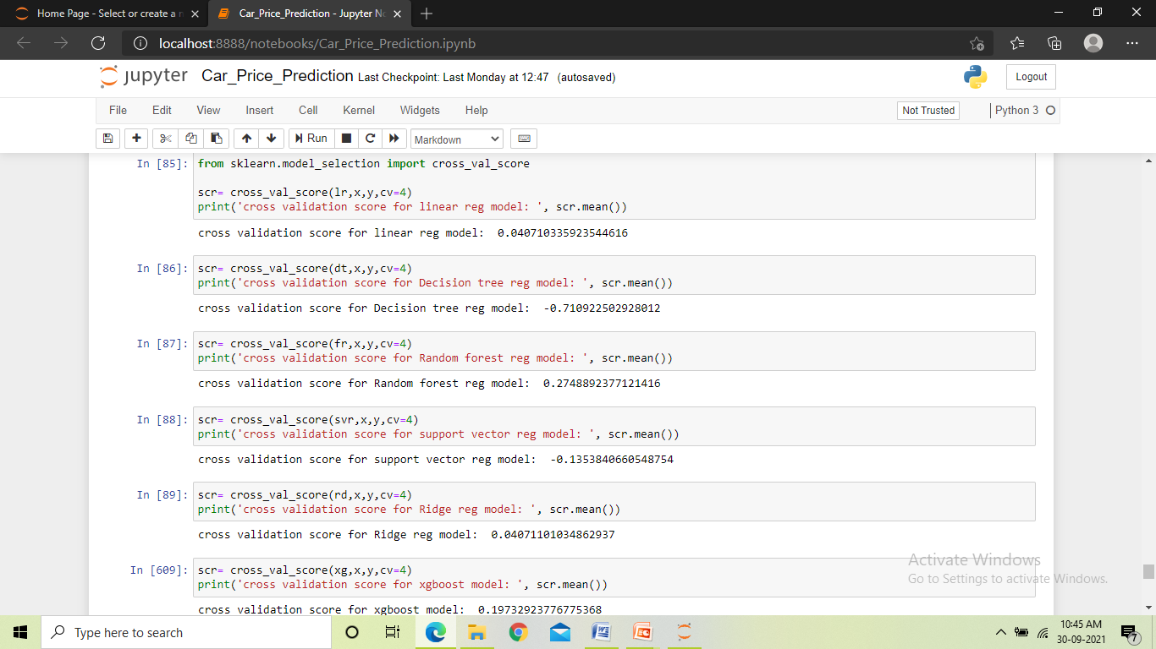
From the cross validation check, we found that the Random forest model and the XGBoost model had the highest scores and least difference between the r2 score and the CV score, which is an indicator of a better performance. Hence we took these two higher scoring models to perform hyper parameter tuning.

Slide 26
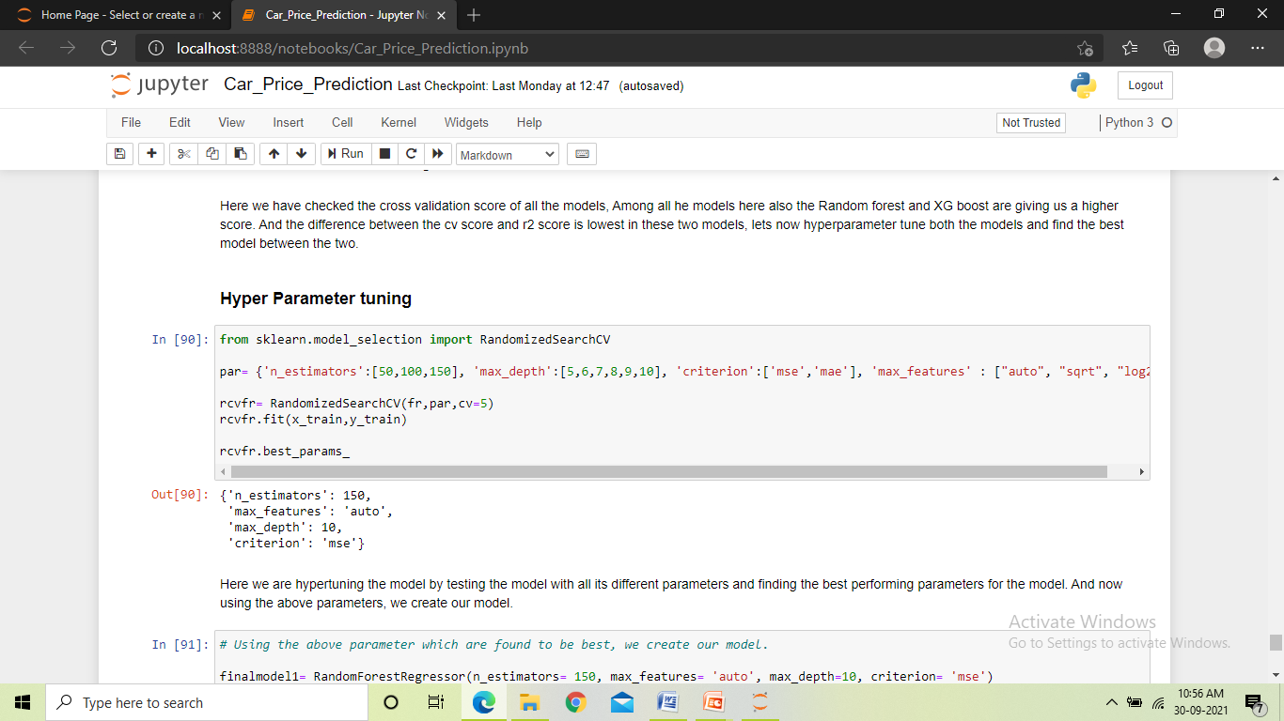
We used Randomized_search_CV to hyper parameter tune both the models. We gave different values for the parameters to the randomized_search_cv and it gave us the best performing values for those parameters. And finally using those values in the parameters, we trained our final two models.

Slide 27
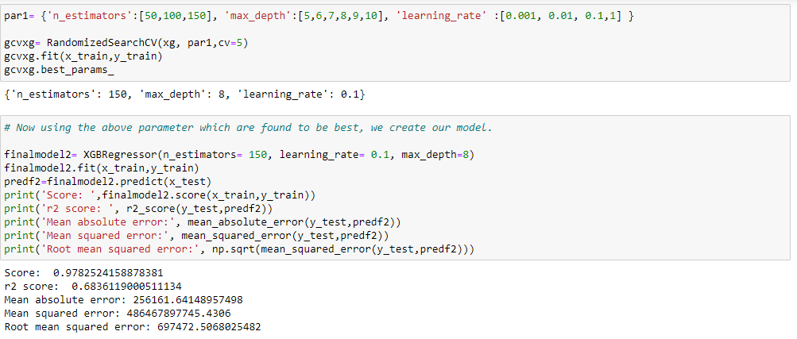
After training the two models and getting their scores, we found that the XGBoost model was performing slightly better as compared to the Random forest model. And hence we made the XGB Regressor model as our final model and saved it.

Slide 28
Conclusion
From the project, we found that while scraping data, it is important to fetch the data from different websites and also use different locations so that there is variance in the dataset. To further improve the results, more data of different cars can be fetched to train the model also more features can be added to the scraping list, which will help our model perform even better.
We found that all the columns in the dataset contained junk data along with the actual value and hence cleansing of the data played a very crucial role in building the model. When cleaning the data, we also found few missing values in certain columns which were denoted by a dash, which needed to be treated. Also the target column had some values in word form and we had to convert all the values to the same format.
From this project we also learnt that EDA and Data cleaning play a very crucial role in the outcome of the model. The EDA when done thoroughly gives us many insights into the data and without cleaning the data we could not have proceeded further.

Slide 29
The visualization of the dataset is very powerful in conveying the importance of different features in the dataset, through visualization we can identify the important features in the dataset, as well as features that do not have any significant importance. We learnt that the features which do not have any correlation with the target data should not be used in building the model as it may affect the model performance. Also we got the idea that scaling the dataset can be very useful in improving the model performance. We also learnt how checking cross validation and hyper parameter tuning can help us find the best model for out project.
The model created can be used by our client to understand the new trend in the market and can familiarize themselves with the changes after covid 19 and also update themselves from the older model to the new one.

