Slide 1
Demystifying
Machine Learning
A practical map of model families, business questions, and trade-offs

Slide 2



THE CORE IDEA
Machine learning is pattern-finding with a purpose
Models learn relationships from data to make predictions, decisions, or generate content.
Find signal
Make it useful
Separate repeatable relationships from noise.
Match the model to the question, the data, and the cost of being wrong.

Slide 3
A BETTER STARTING POINT
Start with the outcome, not the algorithm
The business question determines the useful shape of the answer.
01
02
03
04
Predict a number
Choose a category
Find hidden groups
Generate or recommend
Revenue, demand, time, risk
Churn, fraud, approval, topic
Segments, behaviors, anomalies
Text, images, products, next actions

Slide 4
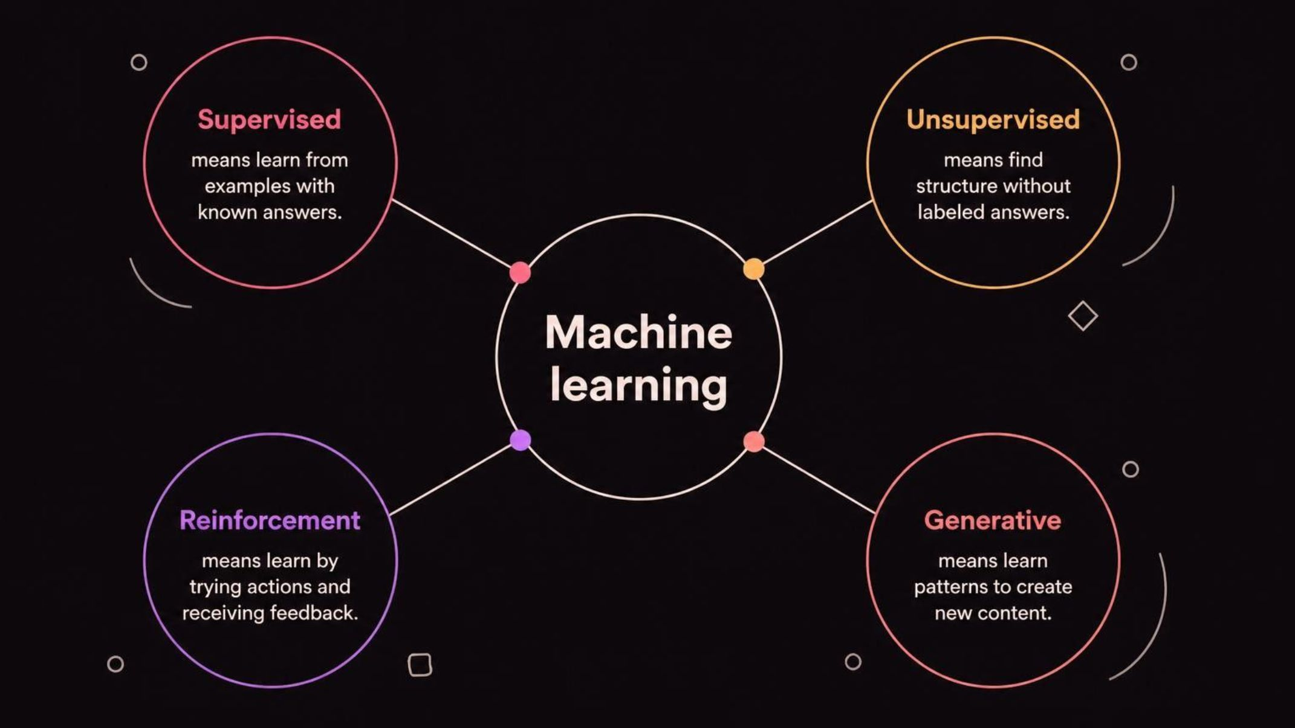
THE MAP
The model family map
Four families answer different kinds of questions. The first decision is the learning setup, not the brand name of the tool.

Slide 5

FAMILY 01 · SUPERVISED
Supervised learning learns from answer-key examples
Historical inputs are paired with known outcomes. The model learns a reusable mapping, then applies it to new cases.
INPUTS → KNOWN OUTCOME → NEW CASE

Slide 6

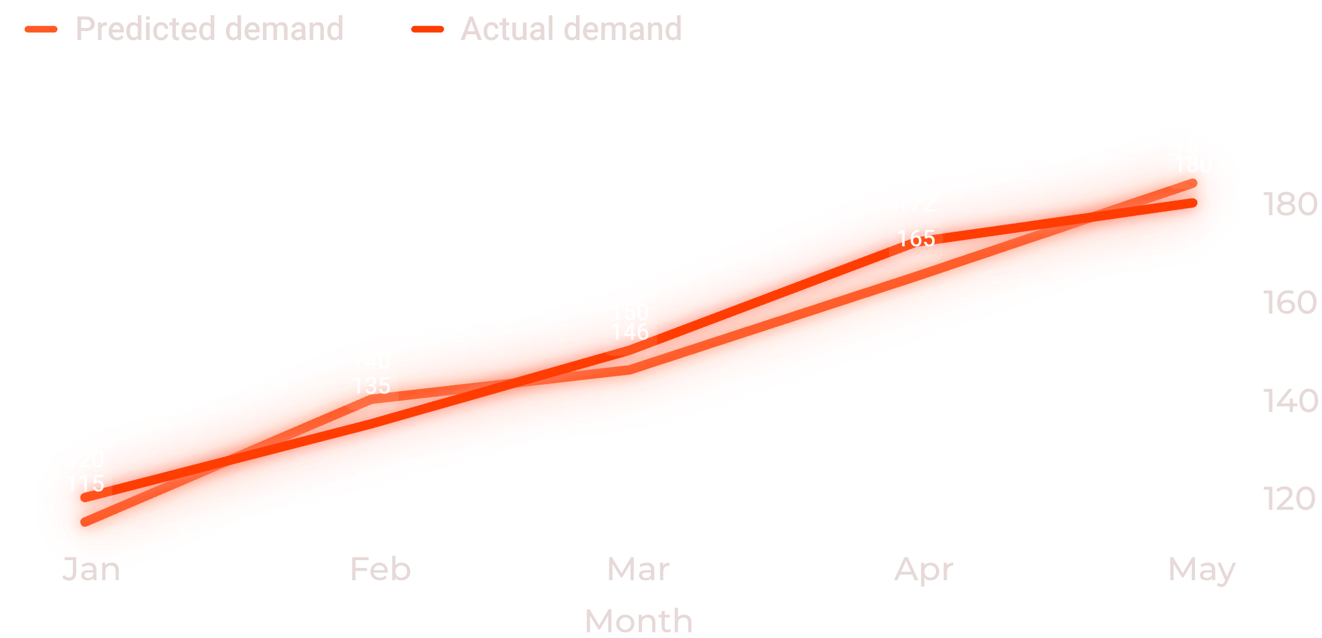
SUPERVISED · QUANTITY
Regression predicts a quantity
The question is “How much?” or “How long?”
Common examples
Sales forecast
Delivery time
Property value
Fit a line, curve, or more flexible function to past examples.
A useful regression model tracks the overall pattern while missing some individual cases.

Slide 7

SUPERVISED · LABEL
Classification predicts a label
The question is “Which bucket?” or “Is this likely?”
Churn / stay
Spam / not spam
High / medium / low risk
Which customers need attention?
Which messages belong elsewhere?
Which level supports the decision?
The output can be a class or a probability that supports a decision.

Slide 8


REPRESENTATIVE MODELS
Linear and logistic models are simple baselines with real value
NUMBER
PROBABILITY
Linear regression
Logistic regression
Estimates a numeric outcome with weighted inputs.
Estimates the probability of a class.
Useful when speed, interpretability, and a clear baseline matter.

Slide 9
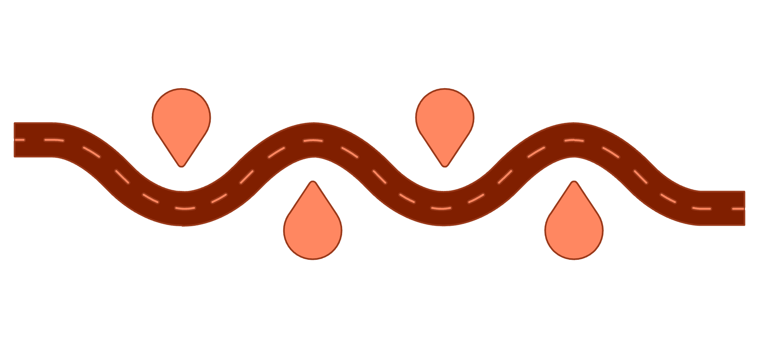





REPRESENTATIVE MODEL
Decision trees turn data into a sequence of questions
Has usage dropped?
Outcome: Likely stay
Check recent activity
Stable usage, low risk
Tenure < 6 months?
Outcome: Likely churn
Each answer sends the case down a different branch.
New customer or established
Significant drop, high risk
EASY TO EXPLAIN

Slide 10

REPRESENTATIVE MODEL
Nearest neighbors decide by resemblance
Find past cases that look most like the new case, then use those neighbors to recommend, classify, or assess similarity.
Works best when “similar” is meaningful and the data is well-prepared.

Slide 11




FAMILY 02 · UNSUPERVISED
Unsupervised learning finds structure without answer labels
Segmentation
Discovery
Find groups with shared behavior.
Expose patterns worth investigating.
Compression
There is no “correct” outcome column. The model surfaces patterns people can investigate.
Simplify complex data.
Anomaly hunting
Spot cases that do not fit.

Slide 12
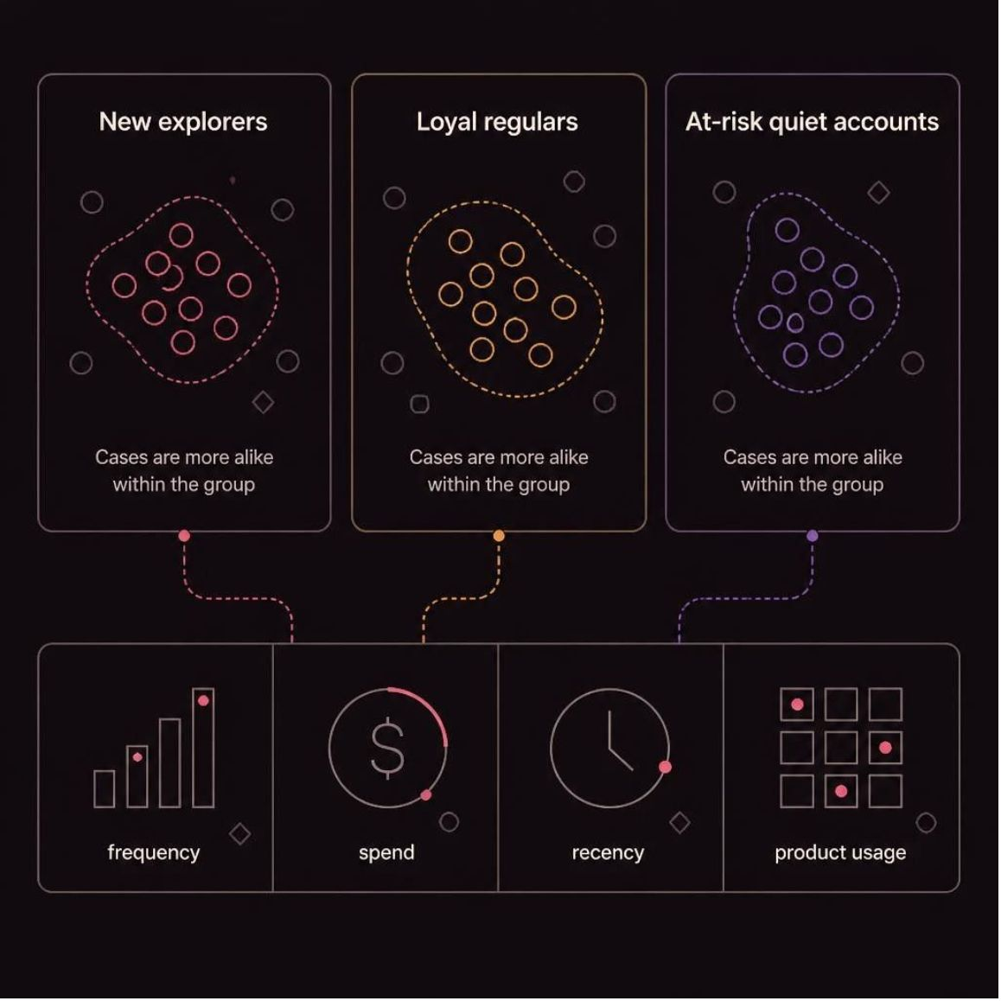
UNSUPERVISED · GROUPING
Clustering groups similar cases
Inputs might include frequency, spend, recency, or product usage.
Human judgment gives the groups meaning and decides what to do next.

Slide 13
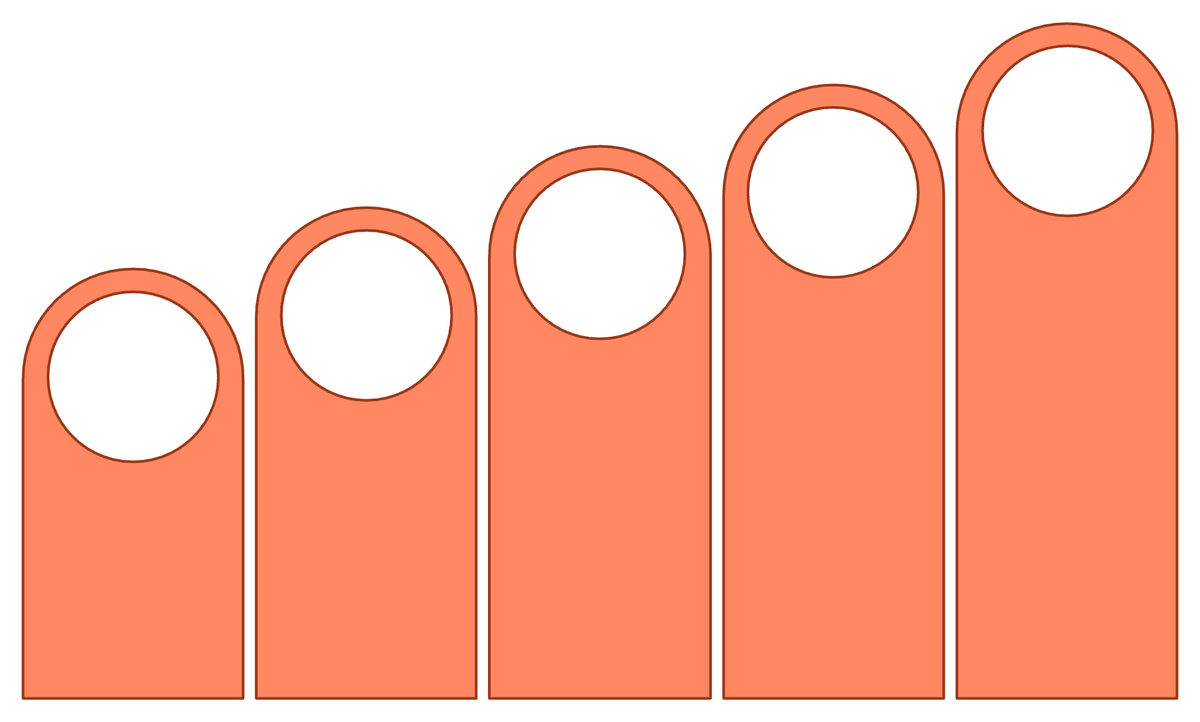





UNSUPERVISED · SIMPLIFYING
Dimensionality reduction makes complex data easier to see
Hidden Detail
Visible Groups
Two Dimensions
Compress
Compress many related measurements into a smaller set of useful dimensions.
Many Metrics
The trade-off: simpler views can hide details.

Slide 14
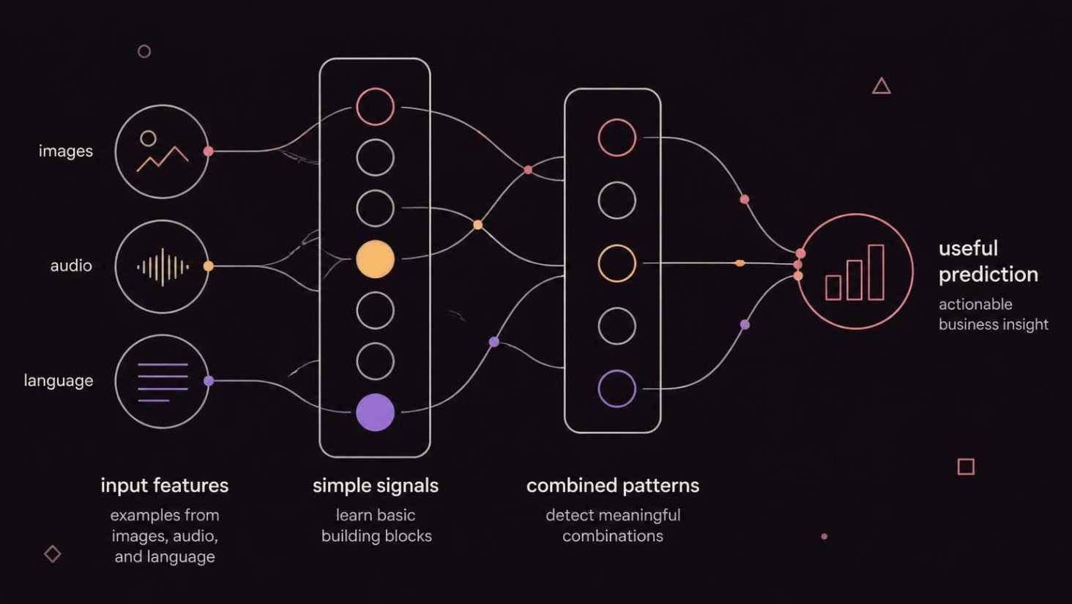
FAMILY 03 · REPRESENTATION
Neural networks learn layered representations
Many small computational units transform inputs through layers.
Early layers detect simpler patterns; later layers combine them into richer ones.

Slide 15

REPRESENTATIVE SCALE-UP
Deep learning scales the neural-network idea
More layers and more data can unlock complex pattern recognition.
Strengths
Perception, language, speech, recommendations
Costs
More data, compute, tuning, and explanation challenges

Slide 16

FAMILY 04 · CREATION
Generative models create new content
They learn patterns from existing examples and produce new text, images, audio, or code.
DRAFTING · SUMMARIZING · IDEATION · SEARCH · PERSONALIZATION
Guardrail: fluent output is not the same as verified truth.

Slide 17
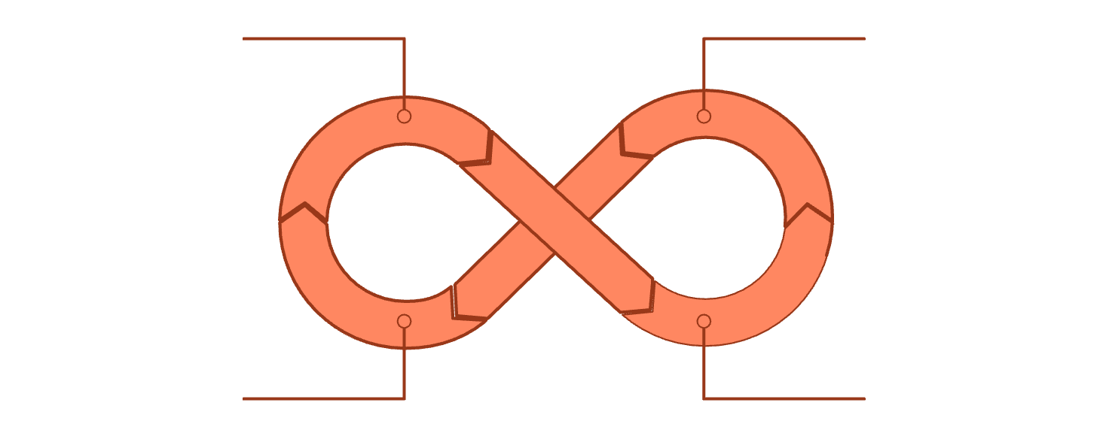

FAMILY 05 · FEEDBACK
Reinforcement learning improves through feedback
Observe Environment
Choose Action
An agent takes actions in an environment. Feedback rewards helpful behavior and discourages poor behavior.
Receive Feedback
Improve Policy
Useful for sequential decisions such as games, robotics, routing, and dynamic recommendations.

Slide 18
A DECISION SEQUENCE
How to choose: question, data, risk, then model
01
02
03
04
05
Define
Check
Baseline
Compare
Test
The business decision and success metric
What data and labels actually exist
Start with a simple model
Performance, interpretability, speed, and cost
In the real workflow, not only in a notebook

Slide 19
THE TRUST TEST
Model quality is more than accuracy
Check | What to ask
Performance | Does it generalize to new cases?
Reliability | Does it behave consistently over time?
Fairness and safety | Who could be harmed by errors or bias?
Adoption | Can people understand and act on the output?

Slide 20

THE PRACTICAL TAKEAWAY
Use the simplest model that earns trust.
Predict with regression and classification.
Reveal structure with clustering and reduction.
Unlock richer problems with neural, generative, and reinforcement models, accepting greater trade-offs.
The best model improves a real decision responsibly.

