Slide 1
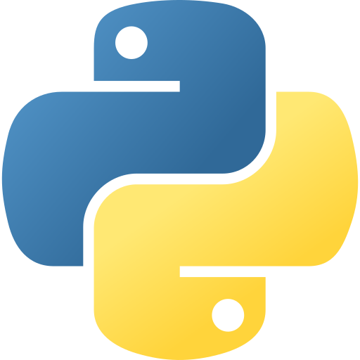
Mastering Python/PySpark Language
By Suraj Gude
Technical Educator
Python Programming

Slide 2
Python Learning Roadmap
Why do we need python?
Introduction to python
Python Variables & Data Types
Python Control Statements
Python Data Structures
Python Functions
Python Modules
Python OOPs
Python Exception Handling
Python File Handling
Python Searching & Sorting
Some Advanced Topics
Python Programming

Slide 3

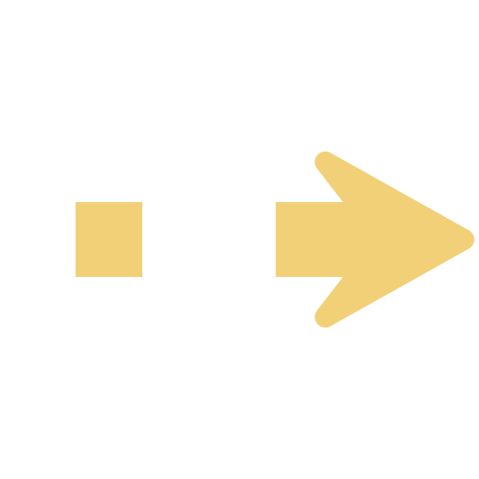









Why do we need python?
Design Web Platform
Flask / Django
Operational Inefficiency
Analyze Customer Data
Pandas / Numpy
Customer Dissatisfaction
Revenue Decline
Scikit-learn
Recommendations & Chatbot
Limited Reach
Capture Customer Feedback
TextBlob or SpaCy
Python Programming

Slide 4





Introduction to python
Features
Easy to Learn &
Readable
High-Level,
Interpreted Language
Extensive Libraries
& Frameworks
Cross-Platform
Compatibility
Supports AI &
Data Science
Python Programming

Slide 5
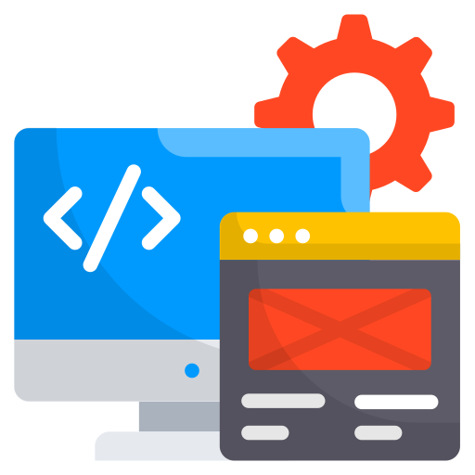



Introduction to python
Applications
Web Development
Data Science &
Analytics
Game development
Automation & Scripting
Machine Learning & AI
Python Programming

Slide 6
Introduction to python
Installation & setup
Windows Installation
Download Python installer from Python.org Downloads.
Run the installer .exe file.
Check “Add Python to PATH” before installing.
Click Install Now and complete setup.
Verify installation in CMD: python --version.
Linux Installation (Debian/Ubuntu-based)
Update package list: sudo apt update.
Install Python: sudo apt install python3.
Verify installation: python3 --version.
(Optional) Install pip: sudo apt install python3-pip.
More details: Python.org Linux Installation.
Python Programming

Slide 7


Introduction to python
Where to execute python code?
1. Command Line
2. Visual Studio Code
3. Google Collaboratory & Jupyter notebooks
Python Programming

Slide 8
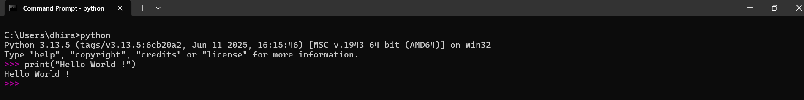
Introduction to python
Python first program on terminal
1. Open Command Prompt (Win + R → cmd).
2. Type python and press Enter (to enter Python shell).
3. At the prompt, type: print("Hello World !").
4. Press Enter → Output will be: Hello World!.
5. Exit Python shell with exit() or Ctrl+Z + Enter.
Python Programming

Slide 9
Thank You…
Python Programming

