Slide 1


IACSD
INSTITUTE FOR ADVANCEDCOMPUTING AND SOFTWARE DEVELOPMENT AKURDI, PUNE
Documentation On
“BITCODE TUTORIAL”
PG-DAC SEPT-2022
Submitted By:
Group No: 86
Mr. Prajwal Raju Patil Mr. Suraj J. Khokrale
Roll No: 9182
Roll No. 9221
Rohit Puranik Centre Coordinator
Mrs. Rupali Thorat Project Guide

Slide 2
IACSD
Table of Contents
Introduction
Document Purpose Problem Statement Product Scope
Aim And Objectives
Overall Description
Operating Environment
Server Side Client Side
Design and Implementation Constraints
Specific Requirements
External Interface Requirements Functional Requirements
Non Functional Requirements
System Design
ER Diagram Activity Diagram Sequence Diagram DFD Diagram Class Diagram Usecase Diagram
Table Structure
Conclusion 10.References

Slide 3
IACSD
Introduction
BitCode Tutorials is an online learning platform that provides various courses on a variety of programming languages. These tutorials are developer documentation based, with the best interpretation of technical jargons into simplified layman terms.
The detailed requirements and specifications for the development of BitCode Tutorials website are provided in this document.
Document Purpose
BitCode Tutorials website aims to create a E-learning programming tutorials website to provide free, extensive and accurate knowledge to the learners at one single place.
Problem Statement
With the advent in technology and with the perpetual increase in the strength of the students and the number of departments in the educational institutions, it is laborious to exchange the study materials between the students and the faculties.
The main objective of the E-Learning is to help the students get over the traditional methods of learning and make them accustomed to the internet where the notes for their respective subjects are easily available. It provides an automation procedure of studying the notes online. The implementation of this project helps the students. The students can gain access to these notes by searching for the name of the file under their respective department.
This project not only helps to facilitate easier access to notes for the students but also helps cutting down on expenditure for the universities as well. Students and Universities alike spend a considerable amount of money on printing costs which can be prevented.
E-Learning is an inexpensive, efficient and comfortable way for students to easily access notes and an easier alternative to study for exams.
Product Scope
This web application is an online E-learning tutorials website that helps programmers with extensive knowledge of various programming languages, along with plenty of coding examples. Each user can signup to this website and keep a track record of their learning journey.
There are options to subscribe for premium contents of this tutorials website which provides user with exclusive content. A course purchase history is maintained for every subscription made.

Slide 4
IACSD
Aims & Objectives
Specific goals are: -
To produce a web-based system that allow users to access the content depending upon the courses available which can be free and paid.
To produce a web-based system that allow admins to add the contents in the existing courses and additional information.
To maintain a track for the admin on the respective courses about the purchase ratios. And also keep tract upon the transactions.
Overall Description
This programming tutorials website provides plenty of code snippets to make user familiar with the programming environment and programming syntax. Each code snippet is followed by a in depth explanation.
The content is thoroughly tested and designed in a manner that assures easy understanding to leaners.
An online coding compiler is made available for users with paid subscriptions for immediate hands on.
Admins have right to access all the user profiles and other related informations such as progress tracking, course enrollments, payment transactions, etc. Admins can add new contents within the existing courses and also can add new courses.
The users are provided various courses with specific contents and relative information as per requirements. Users registration is done for the purchase various paid contents and profile is maintained along with the progress tracking.

Slide 5
IACSD
Operating Environment:
Server Side:
Processor: Intel® Xeon® processor 3500 series
HDD: Minimum 500GB Disk Space
RAM: Minimum 4GB OS: Windows 10, Linux 6 Database: MySQL
Client Side (minimum requirement):
Processor: Intel Dual Core
HDD: Minimum 80GB Disk Space
RAM: Minimum 1GB
OS: Windows 8 and above, Linux
Design and Implementation Constraints:
The application will use ReactJS, Spring Boot API, Ajax, JavaScript, jQuery and CSS as main web technologies.
HTTP and FTP protocols are used as communication protocols. FTP is used to upload the web application in live domain and the client can access it via HTTP protocol.
Several types of validations make this web application a secured one.
Since BitCode Tutorials is a web-based application, internet connectionmust be established.
BitCode Tutorials will be used on PCs and will function via internetor intranet in any web browser.

Slide 6
IACSD
Specific Requirement
External Interface Requirements:
User Interfaces:
All the users will see the same page when they enter in this website. This page asks the users a username and a password.
After being authenticated by correct username and password, user will be redirect to their corresponding profile where they can do various activities.
The user interface will be simple and consistence, using terminology commonlyunderstood by intended users of the system. The system will have simple interface, consistence with standard interface, to eliminate need for user trainingof infrequent users.
Hardware Interfaces:
No extra hardware interfaces are needed.
The system will use the standard hardware and data communication resources.
This includes, but not limited to, general network connection at theserver/hosting site, network server and network management tools.
Functional Requirements
Access Website
New users can register to this website for free and start their programming
journey, or simply browse through the website for free content without registration.
Admin Profile
The admin has all the rights to have an access to the entire courses and the
users profile which contains the user profile tracking, progress of the course for all users. The admin have an access to the payments related detailed information regarding the courses with respect to all users. Admin have an access to modify the existing course contents and also to add a new course as per required.

Slide 7
IACSD
User Profile
Each user has a personalized dashboard that displays user specific information like course purchase history, learning track record, etc.
Various personal details like profile name, password, etc can be updated via this
dashboard as well.
Enrollment of the course
The user can enroll the courses which are free as well as paid. Users need to enroll the paid courses by purchasing the course respective to their enrollment
amounts.
Progress Tracking
The course or contents enrolled by the specific user is been added to respective profiles with proper progress tracking bar. As the contents are been marked as done it reflects the progress within the profile.
Application Interfaces:
OS: Windows 10, Linux
Web Browser:
The system is a web-based application; clients need a modern web browser such as Mozilla Firebox, Internet
Explorer, Opera, and Chrome. The computer must have an Internet connection in order to be able to access the system.
Communications Interfaces:
This system uses communication resources which includes but not limited to, HTTP protocol for communication with the web browser and web server and TCP/IP network protocol with HTTP protocol.
This application will communicate with the database that holds all the bookinginformation. Users can contact with server side through HTTP protocol by means of a function that is called HTTP Service. This function allows the application to use the data retrieved by server to fulfil the request fired by the user.

Slide 8
IACSD
Non-Functional Requirements
Security
The system’s back-end servers shall only be accessible to authenticated administrators. Sensitive data will be encrypted before being sent over insecure connections like the internet.
Availability
The system should be available at all times, meaning the user can access it using a web browser, only restricted by the downtime of the server on which the system
runs. In case of an of a hardware failure or database corruption, a replacement page
will be shown. Also, in case of a hardware failure or database corruption, backups of the database should be retrieved from the server and saved by the administrator.
Then the service will be restarted. It means 24 X 7 availability. Reliability
The reliability of the overall program depends on the reliability of the separate components. The main pillar of the reliability of the system is the backup of the
database which is continuously maintained and updated to reflect the most recent changes. Thus, the overall stability of the system depends on the stability of container and its underlying operating system.
Maintainability
A commercial database is used for maintaining the database and the
application server takes care of the site. In case of a failure, a re-initialization of the program will be done. Also, the software design is being done with modularity in mind so that maintainability can be done efficiently.
Accessibility
The system will be a web-based application it is going to be accessible on the web browser.
Back up
We will take a backup in our system database. In order to enable the administrator and the user to access the data from our system.
Performance
The product shall be based on web and has to be run from a web server. The product shall take initial load time depending on internet connection strength which
also depends on the media from which the product is run. The performance shall depend upon hardware components of the client/customer

Slide 9
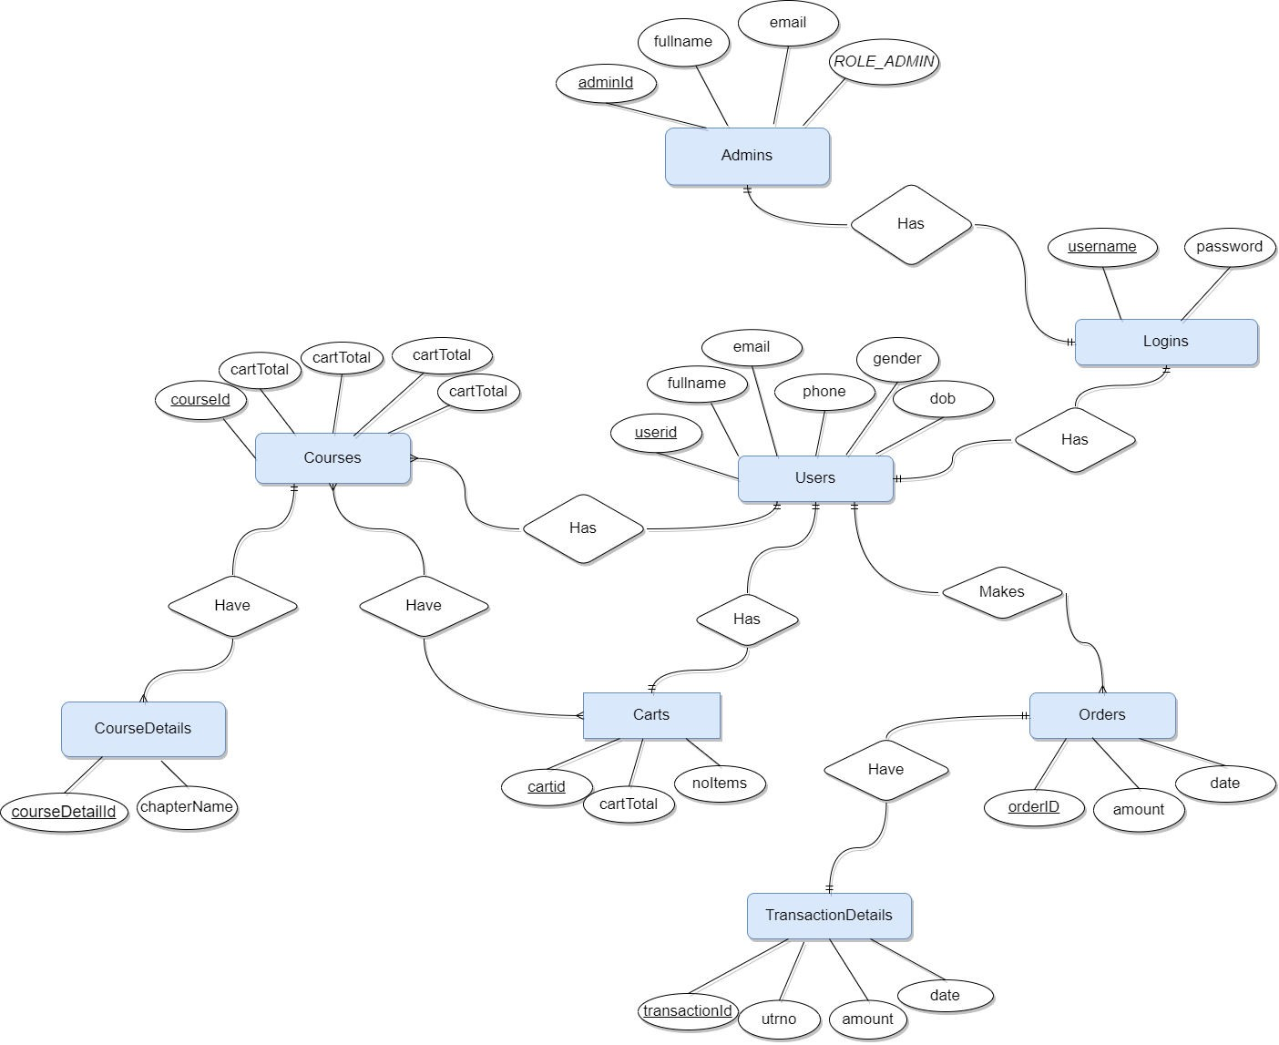
IACSD
System Design
ER Diagram:

Slide 10
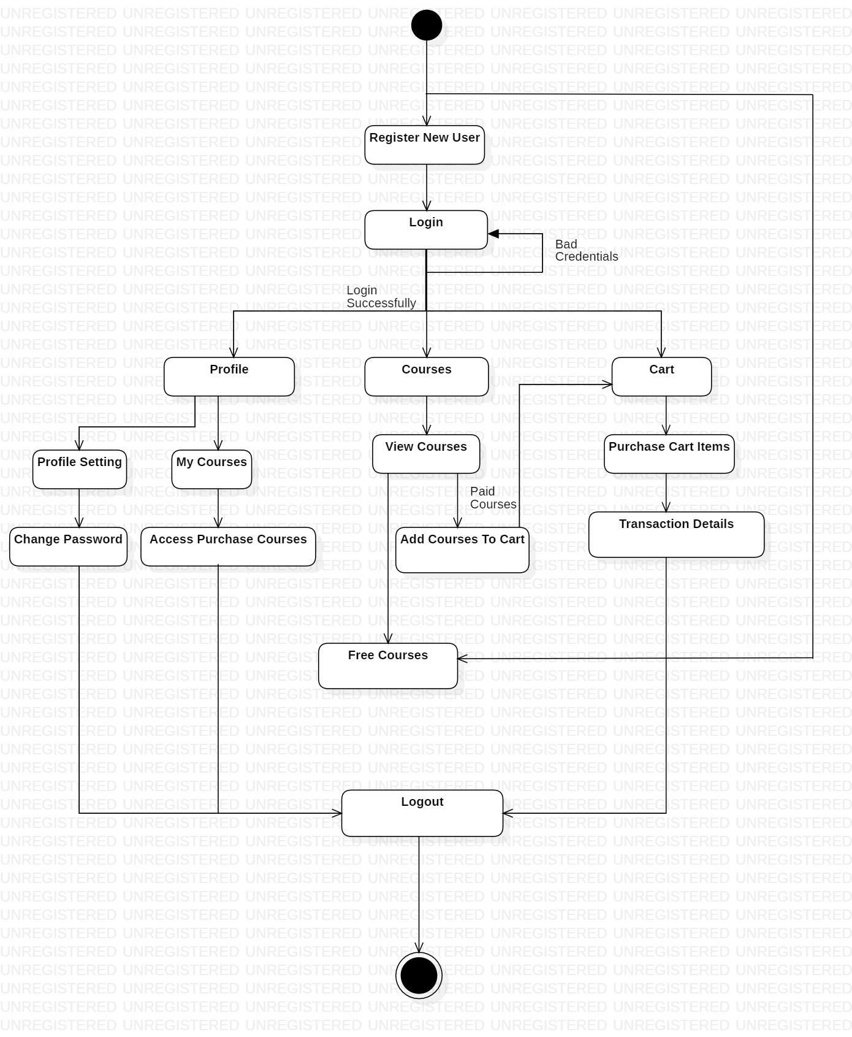
IACSD
Activity Diagram

Slide 11
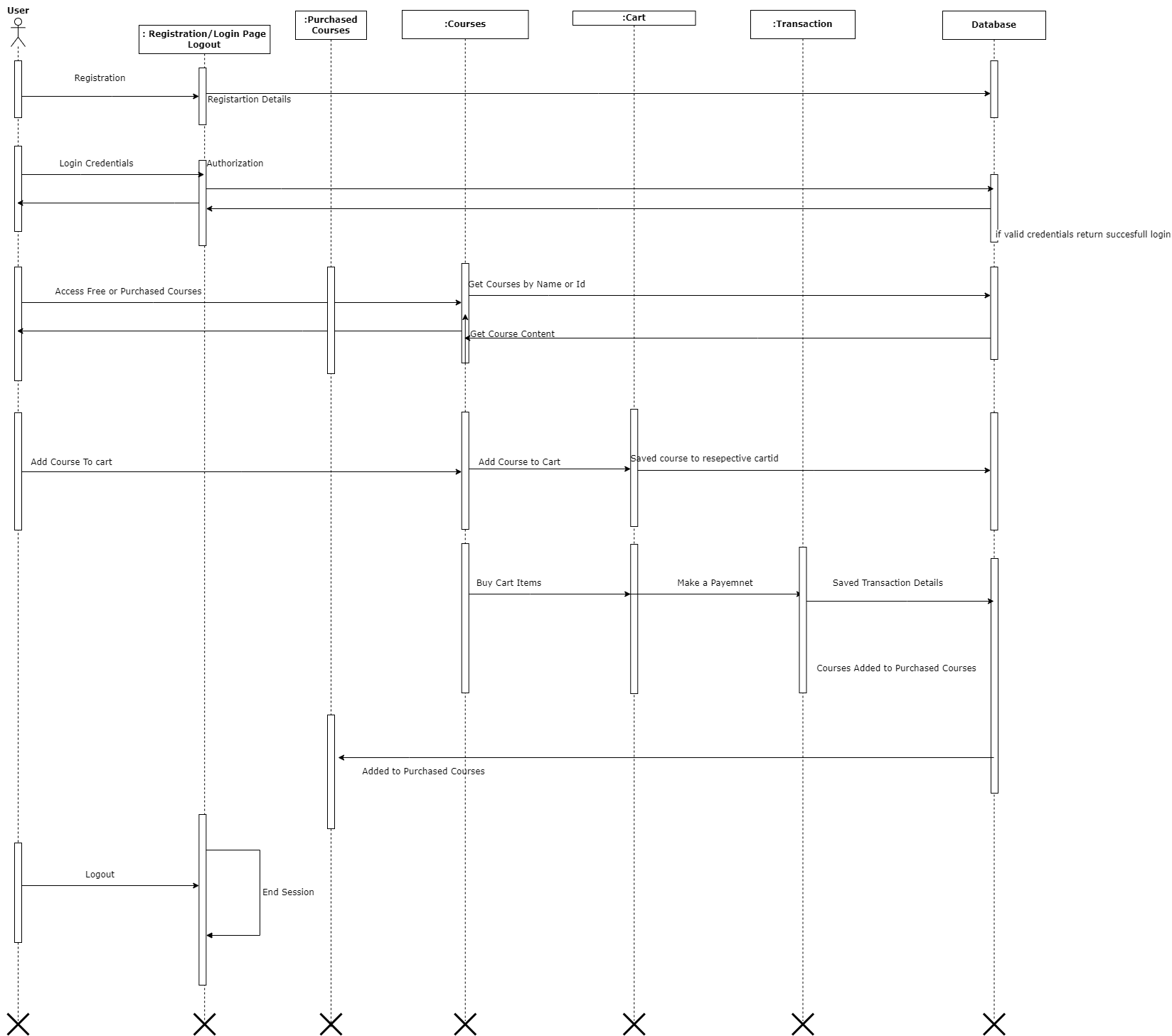
IACSD
Sequence Diagram

Slide 12
IACSD
Data Flow Diagram

Slide 13
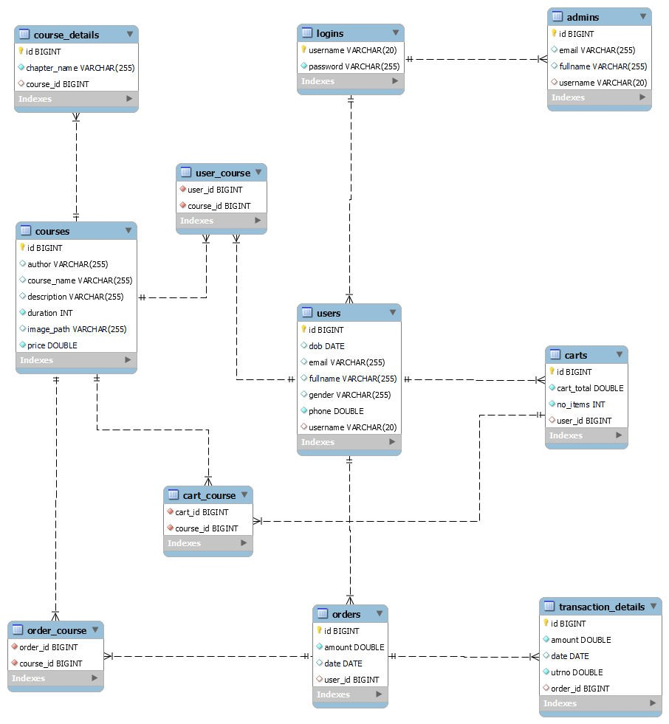
IACSD
Class Diagram

Slide 14
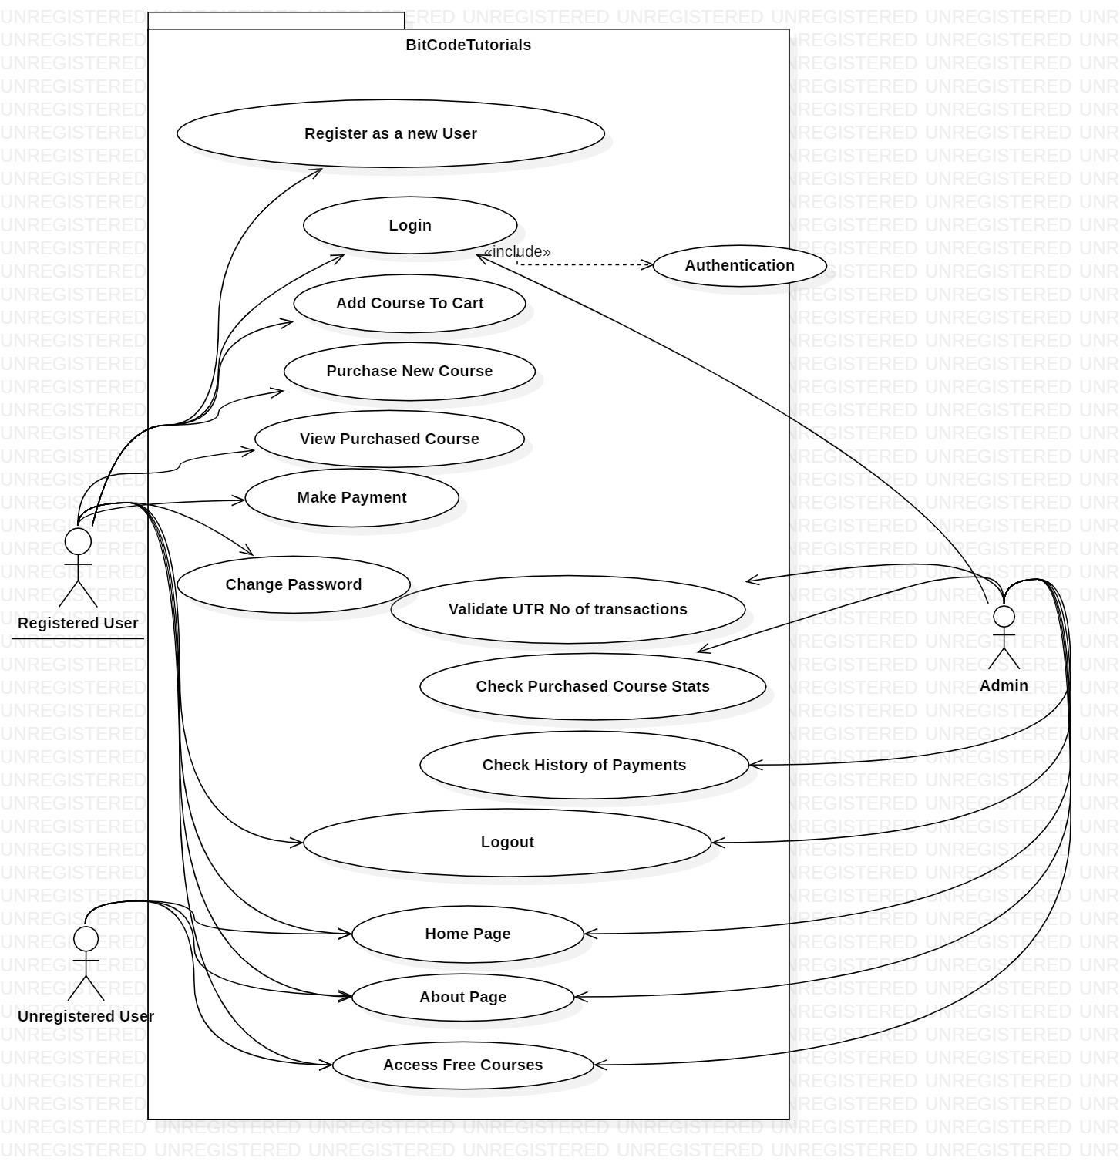
IACSD
Use Case Diagram

Slide 15
IACSD
+
Table Structure
Admin:
+----------+--------------+------+-----+---------+----------------+
| Field | Type | Null | Key | Default | Extra
|
+----------+--------------+------+-----+---------+----------------+
| id | bigint | NO | PRI
| email | varchar(255) | YES |
| NULL
| NULL |
| NULL |
|
| auto_increment |
| fullname | varchar(255) | YES |
|
|
|
| username | varchar(20) | YES | MUL | NULL
+----------+--------------+------+-----+---------+----------------+
Cart_Courses
+-----------+--------+------+-----+---------+-------+
| Field | Type | Null | Key | Default | Extra |
+-----------+--------+------+-----+---------+-------+
| cart_id | bigint | NO | MUL | NULL | |
| course_id | bigint | NO | MUL | NULL | |
+-----------+--------+------+-----+---------+-------+
Cart
+------------+--------+------+-----+---------+----------------+
| Field | Type | Null | Key | Default | Extra |
+------------+--------+------+-----+---------+----------------+
| id
| bigint | NO | PRI | NULL | auto_increment |
| cart_total | double | NO | | NULL |
|
| no_items | int
| NO | | NULL |
|
| user_id | bigint | YES | MUL | NULL | |
+------------+--------+------+-----+---------+----------------+
Course_Details
+--------------+--------------+------+-----+---------+----------------+
| Field | Type | Null | Key | Default | Extra |
+--------------+--------------+------+-----+---------+----------------+
| id | bigint | NO | PRI | NULL | auto_increment |
| chapter_name | varchar(255) | NO | UNI | NULL |
|
| course_id | bigint | YES | MUL | NULL | |
+--------------+--------------+------+-----+---------+----------------+

Slide 16
IACSD
Courses
+-------------+--------------+------+-----+---------+----------------+
| Field | Type | Null | Key | Default | Extra |
+-------------+--------------+------+-----+---------+----------------+
| id | bigint | NO | PRI | NULL | auto_increment |
| author | varchar(255) | YES | | NULL | |
| course_name | varchar(255) | YES |
| description | varchar(255) | YES |
| NULL | |
| NULL | |
| duration | int | NO | | NULL |
|
| image_path | varchar(255) | YES | | NULL |
|
| price | double | NO | | NULL | |
+-------------+--------------+------+-----+---------+----------------+
Logins
+----------+--------------+------+-----+---------+-------+
| Field | Type | Null | Key | Default | Extra |
+----------+--------------+------+-----+---------+-------+
| username | varchar(20) | NO | PRI | NULL | |
| password | varchar(255) | NO | | NULL | |
+----------+--------------+------+-----+---------+-------+
Order _Courses
+-----------+--------+------+-----+---------+-------+
| Field | Type | Null | Key | Default | Extra |
+-----------+--------+------+-----+---------+-------+
| order_id | bigint | NO | MUL | NULL | |
| course_id | bigint | NO | MUL | NULL | |
+-----------+--------+------+-----+---------+-------+
Orders
+---------+--------+------+-----+---------+----------------+
| Field | Type | Null | Key | Default | Extra |
+---------+--------+------+-----+---------+----------------+
| id | bigint | NO | PRI | NULL | auto_increment |
| amount | double | NO | | NULL | |
| date | date | YES |
| NULL |
|
| user_id | bigint | YES | MUL | NULL | |
+---------+--------+------+-----+---------+----------------+

Slide 17
IACSD
Transaction_details
+----------+--------+------+-----+---------+----------------+
| Field | Type | Null | Key | Default | Extra |
+----------+--------+------+-----+---------+----------------+
| id | bigint | NO | PRI | NULL | auto_increment |
| amount | double | NO |
| date | date | YES |
| NULL | |
| utrno | double | NO |
| NULL |
| NULL |
|
|
| order_id | bigint | YES | MUL | NULL | |
+----------+--------+------+-----+---------+----------------+
User_Course
+-----------+--------+------+-----+---------+-------+
| Field | Type | Null | Key | Default | Extra |
+-----------+--------+------+-----+---------+-------+
| user_id | bigint | NO | MUL | NULL | |
| course_id | bigint | NO | MUL | NULL | |
+-----------+--------+------+-----+---------+-------+
User
+----------+--------------+------+-----+---------+----------------+
| Field | Type | Null | Key | Default | Extra
|
+----------+--------------+------+-----+---------+----------------+
| id
| dob
| email
| bigint | NO | PRI | NULL
| date | YES |
| auto_increment |
| varchar(255) | YES |
| NULL |
| NULL |
| NULL |
| NULL |
| NULL |
|
|
|
|
|
| fullname | varchar(255) | YES |
| gender | varchar(255) | YES |
| phone | double | NO |
| username | varchar(20) | YES | MUL | NULL |
|
+----------+--------------+------+-----+---------+----------------+

Slide 18
IACSD
Conclusion

Slide 19
IACSD
References

