Slide 1
BASICS OF UBUNTU
* INSTALLATION
* USER MANAGEMENT
* IMPORTANT COMMANDS
* SHELL SCRIPTING

Slide 2
INSTALLATION
AIM : To dual boot Ubuntu 18.04 Operating System along with Windows 10 in DELL intel core i3 device.
PRE-REQUISITES : Pre installed Windows OS, Live USB ( here, Universal USB Installer ), Pen Drive device
PROCEDURE :
1) Back up all important files from the device to the pen drive.
2) Creation of live USB of Linux OS in the current OS.

Slide 3
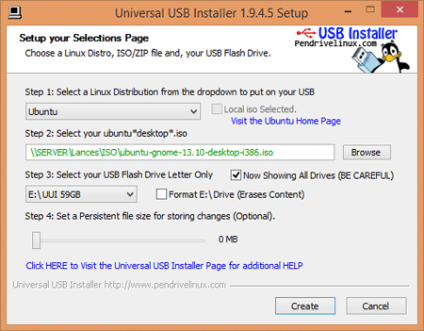
2.1) Install Universal USB Installer.

Slide 4
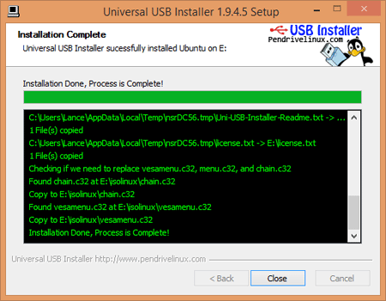
2.2) Making partition in memory disk for Ubuntu OS

Slide 5
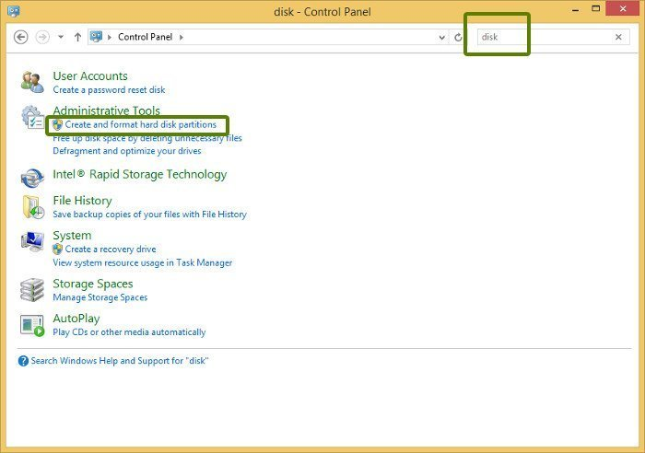
2.3) Choose “Create and format hard disk partitions” option in All Programs.

Slide 6
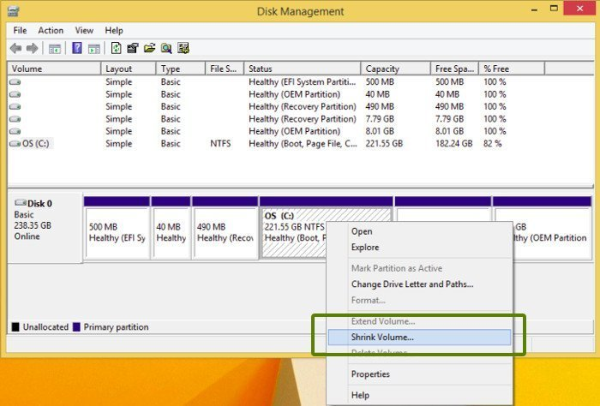
2.4) Shrink volume of the disk.

Slide 7
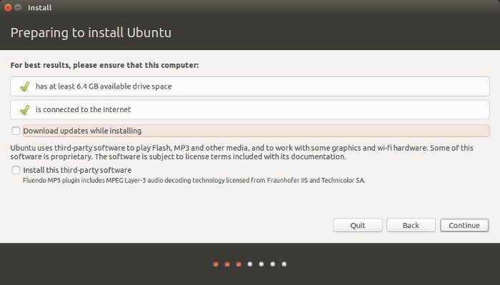
3) Install latest LTS (long term support) version Ubuntu OS from it’s official website as it is open-source.

Slide 8
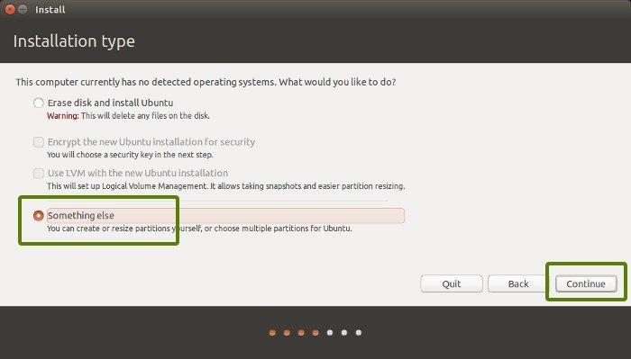
4) Complete Ubuntu installation by restarting the DELL device.

Slide 9
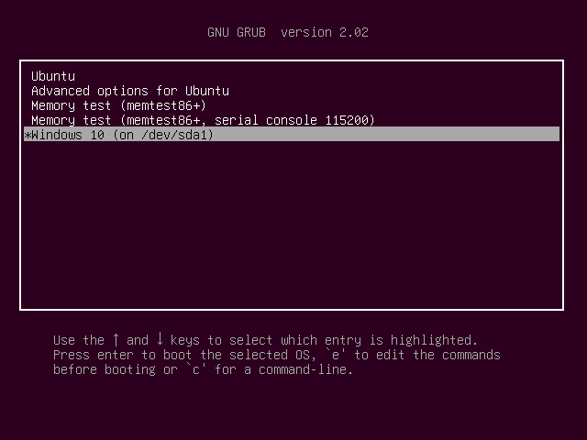
5) Thus, the current booting process looks like the following:

Slide 10
USER MANAGEMENT
AIM : To create a new user in the Ubuntu OS
PROCEDURE :
1) First, we need to log in to the terminal as a super-user. So, we use the command “sudo” with flag -i ..
2) Next, we need to enter the system password to log in

Slide 11
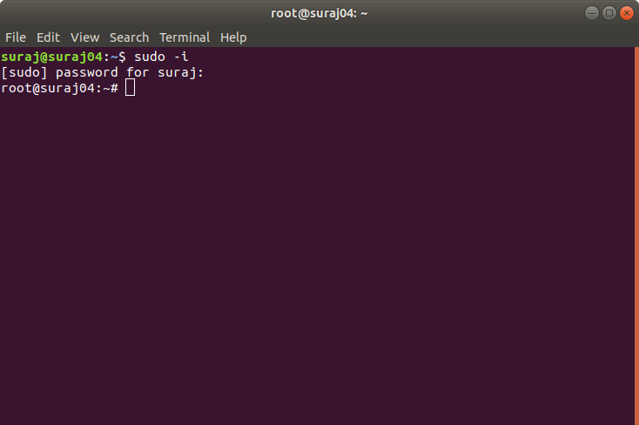

Slide 12
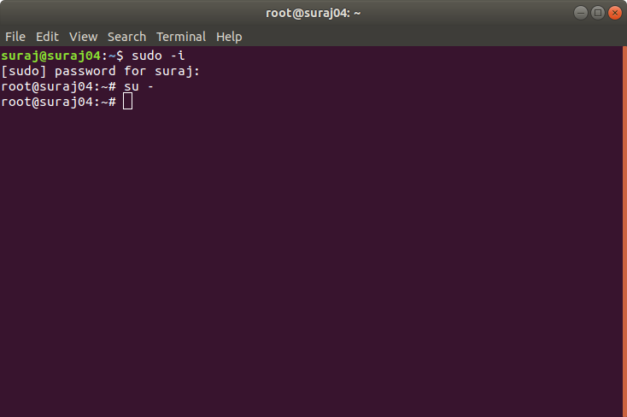
3) Log in to the terminal as a super-user

Slide 13
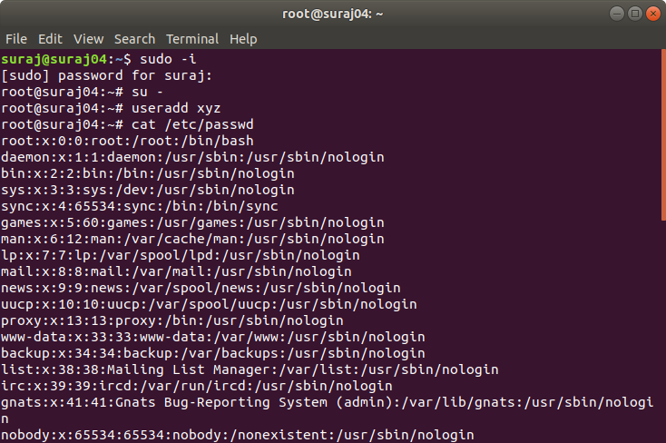
4) Now, we can manage all user operations such adding or deleting users.

Slide 14
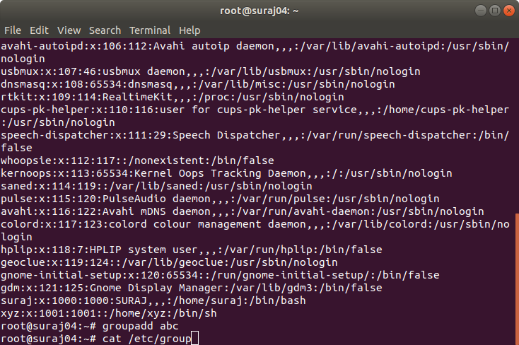

Slide 15
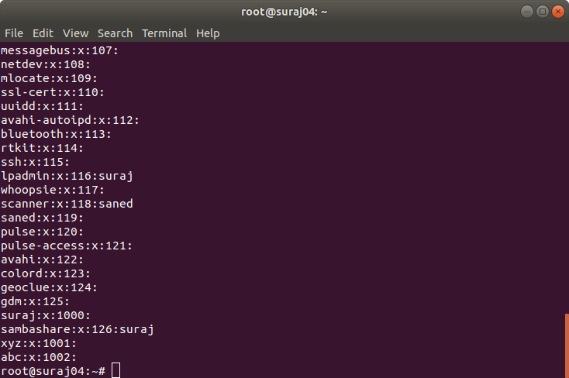

Slide 16
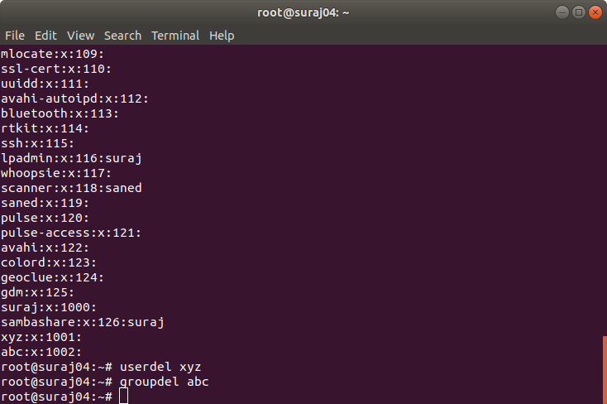
5) We can also delete users.

Slide 17
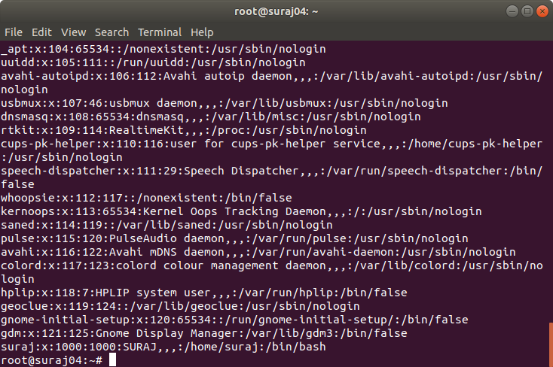
6) After deleting the created user and group..

Slide 18
IMPORTANT COMMANDS
AIM : To learn all the bsic commands of Linux terminal
COMMANDS:
1) Listing Files ( ls )

Slide 19
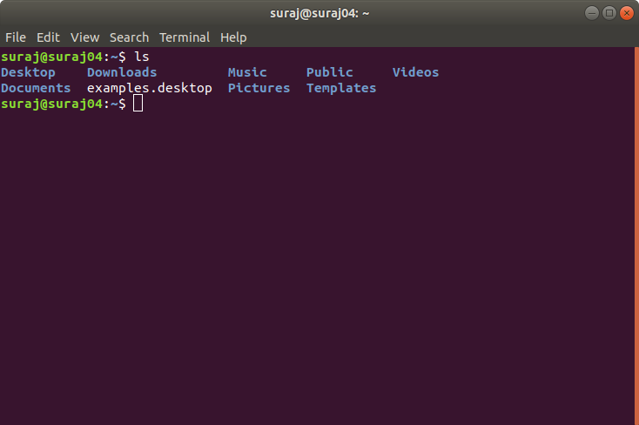

Slide 20
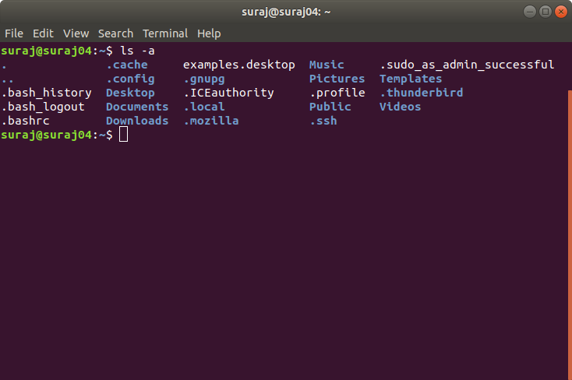
2) Listing Hidden Files ( ls -a )

Slide 21
3) creating, manipulating and deleting files.

Slide 22
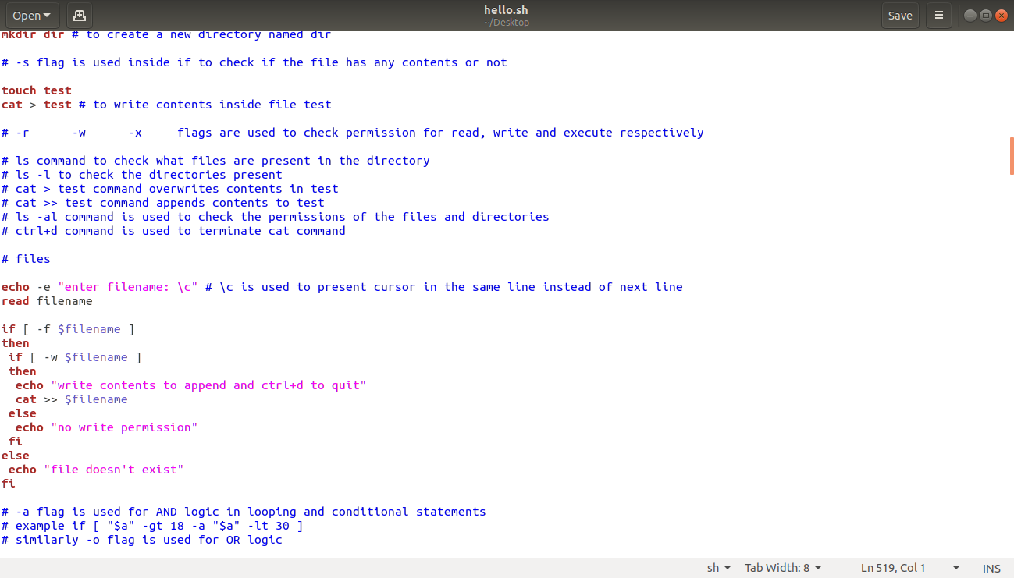

Slide 23
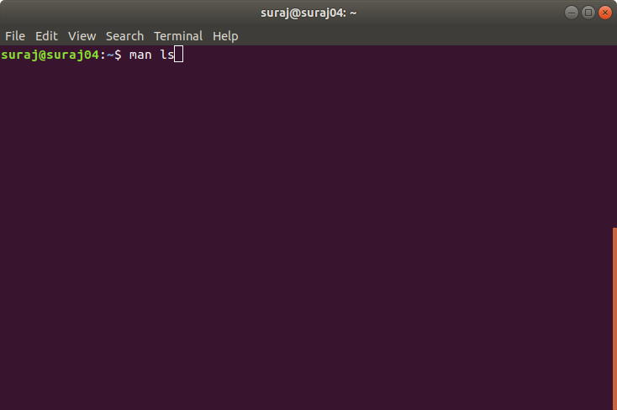
4) the “man” command to get insight on any particular command(s)

Slide 24
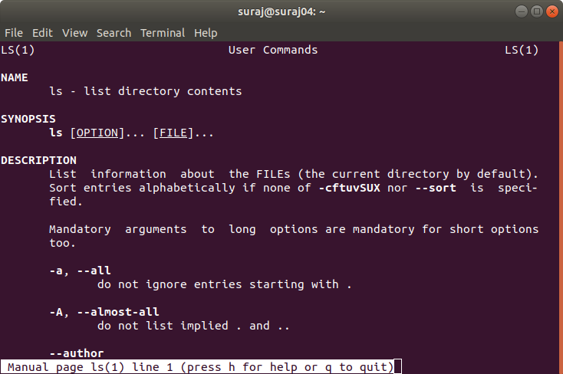

Slide 25
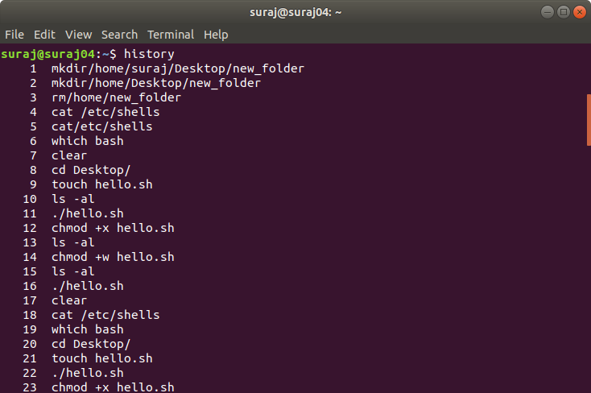
5) The “history” command

Slide 26
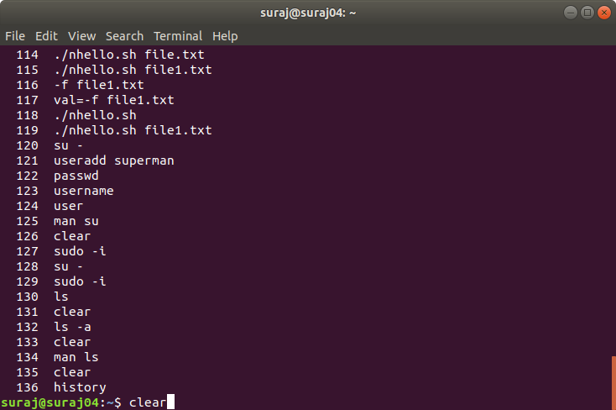
6) the “clear” command

Slide 27
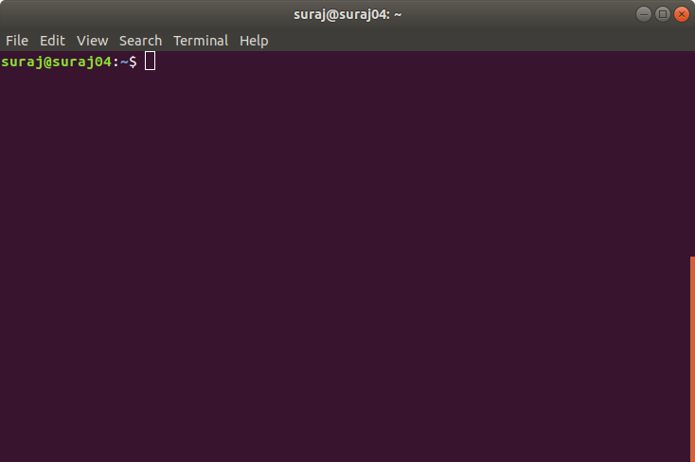
After clear command :

Slide 28
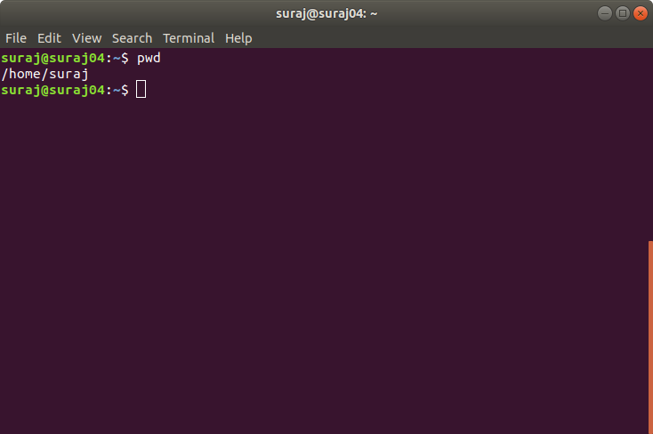
7) pwd – present working directory command

Slide 29
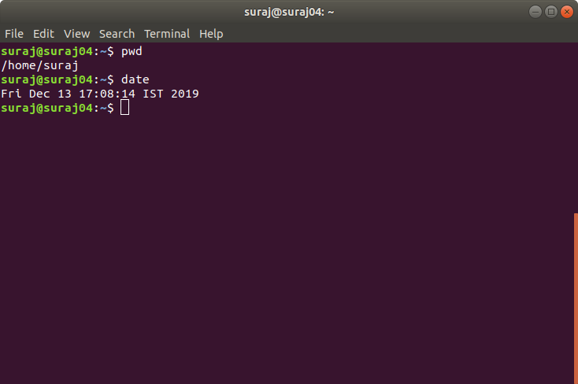
8) Date command

Slide 30
SHELL SCRIPTING
Execution of various logics and program codings have been done using “BASH” scripting written in C. The practiced programs and their respective terminal results are attached along with the mail. Kindly check the mentioned documents.

Slide 31
Presentation By -
K B Suraj
(Intern at CyberNexa)
SRM Institute of Science and Technology
Contact : 9840553489
Mail ID :surajbalu11@gmail.com

Slide 32
THANK YOU

