Slide 1
NEPAL COLLEGE OF INFORMATION TECHNOLOGY
Pokhara University | Department of IT Engineering
Minor Project Proposal — June 2026
Smart Academic
Management System
with AI-Based Attendance & Performance Analytics
By Team :- 4_Bits
Members :- Anamika Aryal | Dip Kiran Limbu | Sumit Kumar Das | Suraj Kumar Jha

Slide 2
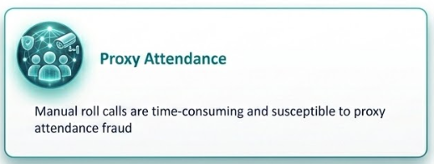
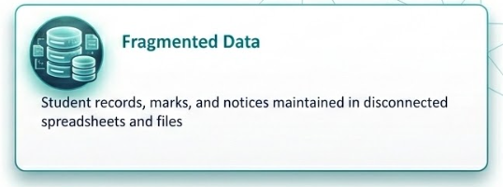
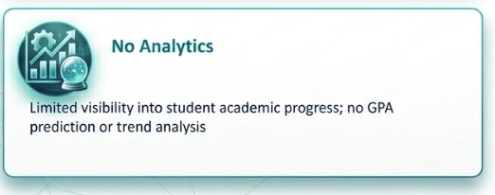
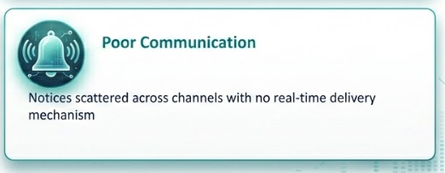

Slide 3
PROJECT OVERVIEW
OBJECTIVES
FOUR USER ROLES
To develop a Smart Academic Management System that integrates academic administration, AI-based attendance tracking, and student performance analytics into a centralized platform.
01
Super Admin
Institution-wide management of depts, semesters, users, notices
02
Department Admin (HOD)
Department-level course, teacher, student management
Role-Based Access Control (RBAC)
AI attendance via YOLOv8 face detection
03
Teacher
Assignment & internal marks management
Attendance, assignments, marks, notices, evaluations
Performance analytics & GPA prediction
04
Student
Real-time WebSocket notifications
Docker-based deployment
View attendance, submit assignments, track GPA, view notices

Slide 4





SYSTEM ARCHITECTURE
Modular Monolith Architecture with API-first design — 5 major layers:
Presentation Layer
Role-specific dashboards & UI
React.js + TypeScript
Application Layer
Business logic, auth, request handling
FastAPI (Python)
Database Layer
Persistent data storage & management
PostgreSQL
AI Attendance Layer
Face detection & student identification
YOLOv8 + Face Recognition
Real-Time Layer
Live notifications & real-time updates
WebSockets

Slide 5
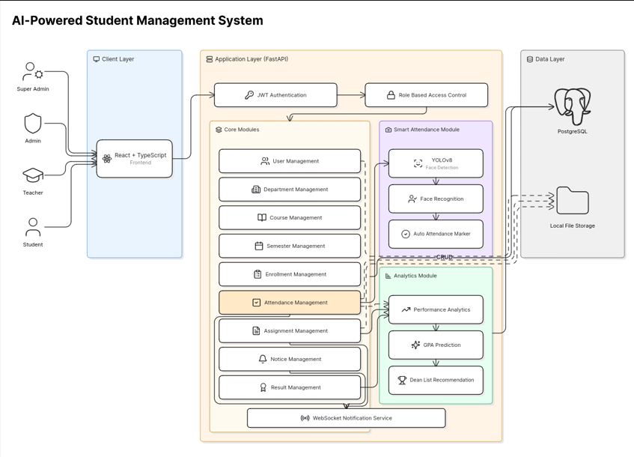

Slide 6
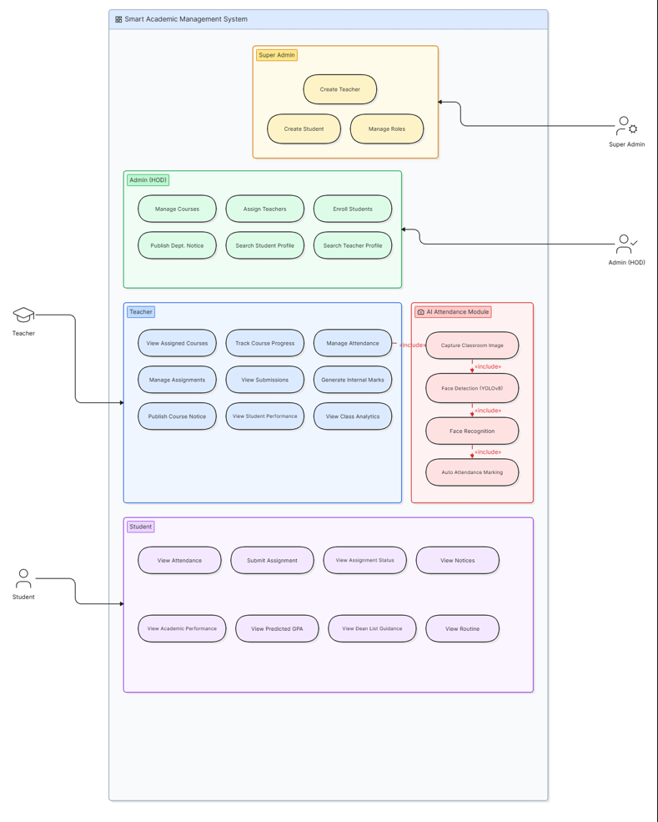

Slide 7
AI-BASED ATTENDANCE MODULE
YOLOv8 Face Detection + Facial Recognition — 8-step automated workflow
1
Teacher captures / uploads a classroom image
→
5
Recognized identities matched with enrolled students
2
Backend sends image to AI attendance service
6
Attendance records auto-generated for teacher review
3
YOLOv8 detects all student faces in the image
7
Teacher confirms or manually edits the record
4
Detected faces cropped & sent to recognition model
8
Final attendance saved to PostgreSQL database
Literature benchmark: up to 98.7% recognition accuracy

Slide 8
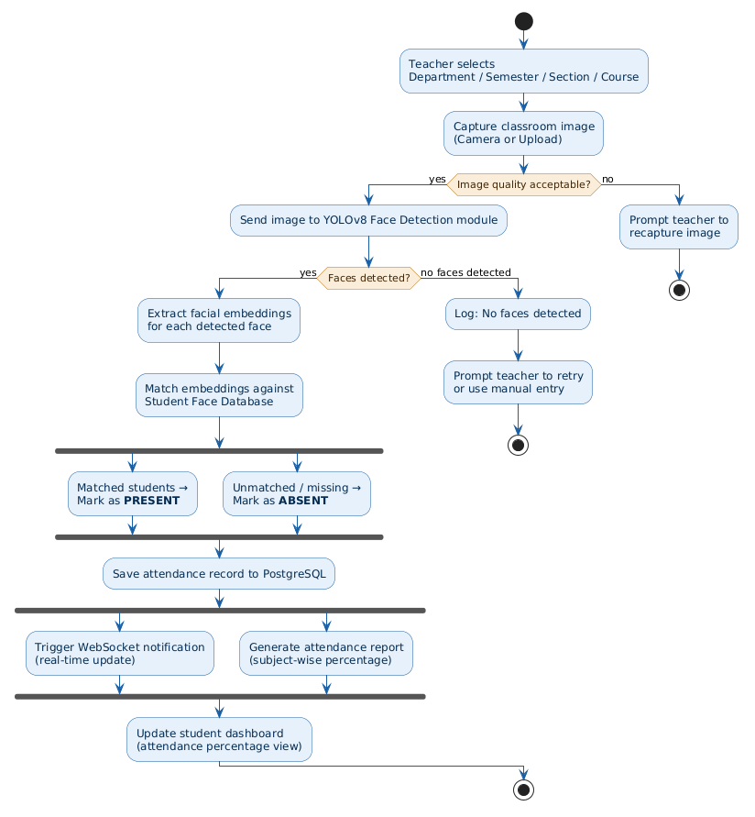

Slide 9



KEY MODULES & FEATURES
RBAC Auth
AI Attendance
Assignments
JWT-based auth with 4 role tiers
YOLOv8 face detection & recognition
Create, submit & grade assignments
Analytics
Real-Time Notices
Dashboards
Performance stats & GPA prediction
WebSocket push notifications
Role-specific academic overviews

Slide 10
TECHNOLOGY STACK
Frontend
Backend
Database
React.js
FastAPI
PostgreSQL
TypeScript
Python
SQLAlchemy
Tailwind CSS
JWT Auth
Alembic
AI / ML
DevOps
Communication
YOLOv8
Docker
WebSocket
FaceNet
docker-compose
REST API
OpenCV
Nginx
Swagger

Slide 11
TEAM MEMBERS & ROLES
1
2
3
4
Suraj Kumar Jha
Anamika Aryal
Dip Kiran Limbu
Sumit Kumar Das
2315537
231502
231512
231536
Project Lead
DevOps & Integration
Data & Analytics
Frontend Dev
System Analysis & Architecture
WebSocket Integration
Database (PostgreSQL)
React.js + TypeScript
Backend API (FastAPI)
Docker Deployment
Assignment Module
UI/UX Design
AI Attendance Module (YOLOv8)
Dashboard Design
Analytics & GPA Prediction
JWT / RBAC Frontend
Database Design
Documentation
Attendance Module
Responsive Layouts
Shared: Requirement gathering · Literature review · Testing & debugging · Report writing · UAT

Slide 12
PROJECT TIMELINE
Phase 1
Planning & Requirements
Weeks 1–2
System analysis, requirement gathering, literature review
Phase 2
Design & Architecture
Weeks 3
Database schema, system architecture, UI wireframes
Phase 3
Core Development
Weeks 4–5
RBAC auth, admin modules, teacher module, student module
Phase 4
AI Attendance Dev
Weeks 5–8
YOLOv8 integration, face recognition, attendance workflow
Phase 5
Analytics & GPA
Weeks 9
Performance analytics, GPA prediction module
Phase 6
Testing & Deployment
Weeks 10
Functional testing, UAT, Docker deployment, documentation

Slide 13
Thank You
for your attention
Smart Academic Management System with AI-Based Attendance & Performance Analytics
Anamika Aryal · Dip Kiran Limbu · Sumit Kumar Das · Suraj Kumar Jha
Nepal College of Information Technology | Pokhara University | 2026
Q & A

