Slide 1

Hackathon
Pitch Desk

Slide 2
Table of Contents for Hackathon
Introduction of our team
Understanding the problem statement
The most optimized solution possible
Details of our ideas/design
Describing the business model
Target Audience/Market
Summary

Slide 3


OUR INITIATIVE AND TEAM
BRAND NAME :
WORKIFY
SURAJ KUMAR
YASHRAJSINH JADEJA

Slide 4

Welcome to our hackathon presentation
BUSINESS MODEL
SOLUTION
MARKET
DEMO
PROBLEM
SUMMARY

Slide 5
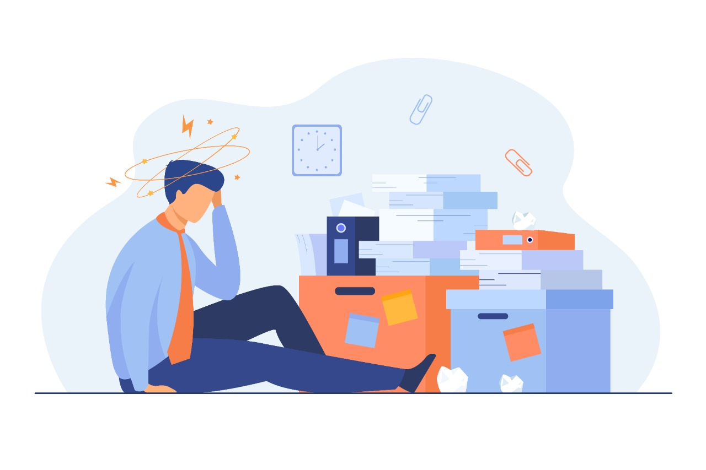
The following are the problems faced by organizations to keep their workforce motivated and energetic :
Long hours of continuous working without sufficient breaks leads to fatigue.
Lack of proper motivation to their working employees.
Lack of organizing fun and creative events for them.
BUSINESS MODEL
SOLUTION
MARKET
DEMO
PROBLEM
SUMMARY

Slide 6



Alert Notifica-
tion
Reward Points
Fun Quizzes
DEMO
Develop an application which will monitor the employee’s performance and for every goal accomplished, they will receive reward points.
While working, the employee will get a pop-up notification reminding him to take a break and have some rest
Every once in a while, some fun quizzes will be conducted for the employees of the organization which will help them improve their skills and win some fun prizes
BUSINESS MODEL
MARKET
SUMMARY
SOLUTION
PROBLEM

Slide 7

1
2
3
MARKET
DEMO
SUMMARY
BUSINESS MODEL
SOLUTION
PROBLEM
Download the application from Google Play Store or App Store
Sign up on the application using your mobile number or email ID
Select the organization in which you are working and link your bank account to avail your rewards directly

Slide 8




01
02
03
BUSINESS MODEL
SUMMARY
SOLUTION
MARKET
DEMO
PROBLEM
VALUE PROPOSITIONS
CUSTOMER RELATIONSHIPS
KEY PARTNERS
One stop solution for bringing-in motivation for the employees and also to make working fun for them
Viewed as a premium application
Google Play Store / App Store
XYZ Bank
PeyTM (payment gateway)
24*7 Customer Support available
Personalized quizzes based on the interests of the users

Slide 9

CUSTOMER SEGMENTS AND TARGET AUDIENCE
The customer segment will mostly consists of people who are aged 22 years and above can use our application.
Our target audience are mainly the working professionals who have a hard time doing monotonous jobs and feeling low & demotivated.
We have defined our target market in these key geographical locations :
Delhi, Mumbai, Bengaluru, Hyderabad, Kolkata, Chennai, etc.
SUMMARY
DEMO
BUSINESS MODEL
SOLUTION
MARKET
PROBLEM

Slide 10
We are willing to develop an application which helps working professionals cope-up with their tedious jobs and to motivate them for their accomplished goals by gifting them exciting rewards.
We are aiming at spreading our services globally to reach out to more people in need and for those who are facing the same issue.
MARKET
DEMO
SUMMARY
BUSINESS MODEL
SOLUTION
PROBLEM

Slide 11
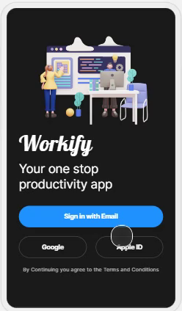
This is the working prototype of our business model / application “WORKIFY”

Slide 12


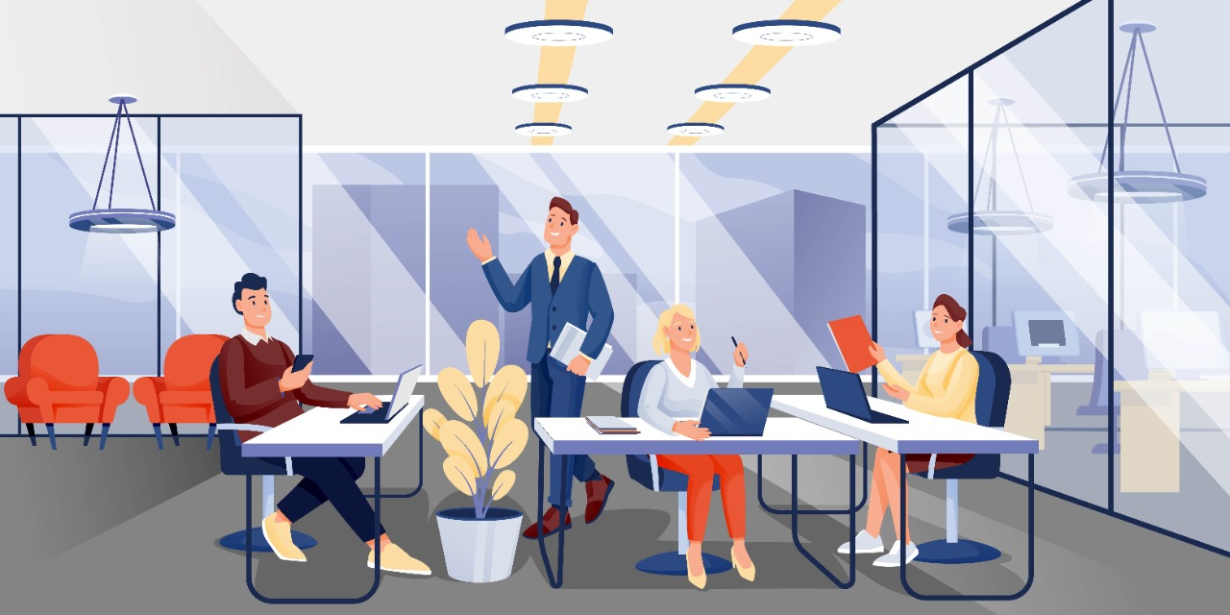
THANK YOU

