Slide 1
CUSTOMISED DISCOUNT - TECHNICAL PROTOTYPE
SWIFT SNIPERS
National Institute Of Technology Karnataka, Surathkal
Suraj Kumar L
Rohit Handique
Mihir BL

Slide 2
MODEL SELECTION
Initial Trials
Data related
Looking at the dataset, it had 20 features. So we figured out after doing one-hot and label encoding it will be around 50 features.
Hence we opted out of neural networks and started using Decision Trees, Random forest, XGBoost and few other models like voting model.
We tested the accuracies of predicting on-invoice discount, off-invoice discount and total discount. Among them, on-invoice discount and total discount had higher accuracy scores. So we concluded to predict total discount(1) and on-invoice discount(2), and subtract (2) from (1) to get off-invoice discount

Slide 3
MODEL SELECTION
Initial Trials
Model related
We checked the MSA, R² and RMSE metrics for all the models with their default parameters. Among them XGBoost, Random Forest and Voting regressor were giving decent results. (for total discount)
(MSA = 260+, R² = approx 66%, RMSE = 2000+)
We chose MSA because it gives the average accuracy unaffected by higher value errors, R² to get the percentage error to better understand the accuracy and RMSE to get the error with the same units as the discount. Although it’s not recommended to use RMSE for financial models, we wanted to minimize the error to a large extent hence we used this 3rd metric
As XGB was doing slightly better than other models we chose it, but while tuning the hyper parameters we realised that XGB regressor wasn’t giving output = 0 for any of the total discounts, instead giving a value 72 for all the zero discounts.
So we wanted to try using both a classifier and a regressor hoping to achieve the best accuracy possible. A classifier to predicts if the discount is zero or not; If non zero then a regressor would predict the value of the discount

Slide 4
MODEL SELECTION
Testing our new hypothesis
Classifier
We trained the XGBClassifier model to predict whether the total discount is zero or not, it gave around 82% accuracy score which was much better than the previous version.
After performing hyper parameter tuning, we got it to 91.7% with the test dataset and 96% train dataset which was a very good improvement from our base model. So we downloaded this model as a pickle file and used it for the web app
We tried the same methods with XGBClassifier to predict on- invoice discount and after hyperparameter tuning, and we got very good results similar to the model mentioned above. Hence this too was downloaded and used.
Accuracy scores, Precision and Recall scores all above 90% mentioned in the .ipynb notebooks for both the models

Slide 5
MODEL SELECTION
Testing our new hypothesis
Regressor
After importing the dataset, we filtered it to include only the data with a discount greater than zero (for both, total discount and on-invoice discount)
As the XGBClassifier gave very good results, we tried using XGB Regressor. We got good results but figured out that the model generalized all the training discounts to 150 unique values which isn’t what we were looking for. Hence we opted to use Random Forest regressor.
After performing hypertuning, we managed to achieve R² = 93%, MAE = 210, RMSE = 1000 (same units as discount) although RMSE isn’t recommended to use for financial models, we just wanted to see how off our higher discount error was, and we got very good results.
All the above was tested for total discount, and we followed similar procedure to train another Random forest regressor to predict on-invoice regressor. After hyperparameter tuning, we got very similar results as of total discount ( MAE, MSE, R² metrics are all calculated for each model in the ipynb notebook)

Slide 6
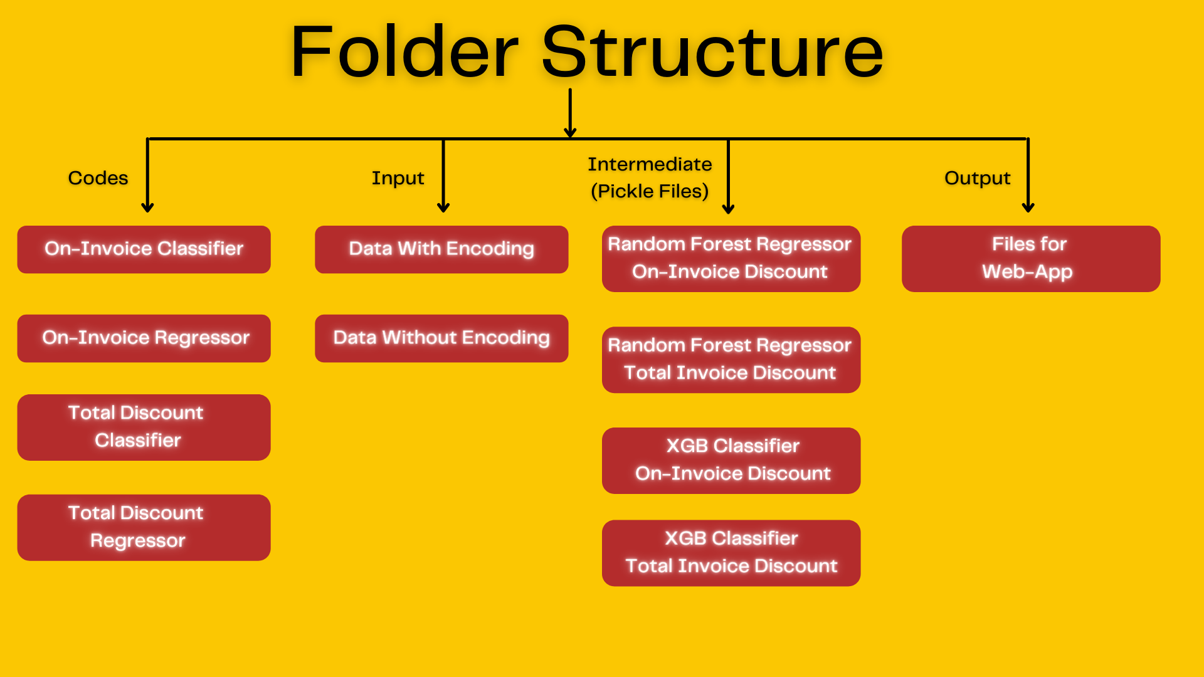

Slide 7
MODEL NOTEBOOKS
5 notebooks have been shared in the codes folder.
2 for classification models and 2 for regression models
1 for the exploratory data analysis and encoding (label/dummy/one hot).
We prefer using Google Colab but Jupyter works too.
The Data_encoded.csv which was used to train the model and the original dataset are in the inputs folder in the drive.
Run the notebooks to train the model and then test it.
Accuracy with 3 different metrics for the same is printed at the end.
We have commented out the hyperparameter tuning code and the code for dumping the model in pickle.

Slide 8
WEB APP
The github repo for the web app - https://github.com/rohithandique/maverick-web-app
The web app is made using the streamlit library (python library), which runs the app.py script from top to bottom and creates the frontend for the web app and hosts it locally. We used pickle to load the trained model into the web app.
Add the inputs to the web app where its asked and run “Get Discount” at the end. Wait for some time for the model to run and display the results.
The README.md in the github repo explains how to setup and run the app locally.
The code for the web app has been uploaded on the drive and also the github repo link for the same has been shared above.

Slide 9
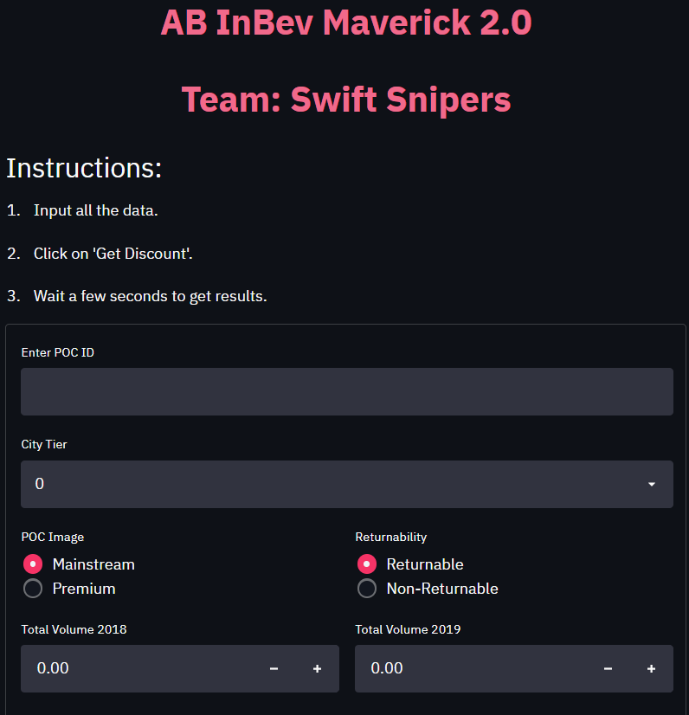
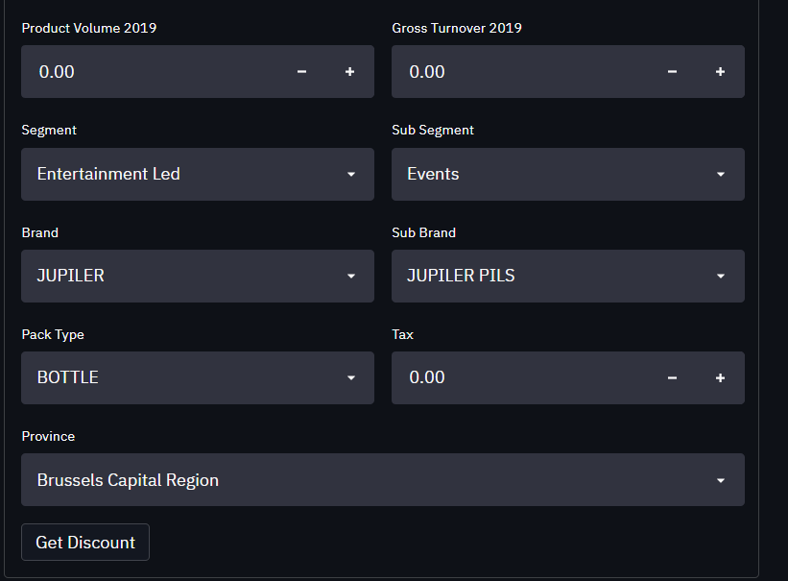
Web App - Before Running

Slide 10
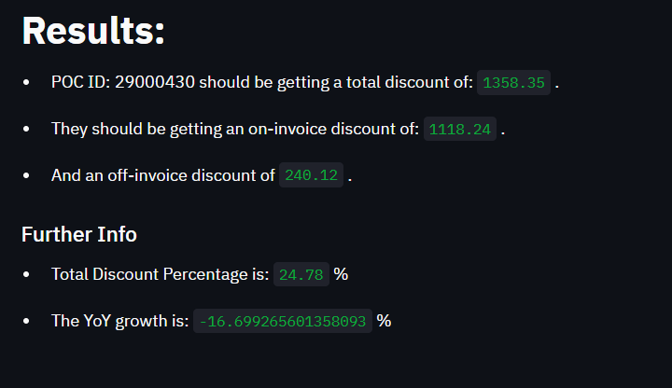
Web App - After Running

Slide 11
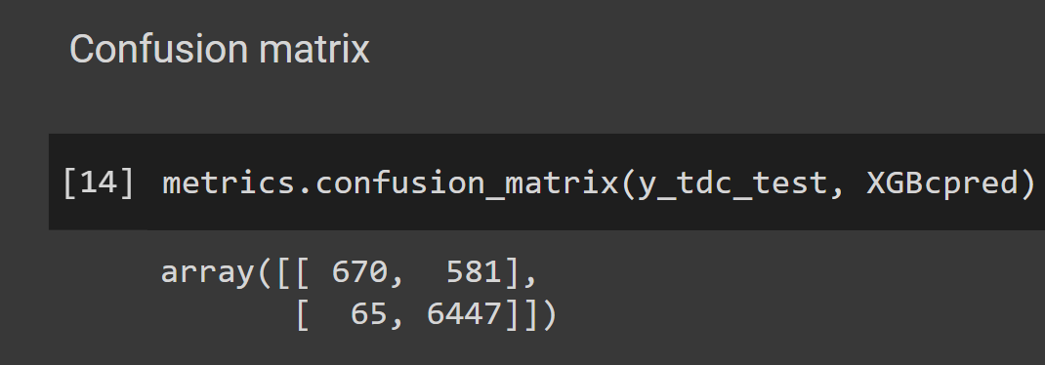
What we achieved by using Classification + Regression
Very Good results in predicting True Negatives (ie. if a poc doesn't deserve a discount then our model will predict it correctly with 99% accuracy) (fig 1)
This ensures company isn’t giving away discounts to POCs which doesn't have a good business significance
Predicting the non-zero values with 90+% R² scores, MAE < 200 because our regression models does not have to worry about the zero discounts as the Classifier models already dealt with it, having a very good accuracy score, hence improving the regression score as well
Fig 1 - (Also present in the submitted .ipynb file)
Additional strategies adopted to increase the accuracy:
By predicting total discount(1) and on-invoice discount(2) and subtracting (2) from (1)to get off invoice discount, we managed to get the most optimum accuracy instead of predicting on-invoice and off-invoice and adding them up to get the total discount.

Slide 12
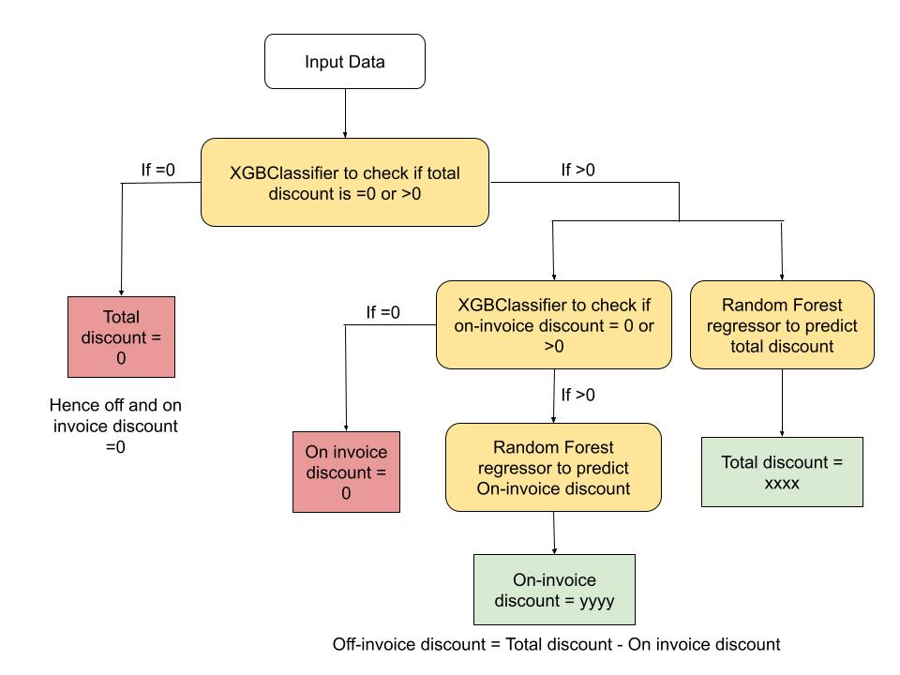
Our Final Champion Algorithm

Slide 13
Scalability Of Solution
Model related
Even if more rows are added, the model will be able to run and get results
If additional features are added, then the ipynb note books can be modified easily to adopt to new features (create a new column, run encoded ipynb to get modified dataset and run the cells to train the models)
The current models still are on the over fitted side, so tuning it more can get both training and test accuracy to around 94 to 96% which is the best version of all our assumptions.
App related
The web app can take in more inputs based on the model (different types also) and run and get results.
A further extension would be to visualise significant data such as POC Rank, Top Selling Products, Segment Wise distribution...etc so that a non-technical person would understand the data easily
To simplify this even further, we could develop a gauge chart showing the business profile level of a certain POC on a scale of 0-100. This score will be calculated by considering parameters such as GTO, YoY Growth, Profitability ...etc, assigning them weights according to the significance and taking the weighted sum.

Slide 14
List of Tools/Technology used
Google Colab/ Jupyter Notebook
a) XGBoost Classifier
b) Random Forest Regressor
c) Scikit-Learn
d) Pandas
e) Numpy
Web app
a) Streamlit
b) pickle
c) Heroku
d) Git/GitHub

Slide 15
Thank You

