Slide 1

XIM UNIVERSITY, BHUBANESWAR
Cold Mail Agent
An Agentic RAG Application for Personalised Job Outreach
SUBMITTED BY
Ananya Verma · Ankit Choudhury · Sonali Nayak
Suraj Maharana · Swayam Mishra
Generative AI Project · October 2026
Notes:
Introduce the team and the project: an AI agent that finds job openings, writes cold emails grounded in the candidate's resume, and manages follow-ups.

Slide 2
Problem statement
Cold emailing recruiters works, but doing it well takes 20 to 40 minutes per company.
Time per email
Researching the company and tailoring the email takes too long, so candidates fall back on generic templates.
Hidden openings and contacts
Openings sit on careers sub-pages or external job boards, and hiring addresses are rarely obvious.
Accuracy
Generic AI tools invent or inflate experience: "AWS basics" becomes "AWS deployment experience".
Follow-up discipline
Most replies come after a follow-up, yet people lose track of who was emailed, who replied and which addresses bounced.
Can an AI agent research a company, ground every claim in the candidate's resume and manage follow-ups, while the person stays in control of what is sent?
Notes:
Four problems drive the project. The question at the bottom is what the system had to answer.

Slide 3
Objectives and technology
Objectives
Technology
An agentic writer that chooses its own tools before writing
Every claim grounded in the resume (RAG), with the evidence shown
Find openings and hiring contacts from a company website
Customise and refine drafts in plain language
Send through Gmail, track replies, send threaded follow-ups
Free tiers only; nothing is sent without human approval
Layer | Technology
Language model | Qwen qwen3.8-27b on Groq (free tier)
Retrieval (RAG) | pypdf chunks, BM25 search
Web data | Apify crawler, BeautifulSoup
Email | Gmail SMTP and IMAP
Interface | Streamlit, three pages
Testing | pytest, Playwright with Edge
Notes:
Six objectives guided the build. Everything runs on free tiers: Groq for the model, Apify's free credit for crawling, and the user's Gmail.

Slide 4
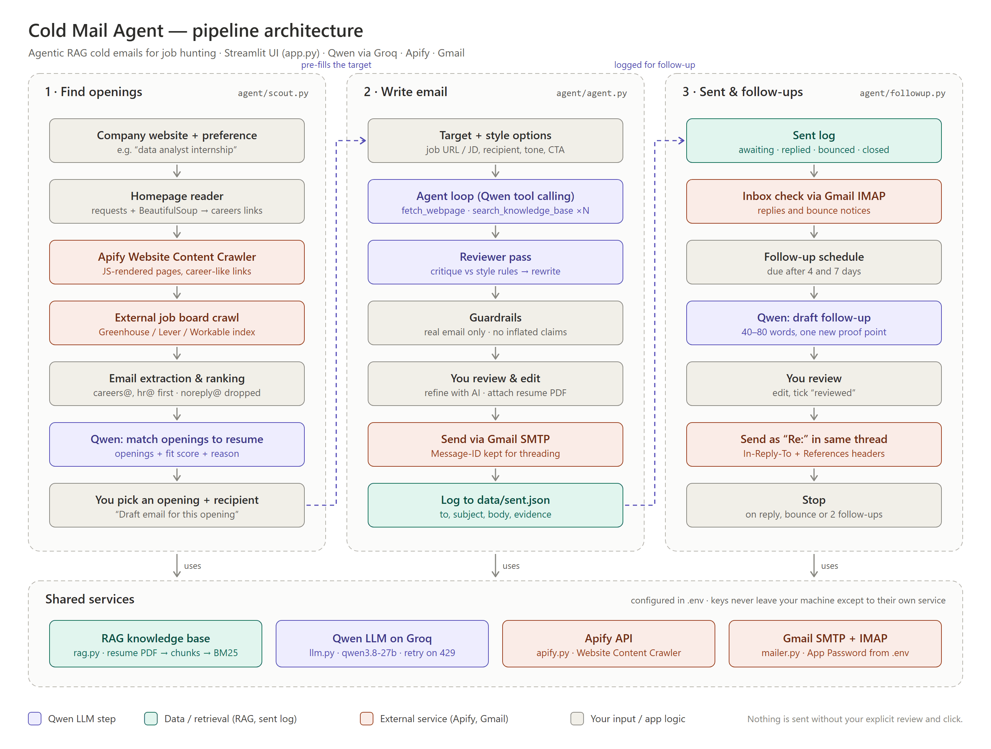
System architecture
Three pipelines
Find openings, Write email, and Sent & follow-ups; each hands its result to the next.
Four shared services
Resume RAG, Qwen on Groq, the Apify crawler, and Gmail SMTP/IMAP.
Human in the loop
The model has no send tool. Every email and follow-up needs the user's approval.
Notes:
The overview: three pipelines on top, shared services underneath. Purple boxes in the diagram are model calls, orange ones external services.

Slide 5
Pipeline 1: the agentic email writer
1
Target and style
Job post URL or pasted description; tone, length, call to action
2
Agent loop
Qwen decides which tool to call next, up to 8 steps
3
Reviewer pass
Critiques the draft against the style rules and rewrites it
4
Guardrails
Real address only; sign-off filled; placeholders blocked
5
Review and send
Edit, refine with AI, attach resume, tick reviewed, send
Tools the agent can call
fetch_webpage(url): reads the job post and collects email addresses
search_knowledge_base(query): BM25 search over the resume chunks, returning only chunks it has not seen yet
Grounding rules
Must search the resume before writing
No inflated skills; refinement may not add facts
Evidence used is shown under every draft
Notes:
The model, not fixed code, chooses the order of tool calls. It is forced to search the resume first, and a separate reviewer call checks the draft. The highlighted box is the agent loop.

Slide 6
Pipeline 2: finding openings and contacts
1
Read the homepage
Find the Careers and Contact links (free, about 1 second)
Live test on sigmoid.com
2
Crawl with Apify
JavaScript-rendered careers pages, up to 25
15
pages crawled, including /early-careers/
3
Follow the job board
Greenhouse, Lever or Workable listings
10
openings scored against the resume
4
Rank contacts
Extract emails; careers@ and hr@ first, noreply@ dropped
careers@
sigmoid.com ranked first as the hiring contact
5
Match to the resume
One Qwen call scores every opening from 0 to 100
4,344
model tokens for the whole scan
6
Hand off
The chosen opening pre-fills the email writer
Notes:
Reading the homepage first aims the crawl at the careers pages instead of spending the page budget on product pages. Many companies list jobs on an external board, so the scout follows it to its index page.

Slide 7
Pipeline 3: replies and follow-ups
Day 0
Any time
Day 4
Day 7
After
Sent
Logged with its Message-ID
Inbox check
IMAP finds replies and bounce notices
Follow-up 1
40 to 80 words, one new proof point
Follow-up 2
Short, and closes politely
Stop
No more emails; a reply or bounce stops sooner
Threaded, not repeated. Each follow-up goes out as "Re:" with In-Reply-To and References headers, so it lands in the same conversation. The user reviews every follow-up before it is sent, and the schedule can be changed in the settings.
Notes:
Follow-ups are where most replies come from, so the app tracks every sent email and suggests follow-ups on day 4 and day 7, then stops.

Slide 8
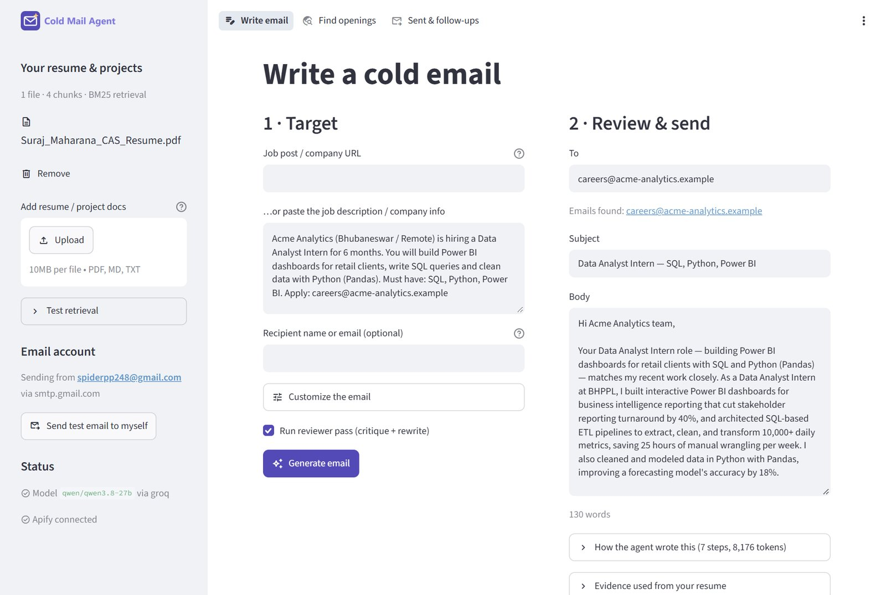
The application: writing an email
Recipient found
The careers@ address is taken from the job post automatically.
Grounded draft
Every figure (40%, 10,000+, 18%) comes from the resume.
Refine in words
Quick edits such as Shorter or Better subject, or any instruction.
Notes:
A sample job description for a data analyst internship. The agent found the recipient, searched the resume and wrote a 110-word email in about 20 seconds.

Slide 9
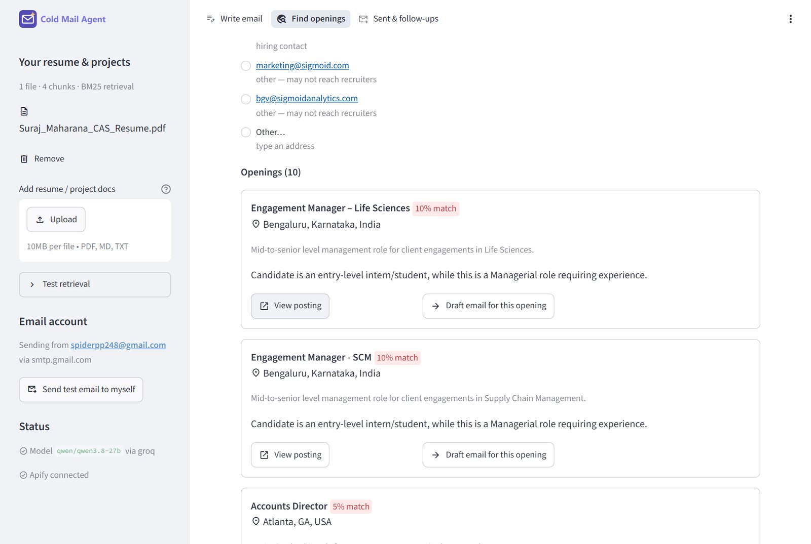
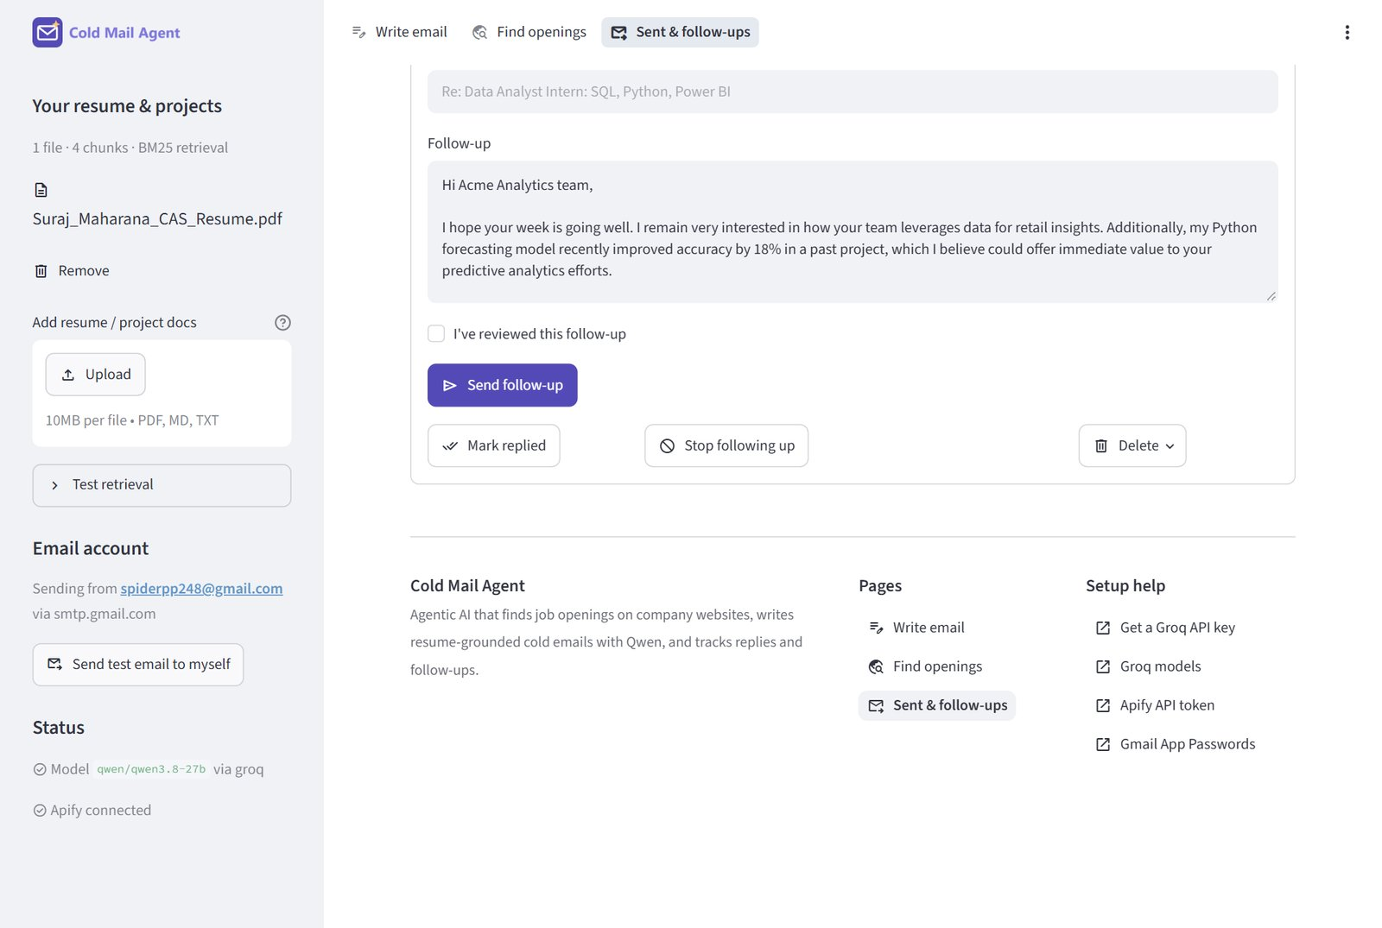
The application: openings and follow-ups
Find openings. Contacts are labelled by type and each opening shows its fit score and the reason for it.
Sent & follow-ups. A drafted follow-up waits for review, with reply tracking and the footer links below (demo entry).
Notes:
Left: a real scan of sigmoid.com. Right: the follow-up workflow, shown with a demo entry; no email was sent for these screenshots.

Slide 10
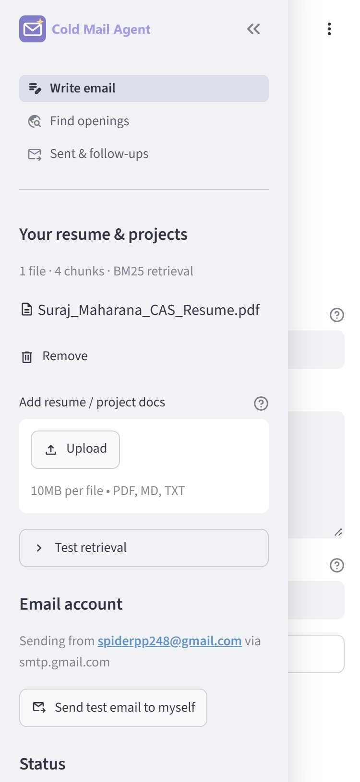
Results and quality assurance
51 / 51
22 / 22
0
automated tests passed
browser checks in Edge, desktop and phone
broken links out of 10 checked
9.2k
61%
~1 s
tokens per email, down from 16.4k
smaller images, no visible change
page load in the browser
Interface
Mobile menu, clickable logo, favicon, page titles, footer and a custom 404 page.
Bugs fixed in QA
Ten, including a button that ignored its first click and success messages lost on reload.
Mobile menu at 375 px
Notes:
The app was checked against a fifteen-point quality checklist before submission. The browser test drove the real app in Microsoft Edge at desktop and phone sizes.

Slide 11
Conclusion
What we built
A free-tier agent that researches a company, finds openings and contacts, writes a resume-grounded email and manages threaded follow-ups.
Thank you
What made it work
Retrieval keeps every claim true to the resume, and a mandatory human review keeps the person in control of what is sent.
Questions are welcome
Next steps
An email-finder API for recruiter addresses, embedding search for larger portfolios, and reply-rate analytics by tone and length.
Ananya Verma
Ankit Choudhury
Sonali Nayak
Suraj Maharana
Swayam Mishra
Notes:
Summarise in one breath: grounded in the resume, agentic in how it works, and the person always approves what is sent. Then invite questions.

