Slide 1

PARKING AVAIBLITY CHECKUP
TEAM MEMBERS :-
2009 Sanket Lohar.
2011 Suraj Padalkar.

Slide 2
Problem Statement
In outer of mall and cinema hall there have the specific parking place , so whenever we go for parking we dont know about where our vehicle to be park so for finding parking good place it takes lot of time. so we solve that problem

Slide 3
SOLUTION
On the solution of problem statement we make the lcd display to show how many parking slot are available in mall area.

Slide 4
METHODOLOGY
Data Collection
Analysisof data
Train prototype
Install Sensor
Test the prototype

Slide 5
Gantt chart
23 feb
1 March
15 march
27 March
29 April
5 April
12 April
19 April
Planning
Methadology
reuirements
Design Algorithm
Prototype build
Presentiation

Slide 6
Literature Review
Sr.No | Title | Journal | Authors
1. | Smart Parking Systems: A Review of the State-of-the-Art | EEE Transactions on Intelligent Transportation Systems | Smith, J. et al.
2. | IoT-based Parking Management: A Survey | Journal of Network and Computer Applications | Johnson, M. and Lee, S
3. | Impact of Parking Availability on Urban Mobility: A Case Study of City X | Transportation Research Part A: Policy and Practice | Wang, Q. and Zhang, L.
4. | User Preferences in Parking Space Selection: Insights from Surveys | Transportation Research Part C: Emerging Technologies | Garcia, R. et al.
5. | Policy Implications of Smart Parking Systems: Lessons from City Y | Urban Studies | Patel, K. and Nguyen, T.

Slide 7
Benefits of parking slot availblity checkup
It save time for parking
Increase parking revenue.
Enhanced User Experiance

Slide 8
Prototype Tools and Technique
Hard Ware : Toy Car
IOT Based :
Ultrasonic and IR Sensor
LCD Screen
Ardino uno

Slide 9
FEASIBLITY
It is achievable . It will need two sensors for detecting the incoming and outgoing vehicle .
Cost Feasiblity
Ardino uno = 380 RS
ultrasonic sensor =300 RS
IR Sensor =187 Rs

Slide 10
System Architecture:
Slot No 1
s Slot No 2
Slot No 3
Slot No 4
Slot No 5
LCD Display
Total Available Slot 5
Remaining Slot 1
Occupied Slot 4
IR Sensors
Exit Point
Entry Point

Slide 11
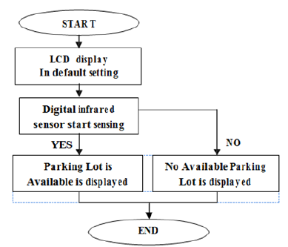
Flowchart :

Slide 12
Modularity :
M1 Module | Collect The Required Components
M2 Module | Assemble all the components and build circuit
M3 Module | Check the Conditions For Taken Input
M4 Module | Work According The conditions

Slide 13
Market Analysis
The market for parking slot availability checkup systems is experiencing steady growth due to increasing urbanization and the need for efficient parking management.
Key players include companies specializing in smart parking solutions and IoT technology providers.
Technological trends include IoT integration, mobile app adoption, and data analytics for optimization. Growth drivers include urban population growth, government initiatives, and consumer demand for convenience.
Challenges include initial costs and integration issues, while opportunities lie in emerging markets and innovation in predictive analytics. Overall, the market is poised for continued expansion driven by technological advancements and urban development trends.

Slide 14
Implementation
We will be building this parking slot availblity checkup project step by step
We First connect the ultrasonic sensor or IR Sensor in parking Slot
We will put the one LCD for showing the available of parking slots
We will then upload the conditional code in Arduino and check the output
Record The output

Slide 15
Product life cycling
Introduction: Product launch with limited adoption.
2. Growth: Rapid market expansion, increased demand.
3. Maturity: Market saturation, stable growth.
4. Decline: Decreasing demand due to obsolescence or competition.
5. Renewal/Extension: Introduction of new features, targeting new markets to revitalize the product.

Slide 16
Cost Estimation
Arduino Uno : 380 RS
Ultrasonic Sensor : 300 Rs
IR Sensor : 380 RS
LCD : approx. 300 RS

Slide 17
Algorithm :
Power on the and connect it toArdino
Implement IR Sensor.
Implement LCD Screen.
Connect wire.
Upload the code.
Display the output on LCD screen.

Slide 18
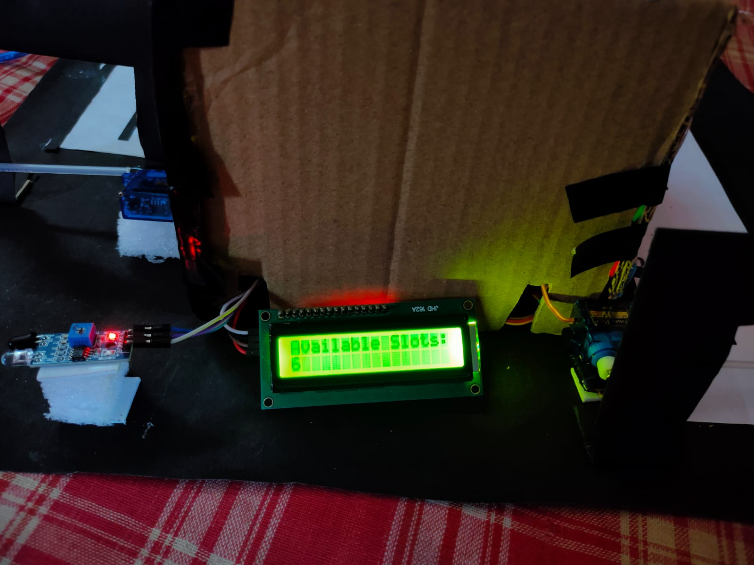
output
LCD display to show how many parking slot are available in mall area.
Its LCD display are shows a parking slot is available or not in that place
Also that shows a count of that parking slot

Slide 19
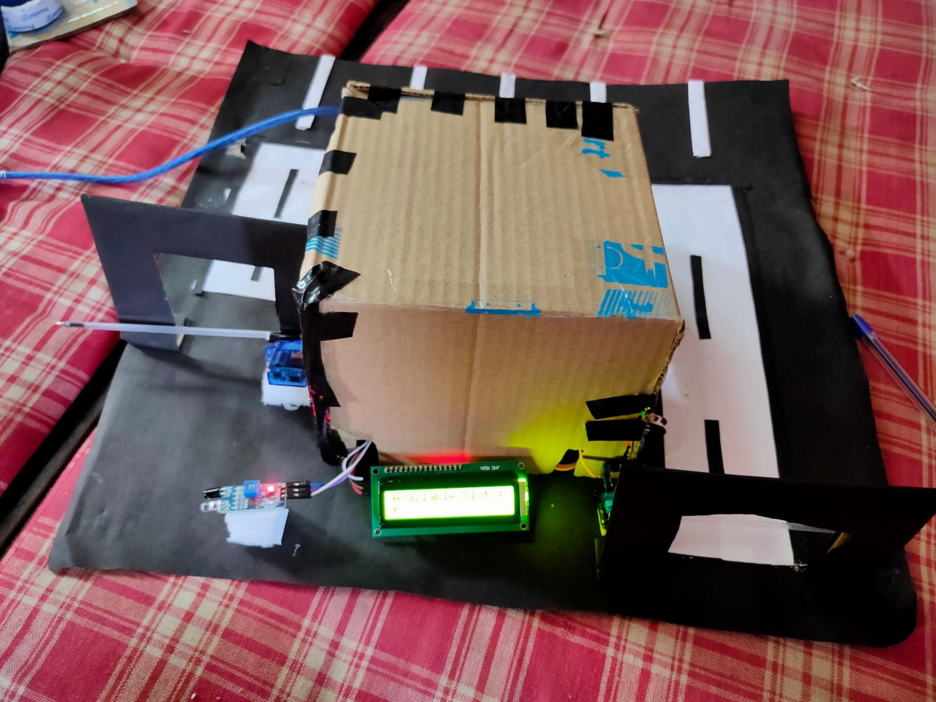
output
It’s a structure of our model and its shows a LCD display, Arduino.
Its fully working model. A car going inside a sensor detect a motion and its show a count a no. of that car

Slide 20
THANK YOU !

