Slide 1
Prediction of hotel booking cancellations
Suraj Rana Vujjini
GJ58372
Department of Data Science
Data 602 – Intro to Data Analysis and Machine Learning
Christopher McGraw

Slide 2

Introduction
Hotels thrive on advance reservation systems. Due to the current completive market, hotels need to have an easy cancellation policy for guests.
The average percentage of canceled reservations is 24%. Cancellations effect the revenue of the hotel will lose potential revenue customers who will not cancel.
As a part of the project, I will be analyzing bookings data from Microtel BWI and will be creating a model to predict if the reservation will cancel or not. This can help the hotel forecast the future revenue and also help price the rooms accordingly.

Slide 3
Aim of this project
The main aim of this project is to create a model that finds reservations that have a high chance of getting cancelled. This solves problems like room management and forecasting income for the hotel management.
The final model can predict the reservations that could be canceled with a good accuracy. These reservations are the ones mostly made by guests who are not sure about their stay at the hotel.

Slide 4
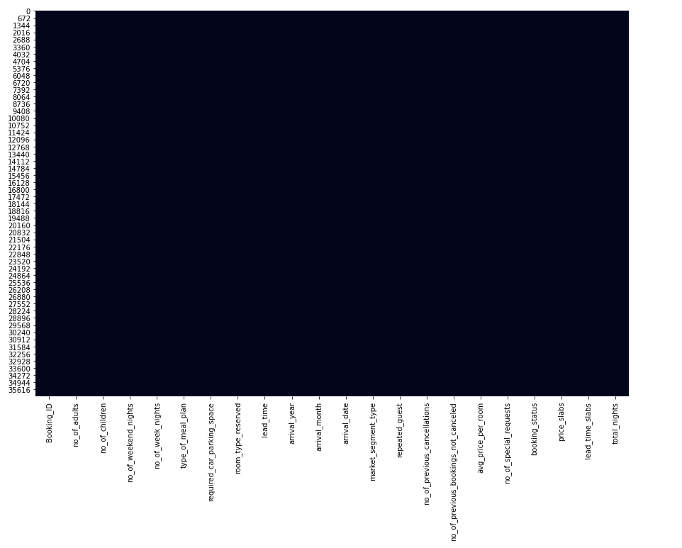
About the dataset
No. of Rows
36,275
No. of columns
19
Total number of values
689,225
SNS heatmap of null values in the dataset

Slide 5
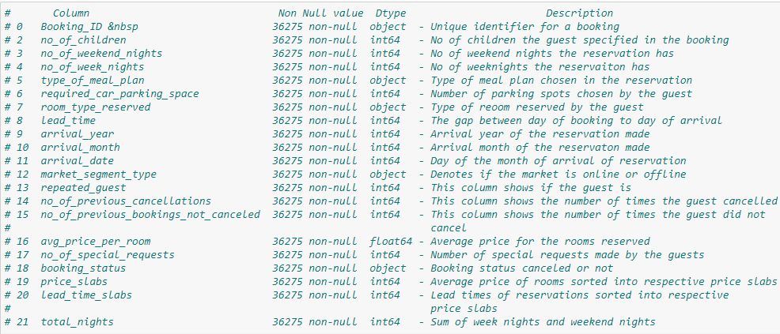
Columns in the dataset

Slide 6
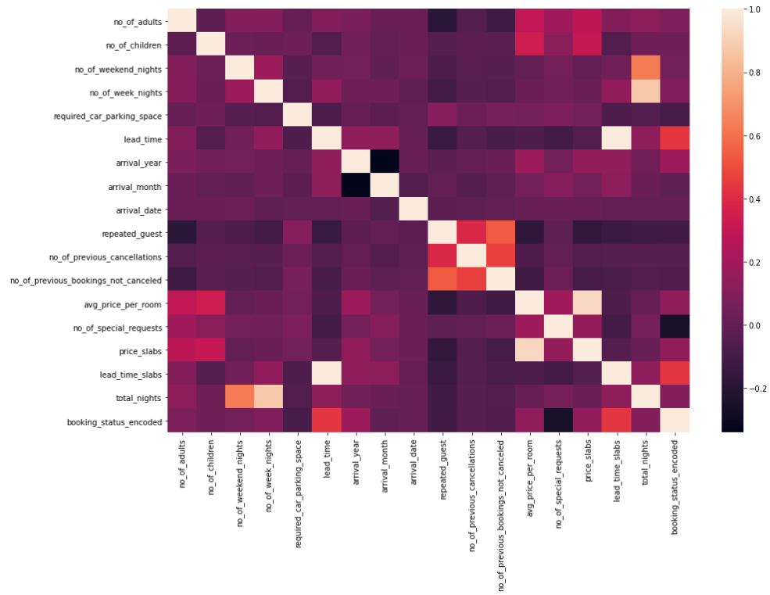
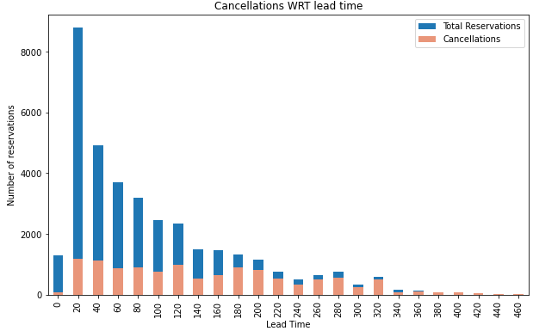
Correlation among the columns
I have created a new column “booking_status_ecoded” to use in the correlation heatmap.
Comparatively there is a good correlation of the booking status column with lead time, as the lead time increases, there is a high chance of a booking getting cancelled.

Slide 7
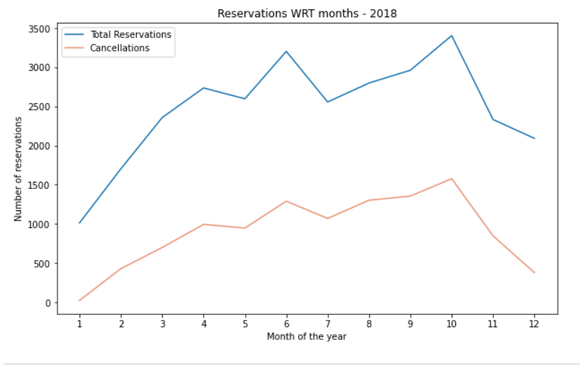
Cancellations WRT months
As expected, the bookings increase for summer months and fall during wintertime.
For this hotel, there was an increase in reservations for the month of October as well.
The cancellations tend to vary with reservations as seen from the graph.

Slide 8
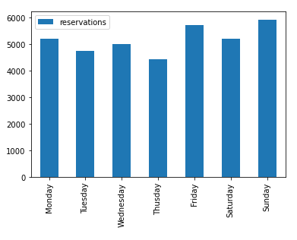
Reservations WRT day of the week
The booking activity is highest on the weekends and lowest on the weekdays as expected.
Friday and Sunday are the ones with highest number of reservations

Slide 9
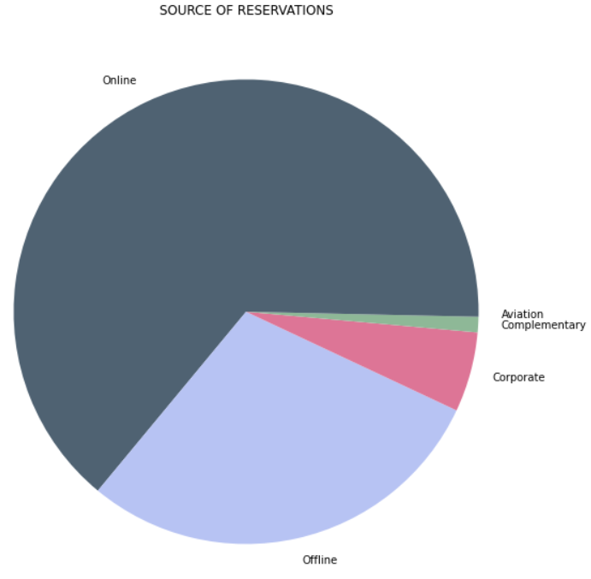
Source of reservations
Online is the major source for reservations at Microtel followed by reservations made offline.
This is due to the ease of use and lucrative offers given by the booking companies.

Slide 10
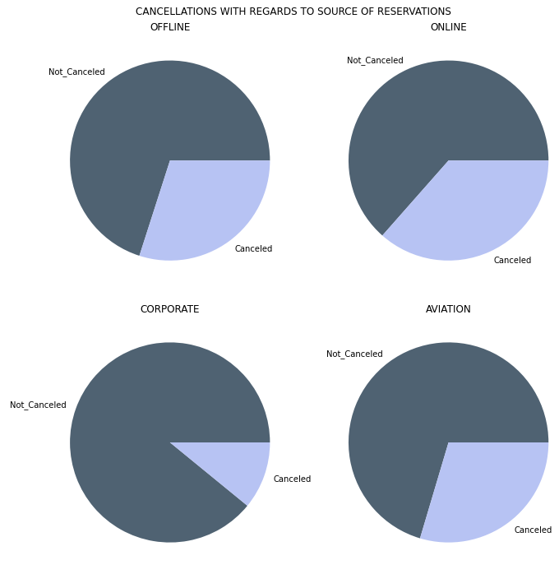
Cancellations WRT Source of reservations
The easy cancellation policy of online booking sites allow users to cancel at their ease.
This can be the reason for the high cancellation ratio for online bookings.
It is followed by offline and aviation.
Corporate has relatively low cancellations.

Slide 11
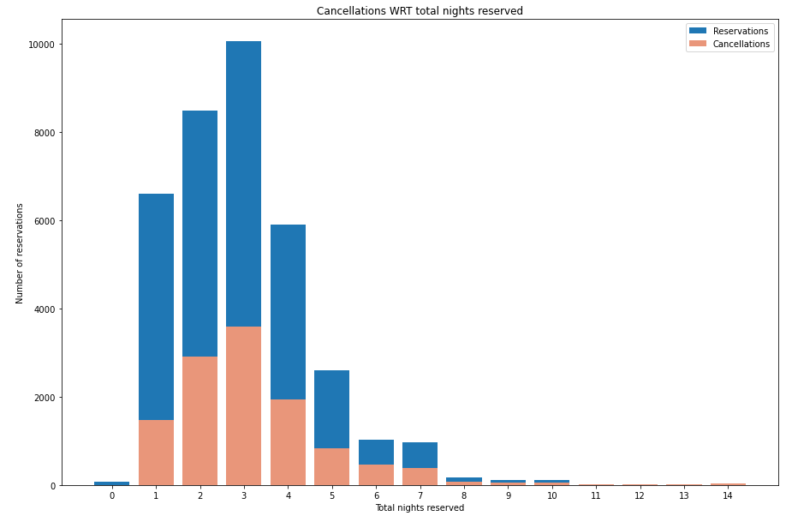
Cancellations WRT Total nights
Most of the guest chose to stay for 3 nights.
There is no good information for cancellations as the cancellations are higher when the reservations are high.

Slide 12
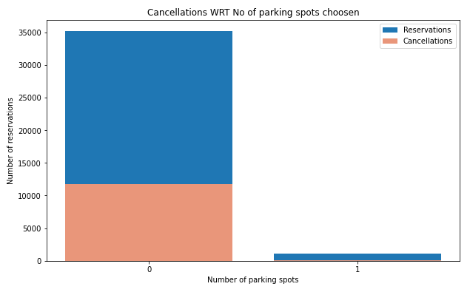
Cancellations WRT no. of parking spots chosen
We can see that if guests choose to reserve a parking spot, they will most likely not cancel the reservation.
If they do not reserve a parking spot, there is a higher chance of the reservation getting cancelled.

Slide 13
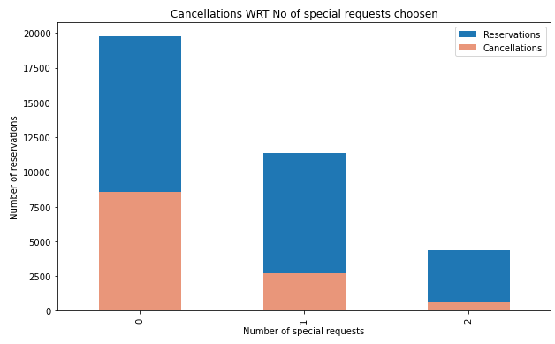
Cancellations WRT no. of special requests made
Special requests are made for online order where a guest can request certain things during their stay at the hotel.
This shows that a guest is serious about his/her stay at the hotel.
As seen from the graph, as the number of special requests increases, there is less chance of a booking getting cancelled.

Slide 14
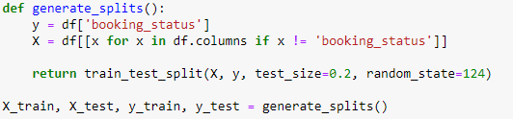
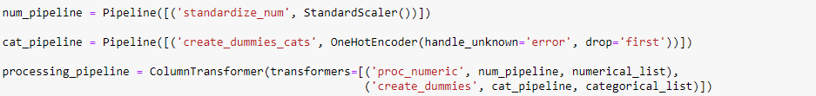
Splitting the data & Preprocessing pipeline
Training examples: 29,020
Test examples: 7,255

Slide 15
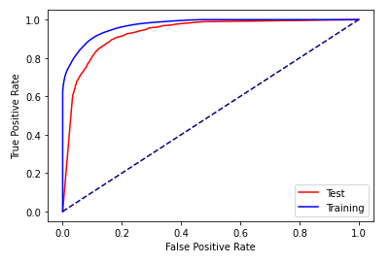
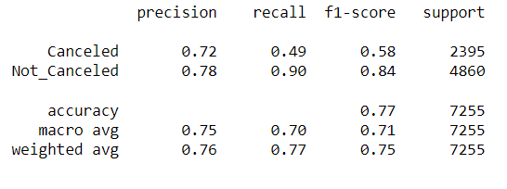
Classification – Logistic regression

Slide 16
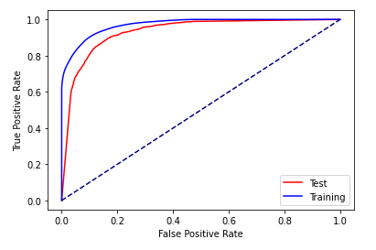
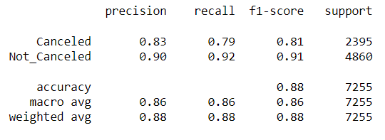
Classification – Decision Tree

Slide 17
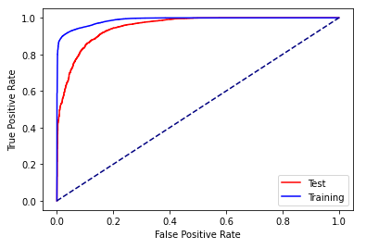
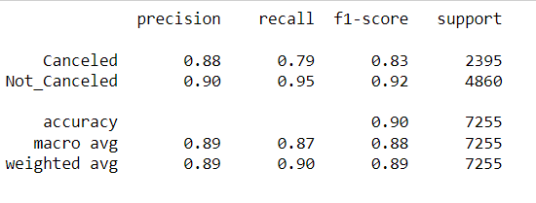
Classification – Random Forest

Slide 18
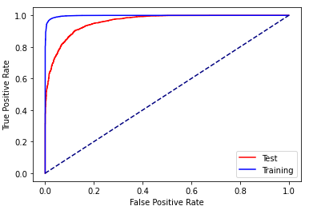
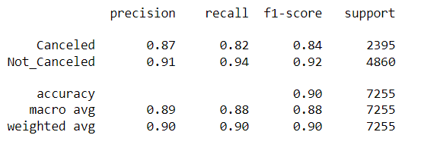
Classification – Gradient Boosting

Slide 19
To conclude, irrespective of the price, hotel reservations get cancelled due to several reasons. From these findings, it can be understood that if a guest has more requests or book a parking spot thereby validating their stay and tend to cancel less. From all the classifiers I have used, I found that Random forest is the best classification algorithm that worked best for this dataset.
Conclusion

Slide 20
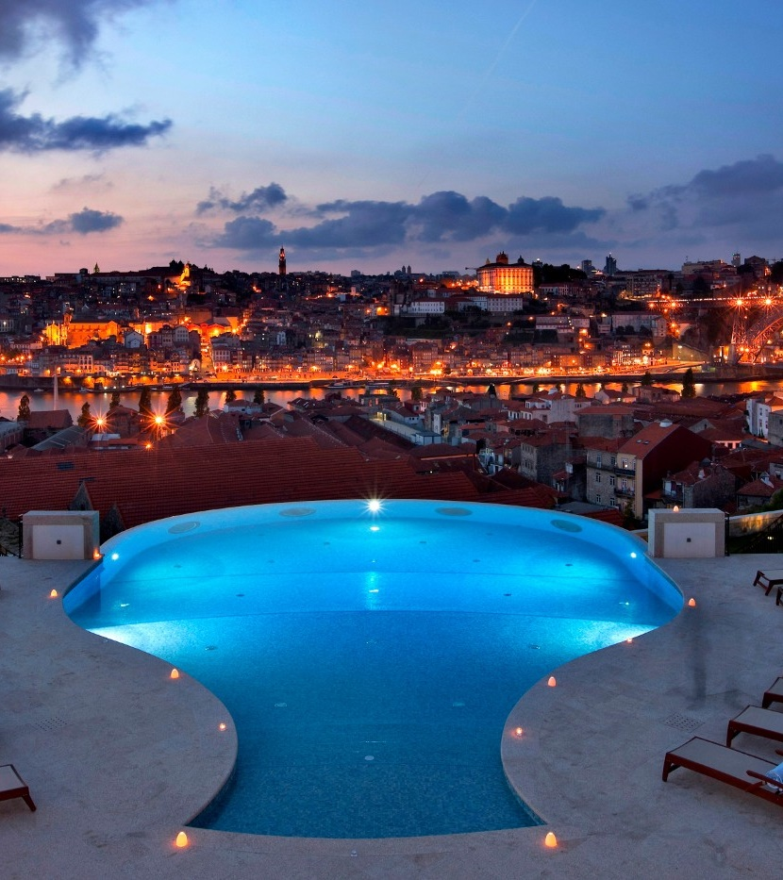
Thank you

