Slide 1
Loan Approval Prediction – Checkpoint 1
Group: Predictive Minds
Team Members:
Suraj Ravindra Rao (ASU ID: 1233990435)
Om Gaurav Patel (ASU ID: 1233379110)
Darren Alaistair Ferrao (ASU ID: 1237189124)
Mohammad Asgar Khan Dalwai (ASU ID: 1237671684)

Slide 2
Background & Problem
Loan approval prediction is essential for financial institutions.
Problem: Binary classification → Approved (0) vs Default (1).
Importance:
Risk Reduction
Process Automation
Fair & Scalable
Reduces loan defaults and financial risk.
Automates decisions for faster processing.
Ensures fairness and scalability.

Slide 3
Dataset Overview
Dataset Evolution
Pitch dataset: 4,269 samples (initial plan).
Updated dataset (Checkpoint 1): Kaggle Playground dataset, 58,645 samples × 13 features.
Features: demographic, employment, loan details, credit history.
Train/Test split: 80/20.

Slide 4
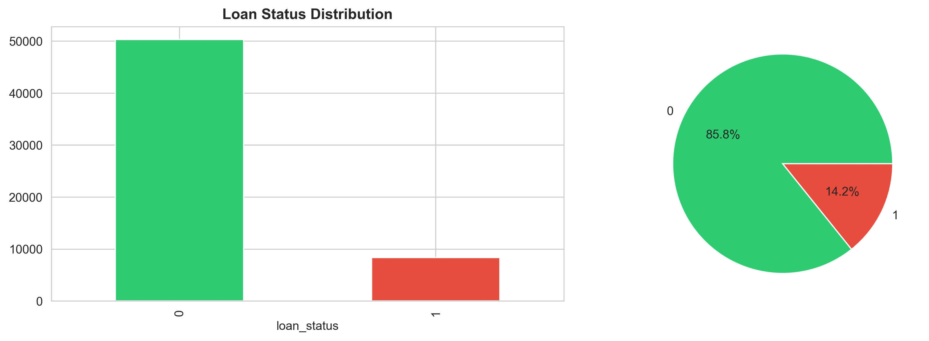

Slide 5
Numerical Feature Exploration
Age
Income
Loan Amount
Concentrated in 20s–30s.
Skewed with large outliers.
Most between 5k–15k.
Interest Rate
Credit History
7–15% range dominates.
Majority < 10 years.

Slide 6
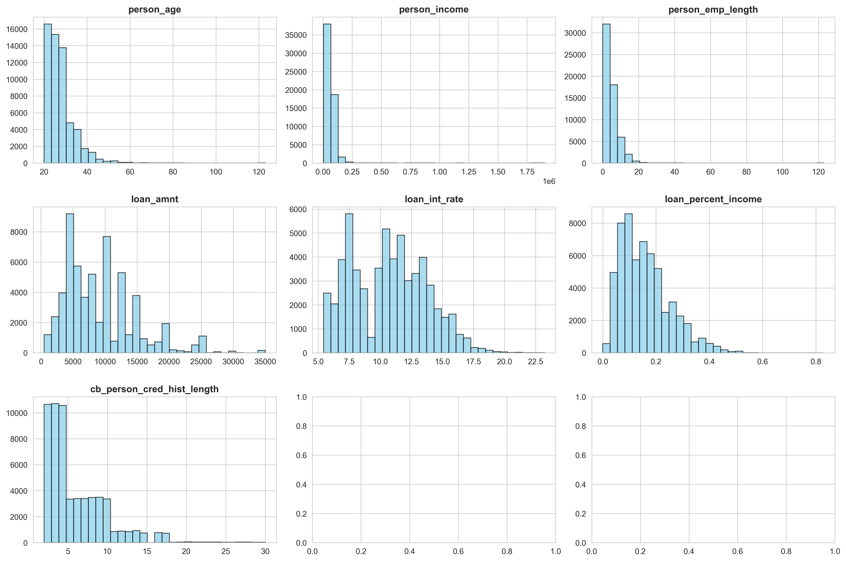

Slide 7
Categorical Feature Exploration
Home Ownership
Loan Intent
Rent and Mortgage are common.
Education and Medical dominate.
Loan Grade
Default History
Lower grades (D–G) have higher default risk.
Strong predictor of loan status.

Slide 8
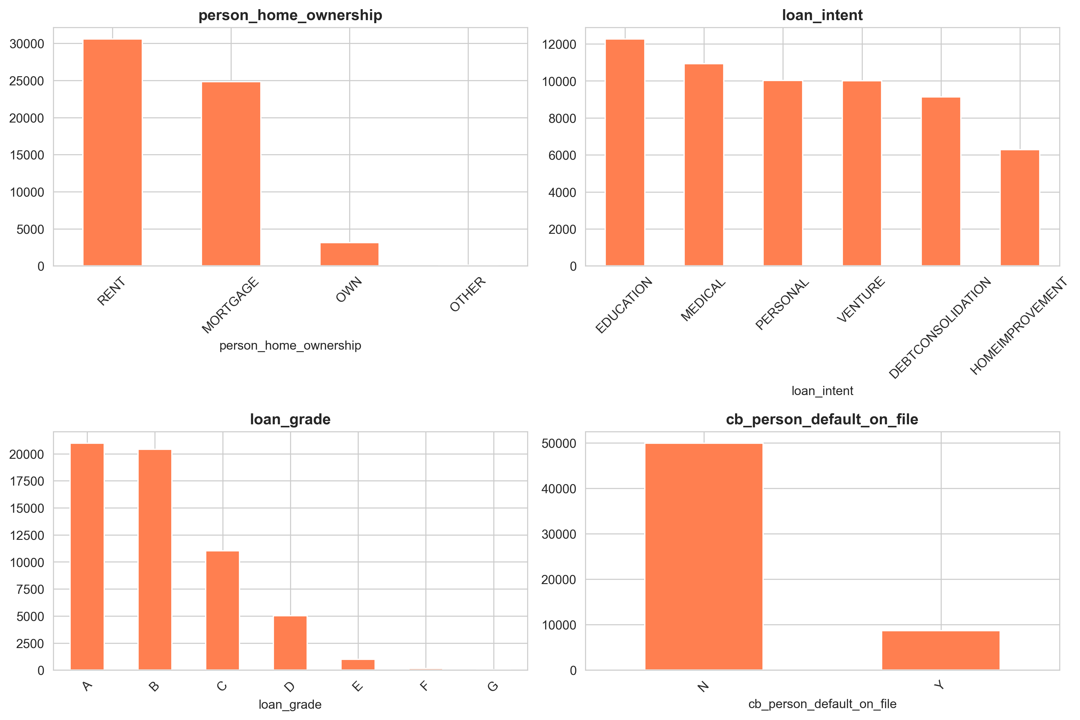

Slide 9



Correlations & Relationships
Strong Correlation
Age Relationship
Status Influence
Loan Percent Income ↔ Loan Amount.
Age ↔ Credit history length also related.
Loan Status influenced by loan grade & percent income.

Slide 10
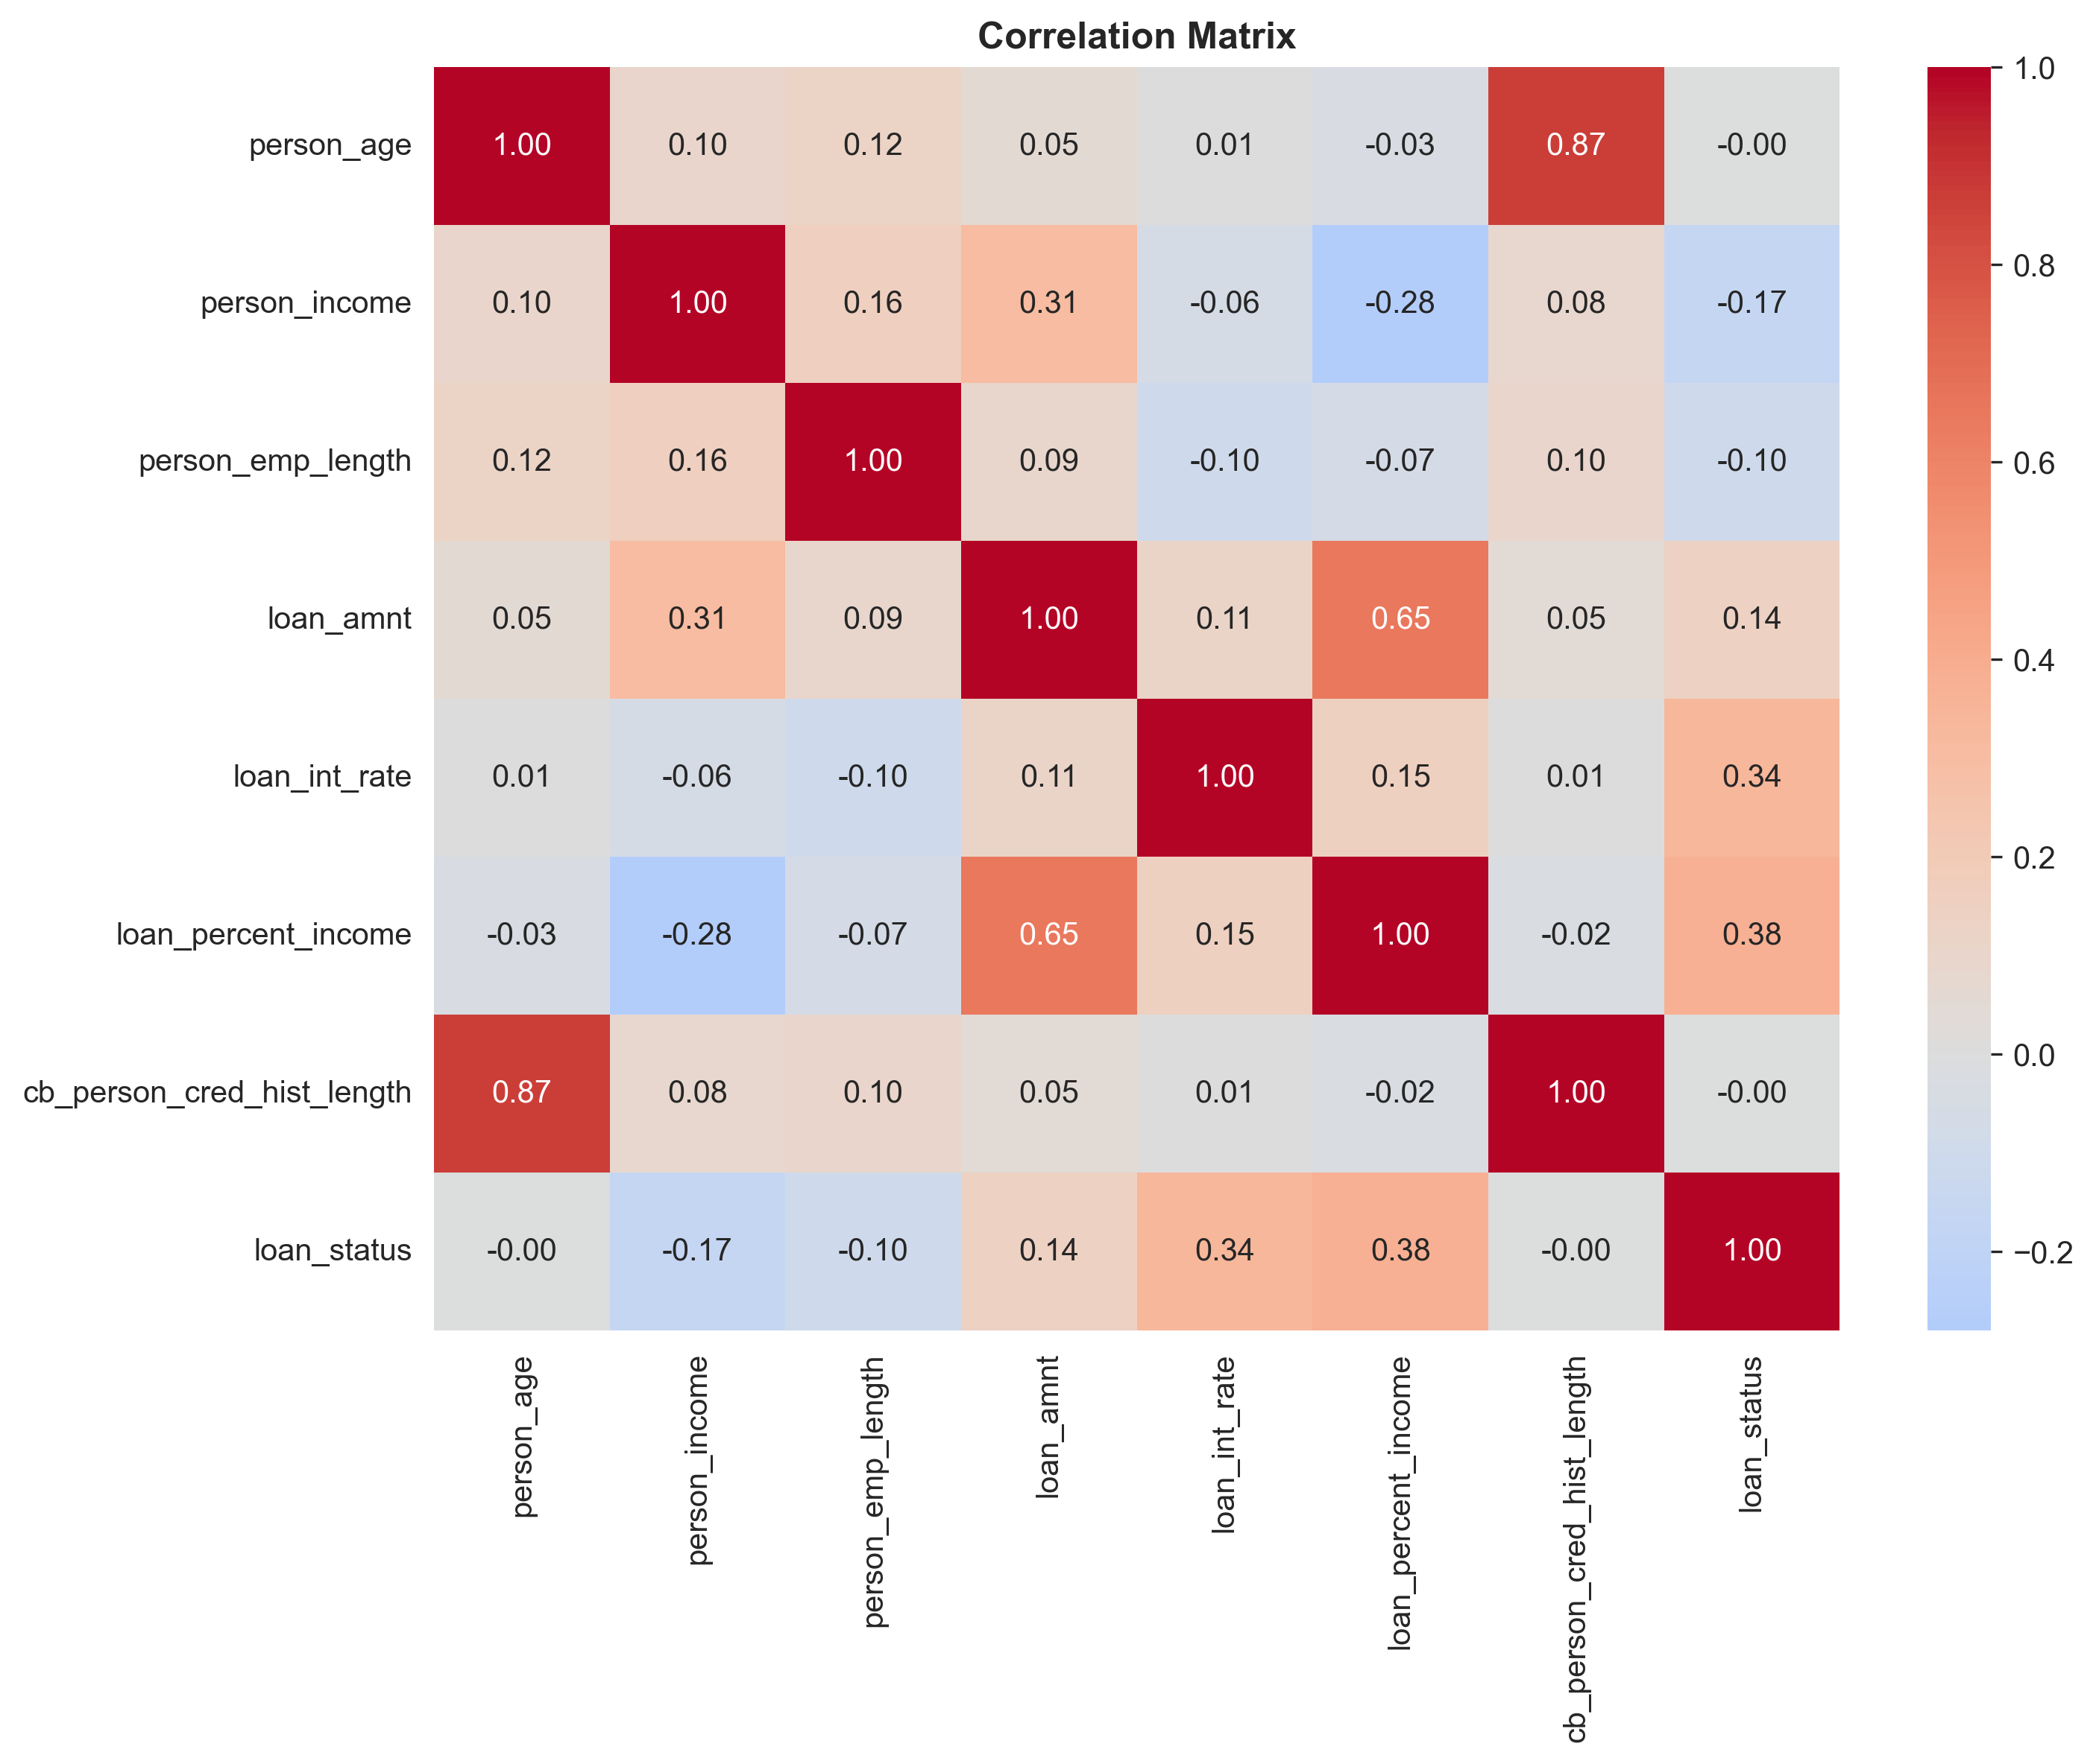

Slide 11
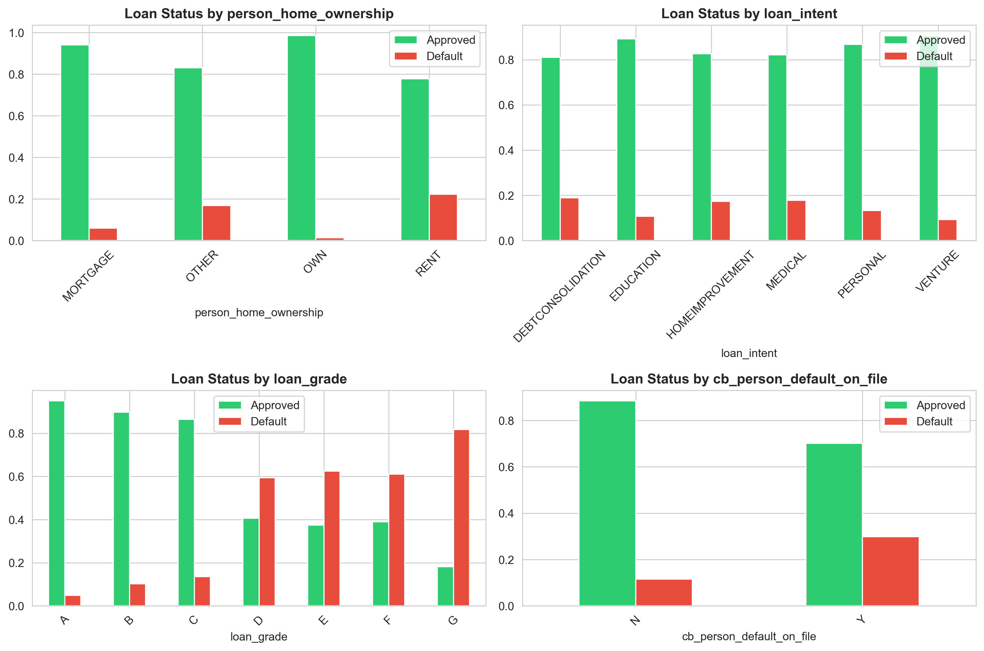

Slide 12
Data Preprocessing
Data Cleaning & Transformation
Feature Engineering:
Dropped IDs and irrelevant fields.
Income-to-loan ratio
Label encoded categorical features.
Standardized numerical features.
Age-to-employment ratio

Slide 13
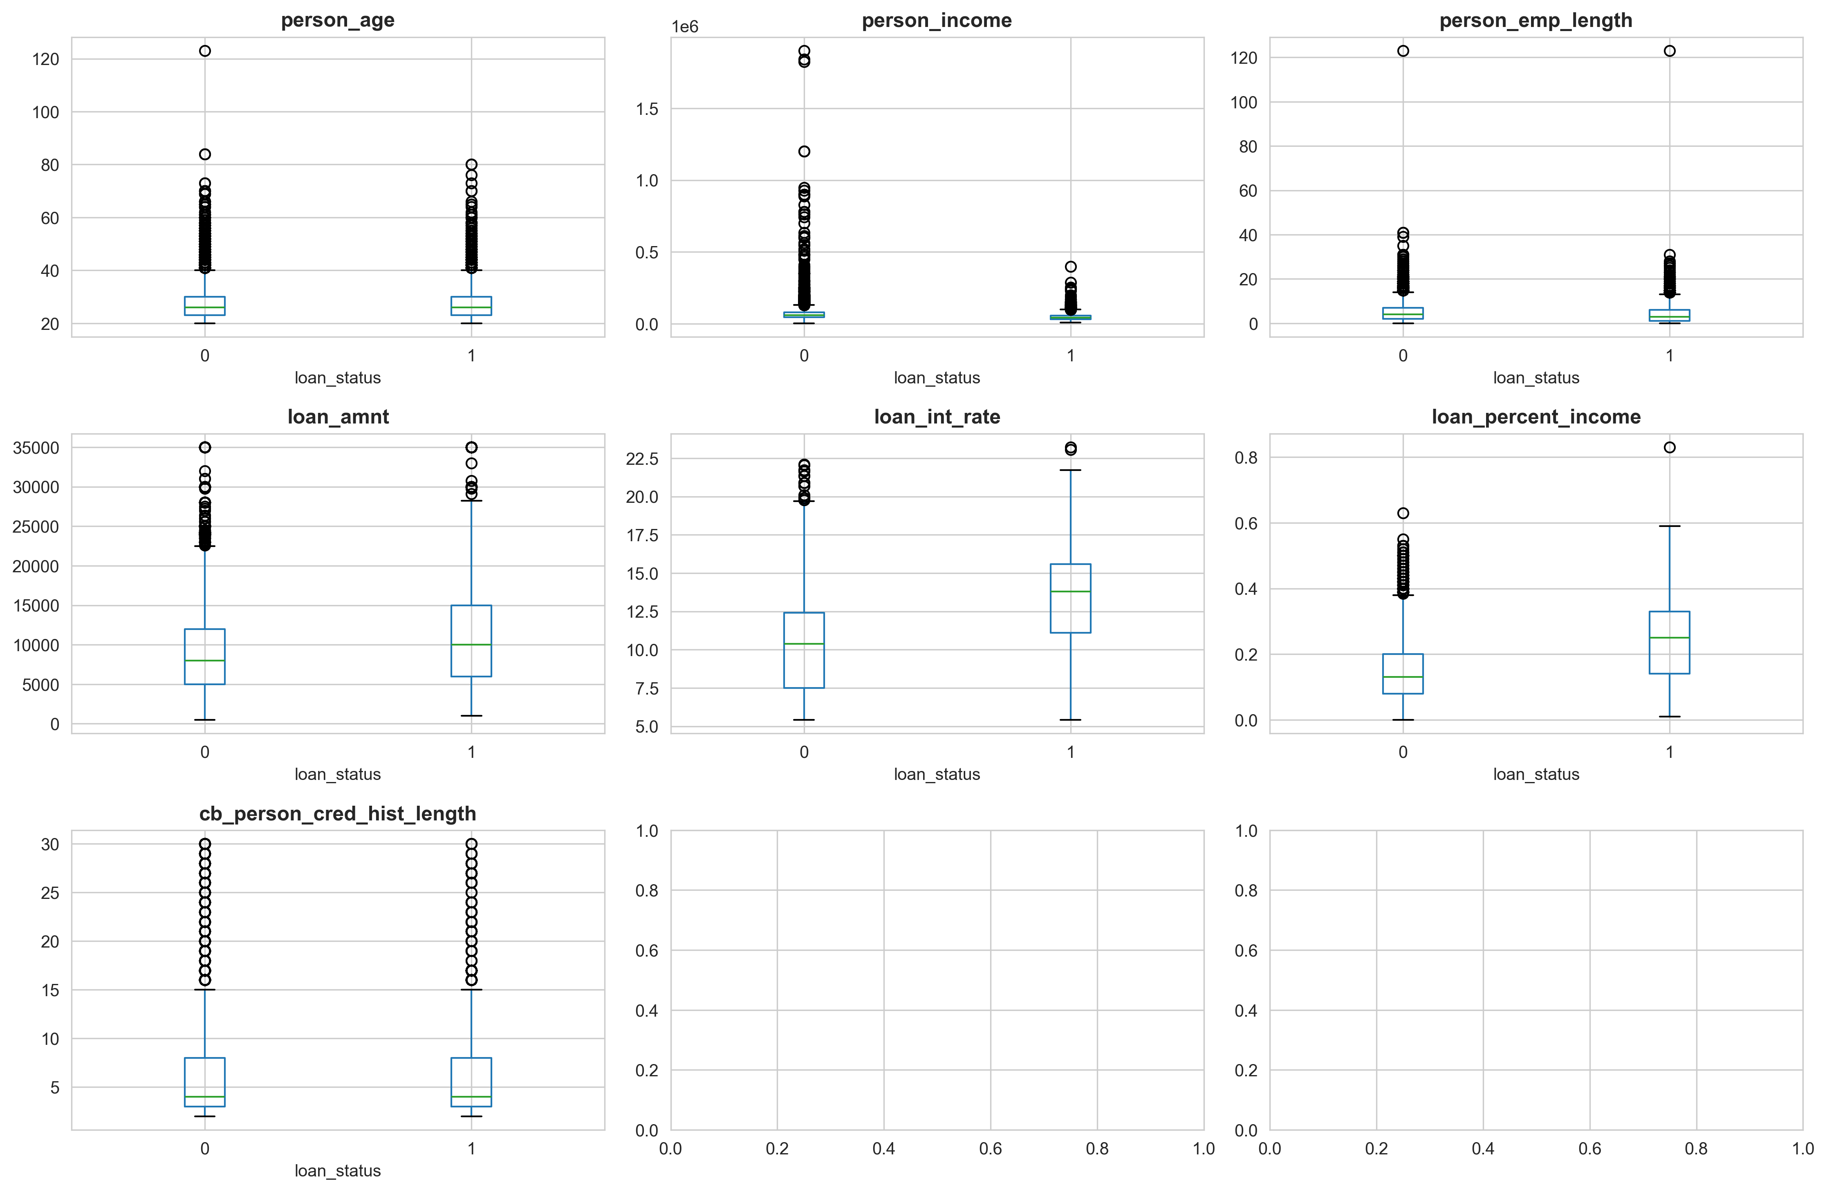

Slide 14
Model Training & Evaluation
Models: Logistic Regression, Decision Tree, Random Forest.
Metrics: Accuracy, Precision, Recall, F1, ROC-AUC.
Results:
Logistic Regression
Decision Tree
Random Forest
Accuracy 0.90, Recall 0.44.
Accuracy 0.95, Recall 0.70.
Accuracy 0.95, ROC-AUC 0.93.

Slide 15
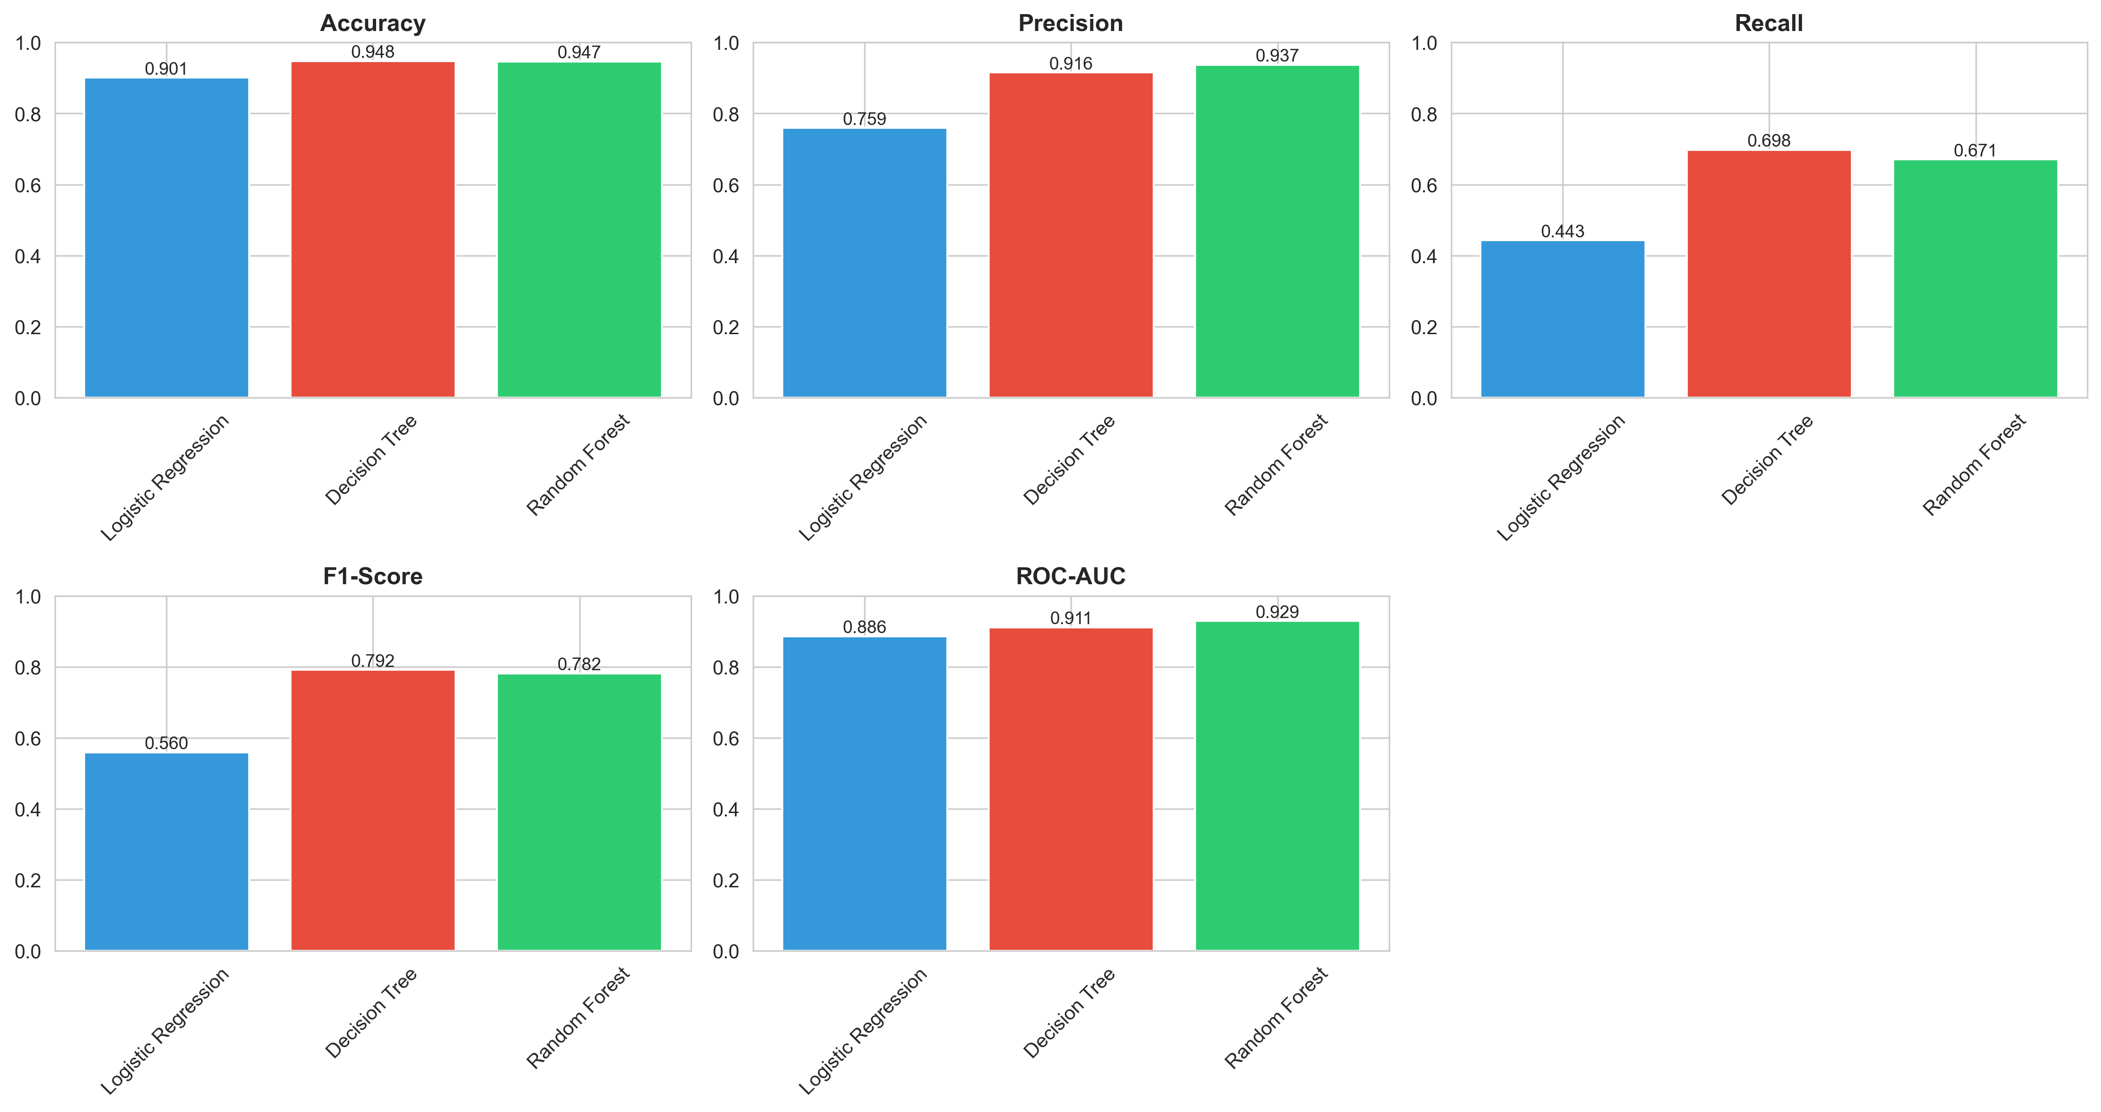

Slide 16
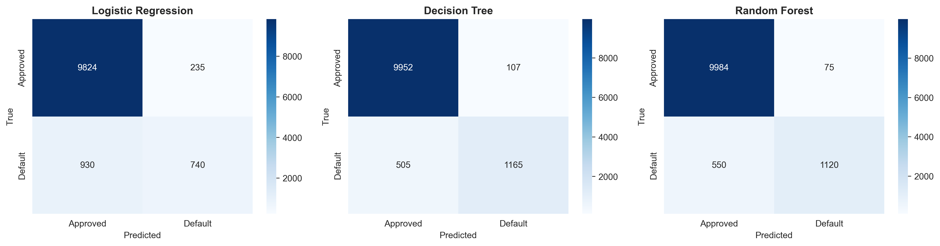

Slide 17
Feature Importance
Top predictors:
01
02
03
Loan Percent Income
Loan Grade
Income-to-loan ratio
04
05
Interest rate
Home ownership

Slide 18
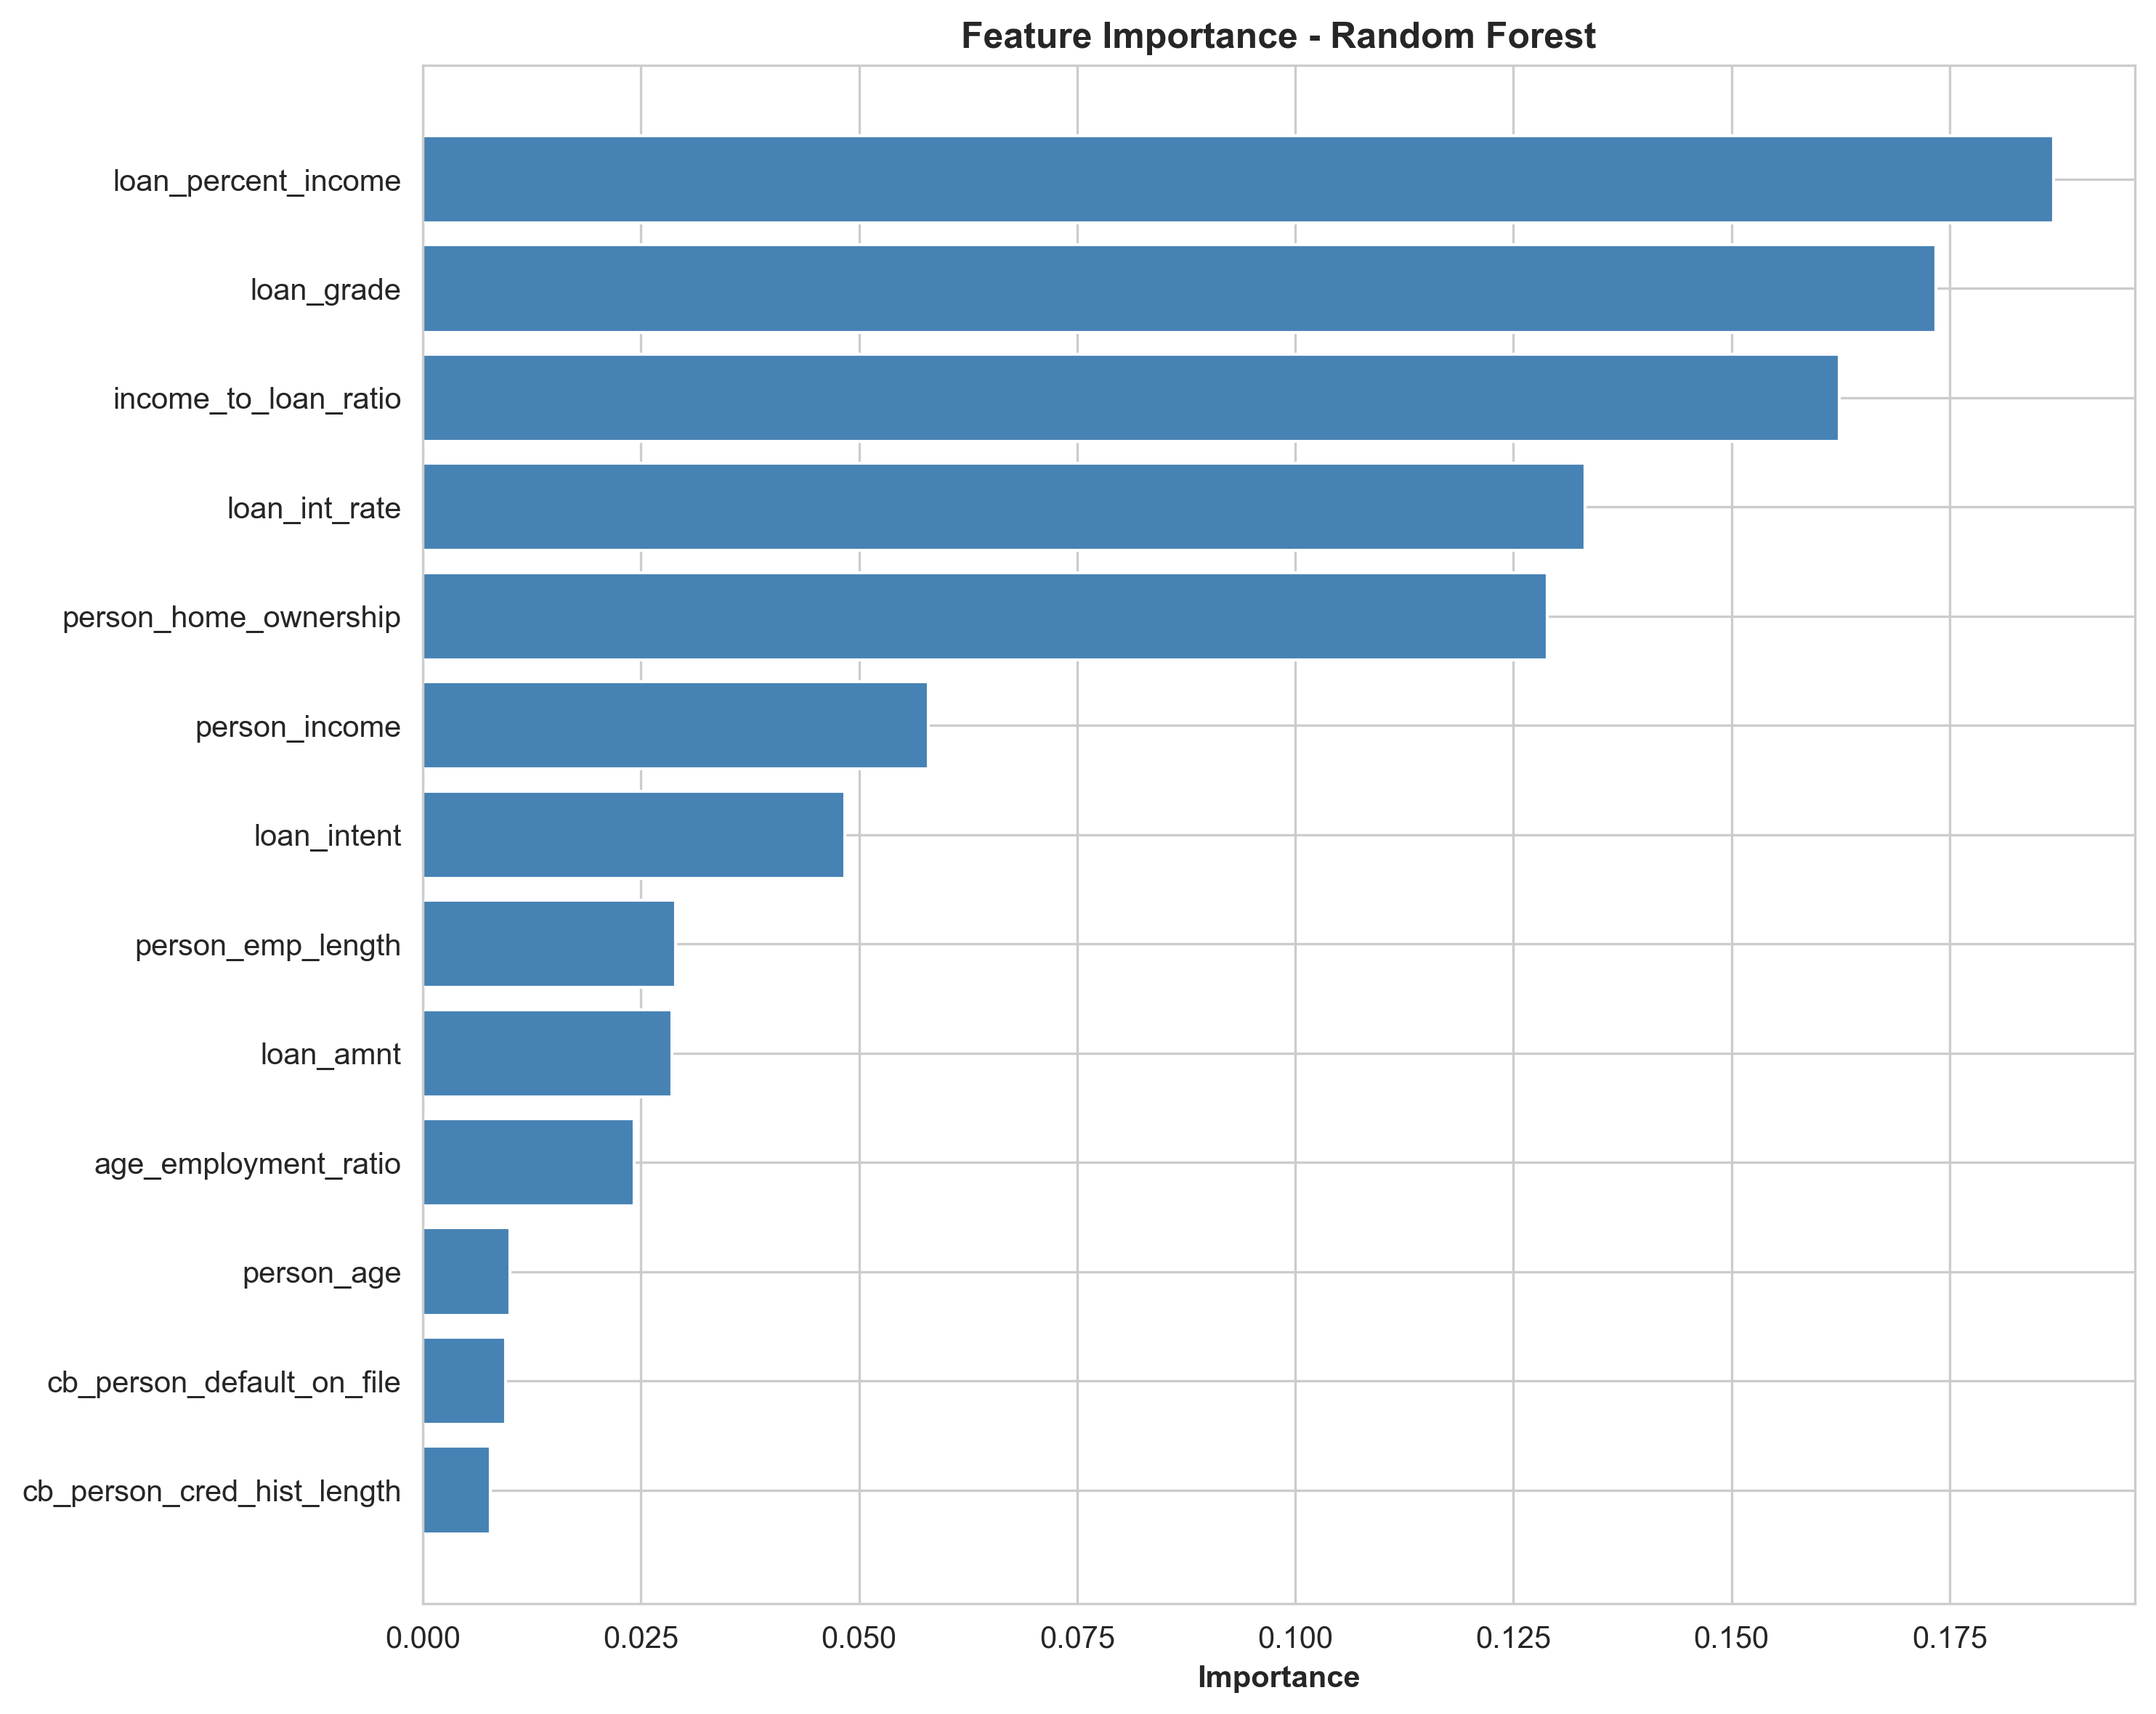

Slide 19
Insights & Next Steps
Insights:
Next Steps:
Tree-based models perform best.
Apply SMOTE/undersampling for balance.
Class imbalance hurts recall for defaults.
Hyperparameter tuning.
Key predictors: income ratios, loan grade.
Try XGBoost/LightGBM.
Add interpretability (SHAP, LIME).

Slide 20
Thank You
Video Link:

