Slide 1
Loan Approval Prediction : Project Checkpoint 2
Team: Predictive Minds
Members: Suraj R. Rao | Om G. Patel | Darren A. Ferrao | Mohammad A. K. Dalwai
Objective: Expand and refine the loan-approval prediction pipeline through multiple models, feature engineering, class-balancing, and model tuning to achieve higher predictive accuracy and recall.

Slide 2
Checkpoint 1 Summary
Dataset
Models
58 645 samples × 13 features.
Logistic Regression | Decision Tree | Random Forest.
Best Model (CP1)
Next Goal
Random Forest → Accuracy 0.95 | F1 0.78.
Improve recall for Default class and add richer features.

Slide 3
Class Distribution & Balancing
Original Distribution
Impact
Original ratio: Approved 50 295 | Default 8 350 (≈ 6 : 1).
Balancing substantially improved minority-class recall and F1.
After SMOTE: 80 472 samples (balanced).
After SMOTETomek: 80 134 samples (balanced & clean).

Slide 4
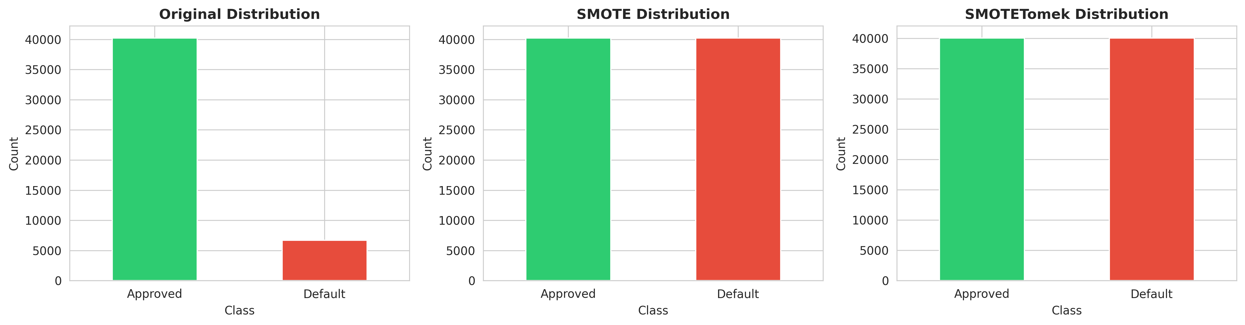

Slide 5
Feature Engineering & Data Preparation
Engineered Features
Data Processing
Train/Test Split
Added 12 engineered features → 25 total variables.
Label encoding + standard scaling for numerical features.
46 916 train | 11 729 test (80/20).
Examples: income_to_loan_ratio, debt_to_income_ratio, age_employment_ratio, log & polynomial terms.

Slide 6
Models Evaluated (10 Algorithms)
Algorithms Tested
Datasets Used
Logistic Regression | Decision Tree | Random Forest | XGBoost | LightGBM | Gradient Boost | AdaBoost | SVM | KNN | Naive Bayes.
Original, SMOTE, SMOTETomek.
Evaluation Metrics
Best Performers
Accuracy | Precision | Recall | F1 | ROC-AUC.
Ensemble models (XGBoost, LightGBM, Gradient Boost) performed best.

Slide 7
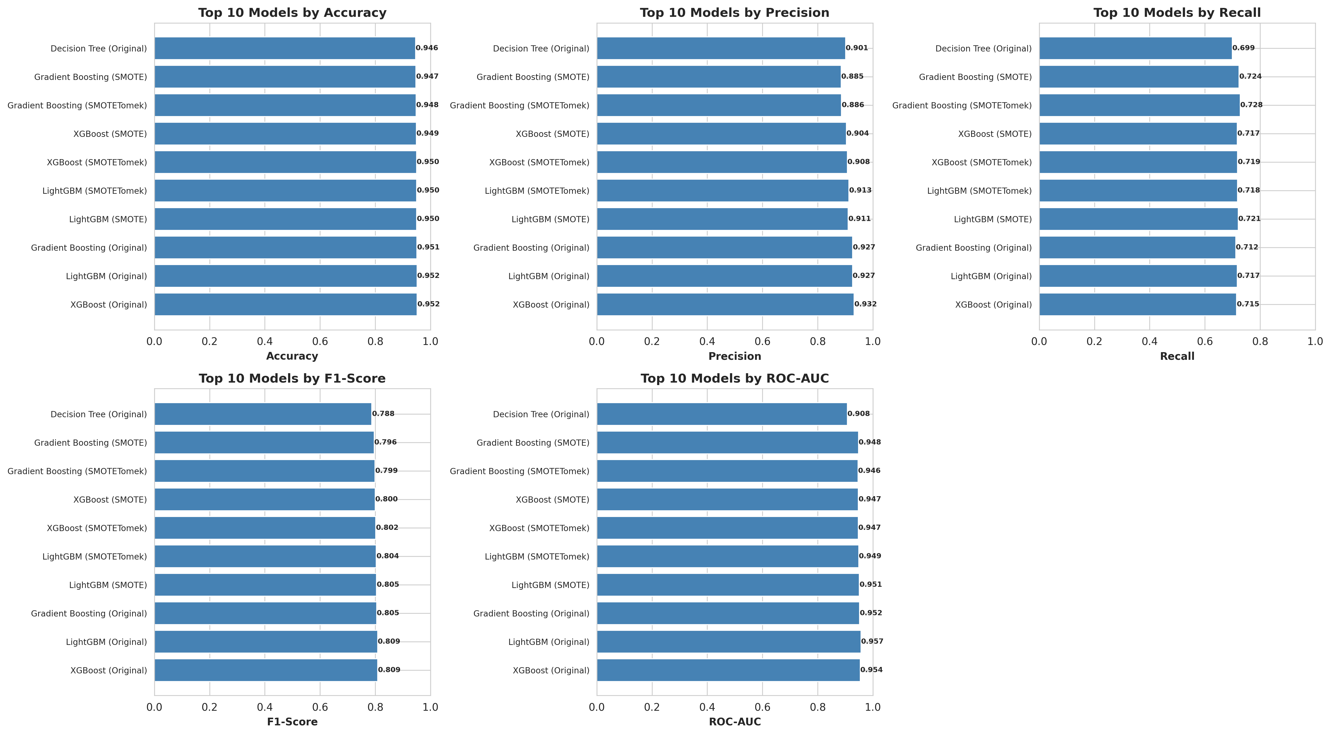

Slide 8


Dataset-Level Performance Comparison
Compared Original, SMOTE, and SMOTETomek datasets for top models.
Balanced Datasets
Original Dataset
Enhanced recall without sacrificing accuracy.
XGBoost and LightGBM achieved highest overall metrics.

Slide 9
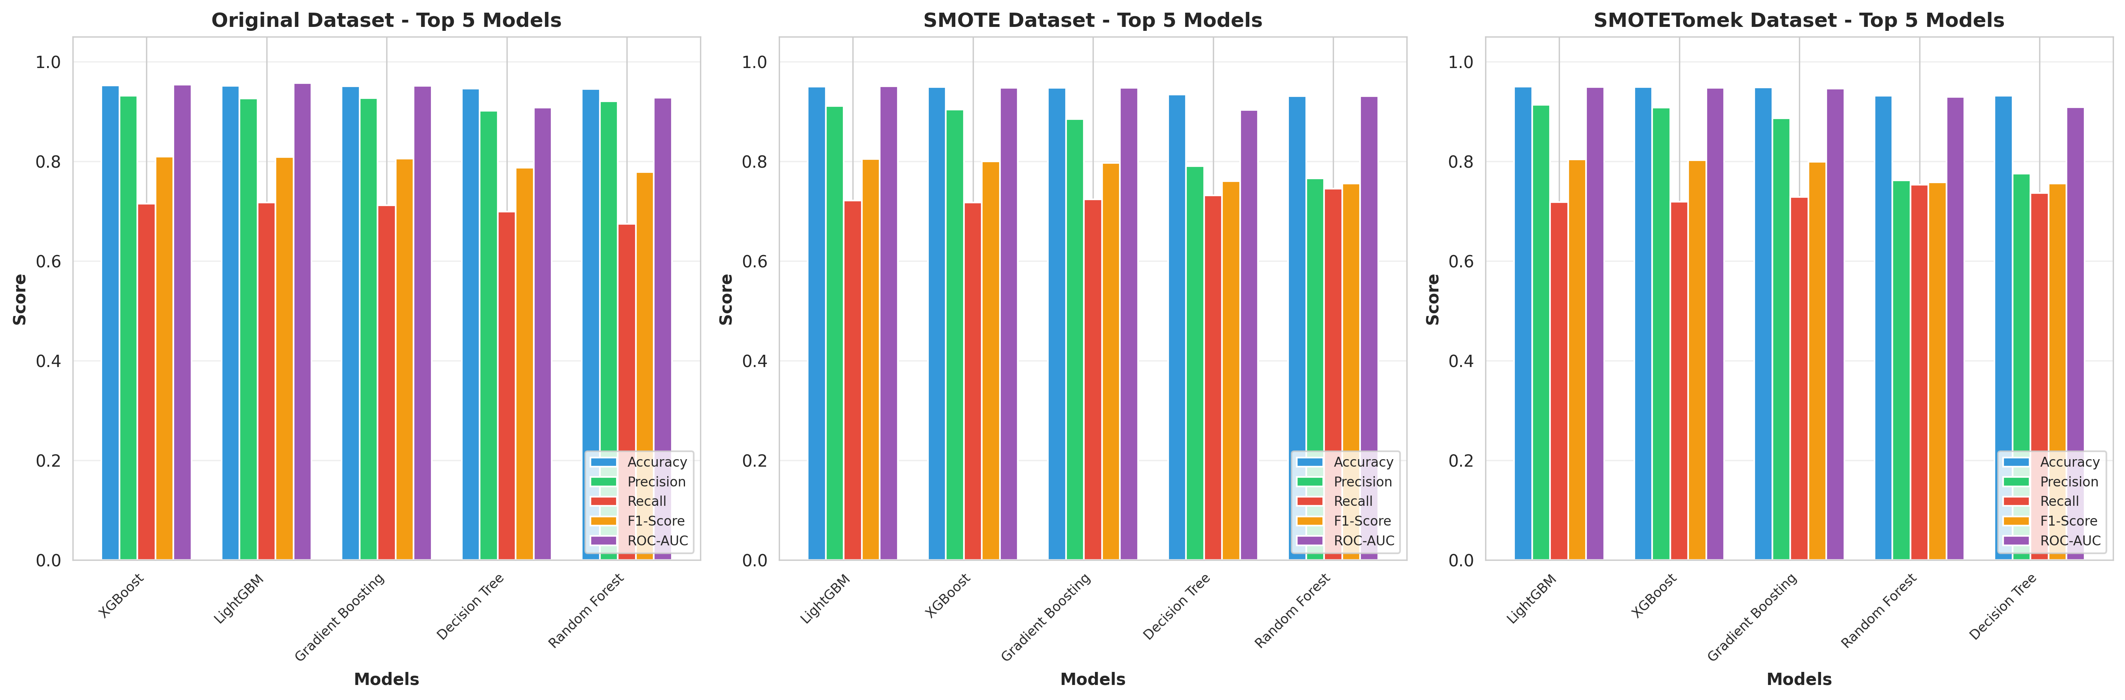

Slide 10

Top Model Results & Evaluation
Top 3 Models
XGBoost (Orig)
LightGBM (Orig)
Gradient Boost (Orig)
Achieved > 95 % accuracy and ≈ 0.81 F1 score.
Achieved > 95 % accuracy and ≈ 0.81 F1 score.
Achieved > 95 % accuracy and ≈ 0.81 F1 score.
High recall (~ 0.72–0.73) for the Default class.

Slide 11
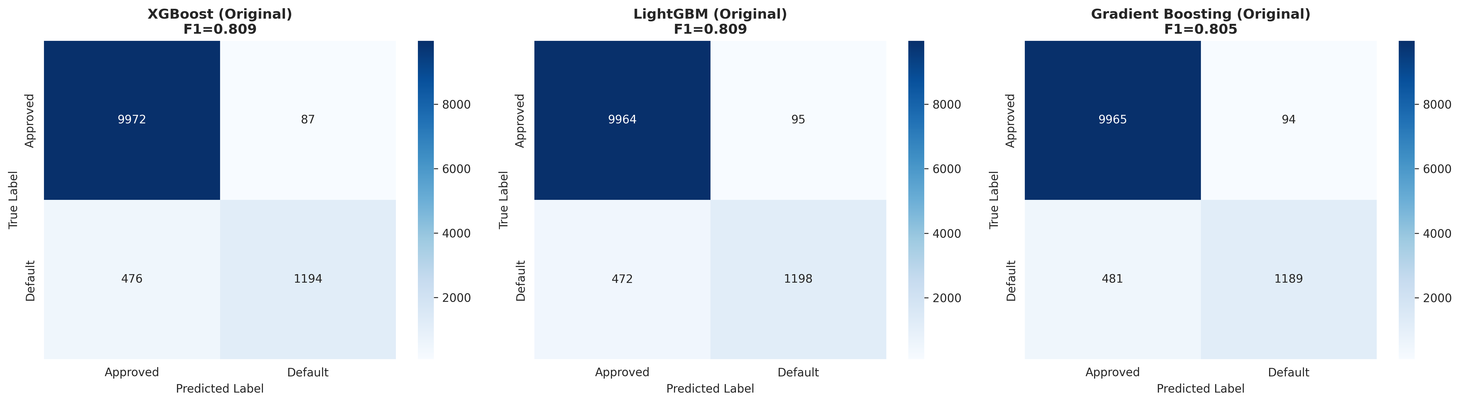

Slide 12
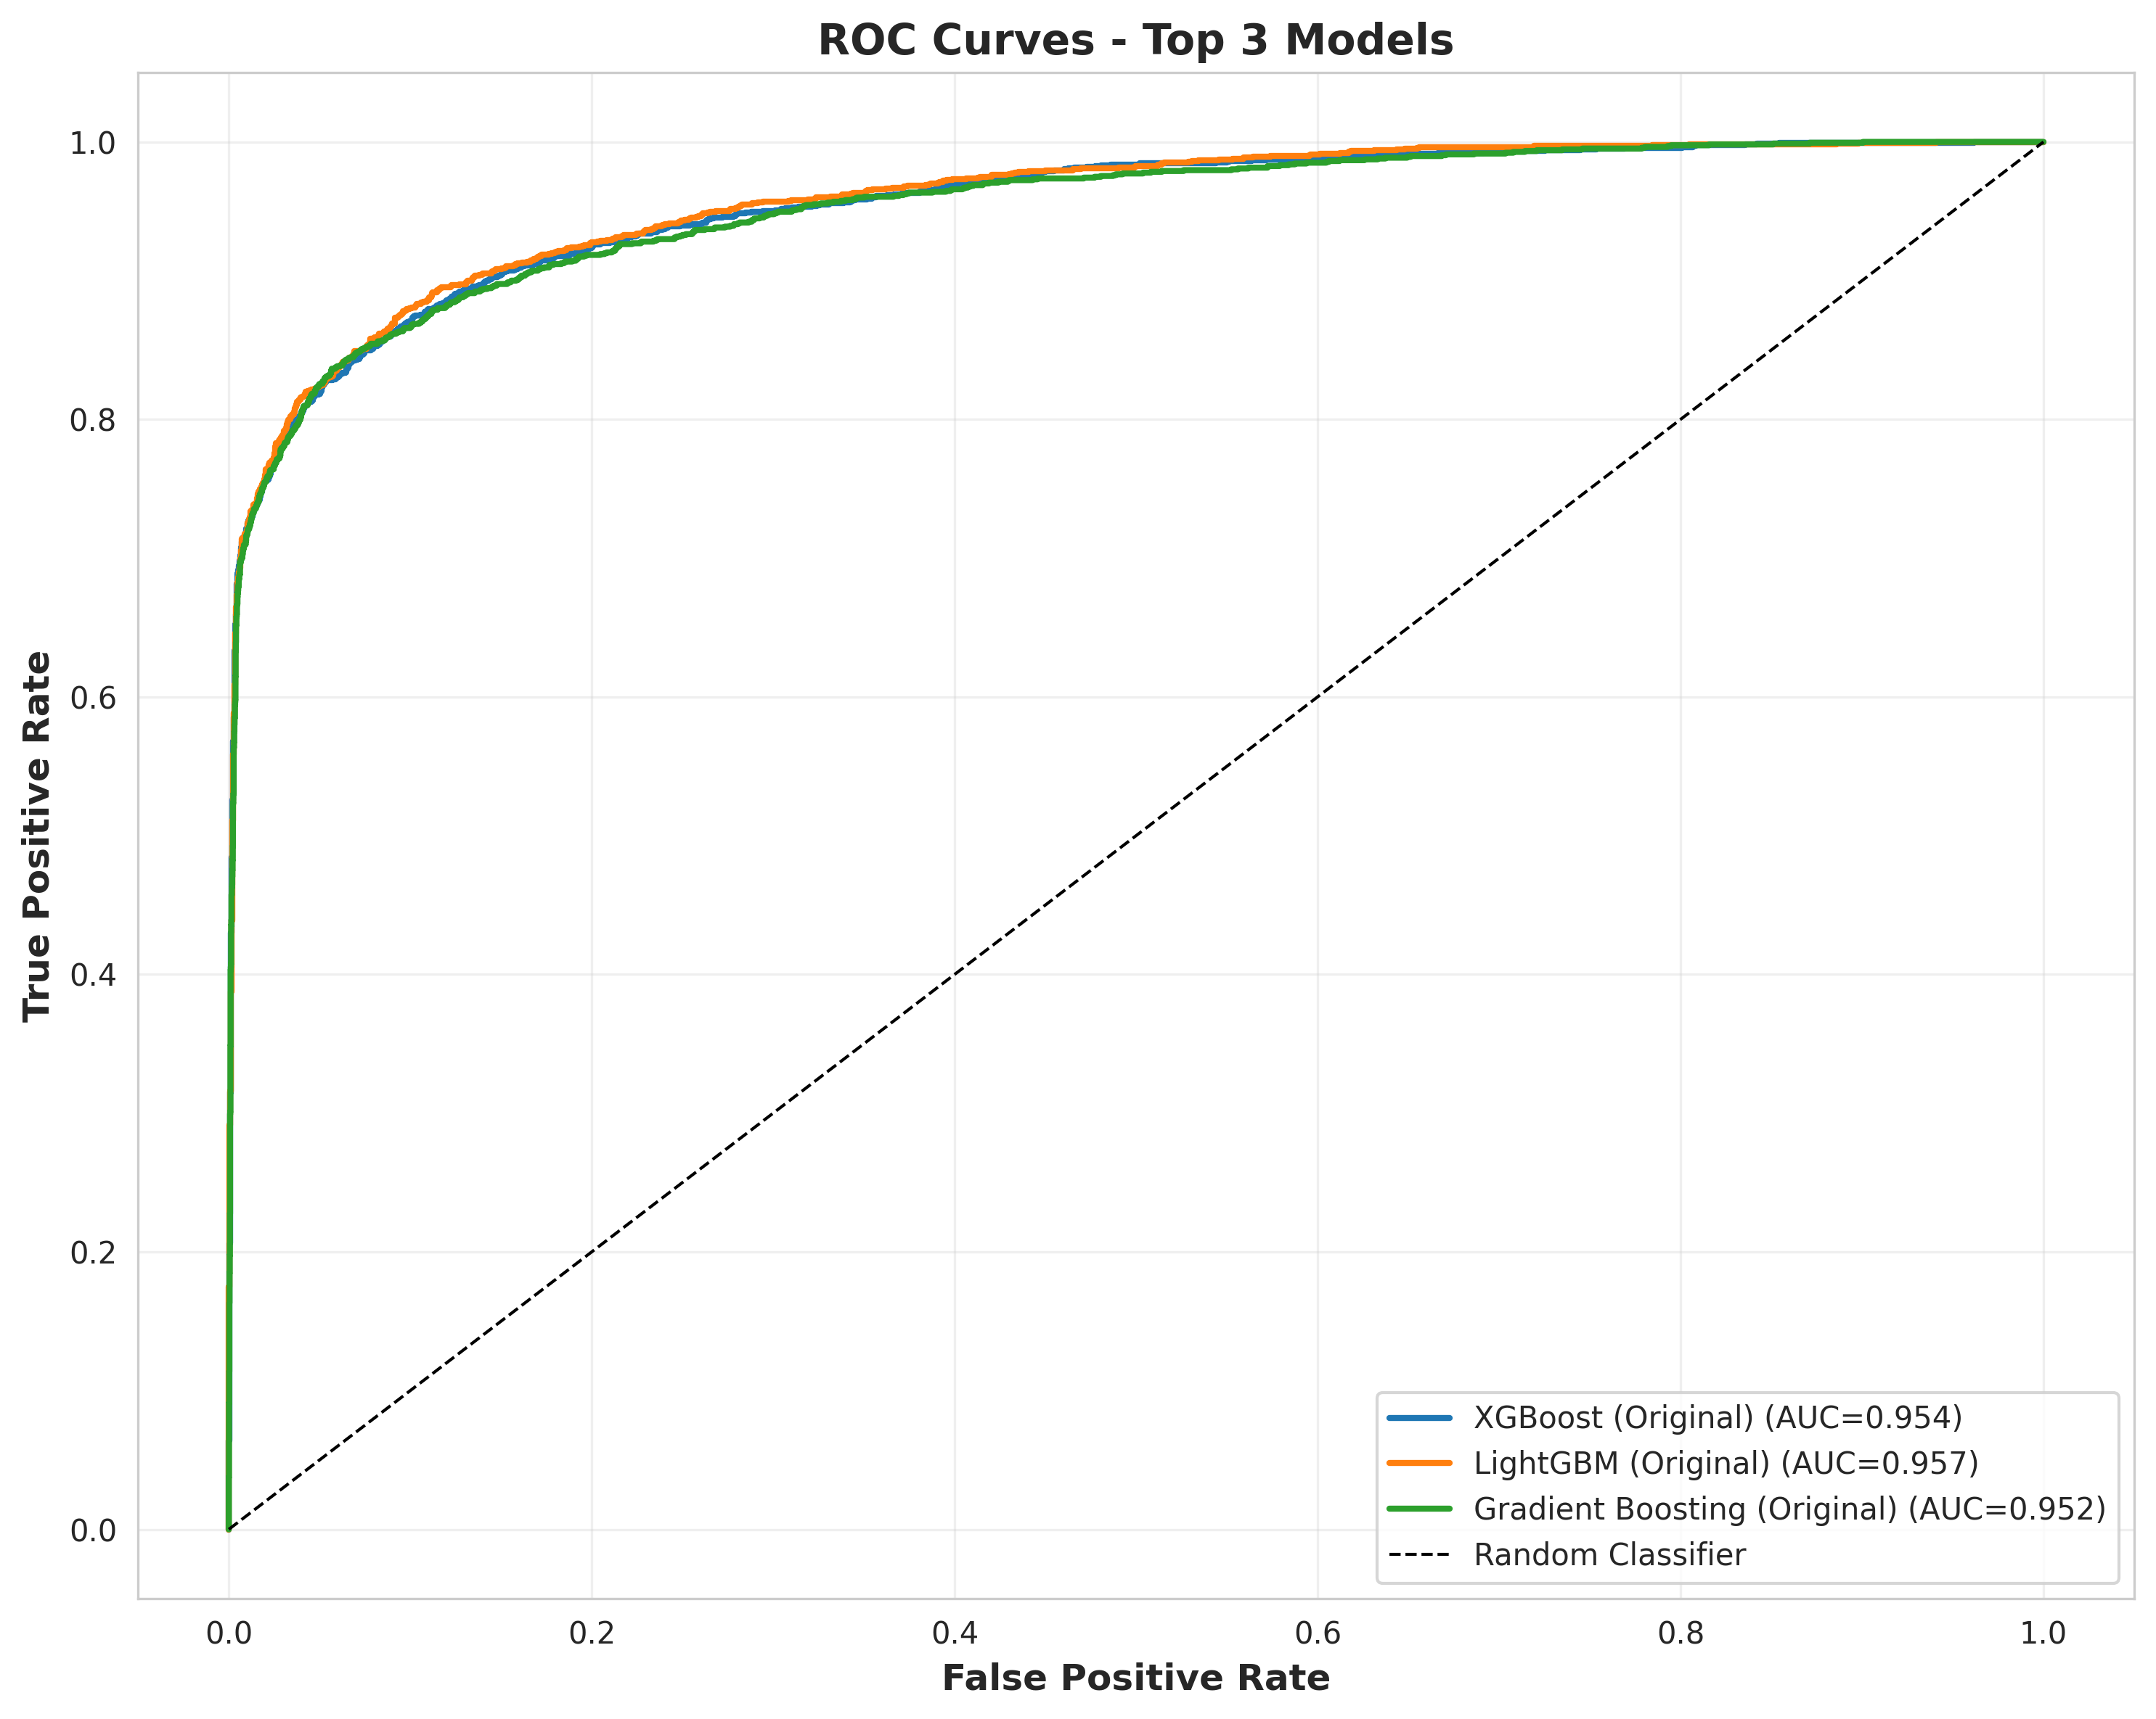

Slide 13
Tuned Best Model (XGBoost) & Validation
Tuning Process
Final Test Metrics
Tuned via GridSearchCV → parameters: colsample_bytree 0.8, learning_rate 0.1, max_depth 7, n_estimators 300.
Accuracy 0.9517
Precision 0.913
Recall 0.731
5-Fold CV F1 = 0.810 (± 0.025).
F1 0.812
ROC-AUC 0.953

Slide 14
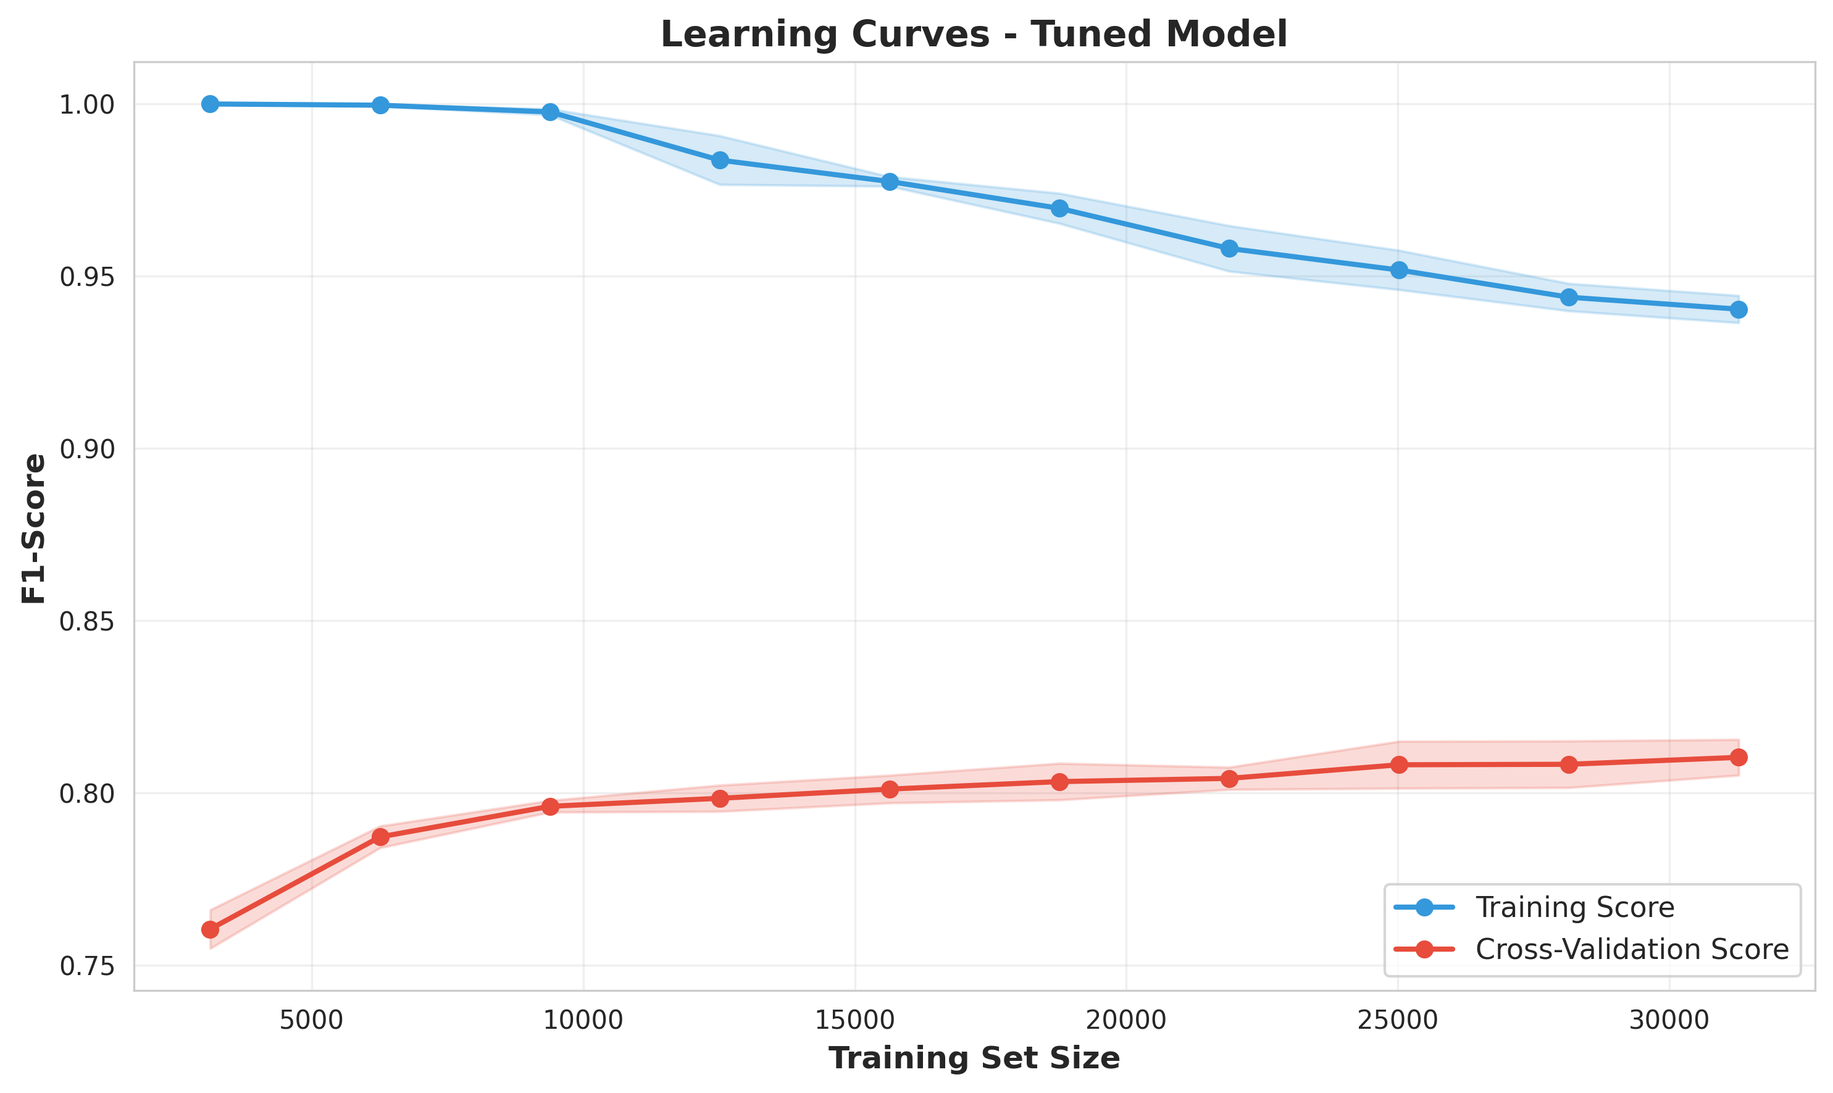

Slide 15
Feature Importance & Progress from CP1
Top Predictors
Enhancement Impact
Improvement vs CP1
loan_grade, high_interest_loan, home_ownership, loan_percent_income, debt_to_income_ratio, income_to_loan_ratio.
Feature engineering and tuning enhanced recall and stability.
F1 + 4.1 % | Recall + 4.4 % | ROC-AUC + 2.5 %.

Slide 16
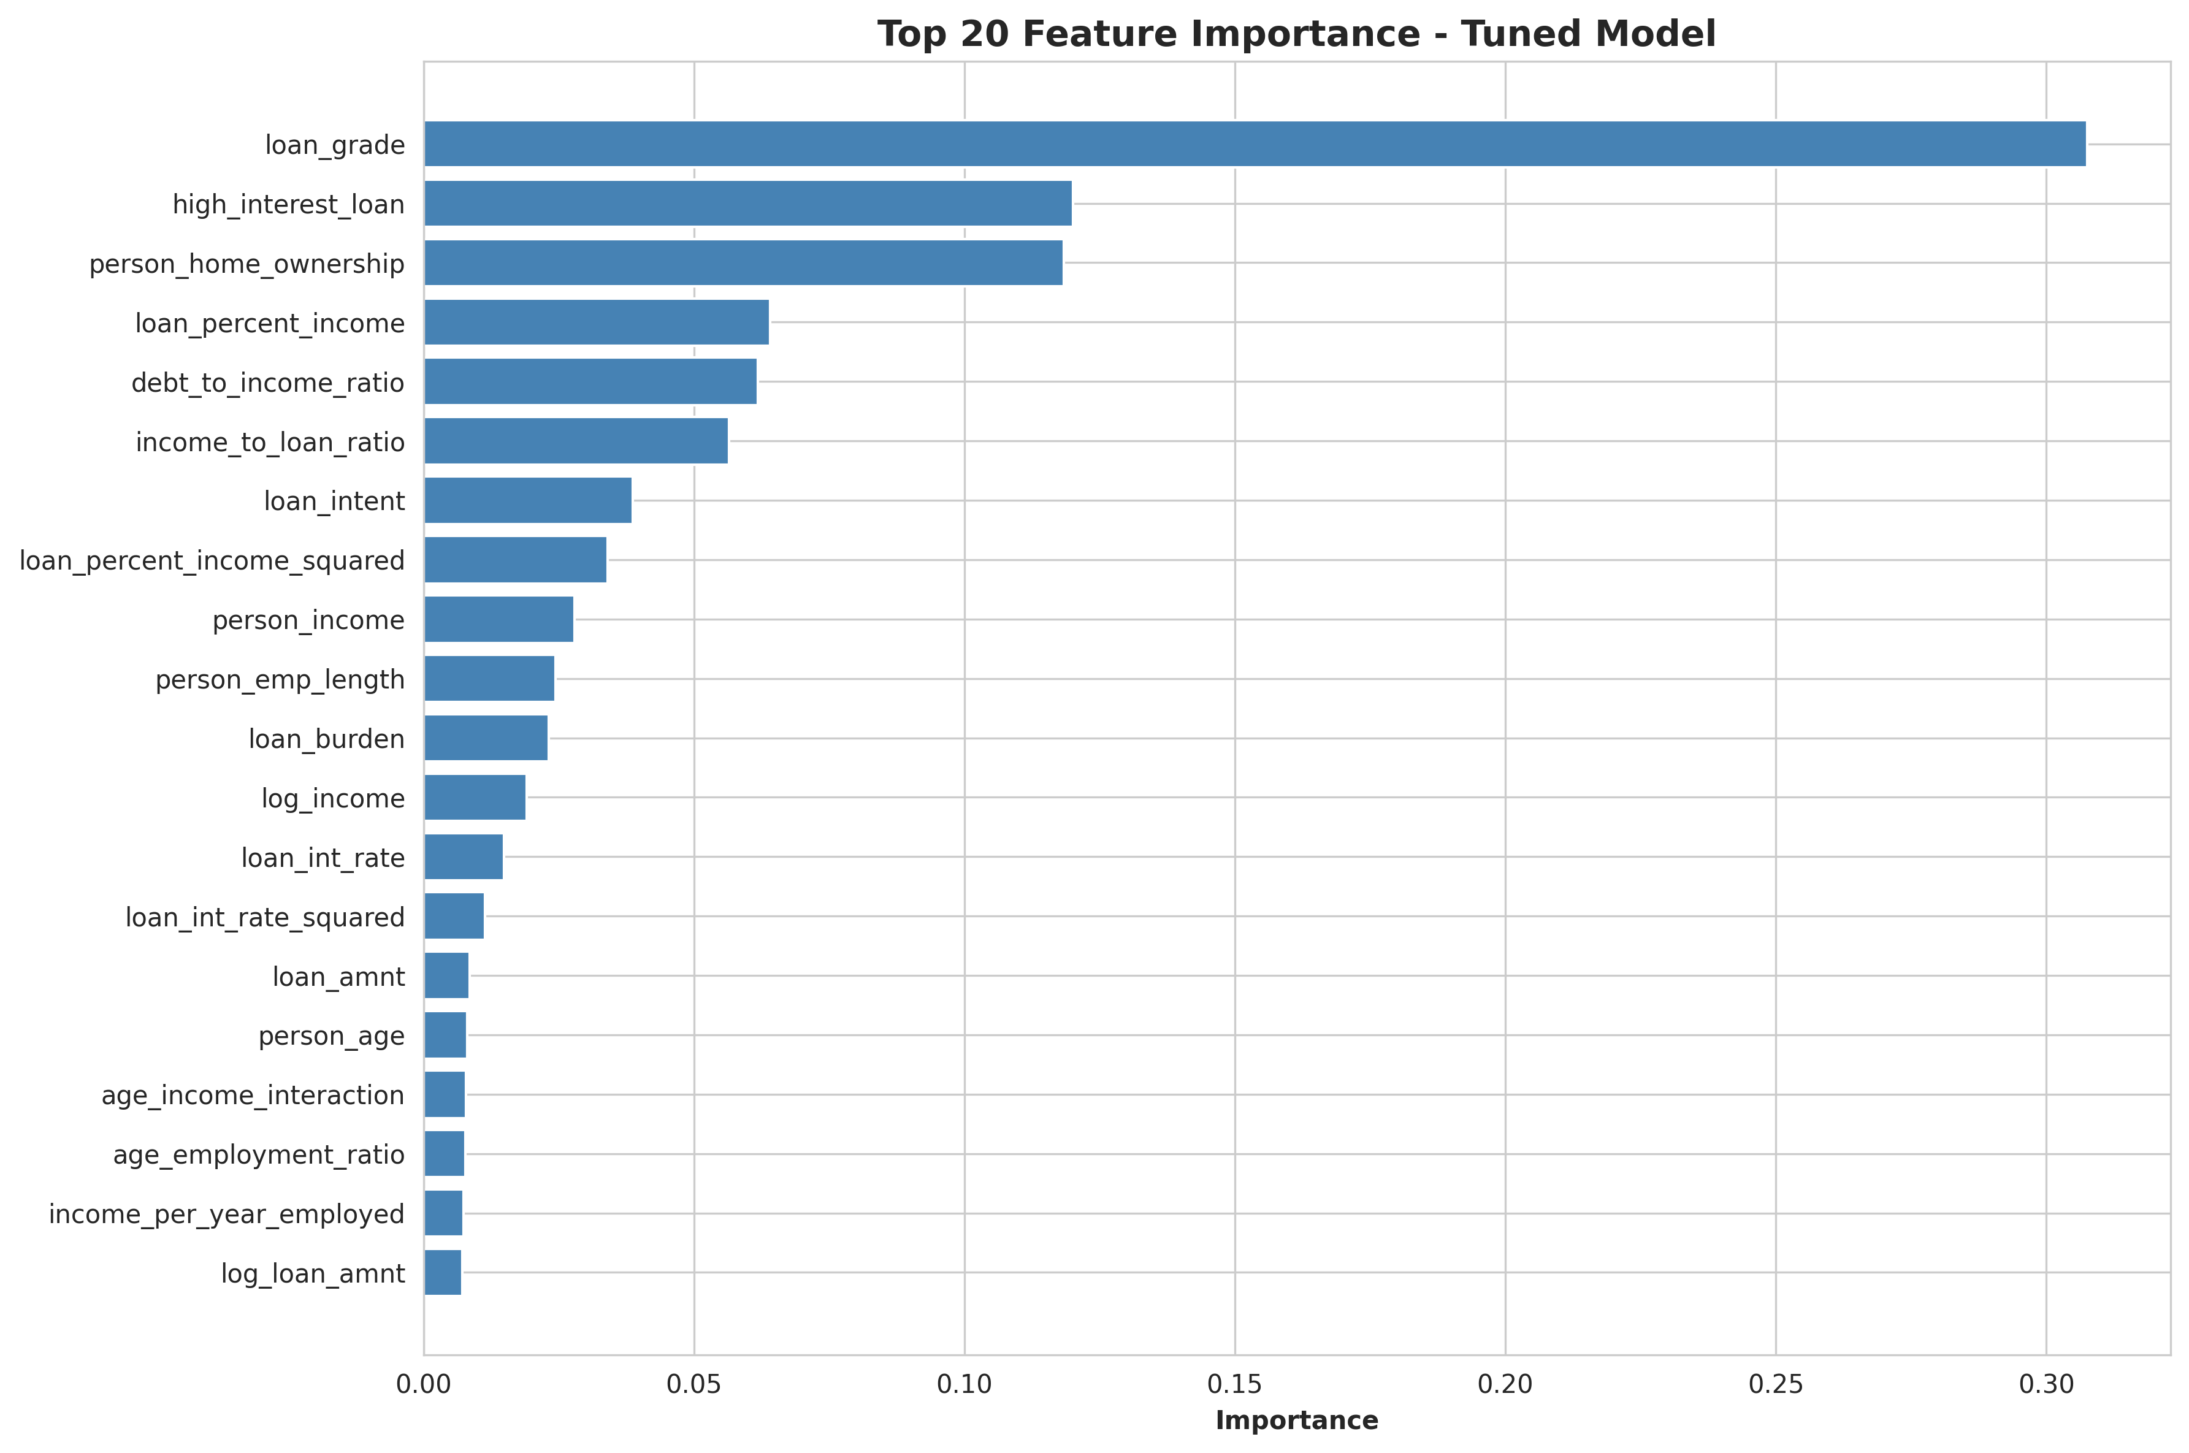

Slide 17
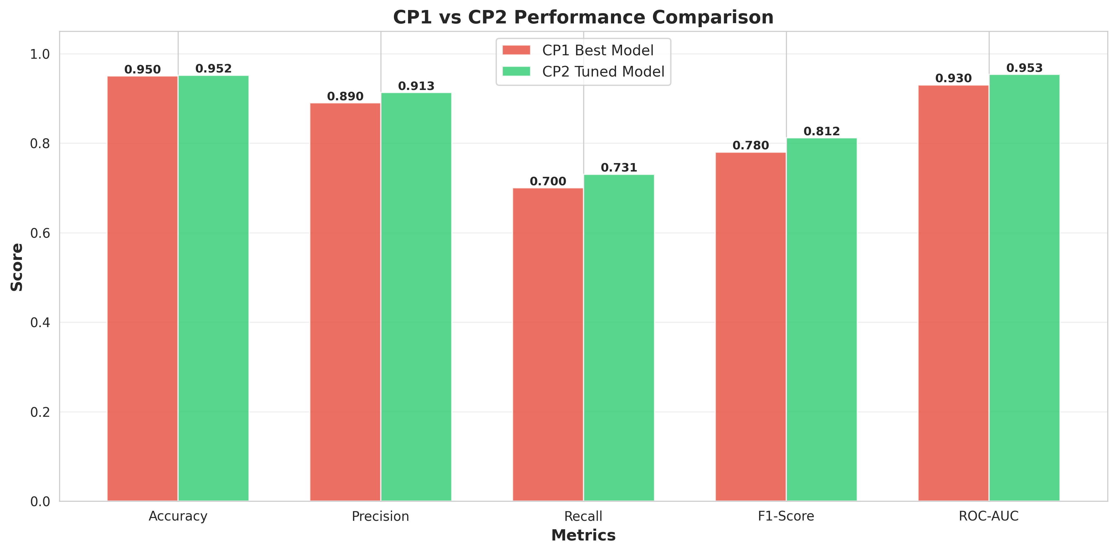

Slide 18
Next Steps (Short-Term Final Scope)
1
SHAP Visualizations
2
Feature Selection
3
Final Report
Finalize SHAP visualizations for model explainability.
Integrate feature selection to streamline the final model.
Prepare final report with business impact discussion and deployment outline.

Slide 19
Thank you
Video Link: https://drive.google.com/file/d/1n0VxR-CIltRnNrpPSafxPl_7Kl55jU8T/view?usp=sharing

