Slide 1

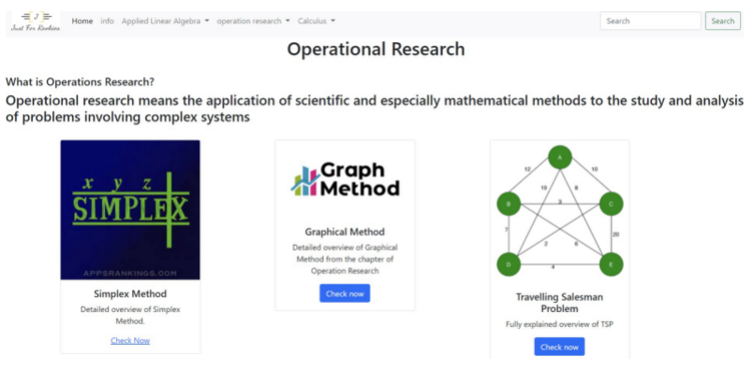
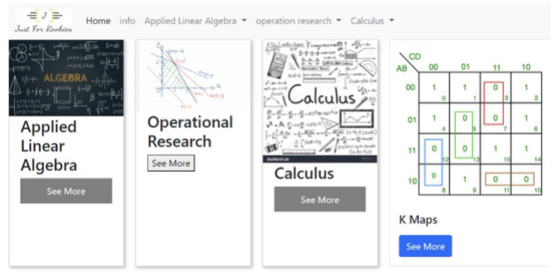
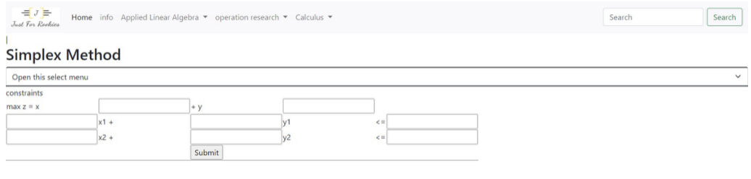
J u s t F o r R o o k i e s
Group members:
Harsh Dwivedi, Aman Gupta,
Suraj Sikchi, Ankit Deb, Vinay Gupta
Guide Name:
Sandeep Sahu
Dr. L Sathish Kumar
Group No. 26
A B S T R A C T
I N T R O D U C T I O N
R E S U L T S
D I S C U S S I O N
JustForRookies is a website and software that contain solutions for various topics relevant to first year engineering subjects. It is a resource that condenses multiple different subjects into one to provide a streamlined, accessible and user-friendly platform and experience to the user and focuses on quick and easy access to solutions.
The purpose off this project was to attempt to create a platform that creates ease of access for effective learning with different topics condensed into one resource for students.
Thus arrived the idea behind the website, a place which can provide calculations and solutions for various questions relevant to engineering freshmen.
With the use of HTML, CSS, Django and Python, there has been progress made towards this goal.
We then wanted to also create a small lightweight software that could serve the same function. For this software, we've used the Tkinter module in Python.
Here, the result essentially consists of the various website pages that have been designed. There is the homepage where the subject can be selected from, there is the subject page which contains the different methods and types of questions in the choosen subject and then there is the method page which acts as a calculator to input values into and get step-by-step solutions to questions relating to the various methods.
When it comes to inside the methods, there are python codes which provide the output. For example, with the simplex method, the steps to reaching the solution and the final table is the result of that code.
For the software, the output are the various screens we have designed.
Screenshots of the website UI can be seen below.
There clearly exists a plethora of resources across the internet relating to engineering subjects and topics, to a near overwhelming extent. As students ourselves, it was our experience that it often felt like there were too many resources we had to cross-refer and access in order to be able to be able to get reliable, correct solutions - even more so when we considered questions where the steps were required.
With this project, the central aim was to condense this information into one spot for everything related to the subjects taught in the freshmen year of engineering college. While there already exist many websites for these questions individually, there aren't any which have such a specific target demographic. Focusing on one particular demographic in this manner means we can refine the user experience, given that the user base has a lot more in common than a general population sample.
Thus, the utility of our project lies in the ease of access and use rather than ground-breaking innovation. Despite serving a market as saturated as this, we believe our project has potential to be highly useful.
M O D U L E S A N D M E T H O D S
C O N C L U S I O N S
For the front end, we have three web separate pages created using HTML and CSS.
For the back end, we have implementation of the Simplex Method and Gauss Elimination, all coded using python.
Further we have modules in the software implementation where we've used Tkinter.
The work put into this project served as quite an enriching experience. It provided an outlet through which we were offered insight into the process of web development and the various elements involved in it. It also offered us a insight into basic software development procedures.
Subject Page
Website Homepage
R E F E R E N C E S
GeeksForGeeks.org
GetBootstrap.com
StackOverflow.com
Method page

