Slide 1

Feature Based Opinion Mining of Cellphone Reviews
-Suraj Suresh Sajjan

Slide 2

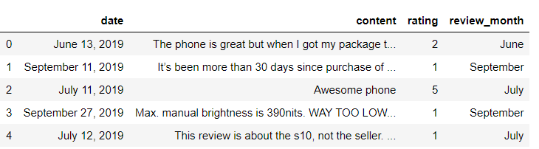
About the dataset.
The data being used is the customer reviews available on Amazon for two cellphones, the Samsung Galaxy S10 and the iPhone XR.
A web scraping tool called “Web Scraper” was used to scrape the data.
The attributes which are made use of are the Date, Rating and Content of the reviews.

Slide 3
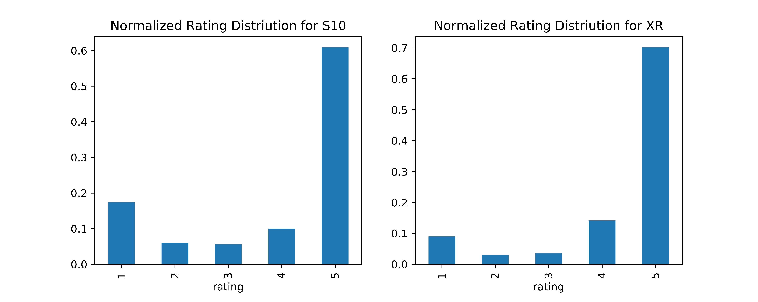
The distribution of star rating for the devices.

Slide 4
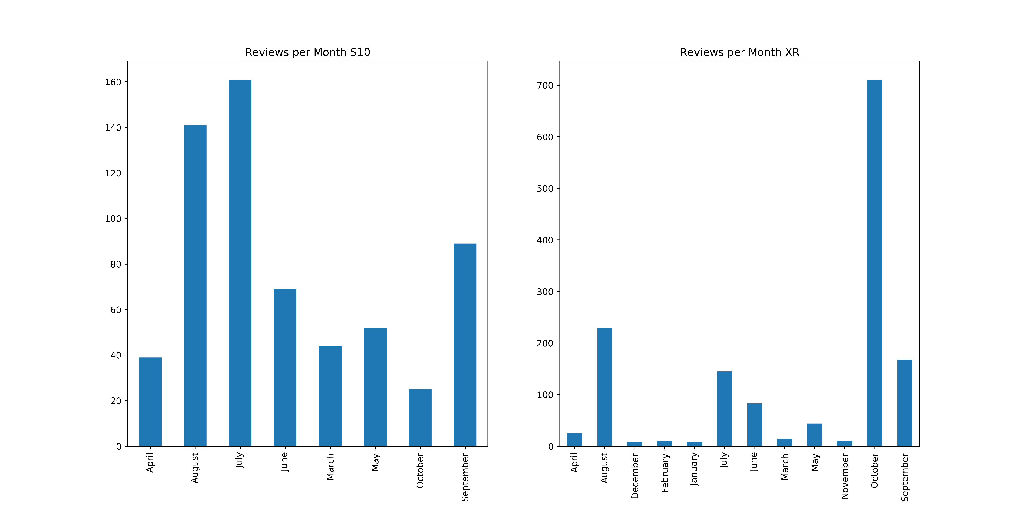
The distribution of the reviews across the months.

Slide 5
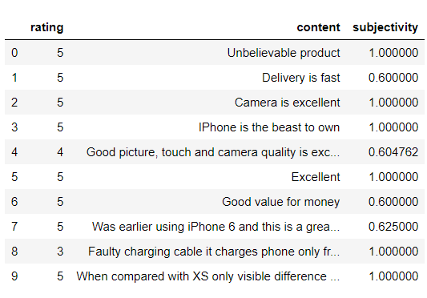
Classification of the reviews based on subjectivity.
We made use of a library called textblob to assign subjectivity scores to the sentences.

Slide 6
Text preprocessing.
Some of the techniques used for text preprocessing:
Stemming.
Lemmatization.
Removal of stop words and special symbols.
Conversion of uppercase text to lowercase.

Slide 7
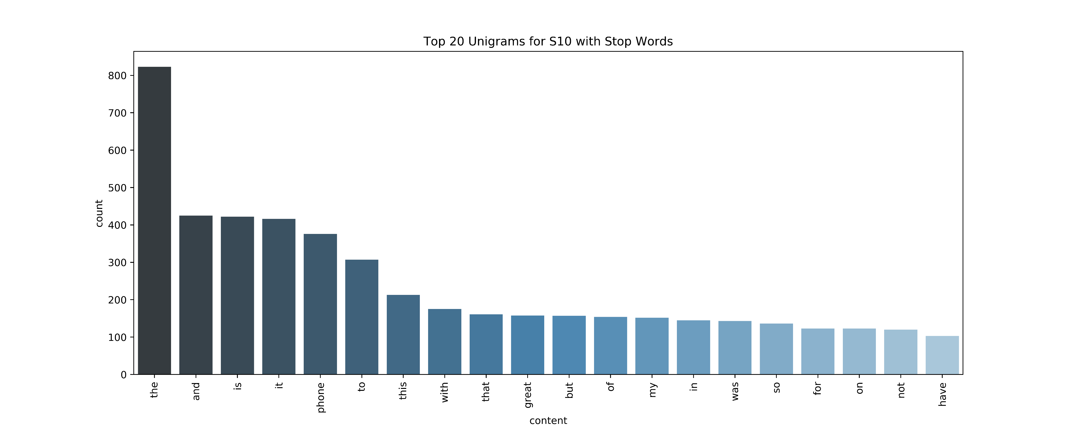
Top 20 Unigrams for S10 with stop words.

Slide 8
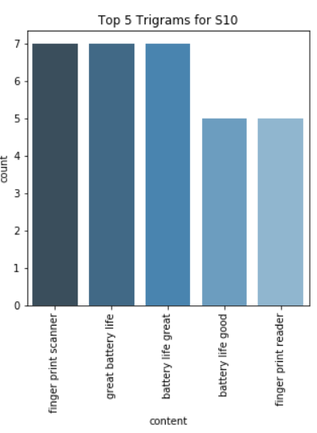
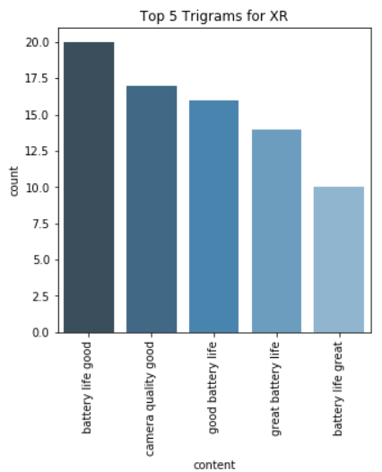
Top 5 Trigrams for the S10 and XR.

Slide 9
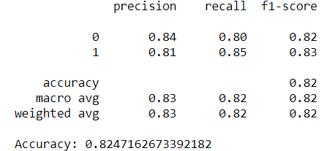
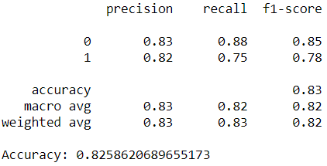
Comparison of ML models for subjectivity classification:
All the sentences with a subjectivity score greater than 0.5 were labelled as 1 and the remaining were labelled as 0 for training of the models.
Random Forest Classifier.
Samsung Galaxy S10. iPhone XR.
We observe an accuracy of around 82.5% for both the devices with this classifier.

Slide 10
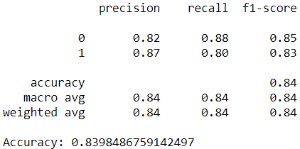
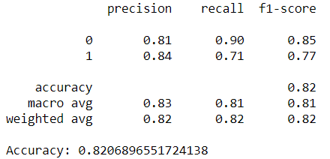
Comparison of ML models for subjectivity classification:
2. Support Vector Machine
Samsung Galaxy S10. iPhone XR.
We observe an accuracy of around 84% for the Galaxy S10 and 82% for the iPhone XR with this classifier.

Slide 11
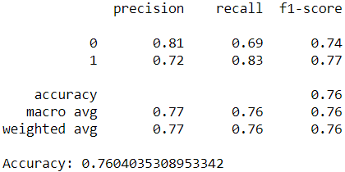
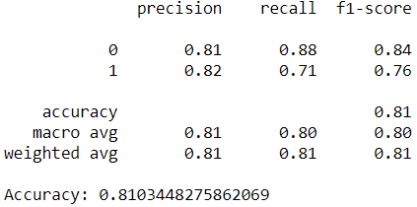
Comparison of ML models for subjectivity classification:
2. Multinomial Naïve Base
Samsung Galaxy S10. iPhone XR.
We observe an accuracy of around 76% for the Galaxy S10 and 81% for the iPhone XR with this classifier.

Slide 12
Rule Based Opinion Mining.
Rule based Opinion Mining is an approach which makes use of sentiment libraries and a set of rules to identify an opinion’s polarity towards an aspect.
Some of the Natural Language Processing techniques utilized in this method are stemming, tokenization, part of speech tagging, parsing.
The sentiment libraries also known as Lexicons are large collection of adjectives, adverbs, and phrases which have been labelled as positive, negative or neutral.
The lexicon used in this project is SentiWordNet.

Slide 13

Part Of Speech(POS) tagging.
POS tagging refers to tagging the words of the sentences based on parts of speech such as Noun, Pronoun, Adjective, etc. Here, NLTK POS-tagger has been utilized.
Some of the tags are - JJ adjective ‘big’
JJR adjective, comparative ‘bigger’
JJS adjective, superlative ‘biggest’
NN noun, singular ‘desk’
NNS noun plural ‘desks’
NNP proper noun, singular ‘Harrison’
NNPS proper noun, plural ‘Americans’

Slide 14
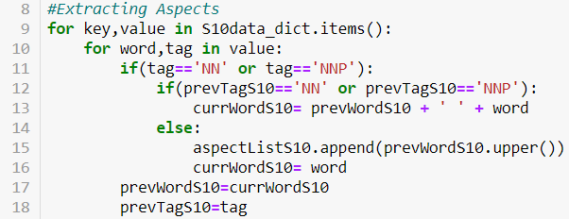
Detection of the aspect words.
After POS tagging is performed, we treat all the sentences present in the reviews as one big text corpus. Since we are more interested in the sentiment expressed towards a particular aspect and not the entire sentence.

Slide 15
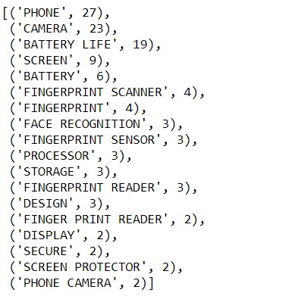
Aspect words for Galaxy S10 and iPhone XR.
Once the aspect words are determined, they are stored in a list.
Few of the selected Aspects for Galaxy S10:

Slide 16
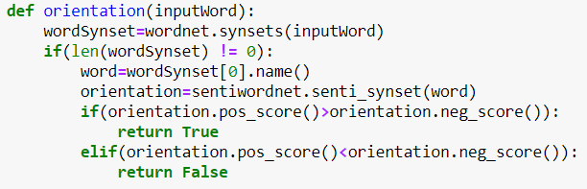
Detection of the sentiment towards Aspects.
Function to determine the polarity of the opinion word:
We also take into account the negative words such as “not”, “isn’t”, “aren’t”.
For example, the finger print reader is not extremely accurate. Here, the presence of the word “not” changes the sentiment expressed from positive into negative.

Slide 17
Classifying the aspects into positive and negative.
For every word present in the aspects list, we take a count of all the adjectives and adverbs describing it and give polarity to it. If there is a negative word such as “not” associated with it, we use a logical NOT to negate the polarity of that sentiment word.
Finally, we take the count of number of positive and negative sentiment words such as adjectives and adverbs and divide it by total number of sentiment words to get a percentage of positivity and negativity expressed towards that feature.

Slide 18
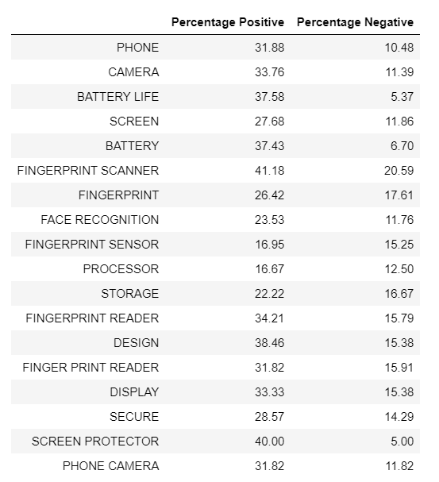
Aspect based opinion results for the Samsung Galaxy S10:

Slide 19
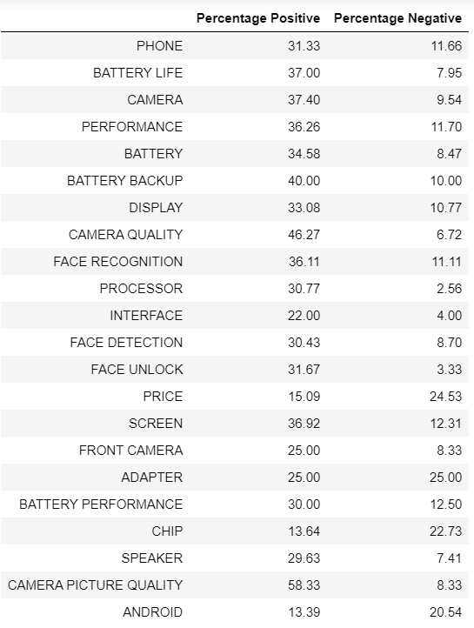
Aspect based opinion results for the iPhone XR:

Slide 20
Conclusion and Future Work.
With regard to subjectivity classification, Random Forest Classifier and Support Vector Machine produce better results than Naïve Base Classifier.
Rule Based Approach towards Opinion Extraction help in fundamentally understanding what exactly is happening inside the system.
They are a little hard to maintain in case a new rule is written to support new vocabulary.
Newer automated methods with the use of machine learning exist which provide sentiment on a sentence level. More research needs to be done on how sentiment can be assigned on a feature level using these techniques.

Slide 21
Thank you.

