Slide 1
Predicting posture of a person based on their personality
Suraj Rana Vujjini
GJ58372
Department of Data Science
Capstone in Data Science

Slide 2
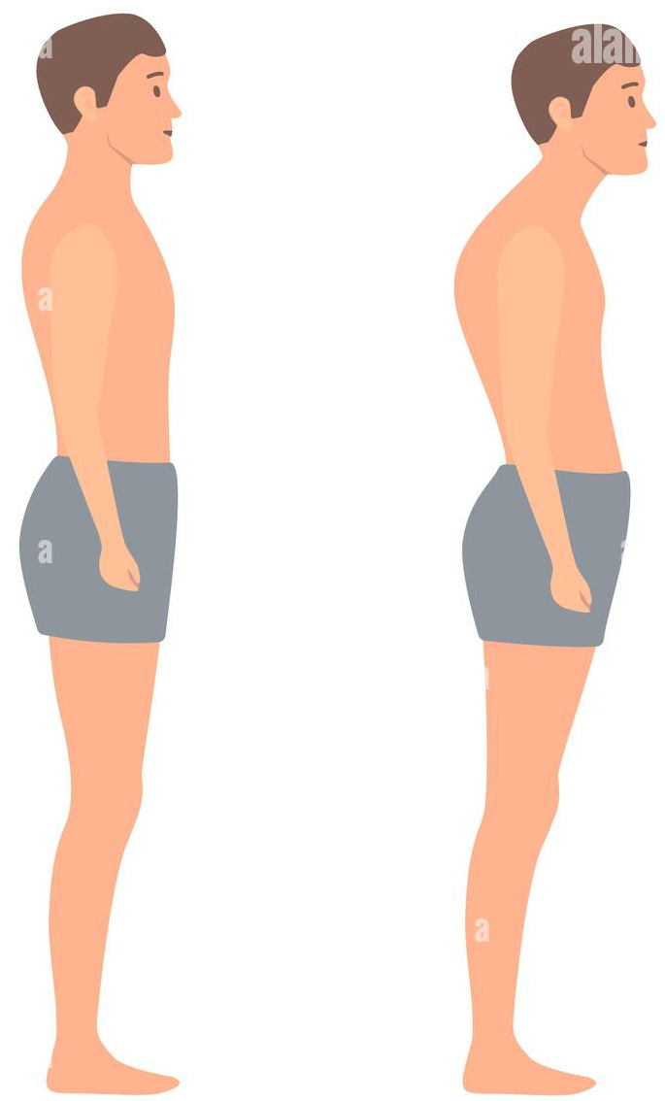
Introduction
Posture plays a significant role in back pain and refers to our dynamic, adjustable, and responsive positioning to the environment. Complications with posture and back pain are projected to become a widespread medical and socio-economic issue across the globe, with more than 70% of the population predicted to be engrossed in the problem.
This project aims to find the relationship between the personality traits and the posture of a person and weather if we can predict the posture of a person based on their personality traits.
The personality traits of a person are calculated from the Myers-Briggs personality trait test.

Slide 3
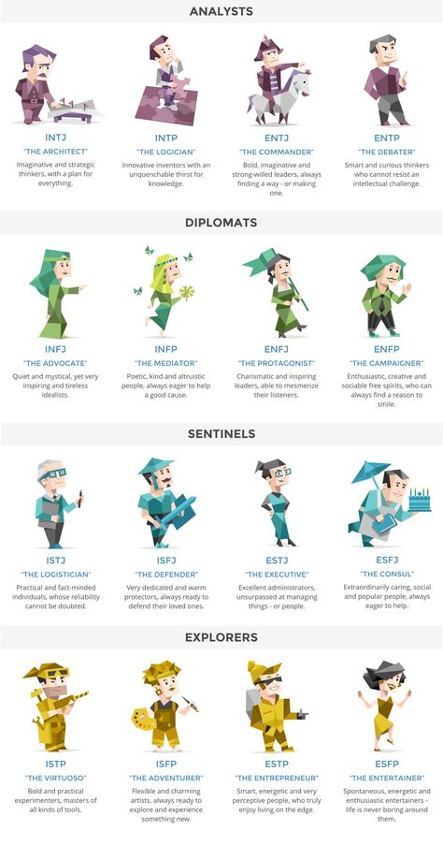
Myers-Briggs Test
Myers-Briggs test is one of the most famous personality assessment. It involves a series of questions in four areas of personality. It indicates differing psychological preferences in how people perceive the world and make decisions.
The test attempts to assign values to each of the four categories.
Introversion or Extroversion
Sensing or Intuition
Thinking or Feeling
Judging or Perceiving
Example: INTJ or ESFP

Slide 4
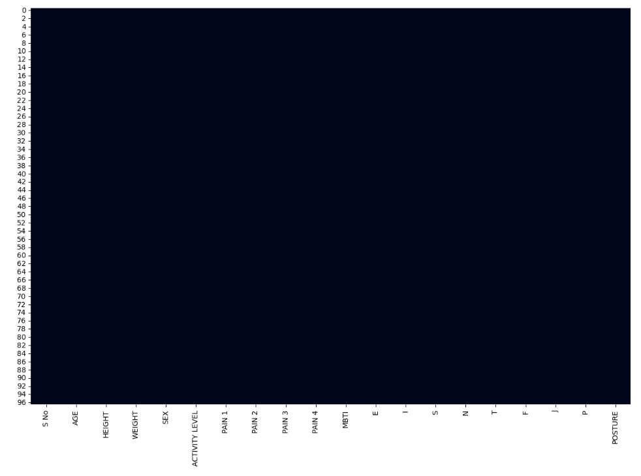
About the dataset
No. of Rows
97
No. of columns
20
Total number of values
1940
SNS heatmap of null values in the dataset

Slide 5
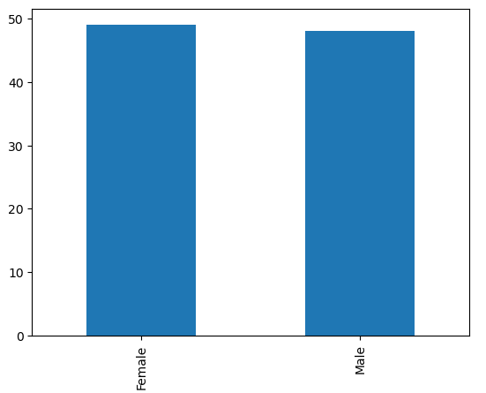
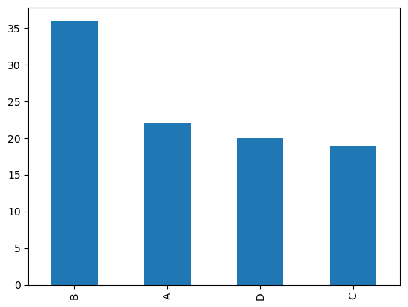
Distributions
Most of the participants seem to have posture B – which is kyphosis-lordosis.
A - Ideal posture
B - Kyphosis-Iordosis
C - Flat back
D - Sway-back
The number of Male and Female participants in the survey are nearly equal

Slide 6
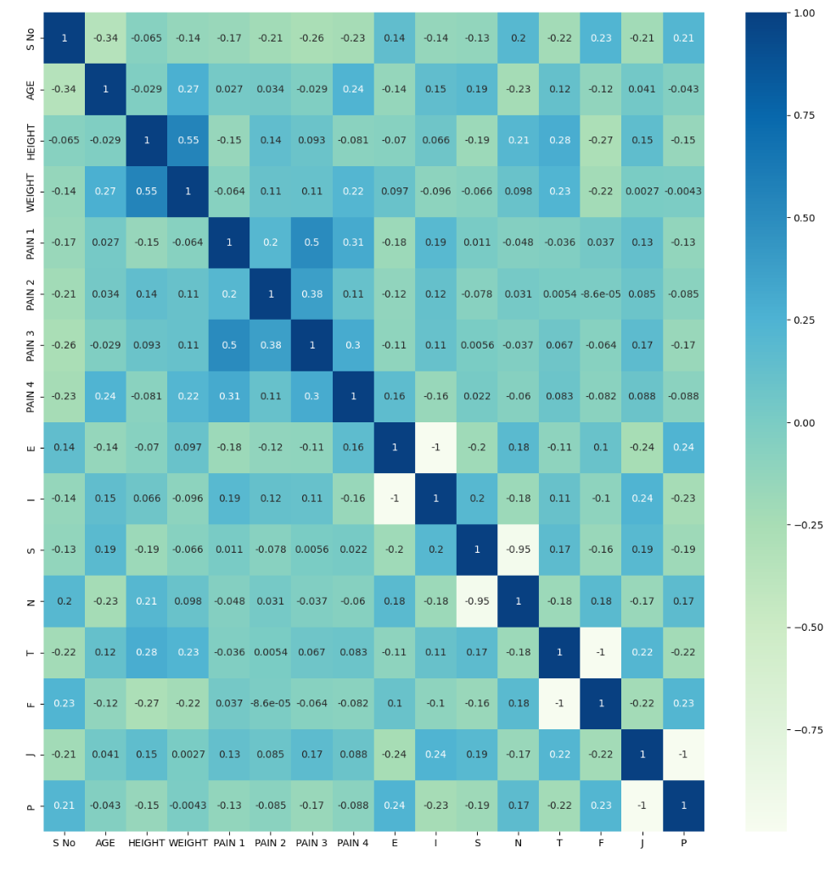
Correlation among the columns
The correlation graph seems to be unconclusive without any useful correlation among the columns.

Slide 7
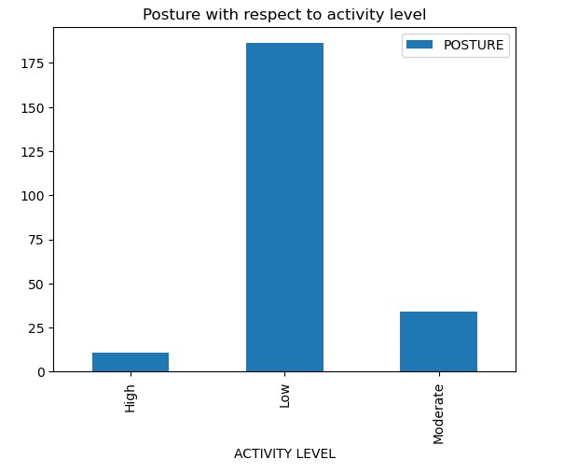
Activity level
The activity level is categorized into three values, High, Moderate and Low.
As seen in the graph, participants with low activity level have worst posture and the participants with high activity level have better posture.

Slide 8
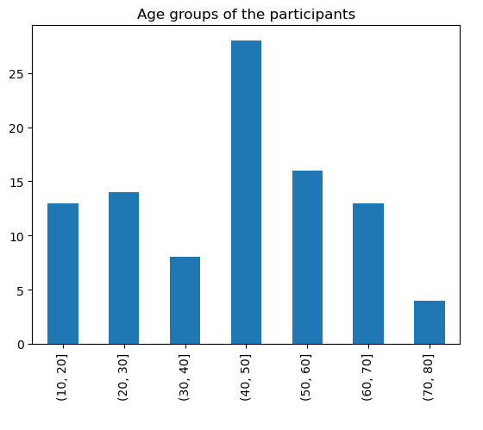
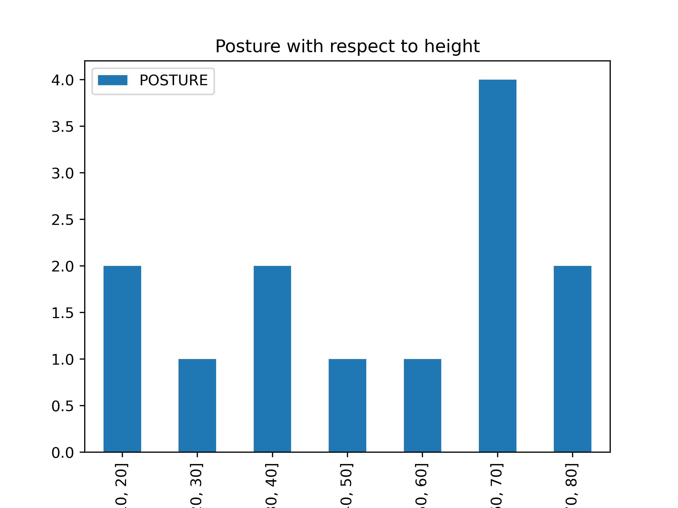
Age
Using bins and cut functions, we can organize the data into well defined slabs of 10-years, so that the visualization of the data is easier.
As seen from the graph, most of the participants are in the ages of 40-50 years.
Least number of participants are from the ages of 70-80.
When age and posture is compared, we can see that that the participants in the ages of 60-70 have a bad posture.

Slide 9
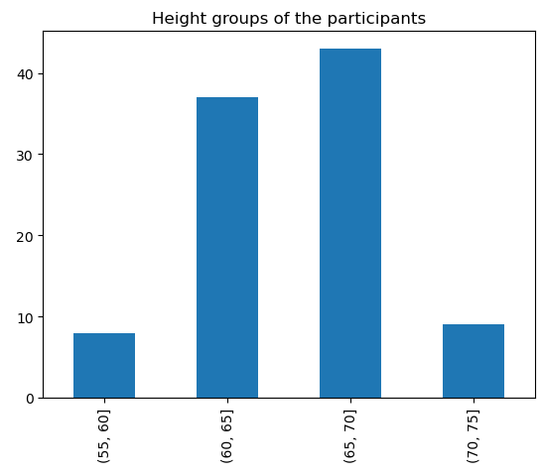
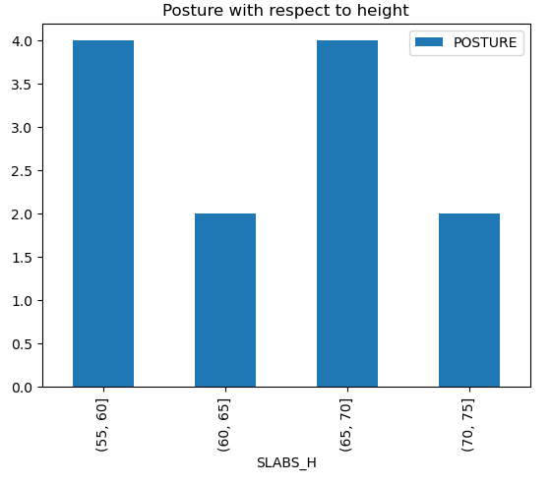
Height
With the help of bins and cut functions, we can create height slabs in which the participants are slotted into.
Most of the participants are in between 65 to 70 inches followed closely by 60 to 65 inches tall. Overall, most of the participants are in between 60 to 70 inches tall.
The y-axis consists of posture score which is the sum of the posture values of the participants in that height slab.
It can be understood that lower the height, worse the posture.

Slide 10
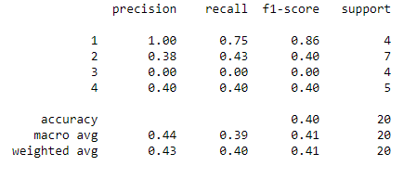
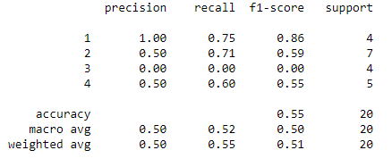
Classification – Logistic regression
With use of MBTI column
Without the use of MBTI column

Slide 11
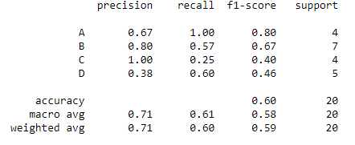
Classification – Decision Tree
Accuracy: 60%

Slide 12
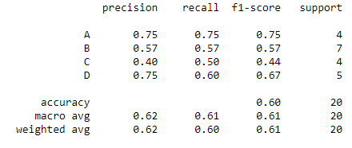
Classification – Gradient boosting
Accuracy: 60%

Slide 13
This analysis suggests that there could be a correlation between personality traits of a person and their posture. Analysis of a bigger dataset might give better results as the program will have a larger dataset to train on.
Conclusion

Slide 14

Thank you

