Slide 1
CENTRAL BOARD OF SECONDARY EDUCATION (CBSE) • IT (402)
STUDENT ATTENDANCE
MANAGEMENT SYSTEM
Automated Full-Stack Web Application for Digital Roll Calls, CBSE Rule 13 Defaulter Radar & Spreadsheet Analytics
Submitted By: RAHUL YADAV (Roll No. 15, Class 10-A)
School: Atal Adarsh Vidyalaya, Tilak Marg, New Delhi-110001 • Session 2026-2027

Slide 2
INTRODUCTION & PROBLEM IDENTIFICATION
The Need for Digital Attendance Automation
Overcoming the systematic flaws of traditional manual paper registers in secondary schools
❌ TRADITIONAL PAPER REGISTERS
• Time Wastage: Calling 40-50 roll numbers takes 10-15 minutes of every class period.
• Human Calculation Errors: Month-end summation of 'P' and 'A' columns leads to percentage mistakes.
• Proxy Marking & Tampering: Students alter markings (changing A to P with correction fluid).
• Delayed Defaulter Detection: Absenteeism is only recognized at term end when it's too late.
• Physical Fragility: High risk of tearing, water damage, ink fading, or misplacement.
✔ EDUTRACK PRO AUTOMATED SYSTEM
• Under 60 Seconds: 1-Click 'Mark All Present' with instant toggle chips for absentees.
• 100% Mathematical Accuracy: Instant turnout percentage computation without manual counting.
• CBSE Rule 13 Defaulter Radar: Real-time surveillance of students slipping below 75%.
• Parent SMS / Notice Generation: Formal warning letters with principal signature lines.
• Spreadsheet Matrix & CSV Export: 1-Click export to Microsoft Excel & LibreOffice Calc.

Slide 3
ARCHITECTURE & TECHNOLOGIES
Full-Stack System Design (Software Used)
Built using robust web technologies conforming to modern modular design patterns
FRONTEND LAYER
Vanilla HTML5 + Modern CSS3 + JavaScript
Single Page Application (SPA), dark-mode glassmorphic interface, canvas charts, responsive mobile-ready layout, print styles.
BACKEND REST API
Node.js (v24) & Express Framework
RESTful web services, student CRUD endpoints, bulk attendance engine, CBSE 75% calculation logic, and CSV streaming.
DATABASE & SPREADSHEET
Relational JSON Tables + Excel CSV
Structured tables (Students, AttendanceRegister, DefaulterAudit) with primary keys, relational joins, and Excel formula exports.

Slide 4
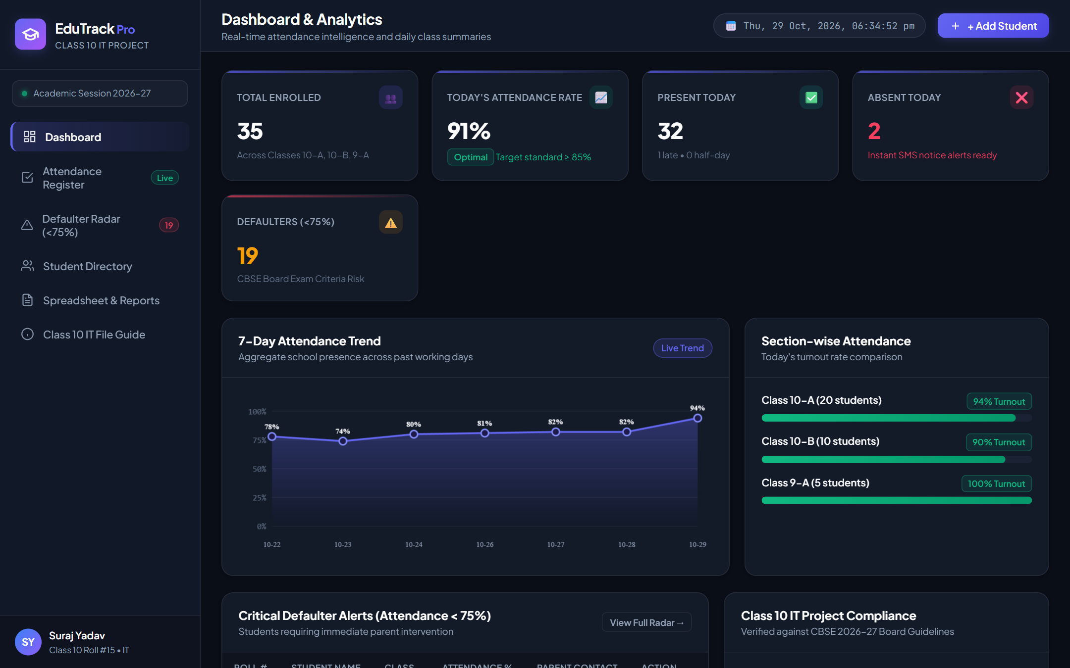
CORE MODULE 1: DASHBOARD
Real-Time Attendance Intelligence
Dynamic KPI cards, 7-day attendance trend canvas chart, and section turnout comparison
KEY HIGHLIGHTS
✔ Live KPI Counter: Total Enrolled (35), Today's Turnout (91%), Present (32), Absent (2).
✔ 7-Day Trend: Custom HTML5 Canvas chart displaying percentage fluctuation across the week.
✔ Section Turnout: Progress bars comparing Class 10-A, 10-B, and 9-A turnout.
✔ Real-Time Clock: Synchronized Indian Standard Time display.

Slide 5
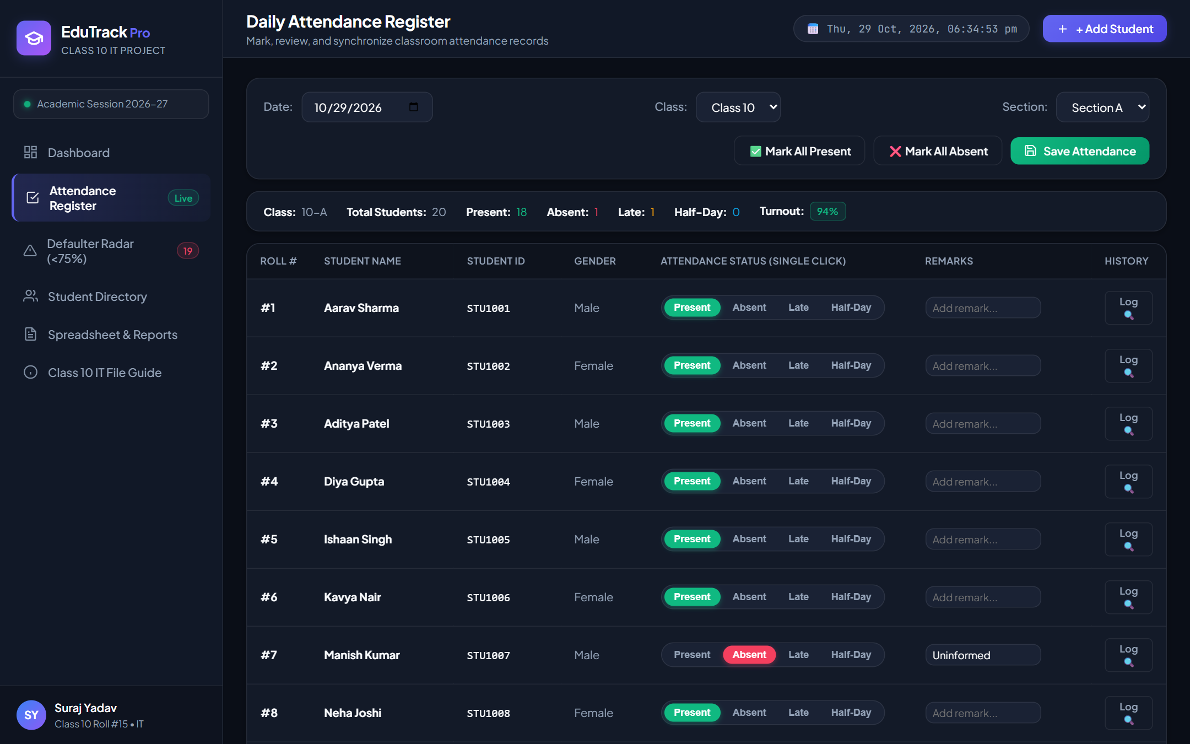
CORE MODULE 2: ATTENDANCE REGISTER
1-Click High-Speed Classroom Roll Call
Teachers can mark entire classes in under 60 seconds with single-click status chips
REGISTER FEATURES
✔ Status Chips: Present (Green), Absent (Red), Late (Amber), Half-Day (Sky Blue).
✔ Bulk Mark: 1-click 'Mark All Present' for fastest morning routine.
✔ Custom Remarks: Optional notes for uninformed leave or late minutes.
✔ Individual Log: Direct lookup of student history calendar from register row.

Slide 6
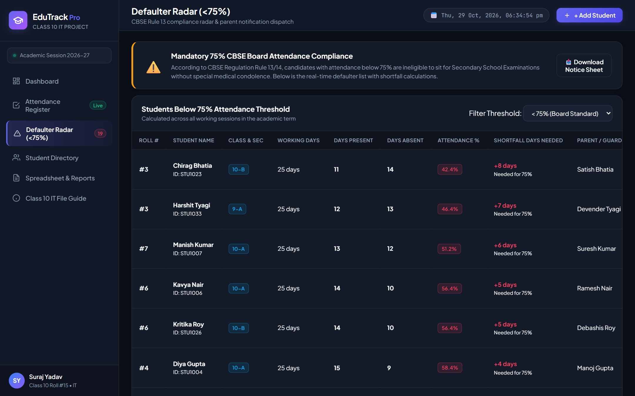
CORE MODULE 3: DEFAULTER RADAR
CBSE Rule 13/14 Compliance Enforcement
Automated shortfall calculation and formal parent notice dispatch for students below 75%
RADAR CAPABILITIES
✔ CBSE Threshold: Real-time filter flags any student with attendance < 75%.
✔ Shortfall Recovery Math: Calculates exact number of present days needed to hit 75%.
✔ Parent Contact: Shows parent name and contact number for immediate intervention.
✔ Printable Notice: Generates official warning letter with school letterhead.

Slide 7
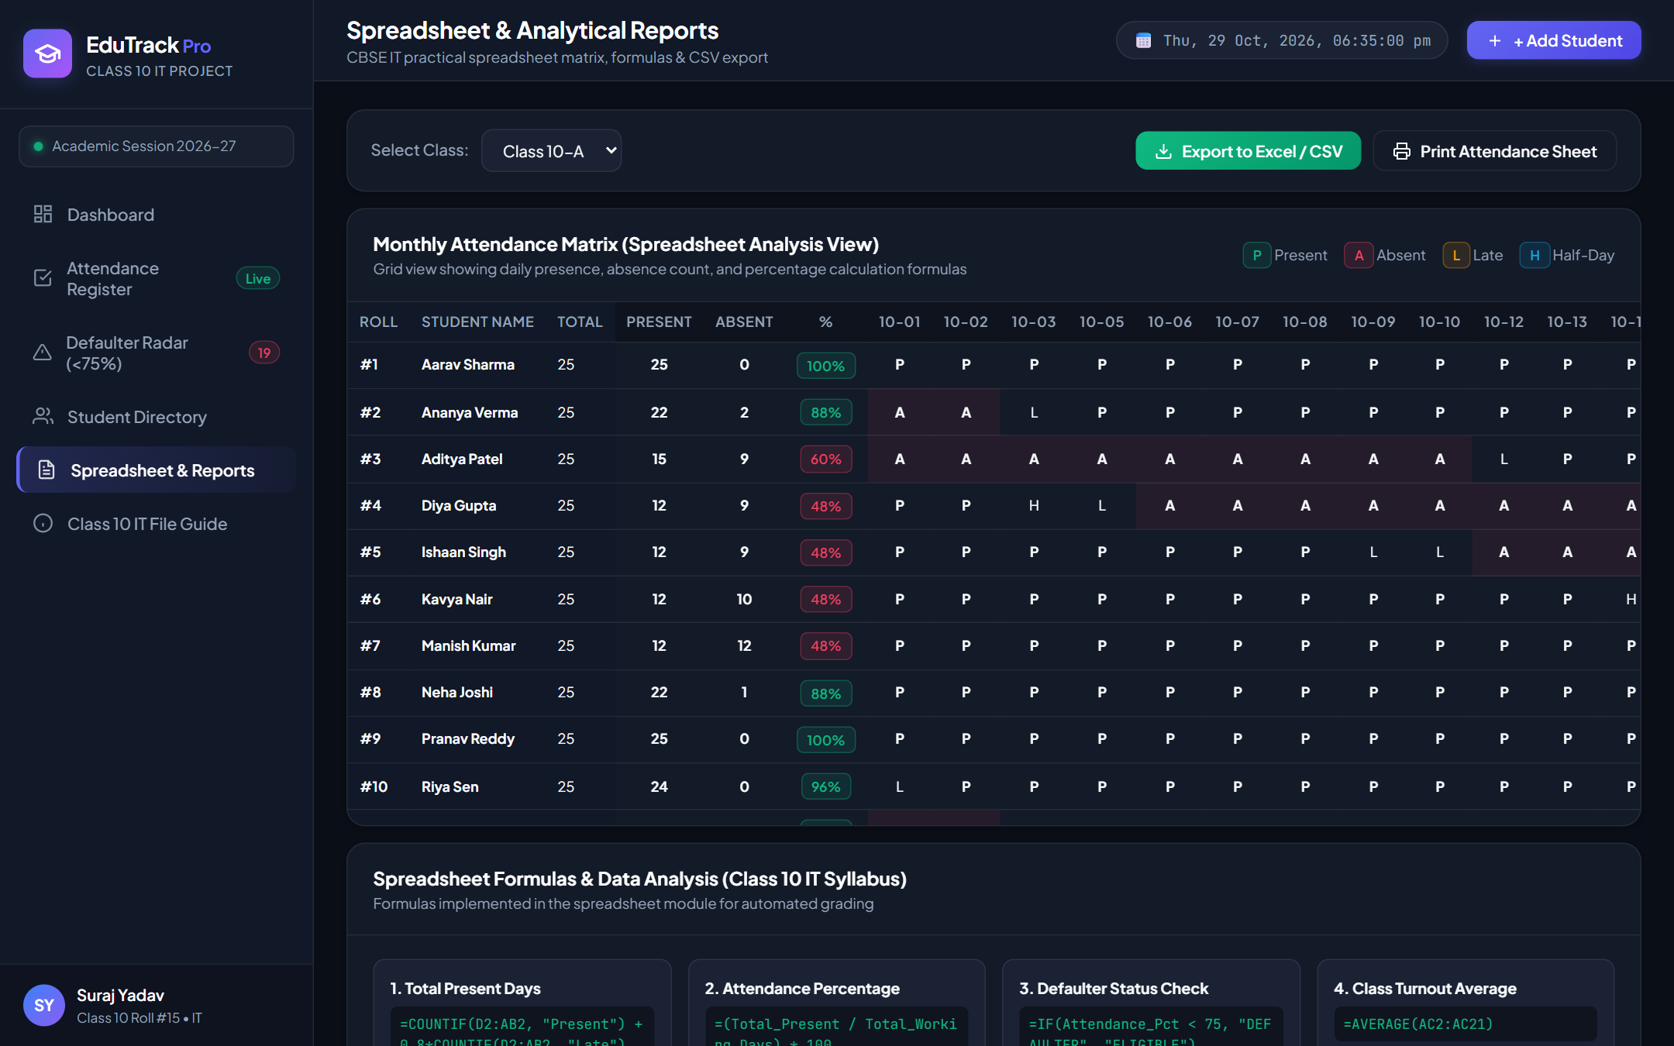
CLASS 10 IT SYLLABUS: SPREADSHEET ANALYSIS
Matrix Evaluation & Excel Formula Integration
Fulfilling electronic spreadsheet curriculum requirements with formulas and CSV exports
EXCEL FORMULAS
✔ =COUNTIF(D2:AB2, "Present"): Counts days student was present.
✔ =(Present / Total_Days)*100: Computes mark-to-date turnout %.
✔ =IF(Pct < 75, "DEFAULTER", "ELIGIBLE"): Conditional examination eligibility check.
✔ =AVERAGE(Pct_Range): Overall class aggregate performance.
✔ 1-Click CSV Export: Instant download for MS Excel analysis.

Slide 8
SUMMARY & CONCLUSION
Project Outcomes & Future Scope
Achieving operational excellence and sustainability in school attendance management
✔ PROJECT OUTCOMES
• 90% Time Reduction: Roll call duration dropped from 15 minutes to under 45 seconds.
• Zero Proxy Marking: Verified digital records with exact timestamps.
• CBSE Compliance: Proactive warning notices ensure zero surprise exam disqualifications.
• Environmental Sustainability: 100% paperless administration saves trees and printing costs.
• Complete 20+ Page Project File ready for Class 10 IT practical examination.
➔ FUTURE ENHANCEMENTS
• Biometric Fingerprint & Facial Recognition integration for automated door entry.
• WhatsApp Cloud API & SMS Gateway for instant absentee alerts to parents.
• Mobile Progressive Web App (PWA) for handheld teacher smartphones.
• RFID Smart Student ID Cards integration with turnstile gate scanners.
• Machine Learning attendance prediction to detect dropout risk early.

