Slide 1
STUDENT EXAM SCORE PREDICTOR
Final Project Review | Department of Computer Science | KLH Bachupally Campus, Hyderabad
TEAM MEMBERS
Suraj Gaur – 2420030108
D.Shiva Ganesh– 2420030035
M.Jathin Kumar – 2420030673
Guide: Dr. N. Sunanda, Associate Professor | Academic Year: 2026–27
Notes:
Title slide. Replace all bracketed text. Use the full project title, list every team member with registration number, and name your guide. Insert the institution logo in the dashed box.

Slide 2




Introduction & Problem Statement
Student inputs → validation → weighted score → performance band
Background
Student performance depends on several factors, including previous marks, internal assessments, attendance, assignment work and study habits. A simple estimate can help identify students who may need support before the final examination.
Problem Statement
Students and teachers may find it difficult to combine different academic indicators into one clear estimate. This project applies a transparent, fixed weighted formula to estimate an exam score without training a machine-learning model.
Motivation / Need
Students can use the estimate to plan revision, while teachers can use it as an early mentoring signal. The score is only a guide and should not replace actual assessment or a teacher’s judgement.
Notes:
State the domain, the exact problem and why it matters. Keep it to about 2 minutes. Add one real-world statistic if you can, with a citation.

Slide 3


Objectives & Scope
Objectives
1
Develop a Python program that estimates an exam score from five academic inputs using a fixed weighted formula.
2
Validate all inputs and ensure each value is within the accepted 0–100 range before calculation.
3
Classify the estimated score as Excellent, Good, Average or Needs Support using the project’s stated score bands.
4
Display an understandable result so students and teachers can see the estimate and decide whether extra revision or support may be useful.
Notes:
Objectives should be measurable and start with action verbs. The scope slide tells the panel what you did and did not attempt.

Slide 4

Literature Survey
S.No | Author(s) & Year | Method / Technique | Key Findings | Limitation / Gap
1 | Python Software Foundation | Python programming tools | Python supports readable, general-purpose program logic. | Language documentation is not evidence of prediction accuracy.
2 | pandas development team | Tabular data handling | Can read and process CSV-style student records. | Requires a suitable, verified dataset.
3 | NumPy developers | Numerical calculations | Supports numeric operations used in weighted calculations. | Does not validate the chosen weights.
4 | Project design (this work) | Fixed weighted scoring | Produces an explainable estimate and performance band. | Weights need evaluation against actual marks.
Research Gap
The project focuses on a practical gap: many prediction approaches require historical datasets and trained models, while this prototype uses an easy-to-understand weighted rule. Its weights are design choices and must be checked against real student records before the estimate is treated as reliable.
Notes:
Summarise four to six relevant papers or existing systems. End with the research gap, because that gap justifies your project.

Slide 5





Proposed System & Methodology
STEP 1
STEP 2
STEP 3
STEP 4
STEP 5
Define Problem
Collect Data
Design
Implement
Test & Evaluate
Identify the need, scope and success criteria.
Use student-entered values or a CSV/Excel file. Historical dataset size is not specified in the project material.
Use Python in VS Code with a fixed weighted formula and a simple input → validation → scoring → output workflow.
Implement input collection, range checking, score calculation, performance-band classification and result display.
Test normal values, boundary values, missing inputs and invalid ranges. Compare with actual marks only when labelled historical records are available.
Key Novelty / Contribution
The main contribution is a lightweight and explainable score estimator that does not require model training. Each input’s contribution is visible through its predefined weight, making the result easy to explain.
Notes:
Walk through the five steps left to right. Rename the steps to match your project (for example, Requirement Analysis, Design, Coding, Testing, Deployment). End with your novelty.

Slide 6
System Architecture
Student / CSV Data → Input Layer → Validation Layer → Weighted Scoring Engine → Score + Performance Category
Components
PREDICTION PIPELINE
1
Input Collection
Reads five academic indicators from the user or a data file.
01
02
03
04
Student
Inputs
Validate
Values
Weighted
Formula
Score &
Category
2
Input Validation
Checks that values are numeric, present and within the accepted range.
3
Weighted Scoring
Applies the fixed formula to calculate an estimated score out of 100.
Output: estimated score out of 100 • performance band • supportive feedback
4
Result Display
Shows the estimate, performance band and guidance for possible support.
Notes:
Insert a clear block diagram: input, processing, storage, output. Number each block and explain them on the right. Redraw the figure yourself rather than copying it.

Slide 7


Hardware & Software Requirements
Hardware
Software & Tools
Libraries / Frameworks
Standard laptop or desktop
Basic RAM and storage
Keyboard and display
Internet access for setup, if needed
Windows / compatible OS
Python 3.x
Visual Studio Code (VS Code)
VS Code terminal and debugger
Python standard library
pandas / NumPy if used for data handling
Optional UI: Streamlit or Tkinter
No machine-learning framework required
Deployment / Platform: Local computer using Python in VS Code; a simple local web interface is optional.
Notes:
List only what you actually used, with versions. For a pure software project, shorten the hardware list and add cloud or deployment resources.

Slide 8
Dataset / Data Understanding
Example input fields:
Previous marks | Internal marks | Attendance
Assignment score | Study-time score
No verified dataset screenshot or record count was provided.
Student Records
Dataset Source
Input Features
To be Checked
Missing Values
Performance Classes
FIVE INPUT FEATURES
Previous marks
Internal marks
Attendance
Source: Student-entered values or CSV/Excel file; a confirmed public dataset is not specified.
Features: Previous marks, internal marks, attendance, assignment score and study-time score. Output: estimated exam score and performance band.
Quality: Check missing values, duplicates and valid ranges when a dataset is supplied.
Assignment score
Study-time score
Notes:
Explain where the data came from and what it contains. Show a screenshot of the first rows or the info summary. For non-data projects, replace this slide with “Requirement Analysis” or “Input Specification”.

Slide 9
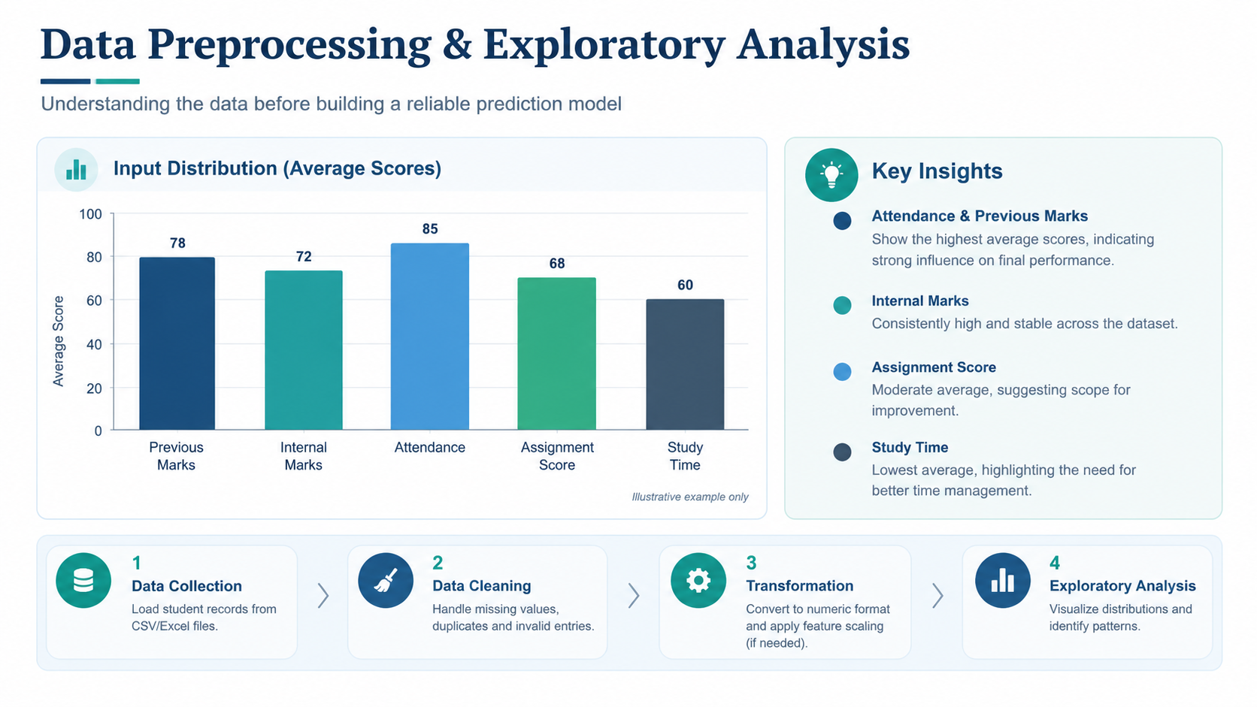



Data Preprocessing & Exploratory Analysis
Input distribution can be plotted after student records are collected.
Compare inputs and actual marks when labelled records are available.
Cleaning
Transformation
Feature Selection
Reject missing or non-numeric values and values outside 0–100. Check duplicate rows when using a file.
Convert all five inputs to a comparable 0–100 scale. Attendance and study time must be normalised before applying the formula.
Use the five project-defined inputs: previous marks, internal marks, attendance, assignment score and study-time score. No automated feature-selection algorithm is used.
Notes:
Show two or three plots that tell a story: distributions, correlations, outliers. Explain what each plot told you and what you did about it.

Slide 10
Module-wise Description
1
Input Collection
2
Validation
Purpose: Gather the five academic inputs.
Input → Output: User/file values → structured inputs.
Developed by: Team allocation to be confirmed.
Purpose: Check input presence, numeric type and range.
Input → Output: Raw values → validated values or an error message.
Developed by: Team allocation to be confirmed.
3
Weighted Score Engine
4
Performance Band & Output
Purpose: Calculate the estimated exam score.
Input → Output: Validated values → weighted score.
Developed by: Team allocation to be confirmed.
Purpose: Map the score to a category and display guidance.
Input → Output: Estimated score → category and explanation.
Developed by: Team allocation to be confirmed.
COLLECT → VALIDATE → CALCULATE → CLASSIFY → DISPLAY
Notes:
Divide the project into three to five modules. For each, state its purpose, inputs, outputs and who built it. Duplicate a card if you have more modules.

Slide 11

Algorithms & Technologies Used
Fixed weighted formula
Input validation
Rule-based classification
Why chosen
Simple, transparent and easy to implement without model training.
Key parameters
Previous 30%; internal 25%; attendance 20%; assignment 15%; study 10%.
Why chosen
Prevents invalid values from producing misleading estimates.
Key parameters
Five inputs; each on a comparable 0–100 scale.
Why chosen
Turns the estimated score into an understandable performance band.
Key parameters
80–100 Excellent; 60–79 Good; 40–59 Average; below 40 Needs Support.
Selection criteria: Explainability, low computational cost, ease of implementation and suitability for a small Python prototype.
Notes:
Name each model, algorithm or technology, say why you chose it, and list the key settings. Then explain how you picked the final one.

Slide 12
Implementation / Model Building
Feature Selection
Code snippet / pseudocode
Previous marks, internal marks, attendance, assignment score and study-time score. These are the five inputs specified in the project approach.
previous = float(input('Previous marks (0-100): '))
internal = float(input('Internal marks (0-100): '))
attendance = float(input('Attendance score (0-100): '))
assignment = float(input('Assignment score (0-100): '))
study = float(input('Study-time score (0-100): '))
score = (0.30 * previous + 0.25 * internal
+ 0.20 * attendance + 0.15 * assignment
+ 0.10 * study)
if score >= 80:
band = 'Excellent'
elif score >= 60:
band = 'Good'
elif score >= 40:
band = 'Average'
else:
band = 'Needs Support'
print(f'Estimated score: {score:.2f}')
print(f'Performance band: {band}')
Preprocessing Pipeline
Read inputs → check missing/non-numeric values → validate 0–100 range → apply weighted formula → classify score → display result.
Data Splitting
No train/validation/test split is required for the rule-based prototype. If labelled historical records become available, reserve a test set for evaluation.
Configuration
Weights: 0.30, 0.25, 0.20, 0.15 and 0.10. All input values must be on a 0–100 scale. No model hyperparameters are used.
30% Previous • 25% Internal • 20% Attendance • 15% Assignments • 10% Study
Notes:
Describe the build in the order you did it. Paste only the most important code or pseudocode, not entire files. For hardware projects, show the circuit or wiring summary instead.

Slide 13
Working Prototype / Output Screens
Input screen / fields
Scoring process
Result screen
STUDENT INPUT FORM
WEIGHTED SCORING
PREDICTED RESULT
Previous marks
0–100
Previous marks
30%
78
Internal marks
0–100
Internal marks
25%
Attendance
0–100
Attendance
20%
15%
Estimated score / 100
Assignment score
0–100
Assignments
Study-time score
0–100
Study time
10%
Good performance
Student academic inputs
Enter five values on a 0–100 scale.
Weighted formula
Each input contributes according to its fixed weight.
Estimated score and category
A simple explanation of the result is displayed.
Notes:
Show real screenshots, photos of the hardware or a short demo video link. Caption each one with what the viewer should notice.

Slide 14
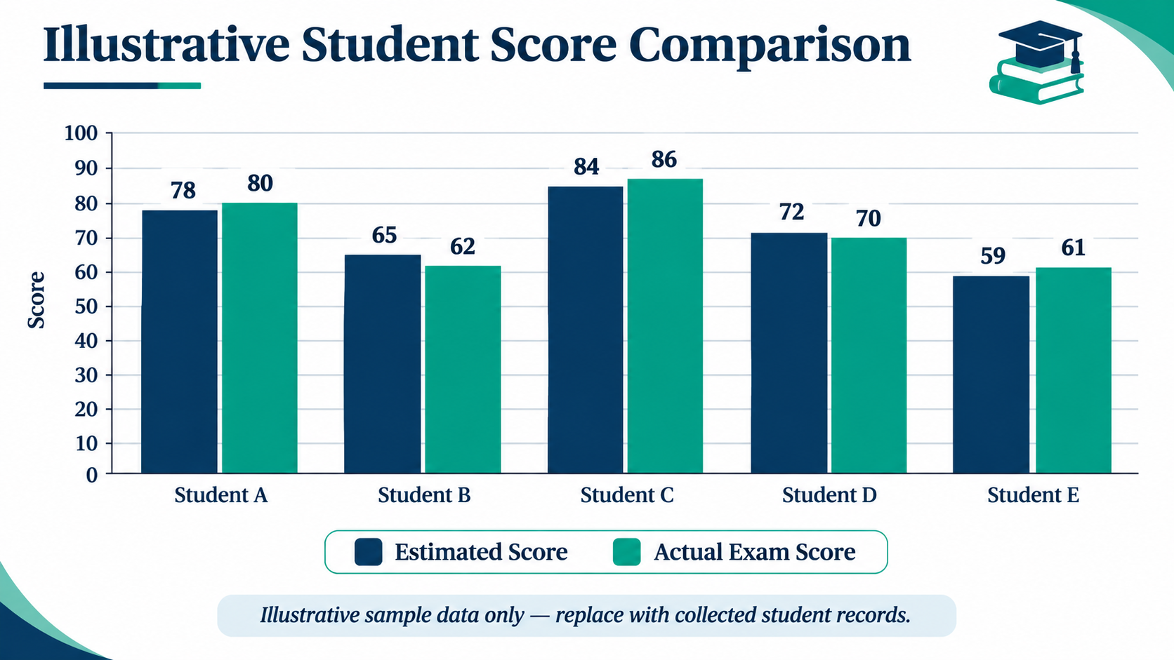
Results & Performance Comparison
Best model: Not applicable — this is a rule-based system, not a trained model.
Notes:
Right-click the chart and choose Edit Data to enter your real numbers. Replace the metrics with the ones that fit your project (accuracy, latency, power, throughput, user rating). State clearly which option performed best.

Slide 15
Analysis & Key Findings
Input values → weighted formula → estimated score → performance band
N/A
FROM INPUT TO GUIDANCE
Performance metric not measured yet
1
2
3
Inputs
Estimated score
Performance band
Interpretation: The output is an estimate based on the five chosen inputs.
Error analysis: Actual prediction error cannot be reported without actual exam marks.
Key drivers: Previous marks (30%) and internal marks (25%) have the largest assigned weights.
Use the estimate as guidance, not as a guaranteed exam result.
Notes:
Explain what the numbers mean. Use a confusion matrix, ROC curve, feature-importance chart or output comparison. Be honest about weak results; panels value that.

Slide 16

Testing & Validation
Test ID | Test Description | Expected Result | Actual Result | Status
TC-01 | All five inputs are valid | Weighted score and band displayed | Run test and record result | Pending
TC-02 | Input below 0 or above 100 | Validation message shown | Run test and record result | Pending
TC-03 | Missing or non-numeric input | Input rejected safely | Run test and record result | Pending
TC-04 | Score category boundary | Correct band selected | Run test and record result | Pending
Functional Testing
Validation Method
Performance Testing
Test input validation, score calculation, category boundaries and output formatting. Record actual results after running each test in the implementation.
Use boundary and functional tests first. If labelled historical data is available, compare estimates with actual marks using mean absolute error (MAE).
Check that the program completes quickly for individual inputs and handles invalid values without crashing. No measured load or accuracy figures are available yet.
Notes:
List representative test cases with expected and actual outcomes. Name the validation methods you used. Delete rows you do not need.

Slide 17


Challenges & Limitations
Challenges Faced
Limitations
Input scales differ → convert attendance and study time to 0–100 scores before calculation.
Invalid entries can affect results → validate numeric values and ranges.
No confirmed historical dataset → treat the current output as a guidance estimate, not a validated prediction.
The fixed weights have not been validated on historical records.
The method does not learn from past student outcomes.
Prediction accuracy cannot be claimed until estimates are compared with actual marks.
Notes:
Be candid. Pair every challenge with how you solved it, and list limitations that the panel would otherwise spot themselves.

Slide 18

Conclusion
A Python-based Student Exam Score Predictor was designed around five academic inputs and a transparent weighted formula, with development and debugging planned in VS Code.
1
Final Outcome
The project defines a clear formula and four performance bands. Numerical accuracy and comparisons with alternatives remain unmeasured because verified test results were not provided.
Rule-based
2
Transparent weighted-score prototype
Objectives: 4 design objectives defined; validation against real records remains future work.
The design meets the core aim of producing an explainable estimate without machine learning. Its practical value is early awareness and mentoring support, not a final judgement of student ability.
3
Notes:
Revisit each objective and say whether you met it. Quote your headline result with numbers. Do not introduce new material here.

Slide 19



Future Scope & Applications
Validate Weights
Compare estimates with actual marks and adjust weights only when evidence supports a change.
Applications
Early academic mentoring
Revision planning for students
Teacher support and progress discussions
Potential users: students, tutors and academic advisors.
Add Historical Data
Use a larger, consented dataset to check performance across different student groups.
Build a Simple Interface
Create a user-friendly form or dashboard using Streamlit or Tkinter if required.
Privacy & Reliability
Limit access to student records, protect personal data and document how scores are calculated.
Notes:
Give concrete next steps, ideally tied to the limitations. Then name two or three real-world uses.

Slide 20
Team Contribution
PROJECT WORK AREAS
Reg. No. | Name | Contribution / Modules Handled
01 | Suraj Gaur | Project concept, scoring design and presentation — confirm allocation.
02 | M.Jathin Kumar | Python implementation, input collection, data validation and score calculation module
03 | D.Shiva Ganesh | Performance classification, result analysis, testing, documentation and project report preparation.
Notes:
Show that work was planned and shared. Every member should be able to explain their own module.

Slide 21

References
[1] Python Software Foundation, “Python Documentation,” official language documentation.
[2] pandas development team, “pandas documentation,” data handling and CSV support.
[3] NumPy developers, “NumPy documentation,” numerical operations.
[4] Project reference presentation, “Student Exam Score Predictor,” methodology and weighted scoring design.
Note: These references support the tools and project design; no research paper or dataset validation was provided.
Project Links
GitHub: To be added if published
Dataset: Student-entered / CSV data; public dataset not specified
Demo video: To be added if recorded.
Notes:
Use IEEE style, numbered in order of first citation in the deck. Include datasets, documentation and code repositories.

Slide 22
THANK YOU
LEARN • TRACK • IMPROVE
Questions & Discussion
Student Exam Score Predictor | Guide: Dr. N. Sunanda
Input
Score
Growth
Notes:
Leave this slide up during questions. Make sure every team member can answer questions about their own module.

